Slide 1
An Assessment of Sustainable Urban Greenery Planning in the Changing Climate of Porto-Novo and Parakou in the Republic of Benin
Presented by Akakpo Bokon Alexis
PhD/SPS/FT/2019/11132
Prof A. A. Okhimamhe
Major supervisor
Prof Vincent A.O. Orekan
Co-supervisor
January 2024

Slide 2
Presentation outline
1- Introduction
  Key study background
  Key problem statement
  Research questions
  Research objectives
  Key justification of the study
2- Study area
3- Key study scope
4-Key study limitation
5- Methodology
6- Key results and implication
7- Key conclusion and key recommendations

Slide 3
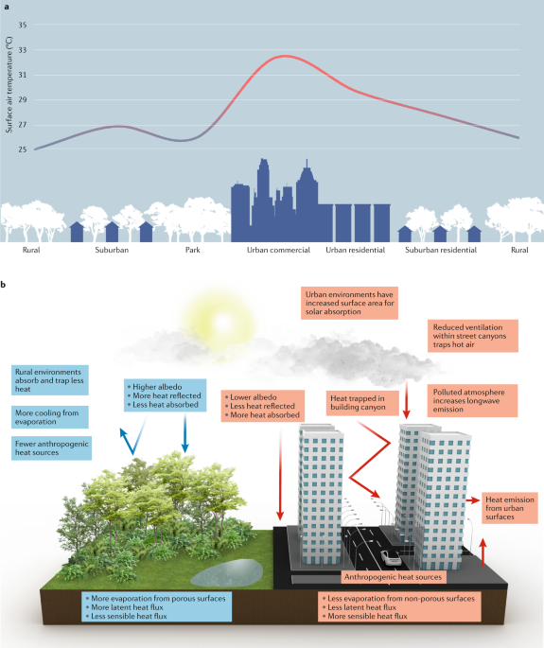
Introduction (1/6)
Study background
Climate change: Global challenges facing humanity
There are the anthropogenic climate changes impacting settlement and its human subjects (IPCC, 2014, 2018).
This change drastically impact the urban settlements than the rural areas (UN-HABITAT, 2011)
3

Slide 4
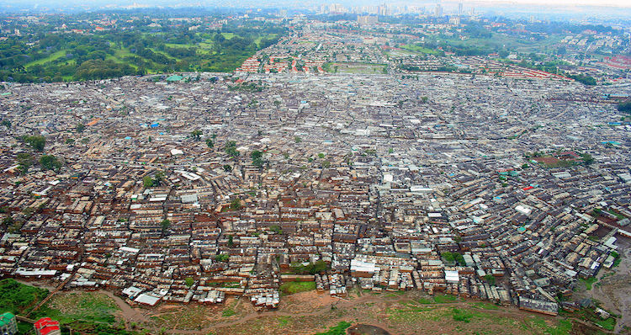
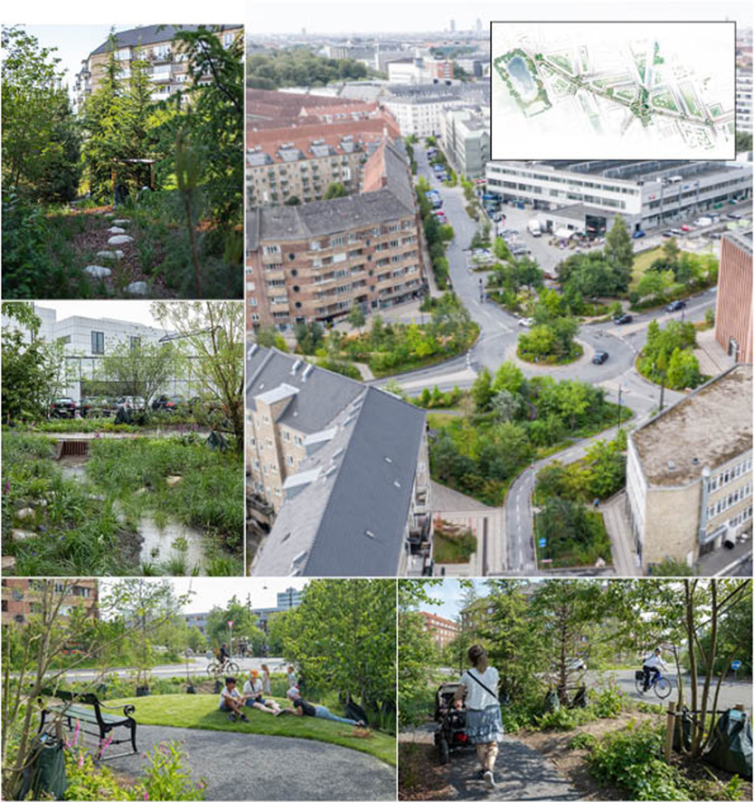
Introduction (2/6)
Study background
In Africa, the uncontrolled urban growth causes the increasing urban heat, air degradation, depletion of water and soil cycles and quality and loss of biodiversity (Siddiqui et al., 2018.
View of Kibera in Nairobi
Adaptative planning and urban management are found as the sustainable solution to these challenges (Wamsler et al., 2013; Scott et al., 2016).
Urban GS protection is adopted as strategy to adapt and mitigate climate change as well as providing good quality of life (EEA, 2009; UN-HABITAT, 2011, 2016; Scott et al., 2016).
4

Slide 5
Introduction (3/6)
Key problem statement
In Benin Republic, cities experience the uncontrolled urbanization, some negative environmental and climatic changes effects.
Also, urban green spaces are poorly understood and monitored (Osseni et al., 2015; Teka et al., 2017).
Porto-Novo and Parakou: scientific knowledges on green spaces development are limited.

Slide 6
Introduction (4/6)
Research questions
The following research questions must be answered to enhance development of urban environment in these cities.
How does urban rapid growth impact natural environment of the cities of Porto-Novo and Parakou?
What are the pattern and distribution of urban greenery spaces in each city?
How do urban greenery variation influences air temperature regulation in the two cities?
Which factors do influence the development of urban greenery spaces?

Slide 7
Introduction (5/6)
Objectives of the study
Assess the urban land use and land cover dynamics of the cities ;
Examine the pattern and distribution of urban green spaces in the cities ;
Evaluate the impact of the variation of seasonal vegetation on urban air temperature in the cities ;
Assess the stakeholder’s perception in urban green spaces development in cities.

Slide 8
Introduction (6/6)
Key justification of the study
Porto-Novo and Parakou: second and third ranking cities in Benin
The development of urban green spaces is fundamental for playing important role in building ecological cities in terms of environmental quality and aesthetics landscapes
To improve the performance of city managers and urban planners (to adapt to current urban issues), there is need of scientific knowledges for optimal management of urban green infrastructures
Students, researchers and professionals need the study results as literature support.

Slide 9
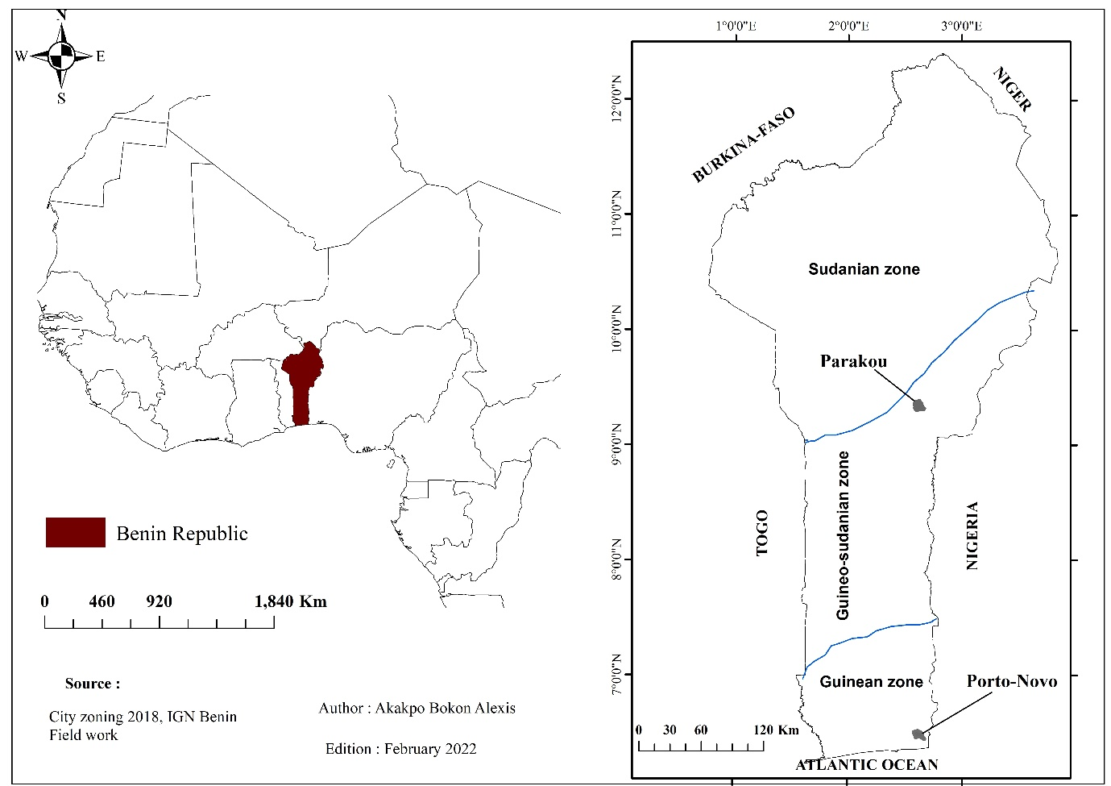
Study area (1/1)
Parameters | Details
 | Parakou | Porto-Novo
Geographical location | 9°15’- 9°27’ and 2°31’- 2°45’ | 6°26’- 6°31’ and 2°34’- 2°41’
Country location | Centre | Southern
Climatic zone (Neuenschwander et al., 2011) | Sudano-guinean | Guinean
Climate type | Sudanian climate (Lanmandjèkpogni et al., 2019) | Subequatorial climate (Houngla et al., 2019)
Rainy season | June to October (Lanmandjèkpogni et al., 2019) | April to July and September to November (Ahokpossi, 2018)
Dry season | November to April (Lanmandjèkpogni et al., 2019) | August and December to March (Ahokpossi, 2018)
Rainfall (average) | 1170 mm/yea (Miassi and Dossa, 2018) | 1200 mm/year (Houngla et al., 2019)
Temperature (average) | 25 °C (Miassi and Dossa, 2018) | 28 °C(Houngla et al., 2019)
Population (INSAE, 2016) | 255,478 inhabitants | 264,320 inhabitants
Fig 1: Study area location

Slide 10
Key study scope (1/1)
Administrative area of each city
Years 2000, 2010 and 2020 considered for data collection except social survey data
All natural green infrastructures (urban forests, wetlands, parks, street trees, small gardens, wetlands and water body, and agricultural small lands) because they emphasize ecosystem services provision and especially climate change effects adaptation strategies

Slide 11
Key study limitation (1/1)
COVID-19 situation during data collection
Using different image sources: SPOT 4 and 5 images (2000 and 2010), Google Earth images (2020) and Landsat 7 and 8 images (NDVI downloading)
Restriction of some local documents availability

Slide 12
Methodology (1/4)
O1- Assess urban land use and cover dynamics of cities
Supervised classification to SPOT 4 (2000) and SPOT 5 (2010) images using maximum likelihood algorithm (Laboratory of Biogeography and Environmental Expertise)
Google Earth Pro imagery digitalization. Validation by photos and field observation data
Land cover percentages, change rates and transition matrices were provided to show the changing on green spaces
Maps were also provided to highlight visual changes in land use and cover

Slide 13
Methodology (2/4)
O2- Examine the pattern and distribution of urban green spaces in cities
Using Google Earth Pro imageries and the detectable green spaces were manually digitalized
Layers were input into ArcGIS environment where green space area (ha), perimeter (km) and coordinates (m) were extracted for statistical analyses
ANOVA was applied to examine the significance of land metrics variation
Spatstat package of R software and Ripley’s K method based on green entity centre distances to assess the spatial distribution

Slide 14
Methodology (3/4)
O3- Evaluate the impact of green spaces on urban air cooling effect in cities
NDVI series were collected using Google Earth Engine open-source
Observed air temperature were obtained at National Meteorological Agency of Benin
Mann-Kendall test to assess the significance of the trends. ANOVA followed by SNK test were applied to examine seasonal variation on NDVI significance
Simple linear regression was used to show the relationship between air temperature and NDVI.
(R 4.2.0 software was used for all statistical analyses)

Slide 15
Methodology (4/4)
O4- Assess stakeholder’s perception in urban green spaces development in cities
Survey was carried out considering the city boroughs of each city. The number of interviewees was sampled by using the formula of Dagnelie (1998) and 400 respondents were reached by city
Use of Pearson Chi-square test for assessing the dependence of stakeholder’s opinions about urban greenery variables on cities and city boroughs
Correspondence Analysis (CA) was also applied to show the association between city boroughs, lost benefits, and causes of the loss of benefits for each city
Binary logistic regression was used to examine the variables that explain people’s willingness to get involved in improving urban greenery in each city

Slide 16
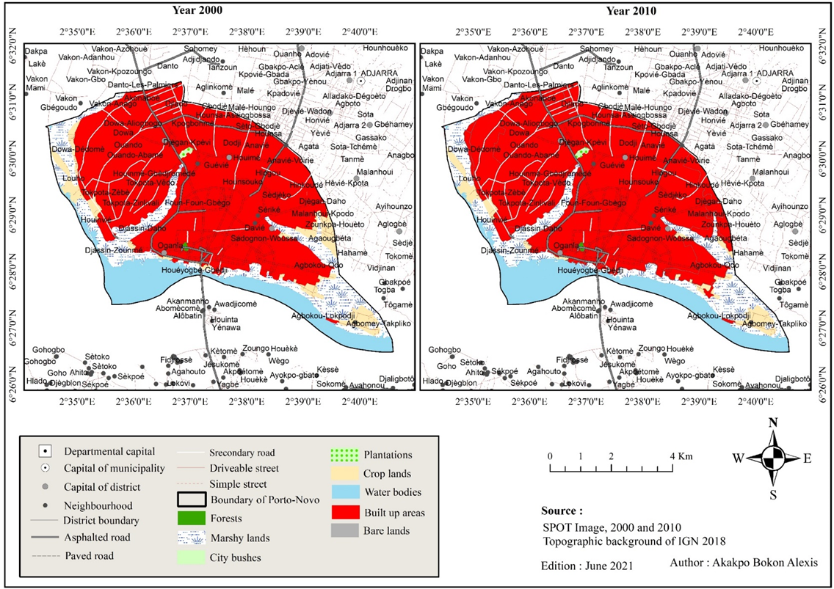
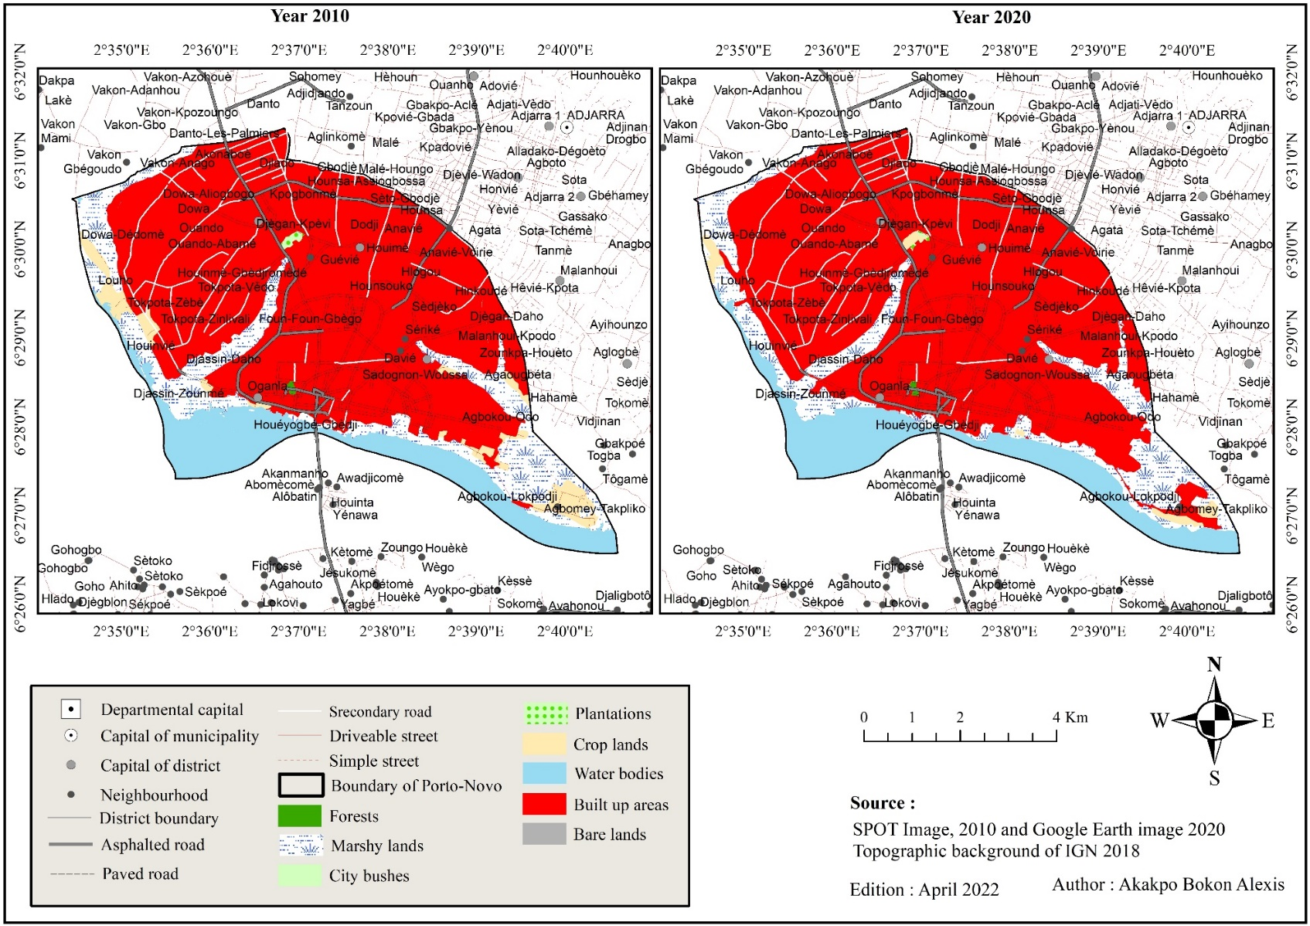
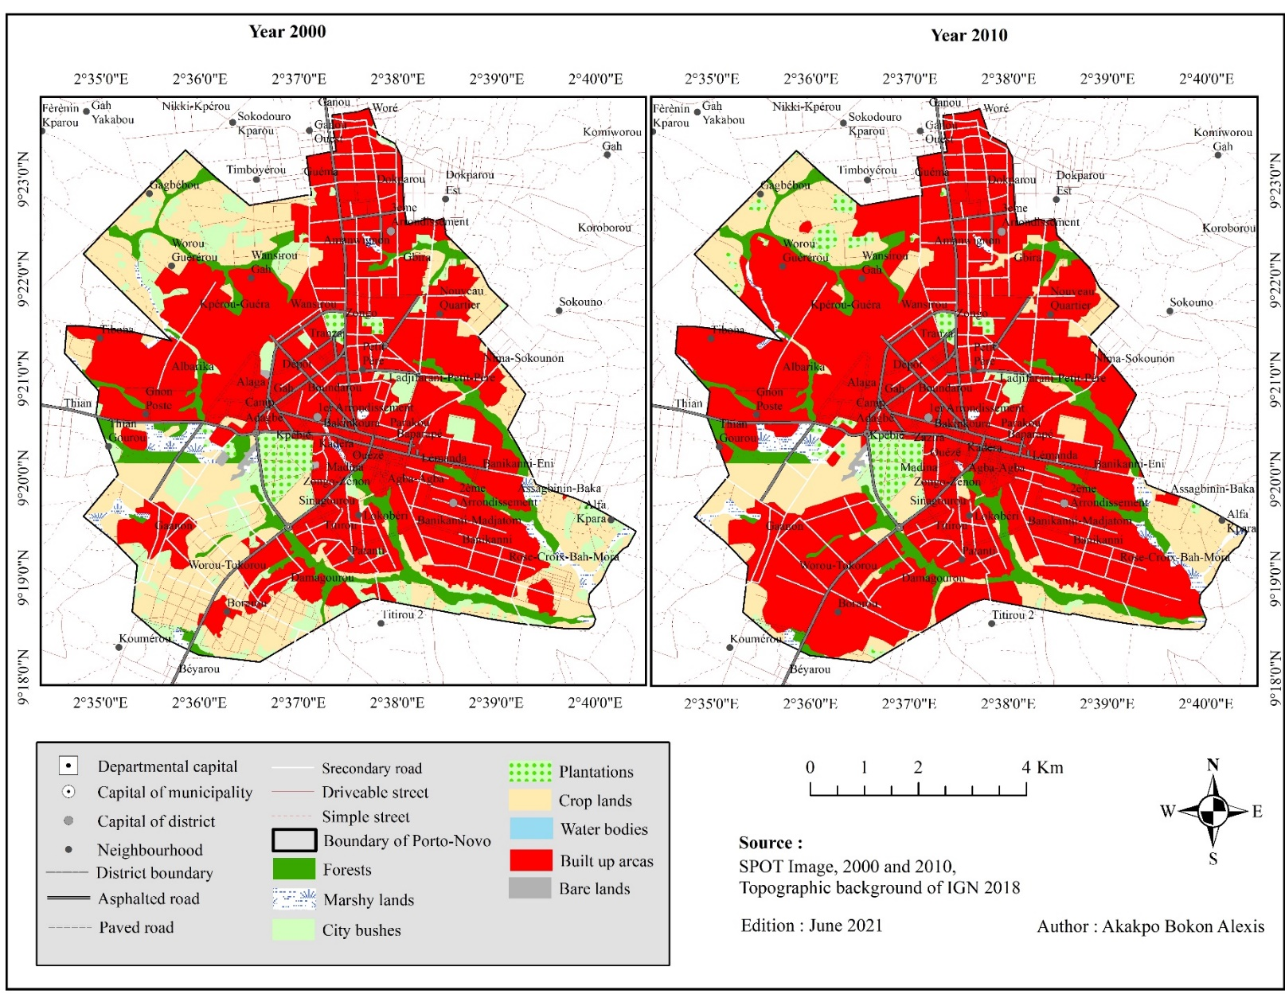
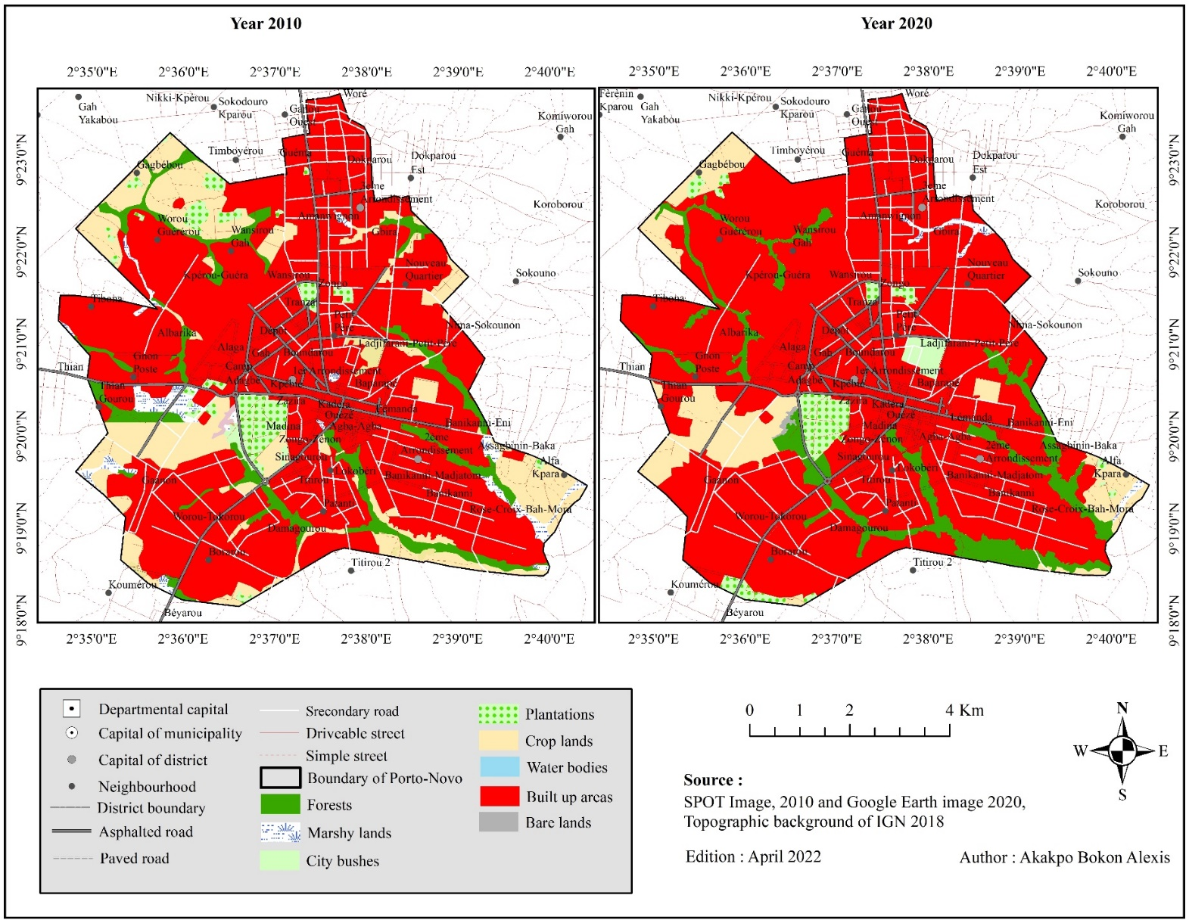
Key results and implication
Urban land use and cover dynamics
The land use and cover of the city have been greatly changed during the last two decades.
The built-up areas exert incredible stress on GS areas (Mandal et al., 2019; Gashu and Egziabher, 2018)
2000-2010
2010-2020
The best land use practices should be promoted by city’s decision makers to cope and prevent natural devastation
Fig: Land use and land cover maps

Slide 17

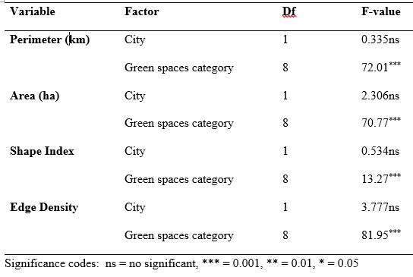
Key results and implication
Pattern and distribution of urban green spaces (UGS)
Summary of ANOVA model on GS configuration
We found the significant difference only for GS category (Fu et al., 2022)
Similar strategies/actions for GS development, improvement or conservation may be apply in different city but not for different GS category

Slide 18
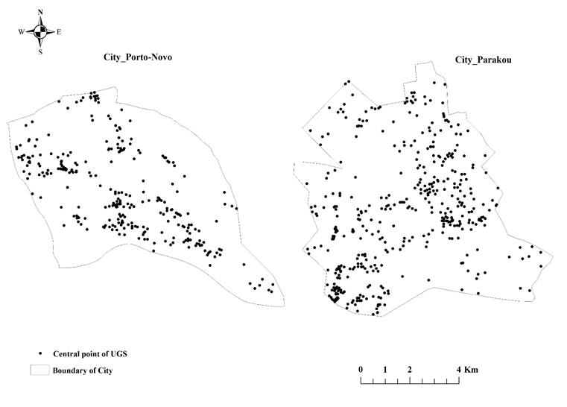
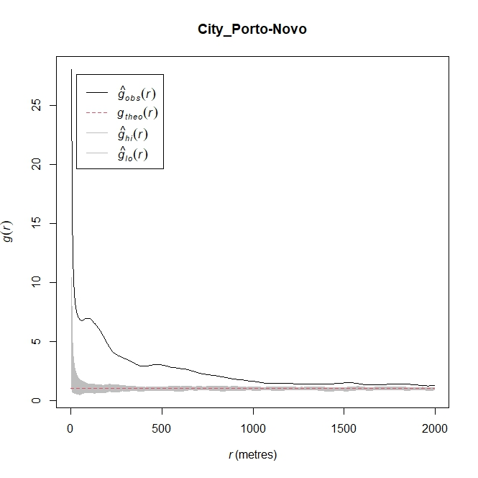
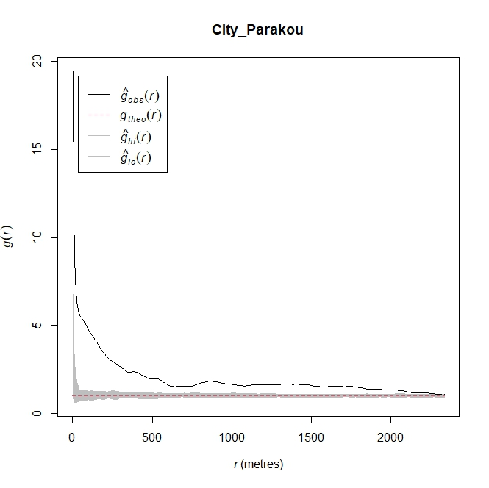
Key results and implication
Pattern and distribution of urban green spaces (UGS)
We found an aggregative distribution throughout each city. The similar findings were found by Liang et al. (2017) in China, Alam et al. (2014) in Pakistan and Fangnon, 2021 in municipality of Seme in Benin
Fig: The pattern and geographical distribution of UGS
Urban decision making and planning are aware about the need for the inclusion of GS benefits to the residents.

Slide 19
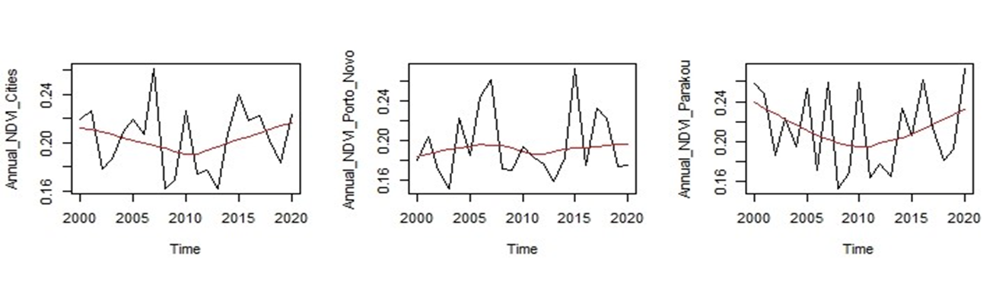
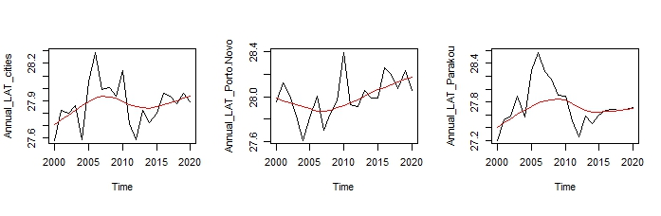
Key results and implication
Impact of green spaces on urban air cooling effect in cities
The results showed no significant linear trends for NDVI in all cases, as well as AT from the combined cities and Parakou (P-values > 0.05).
Thus, NDVI mainly decreases from 2000 to 2010 and increase up until 2020.
This finding can be supported by the national wills and commitments to vegetate cities with governmental projects such as “10 million people – 10 million trees”
Fig: The annual trend of NDVI and air temperature from 2000 to 2020

Slide 20
Key results and implication
Impact of green spaces on urban air cooling effect in cities
Table: Seasonal variation of vegetation index (NDVI)
Period | Both cities |  | Porto-Novo |  | Parakou
 | Mean | Std | Mean | Std | Mean | Std
Jan-March | 0.147ª | 0.051 | 0.137ª | 0.054 | 0.162ª | 0.043
April-June | 0.255^{b} | 0.133 | 0.260^{b} | 0.119 | 0.245^{b} | 0.146
July-Sept | 0.202^{c} | 0.151 | 0.200^{c} | 0.139 | 0.213^{b} | 0.159
Oct-Dec | 0.213^{c} | 0.077 | 0.195^{c} | 0.063 | 0.233^{b} | 0.085
We found a significant difference (P-Value < 0.001) between seasons. NDVI is lower from January to March.
This is in line with the study of Piao et al. (2019) and can be justified by the occurrence of water stress.
Means with the same letter are not significantly different (SNK test).

Slide 21
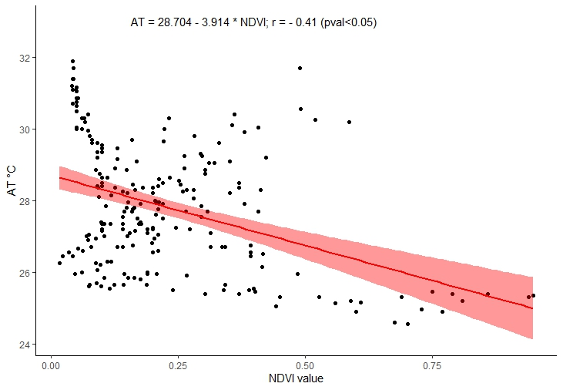
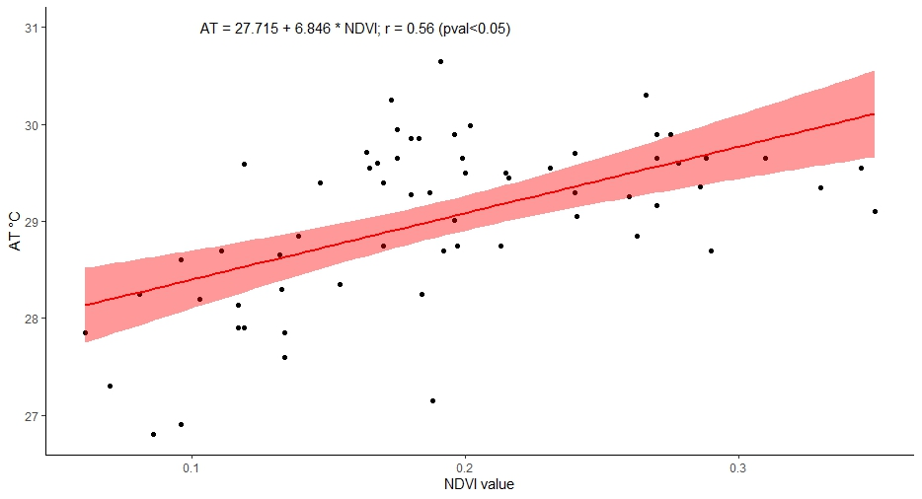
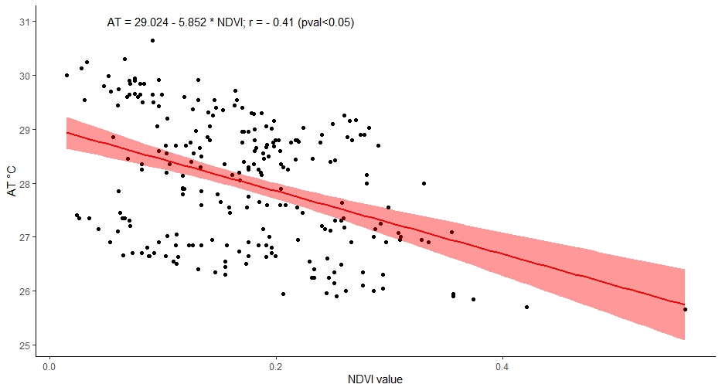
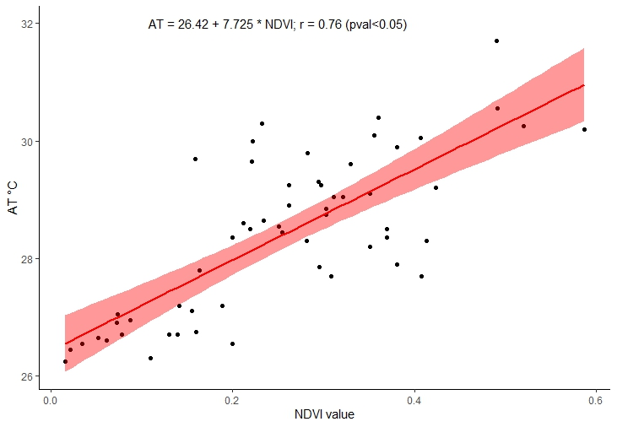
Key results and implication
Impact of green spaces on urban air cooling effect in cities
Annually, the result showed a moderate negative correlation between AT and NDVI. However, there is found a strong positive correlation for January–March in Porto-Novo (r = 0.56) and April–June in Parakou (r = 0.76) (Wollschläger et al. 2022; Norton et al. 2015)
This indicated that urban vegetation cover may not induce to AT reduction during respectively these periods in Porto-Novo and Parakou.
Fig: Urban air temperature and seasonal NDVI relationship

Slide 22
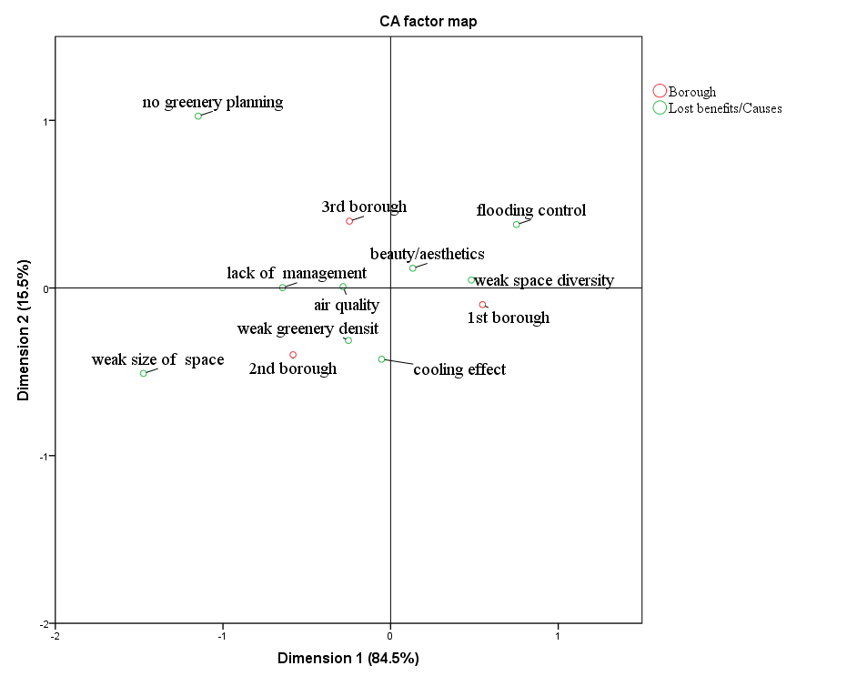
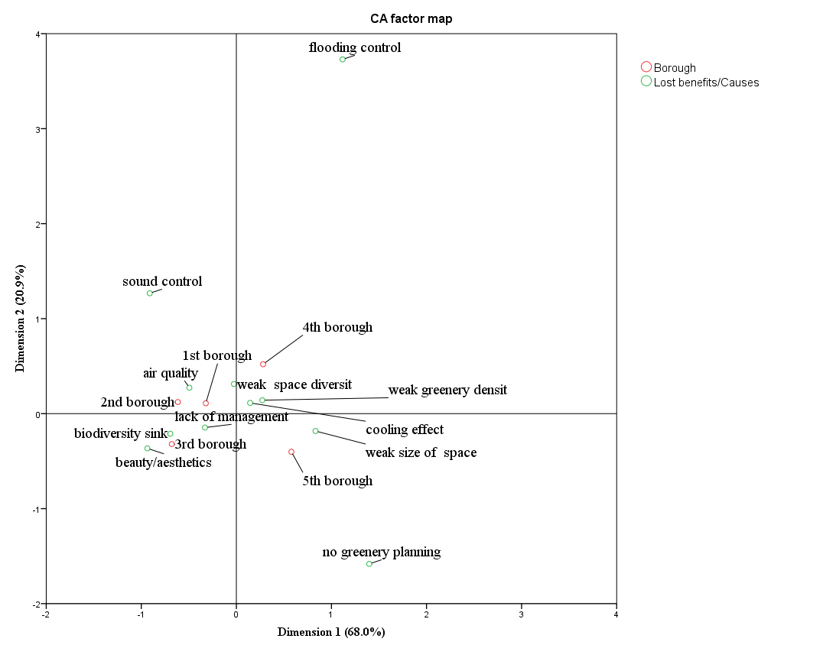
Key results and implication
Stakeholder’s perception in urban green spaces development in cities
We found a significant dependence of the losses of benefits and the causes between the cities and city areas (Bokhari et al., 2018).
Thus, these information are necessary to succeed the projects on GS development in these cities
Fig: Positioning of GS lost benefits, causes of losses and city areas of the cities

Slide 23
Key results and implication
Stakeholder’s perception in urban green spaces development in cities
Resident’s participation for UGS development: The local community involvement in UGS development was significantly low in the cities. This result corroborate with those of Mensah et al. 2016 in Ghana.
Examination of factors determining resident willingness in UGS improvement: Only institutional cooperation can positively determine local community willingness to involve in greenery development in both cities. This conclusion is similar to Gashu et al. 2019 and Cobbinah et al. 2021
However, the Stay duration, House greenery and Knowledge on general impact of urban greenery can also significantly determine community involvement in Porto-Novo and the level of education (senior high school) was found for Parakou.
These findings were relevant as a guideline for policy makers, urban planners and managers, cityscape architects and projects of urban sustainability regarding the UGS in the Republic of Benin

Slide 24
Key conclusion and recommendation
Key conclusion
As the built-up areas are stressing the UGS in the both cities, the best land use practices should be promoted to cope and prevent natural devastation in these cities.
Decision-making must also establish the specific strategies/actions to preserve each UGS categories in the cities.
To allow UGS be effective during the year seasons, a smart urban management of water availability should be helpful for ensuring the sustainable urban temperature mitigation
Public participation and institutional cooperation with local communities must be enhanced to get effective development of UGS in the cities.

Slide 25
Key conclusion and recommendation
Key recommendation
Performance improvement
Urban planning Service at difference level of action must prioritize the UGS conservation strategy and the sustainable land use planning.
Actors who are working in UGS development must know the dispositions to take, such as increase confidence to cooperate with the key stakeholders
Policy improvement
This study calls on town municipality decision makers to effectively enforce urban land use policies in sprawl restriction
The study requires the effective prevention of the allotment of marshy lands and the existing forests for residency and enhance urban parks creation for climate change effect purposes
The study recommends regular UGS implementation in order to procure fair urban ecosystem services to residents

Slide 26
Key contribution to knowledge
The GS could be summarized into forests (sacred forest and gallery forest), marshy lands, plantations, crop lands, city bushes, water bodies, green cemeteries, urban gardens and tree assemblages
The pattern of each category of UGS in each cities is aggregative
The specific strategies or actions must be needed for the development or conservation of each of GS categories
The knowledge of the periods in the year when urban vegetation should not contribute to heat attenuation if no adequate management action in terms of greenery irrigation is carried out
How institutional cooperation with local communities must be improved in order to foster the involvement of people in UGS development.

Slide 27
Key references
Bokhari, S. A., Saqib, Z., Ali, A., & Zaman, M. H. (2018). The impacts of socio-economic factors on the perception of residents about urban vegetation: A comparative study of planned versus semi-planned cities of Islamabad and Rawalpindi, Pakistan. Applied Ecology and Environmental Research, 16(4), 4265–4287. https://doi.org/10.15666/aeer/1604_42654287
Cobbinah, P. B., Asibey, M. O., Zuneidu, M. A., & Erdiaw-Kwasie, M. O. (2021). Accommodating green spaces in cities: Perceptions and attitudes in slums. Cities, 111, 103094. https://doi.org/10.1016/j.cities.2020.103094
Fangnon, B. (2021). Public green spaces and management constraints in the Municipality of Seme-Podji South East of Benin. Journal of Geography and Regional Planning, 14(3), 113–122. https://doi.org/10.5897/JGRP2021.0819
Fu, J., Dupre, K., Tavares, S., King, D., & Banhalmi-Zakar, Z. (2022). Optimized greenery configuration to mitigate urban heat : A decade systematic review. Frontiers of Architectural Research, 11, 466–491.
Gashu, K., Gebre-egziabher, T., & Wubneh, M. (2019). Local communities’ perceptions and use of urban green infrastructure in two Ethiopian cities : Bahir Dar and Hawassa. Journal of Environmental Planning and Management, 0(0), 1–30. https://doi.org/10.1080/09640568.2019.1578643
Liang, H., Chen, D., & Zhang, Q. (2017). Assessing Urban Green Space distribution in a compact megacity by landscape metrics. Journal of Environmental Engineering and Landscape Management, 25(1), 64–74. https://doi.org/10.3846/16486897.2016.1210157
Mensah, Adjei Collins, Andres, L., Baidoo, P., Eshun, J. K., & Antwi, K. B. (2016). Community Participation in Urban Planning: the Case of Managing Green Spaces in Kumasi, Ghana. Urban Forum, 28(2), 125–141. https://doi.org/10.1007/s12132-016-9295-7
Norton, B. A., Coutts, A. M., Livesley, S. J., Harris, R. J., Hunter, A. M., & Williams, N. S. G. (2015). Planning for cooler cities: A framework to prioritise green infrastructure to mitigate high temperatures in urban landscapes. Landscape and Urban Planning, 134, 127–138. https://doi.org/10.1016/j.landurbplan.2014.10.018
Osseni, A. A, Mouhamadou, T., Tohoain, B. A. C., & Sinsin, B. (2015). SIG et gestion des espaces verts dans la ville de Porto-Novo au Benin. Tropicultura, 332(2), 146–156.
Piao, S., Liu, Q., Chen, A., Janssens, I. A., Fu, Y., Dai, J., Liu, L., Lian, X., Shen, M., & Zhu, X. (2019). Plant phenology and global climate change: Current progresses and challenges. Global Change Biology, 25(6), 1922–1940. https://doi.org/10.1111/gcb.14619
Scott, M., Lennon, M., Haase, D., Kazmierczak, A., Clabby, G., & Beatley, T. (2016). Nature-based solutions for the contemporary city/Re-naturing the city/Reflections on urban landscapes, ecosystems services and nature-based solutions in cities/Multifunctional green infrastructure and climate change adaptation: brownfield greening as an adaptation strategy for vulnerable communities?/Delivering green infrastructure through planning: insights from practice in Fingal, Ireland/Planning for biophilic cities: from theory to practice. Planning Theory and Practice, 17(2), 267–300. https://doi.org/10.1080/14649357.2016.1158907
Siddiqui, A., Siddiqui, A., Maithani, S., Jha, A. K., Kumar, P., & Srivastav, S. K. (2018). Urban growth dynamics of an Indian metropolitan using CA Markov and Logistic Regression. The Egyptian Journal of Remote Sensing and Space Sciences, 21, 229–236. https://doi.org/10.1016/j.ejrs.2017.11.006
Teka, O., Togbe, C. E., Djikpo, R., Chabi, R., & Djossa, B. (2017). Effects of Urban Forestry on the Local Climate in Cotonou , Benin Republic. Agriculture, Forestry and Fisheries, 6(4), 123–129. https://doi.org/10.11648/j.aff.20170604.13
UN-HABITAT. (2011). Cities and Climate Change: global report on human settlements. United Nations Human Settlements Programme, Nairobi, Kenya.
UN-HABITAT. (2016). Urban Planning and Design Labs: tools for integrated and participatory urban planning. In UN-HABITAT, 1st Edition, Habitat III, Quito.
Wamsler, C., Brink, E., & Rivera, C. (2013). Planning for climate change in urban areas: From theory to practice, Journal of Cleaner Production. Journal Od Cleaner Production, 50, 68–81. https://doi.org/http://dx.doi.org/10.1016/j.jclepro.2012.12.008
Wollschläger, N., Zinck, F., & Schlink, U. (2022). Sustainable Urban Development for Heat Adaptation of Small and Medium Sized Communities. Land, 11(1385), 1–17. https://doi.org/10.3390/land11091385

Slide 28
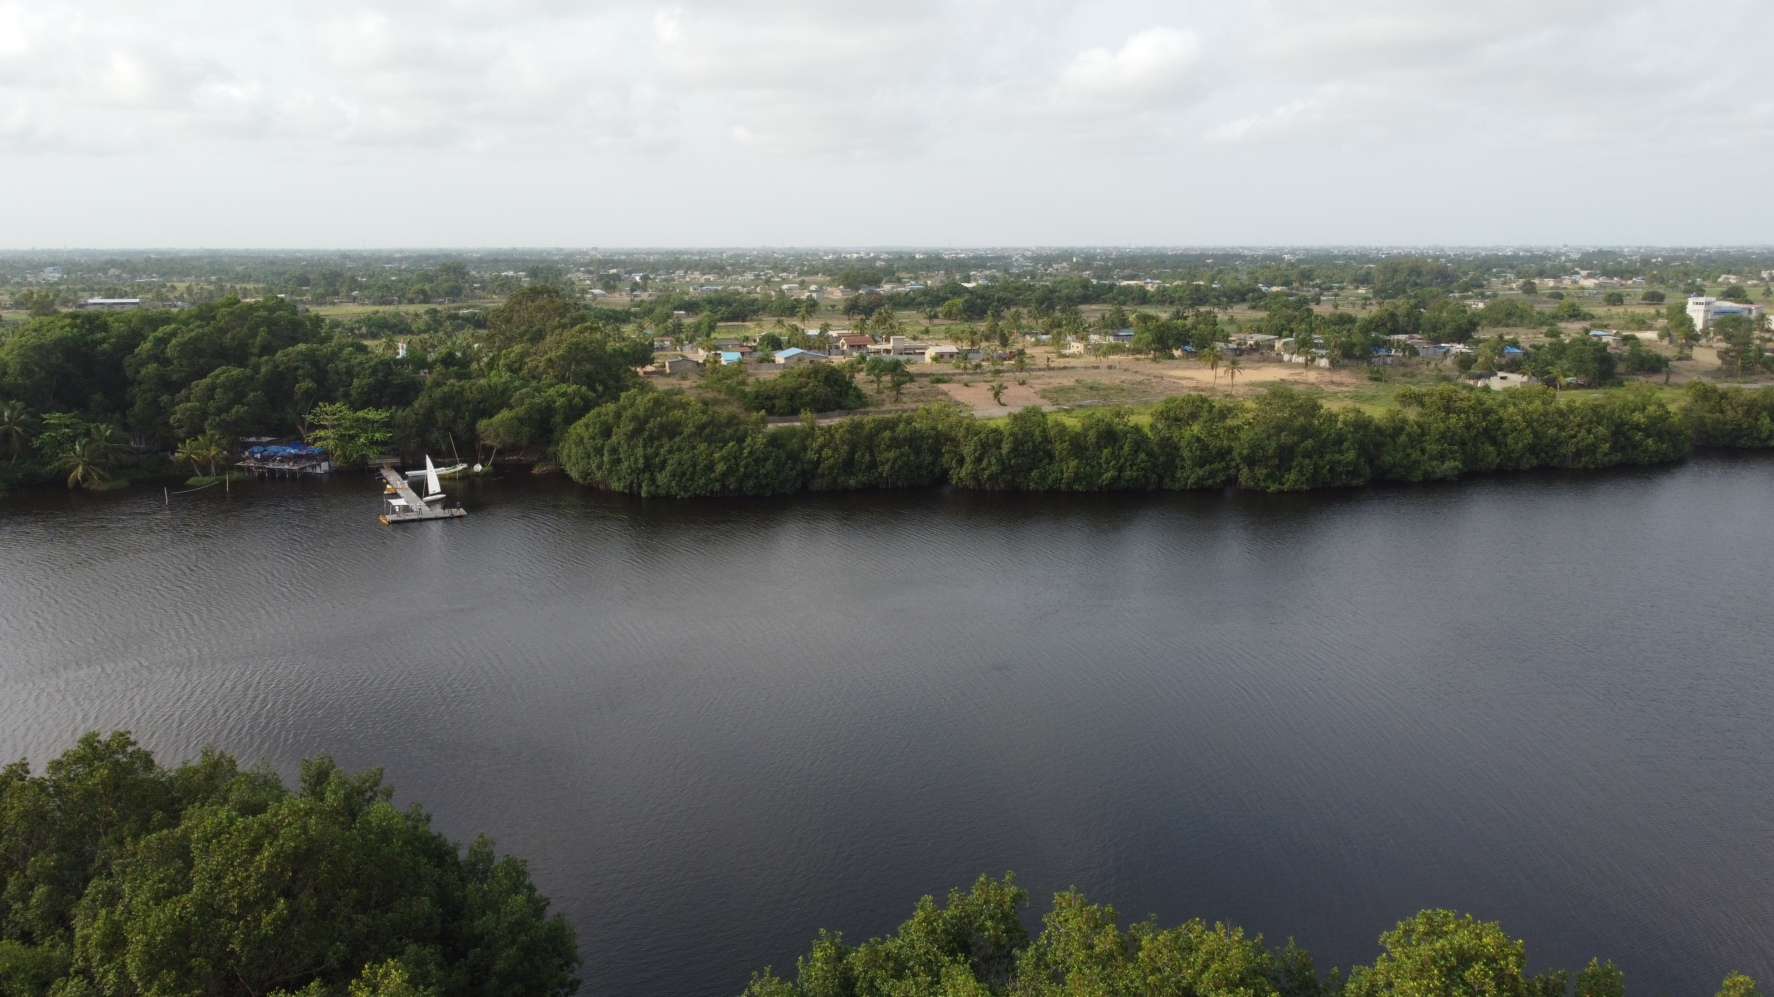
Thank you for the attention

