Slide 1

AWEDA, Emmanuel D.
PHD/SPS/FT/2021/13011
Evaluation of Environment and Climate-Induced Drivers of Migration in Nigeria
Supervisory Team:
Professor A. A Okhimamhe
Professor C. Conrad

Slide 2
Presentation Outline
Introduction
  Key study background
  Key statement of the problem
  Conceptual framework
  Research questions
  Aim and objectives
  Justification of study
Study area
Review of literature
Data Source
Key results
Key conclusions and recommendations

Slide 3
MIGRATION
DRIVERS
Increase in drought intensification thereby affecting livelihoods
Sea level rise affecting coastal regions leading to permanent displacement of households
Environmental degradation affecting ecosystems
Increase in extreme weather events such as heat waves, flash floods
The Environment, Climate and Migration-Nexus
  Key study background

Slide 4
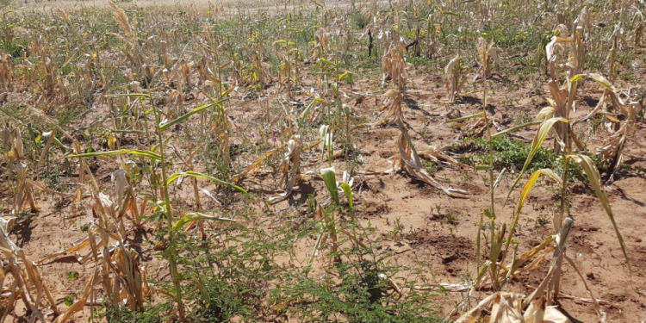
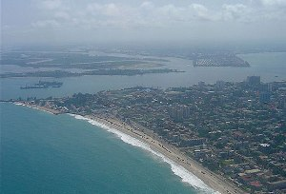


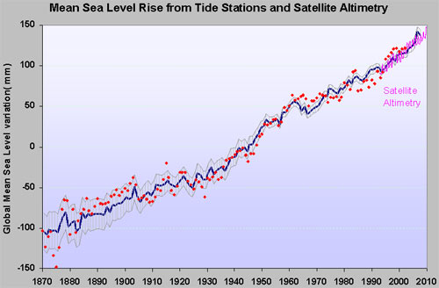


Statement of Problem
Having a well-developed working system to mitigate the impacts of the
changing climate and environmental degradation.
Stakeholders are yet to come to terms with the climate-environment-migration nexus on one hand, and practically sustainable approaches to curb the situation and manage the arising challenges

Slide 5
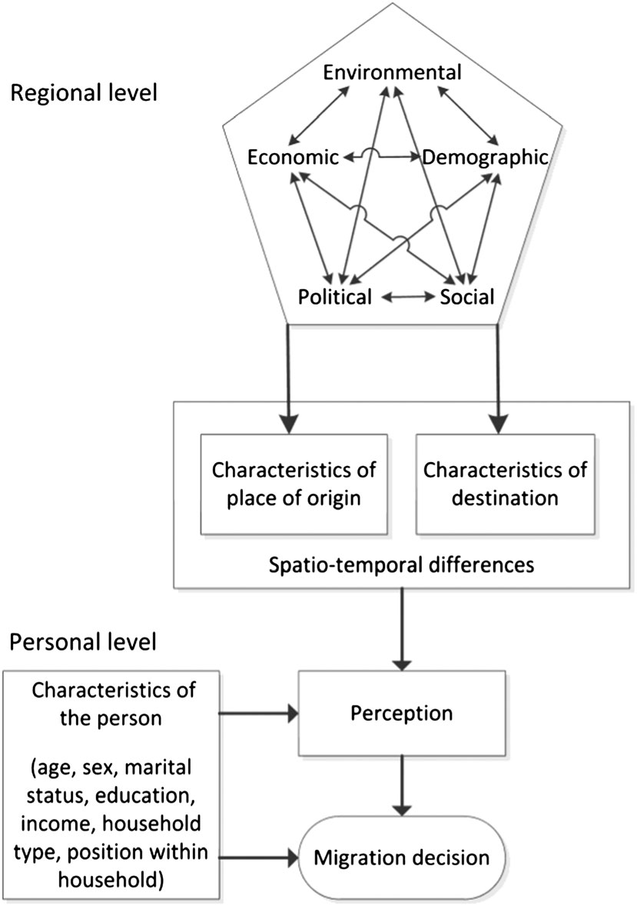
Conceptual Framework
(Source: Neumann & Hermans, 2017)

Slide 6
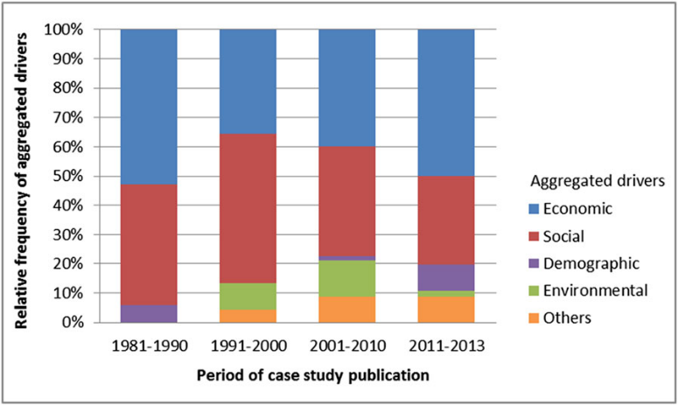
(Source: Neumann & Hermans, 2017)
Over the past decades, studies on migration drivers have shifted from the known socio-economic drivers to other factors such as the degrading environment and climate change

Slide 7
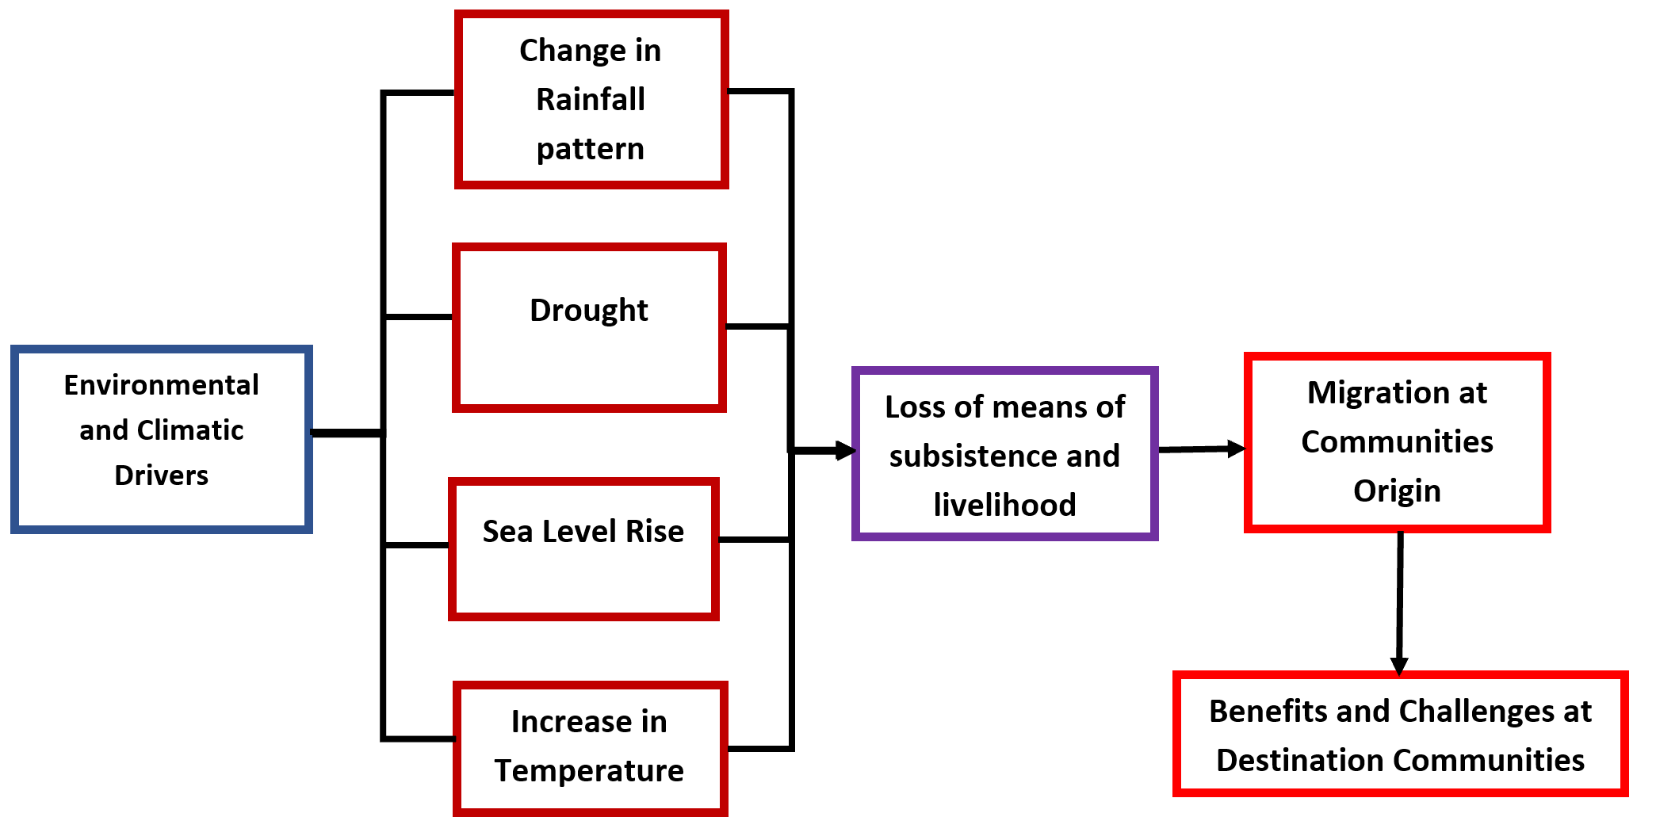





Conceptual Framework of Study
Notes:
(Source: Author, 2024)

Slide 8
Research Questions
What are the ecological and climatic preconditions for migration in Nigeria?
What are the migration patterns at Nigeria's origin and destination hotspots?
To what extent do environmental and climatic factors influence migration decisions in Nigeria?
How does migration shape the social, economic and environmental landscape of destination communities in Nigeria?
1
2
3
4

Slide 9
Aim and Objectives of Study
Identify and analyse the trends of ecological health and climate indicators at the migration origins of Nigeria
Identify the migration patterns at the origin and destination hotspots of Nigeria
Assess the influence of the environment and climate on migration decisions in Nigeria
Evaluate the impacts of migration on destination communities in Nigeria
This study aims to examine the influence of climatic and environmental factors on migration trends in Nigeria
1
2
3
4
Notes:
(Source: Author, 2024)

Slide 10



Justification of the Research Study
Identifying the extent of the roles played by these environment and climate-based drivers in influencing migration decisions will provide essential information in achieving key Sustainable Development Goals (SDG 10.7, 11, 13)
Understanding the motivations behind internal migration and the impacts on migration destinations is crucial for policymakers, researchers, and development practitioners
Designing effective interventions and policies that address the causative factors of environment and climate-based migration in Nigeria

Slide 11
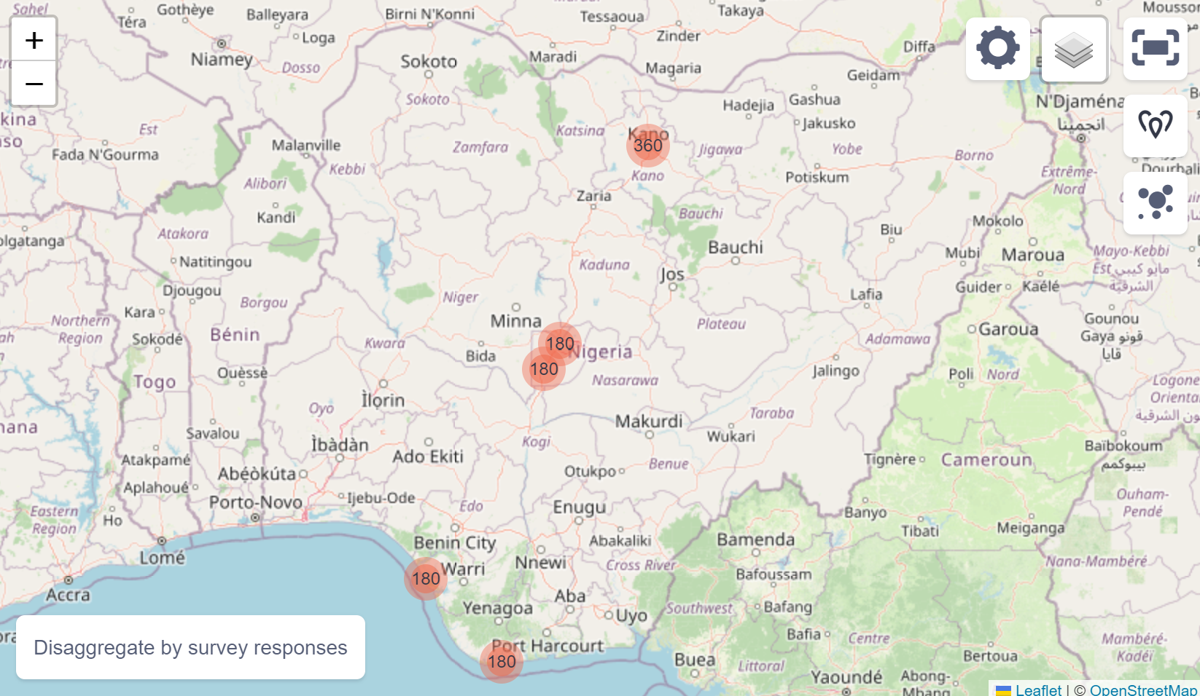
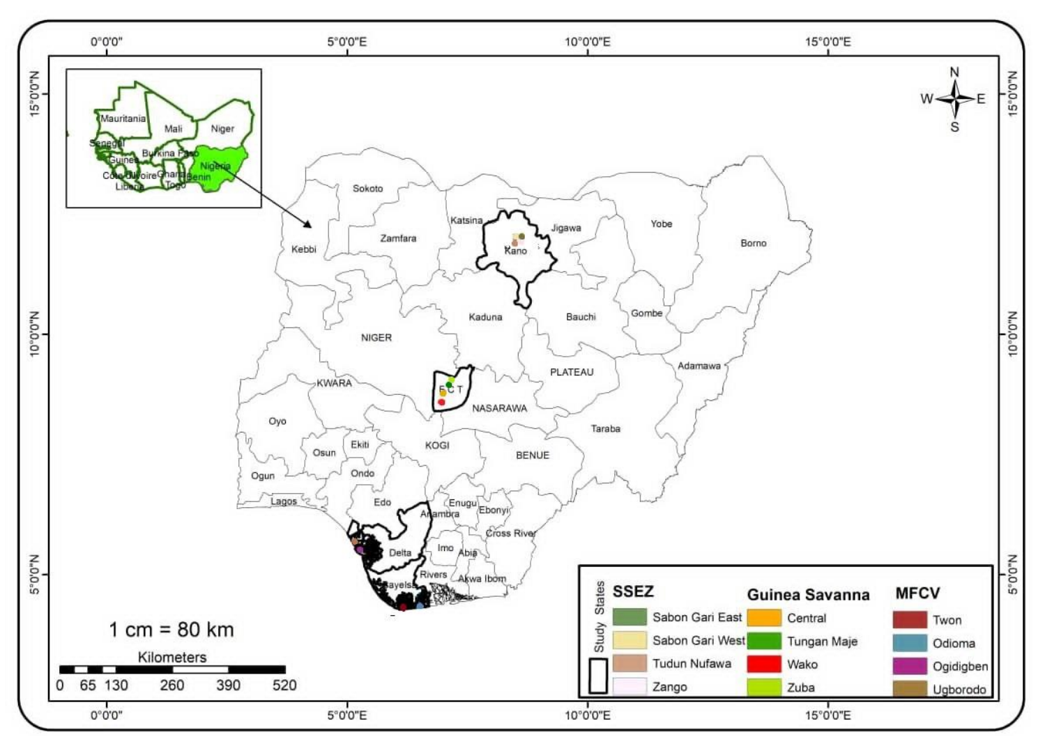
Study Area

Slide 12
Authors | Study Area | Major Argument | Key Findings and Conclusion | Relevance to study | Research Gap
Ologeh et al (2020) | Northern Nigeria | Climate change significantly influences migration decisions among crop farmers in Northern Nigeria. | Farmers migrate due to climate-related challenges | It explains the challenges posed by climate change poses to agricultural communities | There is a need to study the long-term socio-economic impacts of climate-induced migration on migrants and host communities
Lenshie et al (2020) | Sahel region of West Africa | Climate change increases existing vulnerabilities and conflicts in the Sahel, leading to increased population displacement | Policies addressing climate change and migration must consider security implications to be effective. | It provides insights into similar climatic challenges and conflict dynamics in Nigeria | There is a need to study the long-term impacts of climate-induced migration on regional stability and security
Literature Review

Slide 13
Garcia et al (2021) | Global | There has been an increase in scholarly interest linking climate change to migration | It is important to understand migration trends to guide future research and develop effective policies | Provides an understanding of climate and environment-induced migration trends | There is a need to study the specific mechanisms involved in migration
Olagunju et al (2021) | Nigeria | climate change-induced environmental degradation contributes to human displacement and social conflicts in Nigeria | Climate change is a major driver of environmental degradation in Nigeria | It provides information on the complex relationship between climate change, environment, migration, and conflict | There is a need to study the long-term impacts of climate-induced displacement on both host and destination communities in Nigeria
Ghosh and Orchiston (2022) | Global | There is a need to improve the evidence base for climate-induced migration by enhancing current global datasets | Asia is the most studied area, followed by Oceania | It helps to identify the global research gaps in the field of study | There is a need for a universally agreed definition of 'climate-induced migrants' and 'climate-induced migration’

Slide 14
Ofuoku and Okompu (2022) | Delta State, Nigeria | Migration among farmers in Delta State is a climate change adaptation strategy | Farmers often migrate in response to climate-related challenges, such as flooding and soil degradation | It provides information on how climate change significantly impacts agricultural communities | There is a need to study the long-term impacts of climate-induced migration on both origin and destination communities
Teye and Nikoi (2022) | West Africa | West African households use migration to cope with climate change and variability impacts | Increased temperatures and fluctuating rainfall patterns affect the livelihoods of people in the West Africa Sahel, prompting migration decisions | It provides more insights to Nigeria, which faces similar challenges related to climate change and migration | There is a need for further research and policy development
Azumah and Ahmed (2023) | Ghana | Not all climatic conditions trigger migration in the same way. | Drought and decreased rainfall are more likely to trigger migration among maize farmers | Nigeria experiences similar climatic challenges and agricultural systems to Ghana | There is a need to identify the different roles of climatic conditions in migration decisions

Slide 15
Almulhim et al (2024) | Global South | Compounding impacts of multiple climate hazards on migration | Stressors (rising temperatures, water stress, floods, sea-level rise) displace populations, both internally and transboundary | Gives insight into migration patterns due to factors like desertification, flooding, and resource scarcity | There is a need to consider the interactions between various climate factors and their cumulative effects on migration patterns.
Naz and Saleem (2024) | Sahel region of Africa | climate-induced vulnerabilities, increase the risk of conflicts and forced migrations in the Sahel region of Africa | Climate change drives conflict and migration in the Sahel | The study is relevant to Nigeria, which faces similar climate challenges and migration patterns | There is a need for a more detailed analysis of the effectiveness of specific adaptation strategies and their impacts on reducing conflict and migration.
Michael (2024) | Bayelsa State, Nigeria | Climate change significantly influences the migration decisions of women in the riverine area of Bayelsa State | Women in the riverine areas migrating due to the impacts of climate change on their livelihoods | It addresses the impacts of climate change on gendered migration decisions in a coastal region of Nigeria | There is a need to study the long-term impacts of climate-induced migration on women's well-being and livelihoods

Slide 16
Summary of Data
Data Type | Data Source | Resolution | Period | Use | Locations (LGAs)
Precipitation | CHIRPS | 5 km | 1993 - 2022 | Climate Change Indicator | Kano Municipal, Kwali, Warri South West, Brass
Temperature | ERA5 | 31 km | 1993 - 2022 | Climate Change Indicator | Kano Municipal, Kwali, Warri South West, Brass
SLR | C3S | 23 km | 1993 - 2022 | Climate Change Indicator | Warri South West, Brass
NDVI | MODIS | 250 m | 1993 - 2022 | Ecological health Indicator | Kano Municipal, Kwali, Warri South West, Brass
SPEI | CHIRPS | 5 km | 1993 - 2022 | Ecological health Indicator | Kano Municipal, Kwali, Warri South West, Brass
VCI | MODIS | 250 m | 1993 - 2022 | Ecological health Indicator | Kano Municipal, Kwali, Warri South West, Brass
NDVI and NDBI (Land Use Changes) | LANDSAT | 30 m | 2014 - 2023 | Land Use Changes | Fagge, Gwagwalada
Social survey (household survey, FGD) | Fieldwork |  |  |  | Perceptions of the influence of the climate and environment on migration

Slide 17
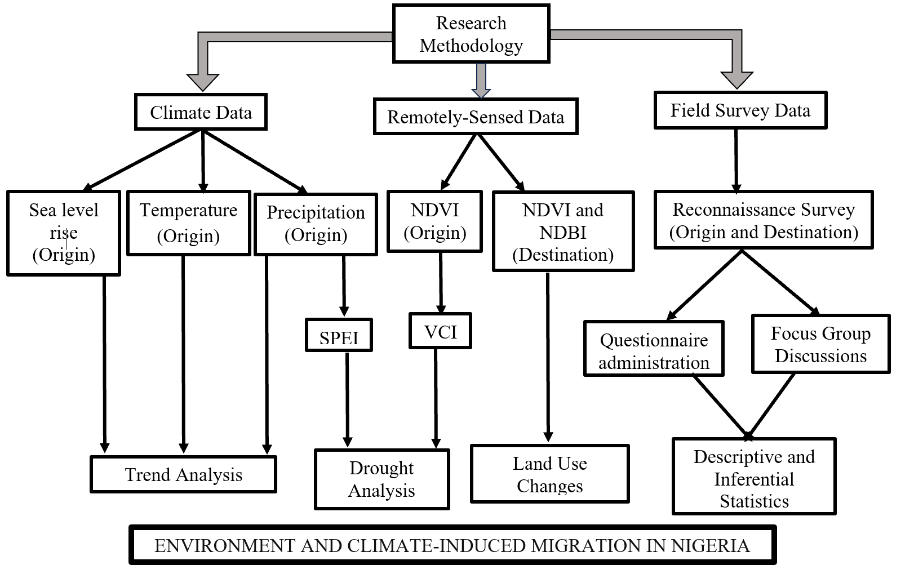
Summary of Methodology

Slide 18
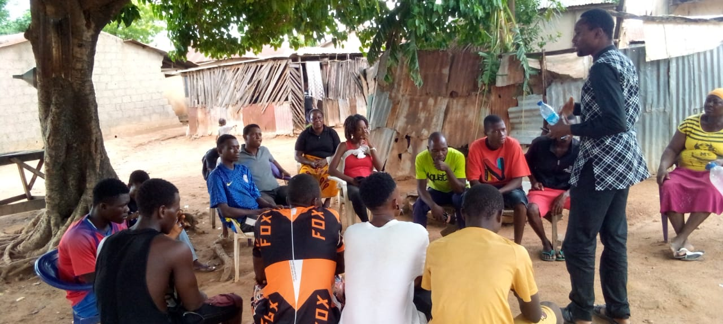

Step 1
Identification and selection of twelve official enumeration areas (EA) from six LGAs nationwide
Step 2
Identification of migrants’ origin and destination enclaves in each community
Step 3
Purposive selection of ninety household heads for each EA
Steps of multi-stage Technique
KoboToolbox (Version 2.022.44) on mobile devices

Slide 19
Zone | State | LGA | Wards | Nature
Mangrove Swamp Forest and Coastal Vegetation | Delta | Warri South West | Ugborodo | Origin
 |  |  | Ogidigben | Origin
 | Bayelsa | Brass | Twon | Origin
 |  |  | Odioma | Origin
Guinea Savanna | Abuja | Gwagwalada | Zuba | Destination
 |  |  | Tungamaje | Destination
 |  | Kwali | Central | Origin/Destination
 |  |  | Wako | Origin/Destination
Sudan-Sahel Savanna | Kano | Kano Municipal | Zango | Origin/Destination
 |  |  | Tundun Nufawa | Origin/Destination
 |  | Fagge | Sabon Gari East | Destination
 |  |  | Sabon Gari West | Destination

Slide 20
Key Results (1)
Climatic Indicators
Location | Parameter | P-value | Trend
Kano Municipal | Temperature | <0.001* | Significant increase
 | Precipitation | 0.378 | Not significant
Kwali | Temperature | <0.001* | Significant increase
 | Precipitation | 0.293 | Not significant
Warri South-West | Temperature | <0.001* | Significant increase
 | Precipitation | <0.001* | Significant decrease
Brass | Temperature | <0.001* | Significant increase
 | Precipitation | <0.001* | Significant decrease
Brass/Warri South West | Sea level anomaly | <0.001* | Significant increase
*Significant at p<0.05

Slide 21
Ecological Health Indicators
Location | P-value | Trend
Kano Municipal | <0.001* | Significant decrease
Kwali | <0.001* | Significant decrease
Warri South-West | <0.001* | Significant decrease
Brass | 0.012 | Not Significant
*Significant at p<0.05

Slide 22
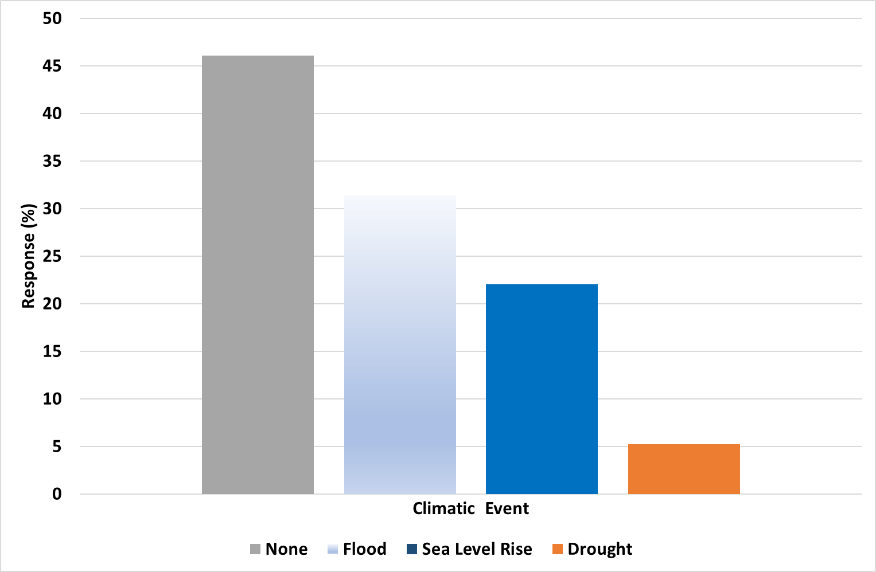

Slide 23
Environmental/climatic events affecting households in communities of migration origin
p < 0.05

Slide 24
Key Results (2)
Migration intentions in various communities

Slide 25
Opinion of respondents on 3rd party migrants

Slide 26
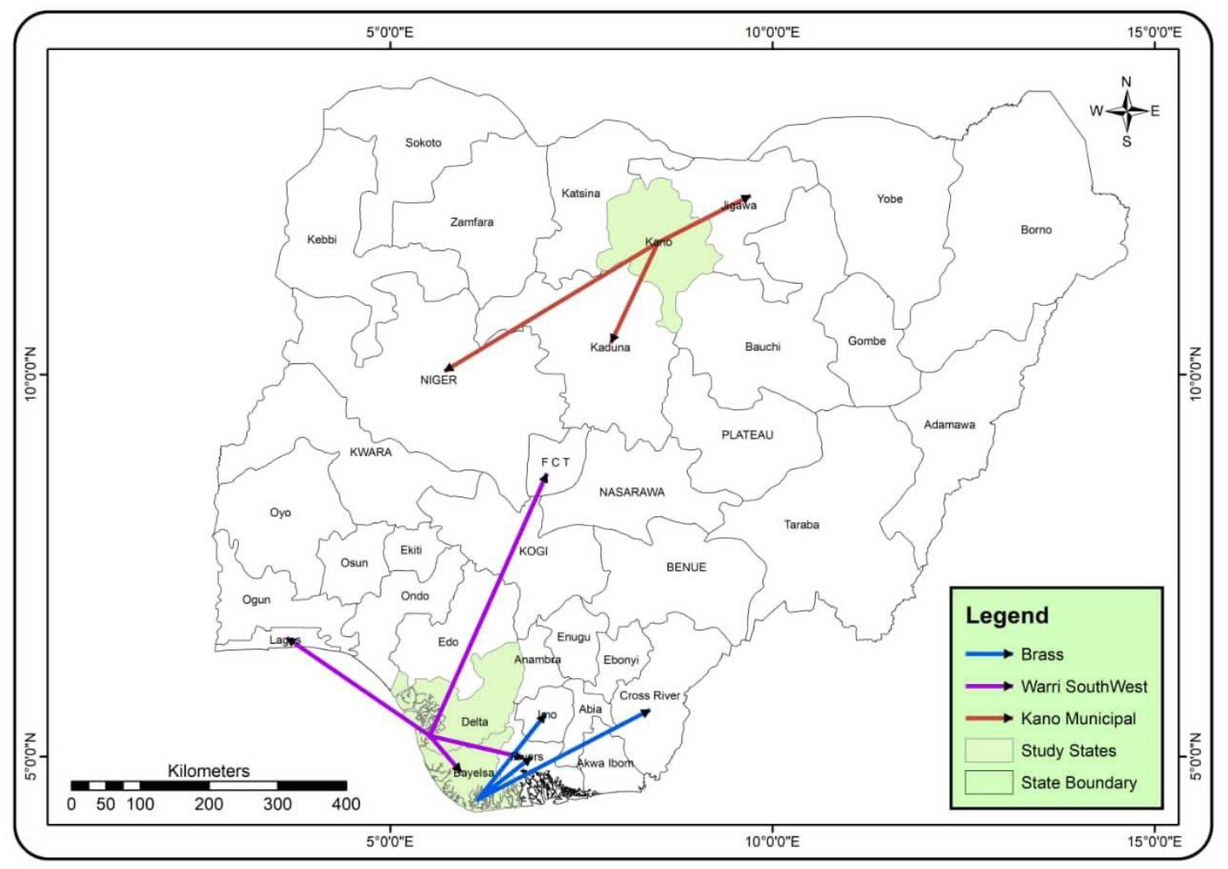
Destination of Migrants from Origin Hotspots

Slide 27
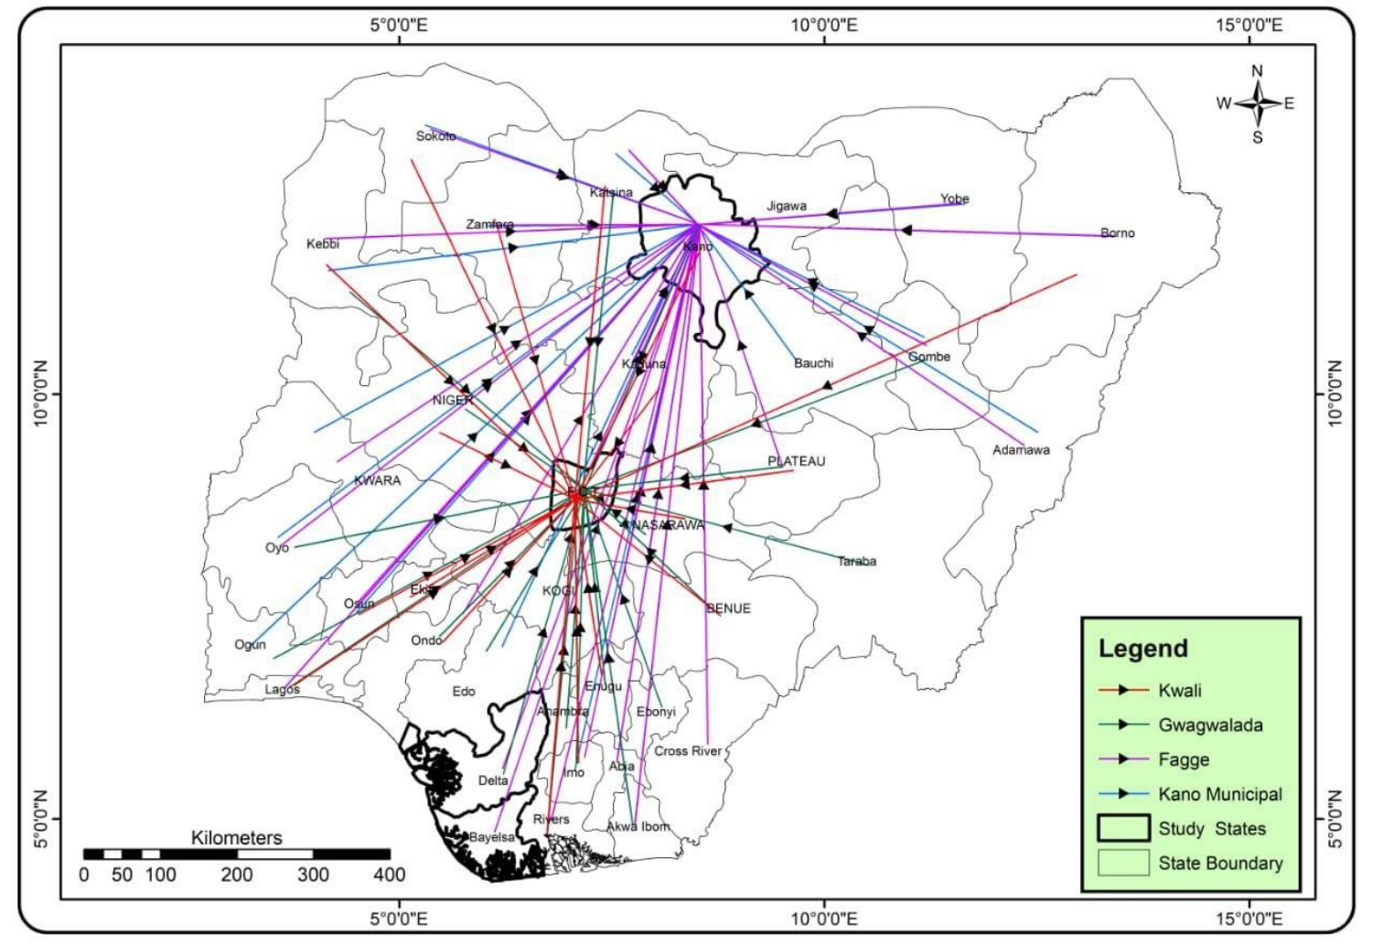
Origins of Migrants to Destination Hotspots

Slide 28
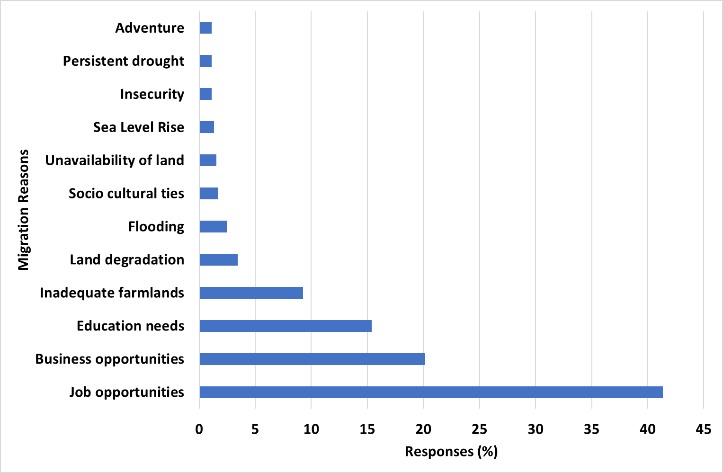
Summary of perceived reasons for migration of 3rd party migrants from origin
Notes:
There is no statistically difference in this perception

Slide 29
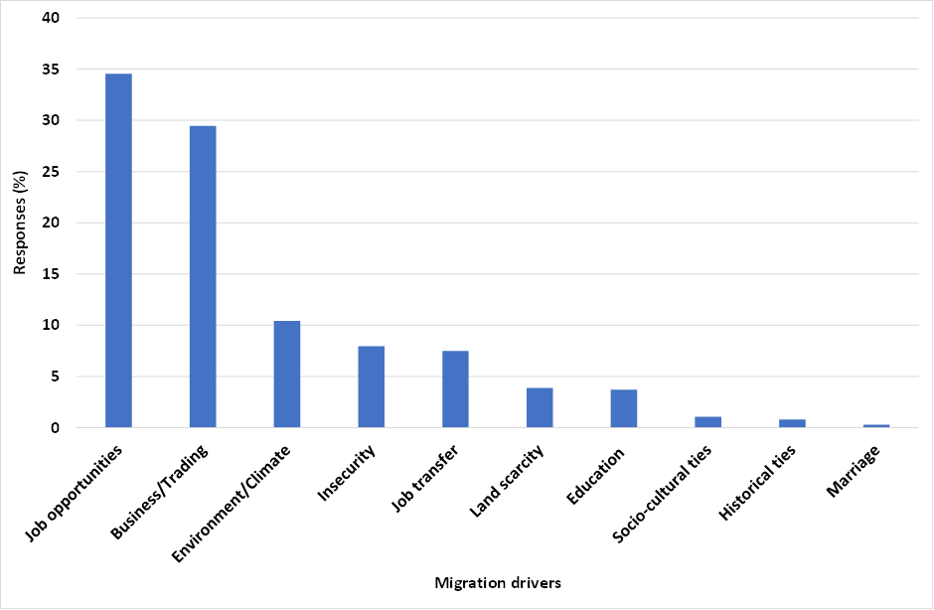
Key Results (3)
Perceived drivers of migration by migrants

Slide 30
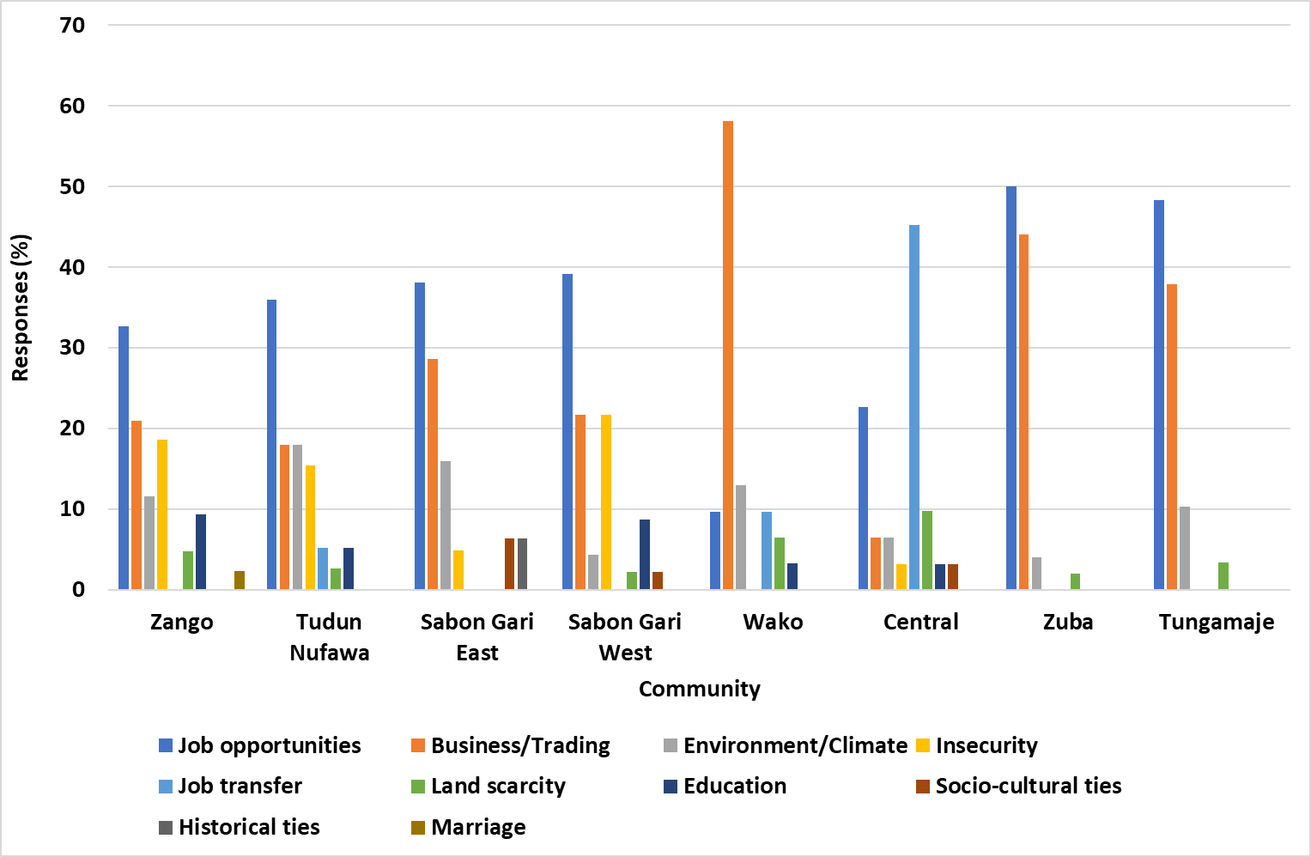
Detailed perception of drivers of migration by migrants
Notes:
There was no statistically significant difference in this perception

Slide 31
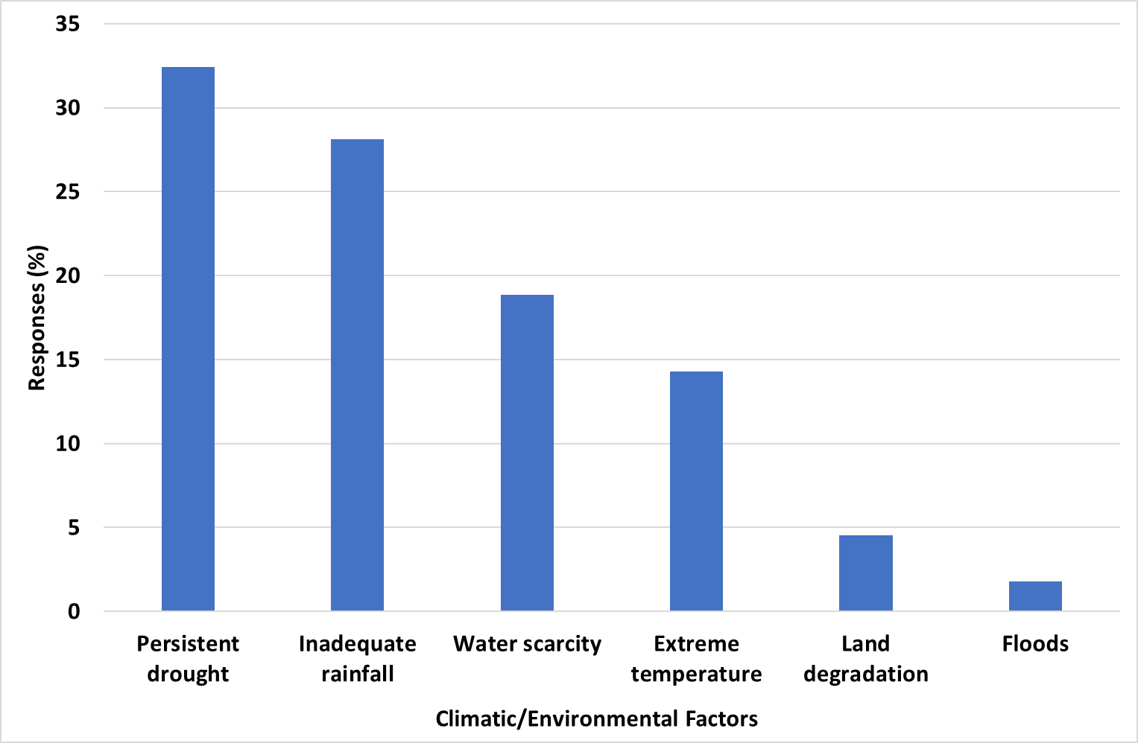
Summary of climatic/environmental push factors of migration from origin

Slide 32
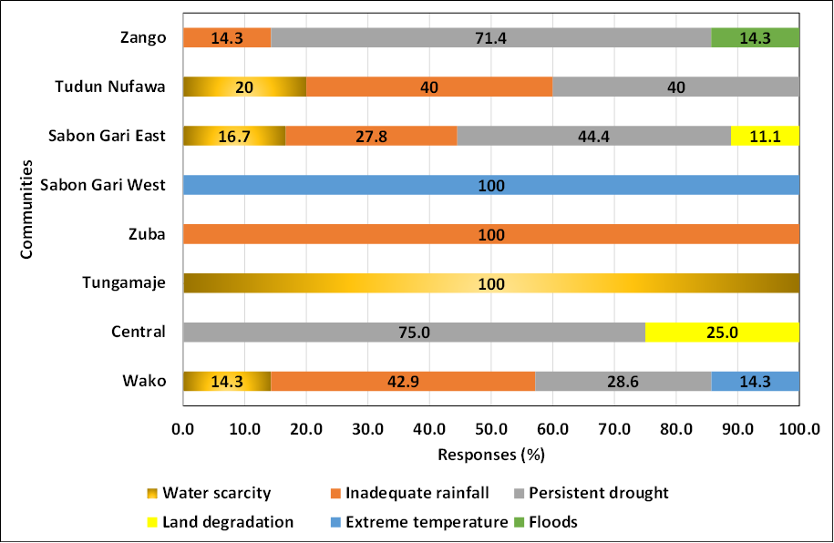
Detailed climatic/environmental push factors of migration from origin
Notes:
There was no statistically significant difference in this perception

Slide 33
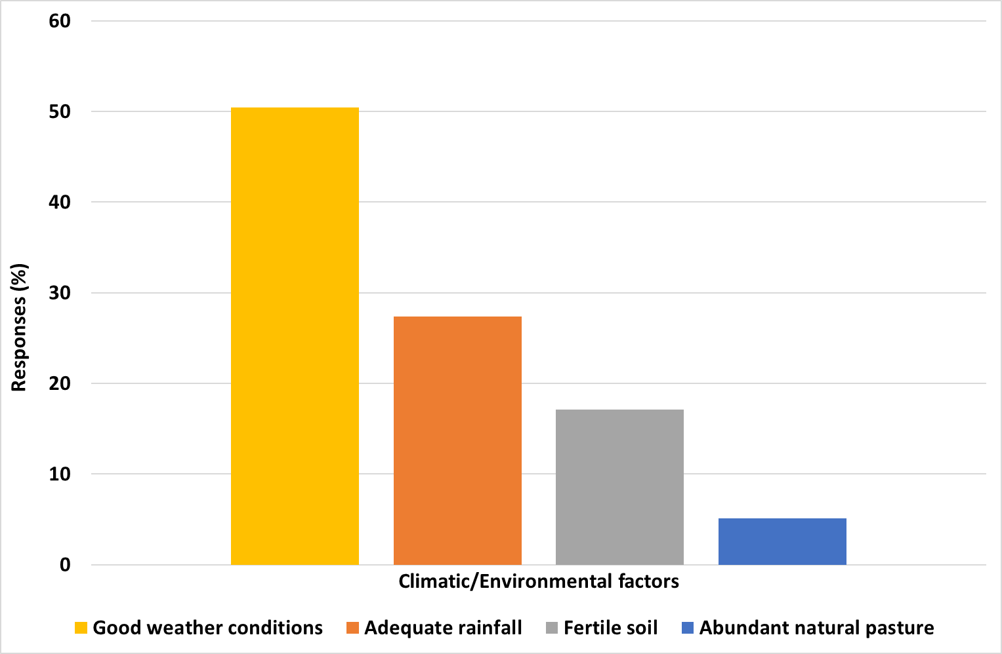
Summarised climatic/environmental pull factors of migration to destination

Slide 34
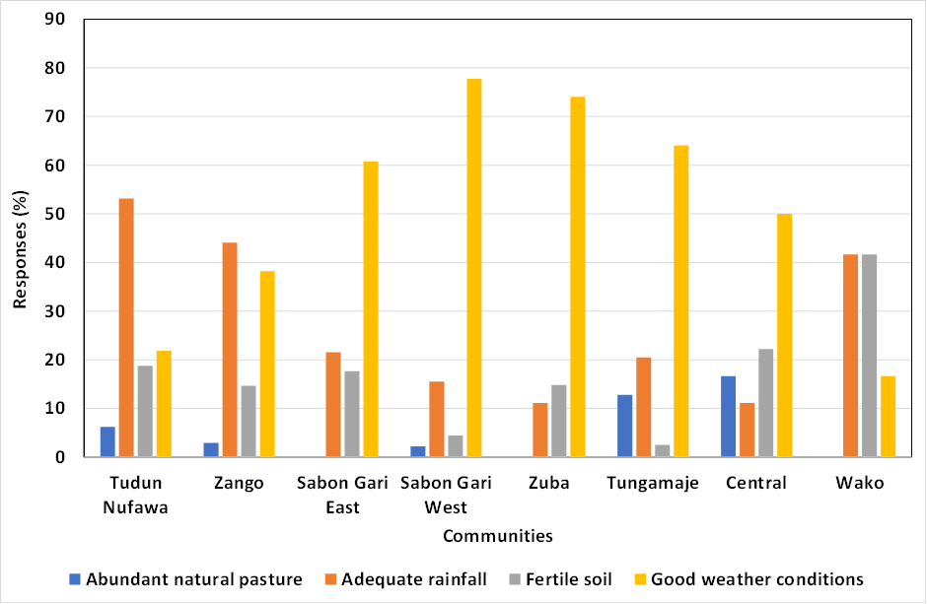
p < 0.05
Climatic/environmental pull factors of migration to destination communities

Slide 35
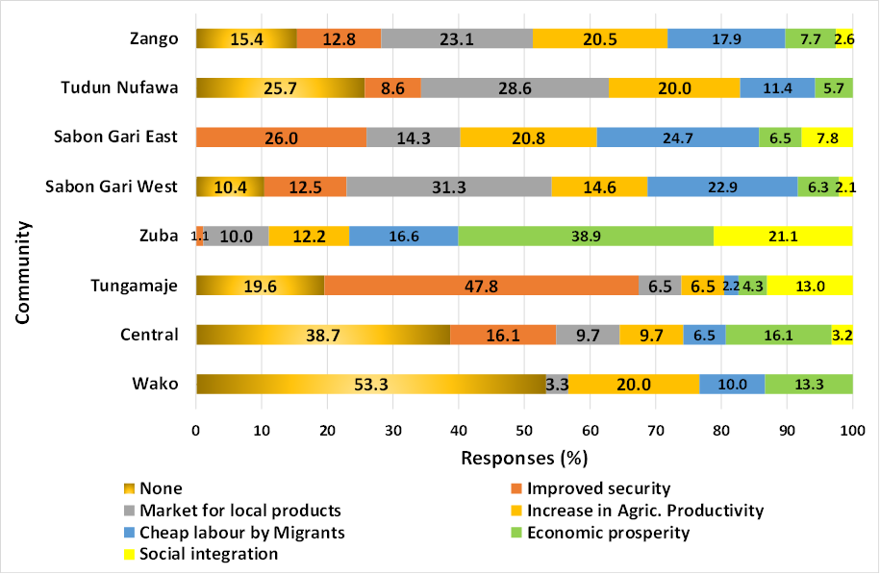
Key Results (4)
Migration benefits at destination communities
p < 0.05

Slide 36
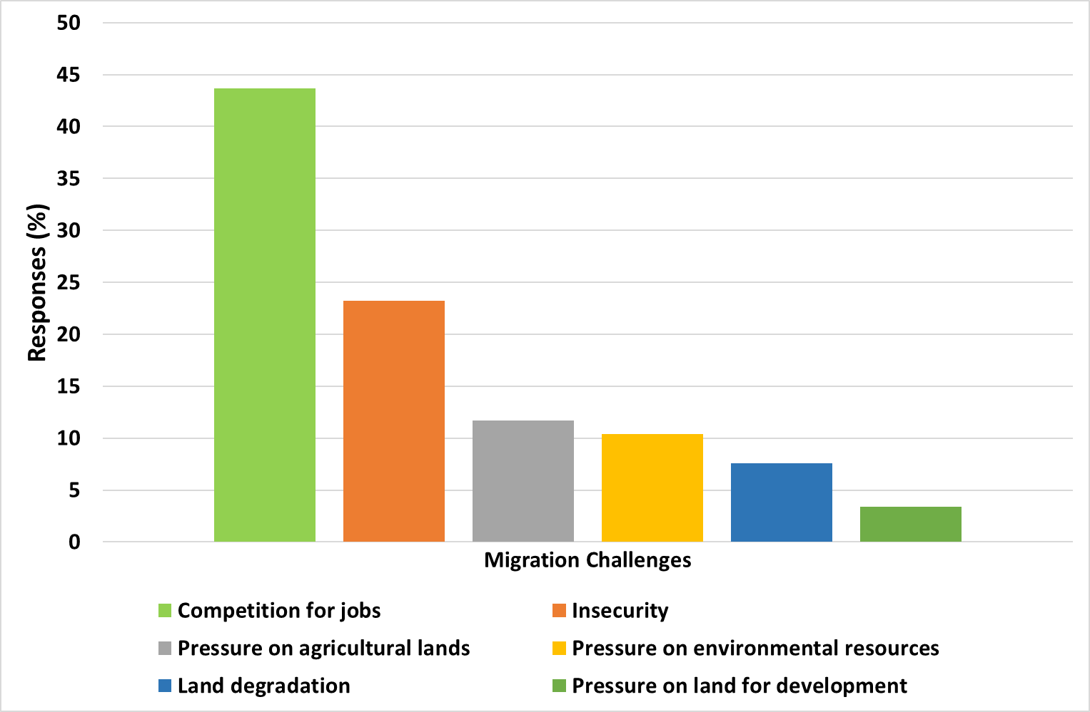
Migration challenges at the destination communities

Slide 37
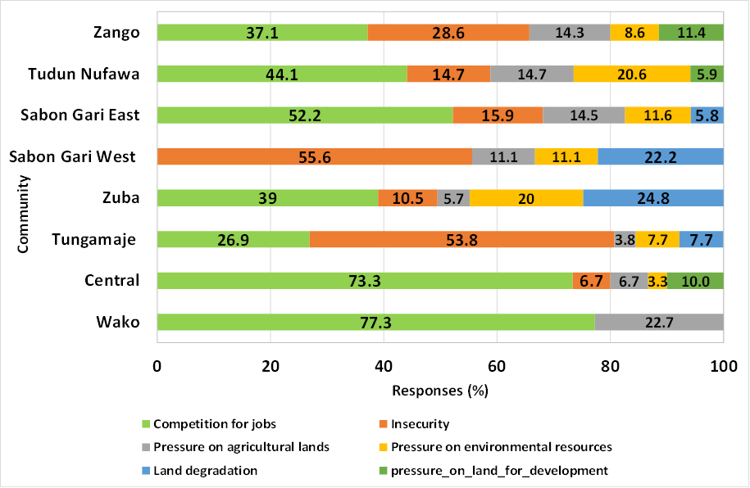
Migration challenges at the at each destination community
p < 0.05

Slide 38
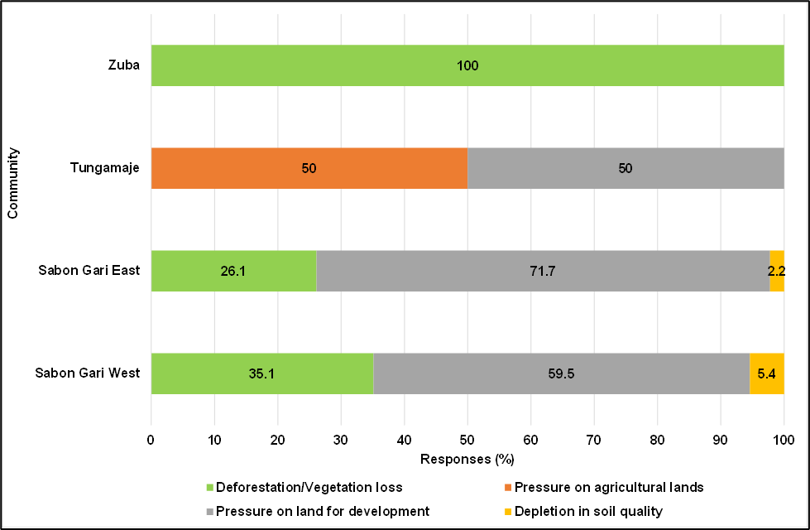
Opinion that migration is a major cause of land degradation
Option | Average
Strongly Agree | 29.5%
Agree | 41.1%
Neutral | 18.4%
Disagree | 8.9%
Strongly Disagree | 2.2%
Land degradation activities at destination communities

Slide 39
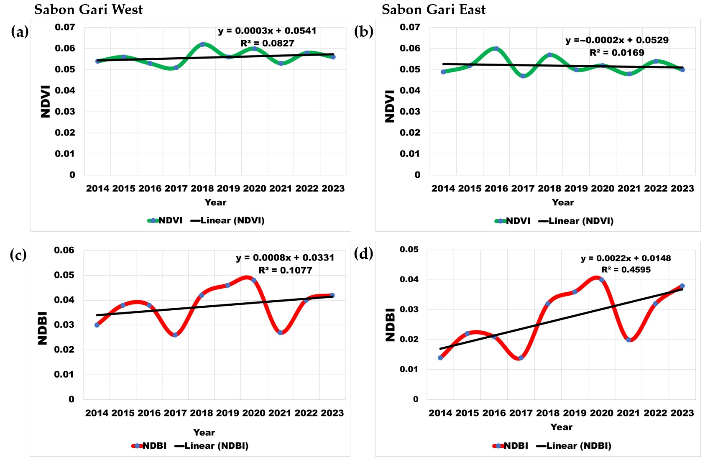
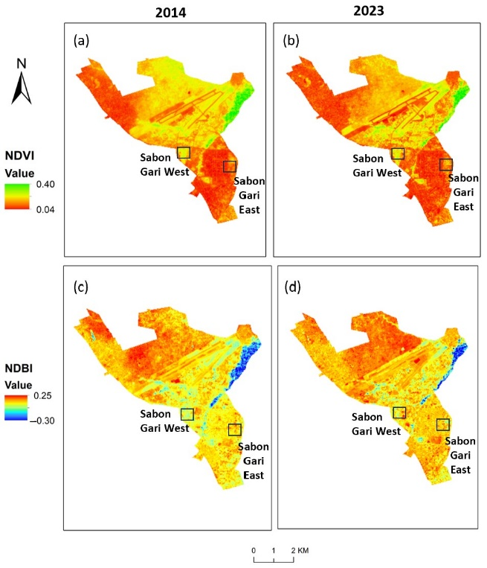

Slide 40
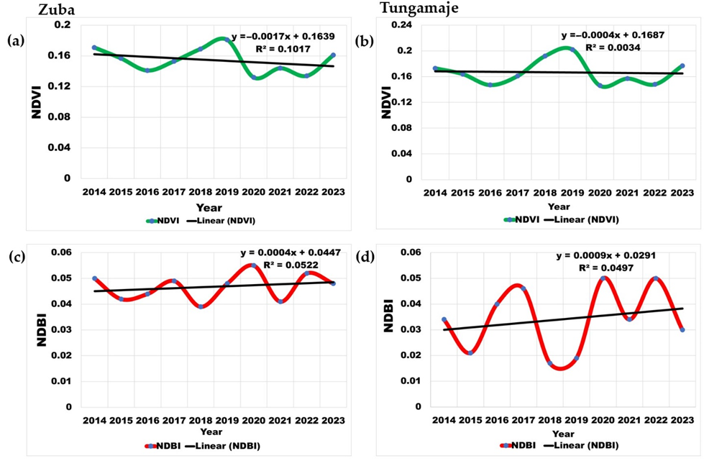
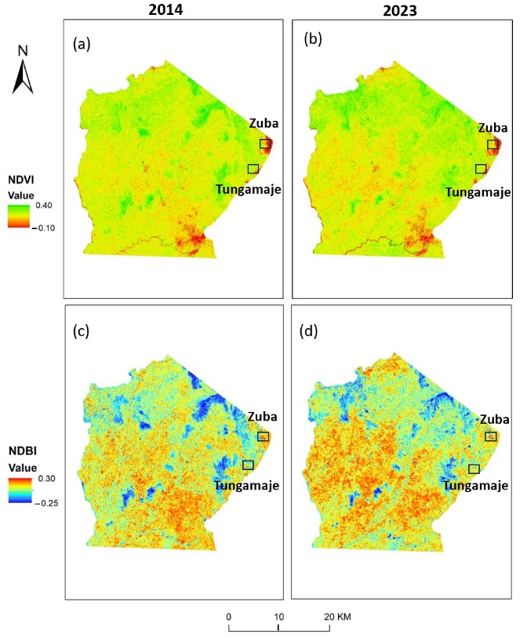

Slide 41
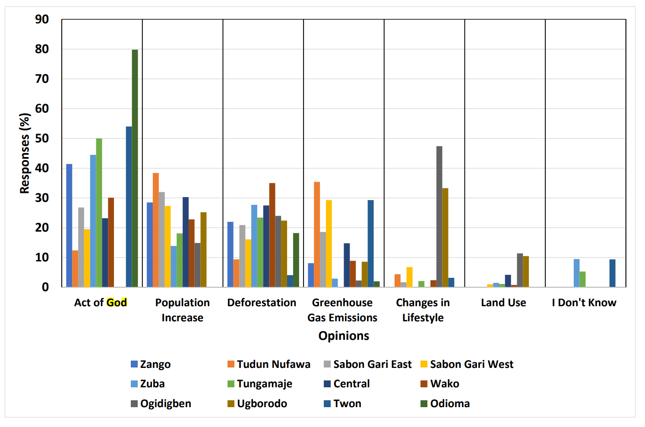
Perception on climate change causes
Notes:
There was no statistically significant difference in this perception

Slide 42
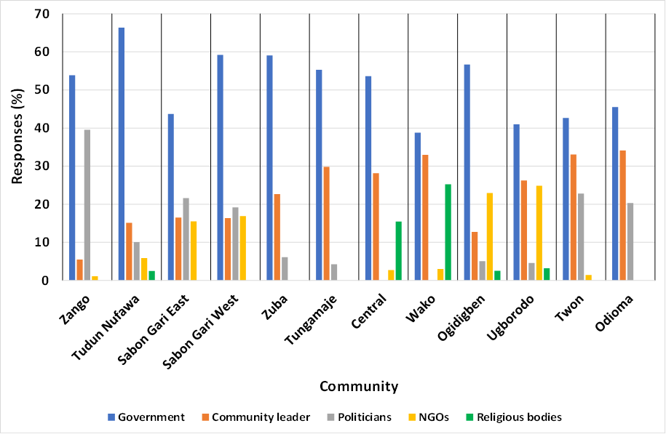
Perception on who leads intervention discussions on environment and climate-induced migration
Notes:
There was no statistically significant difference in this perception

Slide 43
Conclusion (Key Findings)
Socioeconomic factors, such as the search for job and business opportunities, are the most significant migration drivers in Nigeria
The environment/climate is the third most prominent driver of migration in Nigeria with a contribution of 11%
Environmental factors such as drought, inadequate rainfall, and water scarcity are the major environmental/climatic contributors to migration.

Slide 44
There is a significant reluctance in the migration of households despite the environmental/climatic changes
There are significant variations in the perceptions of migration challenges and benefits at the destination communities
The major migration-induced land degradation challenges at the destination communities are deforestation and land pressures due to urban growth
There is a unanimous agreement on the need for government-led interventions in discussing environment and climate-induced migration issues

Slide 45
Recommendations
Develop sustainable frameworks at migration hotspots to address migration needs, improve local livelihoods and sustain human-environmental interactions.
Develop and implement environment-friendly and climate-resilient, climate-smart and sustainable agricultural practices to ensure food security and reduce the economic vulnerability of communities.
Strengthen early warning systems and disaster preparedness measures to minimise the impact of environmental degradation and extreme weather events on communities.
Execute an updated population census to integrate migration data that would help to quantify migration patterns and provide more empirical insights.

Slide 46
Implement sustainable land and forest management practices to enhance carbon sequestration and preserve ecosystems, especially at the migration destination hotspots.
Develop policy frameworks and approaches that can improve adaptation and mitigation measures to environmental and climate impacts through collaborative efforts from the:
  Federal Ministry of Environment
  National Emergency Management Agency (NEMA)
  National Orientation Agency (NOA)
  Nigerian Meteorological Agency (NiMet)
  Department of Climate Change and
  the International Organisation for Migration (IOM)

Slide 47
Key contribution to knowledge
This study enhances the theoretical framework of the general push and pull factors of migration in Nigeria, providing a detailed account of how adverse environments and climatic conditions act as push factors from communities of origin. Favourable conditions in destination communities act as pull factors. Despite the existing environmental and climatic events affecting households, they contributed 11% to household migration as revealed in this study
The findings from this study identified factors such as drought (32%) and inadequate rainfall (27%) as the major environmental and climate-based migration drivers in Nigeria. Destination communities hosted 50% of climate and environment-based migrants due to good weather conditions.

Slide 48
This research provides empirical and quantified evidence of the benefits and challenges associated with in-migration in destination communities, thereby contributing to a more balanced understanding of the impacts of migration to make informed decisions when creating community-specific migration policies.
Through its methodology, this study contributes to the development of robust survey instruments tailored to capture data on environment and climate-induced migration that can be adapted for similar studies in different contexts.
This study contributes to aiding stakeholders in understanding migration decisions through the use of various environmental data via remote sensing and GIS techniques, offering a broad approach to addressing the complex nature of human mobility in the context of environmental change and climate-induced migration.

Slide 49
Policy recommendations derived from the study's findings offer practical strategies for addressing climate-induced migration. For instance, the research recommends investments in early warning systems and climate-resilient infrastructure against drought, adequate urban planning to minimise flood risks, and establishing barriers to curb an annual sea level rise of about 4 mm at the coastal communities.

Slide 50




Thank You!
Danke!

