Slide 1
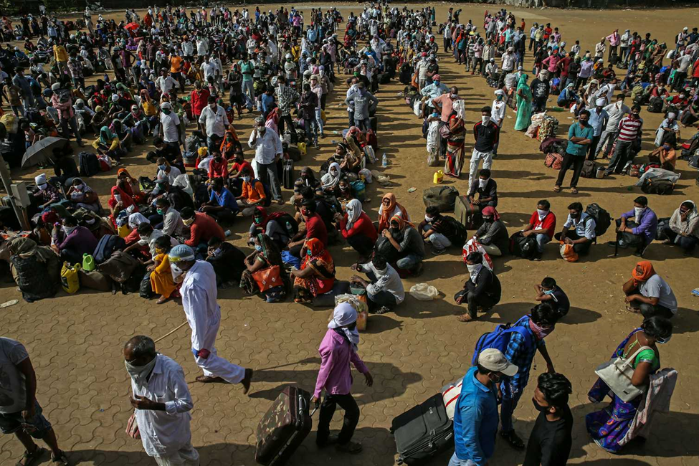

Impact of Migration and Climate Change on Land use and Land cover Transformation of Northeastern Nigeria
DEBORAH ISHAKU
Ph.D/SPS/FT/2021/13008
Major Supervisor: Dr. Emmanuel Umaru
Co-Supervisor: Prof. Abel A. Adebayo
Co-Supervisor: Prof. Dr. Löwner Ralf

Slide 2
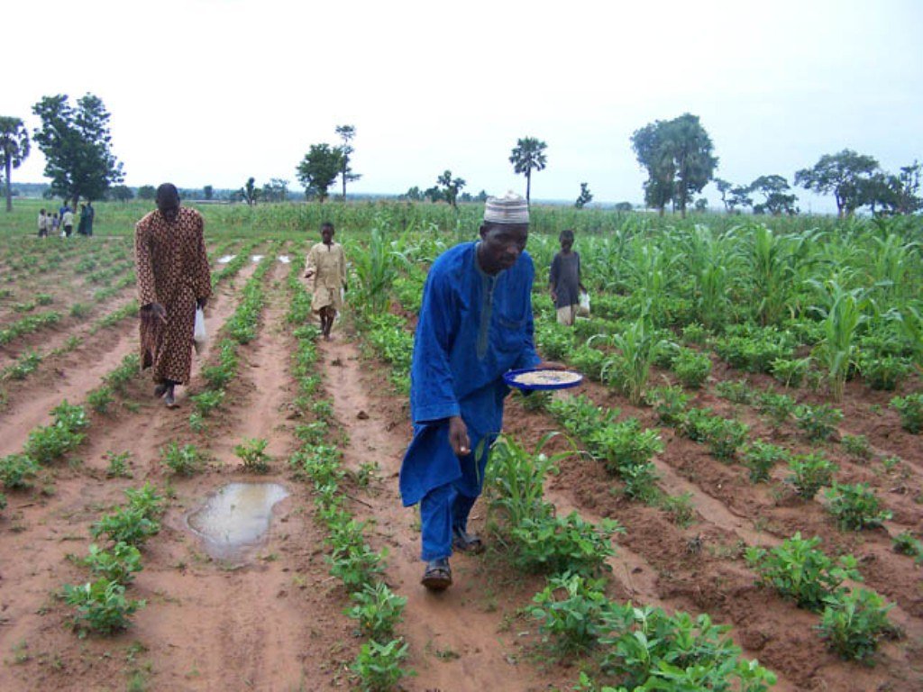
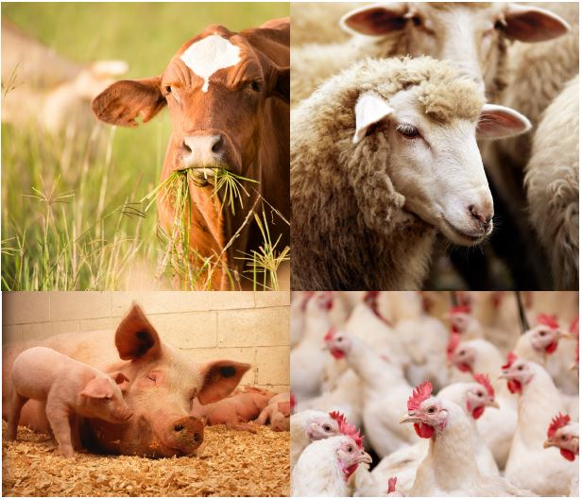
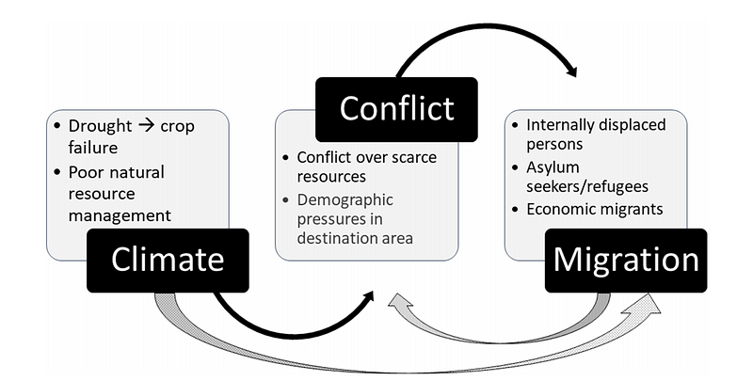
PROBLEM STATEMENT
The rise in insecurity (Boko haram terrorism since 2009)
Covid – 19 pandemic
Desert Encroachment
Shrinking of lake Chad
Climate variability
Economic hardship

Slide 3
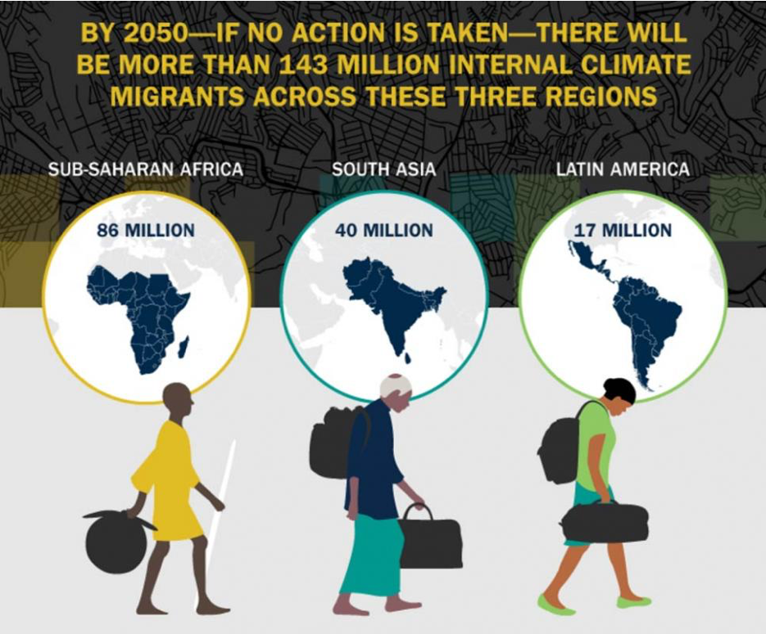
Problem statement Cont.
Weather-related disasters around the world uprooted 30 million people—Internal Displacement Monitoring Centre, 2021.
Currently, There are 2.5 Million IDPs mainly from Northeast Nigeria (IOM).
IN 2024, Maiduguri flooding displaced 300,000 people
Many areas in the northeastern part of Nigeria are prone to increasing consequences of climate change and migration and this is expected to increase Land use and Land cover transformation.
While these topics have been examined globally, the region’s unique challenges—such as the interconnection of insecurity, environmental degradation, and forced migration—remain underexplored. This necessitates urgent policy intervention and sustainable solutions

Slide 4
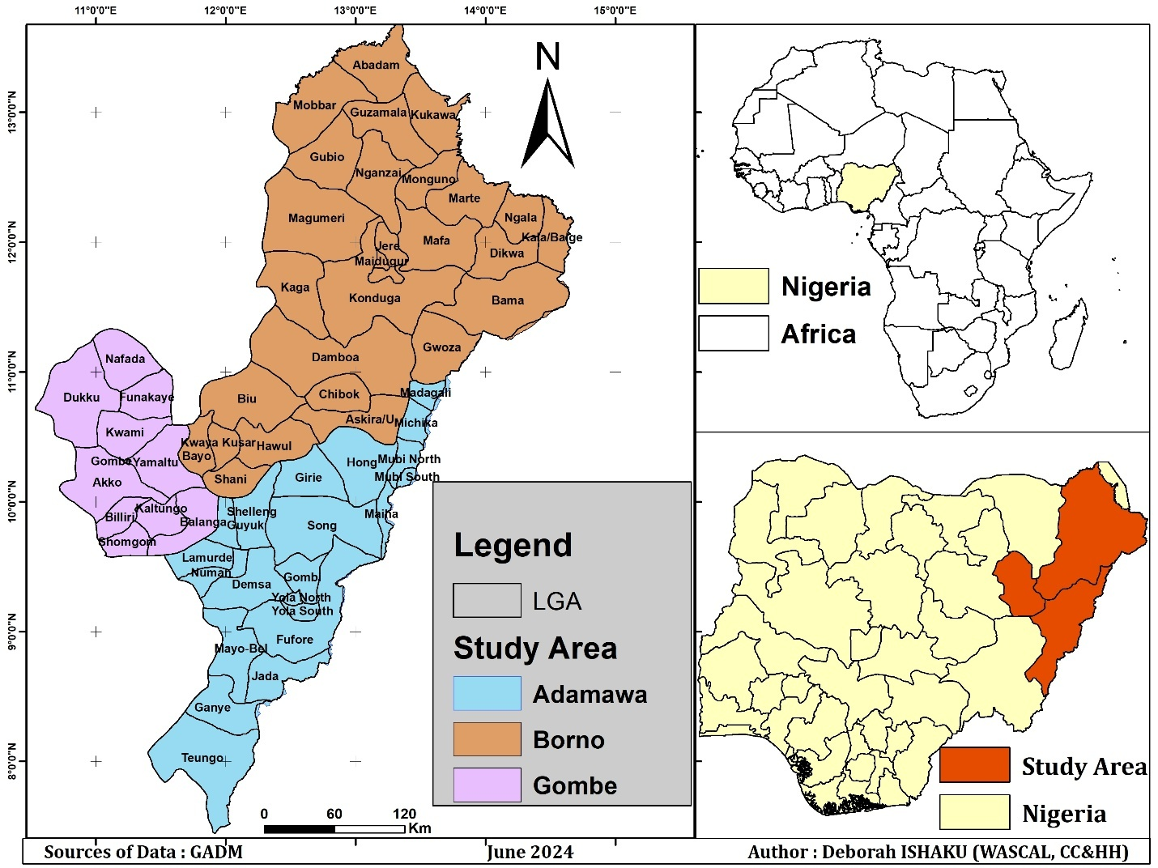
STUDY AREA

Slide 5
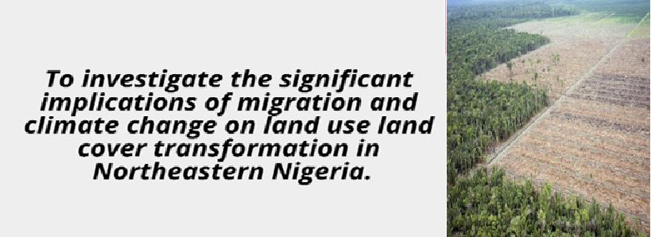
OBJECTIVES OF THE STUDY
AIM OF THE STUDY
Examine the trend in rainfall and temperature between 1981 and 2021 in the study area
Evaluate the factors that influence migration
Model the Land use and Land cover of the study area to 2040
Evaluate the impact of migration and climate on Land Use and Land Cover
Analyse the Land Use and Land Cover dynamics between 1991 and 2021

Slide 6
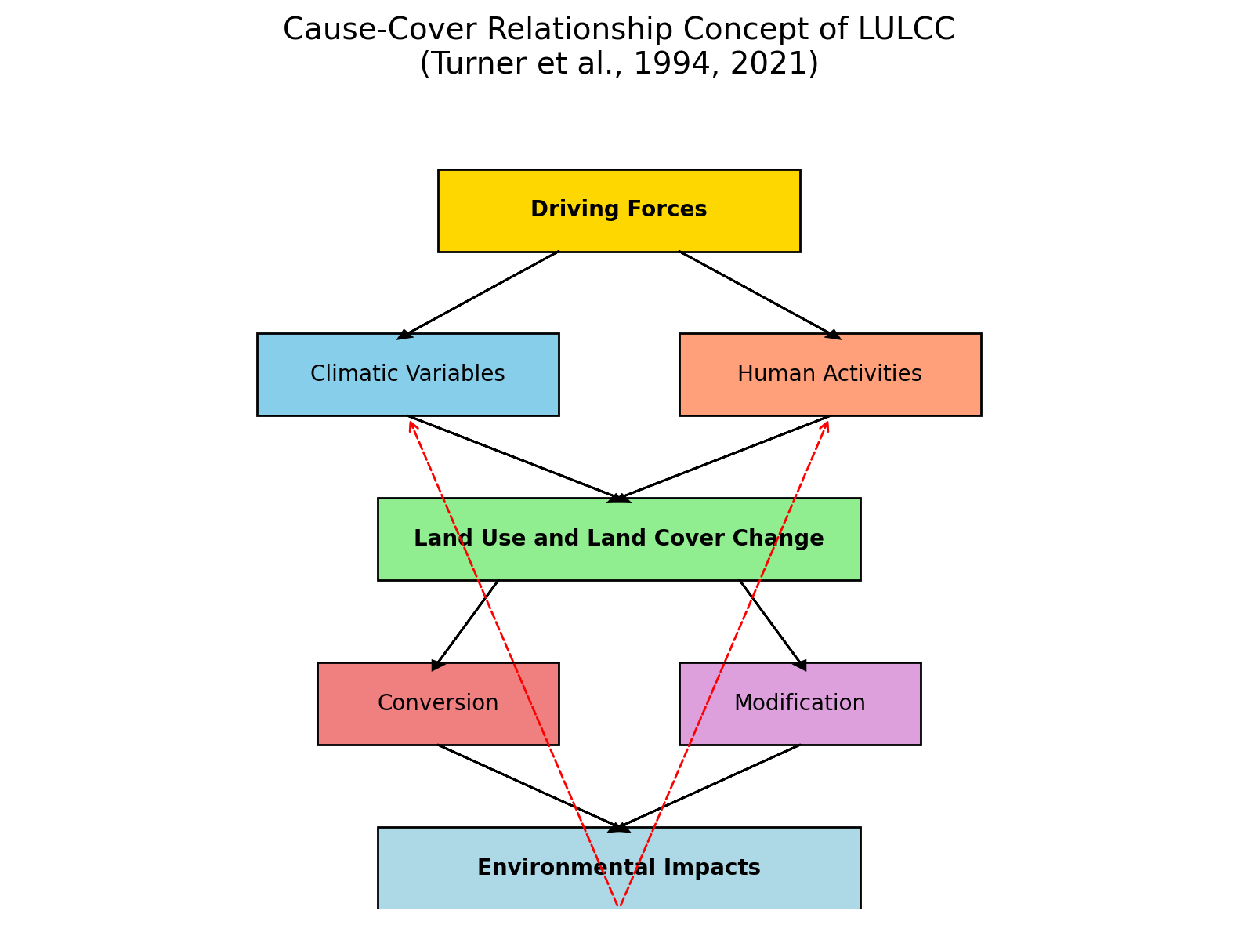
THEORETICAL FRAMEWORK: CAUSE-COVER RELATIONSHIP CONCEPT OF LULCC
Turner et al., 1994 , 2021

Slide 7
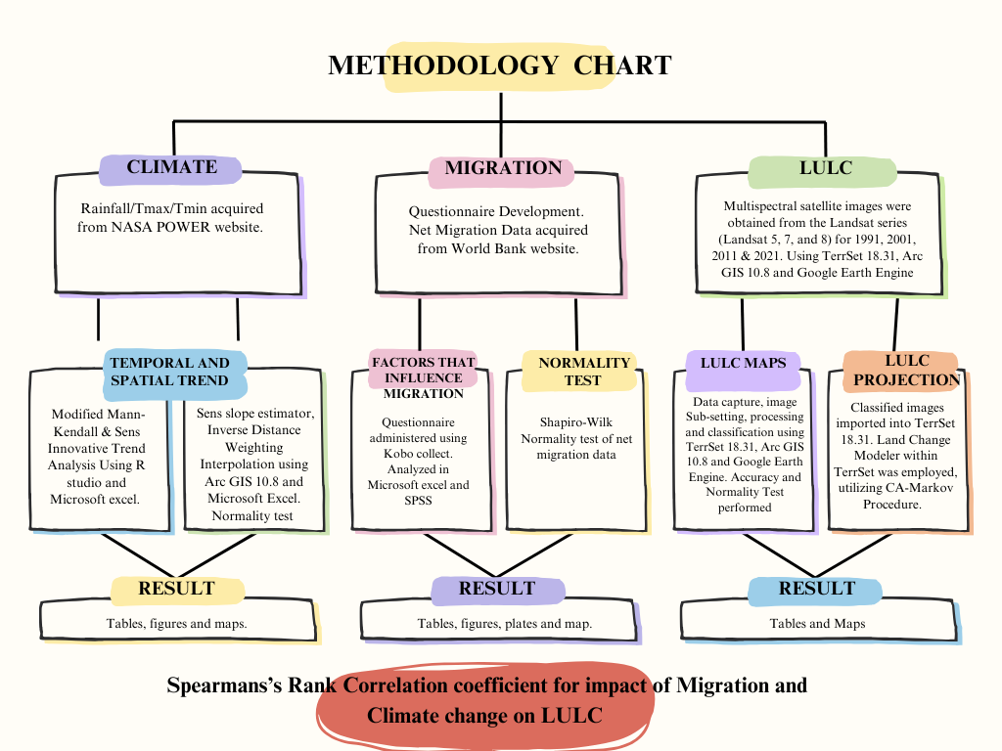

Slide 8
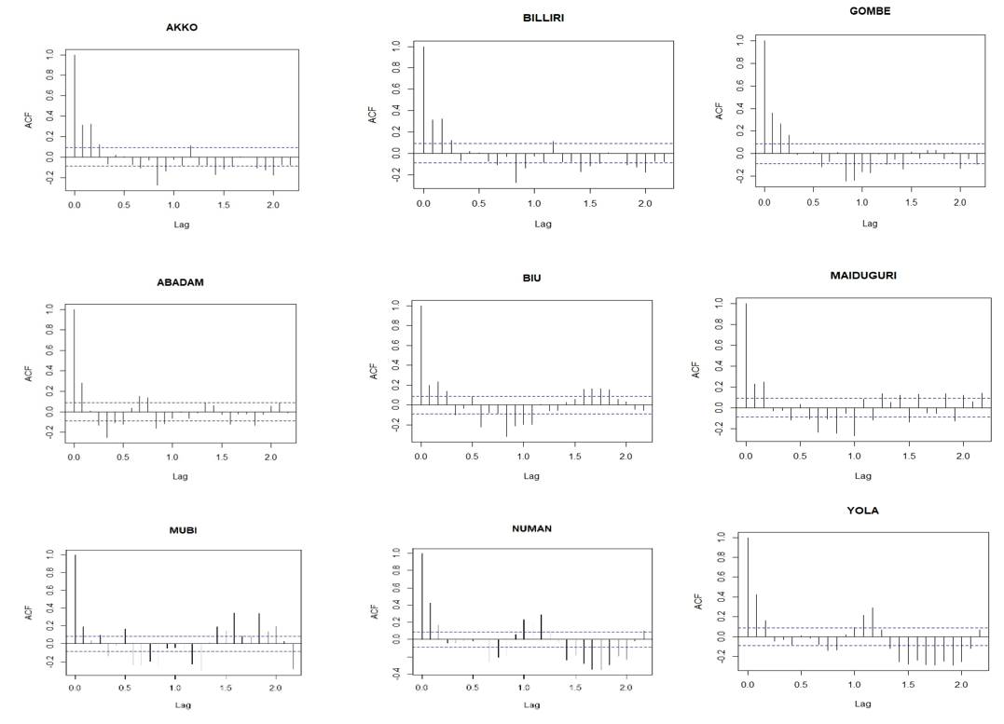
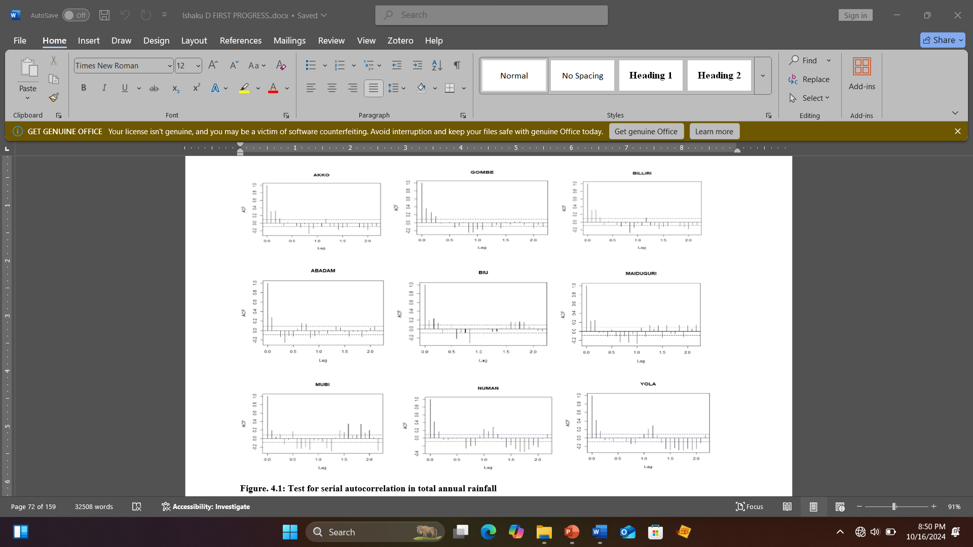
RESULTS AND DISCUSSION
Objective 1. TREND IN RAINFALL AND TEMPERATURE (1981-2021)
Autocorrelation is a statistical property of a time series in which the values of the time series are correlated with their own past values.
Addressing autocorrelation in time series data is crucial, by identifying autocorrelation and applying the right model or method improves accuracy of analysis.

Slide 9

Table 4.2: Sen’s innovative trend analysis for Rainfall
Station | Sen’s analysis | S | Nature of trend
Akko | -0.9665 | 12486.4062 | Decreasing
Gombe | 2.3618 | 12782.1140 | Increasing
Billiri | -0.9665 | 12486.4062 | Decreasing
Abadam | 4.1022 | 7909.3333 | Increasing
Biu | 3.6955 | 10079.0621 | Increasing
Maiduguri | -2.5424 | 5844.7665 | Decreasing
Mubi | 2.9016 | 7818.6666 | Increasing
Numan | -10.2808 | 2751.7806 | Decreasing
Yola | -5.2733 | 7912.0000 | Decreasing

Slide 10
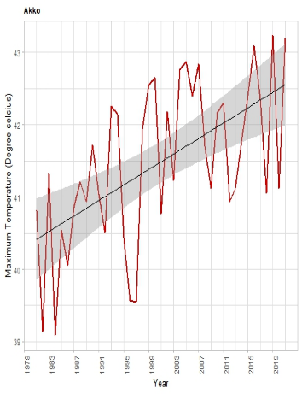
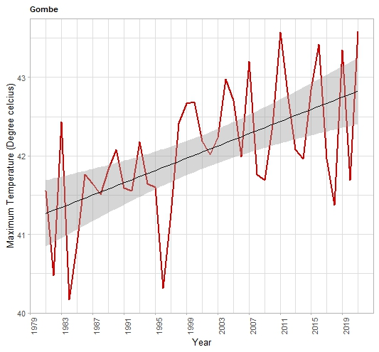
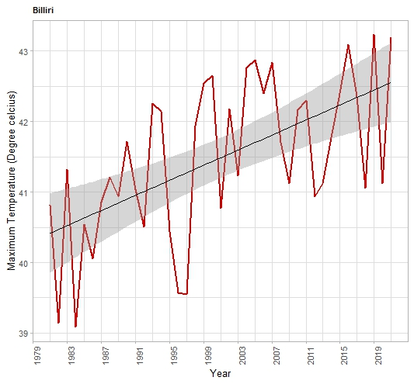
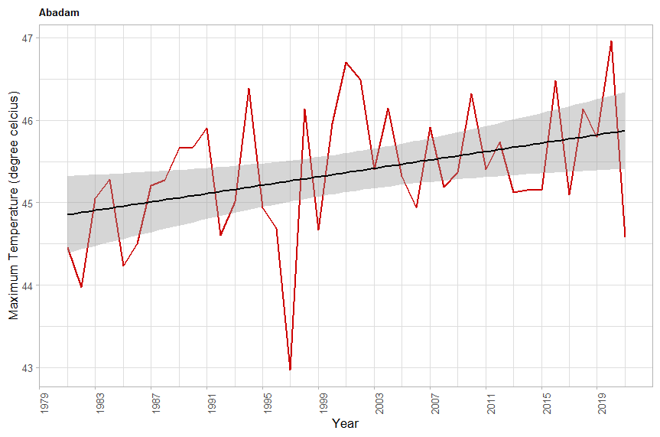
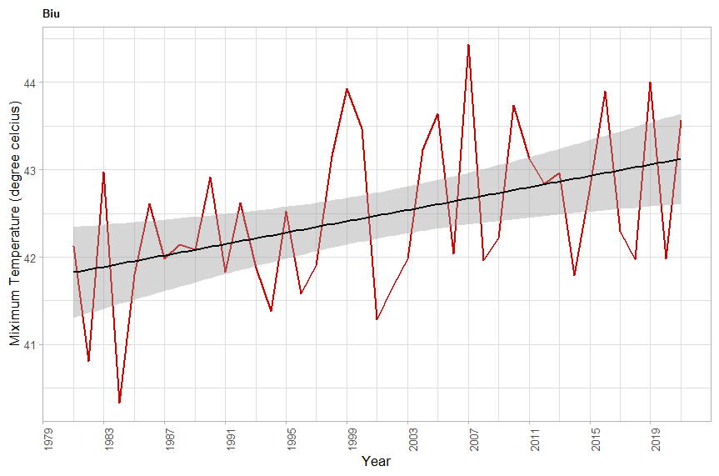
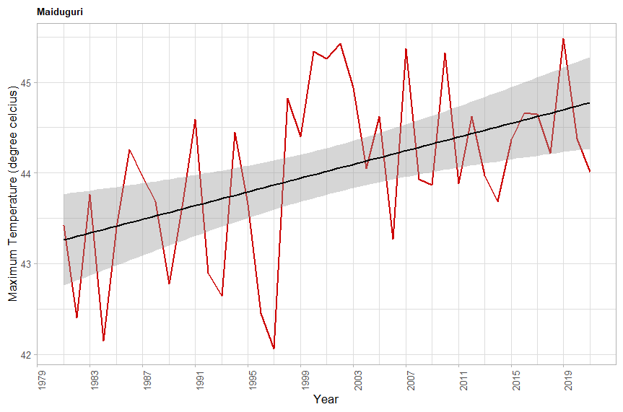
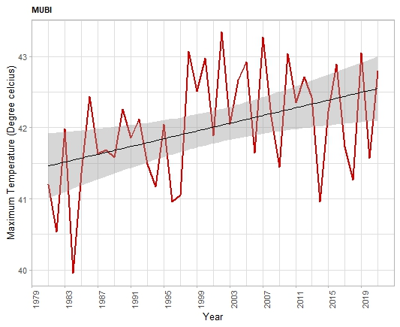
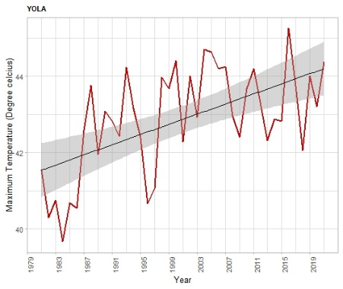
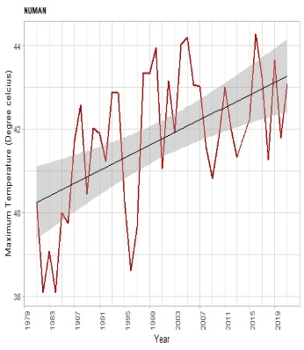
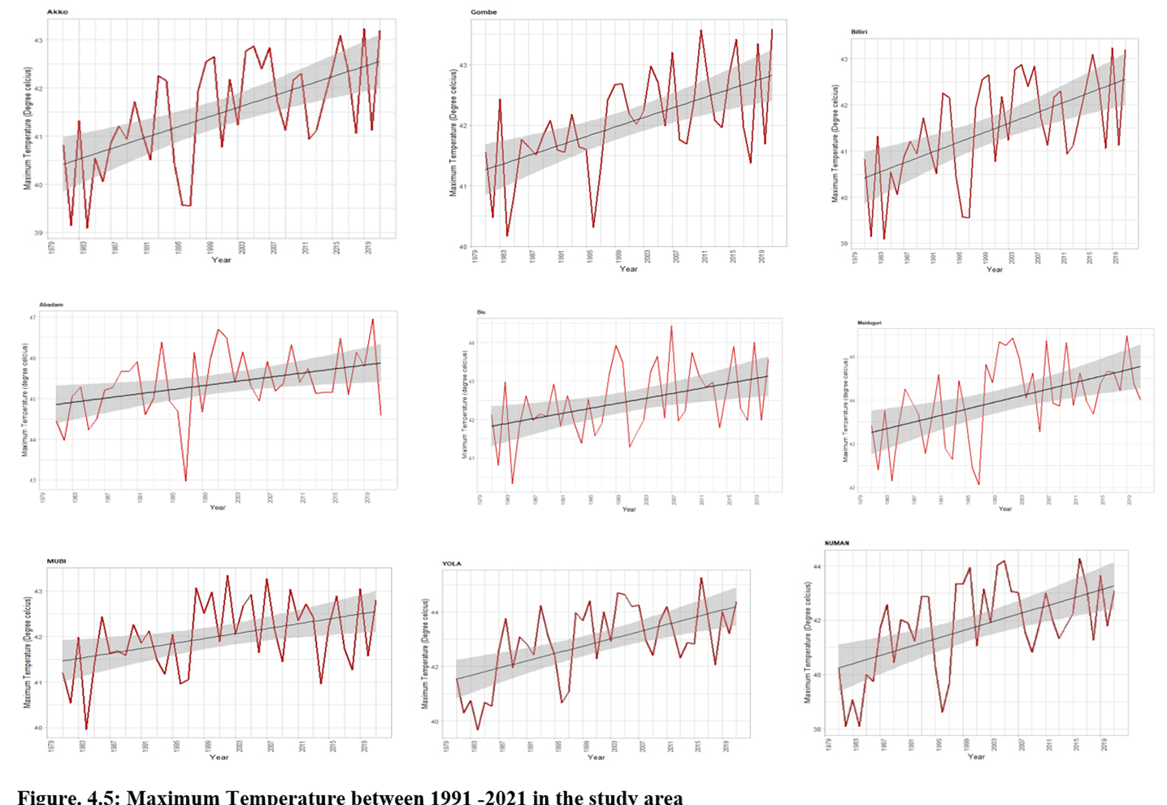

Slide 11
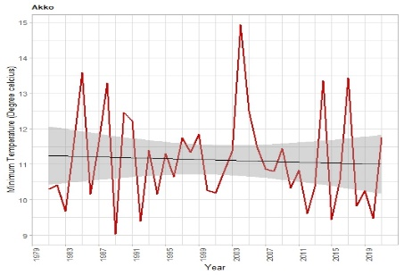
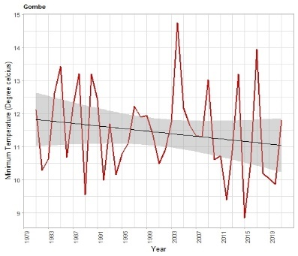
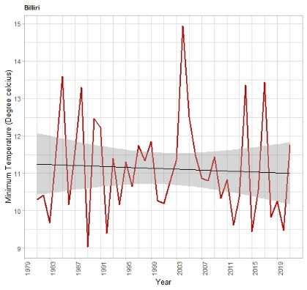
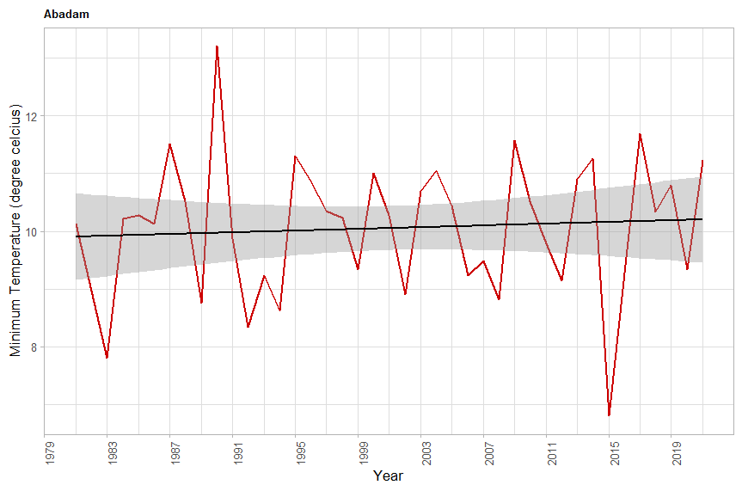
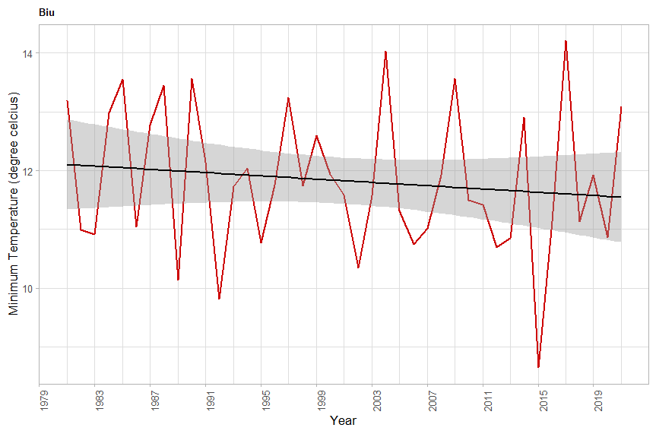
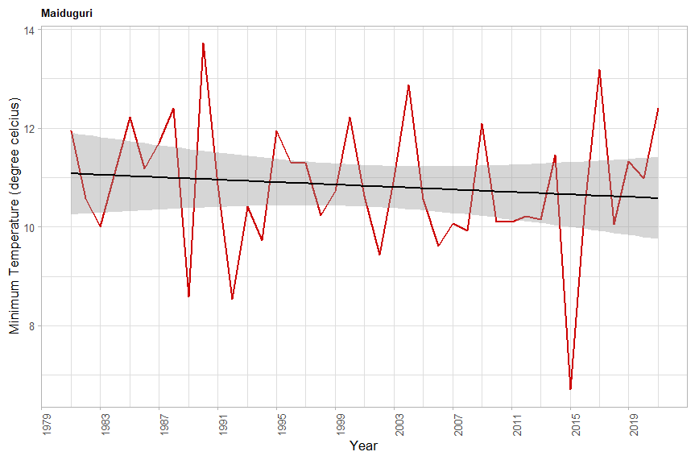
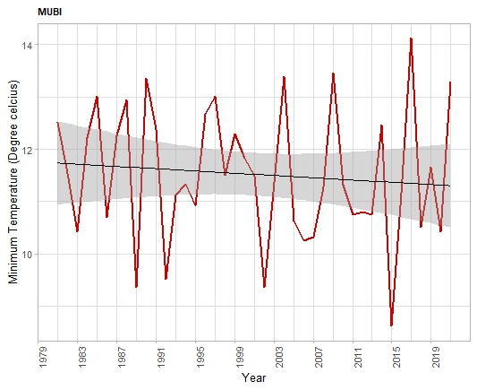
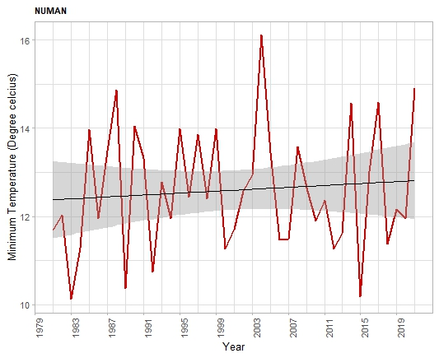
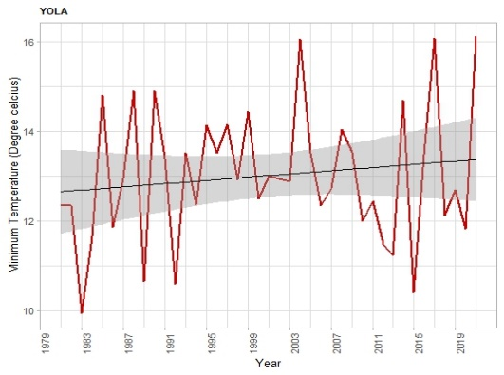
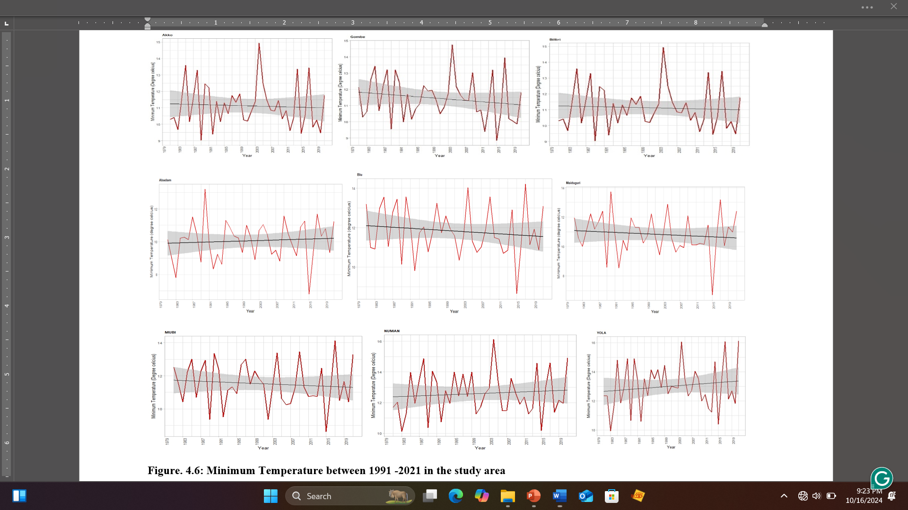

Slide 12
IDW Interpolation

Slide 15
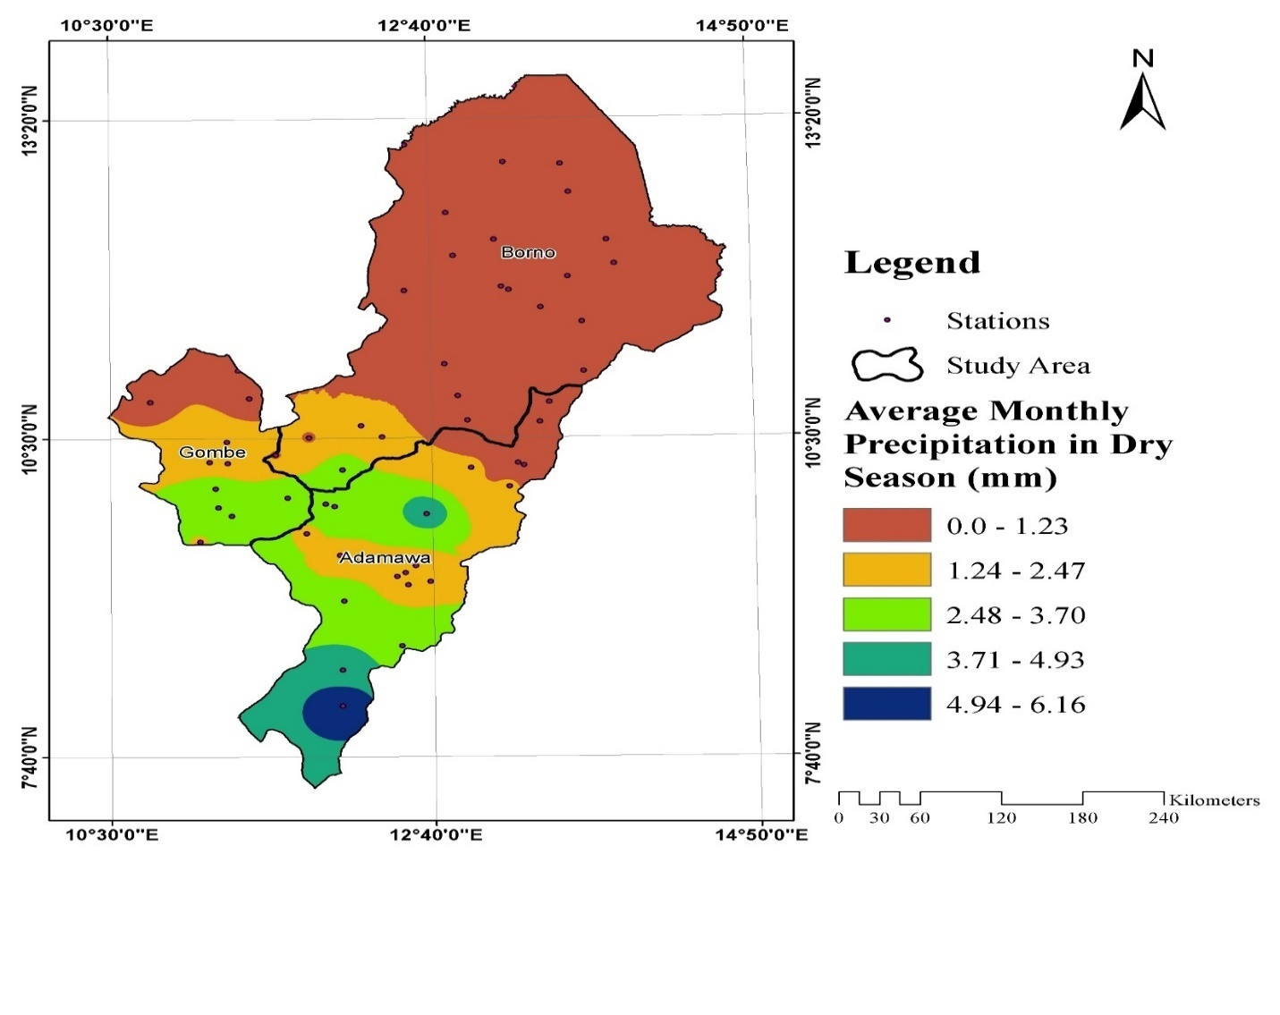
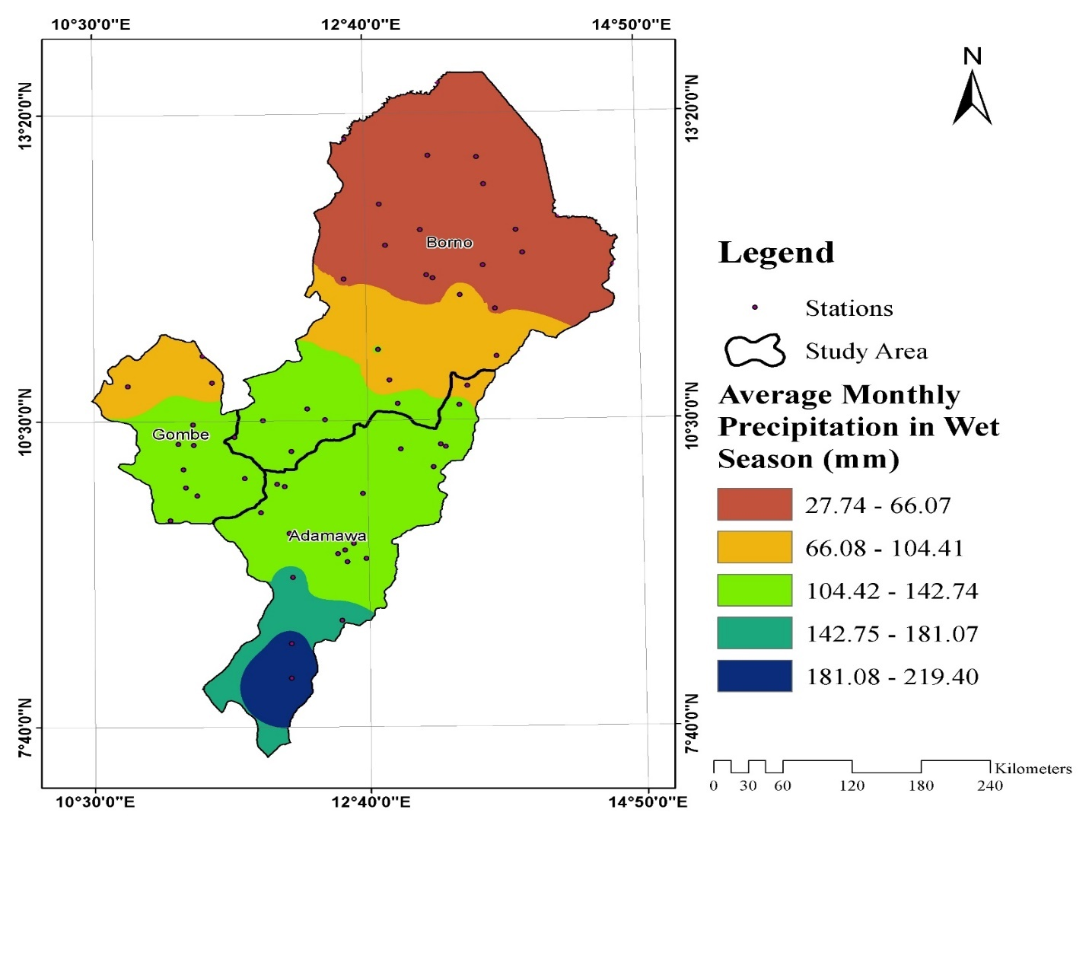
SEASONAL VARIATION
Nov – Mar = Dry Apr – Oct = Wet
Average Monthly Rainfall in Dry Season (mm)
Row Labels | Average Monthly Rainfall in Dry Season (mm)
Adamawa | 2.41
Borno | 0.44
Gombe | 2.06
Mean Total | 1.44
Average Monthly Rainfall in Wet Season (mm)
Row Labels | Average Monthly Precipitation in Wet Season (mm)
Adamawa | 131.96
Borno | 72.27
Gombe | 112.15
Mean Total | 100.95

Slide 16
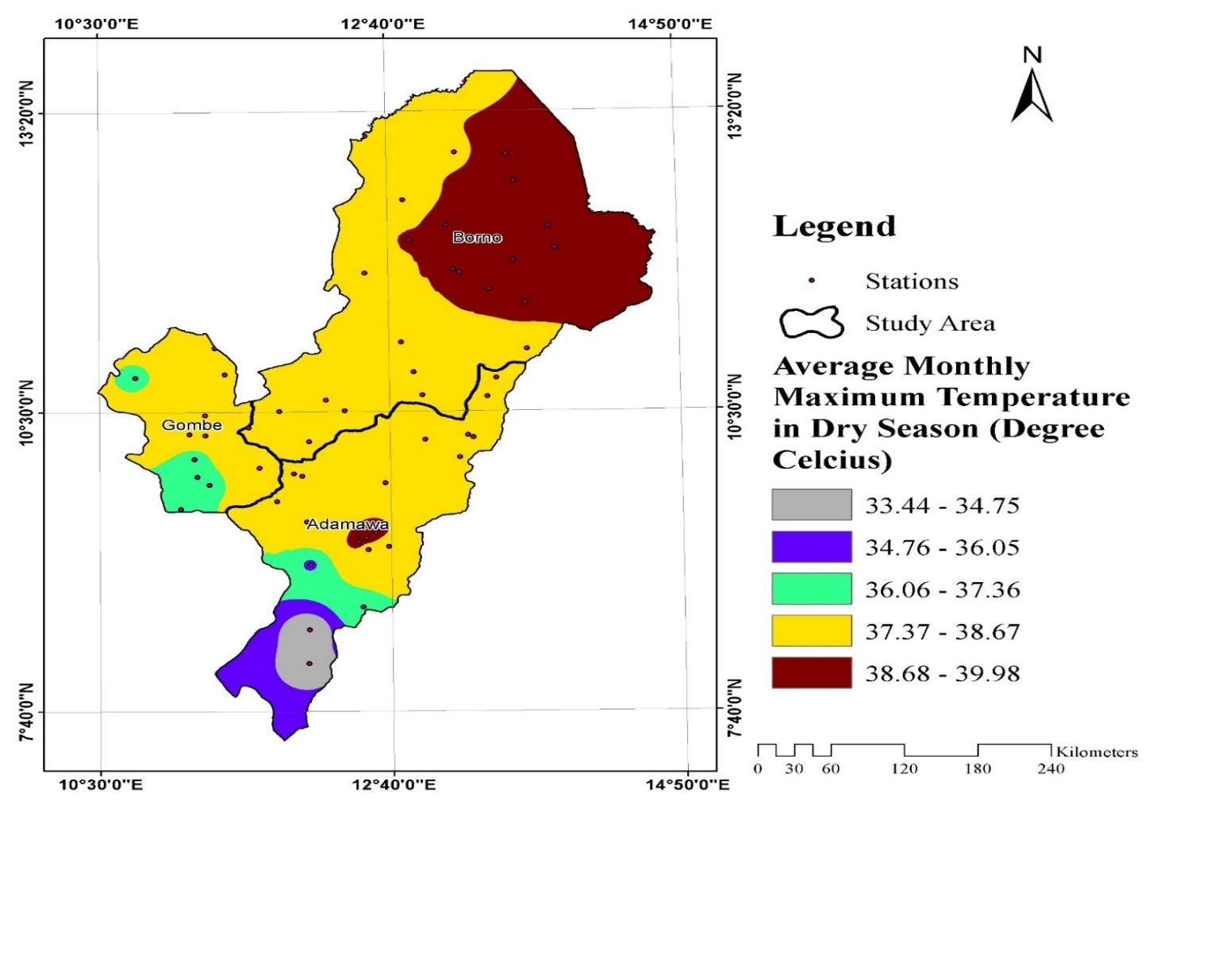
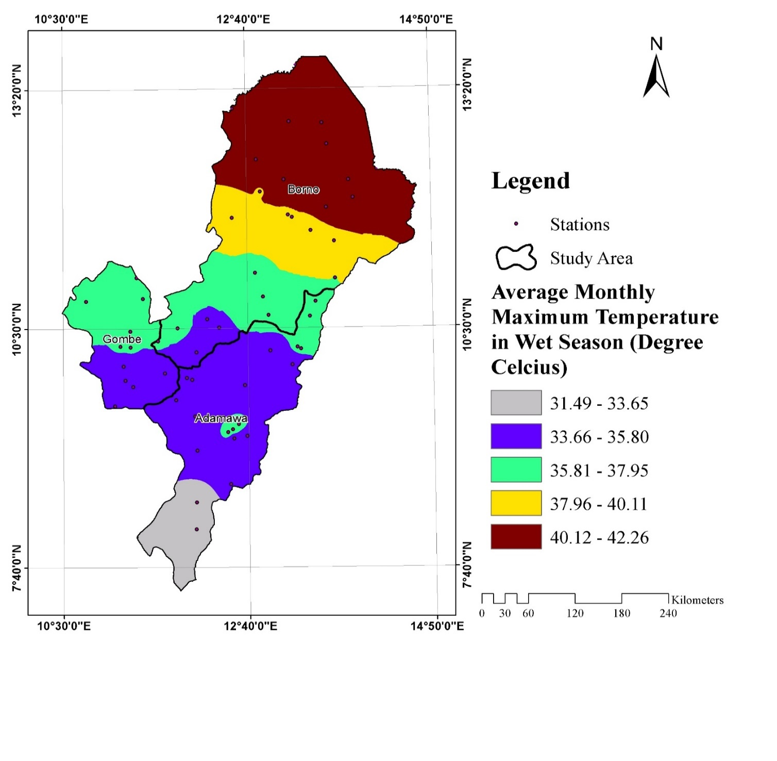
Average Monthly Maximum Temperature in Dry Season (⁰C)
Row Labels | Average Monthly Maximum Temperature in Dry Season (⁰C)
Adamawa | 37.61
Borno | 38.66
Gombe | 37.62
Mean Total | 38.09
Average Monthly Maximum Temperature in Wet Season (⁰C)
Row Labels | Average Monthly Maximum Temperature in Wet Season (⁰C)
Adamawa | 35.14
Borno | 39.29
Gombe | 35.84
Mean Total | 37.17

Slide 17
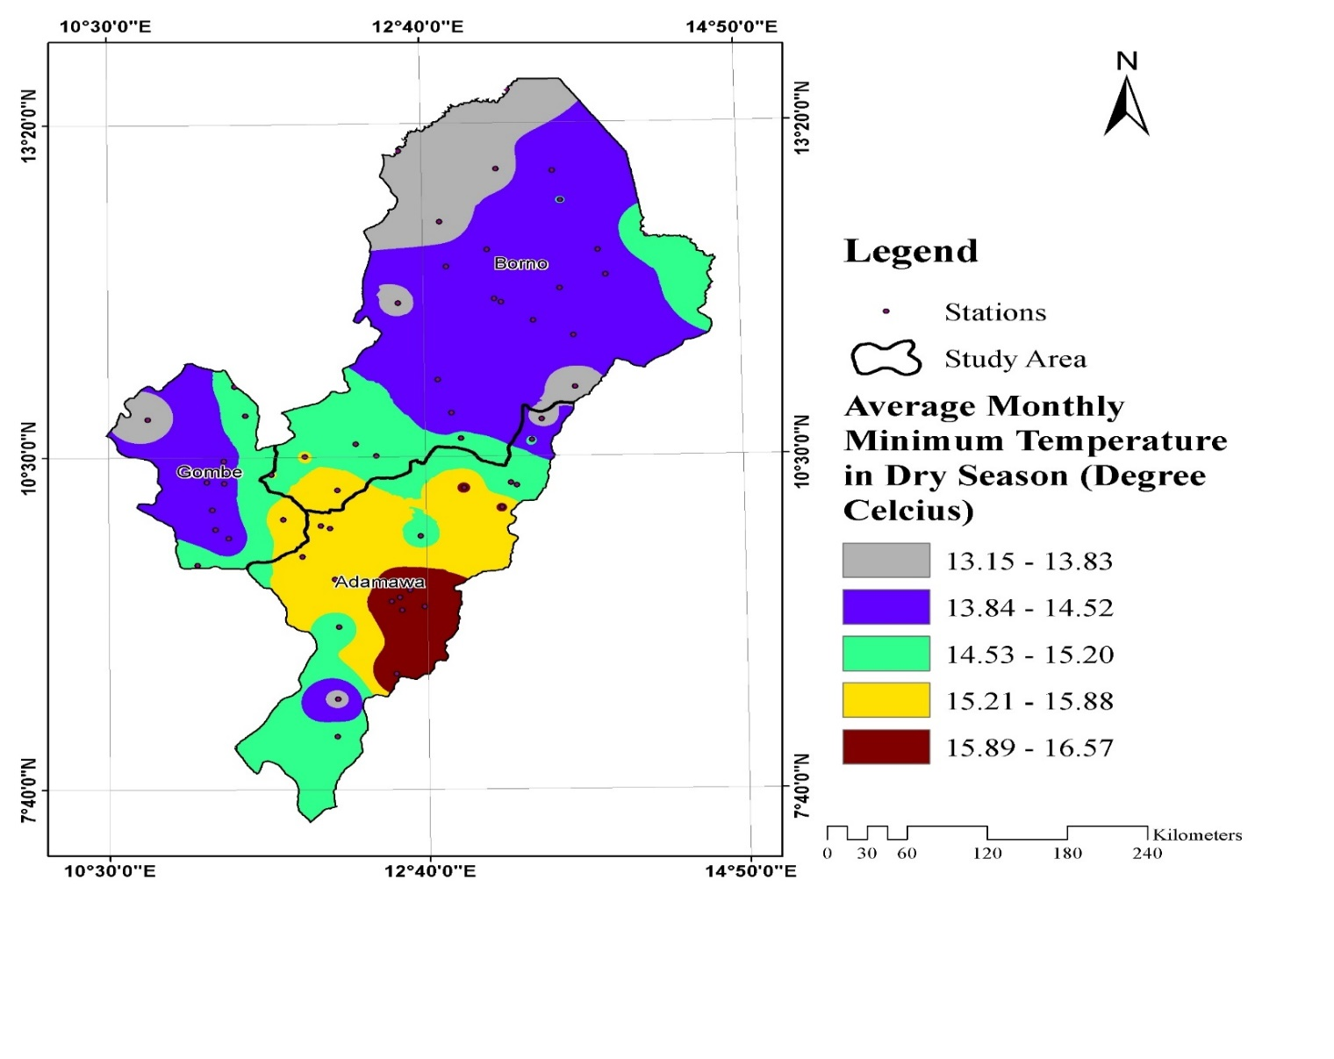
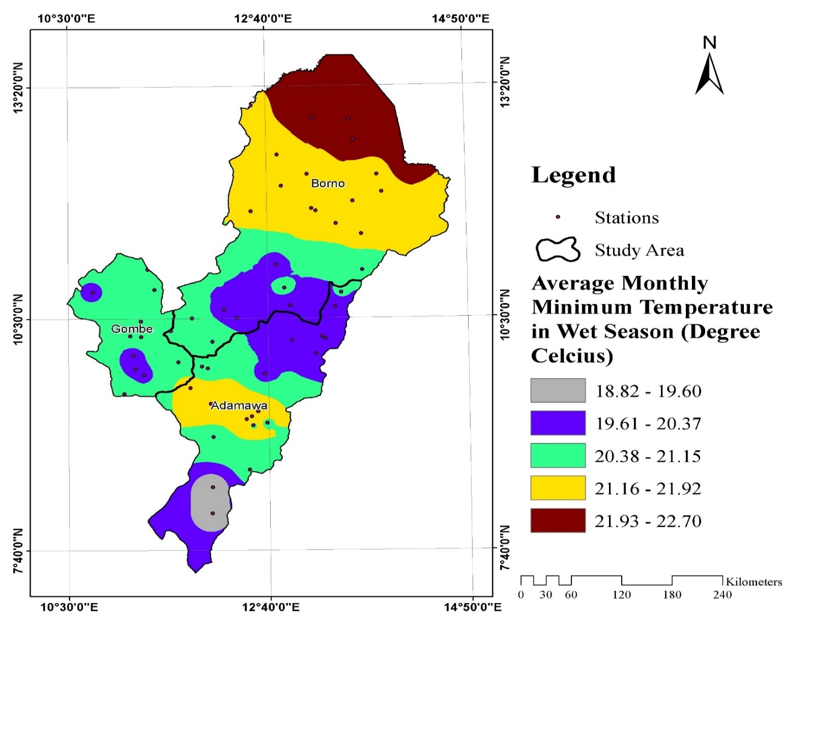
Average Monthly Minimum Temperature in Dry Season (⁰C)
Row Labels | Average Monthly Minimum Temperature in Dry Season (⁰C)
Adamawa | 15.36
Borno | 14.26
Gombe | 14.42
Mean Total | 14.68
Average Monthly Minimum Temperature in Wet Season (⁰C)
Row Labels | Average Monthly Minimum Temperature in Wet Season (⁰C)
Adamawa | 20.64
Borno | 21.34
Gombe | 20.55
Mean Total | 20.94

Slide 18

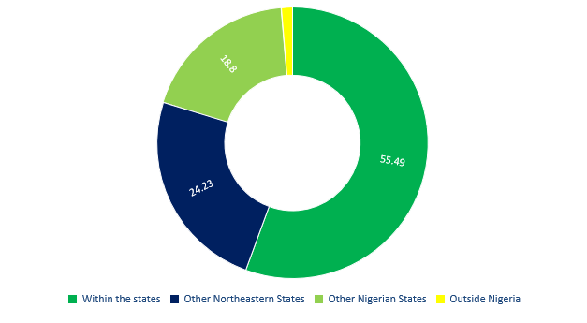
Objective 2. FACTORS THAT INFLUENCE MIGRATION
Migrants’ Origin
Reasons for Migration

Slide 19
Challenges of leaving ones’ origin
Barriers to main livelihood at present location

Slide 20
Negative effect of migration on the destination
Negative effect of migration on origin

Slide 21
Effects of migration on Land use and Land cover at the destination
Positive effect of migration on origin

Slide 22
ATTITUDE TO MIGRATION
Variable | Percentage
What age group migrates the more? Below 15 years 15 - 25 years 26 - 35 years 36 - 45 years 46 - 55 years 56 and above | 3.93 25.36 49.26 19.63 1.42 0.46
What gender migrates more? Male Female | 78.66 21.34
How can migration be controlled? Provision of social amenities Set policies and implement Security Youth Empowerment Loans and incentives Others | 12.30 8.66 40.35 24.20 6.86 7.63

Slide 23
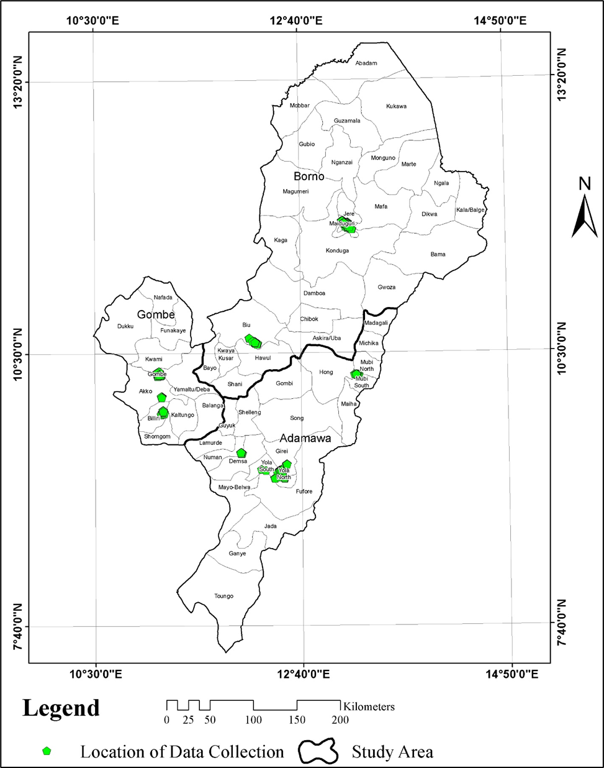
Migration Hotspots
A few migration hotspots where data was collected (sampled locations) include IDP camps (Malkohi camp Yola, Education must continue initiative camp Yola, EYN camp Maiduguri, Jere camp Maiduguri, GG camp Biu) and several communities were found hosting migrants.

Slide 24
Objective 3. LULC Dynamics
1991 Land use and land cover of the study area
2001 Land use and land cover of the study area

Slide 25
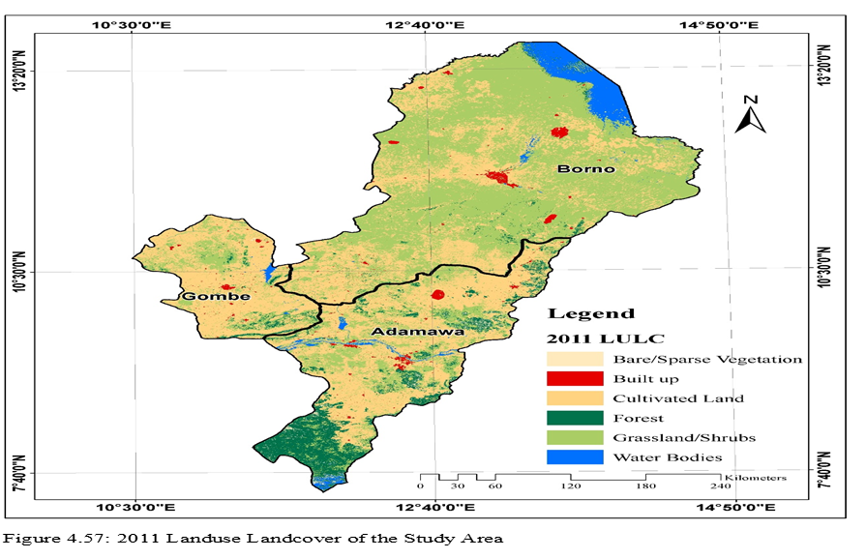
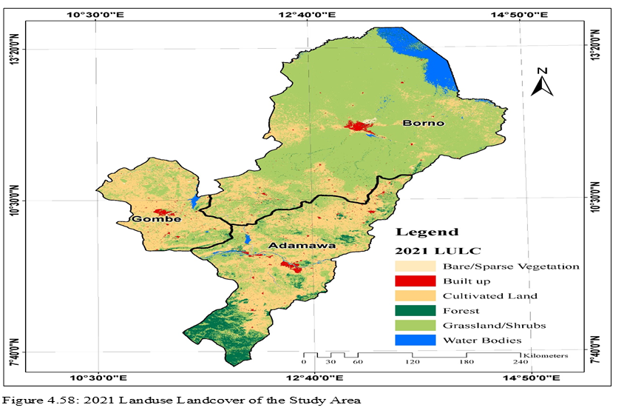
2011 Land use and land cover of the study area
2021 Land use and land cover of the study area

Slide 26
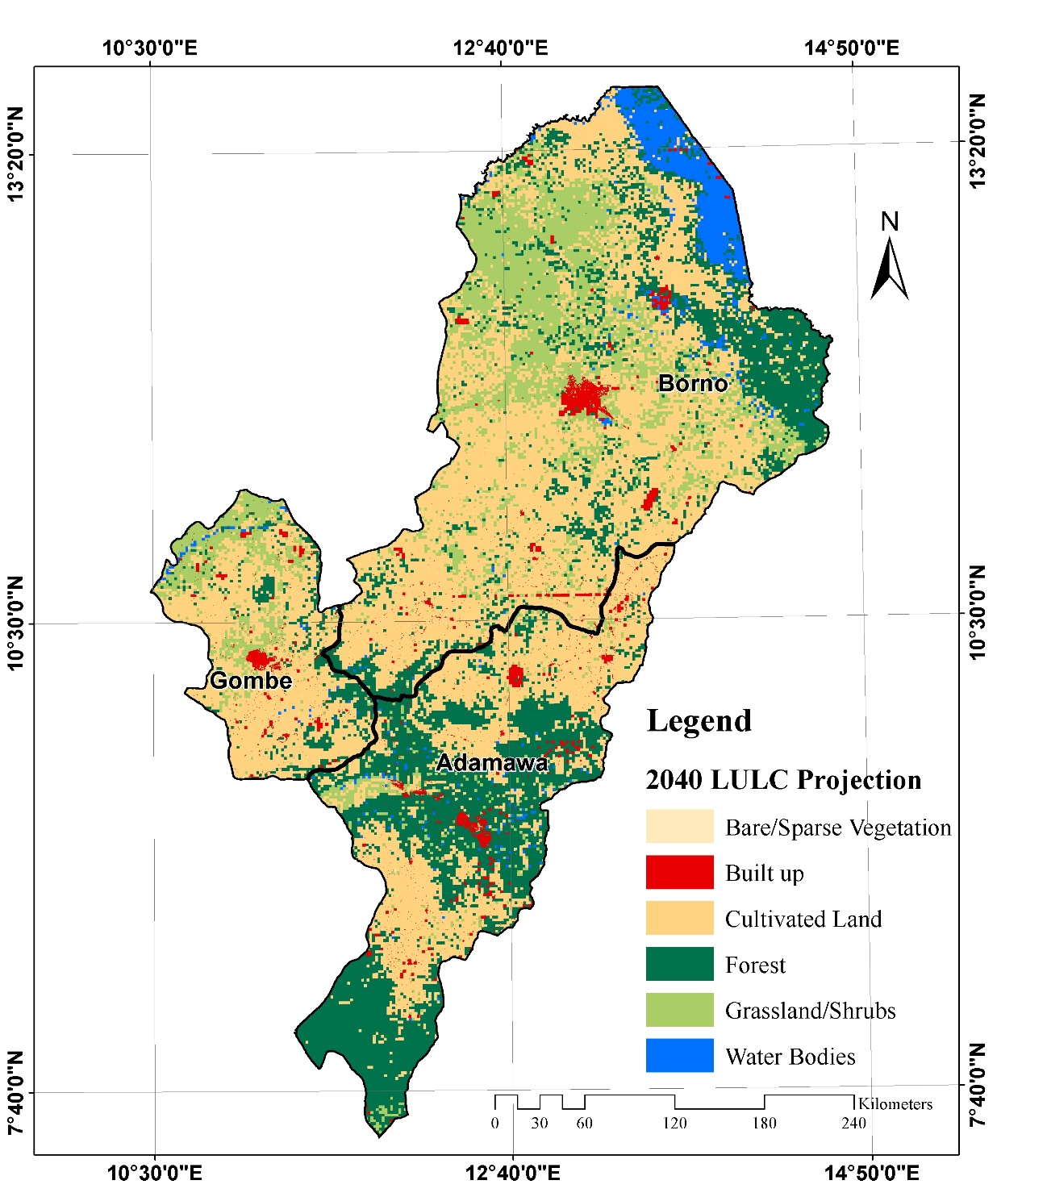
Objective 4. LULC Projection
Apart from being widely used, This integrated approach overcomes the limitations of using either method alone, as the Markov Chain handles temporal transitions while the Cellular Automata component addresses spatial dynamics and neighborhood effects, resulting in more realistic and spatially explicit LULC change projections.
2040 Projected Land use and Land cover of the Study Area.

Slide 27
LULC of the Study for all Periods

Slide 28
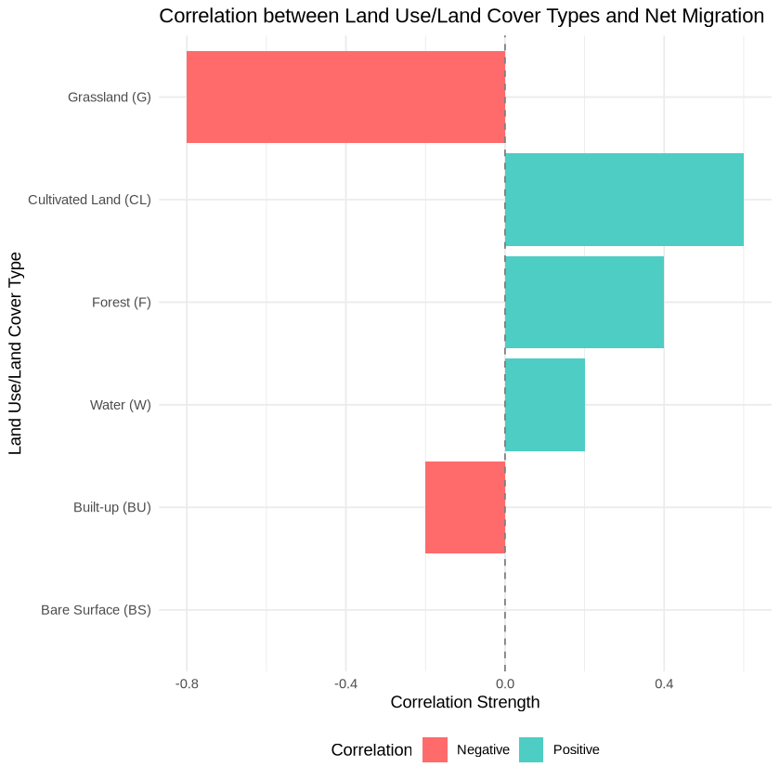
Objective 5. Impact of migration and climate change on lulc
Spearman’s rank correlation maintains statistical validity even when dealing with non-normally distributed variables.
Correlation between Net migration and LULC types
These correlations provide insights into how different land use land cover classes are impacted by changes in net migration
G and BU show negative correlation with net migration. This means that as net migration increases, grassland and BU areas tend to decrease, or vice versa.
CL, F and W have positive correlation with net migration, as net migration increases, cultivated land, F and W are likely to increase.
BS shows no correlation (0), indicating no clear relationship between net migration and bare surface areas.

Slide 29
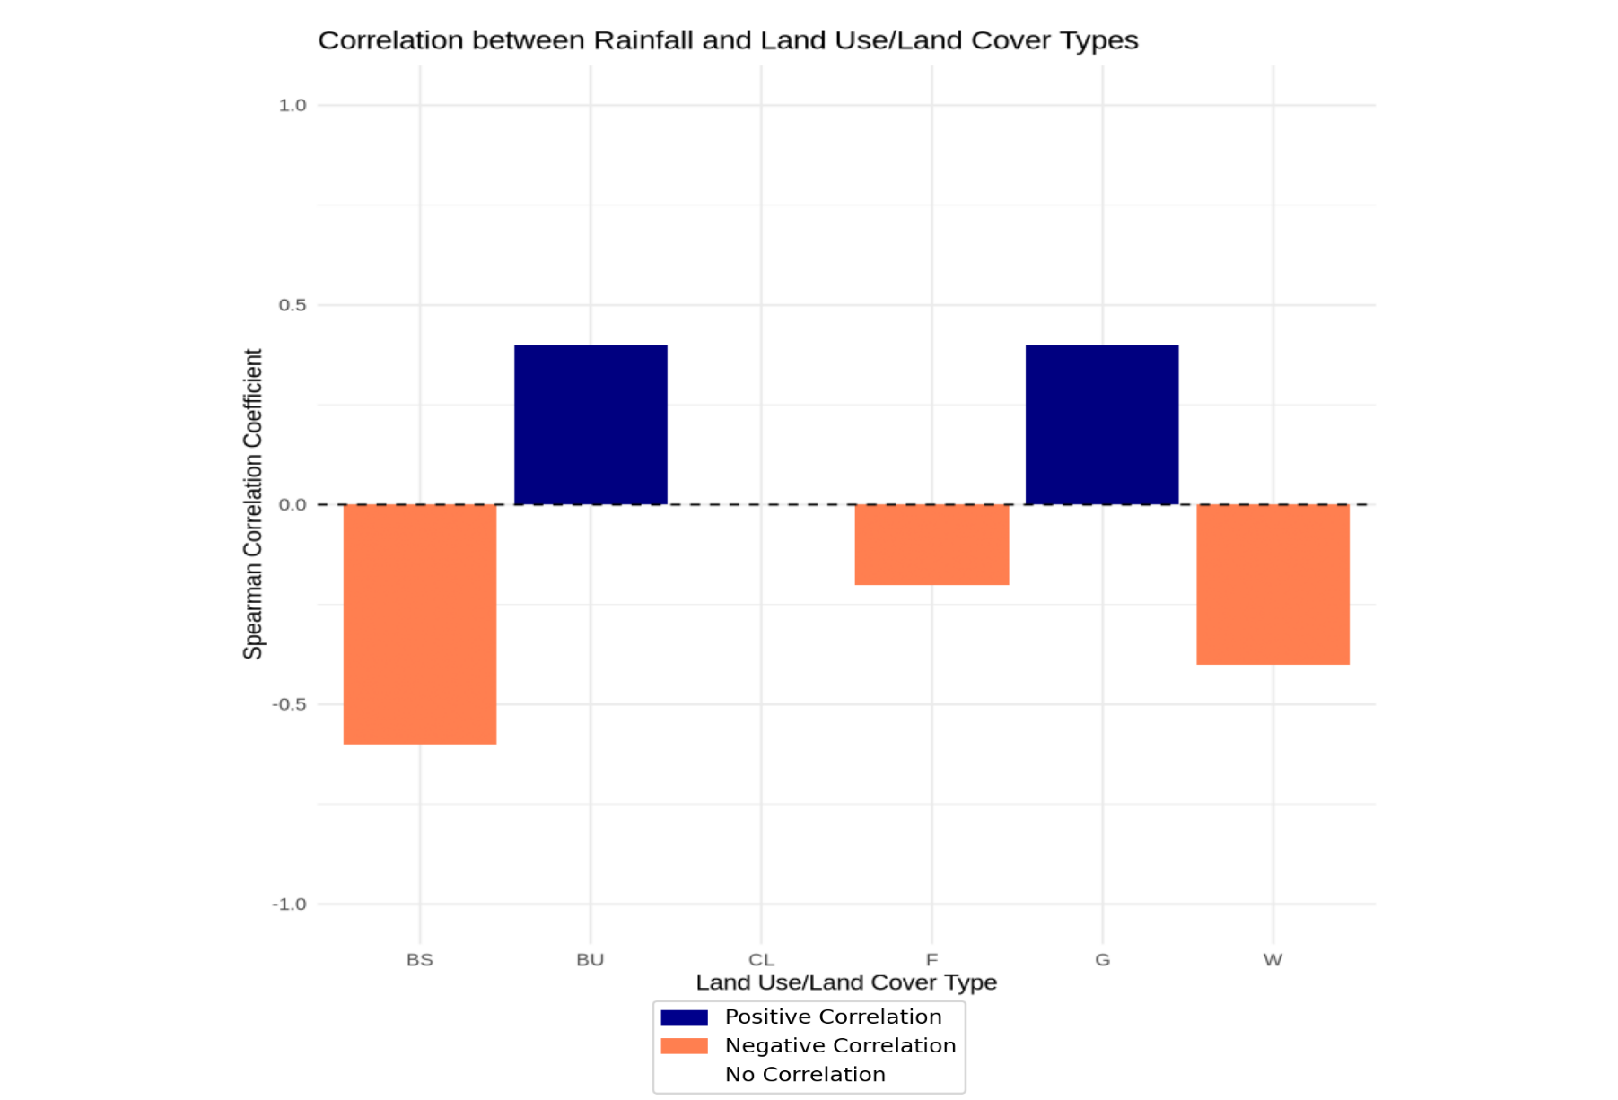
Correlation between Rainfall and LULC types
Bare/sparse land (BS), Forest (F) and Water bodies (W) have negative correlation with rainfall suggesting that areas dominated by barren BS, F and W generally receive less rainfall.
BU (Built-Up) and Grassland (G) exhibit positive relation, suggesting that increased rainfall is associated with more built-up and grassland areas.
CL (Cultivated Land) lacks of correlation (0) suggesting that rainfall in these areas is unaffected by or does not notably affect cultivated land distribution

Slide 30
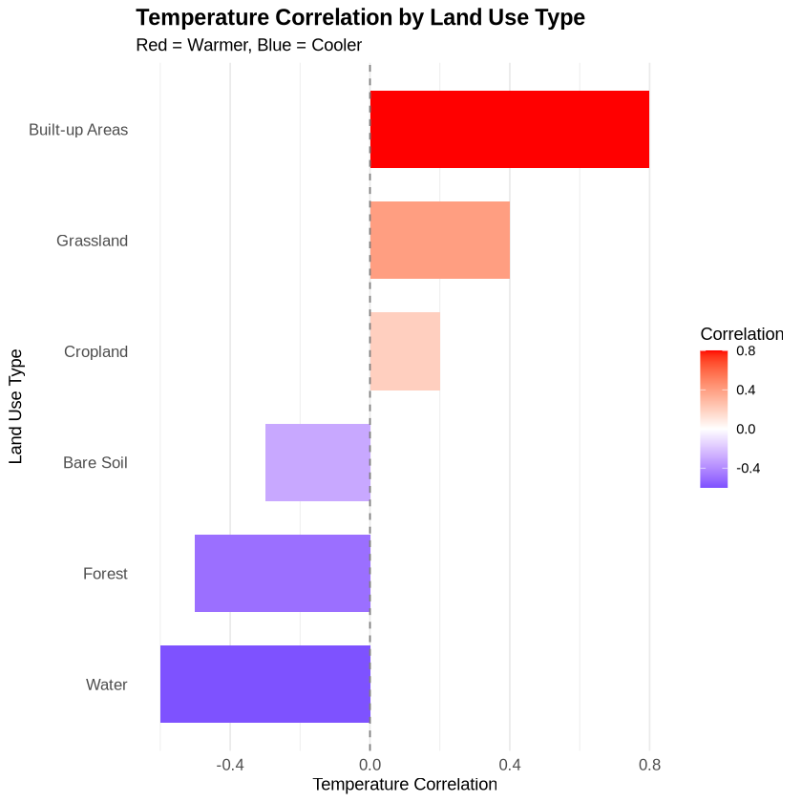
Correlation between Tmax and LULC types
BU, G and CL show a positive correlation with Mean Annual Maximum temperature, indicating that as temperature increases, BU, G & CL areas tend to increase.
W, F & BS exhibit negative correlation, suggesting that higher temperatures are associated with a decrease in W, F & BS areas.

Slide 31
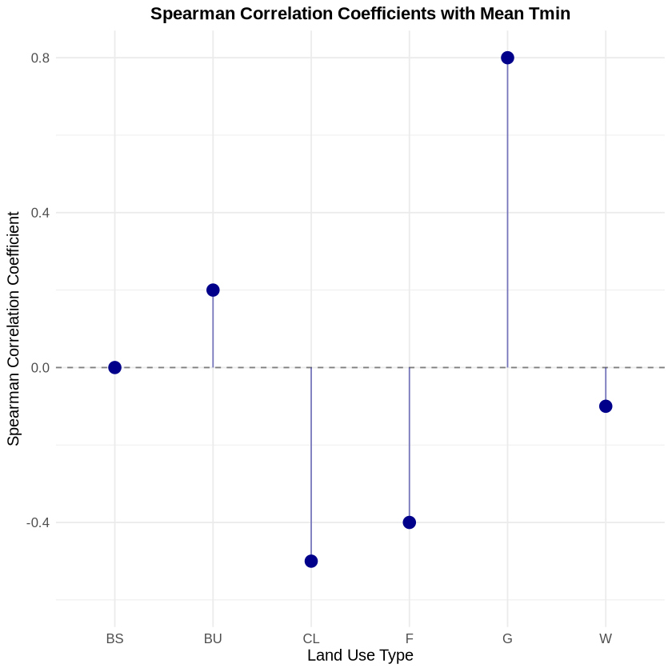
Correlation between Tmin and LULC types
A positive correlation between mean annual minimum temperature and Built-up & Grassland areas, suggesting that urbanized areas and grasslands are most strongly linked to higher minimum temperatures.
Bare surface showed no correlation.
Forest and Water bodies show a negative correlation with minimum temperatures, indicating that these natural areas are associated with cooler temperatures. This cooling effect is due to vegetation and moisture retention, which help moderate temperature fluctuations.

Slide 32
KEY FINDINGS
A significant decrease in rainfall patterns was observed. Maximum temperatures exhibited an upward trend, indicating warming conditions while Minimum temperatures showed a declining trend.
This rural-to-urban migration pattern was consistent across all study locations.
LULC Changes analysis demonstrated progressive expansion of built-up areas over the study period which corresponded with a reduction in cultivated land, forest, bare/sparse land and water bodies. 2040 projection shows increase in built up, cultivated land, forest and water bodies.
Higher precipitation was observed during the Wet season, Maximum temperatures peaked during the Dry season while Minimum temperatures were higher during the Wet season.
Job opportunities, Educational advancement emerged and Security concerns as the primary driver of migration.
Complex interactions were observed between climatic variables (rainfall and temperature), net migration, and LULC classes. Variations suggest how climate factors and migration influence land use and land cover changes.

Slide 33
Conclusion
Migration, climate change and their impacts on LULC are disastrous.
Some of the impacts identified and inferred include increasing urbanization, deforestation, increased competition for water resources, loss of biodiversity, land degradation, loss of cultural heritage and spread of diseases which boomerang as Urban heat islands, loss of green spaces, increased crime rates, water cycle disruption etc.
These calls for immediate action.

Slide 34
RECOMMENDATIONS
For policy improvement; adopt inclusive, people-centered policies that prioritize support for farmers and communities.
In contribution to knowledge; this study develops a comprehensive framework for analyzing the interconnections between environmental, social, and economic factors, providing a holistic approach to studying land use change in the context of climate impacts and migration.
For performance improvement; Encourage collaborations by Engaging government, local communities, NGOs, and international agencies.
Capacity Building, Create policy briefs, fact sheets, M & E, systems.
Future research could explore the use of Kriging, which may provide more precise estimates and allow for comparison with the results from IDW.

Slide 35








THANK YOU !
MERCI !

