Slide 1


ASSESSING CITIES RESPONSE TO CLIMATE CHANGE IN THE SUDAN SAVANNA REGION OF WEST AFRICA THROUGH RENEWABLE ENERGY
External Defense
By DICKO Kagou
B.Sc. in Applied Geology, Université des Sciences, des Techniques et des Technologies de Bamako (USTTB)
M.Sc. In Petrology & Metallogeny, Université Félix Houphouët-Boigny (UFHB)
Supervisors
Dr Emmanuel Tanko Umaru
Dr Souleymane Sanogo
Prof, Dr Ralf Loewner
17/04/2025
1

Slide 2
BACKGROUND
STUDY AREA
RESEARCH OBJECTIVES
JUSTIFICATION
MATERIALS AND METHODS
RESULTS
CONCLUSION
ACKNOWLEDGEMENTS
OUTLINE
2

Slide 3
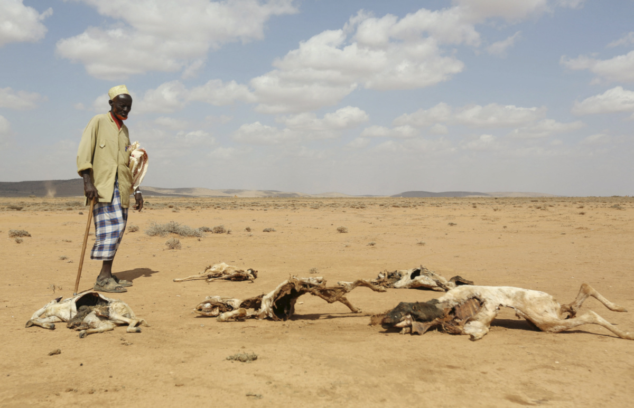
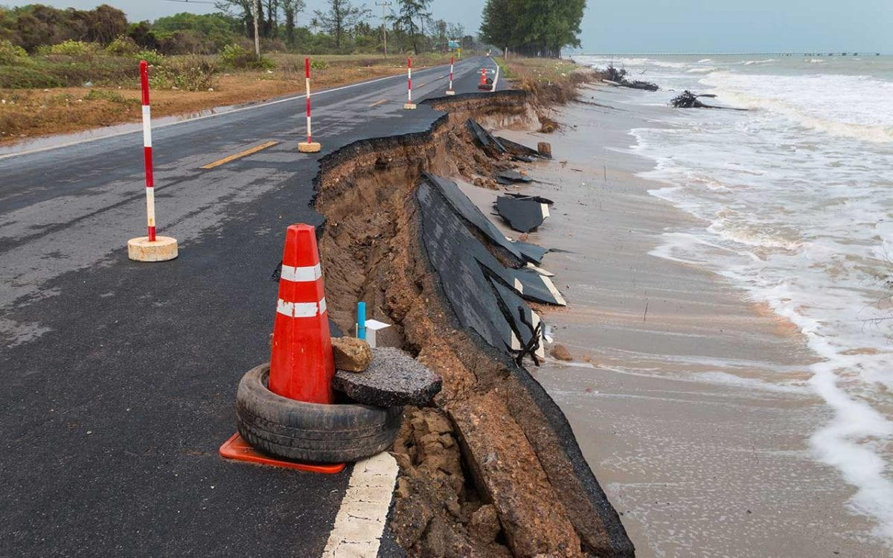
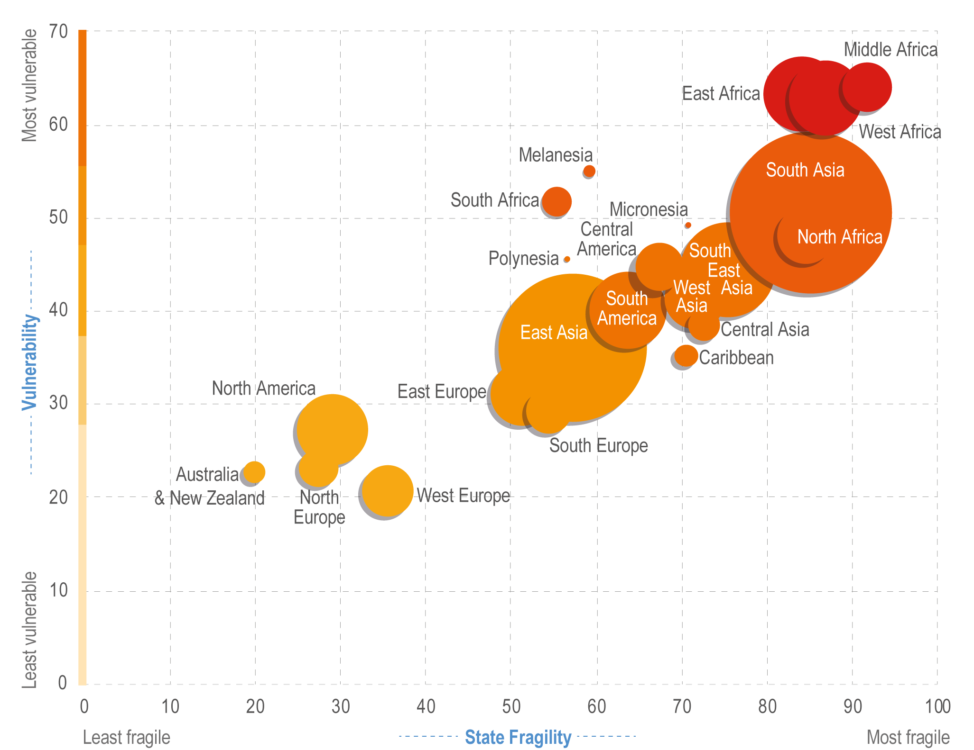
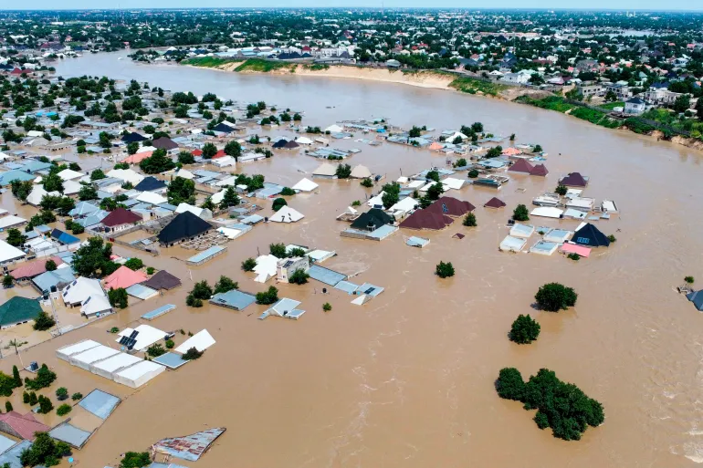
Photo credit: Reuters Feisal
BACKGROUND
Photo credit: Attapol Yiemsiriwut, Shutterstock
Source: IPCC, 2022
3
Photo credit: Musa Ajit

Slide 4
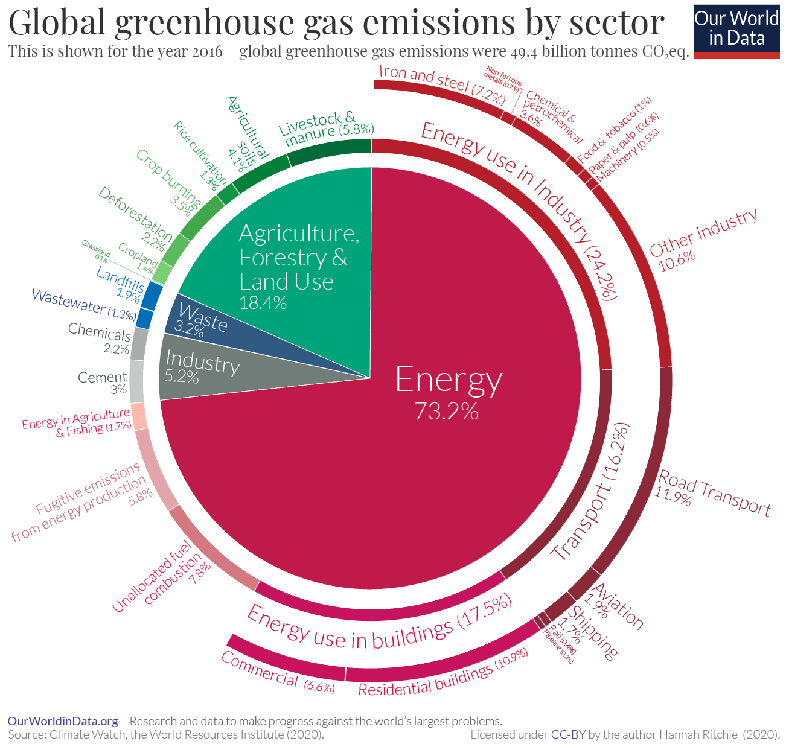
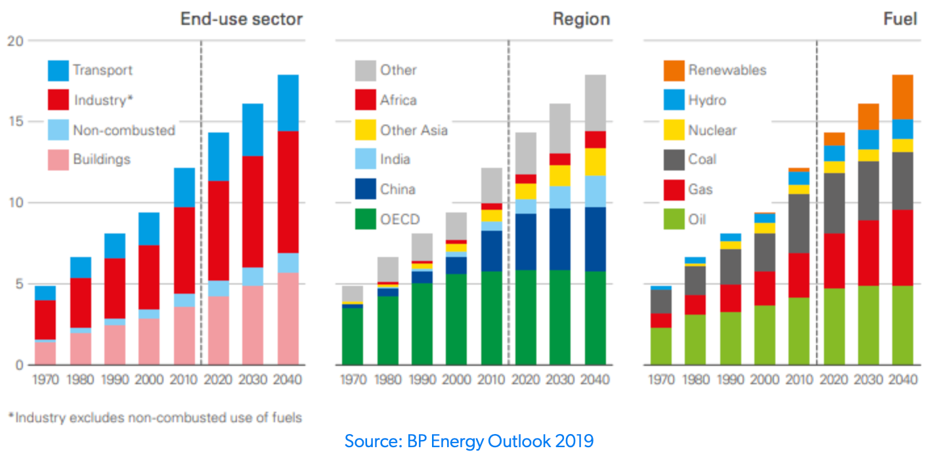
BACKGROUND
Global greenhouse gas emissions by sector
4

Slide 5
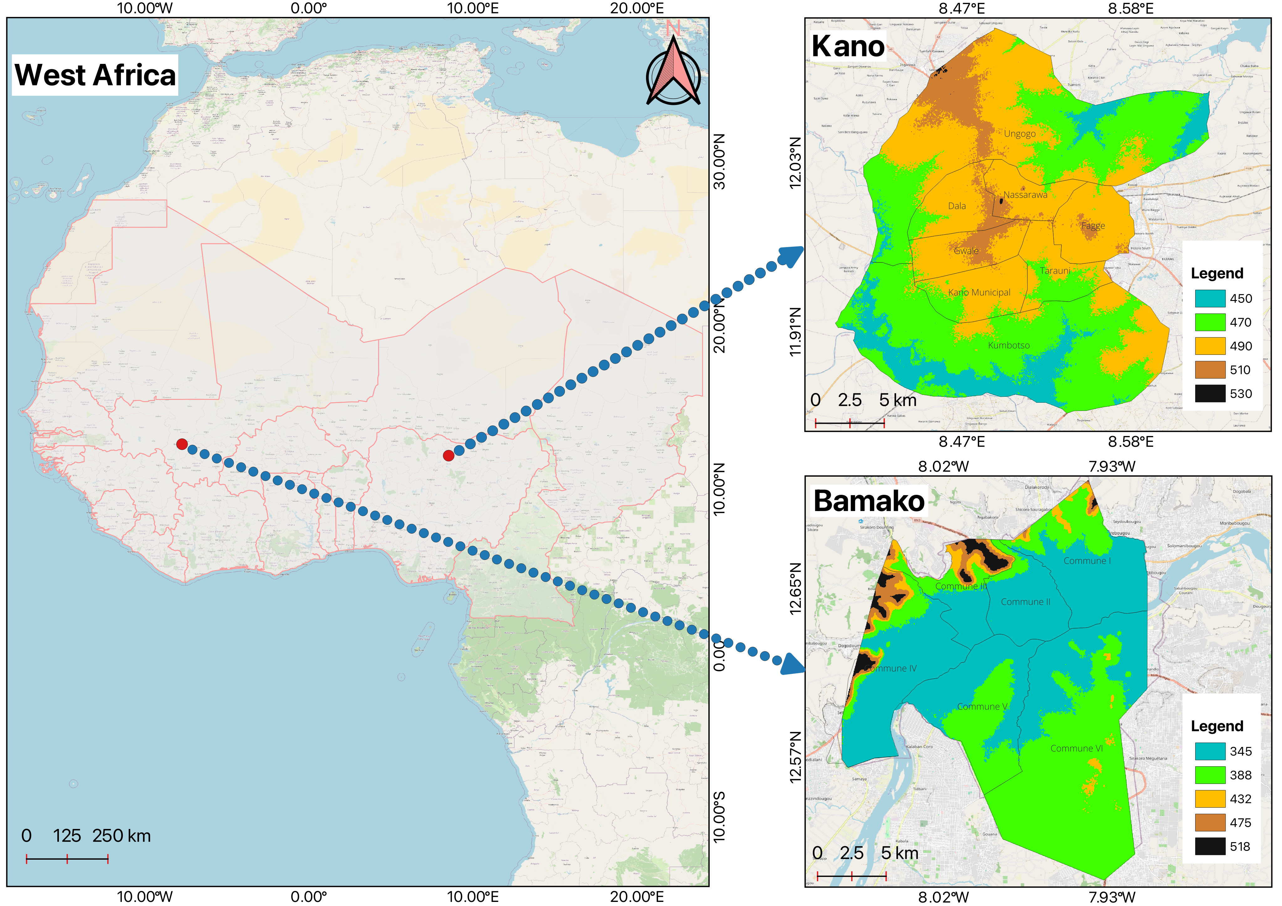
STUDY AREA
Location of the study area
5

Slide 6
Analyse the trends of cooling degree days and heat index between 1992 and 2022
Assess the LULC change of the study area over the period 1992-2022
Identify suitable locations for installing solar powerplants
Examine the current status of renewable energy adoption and potential barriers for renewable energy development
RESEARCH OBJECTIVES
6

Slide 7
JUSTIFICATION
Relevant for national and international organisations
In-depth understanding of the impact of climate change on the cities of Kano and Bamako. Aligns with the 7th and 13th SDGs
Provides the foundation for shaping policies that mitigate trends
7

Slide 8
O1
O2
O3
O4
Daily Maximum and minimum temperature and Relative humidity
Landsat 5 TM, 7 ETM+ and 9 OLI
DEM, Land aspect, Slope, GHI, Temperature, Wind speed, Land Use, shapefiles on Protected areas, Powerlines, Waterways, Rails, Roads
Questionnaire Survey (960 respondents)
MATERIALS AND METHODS
8

Slide 9
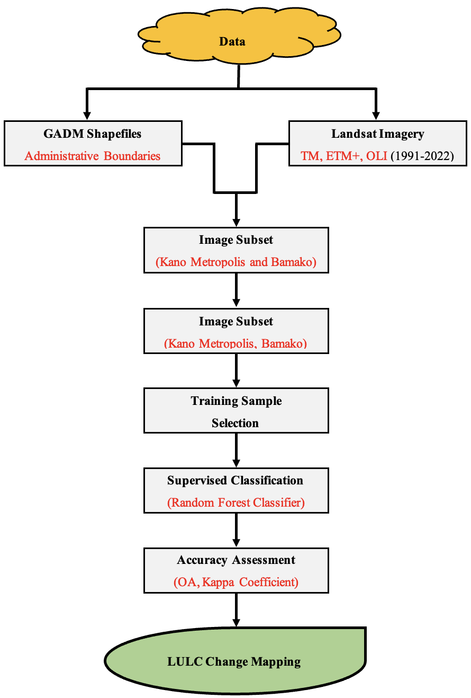
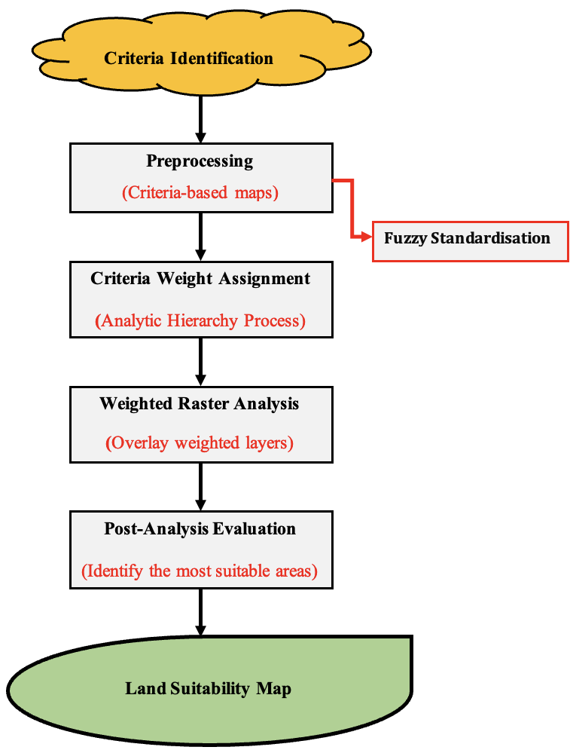






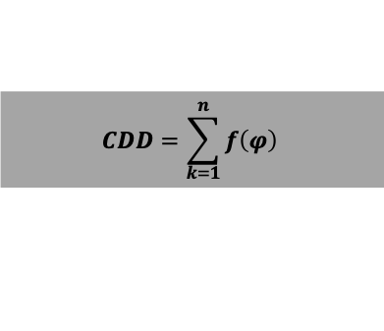

$$CDD=\sum_{k=1}^{n}{f\left(φ\right) }$$
$$Equation 1$$
$$O1$$
MATERIALS AND METHODS
$$Equation 2$$
HI = - 42.379 + 2.049 × T + 10.143 × RH – 0.225 × T × RH – 6.838 × 103 × T2 – 5.482 × 102 × RH2 + 1.229 × 103 × T2 × RH + 8.528 × 104 × T × RH2 – 1.990 × 106 × T2 × RH2
$$O4$$
$$O2$$
$$O3$$
9

Slide 10



MATERIALS AND METHODS
10

Slide 11
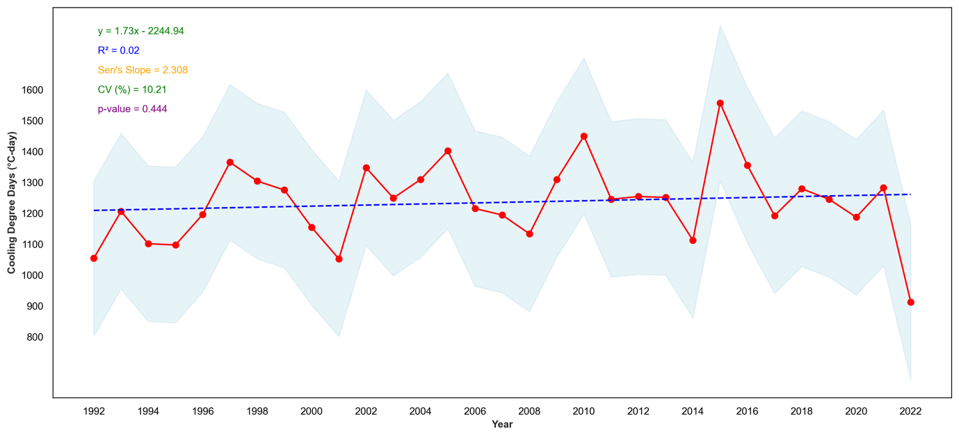
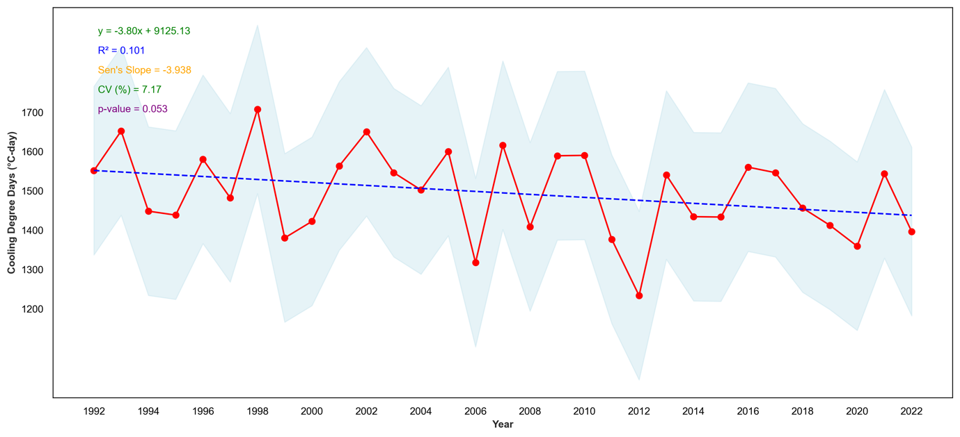
Trends in Cooling Degree-Days in Kano and Bamako
RESULTS
Climatology of Cooling Degree Days for Kano
Climatology of Cooling Degree Days for Kano
11

Slide 12
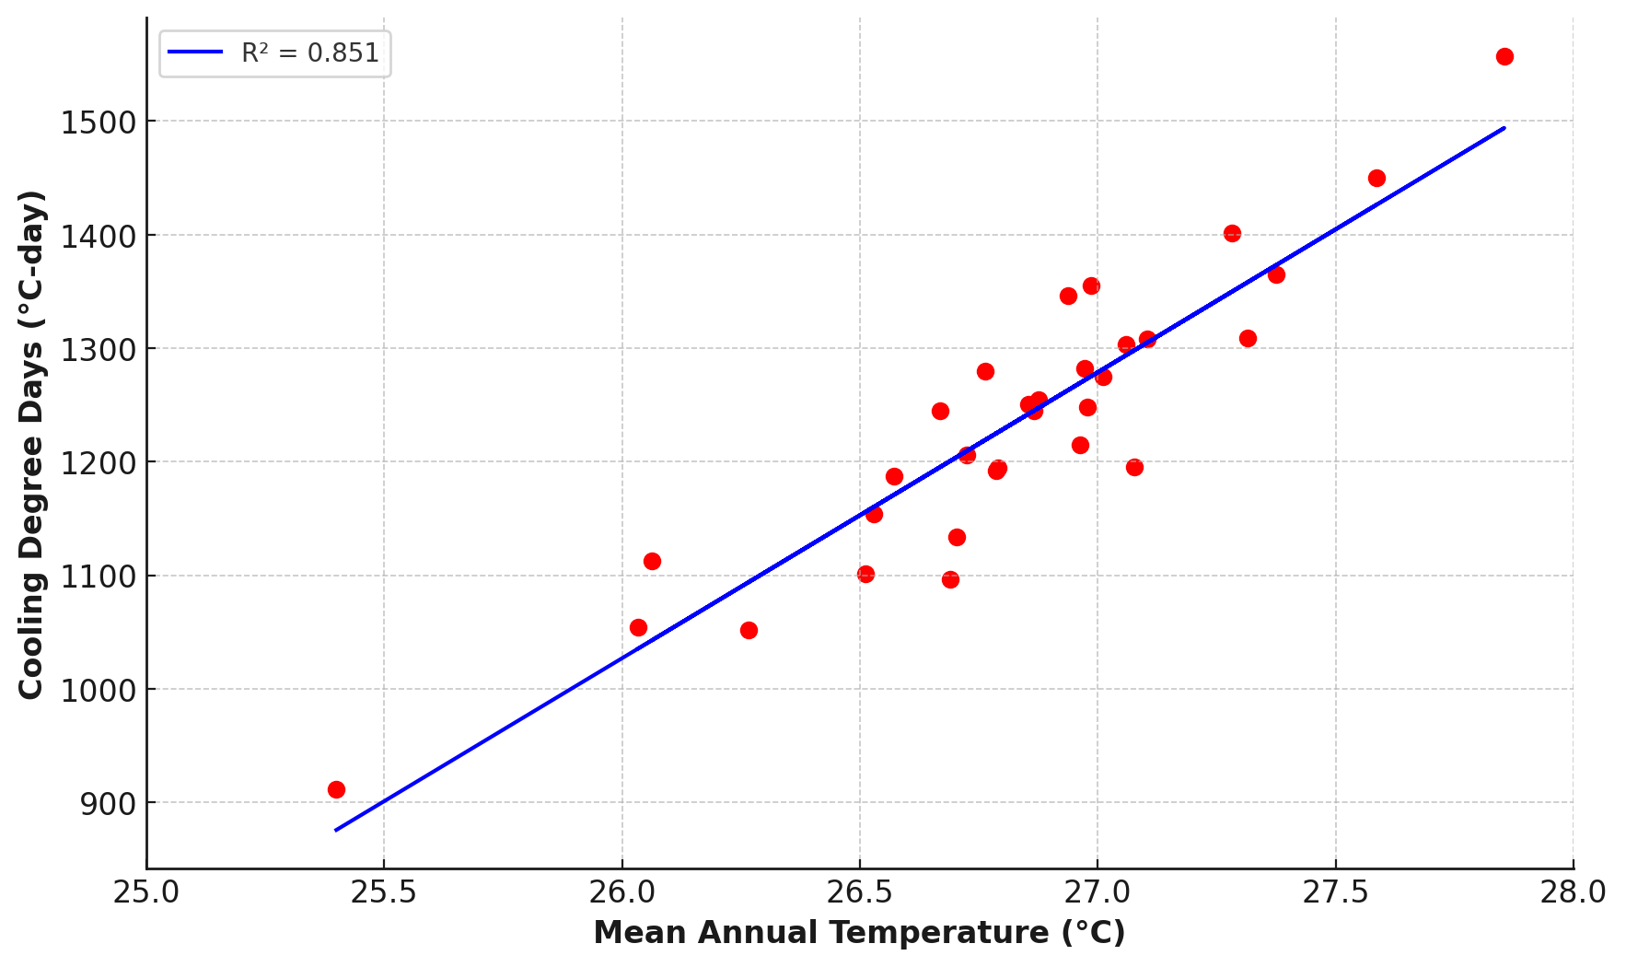
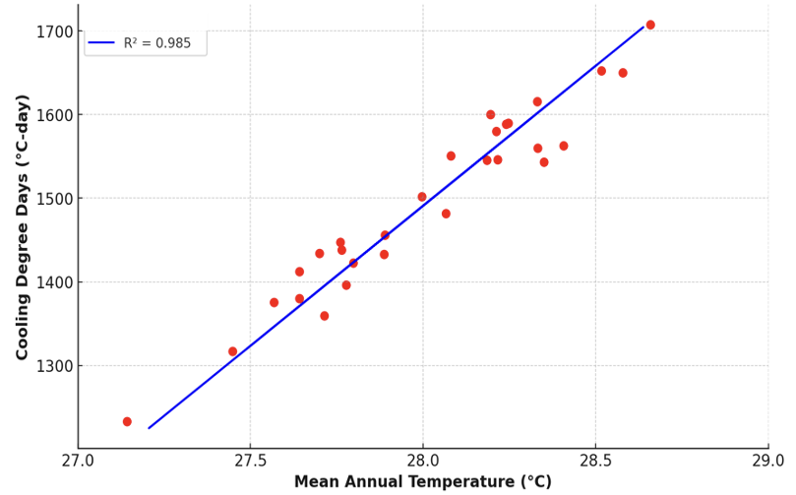
Trends in Cooling Degree-Days in Kano and Bamako
RESULTS
Relationship between CDD and Mean Temperature for Kano
Relationship between CDD and Mean Temperature for Bamako
12

Slide 13
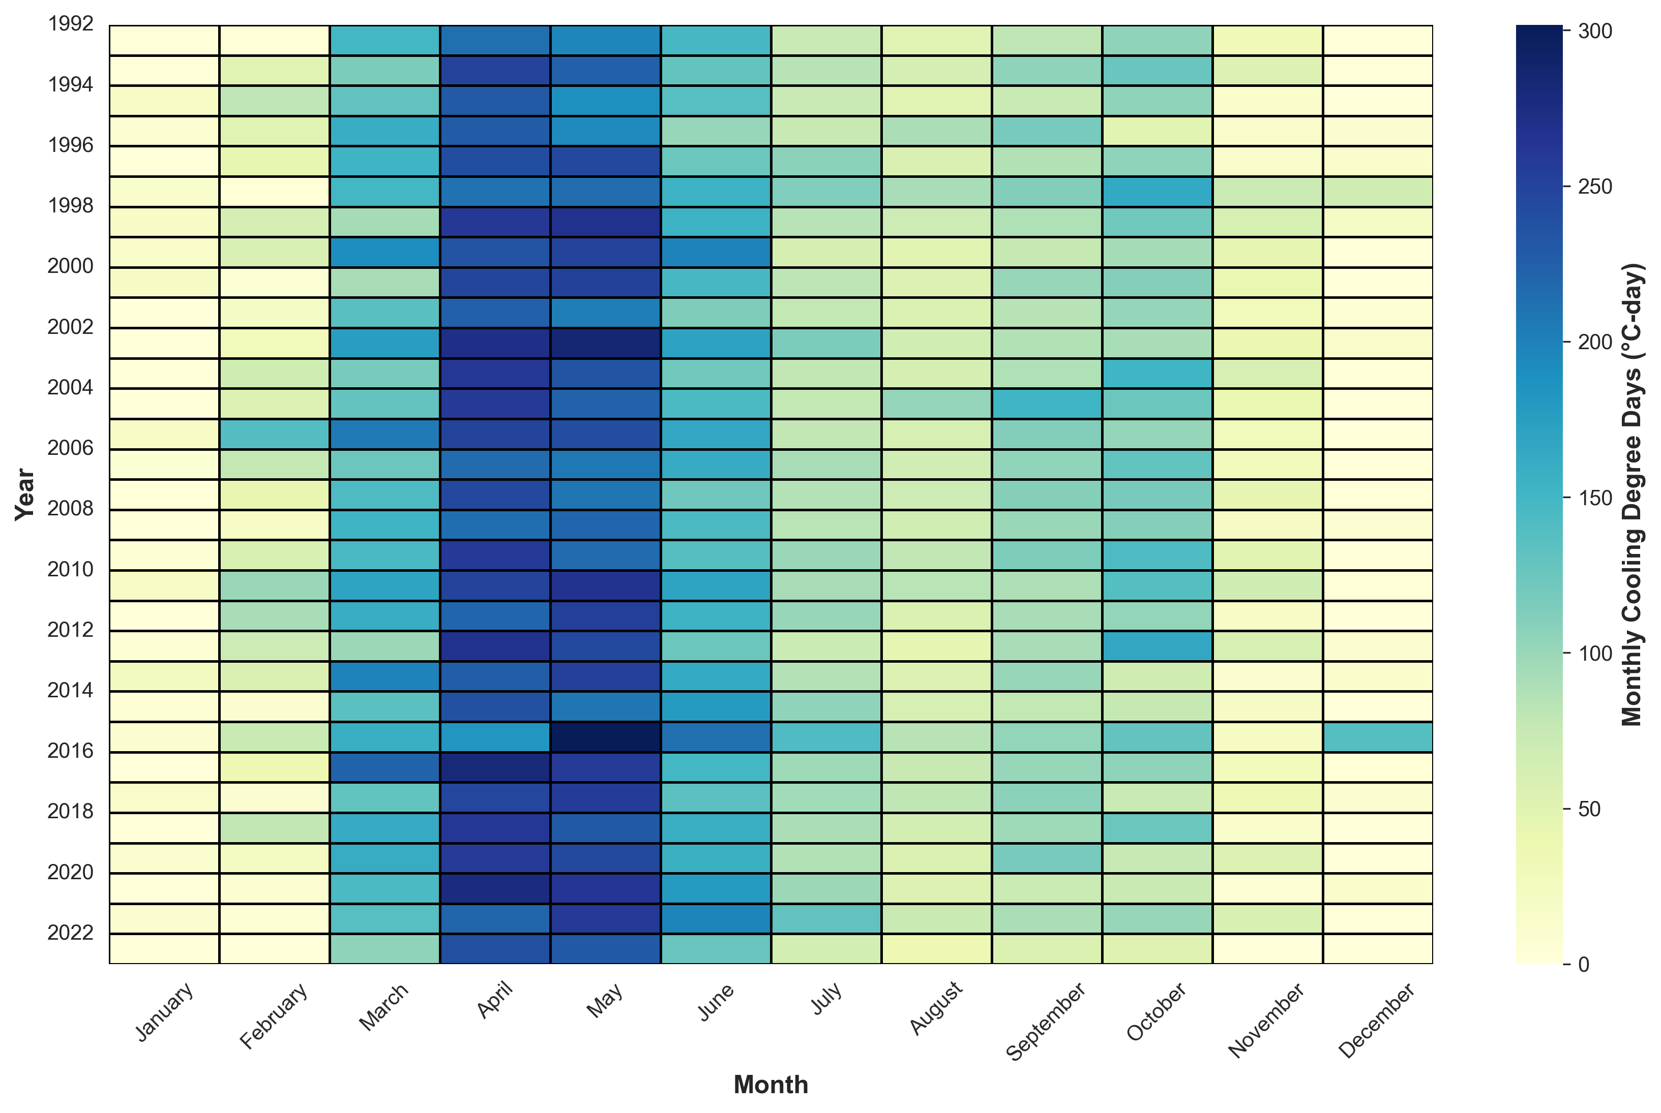
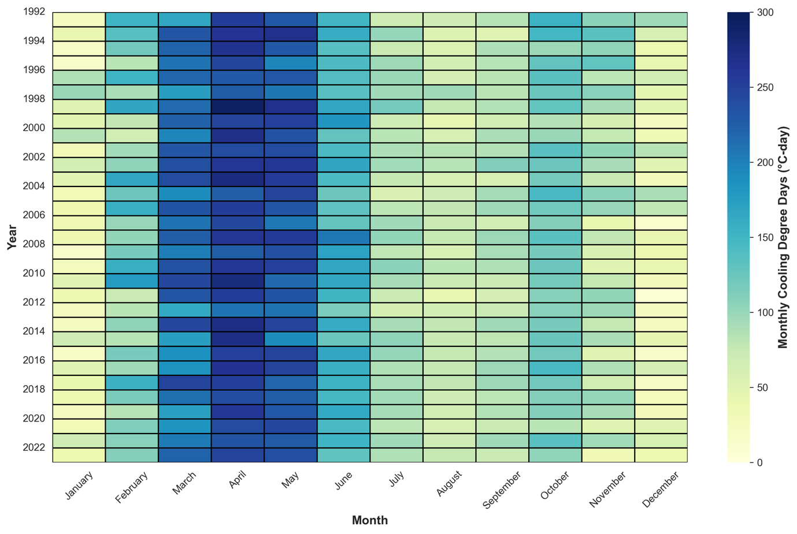
Trends in Cooling Degree-Days in Kano and Bamako
RESULTS
Monthly CDD for Kano
Monthly CDD for Bamako
13

Slide 14
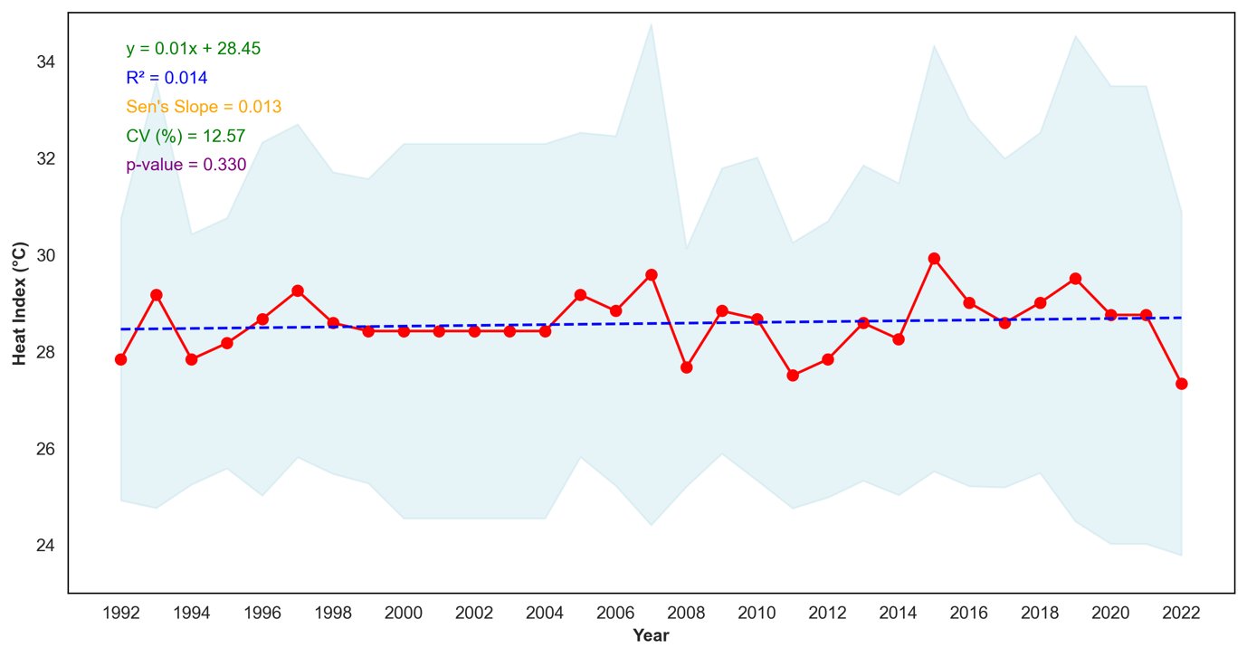
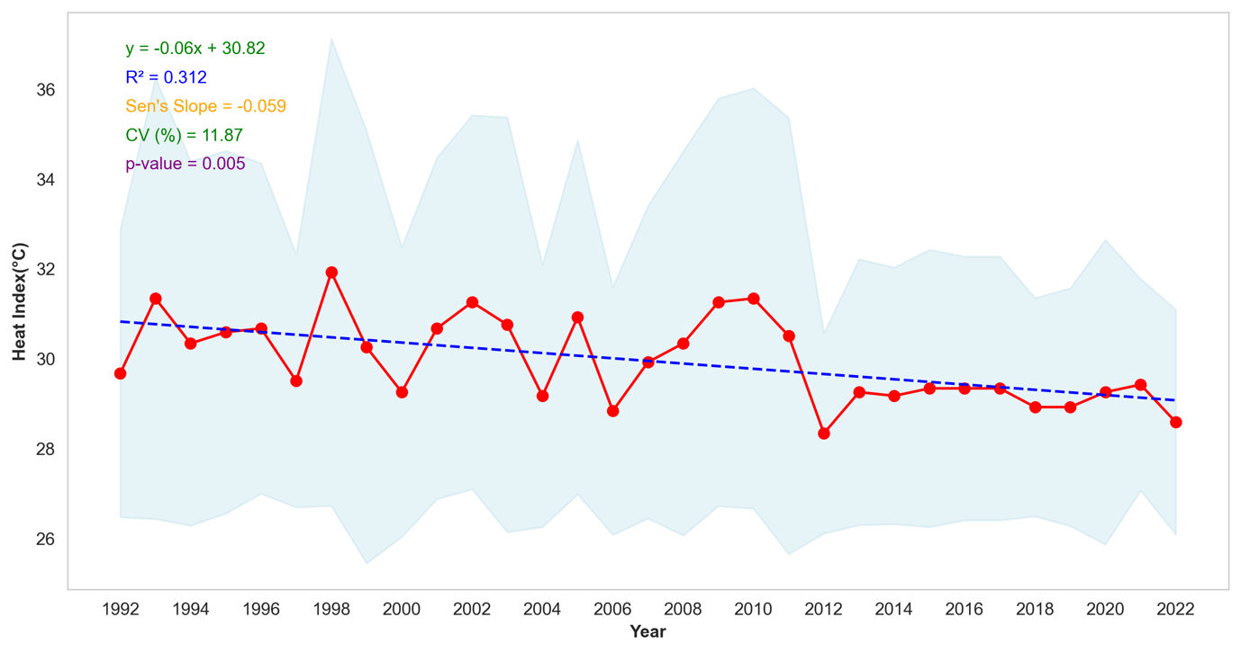
Trends in Heat Index in Kano and Bamako
RESULTS
Climatology of HI for Kano
Climatology of HI for Bamako
14

Slide 15
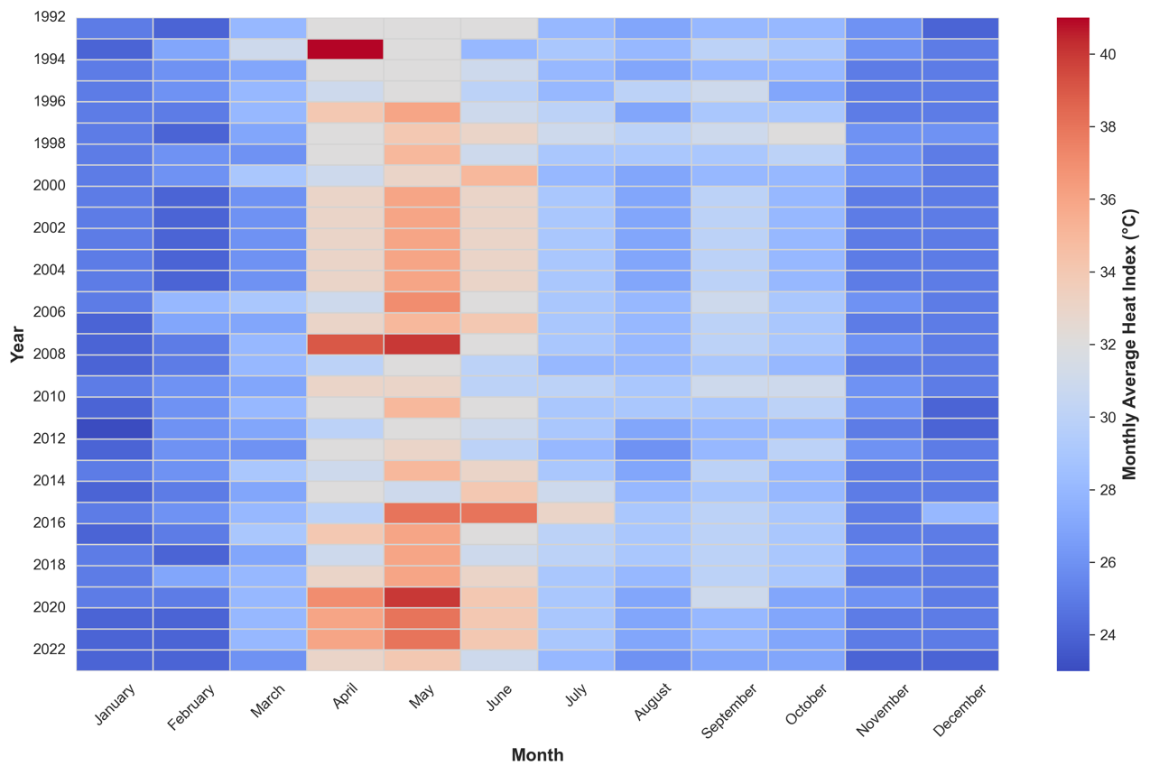
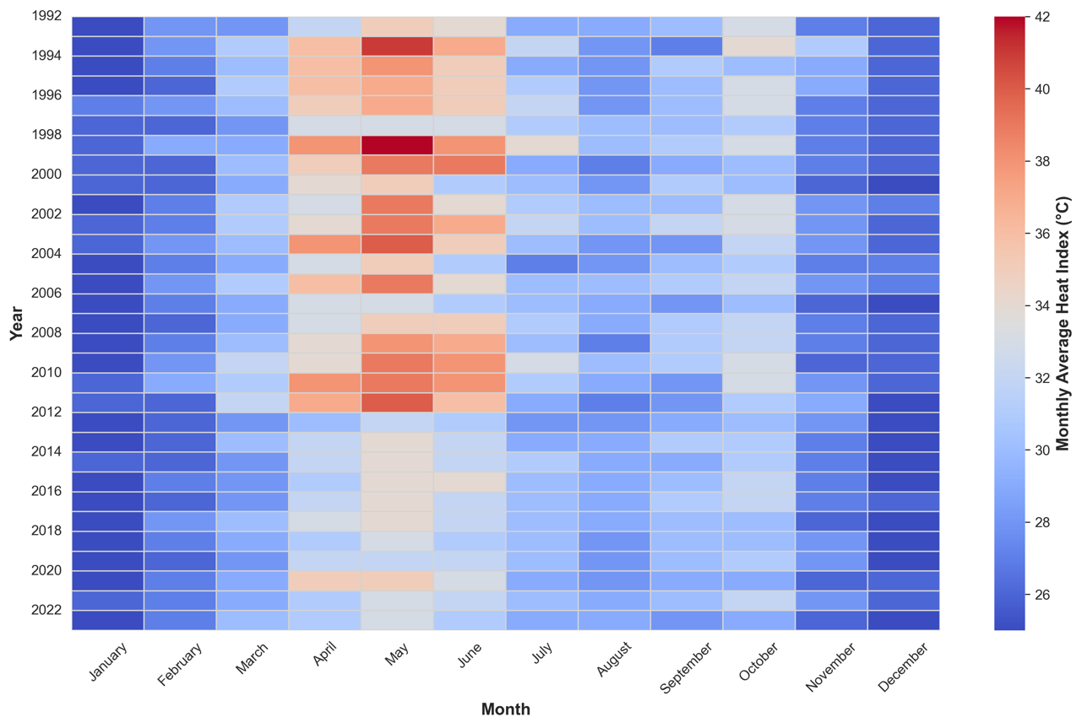
Trends in Heat Index in Kano and Bamako
RESULTS
Monthly Average Heat Index for Kano
Monthly Average Heat Index for Bamako
15

Slide 16
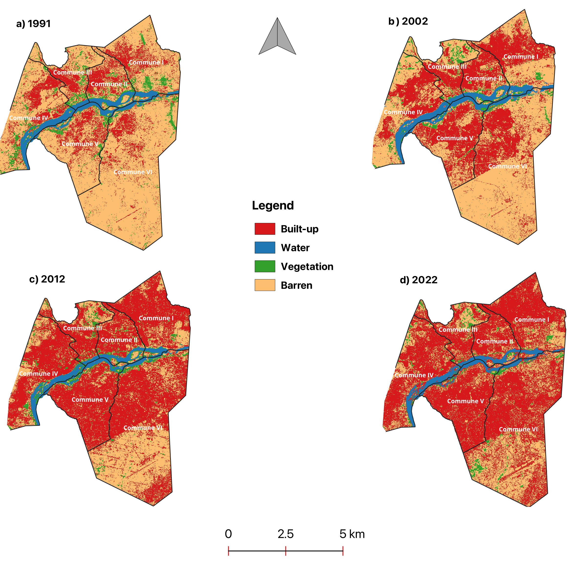
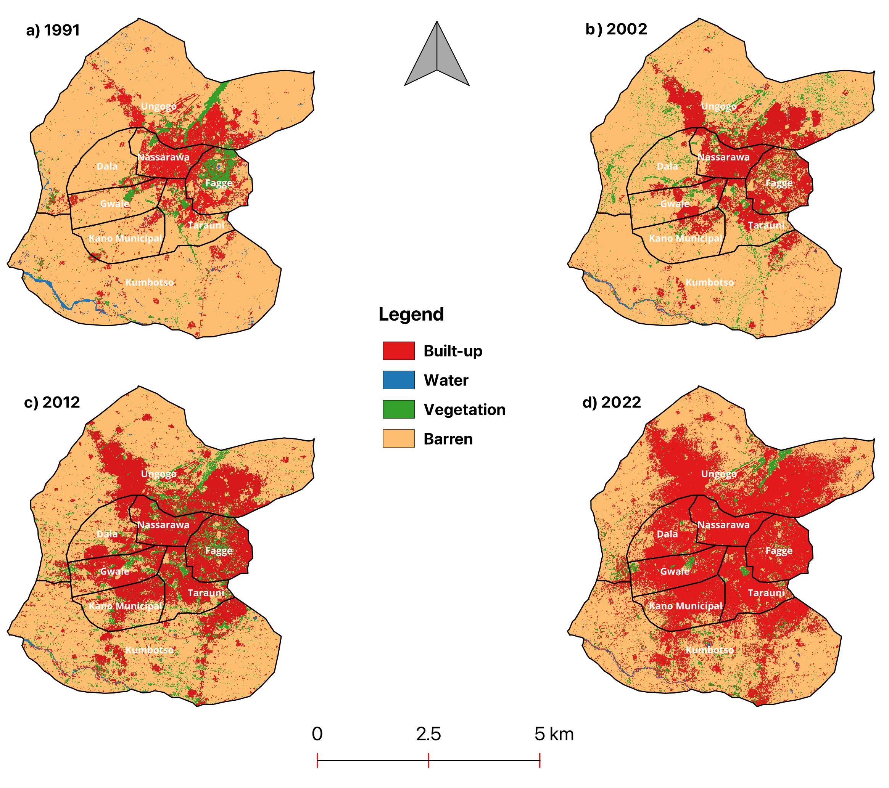
Analysis of LULC change for Kano and Bamako
RESULTS
16
Temporal evolution of LULC classes for Kano
Temporal evolution of LULC classes for Bamako

Slide 17
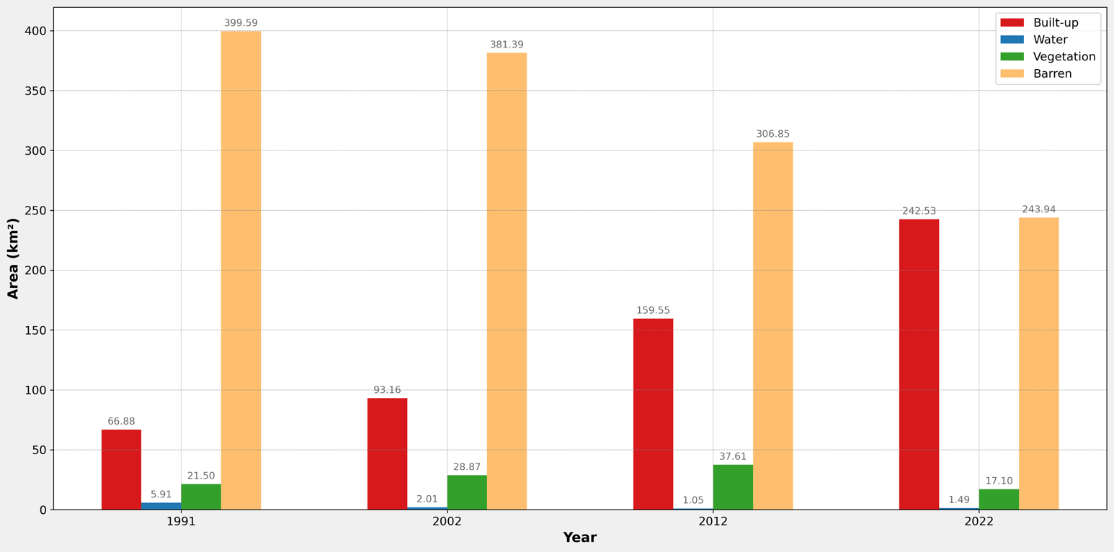
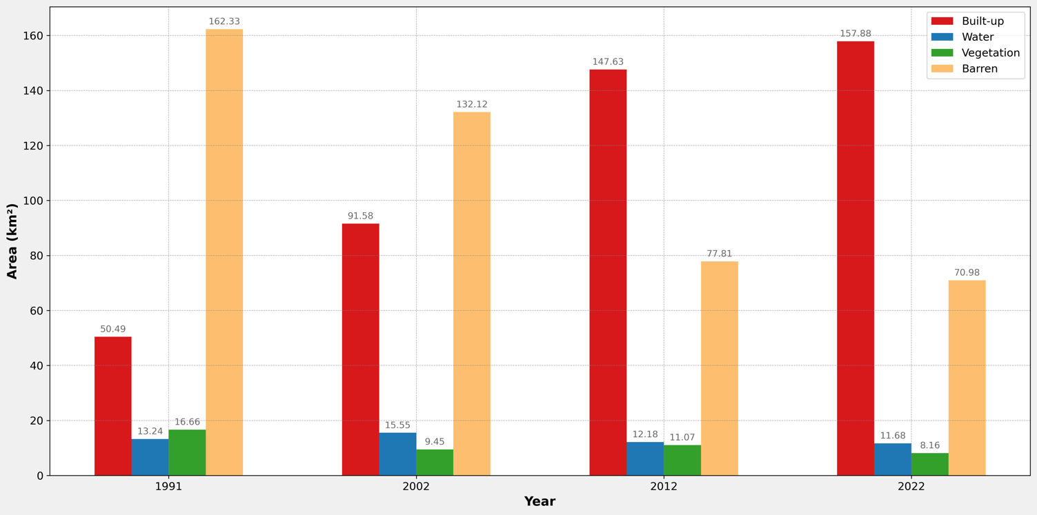
Analysis of LULC change for Kano and Bamako
RESULTS
a)
b)
Temporal evolution of LULC classes for Kano
Temporal evolution of LULC classes for Bamako
17

Slide 18
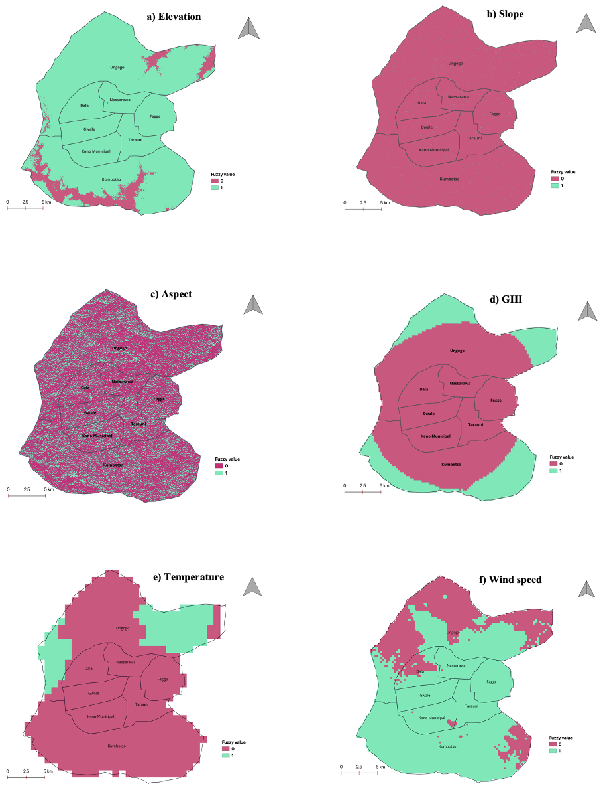
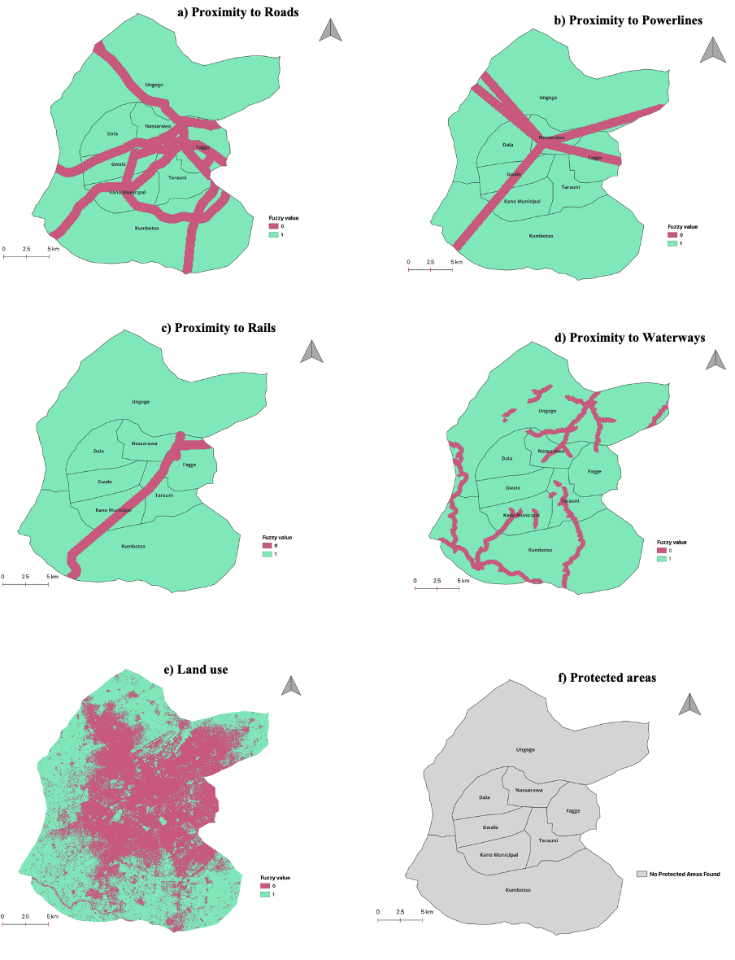
Solar Site Suitability
RESULTS
Classified Restriction Layers for Kano
18
Classified Criteria Layers for Kano

Slide 19
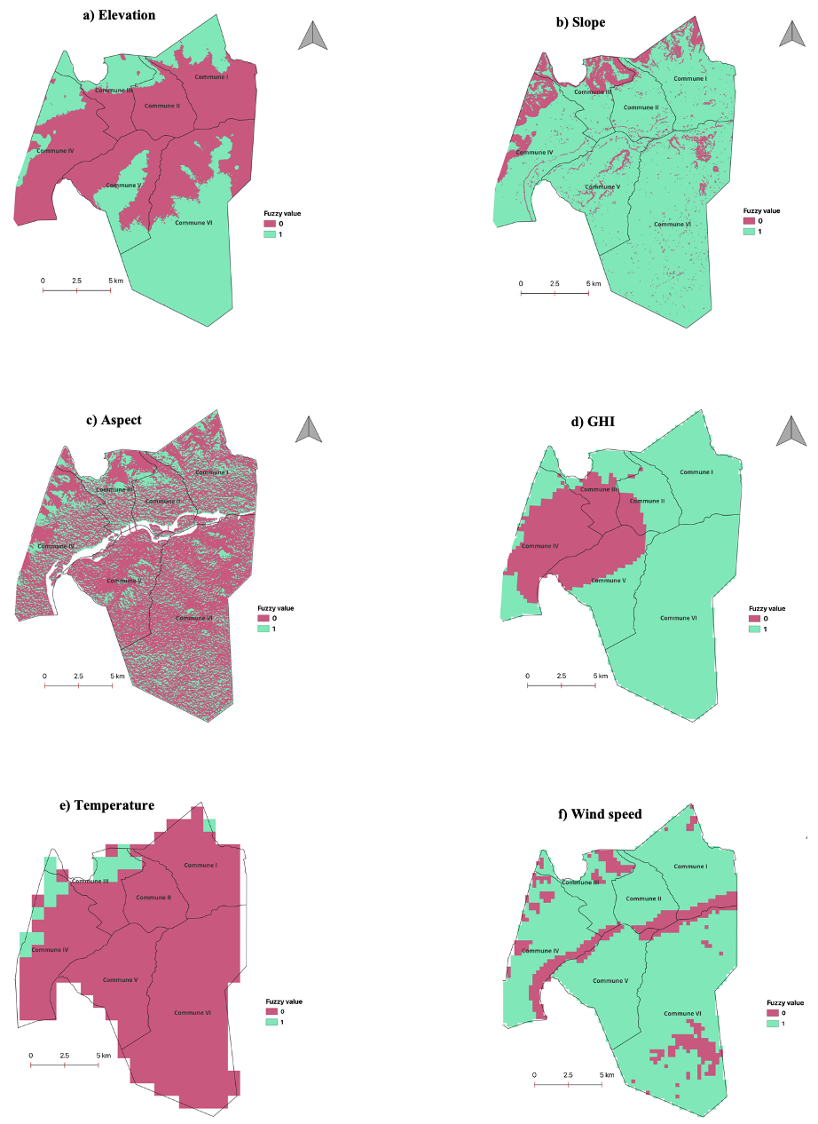
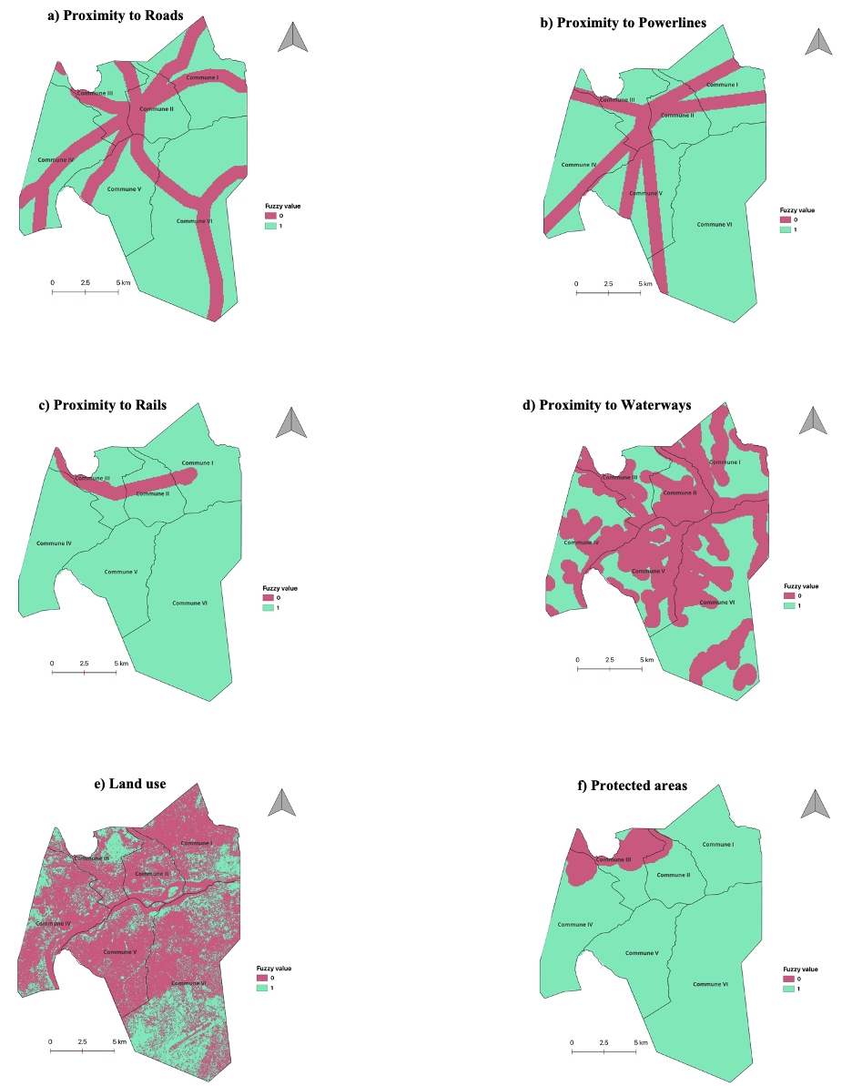
Solar Site Suitability
RESULTS
19
Classified Criteria Layers for Bamako
Classified Restriction Layers for Bamako

Slide 20
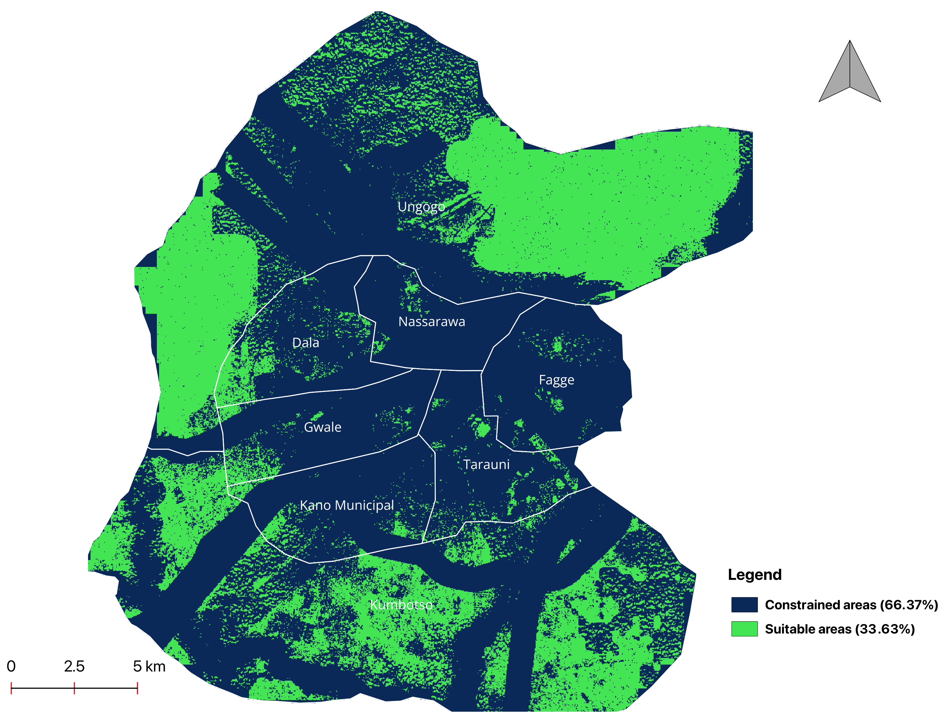
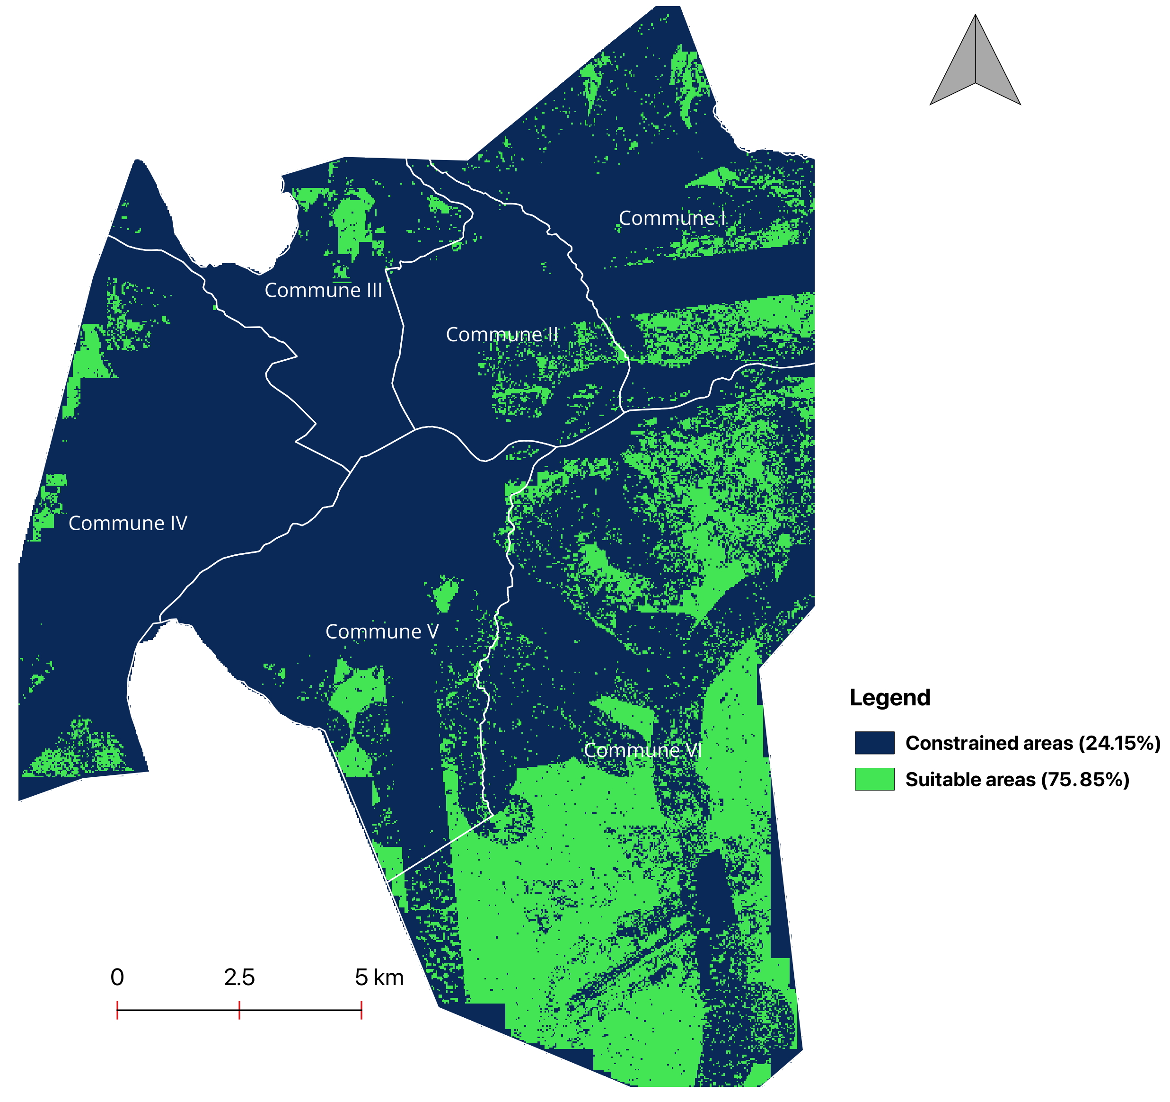
Solar Site Suitability
Suitability Map for Solar Plant for Kano
Suitability Map for Solar Plant for Bamako
20

Slide 21
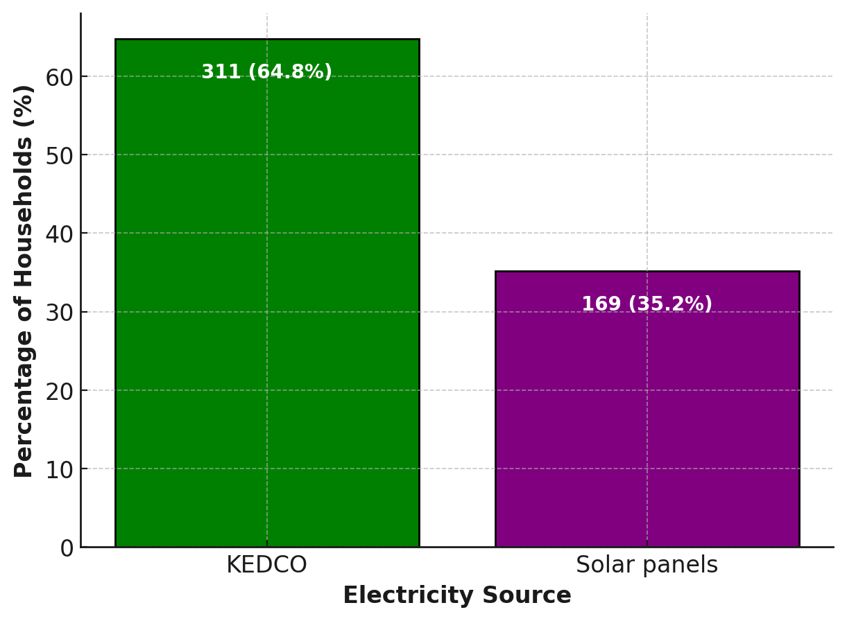
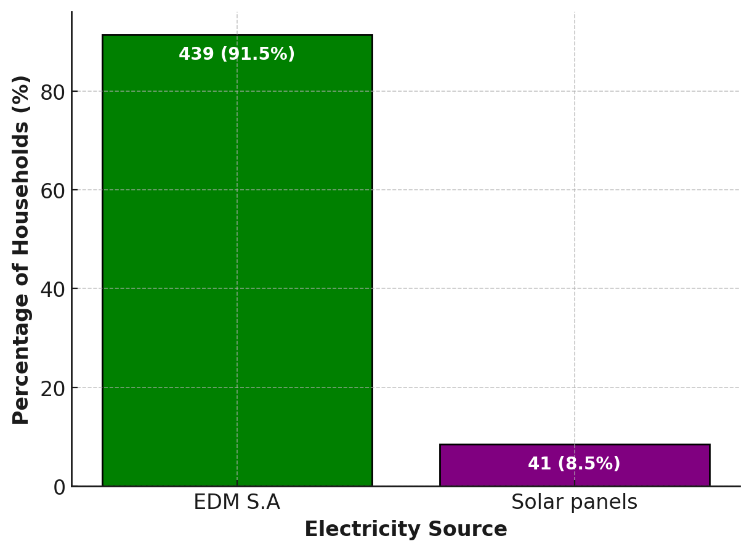
Electricity Sources
Kano
Bamako
21

Slide 22
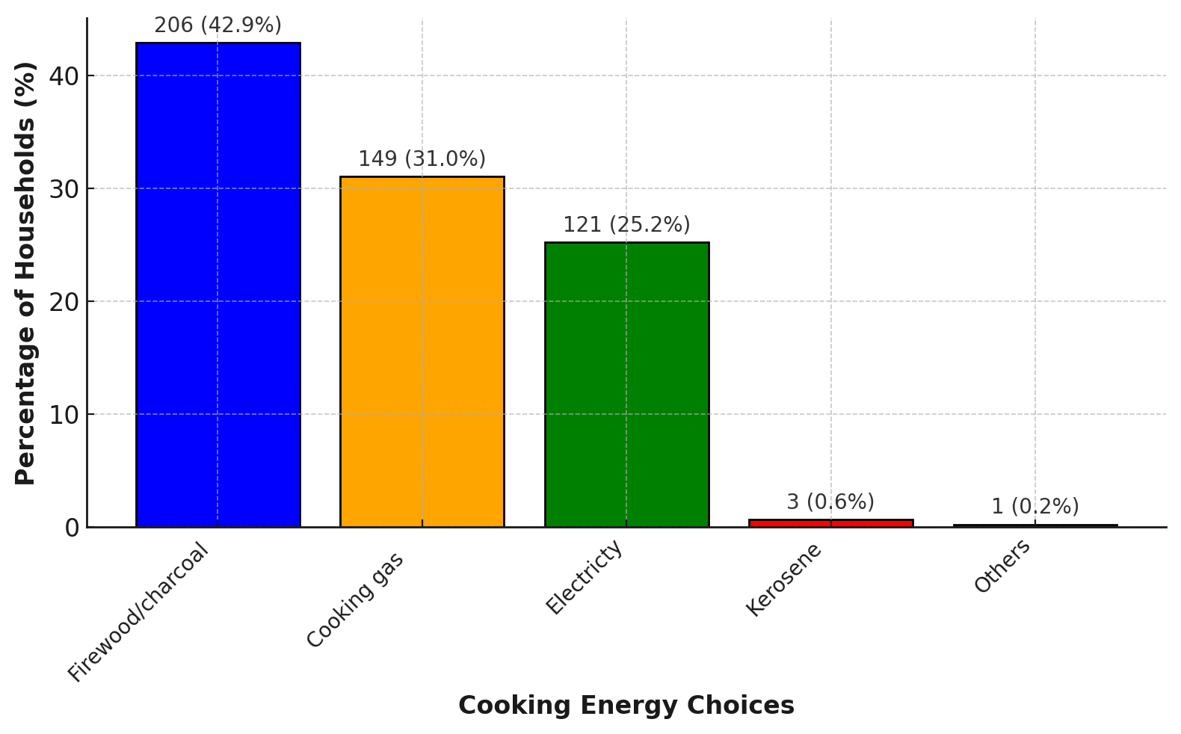
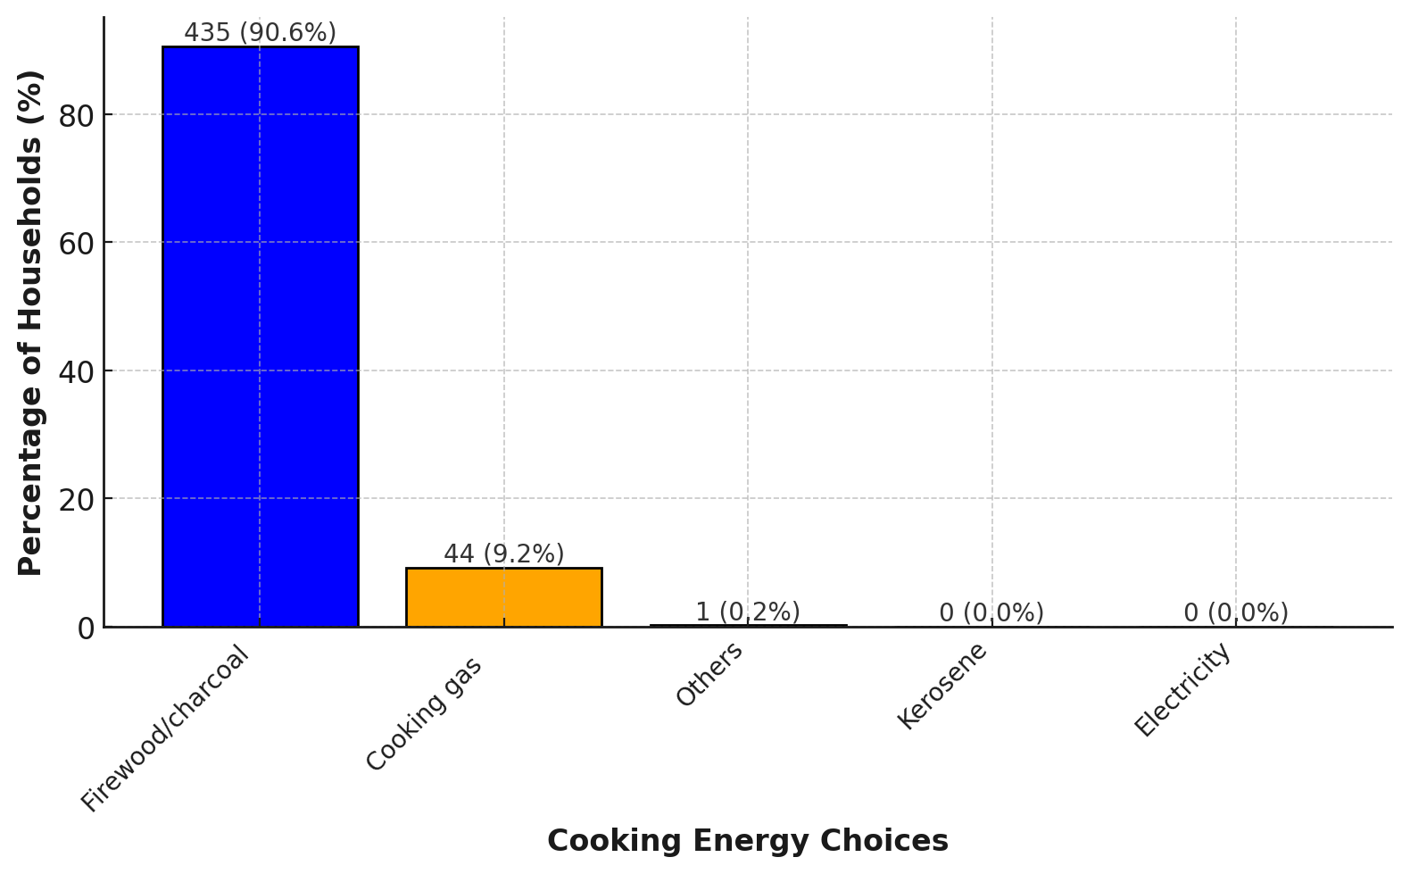
Cooking Energy Choices
RESULTS
Cooking energy choice for Kano
Cooking energy choice for Bamako
22

Slide 23
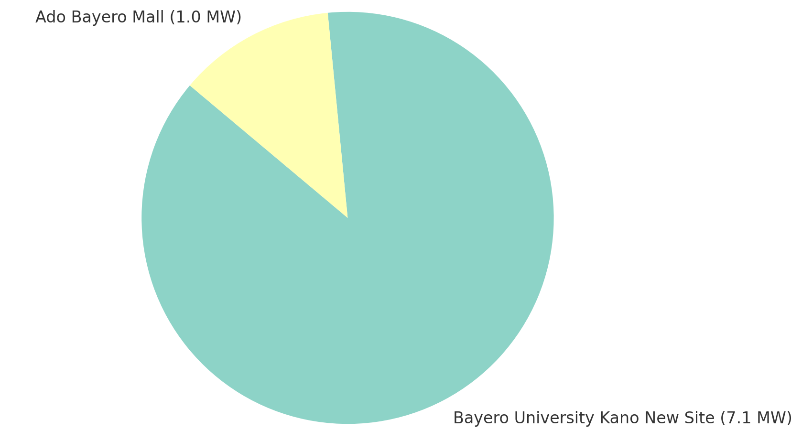
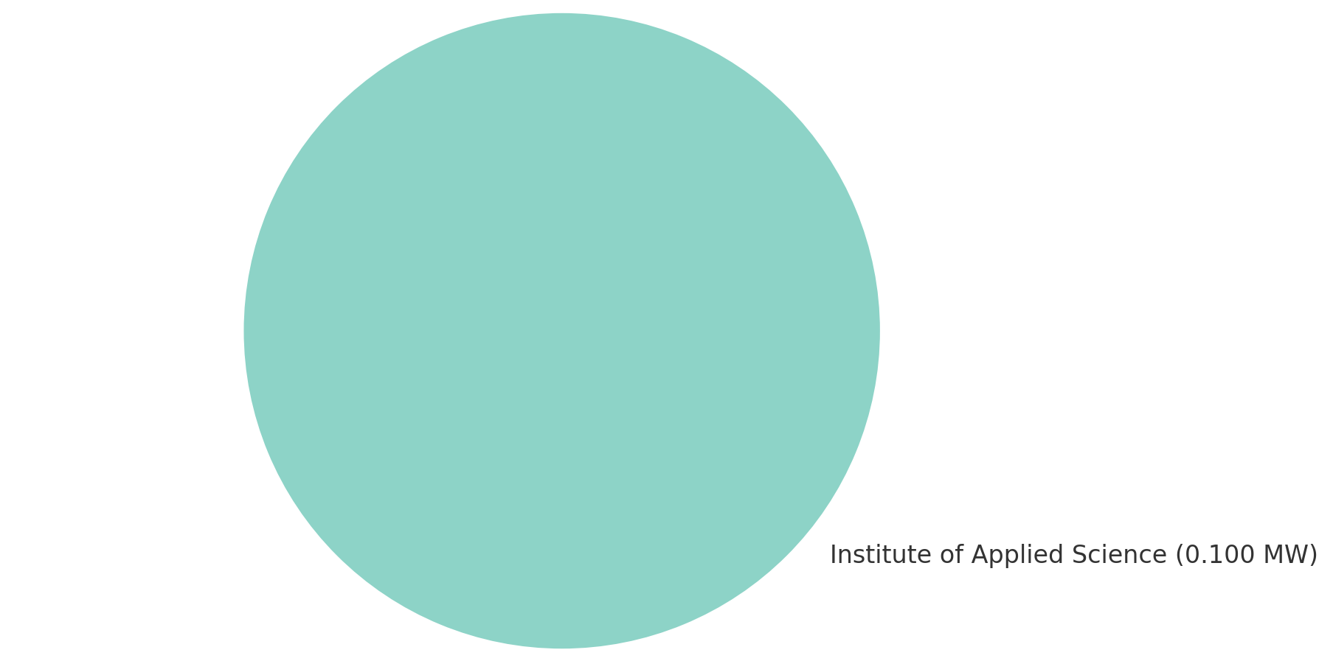
Solar Farms
Number and Capacity of Solar Farms in Kano
Number and Capacity of Solar Farms in Bamako
23

Slide 24
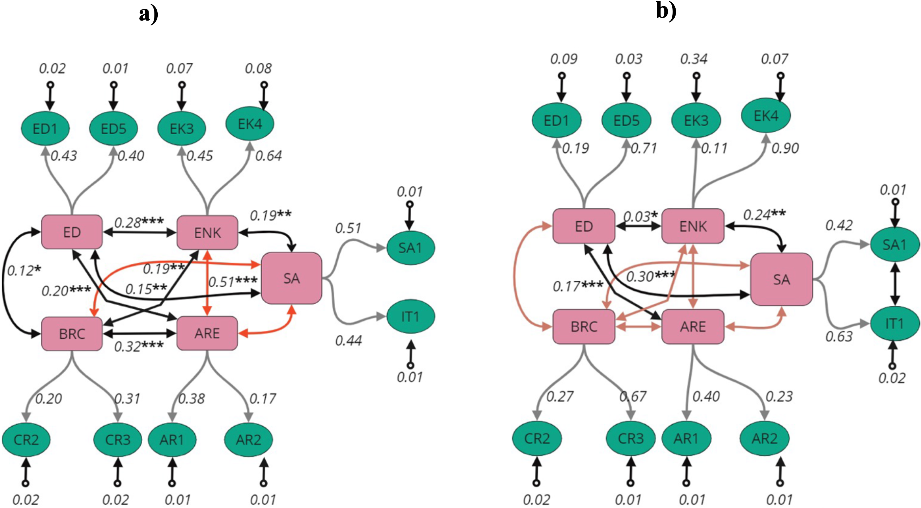
Confirmatory Factor for Kano and Bamako
RESULTS
ED = Energy demand
ENK = Environmental knowledge
SA = Social acceptance
ARE = Beliefs about the advantage of renewable energy
BRC = Beliefs about Renewable Energy Cost
Confirmatory Factor Analysis for Kano
Confirmatory Factor Analysis for Bamako
24

Slide 25
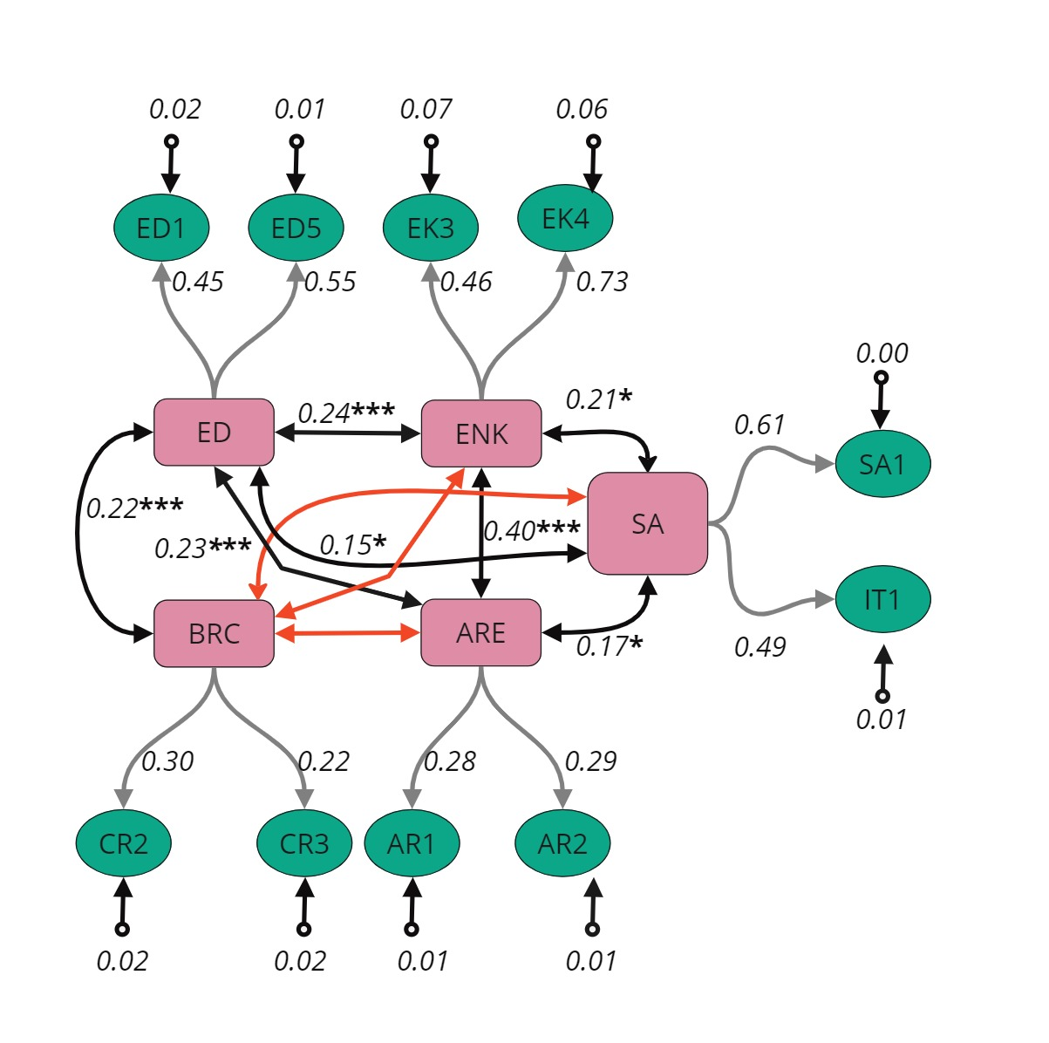
Confirmatory Factor for Kano and Bamako
RESULTS
ED = Energy demand
ENK = Environmental knowledge
SA = Social acceptance
ARE = Beliefs about the advantage of renewable energy
BRC = Beliefs about Renewable Energy Cost
25
Confirmatory Factor Analysis for the pooling (Kano∩Bamako)

Slide 26
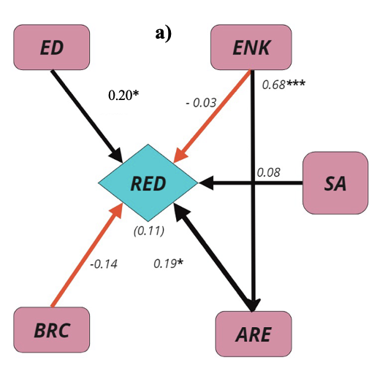
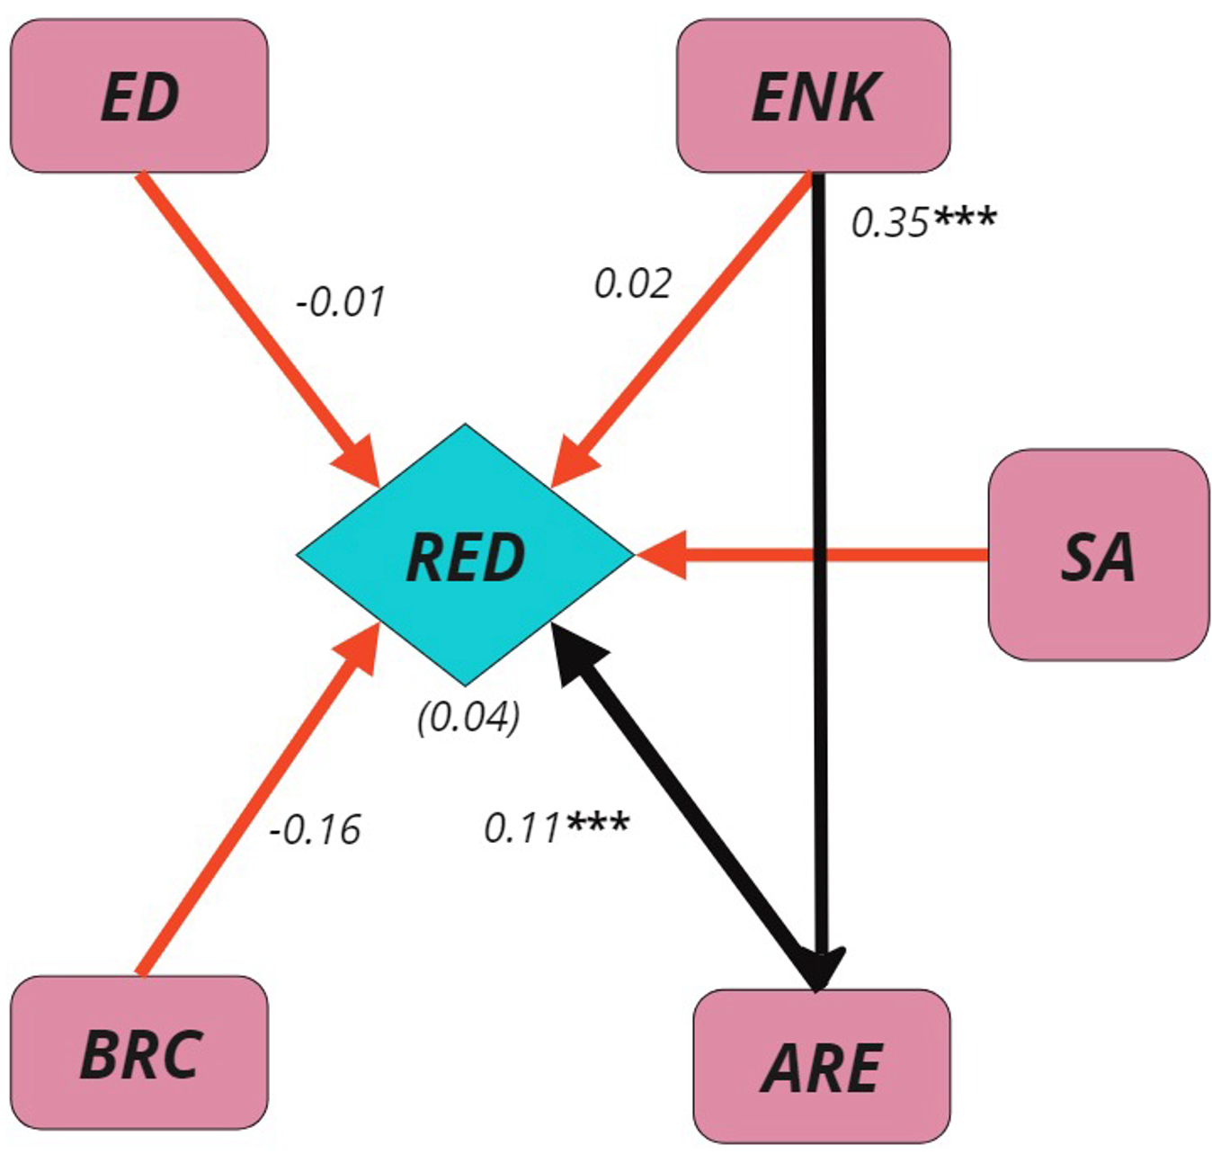
SEM for Kano and Bamako
RESULTS
b)
ED = Energy demand
ENK = Environmental knowledge
SA = Social acceptance
ARE = Beliefs about the advantage of renewable energy
BRC = Beliefs about Renewable Energy Cost
RED = Renewable energy development
SEM for Kano
SEM for Bamako
26

Slide 27
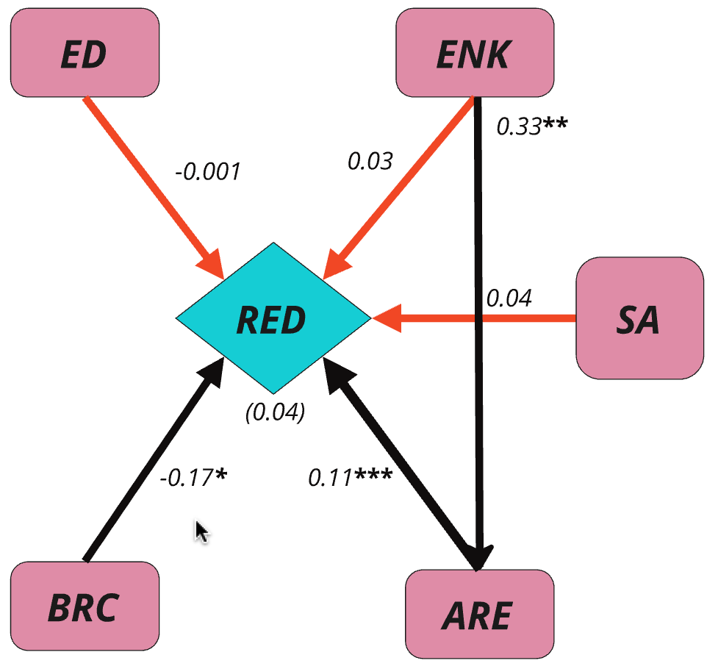
SEM for Kano and Bamako
RESULTS
ED = Energy demand
ENK = Environmental knowledge
SA = Social acceptance
ARE = Beliefs about the advantage of renewable energy
BRC = Beliefs about Renewable Energy Cost
RED = Renewable energy development
27
SEM for the pooling data (Kano∩Bamako)

Slide 28
Kano shows an increasing CDD trend (+1.73 °C-day/year), while Bamako shows a significant decrease (–3.80 °C-day/year).
Beliefs about renewable energy benefits drove its development in Bamako, while energy demand, social acceptance, and perceived advantages influenced its growth in Kano.
Kano showed a positive but statistically insignificant heat index trend, while Bamako exhibited a positive trend with an annual change of -0.06°C.
The built-up area rapidly increased from 66.88 to 242.53 km² with an annual growth rate of 8.47% in Kano and from 50.49 to 157.88 km² with an annual variation of 6.86% in Bamako.
Kano has limited solar farm potential (33.63%), mainly in Kumbotso and Ungogo, while Bamako offers broader suitability (75.85%), especially in Municipality VI.
CONCLUSION
28

Slide 29




ACKNOWLEDGEMENTS
29

Slide 30
THANK YOU
FOR YOUR ATTENTION

