Slide 1



Federal University of Technology, Minna, Nigeria
WASCAL Climate Change and Human Habitat
External Defense
DYNAMICS OF GREEN SPACES AND THEIR IMPACTS ON URBAN ECOSYSTEM SERVICES IN DAKAR REGION (SENEGAL) IN A CLIMATE CHANGE CONTEXT
Supervisory team:
Prof. Oluwole Morenikeji
Prof. Awa Niang Fall
Prof. Elke Mertens
Presented by:
Mariama Cissé

Slide 2
Introduction
Literature Review
Methodology
Results and Discussion
Conclusion and Recommendations
Outline

Slide 3
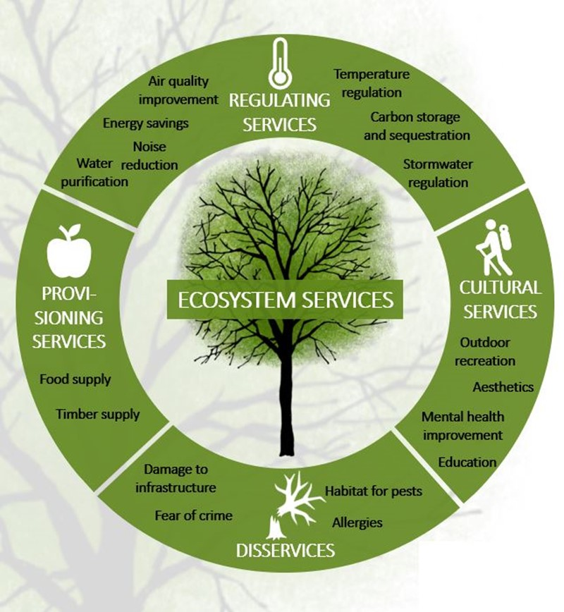
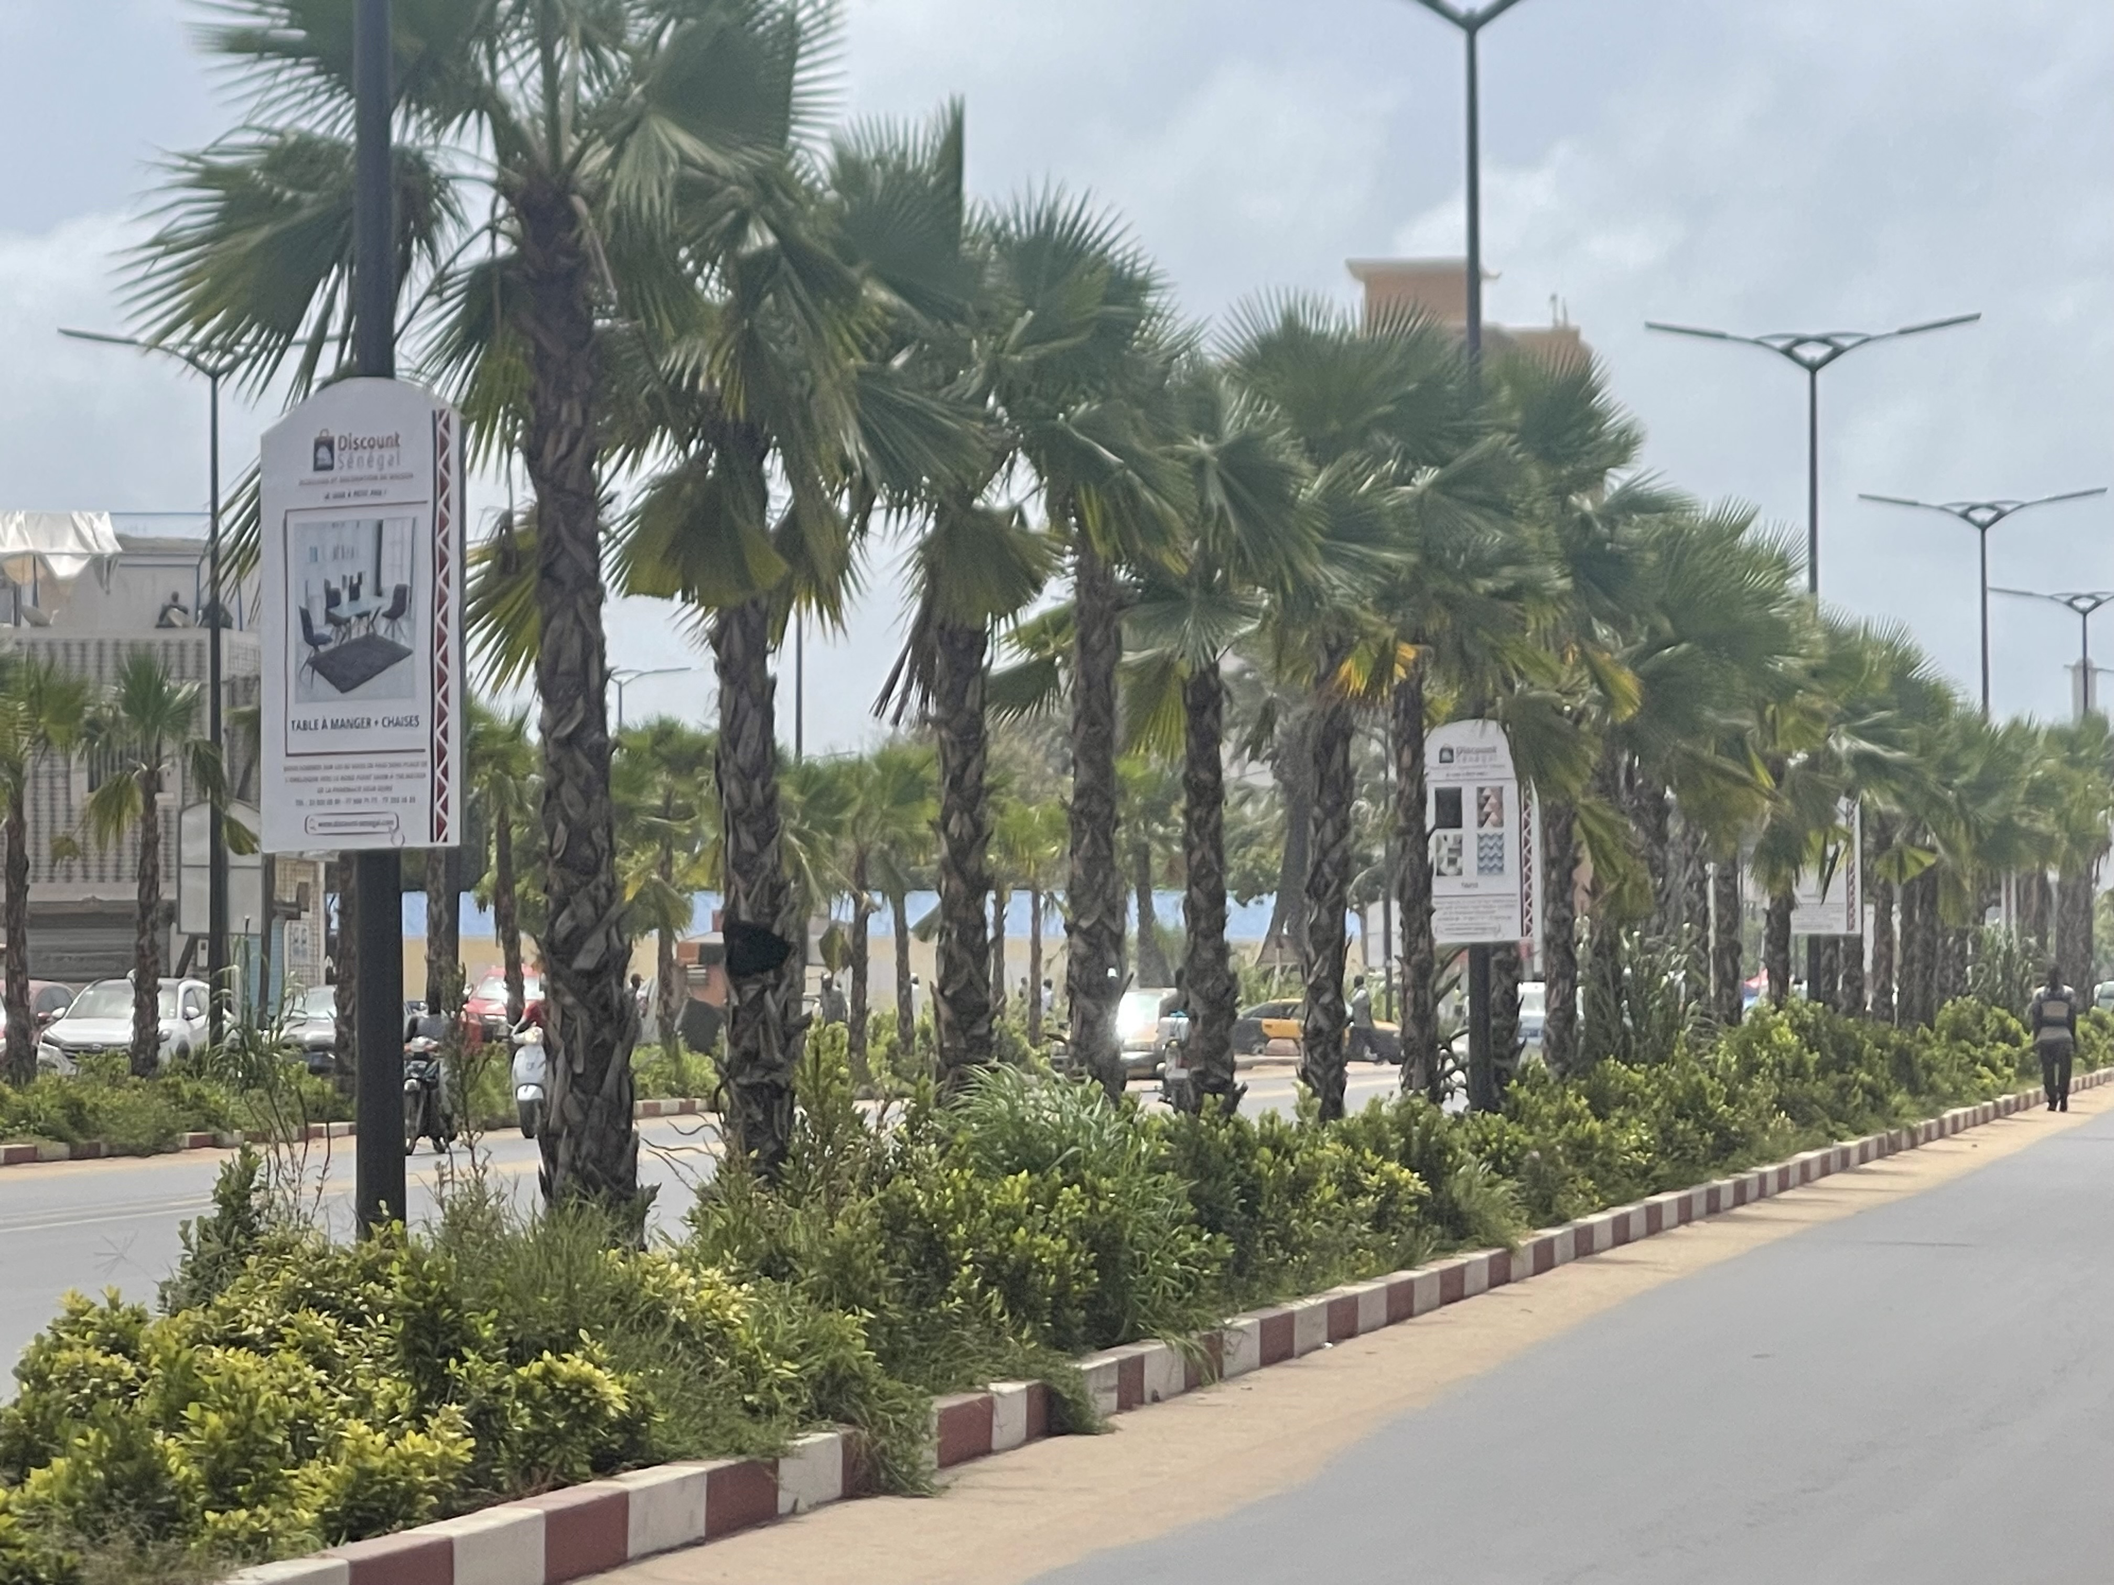
Introduction
Literature Review
Methodology
Results and Discussion
Conclusion and Recommendations
Urban green spaces (UGS) are and remain essential components of the urban landscape and are vital for maintaining the resilience and sustainability of cities (Yu et al., 2018; Sangwan et al., 2022).
UGS provide a wide range of benefits known as ecosystem services that contribute to the quality of life by combatting many urban ills (Bush et al., 2021; Hurlimann et al., 2021).
“In every walk with nature, one receives far more than he seeks” John Muir
Source: www.nina.no

Slide 4
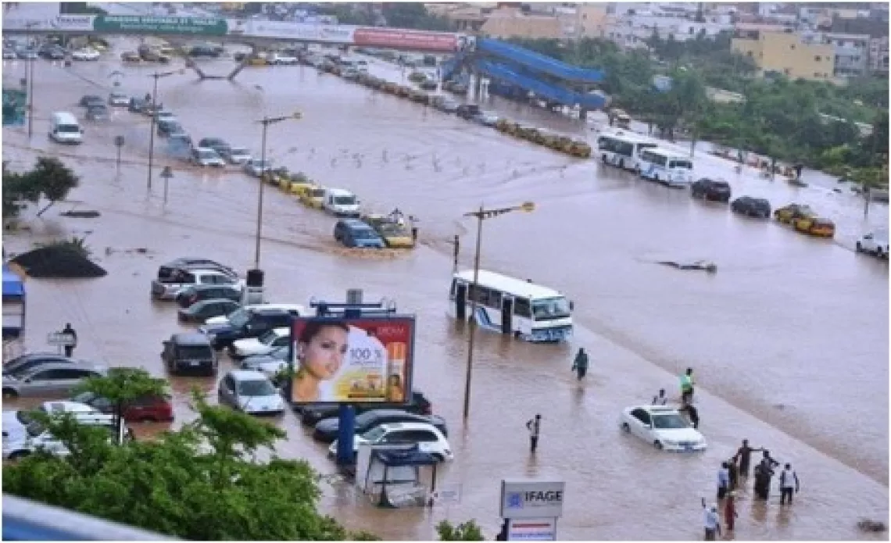
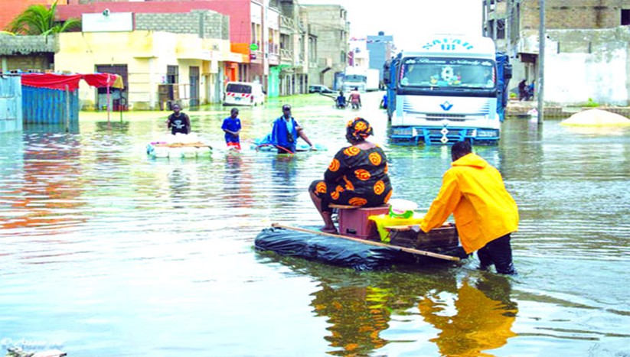
Introduction
Literature Review
Methodology
Results and Discussion
Conclusion and Recommendations
UGS are being lost rapidly in urban areas with their services because of the overpopulation of cities (Mensah, 2014b; Ramaiah & Avtar, 2019).
In Africa, particularly in Senegal, Dakar is experiencing rapid and unplanned urbanisation with an urbanisation rate of 97.2% and is home to more than 20% of the country’s population (Regional Service of Statistics and Demography of Dakar, 2021).
This has led to a continuous decline in green spaces, resulting in them occupying only a small fraction of available space (Mensah, 2014).
While, the region faces increasingly severe climate impacts, including more frequent extreme events.
Source: UNICEF Senegal
Source: Le Quotidien

Slide 5
Introduction
Literature Review
Methodology
Results and Discussion
Conclusion and Recommendations
Evaluate the effects of public green space dynamics on the urban ecosystem services in the Dakar region, taking into account the context of climate change.
OS1: Identify, and classify the types of public green spaces in the Dakar region, and analyse their characteristics, including diversity, spatial distribution, density, coverage rate, ratio per inhabitant, and quality.
OS2: Analyse the spatial and temporal dynamics of public green spaces in the Dakar region from 1990 to 2022, and identify the factors contributing to their degradation.
OS3: Assess the impacts of the dynamics of public green spaces on the urban ecosystem services in the Dakar region, particularly their effects on climate regulation.
OS4: Determine suitable locations for future public green spaces in the Dakar region that consider ecosystem services and enhance access for underserved communities.

Slide 6
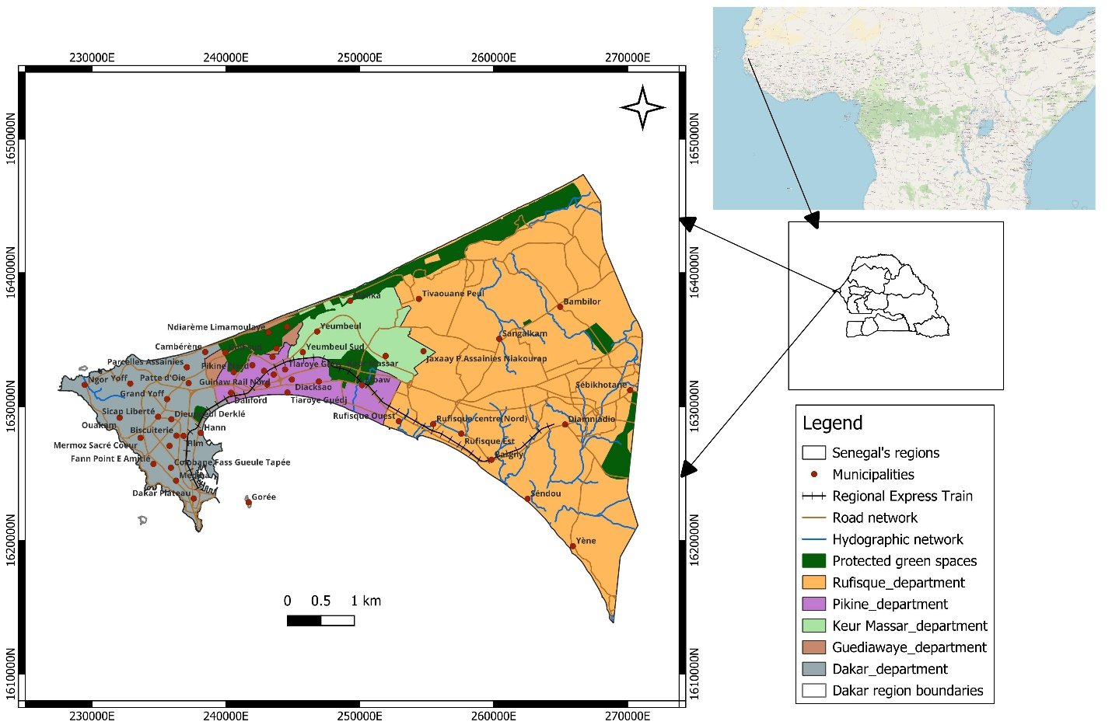
Introduction
Literature Review
Methodology
Results and Discussion
Conclusion and Recommendations
Longitudes: 17°10 and 17°32 West and
Latitudes: 14°53 and 14°35 North.
Area: 550 km²
Temperatures: 17° C to 25° C (December to April) and 27° C to 30° C (May to November)
Rainfall: Average of 161.51 mm
Population: 4 157 756 inhabitants
Figure 1.1: Presentation of the study area

Slide 7
Introduction
Literature Review
Methodology
Results and Discussion
Conclusion and Recommendations
Justification of the study
Emphasises the development of green areas as a vital component for achieving the Sustainable Development Goals, particularly SDG 11, which focuses on inclusivity, safety, resilience, and sustainability.
Provides a database that serves as a key resource for creating and implementing a strong policy to manage green spaces both in the capital and nationwide.
Contributes to addressing the challenge of limited scientific data in Senegal, particularly regarding urban green spaces.

Slide 8
Introduction
Literature Review
Methodology
Results and Discussion
Conclusion and Recommendations
Urban green spaces and their ecosystem services
Climate change mitigation services through carbon sequestration (Demuzere et al., 2014); Nero et al., 2017; Gomgnimbou et al., 2019)
Climate change adaptation services through cooling effect, flood risk reduction (Mees and Driessen, 2011; Mathey et al., 2011; Capriolo et al., 2020); Kadaverugu et al., 2021)
Urban green space planning
(Abebe and Megento, 2017; Gelan, 2021; Semeraro et al., 2021)
Gap
Lack of sufficient research that focuses on the relationship between urban green space changes and their ecosystem services to guide stakeholders and decision-makers on their preservation and conservation, mainly in Africa, where few studies have been done.
Changing in urban green spaces
Urbanisation, as the primary cause (Vasenev et al., 2019; Theodorou, 2022; Xiao et al., 2022)
Climatic causes through extreme events such as floods and droughts (Ma et al., 2015; Zhai et al., 2024)

Slide 9
Introduction
Literature Review
Methodology
Results and Discussion
Conclusion and Recommendations
Data collection
Itinerant inventory
Semi-structured interview with interview guide
Surveys by questionnaire
Public green spaces based on an established list
Direction of Urban Landscapes and Public Spaces
Direction of the Forest and Zoological Park of Hann
Forestry Sector of Pikine and Guediawaye
Direction of the Natural Urban Reserve of Great Niaye and Dependence
Neighbourhood delegates

Slide 10
Introduction
Literature Review
Methodology
Results and Discussion
Conclusion and Recommendations
Data analysis
OS1a: Typology and classification of public green spaces in the Dakar region
1. parks and squares
2. green spaces accompanying roads;
3. green spaces accompanying public buildings (with the role of enhancing the buildings);
4. green spaces accompanying industrial and commercial establishments;
5. green areas surrounding social and educational establishments (nursery gardens, retirement homes, etc.);
6. green spaces in stadiums and sports centres;
7. cemeteries;
8. campsites, reception areas, holiday villages;
9. allotment gardens
10. horticultural establishments (municipal greenhouses, horticultural colleges, etc.);
11. landscaped natural areas;
12. roadside trees, grouped or not.
Association of French Cities Engineers (AIVF) (Amontcha et al., 2017)
Swanwick et al. (2003)
1. Amenity green spaces;
2. functional green spaces;
3. semi-natural habitats;
4. linear green spaces.

Slide 11
Introduction
Literature Review
Methodology
Results and Discussion
Conclusion and Recommendations
OS1b: Characterisation of public green spaces in the Dakar region
Gini coefficient
Lorenz curve
Spatial distribution of public green spaces
$$D=\frac{N}{S}$$
D=𝑁/S
Density of public green spaces
$CR=\frac{s}{S}$ * 100
CR=𝑠/S * 100
Rate of coverage of public green spaces
$$RGS=\frac{S}{PS}$$
𝑅𝐺𝑆=𝑆/𝑃𝑆
Ratio green spaces per inhabitant
$$NDVI=\frac{NIR−R}{NIR+R}$$
𝑁𝐷𝑉𝐼=(𝑁𝐼𝑅−𝑅)/(𝑁𝐼𝑅+𝑅)
Quality of public green spaces using NDVI
Shannon and Pielou’s Evenness
Diversity of public green spaces

Slide 12
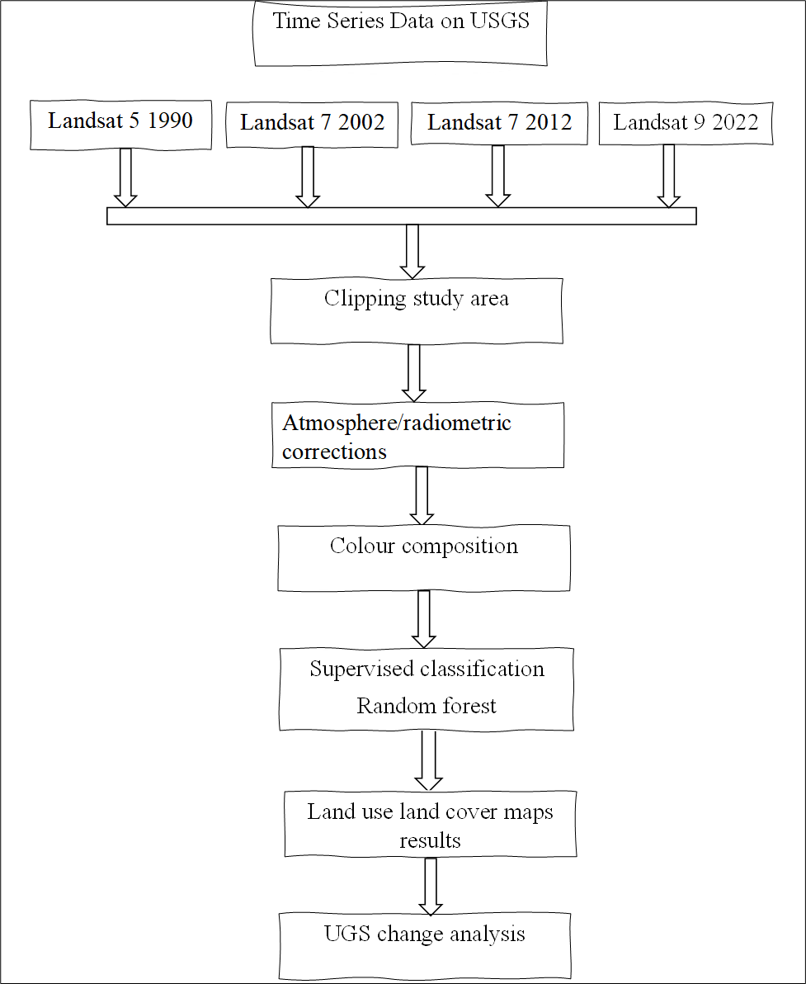
Introduction
Literature Review
Methodology
Results and Discussion
Conclusion and Recommendations
OS2: Spatio-temporal dynamics of public green spaces 1990-2022 and the factors of their degradation
Factors of degradation
Descriptive analysis
Content analysis through word cloud
Figure 3.1: Flowchart of processing Landsat data

Slide 13
Introduction
Literature Review
Methodology
Results and Discussion
Conclusion and Recommendations
OS3: Impacts of green space dynamics on urban ecosystem services in the Dakar region
InVEST Models
Carbon storage and sequestration
Urban flood risk mitigation
Urban cooling
Spearman rank model was employed to establish a correlation between the vegetation cover of the three green spaces and the three ecosystem services assessed.

Slide 14
Introduction
Literature Review
Methodology
Results and Discussion
Conclusion and Recommendations
OS4: Identification of suitable areas for future development of public green spaces in the Dakar region
MCA approach
Determination of criteria and sub-criteria
Standardisation and mapping criteria
Calculating the weight of the criteria (AHP)
Weighted overlay

Slide 15
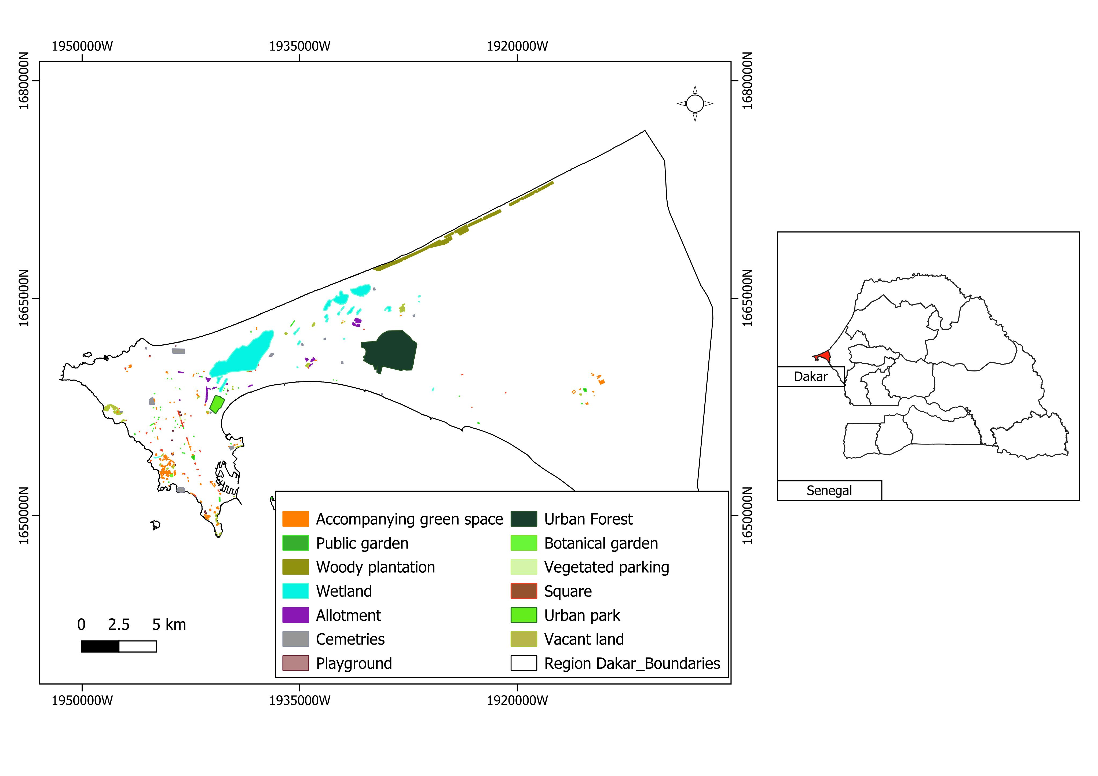
Introduction
Literature Review
Methodology
Results and Discussion
Conclusion and Recommendations
1. Typology and characteristics of public green spaces in the region of Dakar
Typology of public green spaces in the region of Dakar
This result differs from that found by Tine et al. (2021) in the same area who did not include public gardens and parks in their identification.
The findings of this study align with those discovered in Benin, exhibiting relatively similar types of PGS with a smaller number (Amontcha et al., 2017).
Figure 4.1. Typology map of public green spaces of the region of Dakar

Slide 16
Introduction
Literature Review
Methodology
Results and Discussion
Conclusion and Recommendations
Characteristics of public green spaces in the Dakar region
Moderate level of diversity in the types of public green spaces with Shannon index and Pielou’s Evenness index equal to 1.44 and 0.56 respectively.
Uneven spatial repartition of public green spaces, with a Gini coefficient of 0.59, which is more or less close to 1.
Density of public green spaces in the Dakar region is 2 green spaces per square kilometre.
Coverage rate of public green spaces is estimated at 3.6 % of the total area of the region of Dakar.
Ratio is 4.69 m² of public green space per inhabitant in the region of Dakar
Low quality of public green spaces with NDVI values being between 0.18 and 0.61.

Slide 17
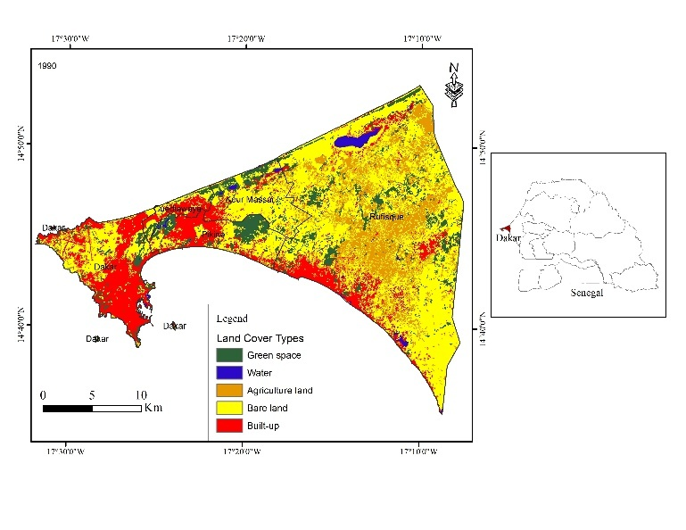
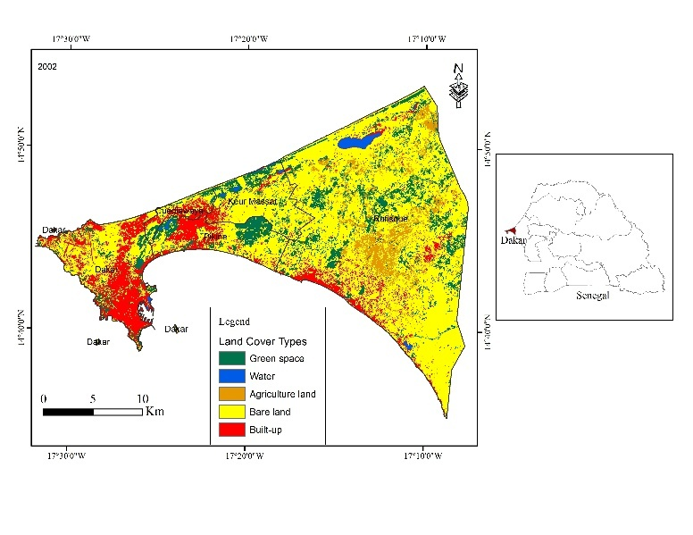
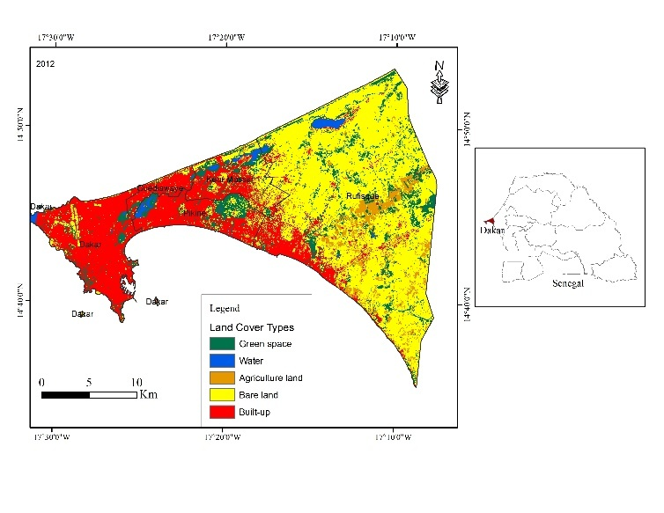
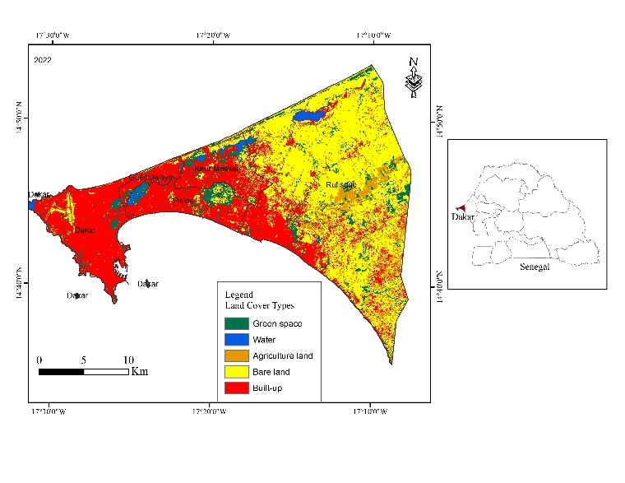
Introduction
Literature Review
Methodology
Results and Discussion
Conclusion and Recommendations
2. Spatio-temporal dynamics of green spaces in the Dakar region and the factors drivers of their degradation
Global land use and land cover of the region of Dakar from 1990 to 2022
This trend has been observed in several cities. For instance, in Zimbabwe, Matsa et al. (2021) have shown that the built-up area increased considerably in less than 20 years.
Figure 4.10: Land cover map of the Dakar region from 1990 to 2022

Slide 18
Introduction
Literature Review
Methodology
Results and Discussion
Conclusion and Recommendations
Global land use and land cover of the region of Dakar from 1990 to 2022
Table 4.2: Land cover of the Dakar region from 1990 to 2022
Land cover types | 1990 |  | 2002 |  | 2012 |  | 2022
 | ha | % | ha | % | ha | % | ha | %
Green space | 7 242.84 | 13.36 | 4 269.6 | 7.88 | 6 794.37 | 12.54 | 5 170.59 | 9.54
Water | 931.32 | 1.72 | 528.03 | 0.97 | 855.72 | 1.58 | 853.02 | 1.57
Agriculture land | 10 486.35 | 19.35 | 8 232.93 | 15.19 | 2 894.85 | 5.34 | 2 324.61 | 4.29
Bare land | 25 116.39 | 46.34 | 28 325.34 | 52.26 | 27 864.9 | 51.41 | 24 541.92 | 45.28
Built-up | 10 424.52 | 19.23 | 12 845.52 | 23.7 | 15 791.58 | 29.13 | 21 311.28 | 39.32
Total | 54 201.42 | 100 | 54 201.42 | 100 | 54 201.42 | 100 | 54 201.42 | 100

Slide 19
Introduction
Literature Review
Methodology
Results and Discussion
Conclusion and Recommendations
Land use and land cover changes of three major public green spaces of the Dakar region
Figure 4.11: Land cover of Hann Forest and Zoological Park (a), Mbao Classified Forest (b) and Natural Urban Reserve of Great Niayes and Dependence (c) from 1990 to 2022
Figure 4.13: Vegetation gain and loss in Dakar's three major green lungs in percentage

Slide 20
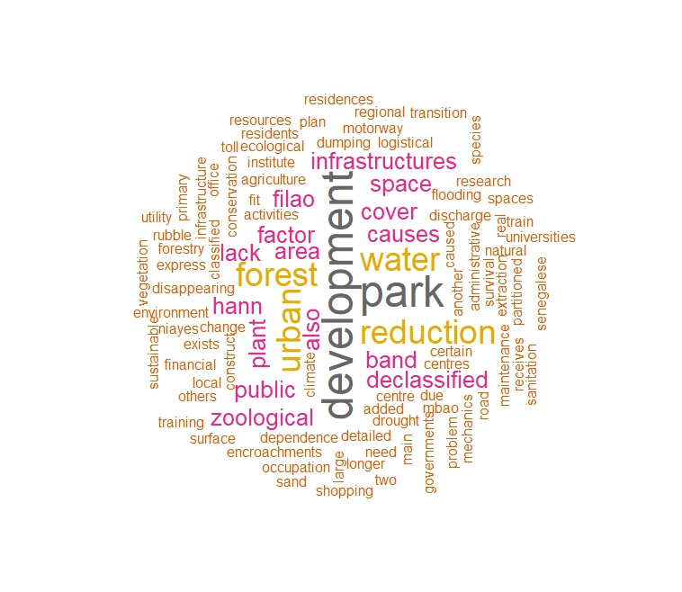
Introduction
Literature Review
Methodology
Results and Discussion
Conclusion and Recommendations
Drivers of degradation of public green spaces in the Dakar region
Figure 4.14: Causes of the degradation of public green spaces in the Dakar region
Figure 4.15: Nature of public green spaces degradation causes
Figure 4.16: Word cloud on the causes of degradation of public green spaces in the Dakar region
This phenomenon has been observed in Shanghai, where rapid urbanisation has resulted in a significant decline in urban green spaces (Liu et al., 2021).

Slide 21
Introduction
Literature Review
Methodology
Results and Discussion
Conclusion and Recommendations
3. Impacts of green space’s dynamics on urban ecosystem services in the Dakar region
Changes in ecosystem services of the three major green spaces
HM_index
Figure 4.17: Evolution of carbon stocks, heat mitigation index and runoff retention capacity in the three major public green spaces in Dakar from 1990 to 2022

Slide 22
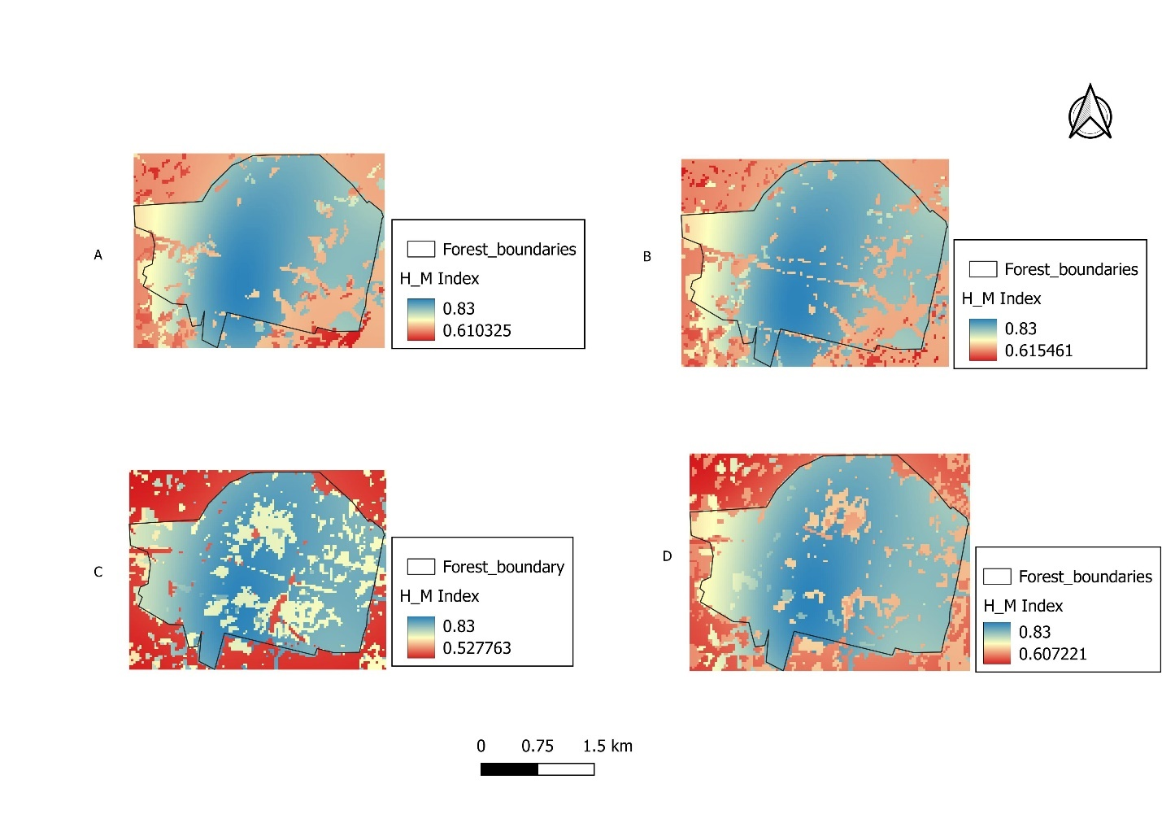
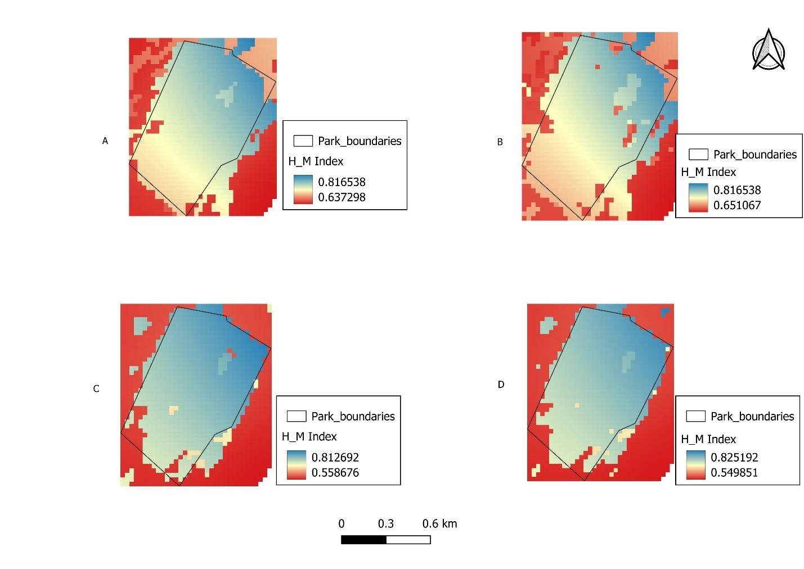
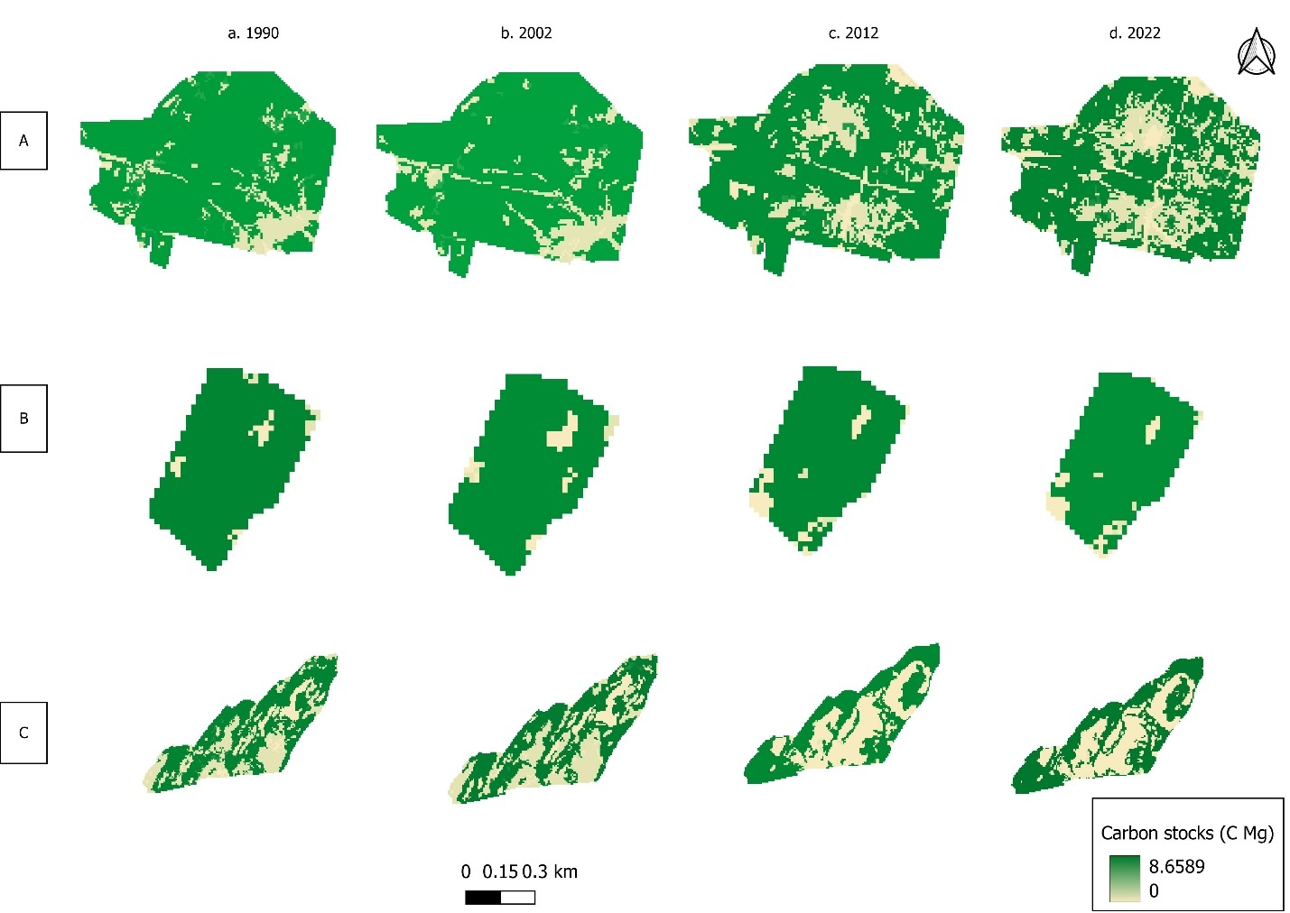
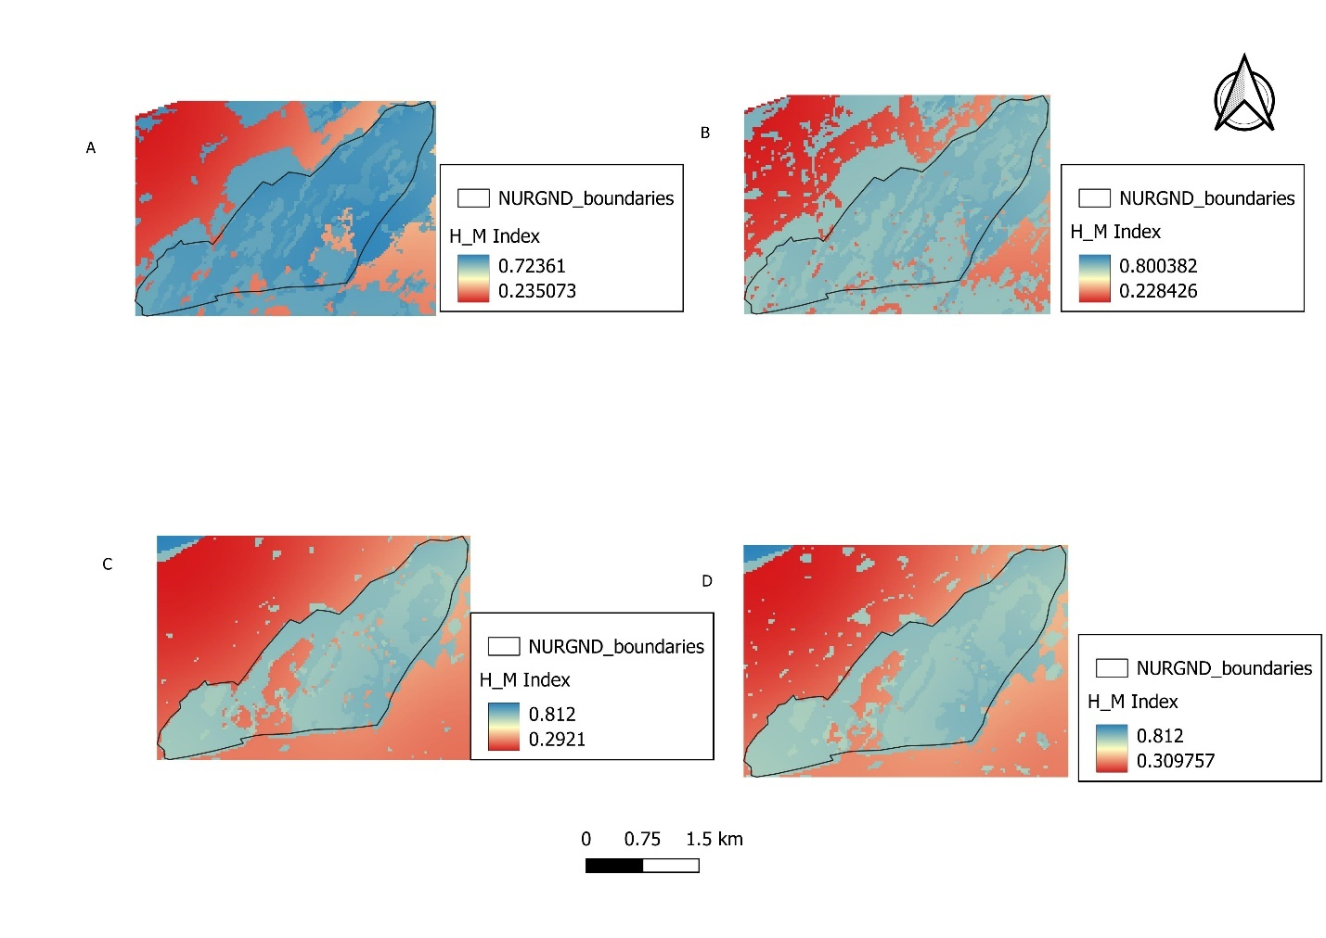
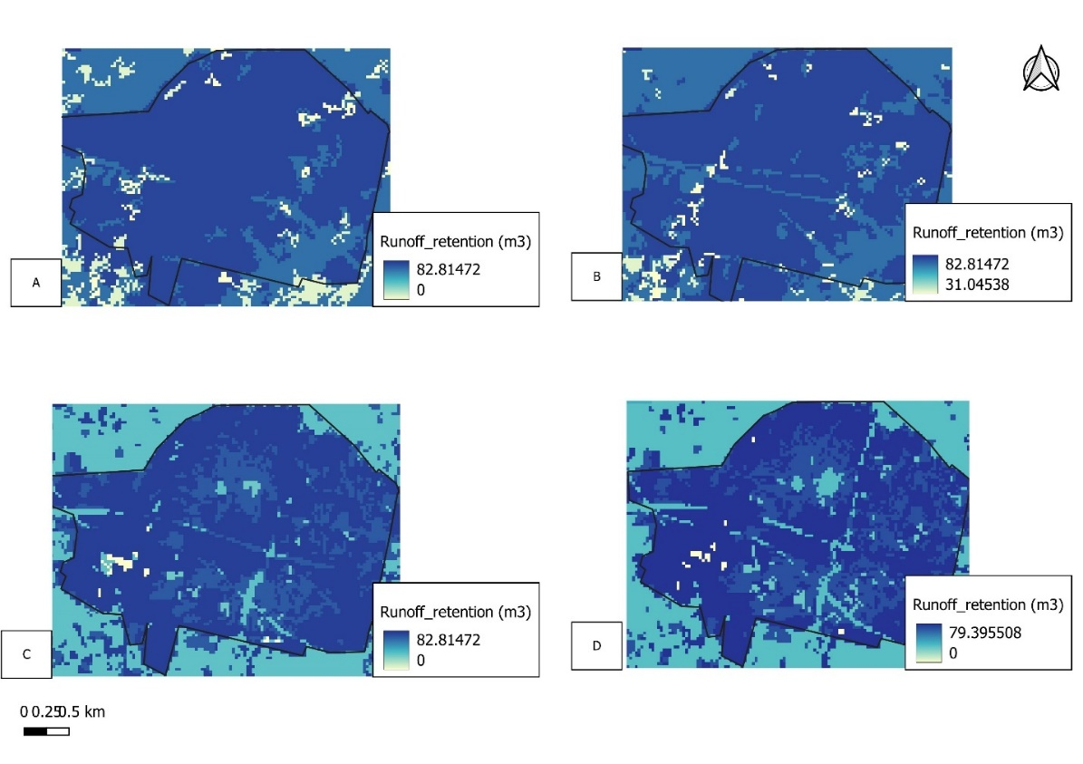
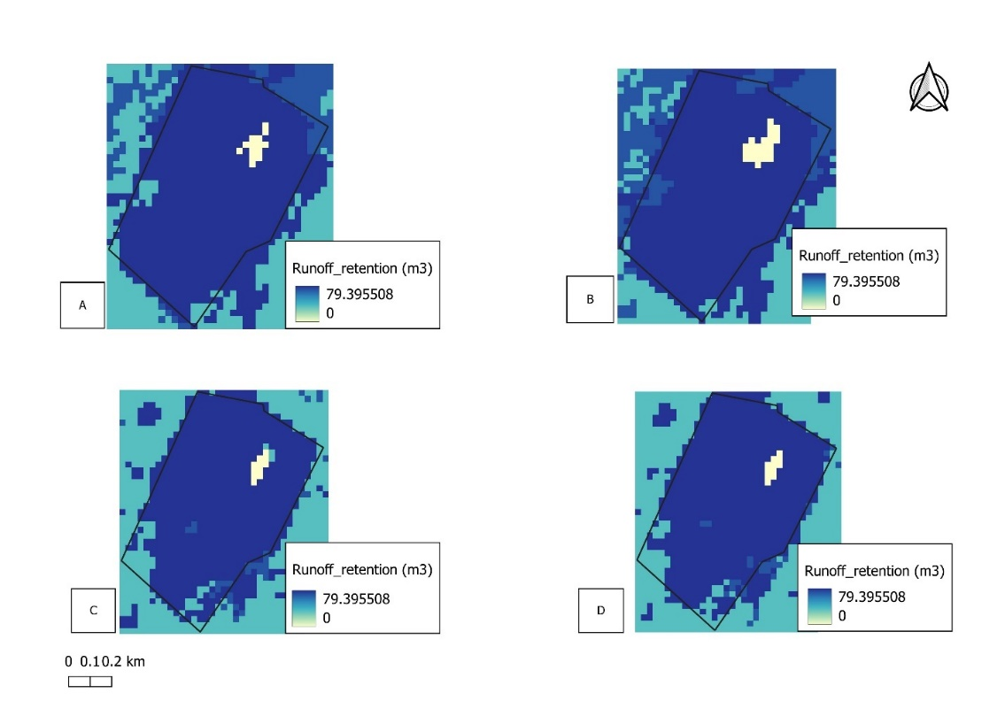
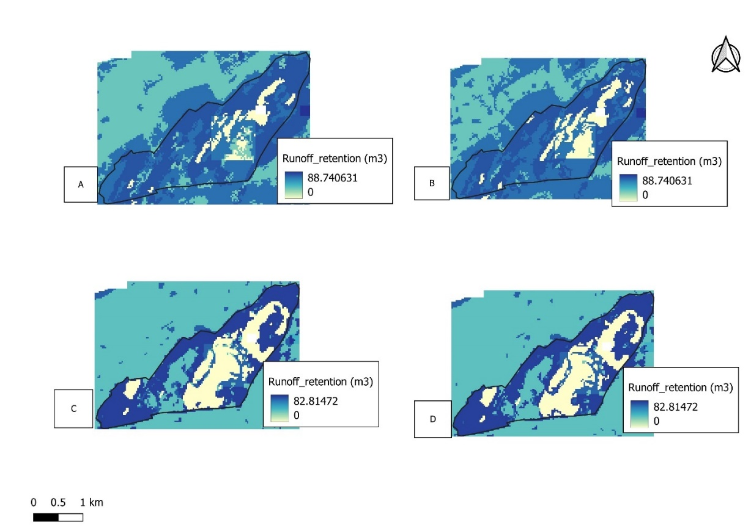
Introduction
Literature Review
Methodology
Results and Discussion
Conclusion and Recommendations
Changes in ecosystem services of the three major green spaces
Figure 4.19: Spatial distribution of the three ecosystem services in the three major public green spaces in Dakar from 1990 to 2022

Slide 23
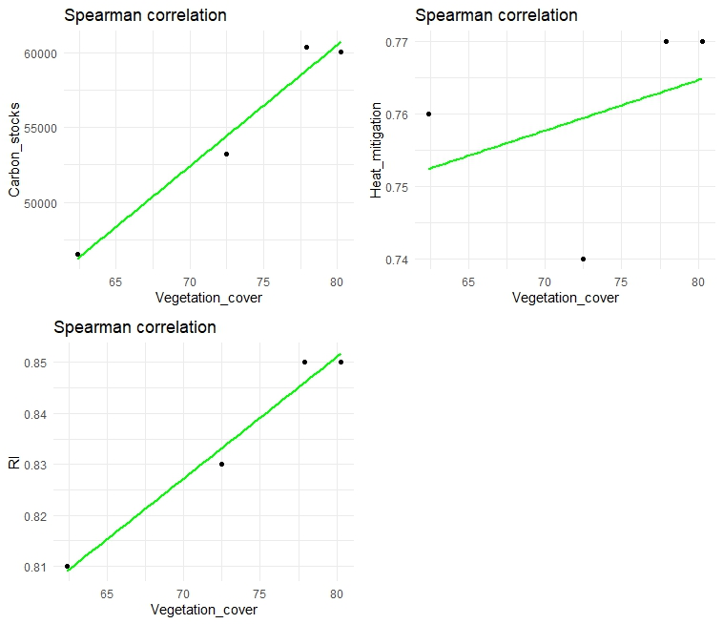
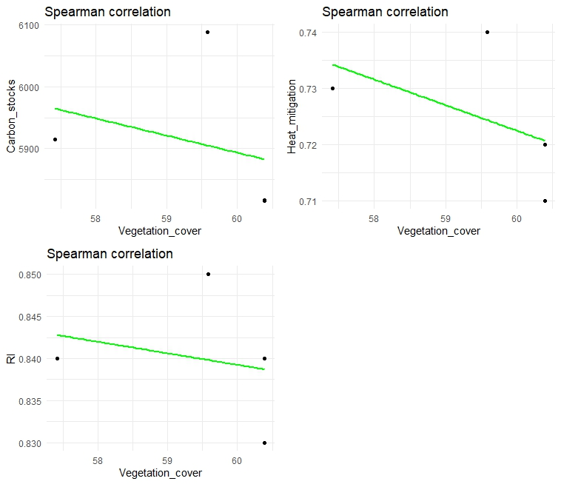
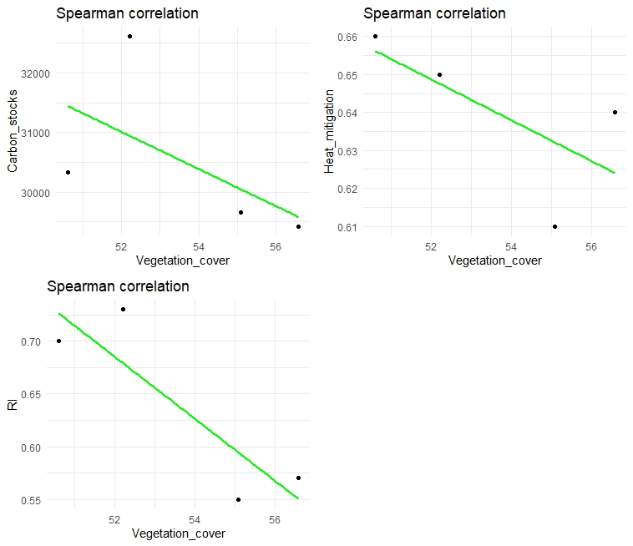
Introduction
Literature Review
Methodology
Results and Discussion
Conclusion and Recommendations
Relationship between the vegetation cover of the three green spaces and ecosystem services
p-value =0.33
p-value = 0.26
p-value = 0.26
p-value = 0.26
p-value = 0.33
p-value = 0.33
p-value = 0.05
p-value = 0.5
p-value = 0.42
A
B
C
Figure 4.24: Relationship between vegetation cover and ecosystem services in the MCF (A), HFZP (B), and NURGND (C)
Elsewhere, Essel (2017) and Okikiola and Akintunde-Alo (2020) in Kumasi (Ghana) and Nigeria have discovered that the rise in surface temperature is positively correlated with the decrease in green spaces.

Slide 24
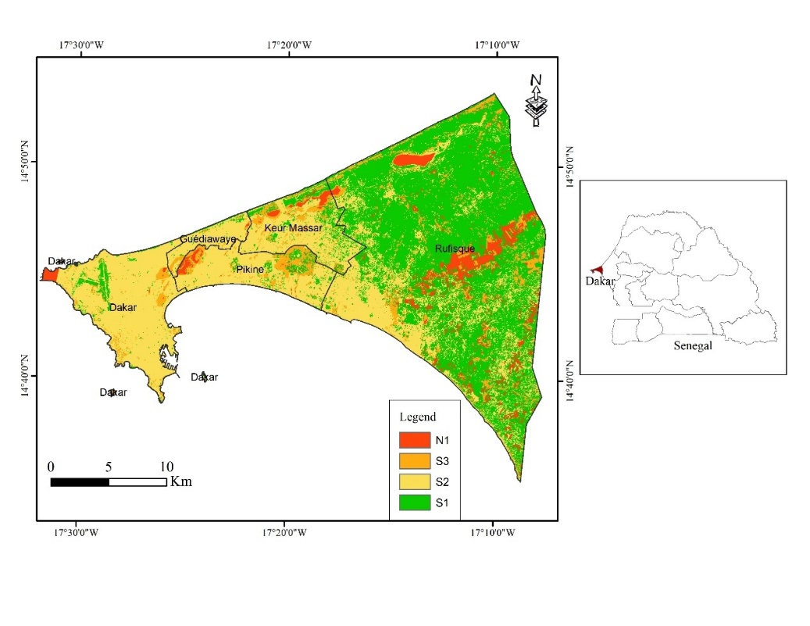
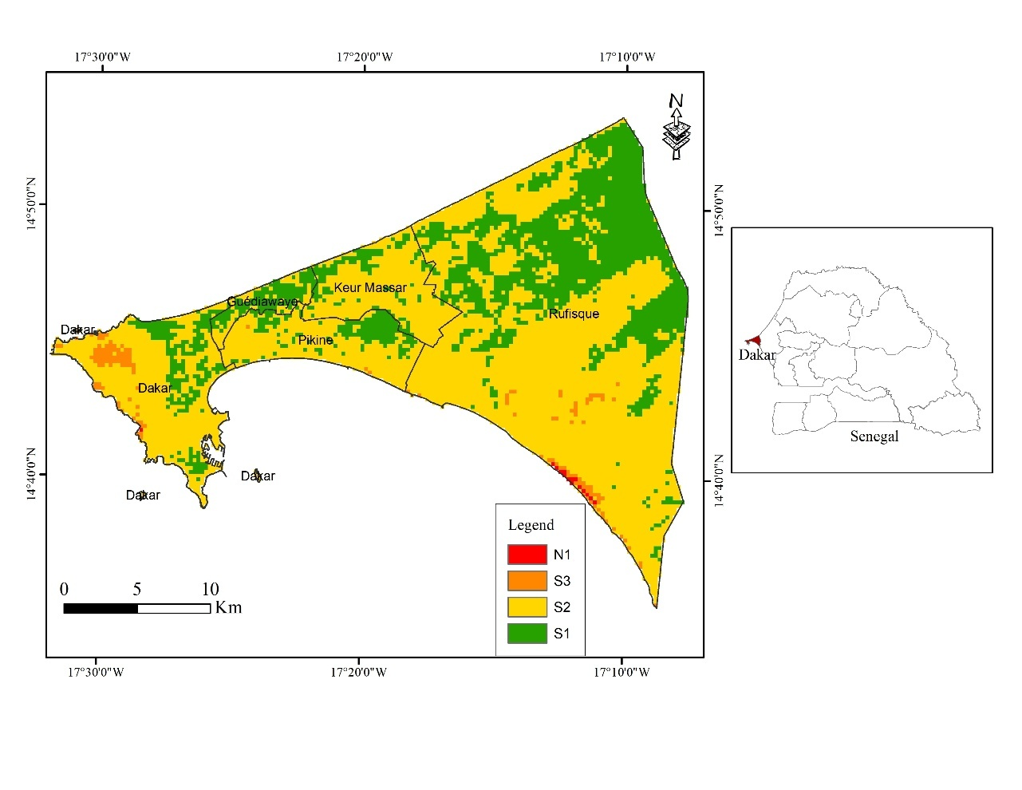
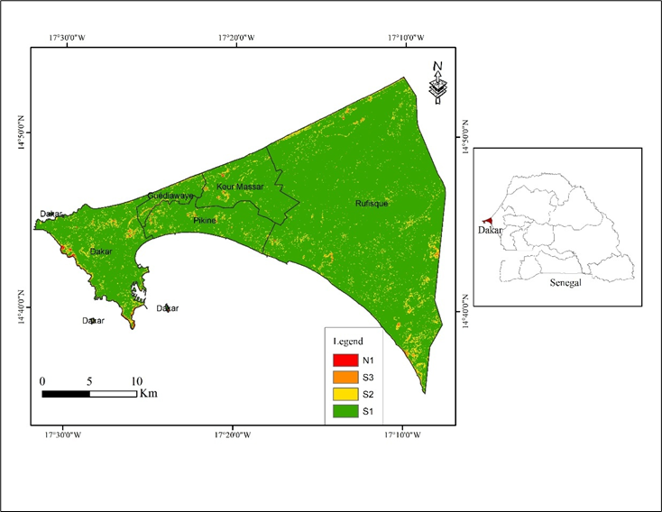
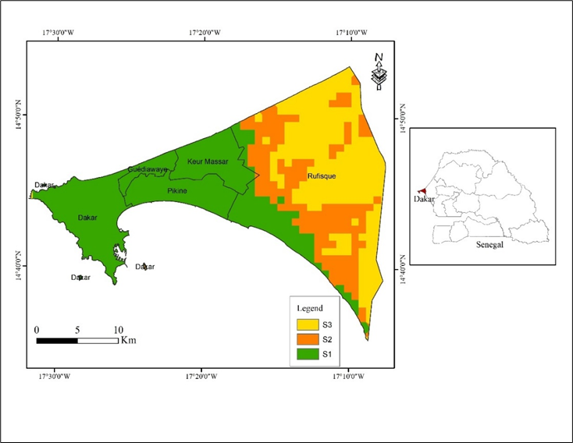
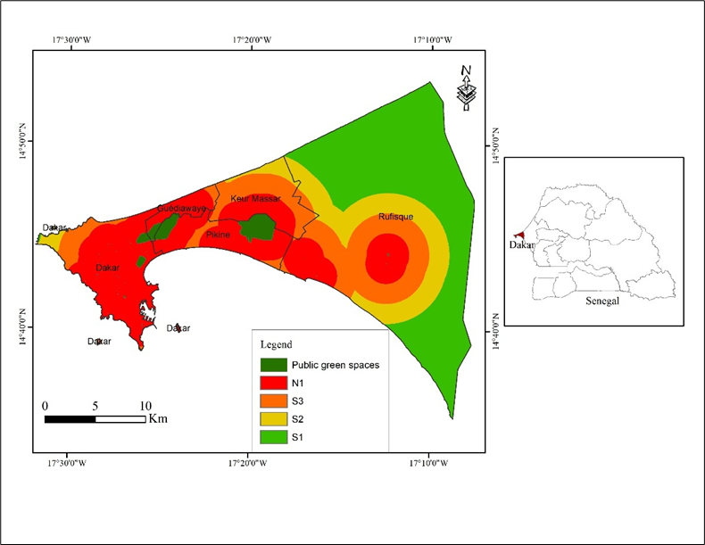
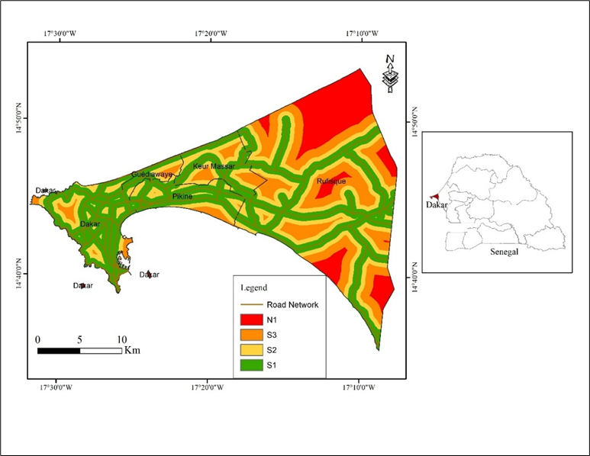
Introduction
Literature Review
Methodology
Results and Discussion
Conclusion and Recommendations
4. Land suitability analysis for future public green space development in the Dakar region
Suitability analysis of the criteria
LULC
Soil types
Slope
Population density
Proximity to existing green spaces
Proximity to roads

Slide 25
Introduction
Literature Review
Methodology
Results and Discussion
Conclusion and Recommendations
Weight of the criteria
Table 4.3: Computation of the weight of the criteria
Criteria | LULC | PD | PGS | ST | Sl | PR | Weight | λ | CI | RI | CR
LULC | 0.43 | 0.48 | 0.44 | 0.25 | 0.29 | 0.29 | 0.36 | 6.39 | 0.11 | 1.24 | 0.09
PD | 0.14 | 0.24 | 0.30 | 0.25 | 0.29 | 0.29 | 0.19 | 6.54
PGS | 0.14 | 0.12 | 0.15 | 0.20 | 0.23 | 0.29 | 0.25 | 6.49
ST | 0.09 | 0.05 | 0.04 | 0.05 | 0.03 | 0.02 | 0.05 | 6.04
Sl | 0.09 | 0.05 | 0.04 | 0.10 | 0.06 | 0.04 | 0.06 | 6.04
PR | 0.11 | 0.06 | 0.04 | 0.15 | 0.11 | 0.07 | 0.09 | 6.09
LULC= land use and land cover; PD= population density; PGS= proximity to green spaces; ST= soil types; Sl=slope; PR= proximity to roads; CI= consistency index; RI= random inconsistency; CR= consistency ratio

Slide 26
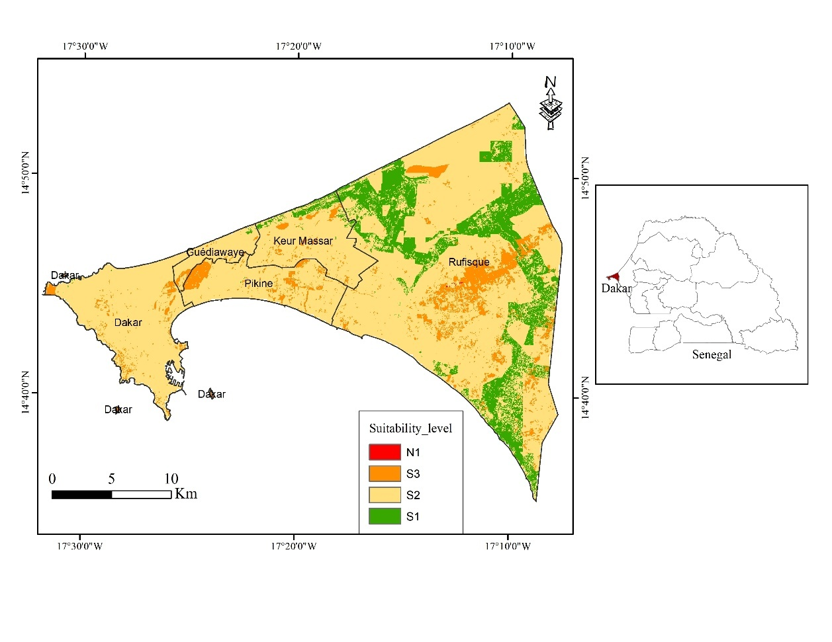
Introduction
Literature Review
Methodology
Results and Discussion
Conclusion and Recommendations
Overall suitability areas
Suitability level | value | Area (km²) | Percentage (%)
Highly suitable | 5 | 79.06 | 14.75
Moderately suitable | 4 | 407.70 | 76.08
Less suitable | 3 | 49.07 | 9.16
Not suitable | 2 | 0.08 | 0.02
Figure 4.31: Final suitability map of the Dakar region

Slide 27
Introduction
Literature Review
Methodology
Results and Discussion
Conclusion and Recommendations
Conclusion
Despite the moderate diversity in types, public green spaces in Dakar are of low density, limited spatial coverage, uneven distribution across the region, a low per capita green space ratio below international standards, and relatively low NDVI values indicating their low quality.
Over the years, green spaces have declined, accompanied by increased built-up areas.
Generally, the decrease in green spaces has negative impacts on the ecosystem services such as carbon sequestration, urban cooling, and flood risk mitigation.
The findings underscore the importance of increasing the quantity of public green spaces in the region by developing new ones in suitable locations to sustain urban ecosystem services.

Slide 28
Introduction
Literature Review
Methodology
Results and Discussion
Conclusion and Recommendations
Policy improvement
Reviewing urban planning policies, emphasising the integration of green spaces
Making spatial zoning
Performance improvement
Revising or develop management plans and include ecosystem services
Specialising green space types based on ecosystem services
Further research
Explore other ecosystem services that urban green spaces provide, taking into account private green spaces
Expand such studies to other cities experiencing significant urbanisation rates
Body of knowledge
Use the ecosystem services evaluation and urban green space planning tools, particularly in Africa, where these tools are not well known or widely used
Recommendations

Slide 29
“Cities are where the climate battle will be won or lost.” Ban Ki-Moon
Thank you for your attention

