Slide 1




External defense
WASCAL CC & HH
AHOUANDJINOU, Enagnon Benoit Olivier
PhD/SPS/FT/2021/13000
Supervisor:
Prof. Moses A. Olutoye
Supervisor 2:
Prof. Orou G. Gaoue
Supervisor 3:
Prof. Fabian E. Fassnacht

Slide 2
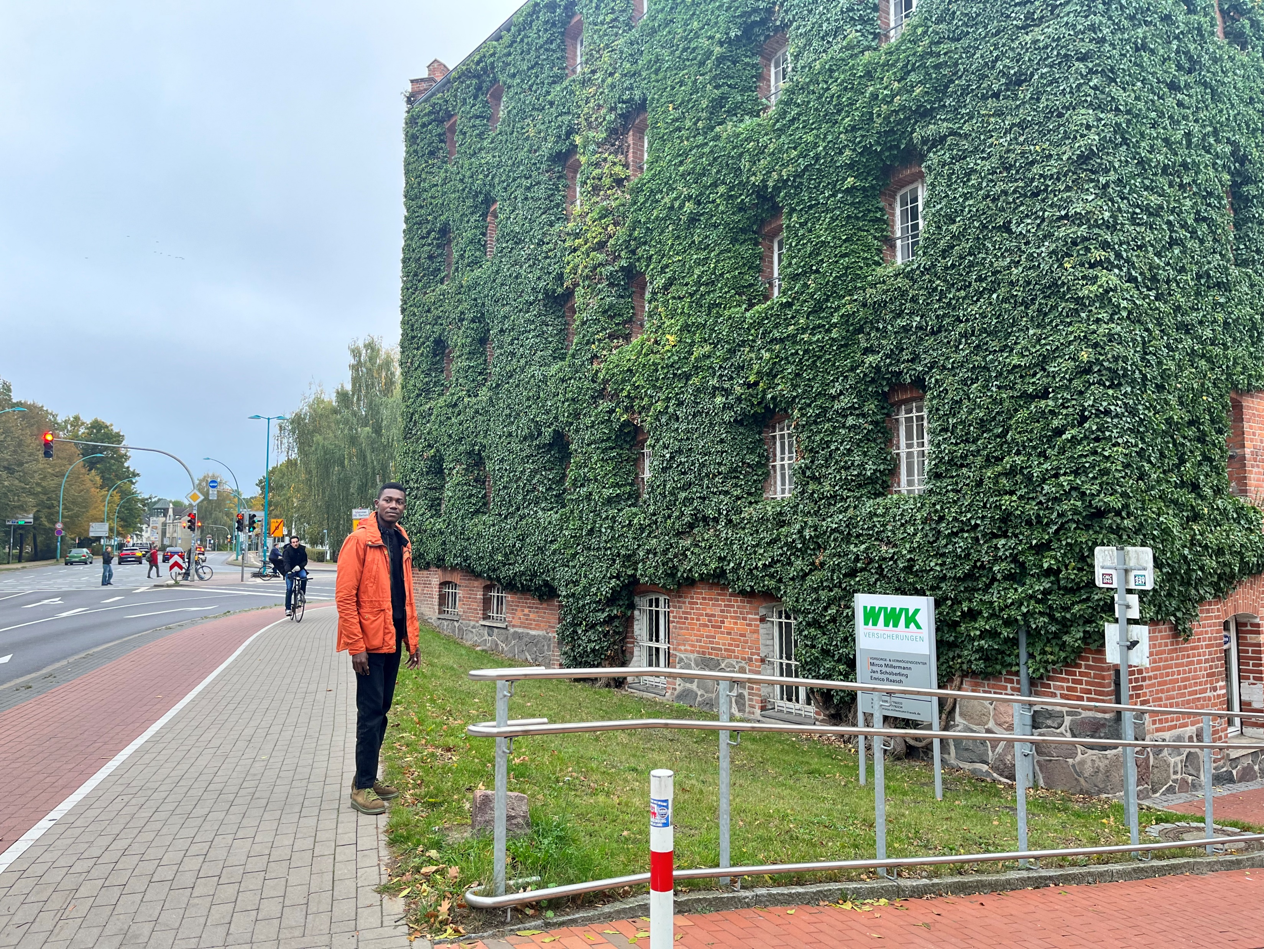

The role of urban plant phylogenetic diversity in mitigating urban heat island effects and promoting co₂ reduction in west African coastal and savannah cities
Olivier AHOUANDJINOU
olienagnon@st.futminna.edu.ng
www.wascal.org
Federal University of Technology Minna
Climate Change & Human Habitat

Slide 3
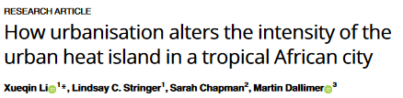
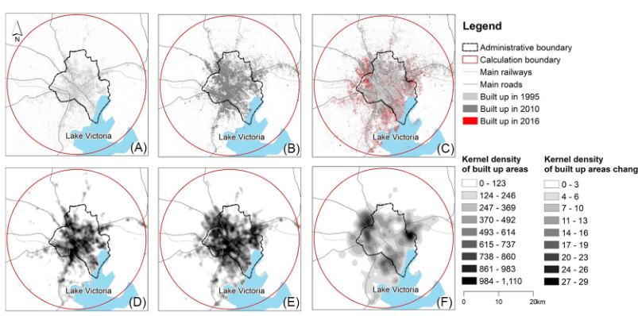
https://doi.org/10.1371/journal.pone.0254371.g003

Slide 4

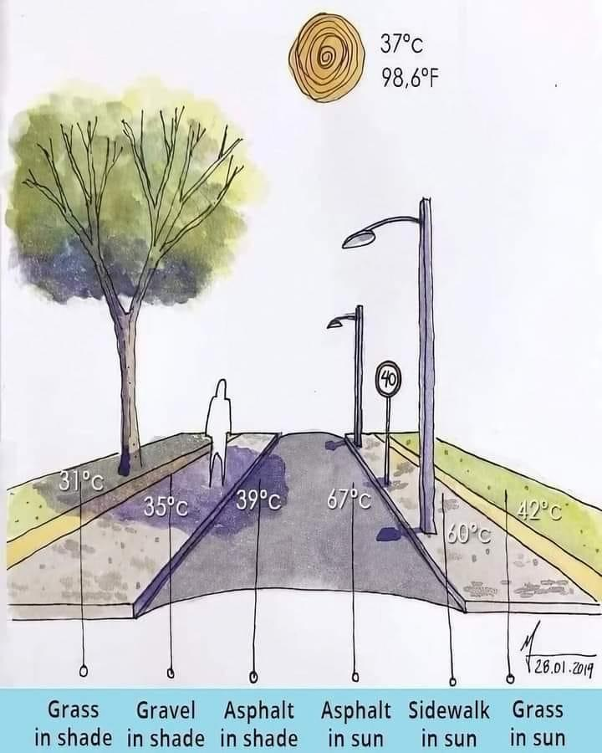
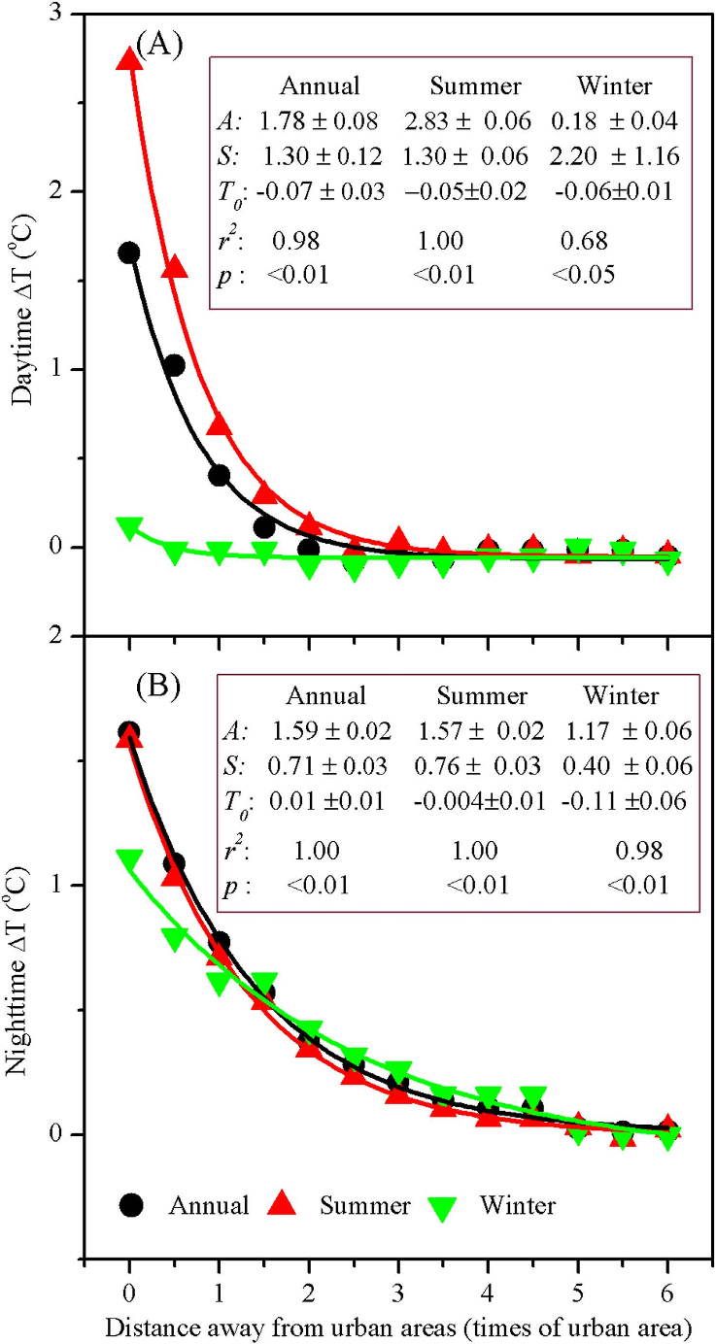
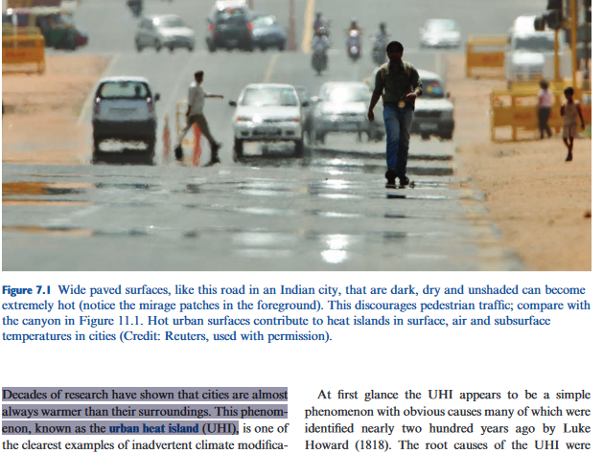

Slide 5
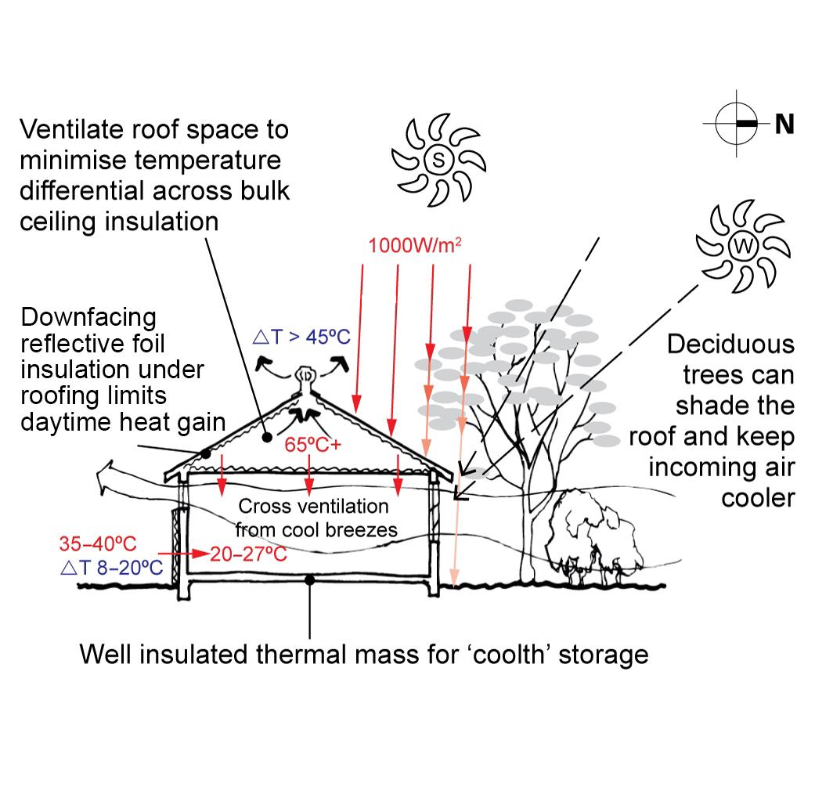
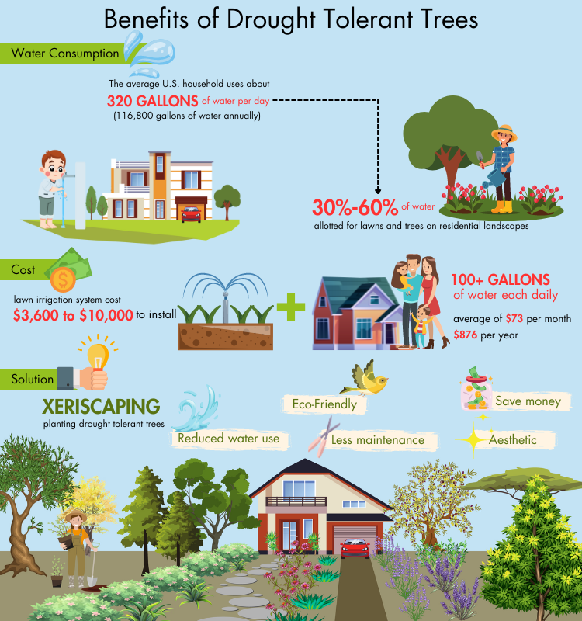
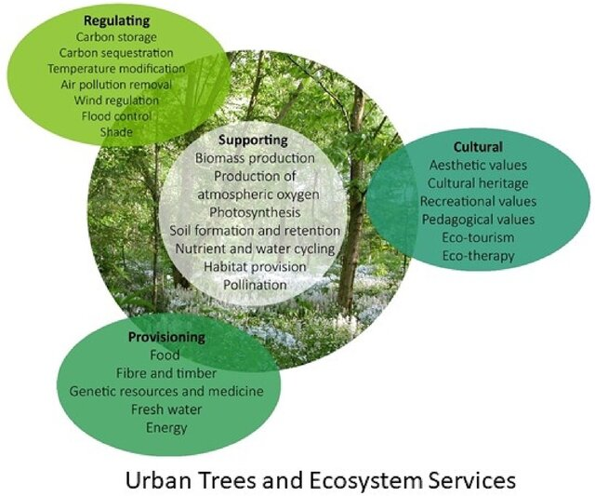
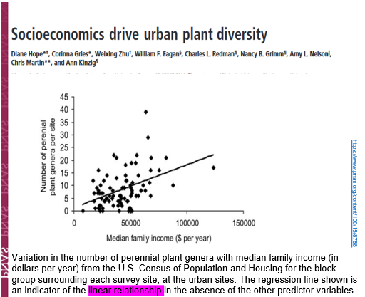
Strategic Tree Planting
https://8billiontrees.com/gardening/drought-tolerant-trees/
10.1002/ppp3.10518

Slide 6
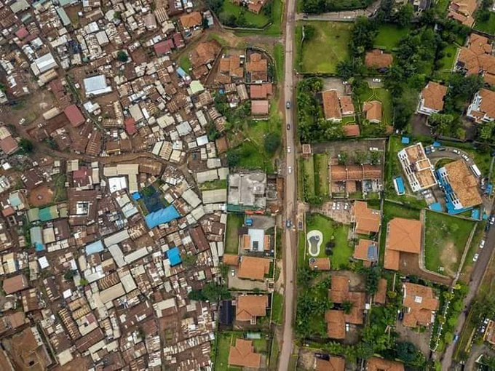
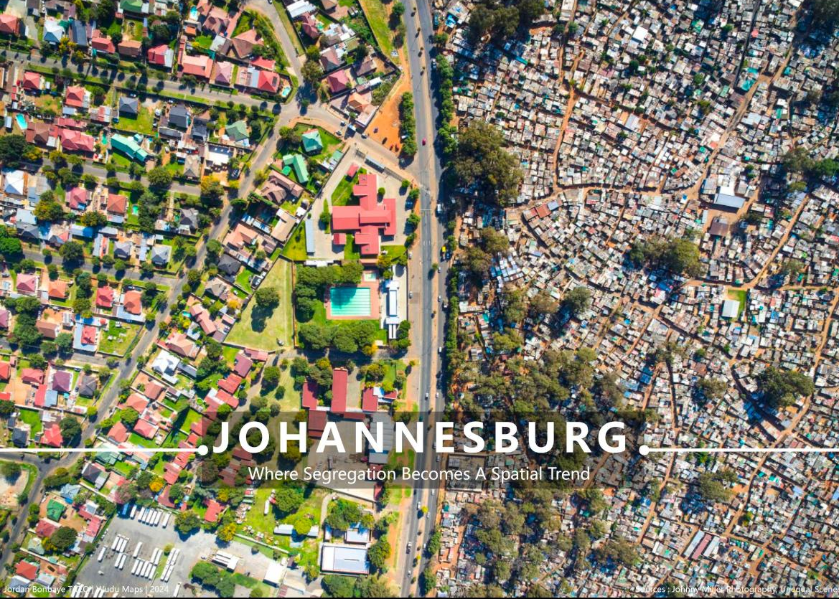

Slide 7

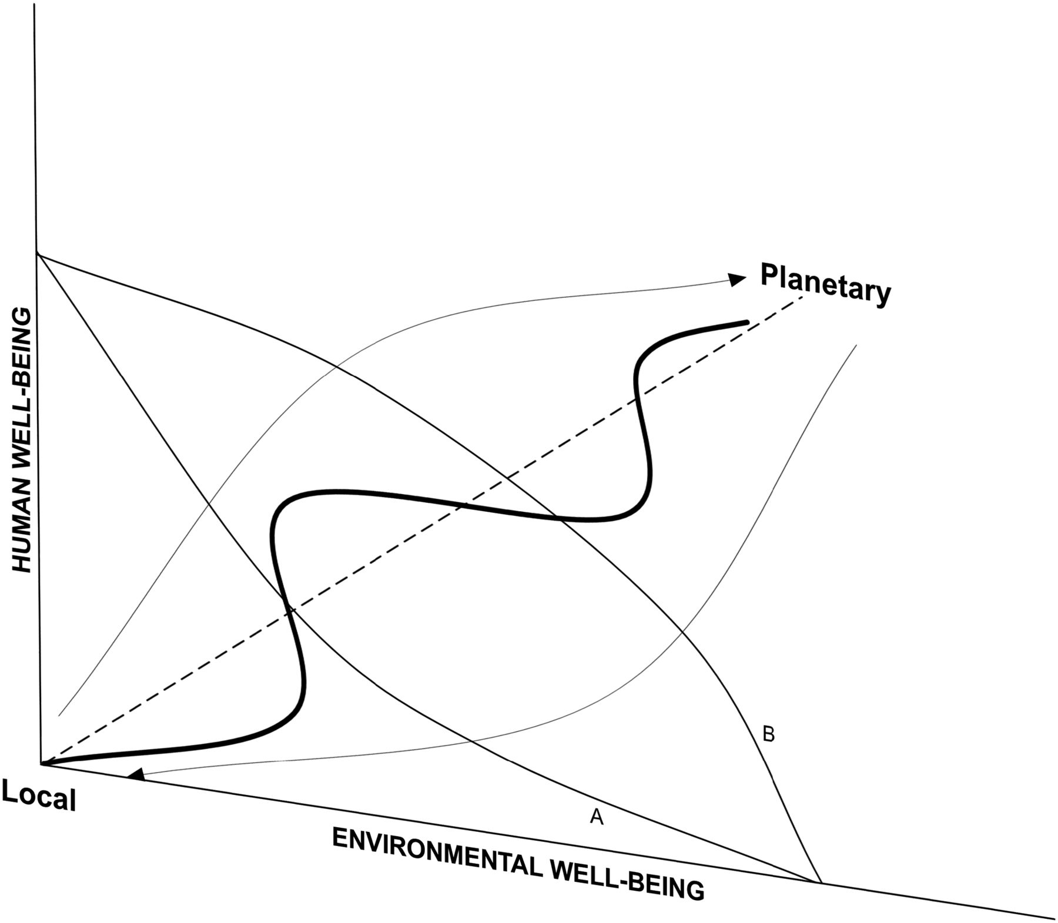
…….. Urban sustainability solutions will affect human and environmental well-being differently at different scales. The nature and function of the relationship between human and environmental well-being to achieve urban sustainability have not been resolved…………
Understanding how the diversity and evolutionary history of plant species assemblages in residential yards can enhance thermal comfort is not only a matter of environmental necessity but also of public health and urban resilience

Slide 8
Examine the spatial variation in the intensity of UHI, and co₂ emission and the influence of urban plant community weighted functional diversity, phylogenetic diversity, and socioeconomic factors.
i) Evaluate the effect of plant functional traits and phylogenetic diversity on UHI reduction and co₂ in urban areas;
ii) Elucidate the contribution of non-native species to urban plant communities UHI reduction and co₂ in urban areas;
iii) Examine the effect of household income and ethnic diversity on the composition of urban vegetation and the implication for UHI reduction and co₂
iv) Assess the dynamic of species diversity of urban vegetation based on latitudinal diversity gradient and their effect on future UHI reduction.
O1
Aim
O2
O3
O4

Slide 9
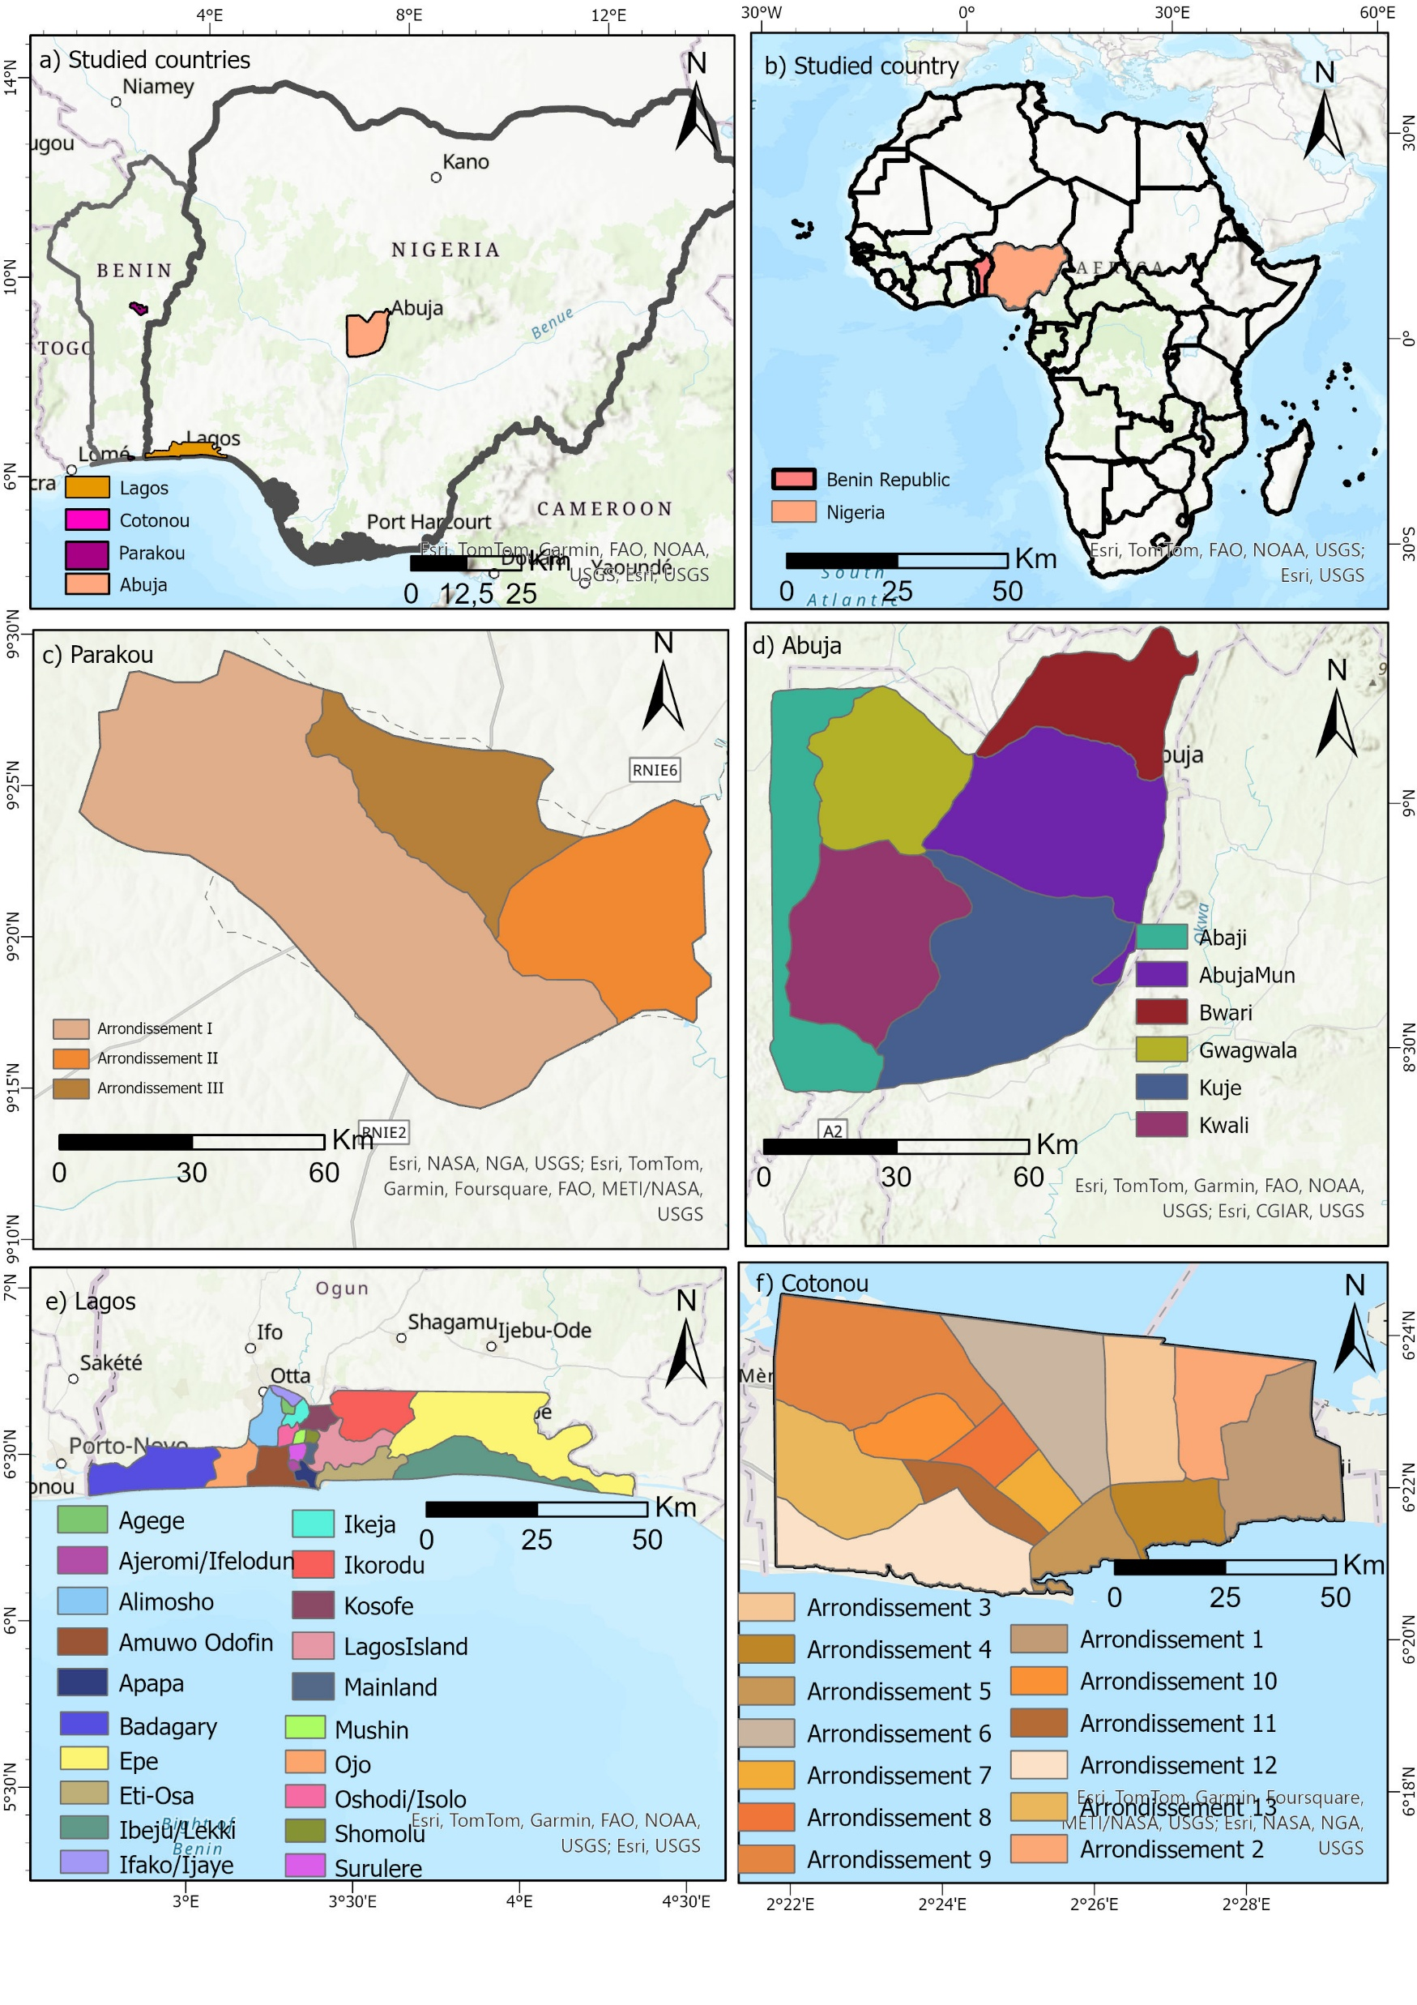
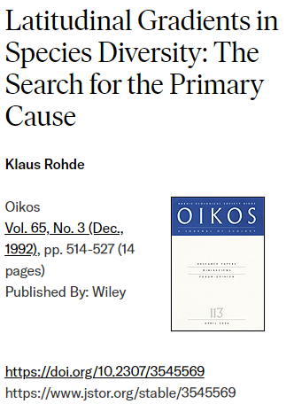
Availability of energy
Republic of Benin (RB) (6°20' and 12°25'N and 1° and 3°40’E)
Federal Republic of Nigeria (FRN) (4° and 14° N, and 1° and 15° E)
Coastal cities: Cotonou and Lagos
Savannah cities: Parakou and Abuja

Slide 10
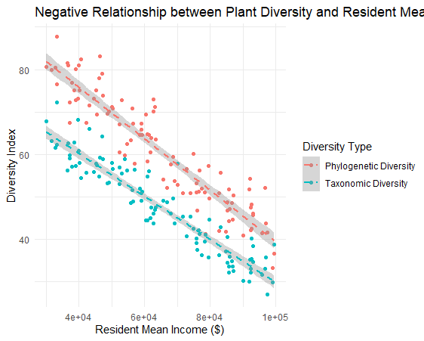
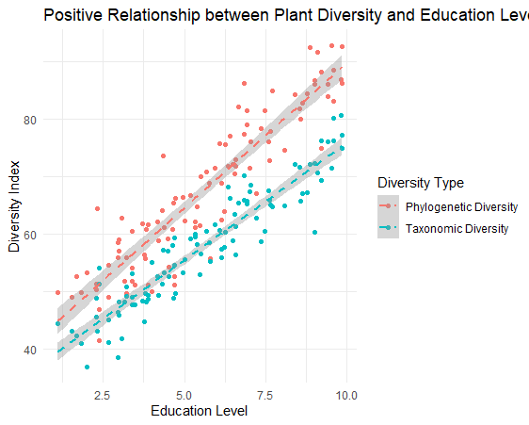
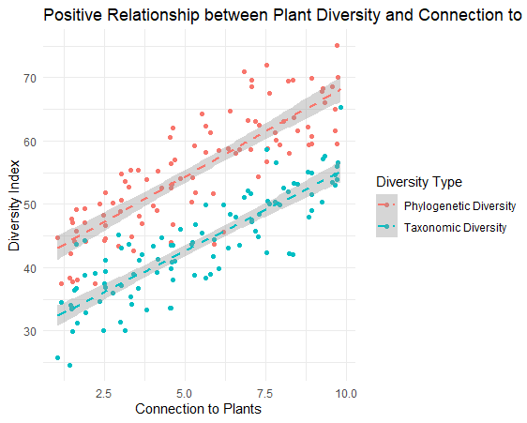
How household income and ethnic diversity and urban attributes affect the composition of urban vegetation and the implication for UHI reduction?

Slide 11
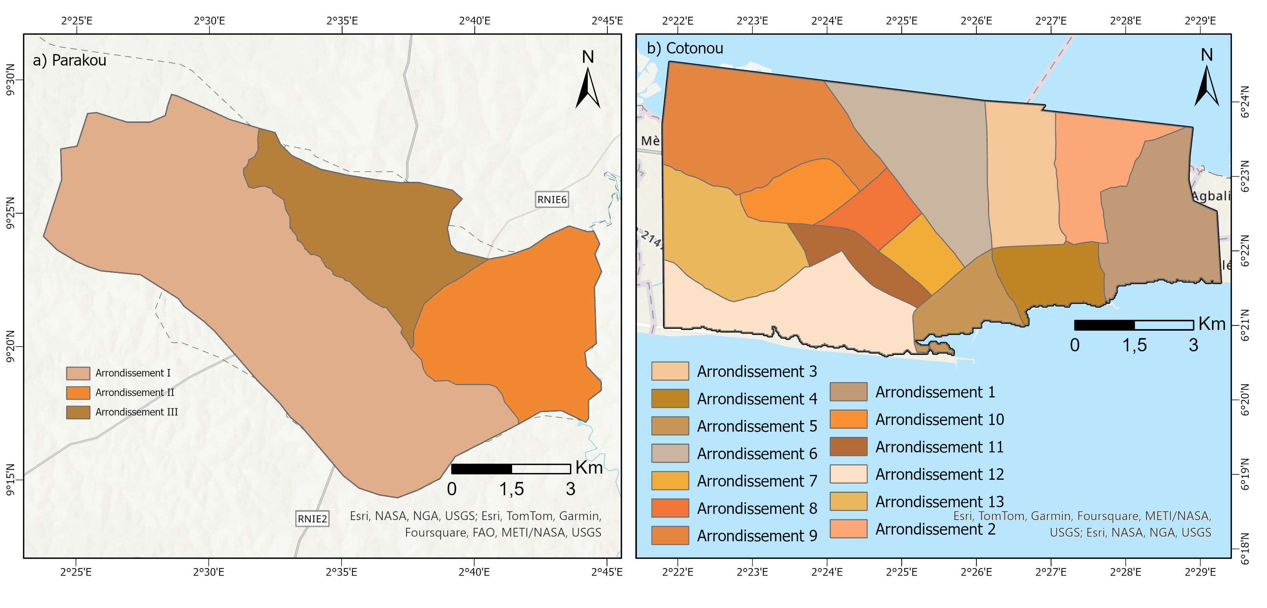

Slide 12
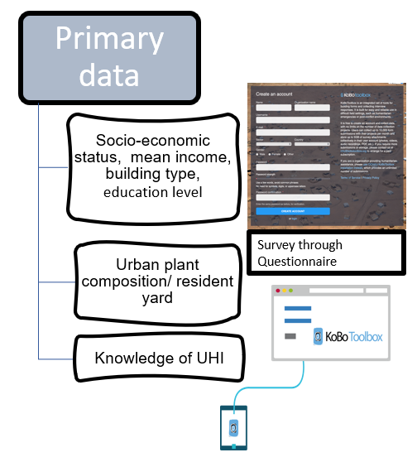


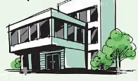





Road within selected neighborhoods, systematic selection of each third house’ with a garden or at leas one plant species
Parakou- 386 households
Cotonou- 559 households
945 houses
Z is the confidence degree accepted (usually 1.96 for a 95% confidence degree).
p is the proportion of people (head of the household) with the correct estimated behaviour (p = n/N).
N is the size of the population under study. For this study, the maximum proportion of 50% has been chosen.

Slide 13
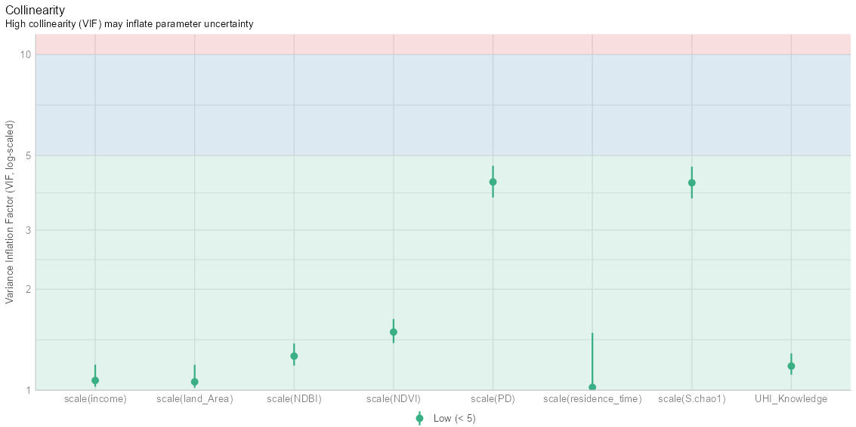
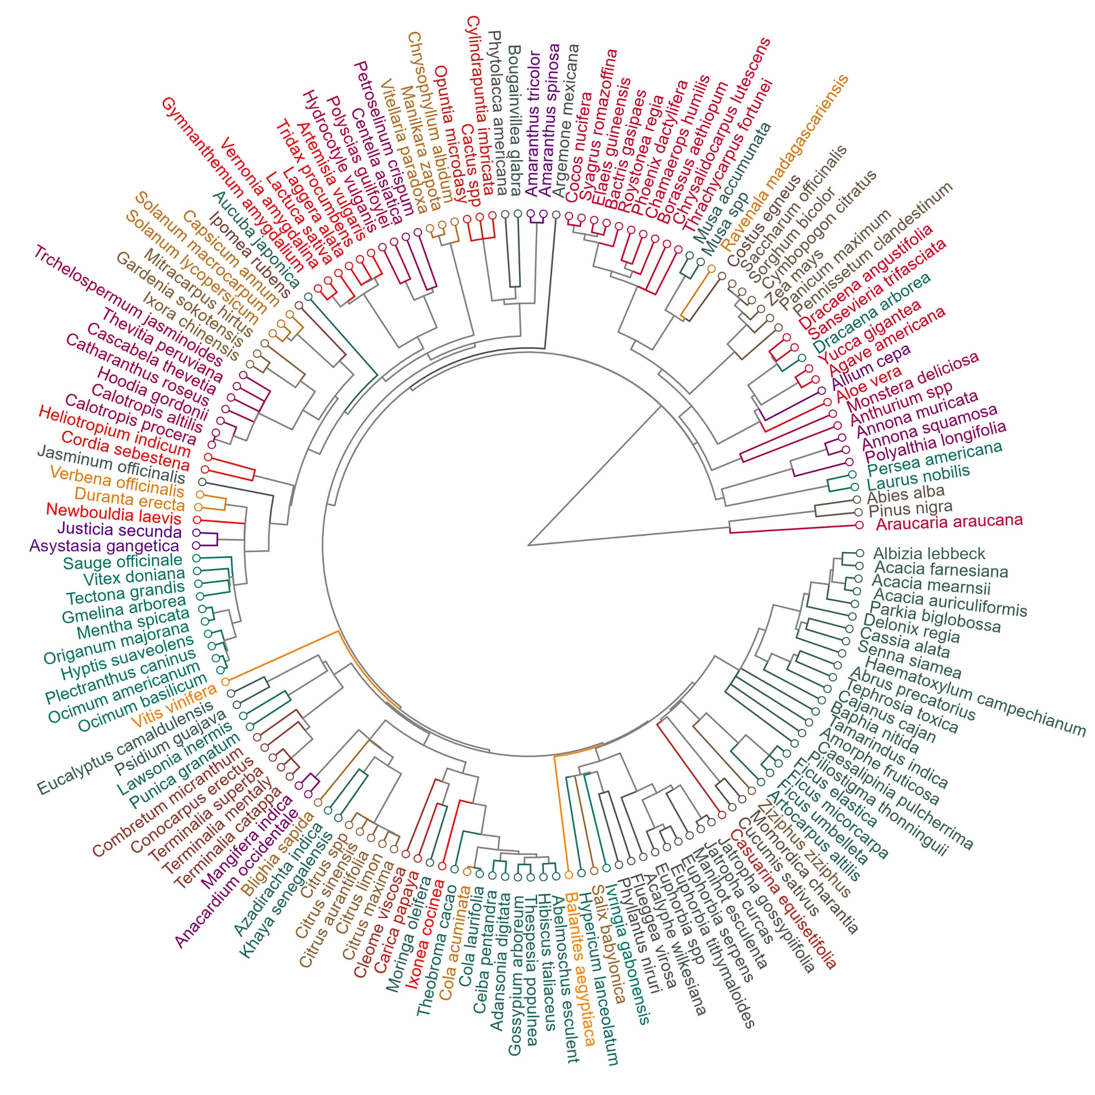
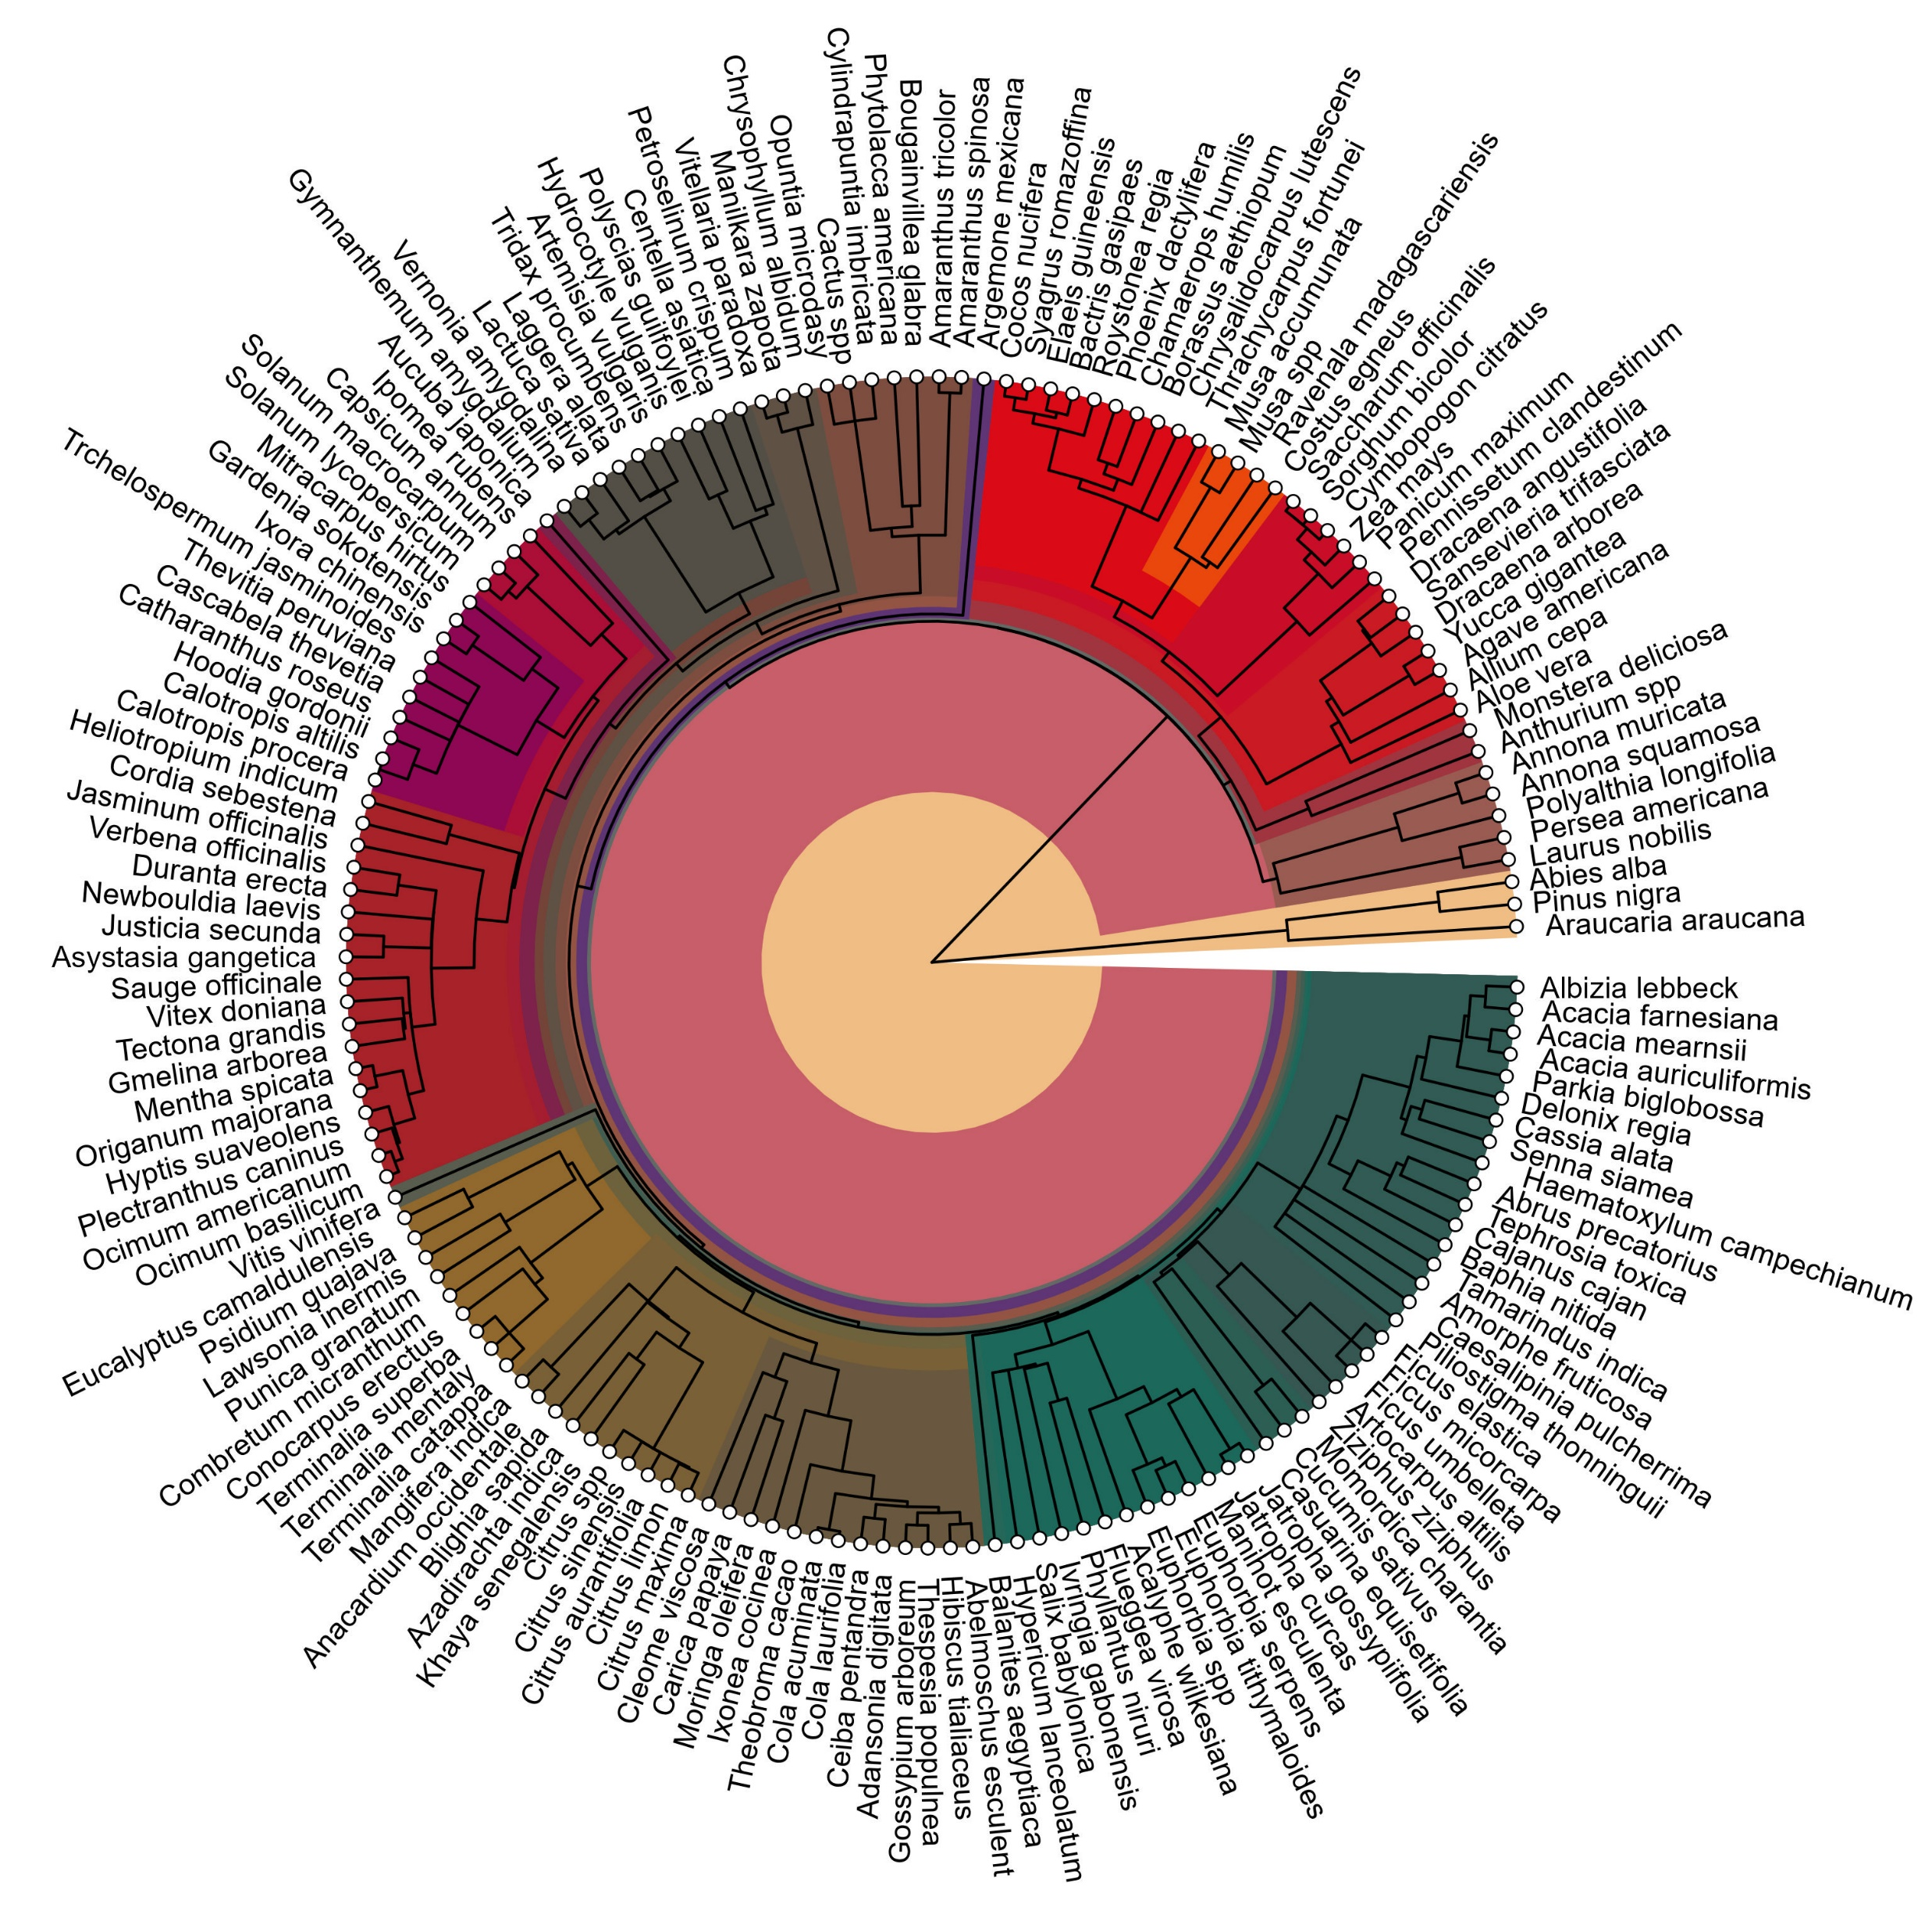

Slide 14
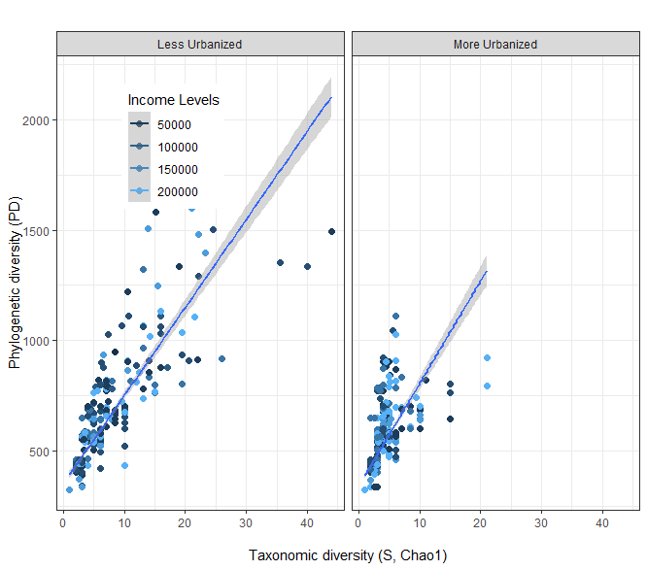
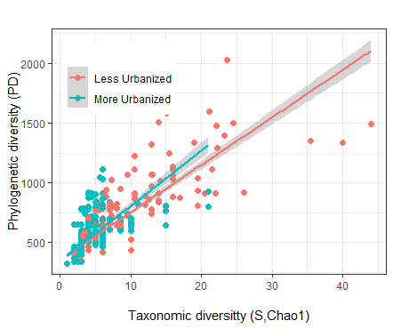
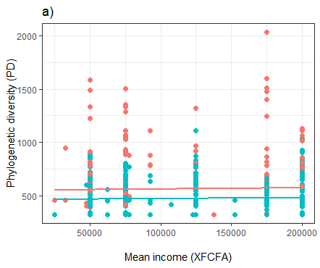
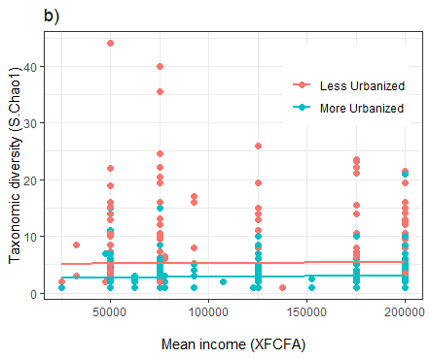
Different income levels influence on diversity

Slide 15
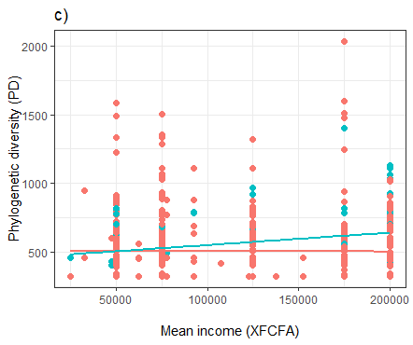
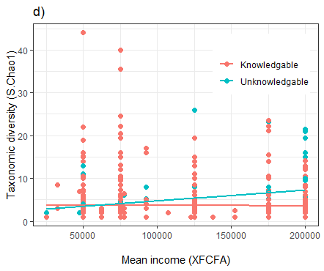
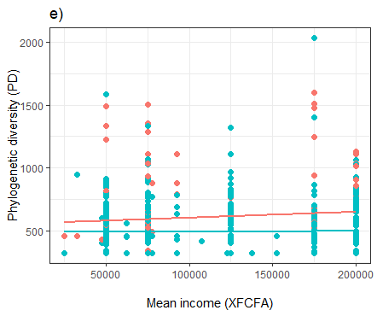
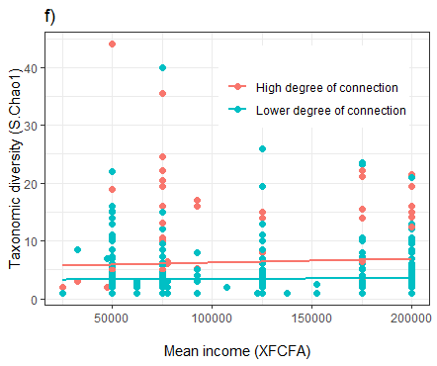

Slide 16
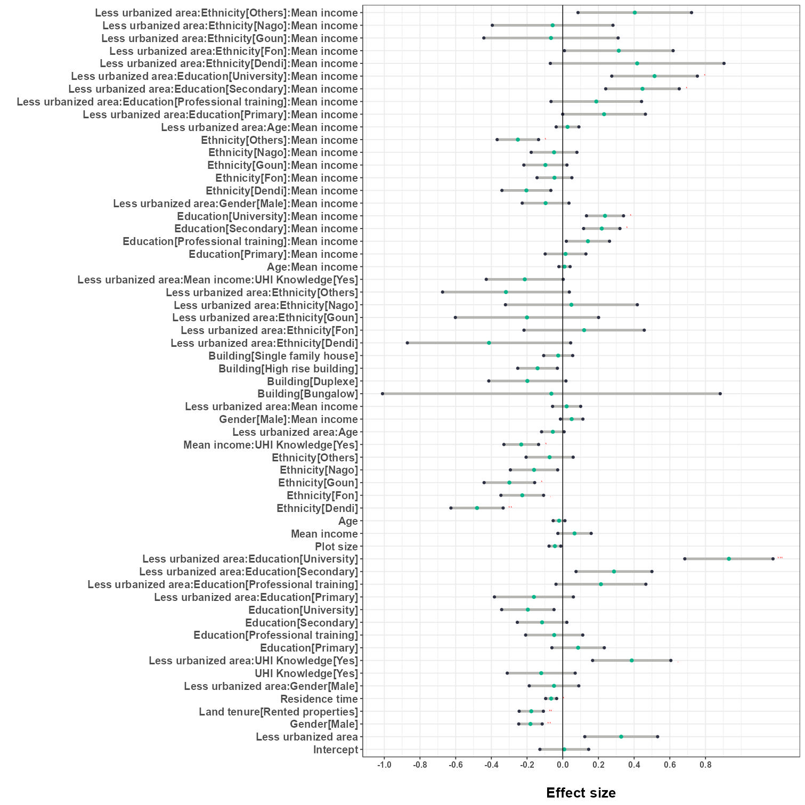
Gender balance in increase phylogenetic diversity
Residence time, income :UHI_knowledge exhibited a notable negative impact on phylogenetic diversity
Demographic traits and households’ ownership increase Phylogenetic diversity in urban settings

Slide 17
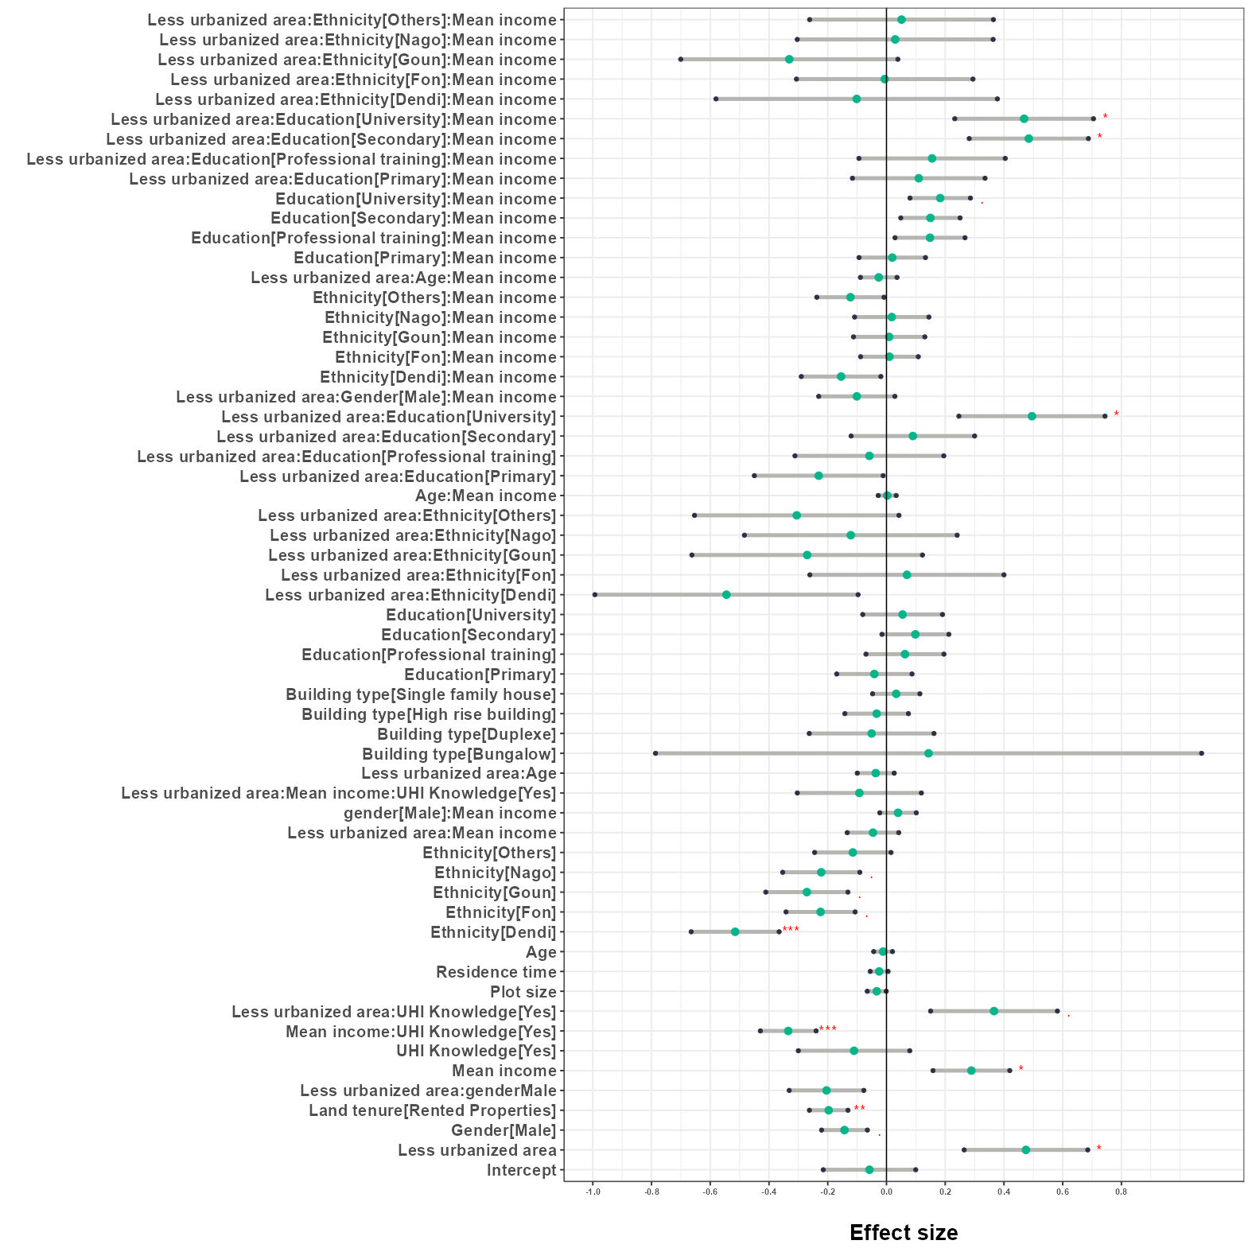
Land tenure significantly affects Taxonomic diversity
Education level mediate mean income and household ownership in taxonomic diversity variation in less urbanised setting

Slide 18

How the effect of residential greenery and urban attributes can act for UHI reduction withing growing cities?

Slide 19
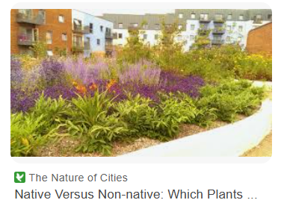
Road within selected neighborhoods, systematic selection of each third house’
1904 sample houses
Abuja- 453 households
Parakou- 386 households
Cotonou- 559 households
Lagos- 506 households

Slide 20
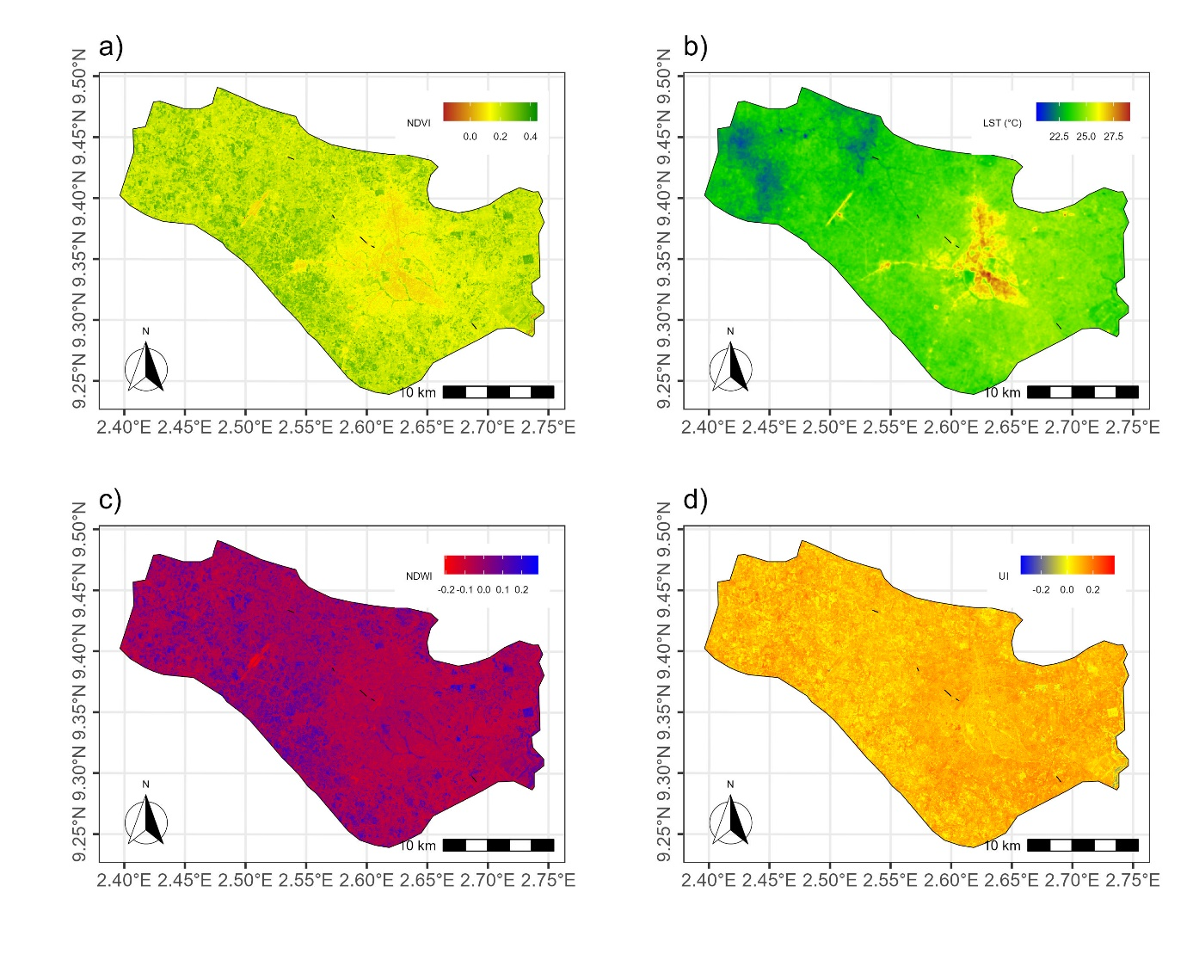
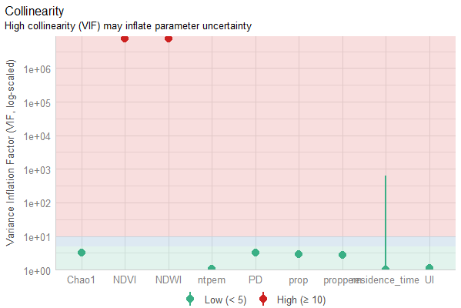
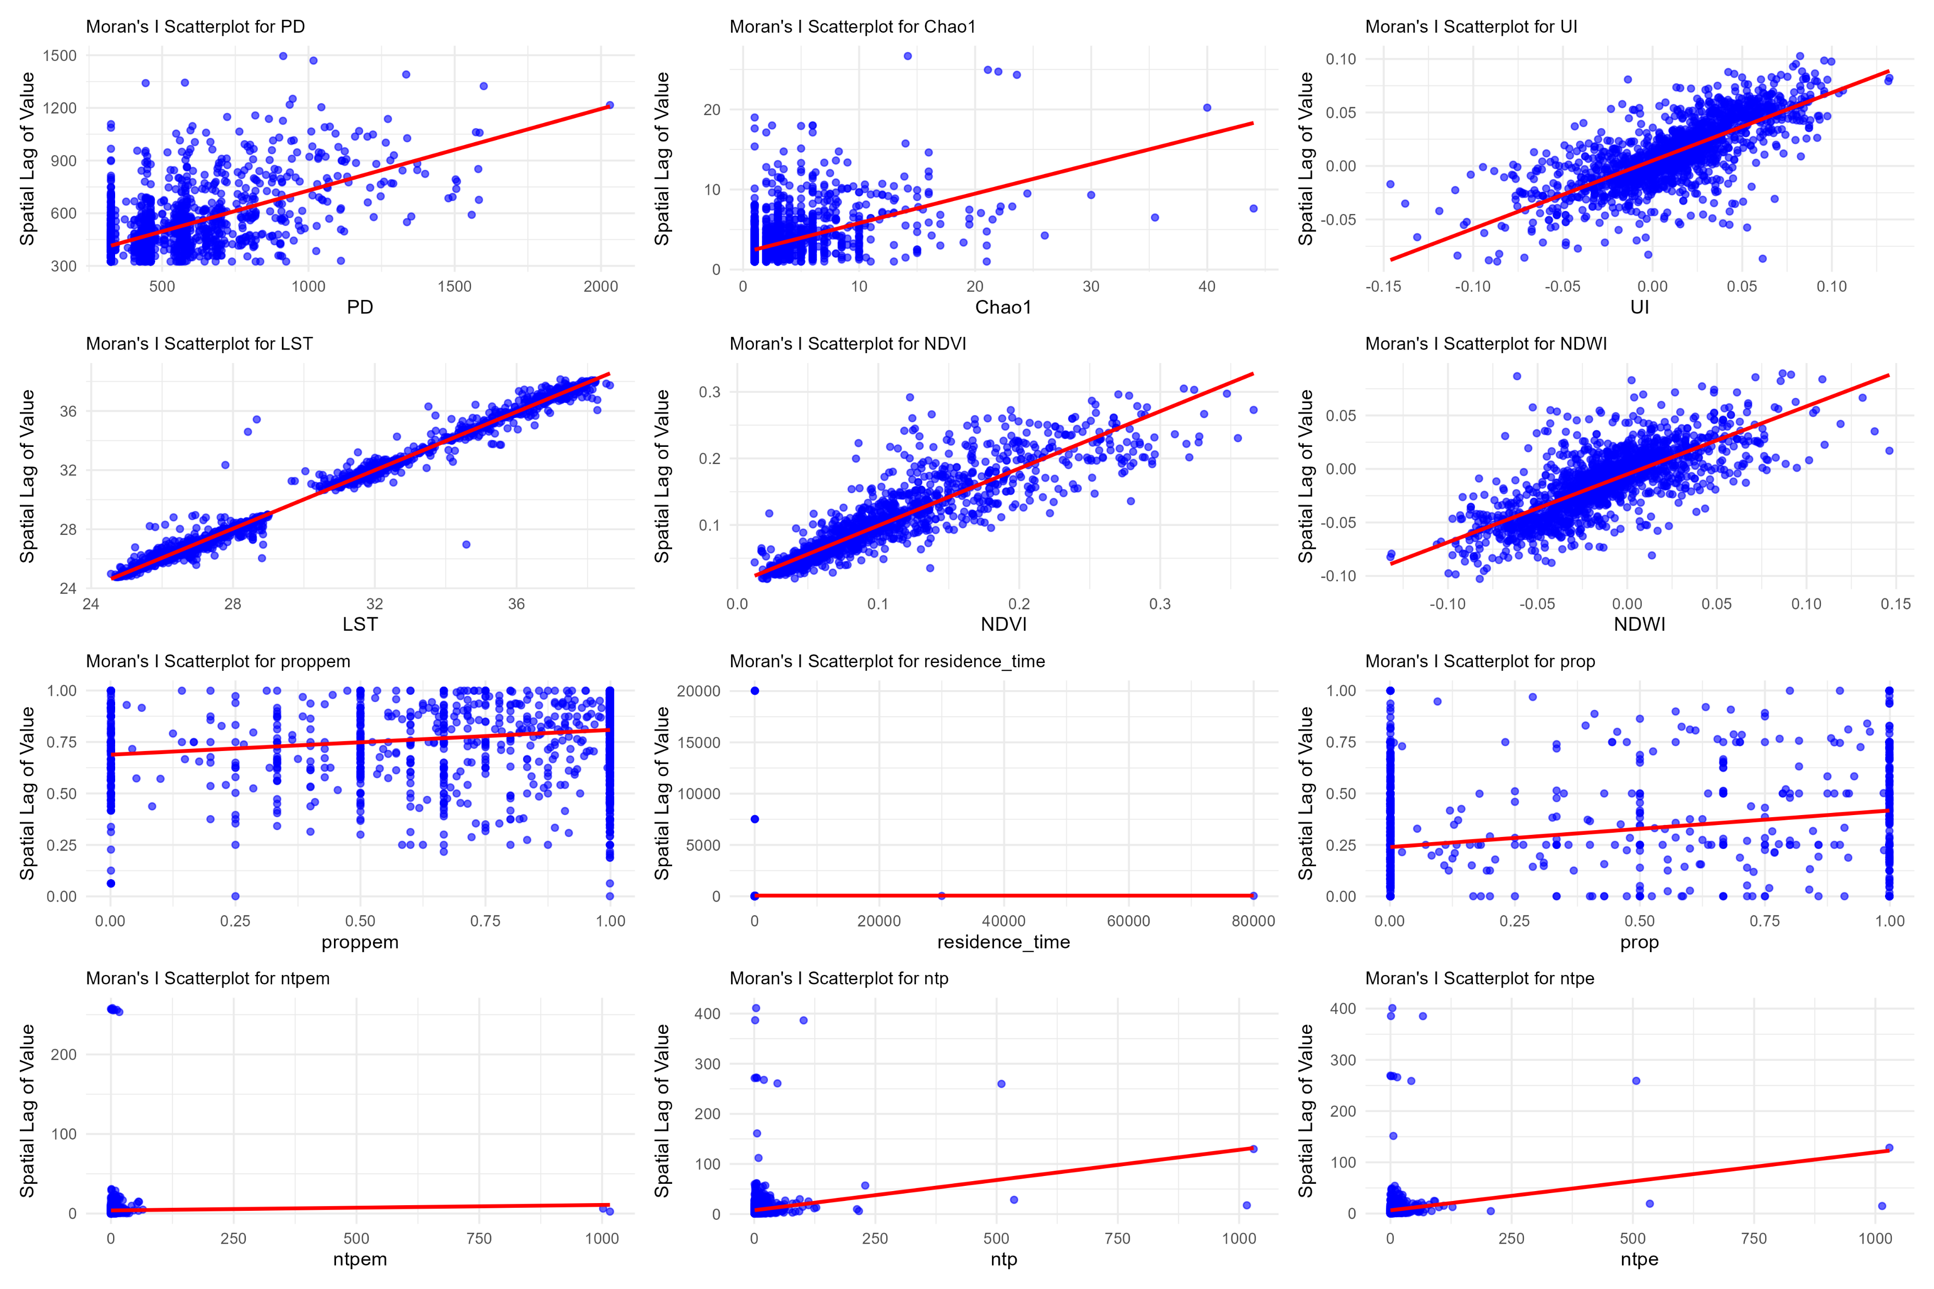
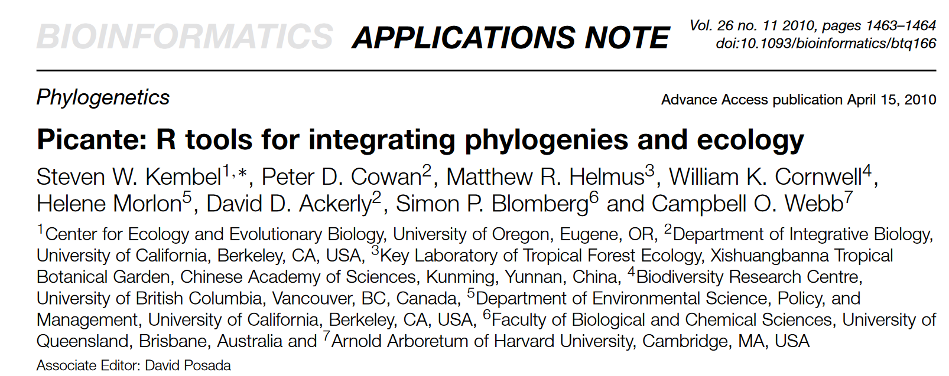

Slide 21
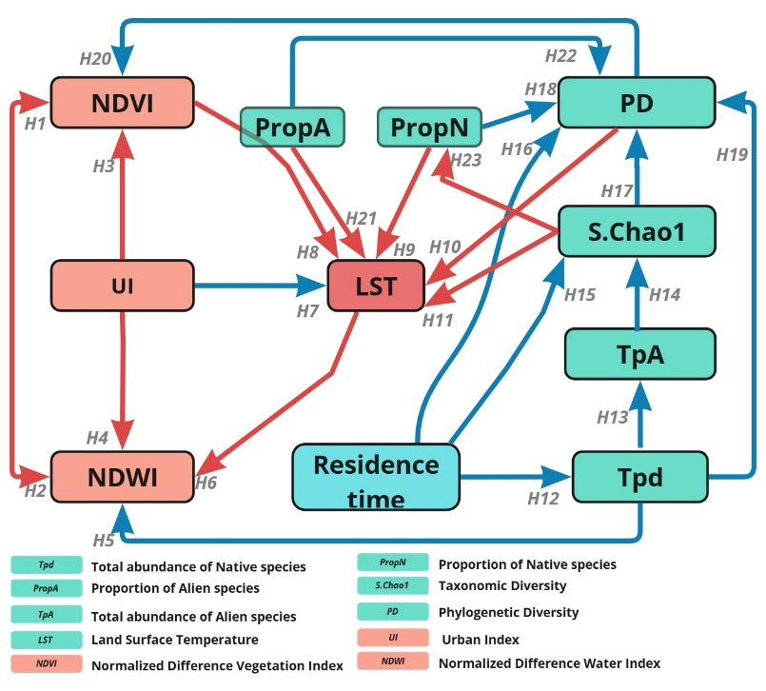
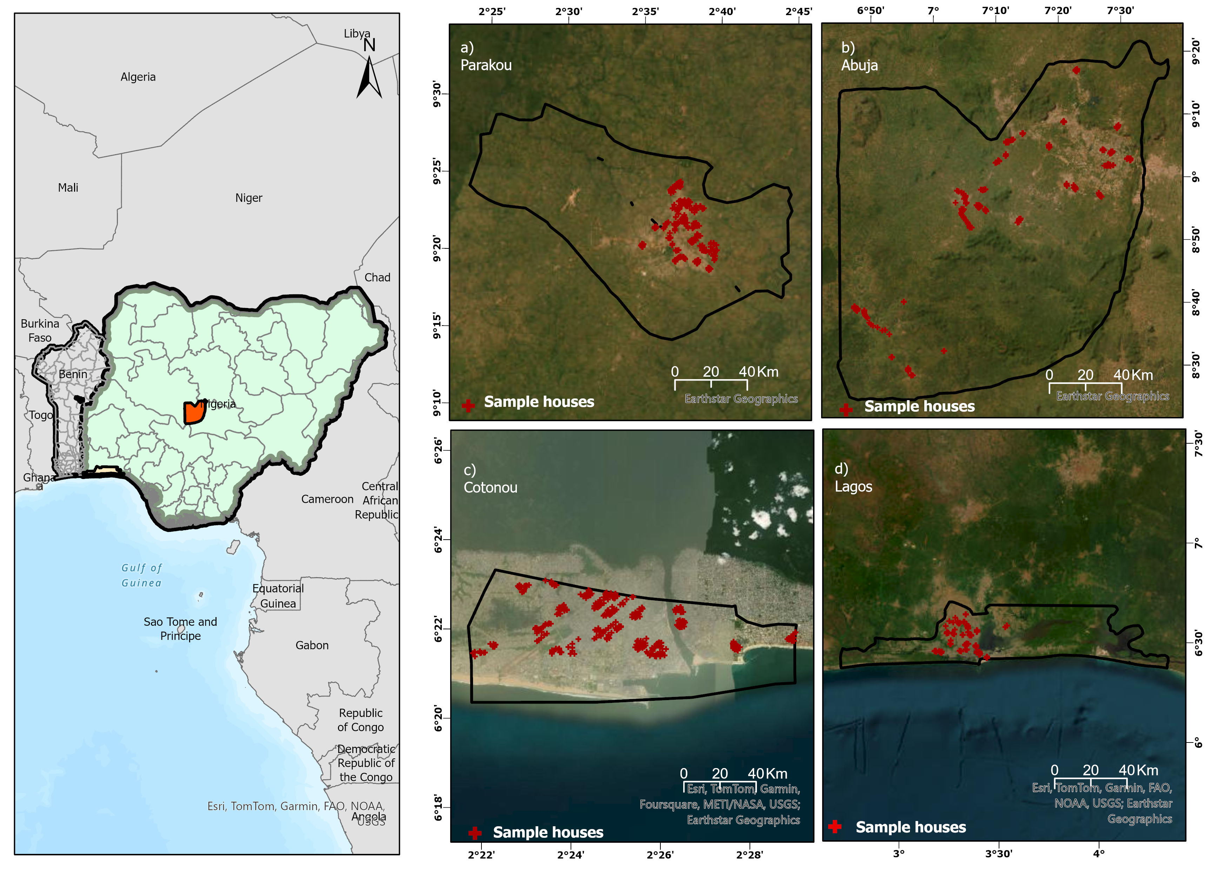
Structural Equation model

Slide 22
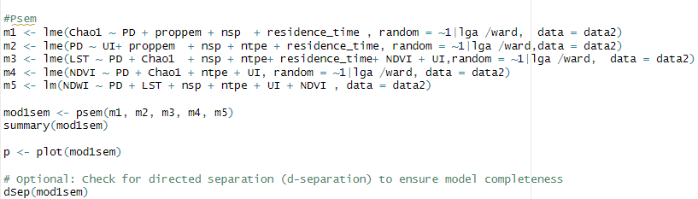
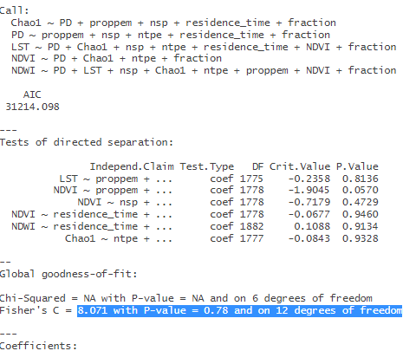


Slide 23
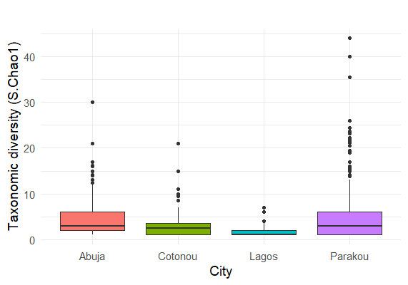
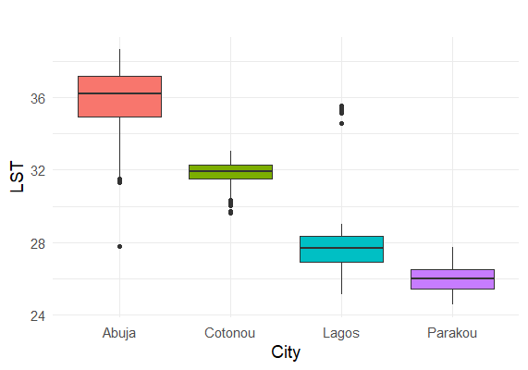
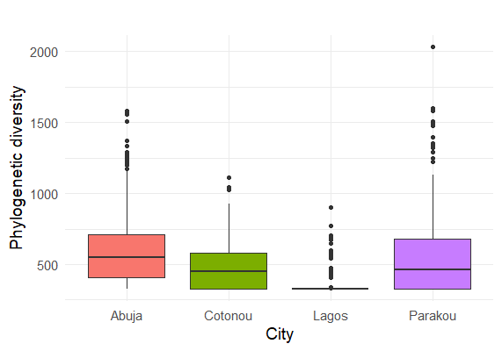
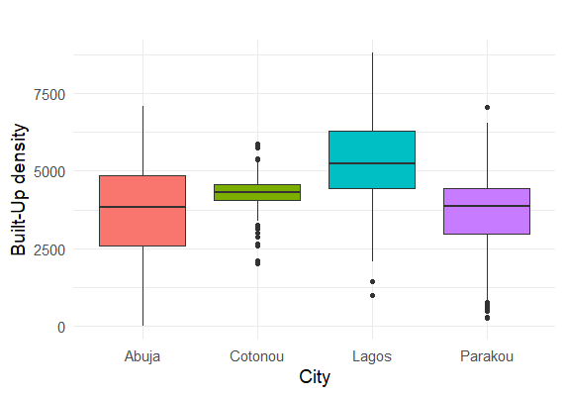
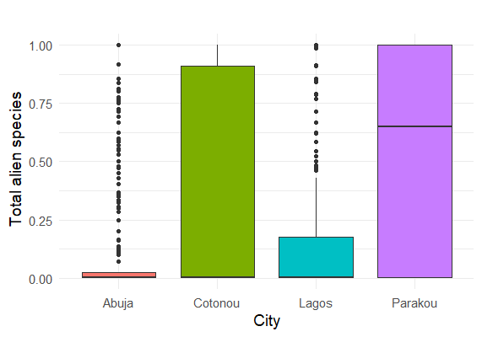
Are Alien Species decreasing LST in low urbanizing city?

Slide 24
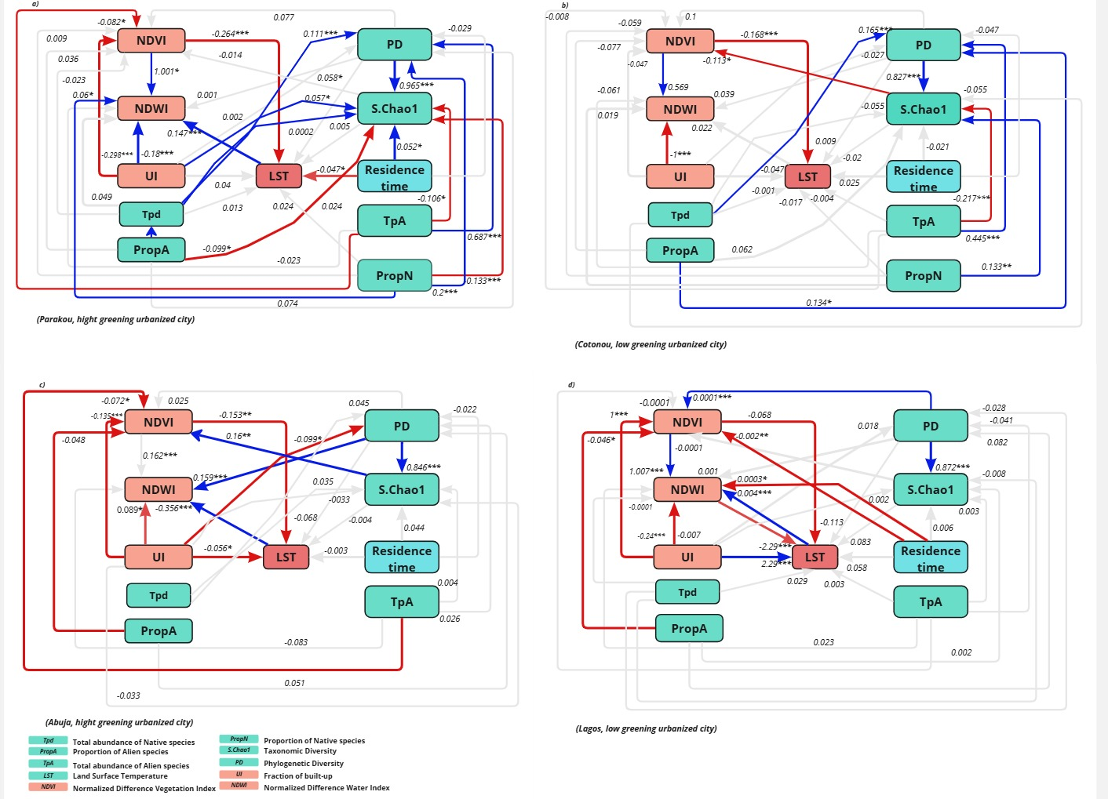
No effect of phylogenetic diversity in reducing the LST at the city level
Positive relationships
Negative relationships

Slide 25
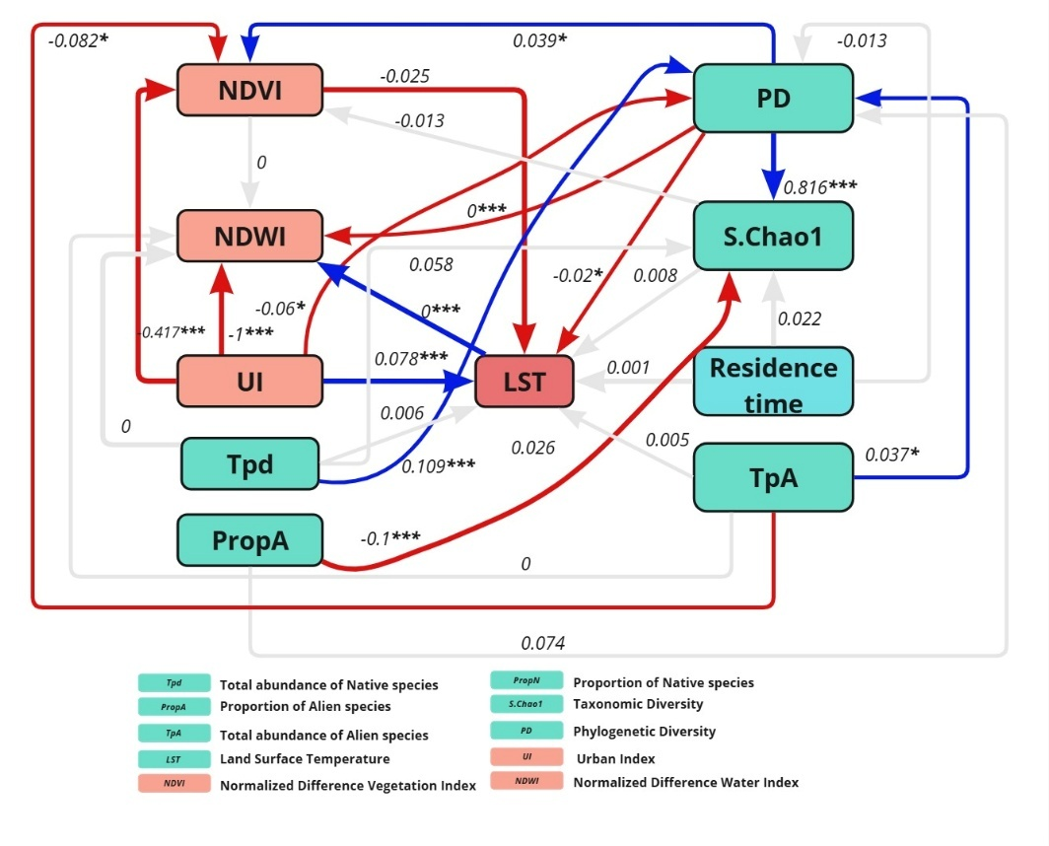
Diversity of alien species mediate the increasing effect of the phylogenetic diversity in reducing the LST at the regional scale
Total diversity of plant species mediating the effect of the phylogenetic diversity on the taxonomic diversity
Positive relationships
Negative relationships
Interesting! Now the question is why only including evolutionary relatedness makes diversity matter? And why this effect is weakened at smaller scale ?

Slide 26





What extent do urban footprints dynamics and green infrastructure affect LST?

Slide 27

Localized increasing urban development

Slide 28

Both cities exhibit rapid urban growth over the decades.
Lagos shows more extensive urbanization compared to Cotonou, reflecting its role as a megacity and regional economic hub. In contrast, Cotonou's urban expansion is significant but relatively slower and more localized. This trend underscores the pressures of population growth and urbanization in West Africa

Slide 29


Built-up areas expand dramatically, covering much larger portions of the central and southern areas. The expansion appears to spread radially outward from existing urban centers, replacing vegetation and bare soil, and leading to significant urban sprawl.

Slide 30

Synthesis
Is Planting trees and promoting green spaces, sufficient to mitigate UHI and promote carbon storage and co2 reduction in African cities ? NO
Economic factors may not have a direct impact on biodiversity patterns
Linking long-term residence and a sense
of place attachment to increased investments in maintaining ecological attributes
Context-specific conservation strategies emerged as a key recommendation from this study.
Promoting sustainable behaviors within households and addressing
socioeconomic disparities, Urban planners can lay a strong foundation for effective biodiversity conservation
Empowering women and incorporating
environmental education into curricula
hold great promise for nurturing a culture
of conservation in West African cities.

Slide 31
Synthesis
Higher phylogenetic diversity contributes to lowering temperatures at the regional scale
Built-up footprint has a highly significant positive effect on LST, indicating that increased urbanization leads to higher temperatures, counteracting natural cooling mechanisms
NDVI (vegetation index) and NDWI (water index) showed intermediary roles by reducing the LST via interaction with plant diversity, helping to explain how vegetation regulates urban heat islands.

Slide 32


Contribution to Knowledge

Slide 33


Policy development

Slide 34




Slide 35




In drafting
Enagnon B. O. Ahouandjinou; Moses A. Olutoye; Orou G. Gaoue; Fabian E. Fassnacht; Appollonia A. Okhimamhe
Under supervision review

Slide 36









Slide 37





Prof. Orou G. Gaoue (PhD)
Ecology & Evolutionary Biology, University of Tennessee, Knoxville, USA
ogaoue@utk.edu
Prof. Appollonia A. Okhimamhe(PhD)
Applied Remote Sensing/GIS in Geographical Sciences including Climate Change, Federal University of Technology Minna
aaokhimamhe@futminna.edu.ng
Prof. Fabian E. Fassnacht (PhD)
Institute of Geographical Sciences Remote Sensing and Geoinformatics, Freie Universität Berlin.
fabian.fassnacht@fu-berlin.de
Prof. Moses A. Olutoye (PhD)
Chemical Engineering ,Federal University of Technology Minna
m.olutoye@futminna.edu.ng
Enagnon B. O. Ahouandjinou
Climate change & Human Habitat,
Federal University of Technology Minna
olienagnon@st.futminna.edu.ng

Slide 38

Olivier AHOUANDJINOU
olienagnon@st.futminna.edu.ng
Federal University of Technology Minna
Climate change & Human Habitat

