Slide 1
DOCTOAL RESEARCH PROGRAMME IN CLIMATE CHANGE AND HUMAN HABITAT (CC & HH)
FEDERAL UNIVERSITY OF TECHNOLOGY, MINNA (FUTMINNA)
URBAN GREEN SPACES DEVELOPMENT AND THEIR CONTRIBUTION TO SUSTAINABLE CLIMATE CHANGE RESILIENCE OF BAMAKO AND SIKASSO CITIES IN MALI
Supervisors:
Prof. Mrs. Zinash D. Osunde, Nigeria
Prof. TRAORE Souleymane S, Mali
Prof. Dr. Christine Fürst, Germany
By : FOMBA Mohamed, PhD/SPS/FT/2019/11125; PGS4513003

Slide 2
Introduction Problem statement Research questions Aim and objectives Justification | Study area Methodology Key results Implication of results Conclusion & Recommendations
OVERVIEW

Slide 3
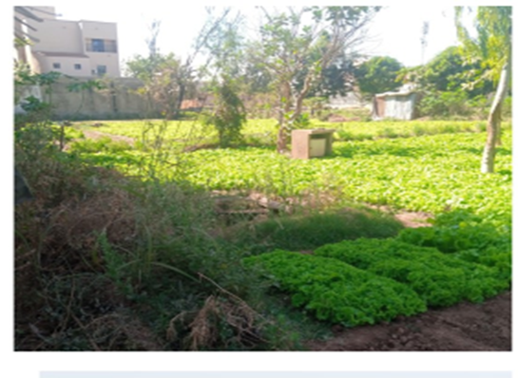
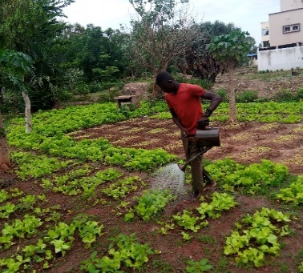
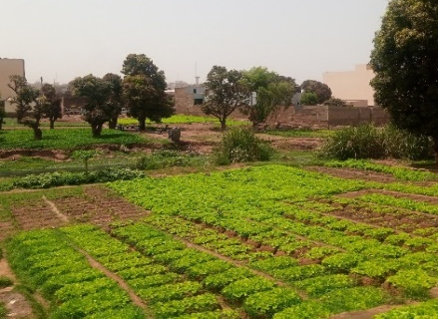
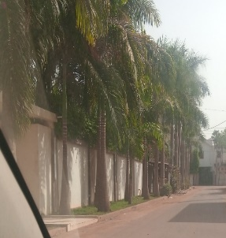
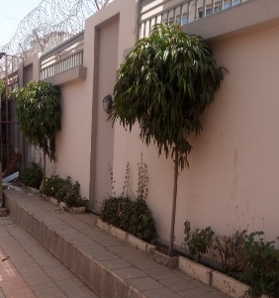
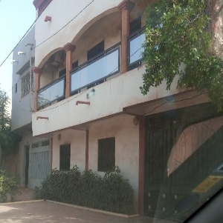
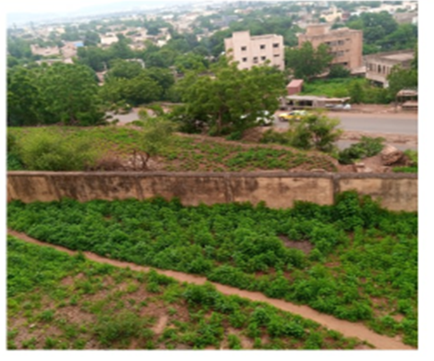
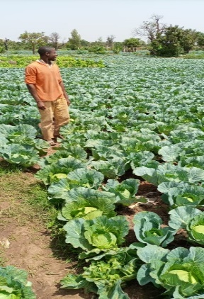
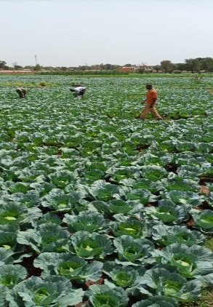
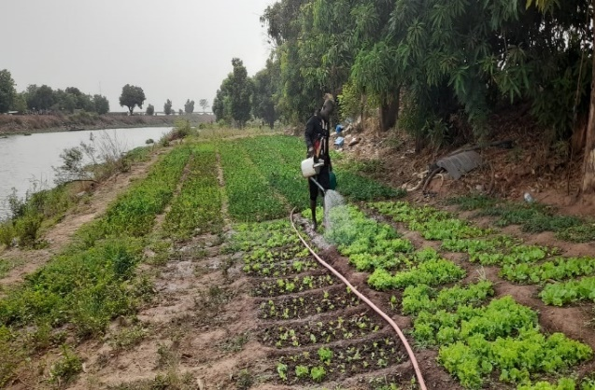
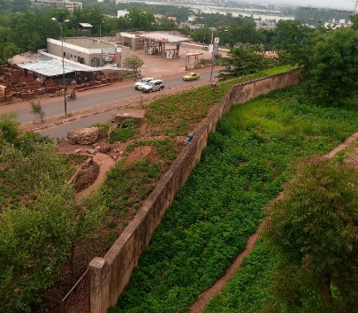
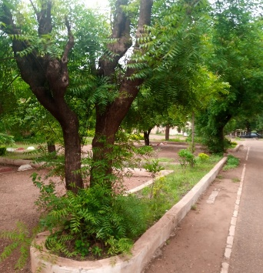
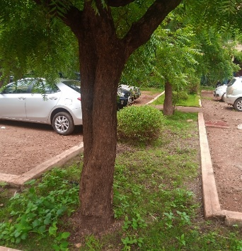
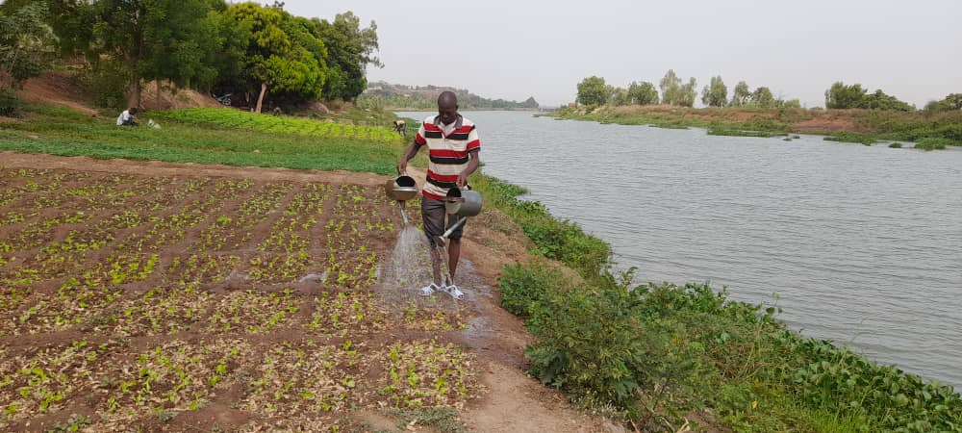
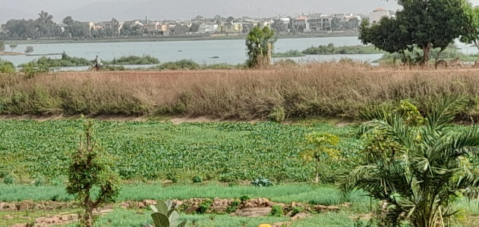
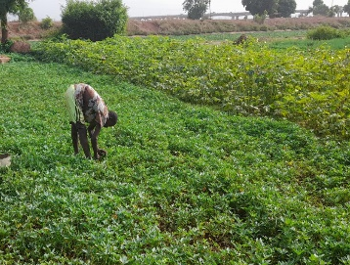
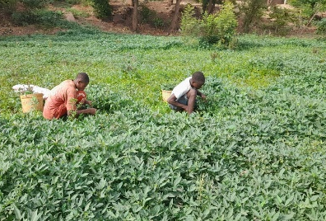
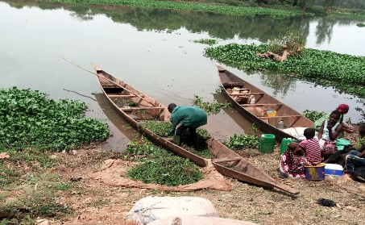
The perception is individual, linked to sensory knowledge and endogenous knowledge.
We have defined the criteria taking into account the Common International Classification of Ecosystem Services (CICES) Haines-Young, R. and M.B. Potschin (2018)
Market Gardening in Bamako
INTRODUCTION
Tree in front of the houses Bamako
Provisioning services:
Vegetables production; food; water; genetic resources; social cohesion; drinking water in the public supply system; mineral water; decoration; health benefits; renewable energy source; waste disposal; visual quality; human comfort; ecotourism; recreation; identity;…
Regulating and maintenance services:
Climate regulation; disease regulation; water and air regulation; water cycling; soil formation; Sustainable waste disposal and reduction of respiratory diseases; reduction of odour nuisance from rubbish and livestock pens; low noise environment and visual amenity; mitigation of damage resulting from reduction in magnitude and frequency of floods/storms; contribution to erosion control.
24/06/2021
24/06/2021
07/03/2022
22/02/2022
Market Gardening in Bamako
22/02/2022
23/02/2022
04/06/2021
Market Gardening in Sikasso
Public Gardens
Cultural services: Spiritual or religious enrichment; recreation, fitness, de-stressing or mental health; nature-based recreation; eco-tourism; knowledge about the environment and nature; skills or knowledge about environmental management; tourism; local identify; artistic inspiration; social cohesion; cultural icon; mental and moral well-being; nature documentary;…
07/01/2021
07/01/2021
17/05/2022
04/06/2021
12/04/2021
12/04/2021
Ecosystem Services Provided in Bamako
17/05/2021
17/05/2021
15/04/2021
13/05/2022
17/05/2021

Slide 4
PROBLEM STATEMENT
Statistics show that in Africa, Urban Green Spaces (UGS) are being depleted at an alarming rate with a small proportion of the land mass in several urban areas (Mensah, 2014).
Climate Change and rapid urbanisation have become two major issues related to human welfare and development around the world for recent decades.
In Mali, urban population is 43.9% of total population in 2020.
Even though Mali has green spaces and agricultural areas in these urban areas, climate change and rapid urbanisation that impact the well-being of urban populations are major problems that persist.

Slide 5
RESEARCH QUESTIONS
This work should answer at follower questions:
What are the spatial changes and the characteristics of UGS types in Bamako and Sikasso?
What impact do urbanisation and climate change have on designated green spaces and the Ecosystem Services (ES) they provide?
How could planning strategies be created in order to enhance UGS's ES and climate change resilience?
How are green spaces in Bamako and Sikasso used in terms of land use, as well as the condition of the ES they offer?

Slide 6
AIM AND OBJECTIVES
This study aims to assess and develop a planning model for the effect of climate change and anthropogenic activities on UGS distribution dynamics for resilient and sustainable urban living in Bamako and Sikasso.
OS1: Evaluate the spatial changes and the characteristics of the different types of UGS in Bamako and Sikasso cities
OS2: Examine the impact of UGS and ecosystem service distribution dynamics on climate change resilience.
OS3: Develop a planning model for the improvement of UGS and their ES and the climate change resilience of Bamako and Sikasso green spaces.
OS4: Develop a sustainable planning design for Bamako and Sikasso green spaces.

Slide 7
West Africa has been reported as one of the most increasing from rapid urbanisation, which is described as urban areas with significantly warmer temperatures than its surrounding rural areas. (Amani-beni et al., 2019).
So, we must pay attention to the urban heat island which caused by replacing vegetated surfaces with sealed surfaces in urbanisation.
The importance of UGS for the sustainability and well-being of societies is very high in increasingly urbanized societies (Contesse et al., 2017).
This study will certainly help to address these multiple challenges so that cities provide healthy, resilience, food security and sustainable living environments.
JUSTIFICATION

Slide 8
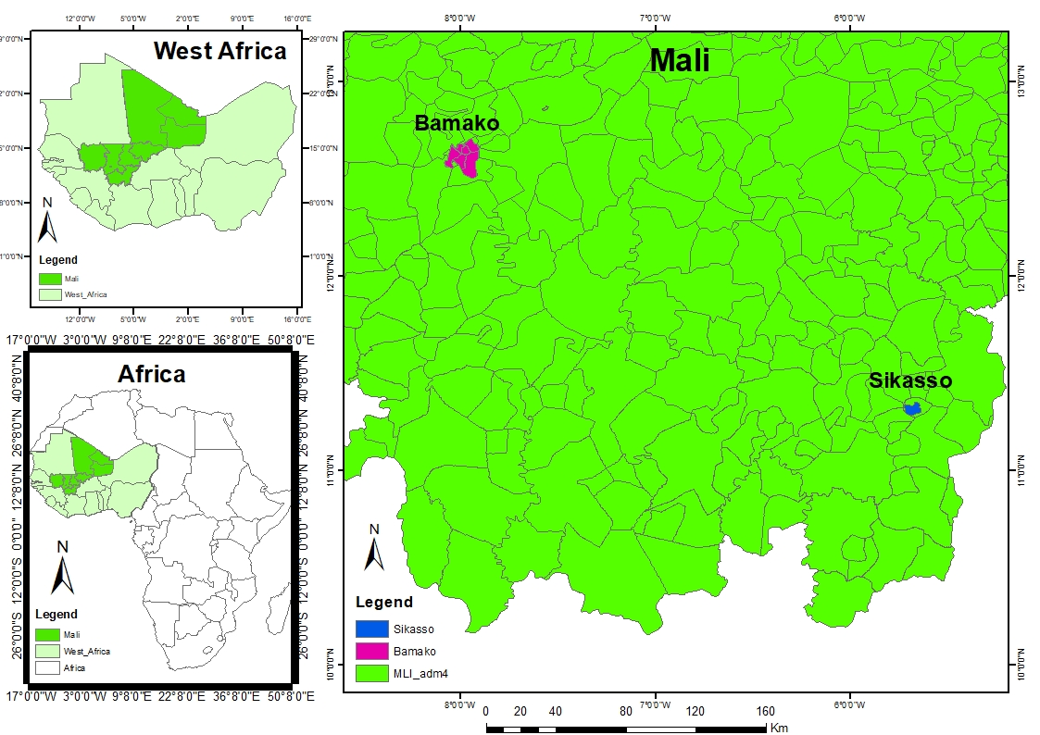
With 267 km² Bamako is located between 12º29'12º29'57 and 12º42'7º54'22 north latitude and 7º54'8º4'6 and 8º4'12º29’57 , West longitude.
Population: 2 617 686 (Growth Rate 3.82%)
STUDY AREA
https://worldpopulationreview.com/world-cities/bamako-population
With 400 km² Sikasso is located between 10° 49 and 12° 18 of north latitude and between 5° and 6° 35 of west longitude.
Population 386 262 (Growth Rate 4.83%)
https://worldpopulationreview.com/world-cities/sikasso-population
Figure 1: The locations of Mali's cities of Bamako and Sikasso (M. FOMBA, 2023, ArcGIS 10.8).

Slide 9








PRIMARY AND SECONDARY DATA ACQUISITION
GPS, Social Survey
& Pictures
Climate Data, Landsat and
Images
Google Earth Pro
Literature review
METHODOLOGY
Sampling for survey
Precipitation
Classification
ROIs Sampling, NDVI, NDWI, NDBI
UGS Knowledge
Georeferencing & Pictures
Temp Max
Post-Classification
Accuracy assessment, Kapa, LULC Maps 1990- 2000-2010-2020
Temp Min
Ecosystems Services
Analysis survey data
Trend Analysis
Climate Change & Urbanization Effects
on UGS & ESS
GISCAME
LUC Change Simulations,
Expected LUC change in UGS
Climate variability
Sustainable LU System
Examination of UGS & ES contribution to Sustainability and Climate Change Resilience
Figure 3. Methodology framework

Slide 10
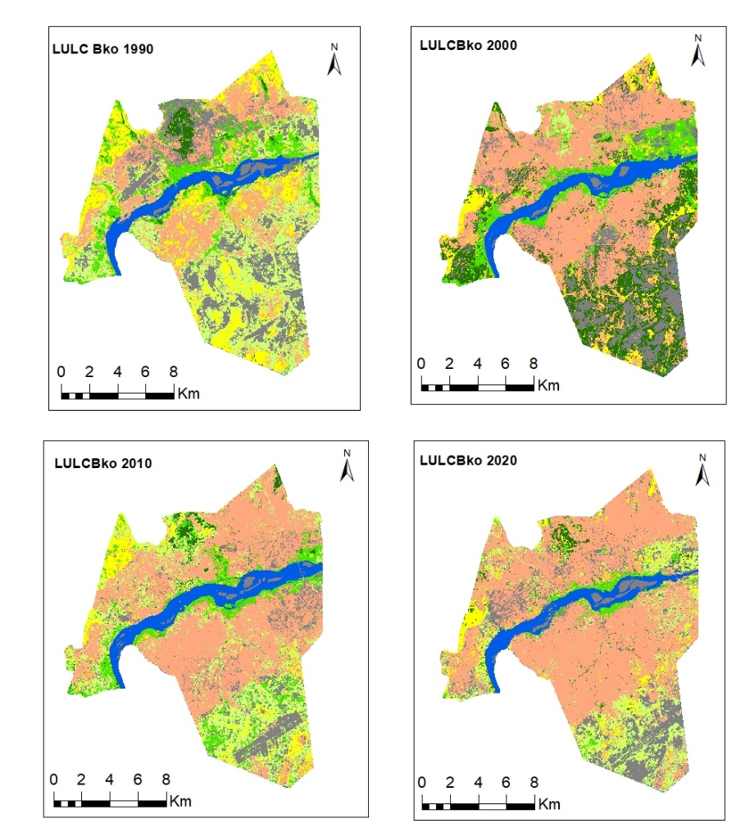
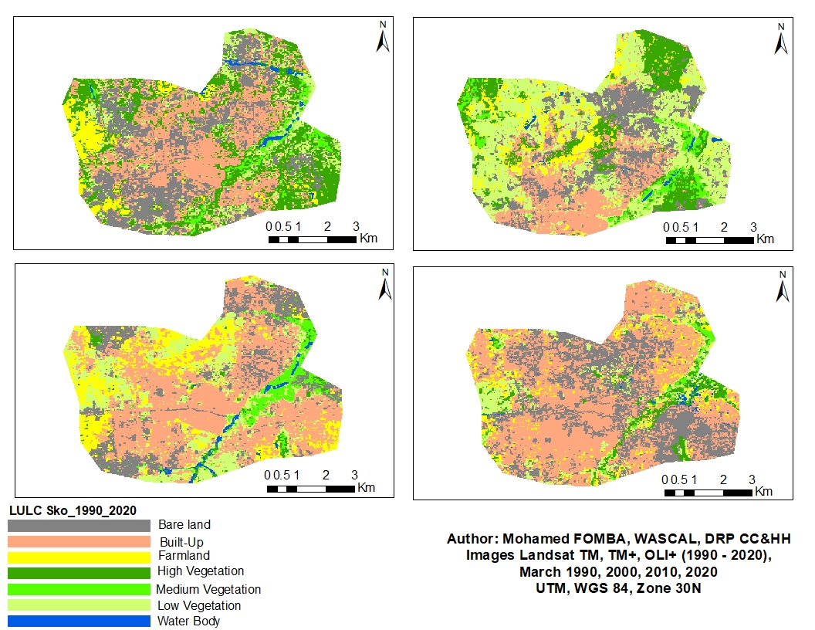


OS1
Objective 1: Spatial changes and the characteristics of the different types of UGS
Land Use Land Cover, Bamako and Sikasso 1990 - 2020
2000
1990
2000
RESULTS
Figures 4 and 5:LULC classification from 1990 to 2022 of Bamako
2010
2020
2010
2020
Built-Up and Bare land are increasing from 1990 to 2020 in the both cities. So, the decrease of UGS was mainly due to the expansion of built-up areas.

Slide 11
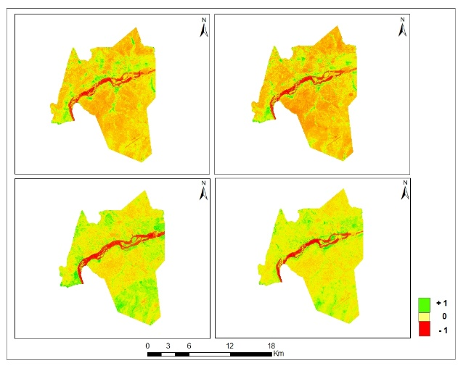
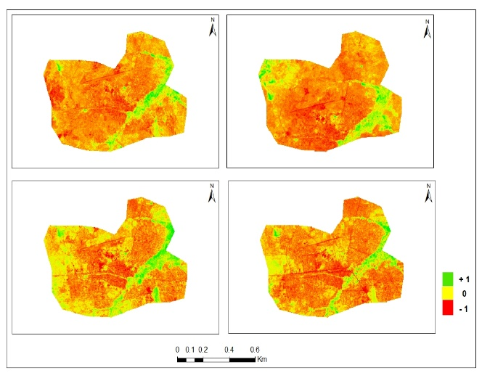
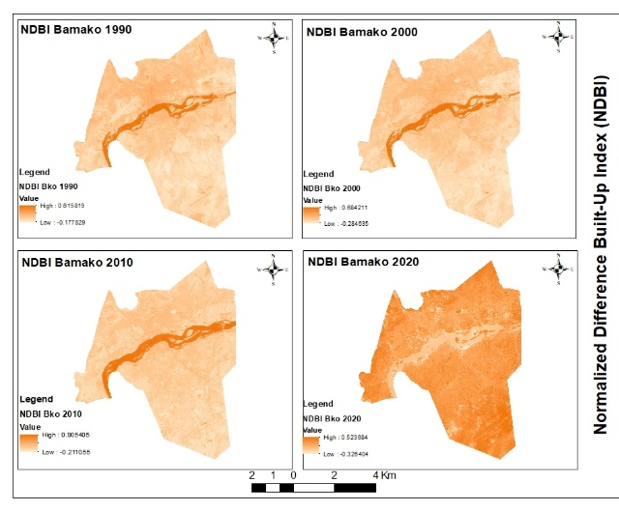
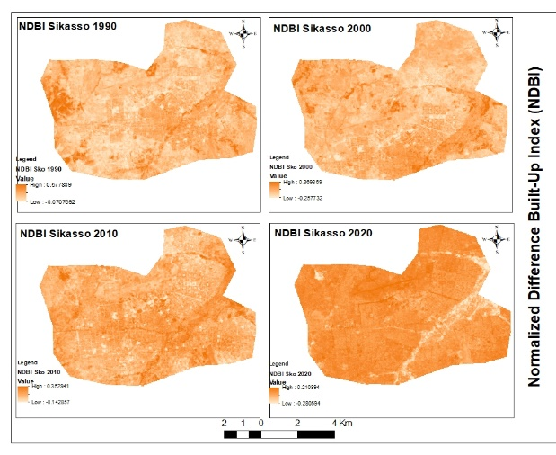
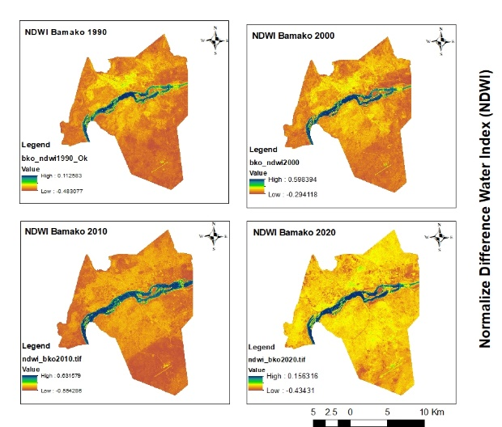
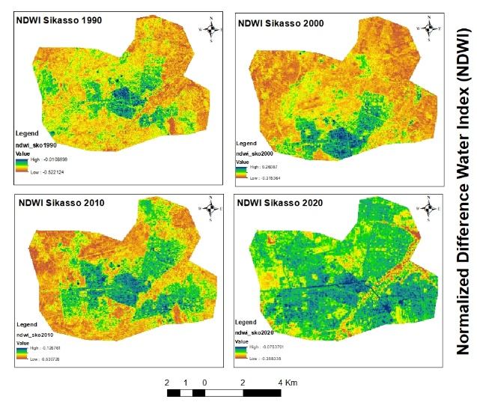

OS1
Objective 1: Spatial changes and the characteristics of the different types of UGS
Normalized Difference Vegetation Index (NDVI) Bamako, Sikasso
Normalized Difference Built-Up Index (NDBI) Bamako and Sikasso
1990
2000
1990
2000
RESULTS
2010
2020
2010
2020
Figures 6 AND 7: Normalized Difference Vegetation Index (NDVI) from 1990 to 2022
Figures 8 AND 9: Normalized Difference Built-Up Index (NDBI) Bamako and Sikasso from 1990 to 2022
Normalized Difference Water Index (NDWI) Bamako and Sikasso
The NDVI values have decreased in both cities between 1990 and 2000.
The NDBI values have increased in the both cities between 1990 and 2020.
The NDWI values have increased in Bamako between 2000 and 2020. In Sikasso the NDWI values have increased between 1990 and 2020.
Figures 10 AND 11: Normalized Difference Water Index (NDWI) Bamako and Sikasso from 1990 to 2022

Slide 12
OS1
Objective 1: Evaluate the spatial changes and the characteristics of the different types of UGS
Type of Green Spaces
Percentage %
RESULTS
Figure 12:Respondents' knowledge of the types of green spaces in Bamako and Sikasso
The types of UGS mentioned by the most of respondents are street trees.

Slide 13
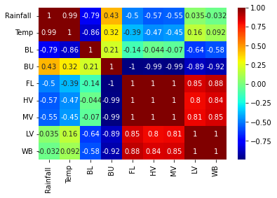
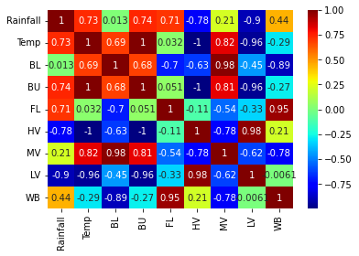
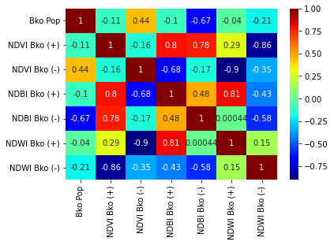
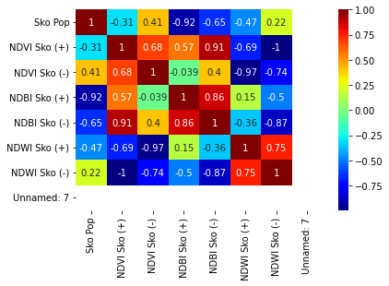
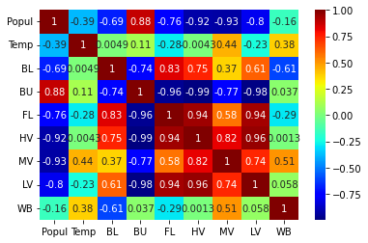
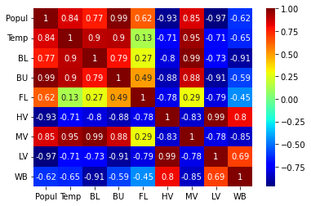
OS1
Objective 1: Spatial changes and the characteristics of the different types of UGS
CORRELATION BETWEEN LULC AND CLIMATE IN BAMAKO AND SIKASSO
CORRELATION BETWEEN DEMOGRAPHC AND NDVI, NDBI & NDWI IN BAMAKO AND SIKASSO
RESULTS
Figures 17 and 18:Correlations between Land Use Land Cover (LULC) and Climate Variability from 1990 to 2022
CORRELATION BETWEEN LULC AND DEMOGRAPHIC IN BAMAKO AND SIKASSO
Figures 21 and 22: Correlation between LULC and Demographic
Figures 19 and 20: Correlation between LULC and Demographic in Bamako (1) and Sikasso (2) from 1990 to 2020

Slide 14
OS2
Objective 2: Effects of UGS on Sustainability and Climate Change resilience and their ES
SOCIO-DEMOGRAPHIC CHARACTERISTICS OF THE RESPONDENT
Gender of respondent
Percentage %
Educational level of respondents
Percentage %
Most of the respondents are male in Bamako and female in Sikasso, with high educational level
RESULTS
Residence status
Percentage %
Mains activities
They have high level of residence status and Student as main activities
Figures 23, 24, 25 and 26: Socio-demographic characteristic of the respondents in Bamako and Sikasso

Slide 15
OS2
Objective 2: Effects of UGS on Sustainability and Climate Change resilience and their ES
Table 1: Criteria about the perception on Urban Green Spaces and their ecosystem services provided
Criterias | Perceptions
Provisioning ; Regulation and Maintenance ; Cultural | Excellent
Provisioning; Regulation and Maintenance | Good
Provisioning and regulating or Provisioning and Cultural or Cultural and Regulating | Moderate
Any of them | Poor
RESULTS
Figure 27: Perception of the status of urban green space in Bamako (n = 370) and Sikasso (n = 384) related to the sustainability of the respective respondents´ communities.
According to the criteria above, the majority of the respondents have a good perception on UGS.

Slide 16
OS2
Objective 2: Effects of UGS on Sustainability and Climate Change resilience and their ES
Mann-Kendall trend test for Bamako Senou
RESULTS
P-value = 0,990
P-value = < 0,019
P-value < 0.0001
Figures 32, 33 and 34: Mann-Kendall trend test for Bamako Senou
Mann-Kendall trend test for Bamako Sotuba
P-value = 0,587
P-value = 0,444
P-value < 0,0001
Figures 35, 36 and 37: Mann-Kendall trend test for Bamako Sotuba
Rainfall shows a non-significant trend in all cities, while the seasonal minimum temperatures show increasing trends in all cities except Bamako Senou where the trend is downwards.

Slide 17
OS2
Objective 2: Effects of UGS on Sustainability and Climate Change resilience and their ES
Mann-Kendall trend test for Bamako Ville
P-value = 0,505
RESULTS
P-value = 0,771
P-value < 0,0001
Figures 38, 39 and 40: Mann-Kendall trend test for Bamako Ville
Mann-Kendall trend test for Sikasso
P-value = 0,742
P-value < 0,0001
P-value < 0,0001
Figures 41, 42 and 43: Mann-Kendall trend test Sikasso
The seasonal maximum temperature of Sikasso city shows an upward trend, unlike the other stations where no trend is observed.

Slide 18
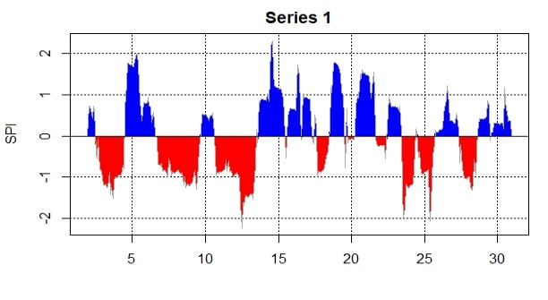
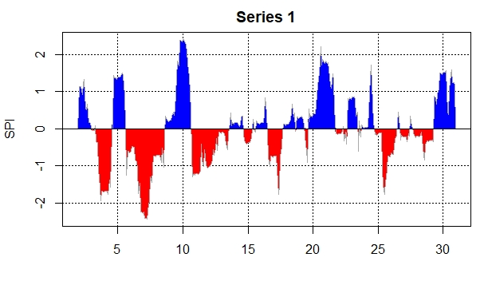
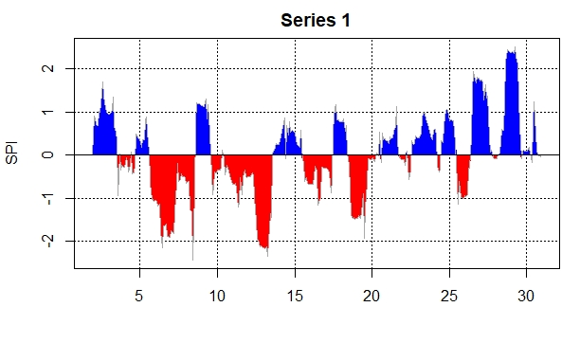
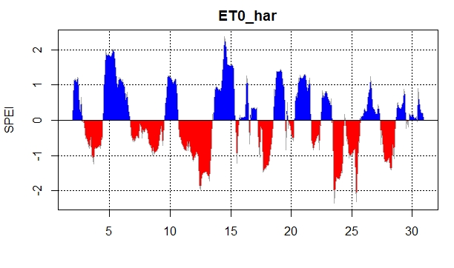
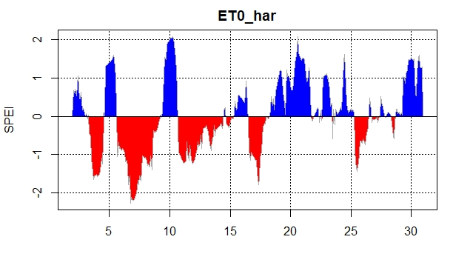
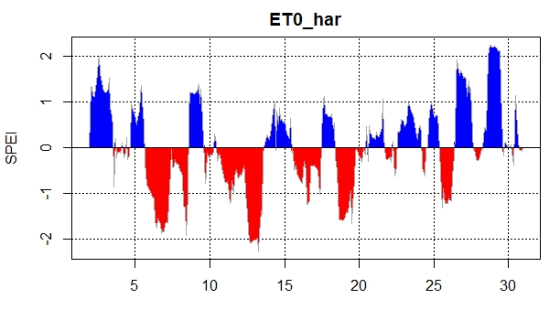
OS2
Objective 2: Effects of UGS on Sustainability and Climate Change resilience and their ES
Standardized Precipitation Index (SPI)
SPI 12 Bko_Senou
SPI 12 Bko_Sotuba
SPI 12 Bko_Ville
SPI 12 Sko_Ville
RESULTS
Figures 44, 45, 46 and 47: Standardized Precipitation Index (SPI) for Bamako Senou, Bamako Sotuba, Bamako Ville and Sikasso Ville
Standardized Precipitation Evapotranspiration Index (SPEI)
SPEI 12 Bko_Senou
SPEI 12 Bko_Sotuba
SPEI 12 Bko_Ville
SPEI 12 Sko_Ville
Figures 48, 49, 50 and 51: Standardized Precipitation Evapotranspiration Index (SPEI) for Bamako Senou, Bamako Sotuba, Bamako Ville and Sikasso Ville
The Figures show precipitation deficit, calculated using monthly precipitation, while the SPEI was calculate by incorporating the temperature which here gives us a drought (between -2 and 2).
The onset, duration and magnitude of drought conditions compared to normal conditions in a variety of natural systems such as green spaces has been determined.

Slide 19
OS3
Objective 3: Planning model for the improvement of UGS and their ES and the climate change resilience of Bamako and Sikasso green spaces
Based on the Standard for Classification of UGS by the Ministry of Urbanism and Habitat via the Regional Direction of Urbanism and Habitat, there are many ways urban planners can design and install green spaces in our cities.
For this purpose, the multi-level governance framework of transition management developed by (Loorbach, 2010) and applied by (Coronil, 2021; Kabisch, 2015b) was adapted to the case of green space planning strategies.
RESULTS

Slide 20
OS3
Objective 3: Planning model for the improvement of UGS and their ES and the climate change resilience of Bamako and Sikasso green spaces
Strategic
Setting long-term goals and visions for urban green space development for the whole city.
RESULTS
Tactical
Developing concrete green space related agendas, establishing networks and partnerships
Reflexive
Monitoring and evaluation.
Operational
Implementation of green space strategies and assets, execution of projects.
Figure 52: Multilevel governance framework
Planners are in favour of an assessment, as it can serve as a positive argument for developing green infrastructure.

Slide 21
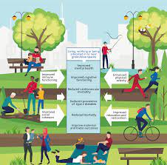
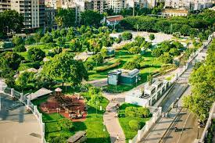
OS3
Objective 3: Planning model for the improvement of UGS and their ES and the climate change resilience of Bamako and Sikasso green spaces
RESULTS
Plate 1: Urban Green Space Benefits
Plate 2: Example of UGS Distribution
The planning and management of these green spaces are crucial to the idea of compact cities.

Slide 22
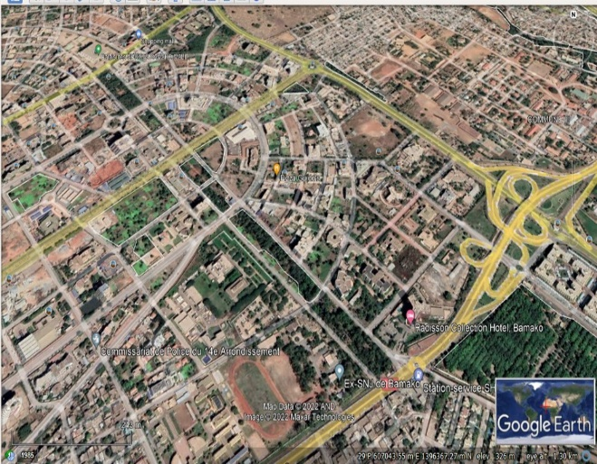
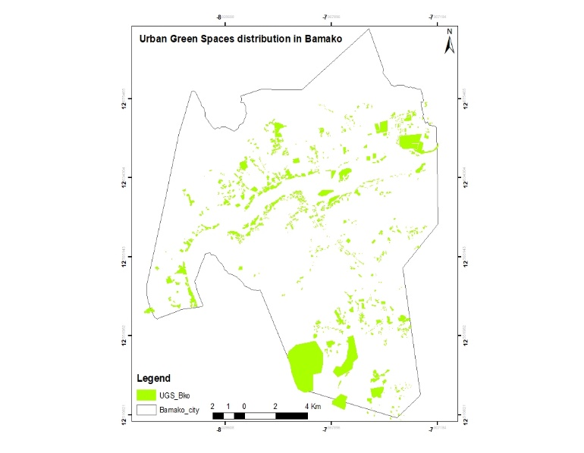
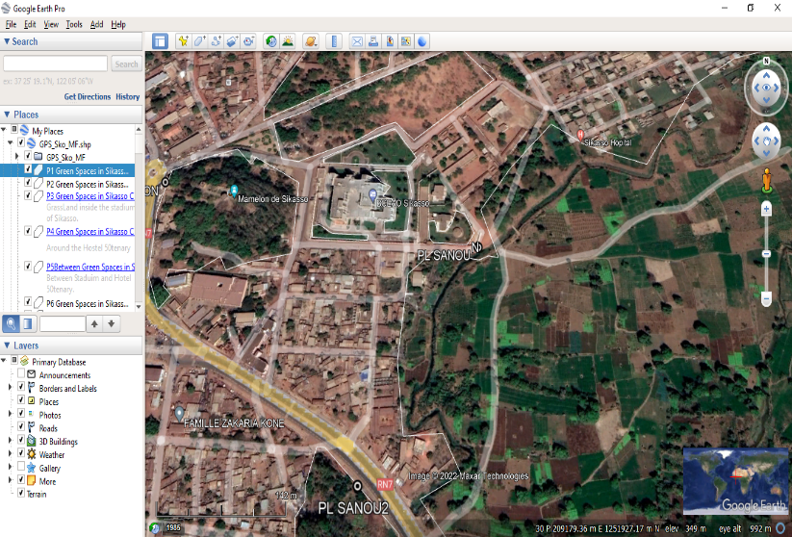
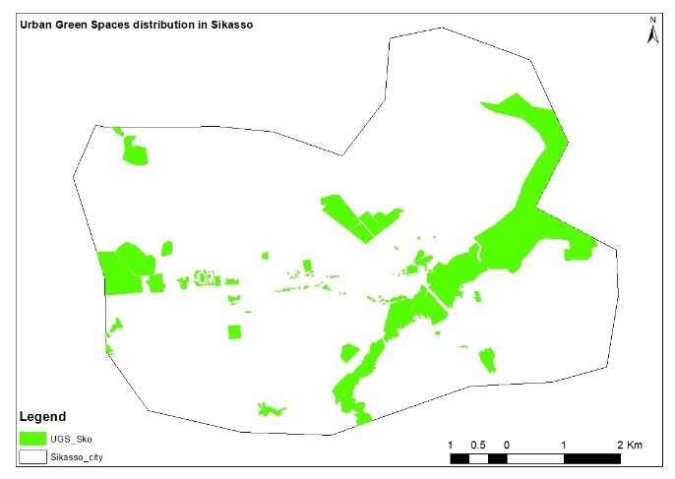
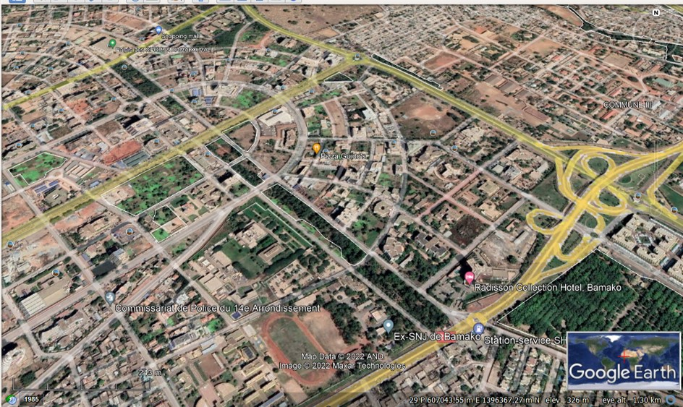
OS3
Objective 3: Planning model for the improvement of UGS and their ES and the climate change resilience of Bamako and Sikasso green spaces
Digitalization and Georeferencing of Bamako
Digitalization and Georeferencing of Sikasso
RESULTS
Plate 3: Bamako city
Figures 53 : Digitalization of Bamako
Plate 4: Sikasso city
Figure 54: Digitalization of Sikasso
The results showed the same areas covered by vegetation in LULC maps in Bamako and Sikasso cities, with high level density of settlements.

Slide 23
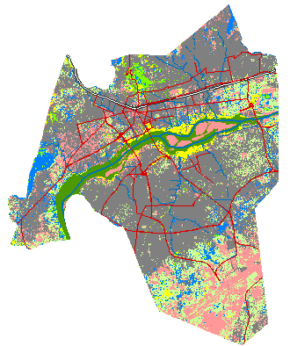
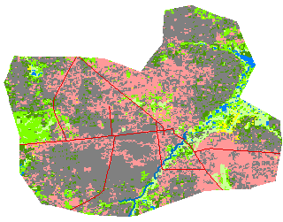
OS4
Objective 4: Develop a sustainable planning design for Bamako and Sikasso green spaces
Loading Scenario LULC_of Bamako and Sikasso
Bamako
Sikasso
RESULTS
Figure 55 and 56: Load scenario of Bamako and Sikasso
Likert scale indicator which runs from 0 to 100, criteria established, was used to simulate scenarios. So, this study concentrated on forecasts based on modifications in land use and perceptions of green spaces and their ecosystem services in urban areas based on the findings of land use analysis.

Slide 24
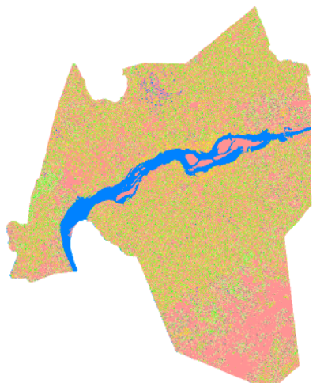
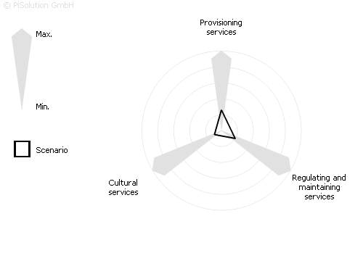


OS4
Objective 4: Carry out a sustainable planning design for Bamako and Sikasso green spaces
a. LULC status in Bamako
b. Status of the ES balance
a. LULC cover status in Sikasso
b. Status of the ES balance
RESULTS
Provisioning services | 26
Regulating and maintaining services | 20
Cultural services | 10
Provisioning services | 24
Regulating and maintaining services | 16
Cultural services | 13
Figures 57 and 58: Values of ES Provided by UGS in Bamako and Sikasso: a. The current land-use pattern, b. The status of ecosystem services is shown in the balance table corresponding to the spider chart.
In the balancing table corresponding to the spider map, the highest values for ecosystem services in both cities are provisioning services.

Slide 25
IMPLICATION OF RESULTS
These results can be used to set up some policies, to solve some climate issues in cities in order to improve sustainable cities and climate change resilience, through green spaces and ecosystems services provided in both cities.

Slide 26
This study conclude that:
Most of the vegetation classes have been converted into built-up areas
Strong relationship (social cohesion) with UGS (96.13%) in both cities, and good status attributed to UGS in Sikasso (64.59%).
Climate variables indicated a significant trends (P-value < 0.0001) on seasonal minimal temperatures which have positive correlation with rainfall, LULC classes and population.
Groundwater resources are considered non-existent, as shown by the SPI and SPEI indexes.
CONCLUSION

Slide 27
This study recommends specific actions needed:
RECOMMANDATIONS
To promote the sustainable land use system such as UGS which are crucial for the provision of ES and climate change resilience of cities;
To help urban planners to take into account the population's perception of the benefits of UGS for sustainable city with multiple ES.
To carry out land division and construction in accordance with the policy-making and urban master plan, which should be reviewed in light of the spatial dynamics of the cities.

Slide 28
Percentage of achieving of each Specific Objective
Manuscript under-review in International Journal of Geo-Informatique (IJG)
% OF ACHIEVING
Published in MDPI, Land Journal https://doi.org/10.3390/land13010059
5. COP 27 SHARM EL-SHEIKH EGYPT 2022: Urban climate change action: multi-dialogue of scientist – PhD Student – Entrepreneur – Public
OBJECTIVE 04
Reach
OBJECTIVE 03
3. Early-Career Researcher: Urban climate change action: interdisciplinary approaches, Berlin, Germany
4. World PhD Students Climate Change Summit, www.haw-hamburg.de/ftznk.html
OBJECTIVE 02
Conferences
1st International Electronic Conference on Land https://sciforum.net/event/IECL2022.
Landscape Development, University of Halle, Germany, https://link.springer.com/ book/10.1007/978-3-030-45106-6
OBJECTIVE 01
From January 2020 to March 2023
Time

Slide 29
THANK YOU FOR YOUR
ATTENTION!
  Mohamed FOMBA, Ph.D/SPS/FT/2019/11125
  E-mail: fonbamohamed@gmail.com; fomba.m@edu.wascal.org

