Slide 1
PhD External defence presentation
ASSESSMENT OF THE EFFECT OF URBANISATION AND GLOBAL WARMING NEXUS ON TAHOUA AND ZINDER CITIES OF NIGER REPUBLIC
By
Kadiza DOULAY SEYDOU
PhD/SPS/FT/2021/13005
Major supervisor
Prof. Oluwole MORENIKEJI , Nigeria
Co-supervisors
Dr. Abdoulaye DIOUF, Niger
Prof. Ralf Loewner, Germany
17th of April 2025

Slide 2
CONTENT
Introduction
  1.1 Background
  1.2 Research gap
  1.3 Aim and Objectives
Material and Methods
Results and discussion
Conclusions and Recommendations
References
Dissemination

Slide 3
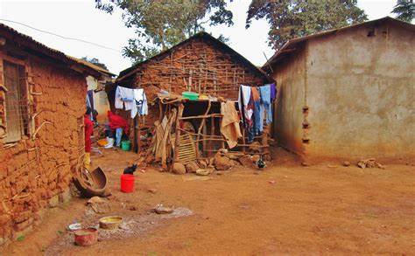
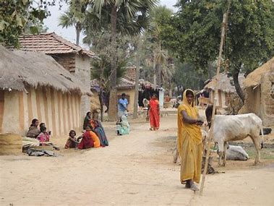

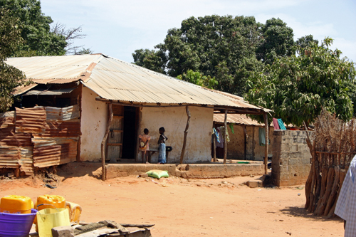
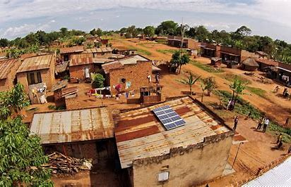
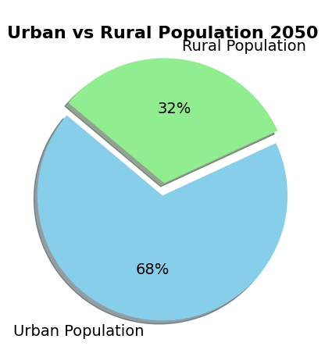
1.Introduction
Education and health care
Technological Advancements
1.1 Background
Economic Opportunities
Infrastructure and Amenities
Africa and Asia (United Nations, 2018)
90%

Slide 4
1. Introduction
Institutional conflicts
Politics
Tahoua and Zinder
Inequal right
Unplanned urban growth
1.1 Background
Educational stratification
Culture
Ecology
LULC CHANGE
Extreme heat hazard
URBANISATION
Rural tradition loss
(World Bank, 2007).
Rising temperatures
health and environmental risks
Housing prise rising
Economy
society
Tahoua is ranked among the highest-risk regions> 1000 cases of measles
Zinder : 500 -1000 cases
(Lamine, 2023).
Lifestyle change
Income inequality
Social capital reduction

Slide 5
1.2 Research Gap
Tahoua, Zinder: medium size cities;
Lack of information about development;
Heat vulnerability and risk studies only at large scales (Inostroza et al., 2016; Manik and Syaukat, 2017; Voelkel et al., 2018; Jagarnath et al., 2020);
No such studies in Niger;
Regional or multicity-level studies do not have the required resolution for targeted interventions.

Slide 6
1.3 Aim and objectives
i. Land use and land cover (LULC) dynamics
from 1988 to 2022
v. Simulation of future urban growth and LST
business-as-usual scenario
ii. Spatiotemporal patterns of land surface temperature (LST);
relationship with LULC
Tahoua & Zinder
urban growth dynamics,
effect of urban growth and global warming on LST
sustainable urban planning
iv. Extreme heat vulnerability analysis
Identification of coping and adaptation strategies
iii. Historical trend of heat indices
relation to global climate change

Slide 7
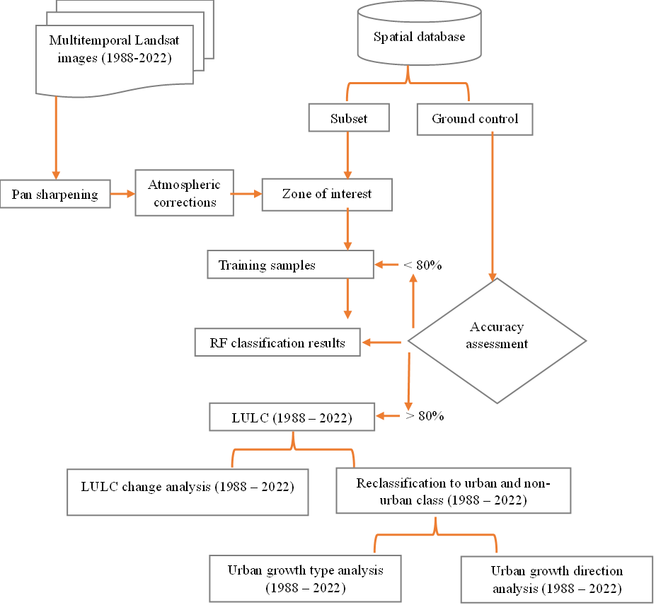


2. Material and methods 1/5
2.1 Landscape change analysis (1988-2022)

Slide 8
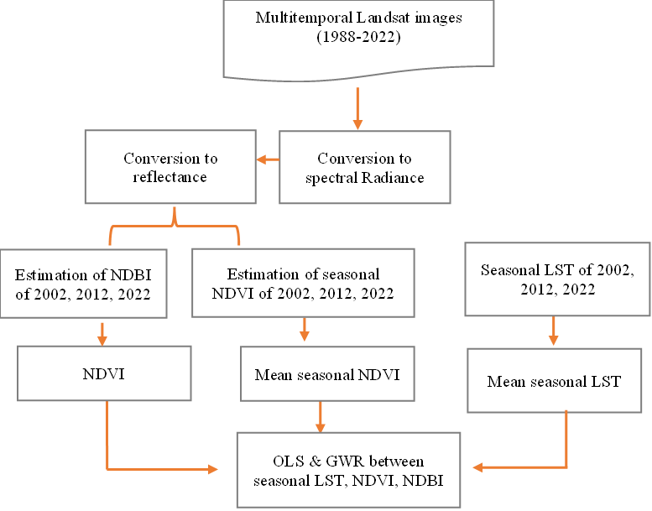

2. 2 Spatiotemporal pattern of LST and the relationship between LULC Indices (NDVI, NDBI) and LST
2. Material and methods 2/5

Slide 9



3. Trend of extreme temperature indices
Description of extreme temperature indices
Index | Full Name | Definition | Units | Time Scale
TXx | Max temperature | Warmest daily maximum temperature (hottest day) | °C | Mon/Ann
TXn | Min temperature | Coldest daily maximum temperature (coldest day) | °C | Mon/Ann
TXm | Mean temperature | Mean daily maximum temperature | °C | Mon/Ann
TN10p | Cold nights | Percentage of days when TN < 10th percentile | % | Ann
TN90p | Warm nights | Percentage of days when TN > 90th percentile | % | Ann
TX10p | Cool days | Percentage of days when TX < 10th percentile | % | Ann
TX90p | Hot days | Percentage of days when TX > 90th percentile | % | Ann
TNm | Mean minimum T | Mean daily minimum temperature | °C | Mon/Ann
TNn | Min TN | Coldest daily minimum temperature (coldest night) | °C | Mon/Ann
TXgt40 | Days with TX > 40°C | Number of days where TX > 40°C | Days | Ann
WSDI2 | Warm Spell Duration Indicator | Annual count of days with warm spells of at least 6 consecutive days where TX > 90th percentile | Days | Ann
HWN | Heatwave Number | Number of heatwave events (≥ 3 consecutive HW days) | Events | Ann
HWF | Heatwave Frequency | Number of days contributing to heatwaves | Days | Ann
HWD | Heatwave Duration | Duration (in days) of the longest heatwave | Days | Ann
HWM | Heatwave Magnitude | Mean of the mean temperature during HW days | °C | Ann
HWA | Heatwave Amplitude | Peak daily value in the hottest HW | °C | Ann
2. Material and methods 3/5

Slide 10
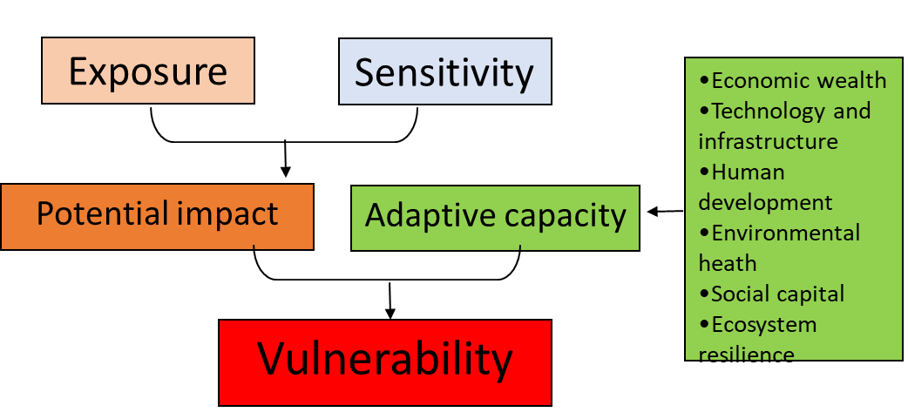
4. UHV assessment
Calculation of Vulnerability Indices
Components of UHV
Additive overlays Analysis of the indicators was done to compute each vulnerability component
Indices Formulas
  V1=E+S−A ( Inostroza et al., 2016)
  V2=E×S×A (Voelkel et al., 2018)
4. Material and methods 4/5
Societal Heat Vulnerability Assessment
Framework (Nakul et al., 2018)

Slide 11
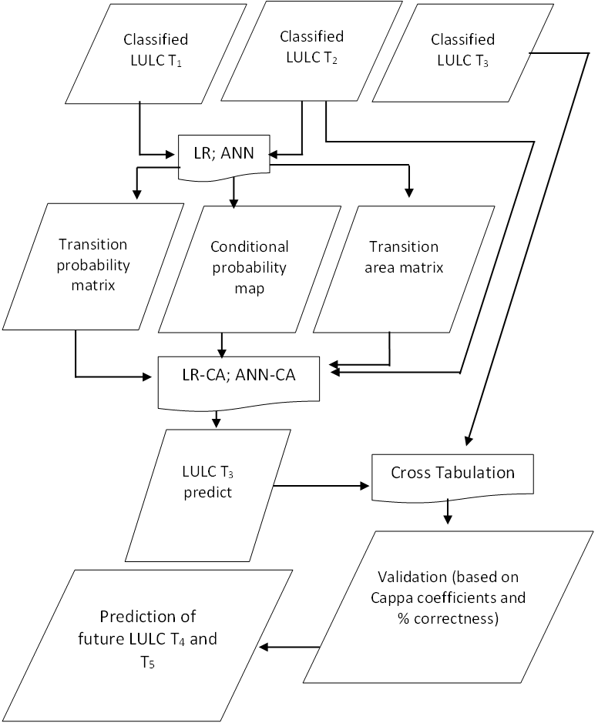
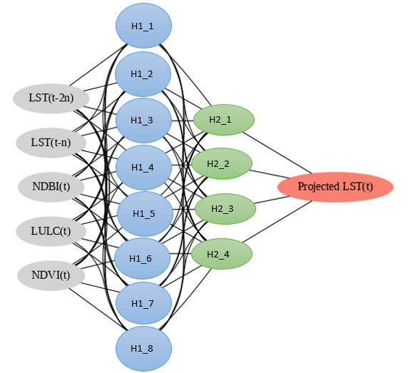

5. Simulation of LULC and LST
Workflow for projecting LULC
Neural network model for projecting LST
2. Material and methods 5/5

Slide 12
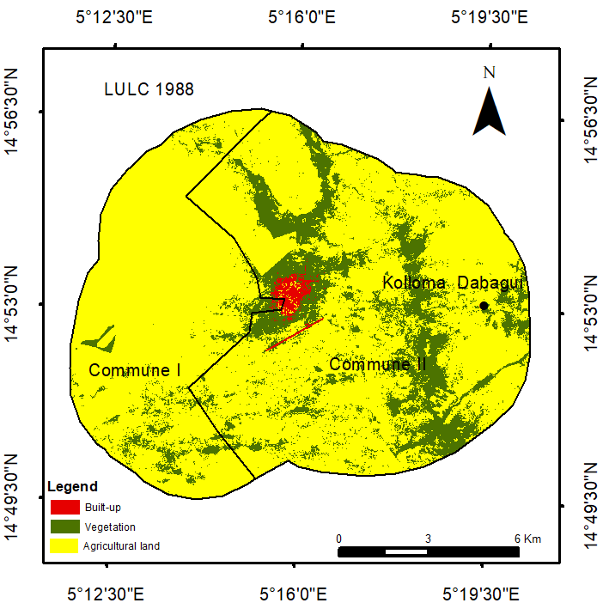
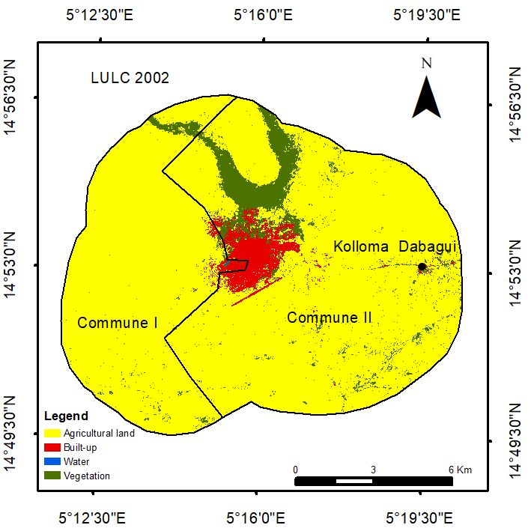
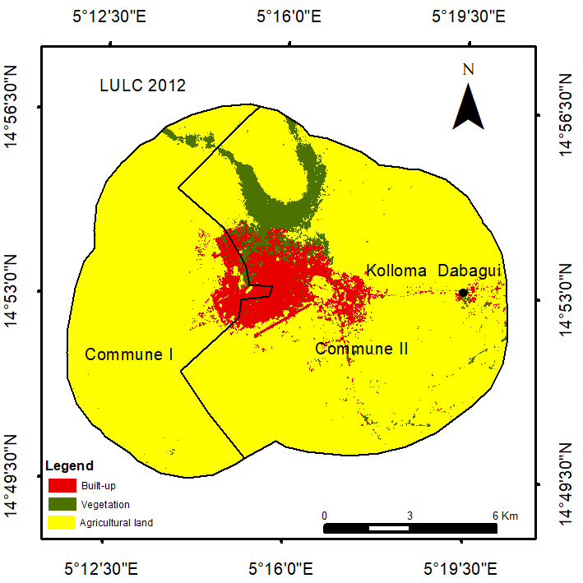
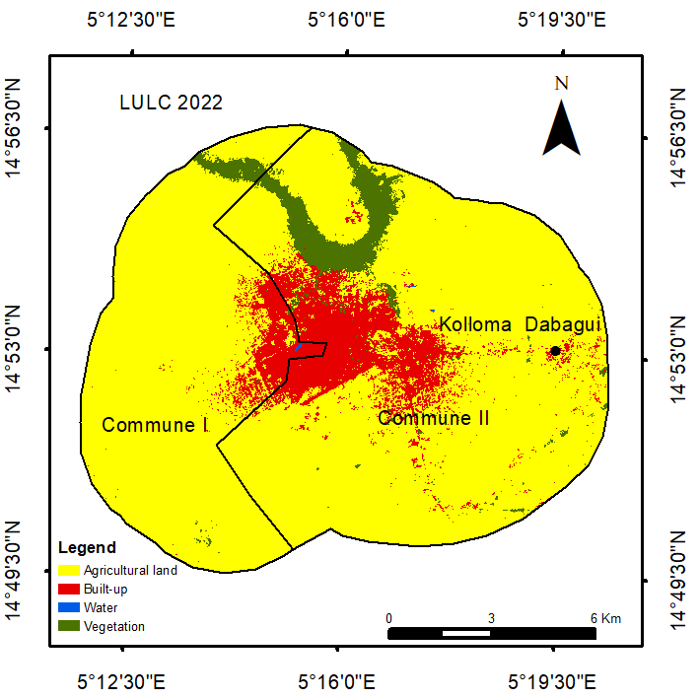
3.1 Landscape change dynamics in Tahoua and Zinder
LULC change 1988-2022
Obj.1
Proportion of LULC change 1988-2022
3. Results and Discussions 1/12

Slide 13
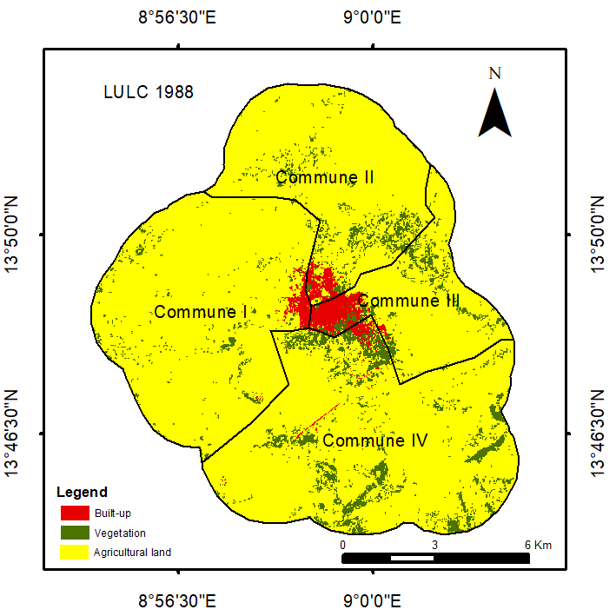
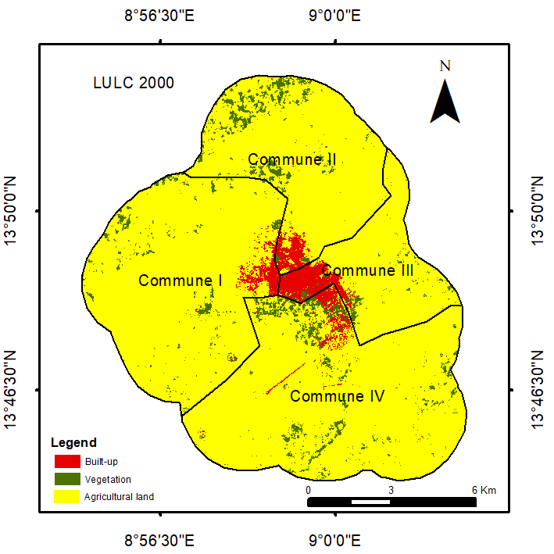
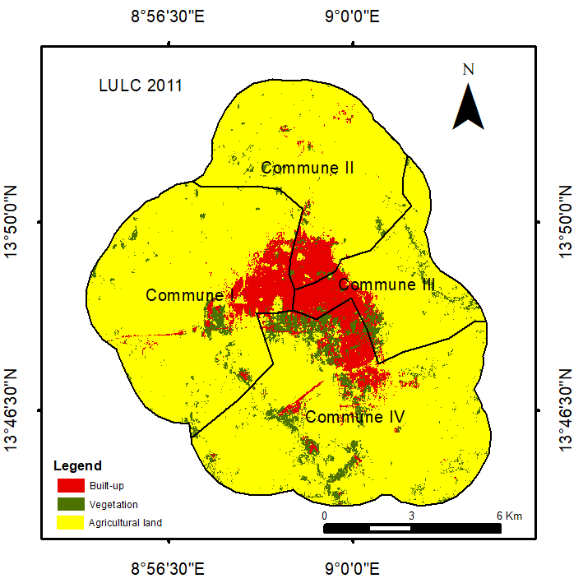
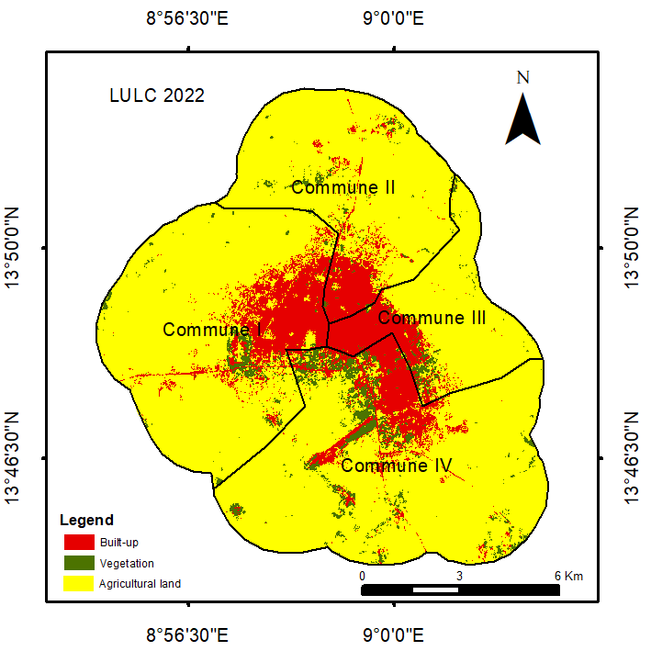
3.1 Landscape change dynamics in Tahoua and Zinder
LULC change 1988-2022
Proportion of LULC change 1988-2022
3. Results and Discussions 2/12

Slide 14
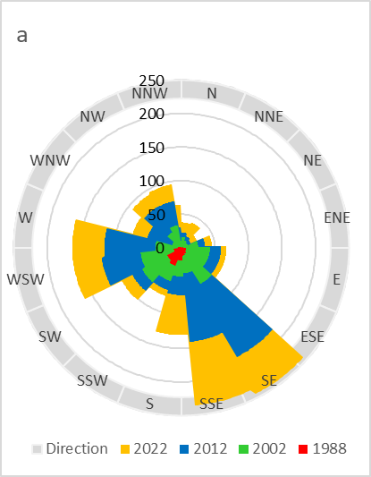
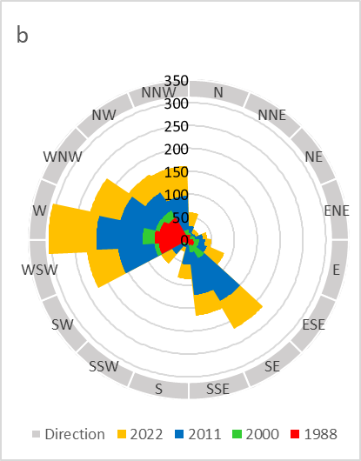
3.1 Landscape change dynamics in Tahoua and Zinder
Urban Growth Direction from 1988 to 2022
Tahoua
Zinder
Jibrin et al. (2024) – Abuja-Keffi,
Oladepo et al . (2021) in Ille-Ife
Mallick (2020) in Abha City, Saudi Arabia
3. Results and Discussions 4/12

Slide 15
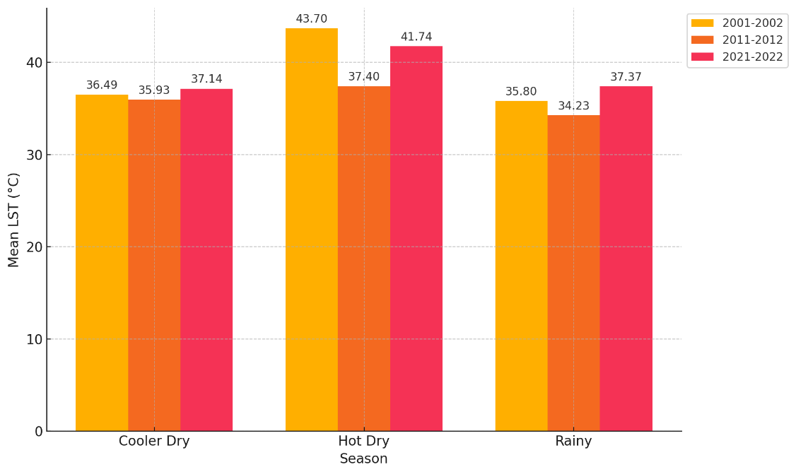
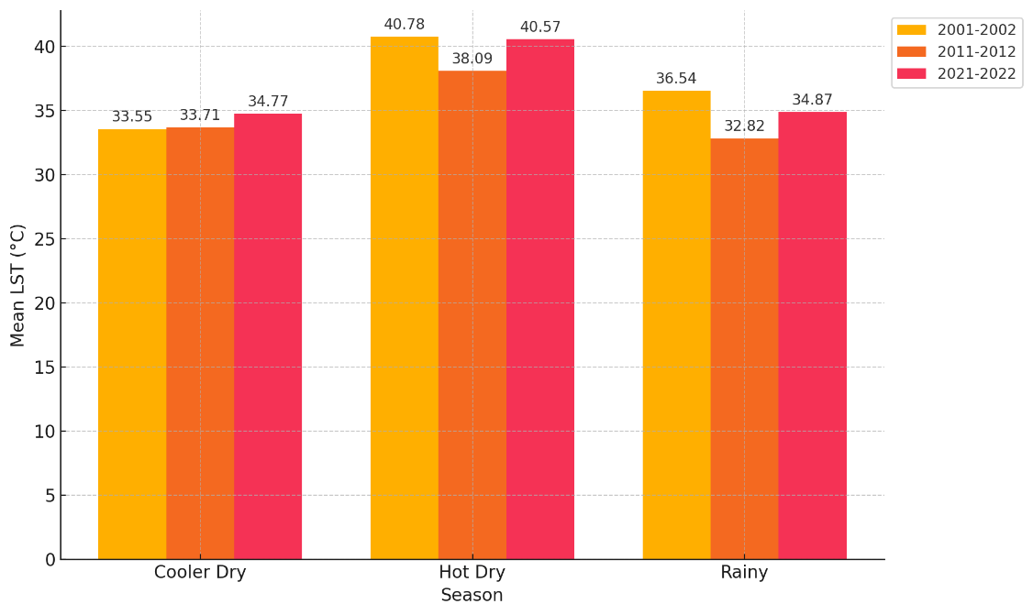
3. 2.1 Spatiotemporal pattern of LST
Tahoua
Zinder
2002
Land temperatures 0.87°C and
ocean temperatures 0.42°C mean 1880-2001 (NOAA, 2003)
3. Results and Discussions 5/12

Slide 16
3.2.2 LST, NDBI, NDVI relationship
OLS model highest performance value during the rainy season (in Tahoua 23% and in Zinder 37%) .
The GWR model outperformed OLS: R² values with ranges from 94% to 96% and the Corrected Akaike Information Criterion values (AICc) of GWR in all seasons are less than that of OLS.
An inconsistent direction and intensity of the relationship
  Similarity: Alademomi et al.(2022)
  Dissimilarity: Ghobadi et al., 2015; Guha et al., 2019; Guha & Govil, 2020; Hussain et al., 2022; Yue et al., 2007.
3. Results and Discussions 6/12

Slide 17
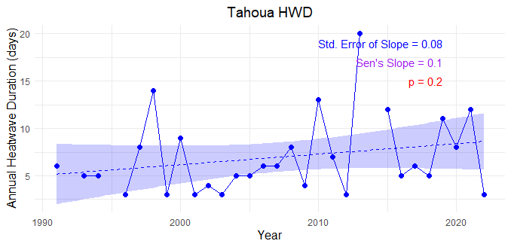
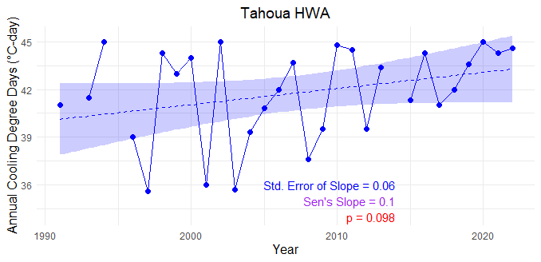
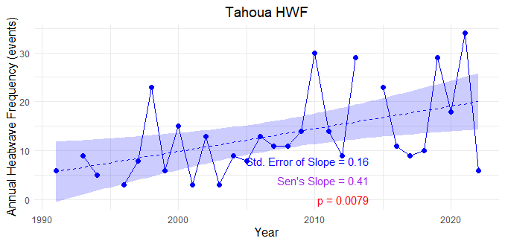
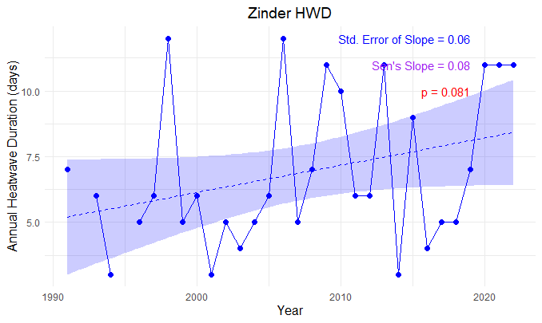
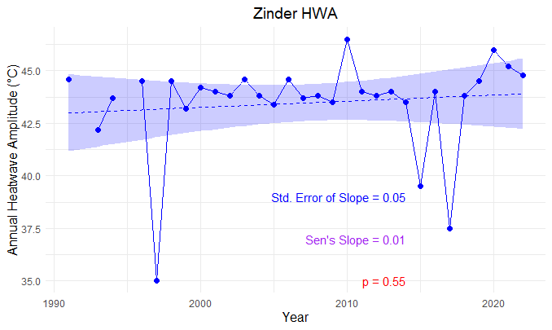
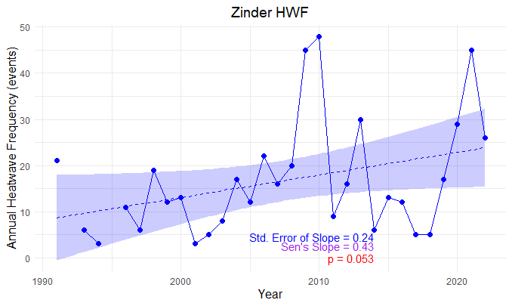
3.1 Trend of Extreme heat indices
3. Results and Discussions 6/12
This aligns with the patterns seen throughout West Africa and highlighted by the IPCC (IPCC, 2021; Sylla et al., 2015; T. Weber et al., 2018).

Slide 18
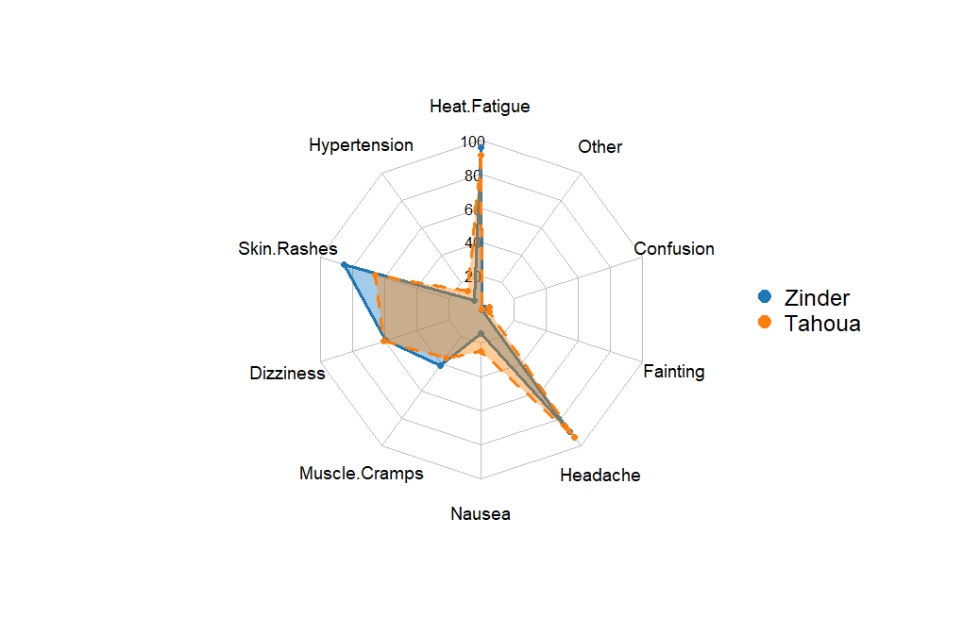
3.2 Heat health impact
3. Results and Discussions 6/12
Heat-related illnesses are underrecognized public health concerns.

Slide 19
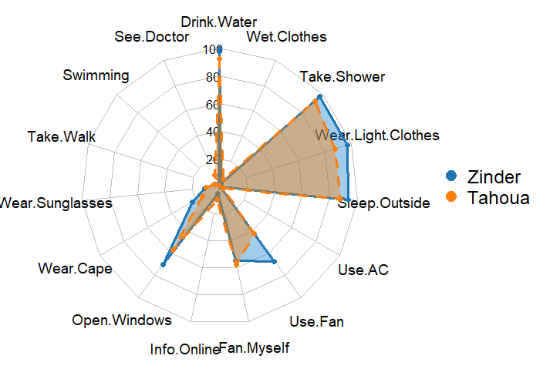
3.3 Heat Stress Coping Strategies
3. Results and Discussions 6/12
The low rate of medical intervention than 5%):
limited access to care
lack of awareness about heat illness severity

Slide 20
Results and Discussions 10/12
3. 4. Urban heat vulnerability
Tahoua: Adoum, Tougoulaoua, and Kourfayawa
Zinder: Garin Liman, Karkada, Charé, Malan Amar, and Yanda Kwandagué.

Slide 21
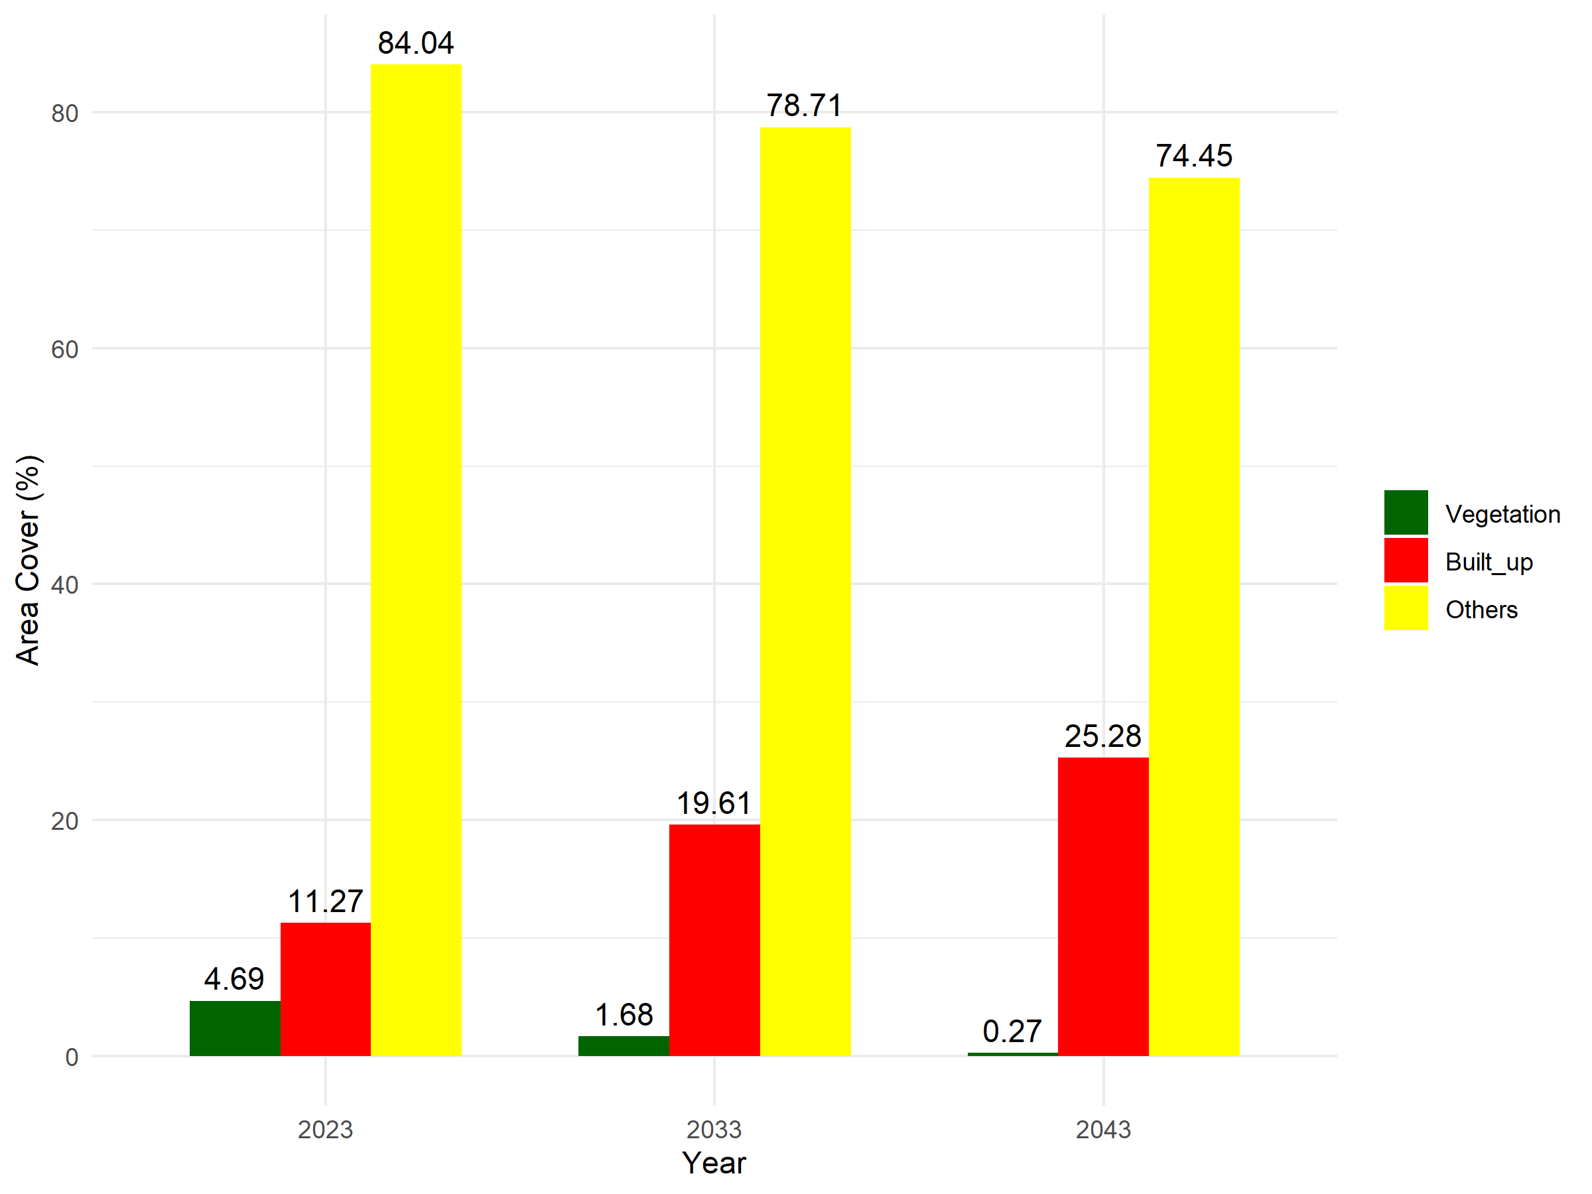
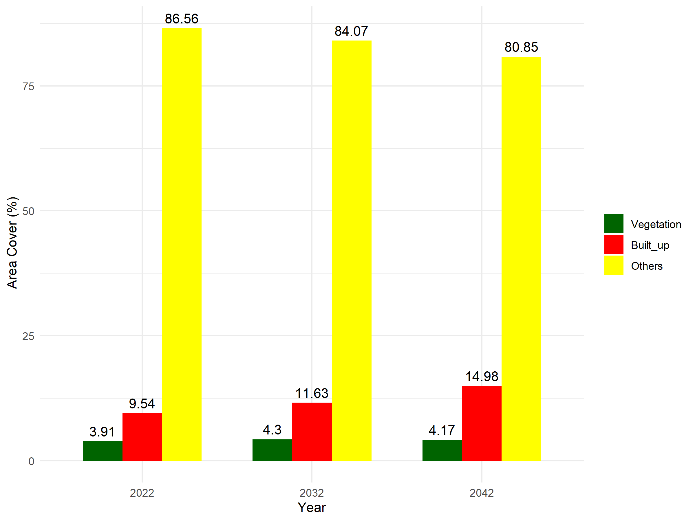
3.5.1 Future LULC
Tahoua
Table 3: Model Accuracy Assessment
LULC Class | CA-ANN | CA-LR
Vegetation | 84.91 | 81.97
Built-up | 72.16 | 88.25
Others | 95.57 | 97.47
Overall Accuracy | 92.53 | 95.73
Kappa Coefficient | 0.77 | 0.76
3. Results and Discussions 11/12
Zinder

Slide 22
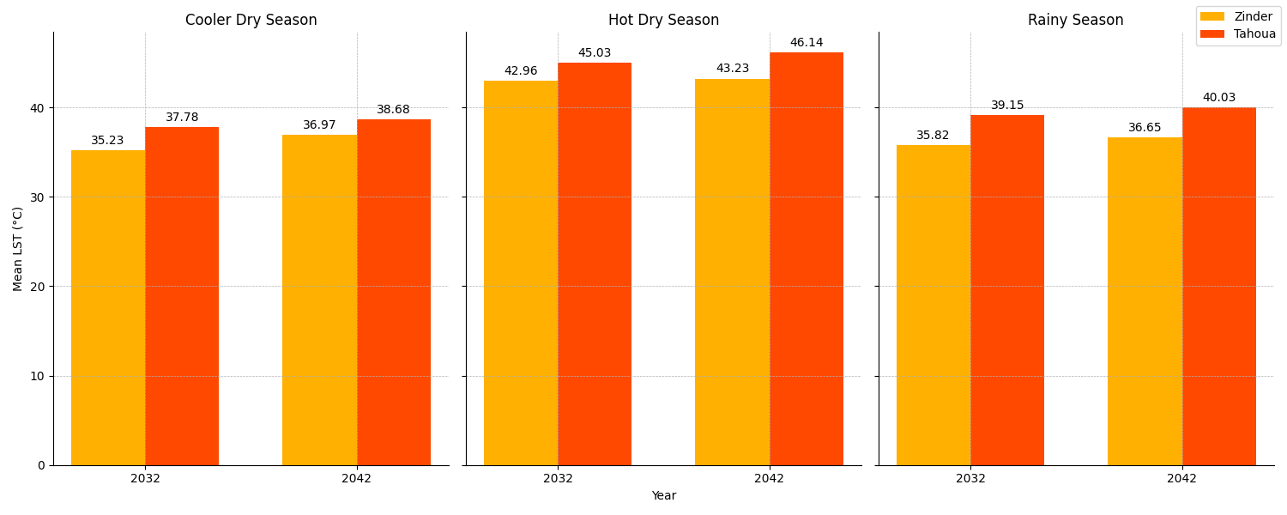
3.5.2 Future LST
3. Results and Discussions 6/12

Slide 23
The study analysed urban landscape dynamics over 34 years and provided future projections using remote sensing, GIS, machine learning and urban growth modelling. It also highlighted the seasonal variation and relationship between LULC and LST, providing vital information about heat-vulnerable areas, which is functional for targeted interventions.
-Urban growth and direction drivers: Guiding expansion
-Vulnerability mapping Heat mitigation
-Future projection highlights Calls for intervention
4. Conclusions and Recommendations

Slide 24
5. References
Alademomi, A. S., Okolie, C. J., Daramola, O. E., Akinnusi, S. A., Adediran, E., Olanrewaju, H. O., Alabi, A. O., Salami, T. J., & Odumosu, J. (2022). The interrelationship between LST, NDVI, NDBI, and land cover change in a section of Lagos metropolis, Nigeria. Applied Geomatics, 14(2), 299–314, doi.org/10.1007/S12518-022-00434-2/METRICS
Hussain, S., Lu, L., Mubeen, M., Nasim, W., Karuppannan, S., Fahad, S., Tariq, A., Mousa, B. G., Mumtaz, F., & Aslam, M. (2022). Spatiotemporal Variation in Land Use Land Cover in the Response to Local Climate Change Using Multispectral Remote Sensing Data. Land, 11(5), 595, doi.org/10.3390/land11050595
Inostroza, L., Palme, M., & Barrera, F. De. (2016). A Heat Vulnerability Index : Spatial Patterns of Exposure , Sensitivity and Adaptive Capacity for Santiago de Chile. PLOS One, 11(9), e0162464, doi.org/10.1371/journal.pone.0162464
Liu, X., Li, X., Chen, Y., Tan, Z., Li, S., & Ai, B. (2010). A new landscape index for quantifying urban expansion using multi-temporal remotely sensed data. Landscape Ecology, 25(5), 671–682, doi.org/10.1007/s10980-010-9454-5.
Nakul, C., Karma, T., Arun, S., & Eklabya, S. (2018). Ecological vulnerability to climate change in the mountains: a case study from the Eastern Himalayas. Google Scholar, 707-721. doi.org/10.3390/RS1020333
NOAA. (2003). National Centers for Environmental Information, Monthly Global Climate Report for Annual 2002. Retrieved from https://www.ncei.noaa.gov/access/monitoring/monthly-report/global/200213, 23rd January, 2025.
United Nations. (2018). World Urbanisation Prospects : The 2018 Revision Retrieved from https://population.un.org/wup/Publications/Files/WUP2018-KeyFacts.pdf, 25th Janvier, 2022.

Slide 25
PUBLICATION
Doulay Seydou, K.; Morenikeji, W.; Diouf, A.; Dicko, K.; Erdanaev, E.; Loewner, R.; Okhimamhe, A.A. Dynamics of Zinder’s Urban Landscape: Implications for Sustainable Land Use Management
CONFERENCES
Doulay, S. K., Morenikeji, W., Diouf, A., Erdanaev, E., Loewner, R. (7th November 2024). Assessing Heat-Related Disaster Risks: Trends of Extreme Temperature Indices from 1991 to 2022 in Tahoua, Niger Republic. Oral presentation at the International Conference on Global Warming, Climate Change and Pollution Control (GWCCPC-24) held in Rostov-on-Don, Russia .
Doulay, S. K., Morenikeji, W., Diouf, A., Erdanaev, E., Loewner, R., (19 November, 2024). Land Use and Land Cover Changes in Tahoua, Niger Republic: Implications for Biodiversity Conservation and Environmental Sustainability. Oral Presentation at the First International Conference of the Pan African University organized by PAULESI, Ibadan, Nigeria
Doulay, S. K., Morenikeji, W., Diouf, A., Erdanaev, E., Loewner, R., (12 November, 2024). Mapping the vulnerable: Assessing urban heat vulnerability and its impacts in Tahoua and Zinder, Niger republic. Oral Presentation at the 5th Faculty of Science International Conference, 2024. Adekunle Ajasin University, Nigeria
6. Dissemination

Slide 26
Thank you
Merci

