Slide 1
ORAL EXAMINATION
Thesis Title:
CLIMATE CHANGE AND LAND USE IMPACTS ON MIGRATION AND FOOD SECURITY IN NORTH CENTRAL REGION OF NIGERIA.
By:
OKELEYE, SUNDAY OPEYEMI [B.Agric (OAU Ile-Ife), M.Res (Lomé)] (PhD/SPS/FT/2019/11129)
Major Supervisor: Prof. Appollonia A. OKHIMAMHE
Co-Supervisor : Dr. Safiétou SANFO
German Co-Supervisor : Prof. Christine FÜRST
September 2023

Slide 2
Presentation Outline
Background to the study
Problem statement
Justification
Aim and objectives
Description of study area
Scope
Methodology used
Key results
Implication of results
Conclusion and recommendations
References

Slide 3
1.1 Background to the Study
Nigeria is faced with food crisis worsened by negative effects of climate change.
Climate change is a major threat to food security and sustainable development in Africa and Nigeria.
Climate change is a driver of rural migration and increases other socio-economic causes of migration like food insecurity and rural poverty.
Migration is seen as a growing and complex global phenomenon

Slide 4
1.2 Problem Statement
Climate change and agriculture are deeply related.
Combination of food insecurity and poverty contribute to rural-urban migration.
Migration can be regarded as an adaptation strategy to climate change.
One to four members of the majority of the farming households in North Central Nigeria migrate every year (Ngutsav 2021).

Slide 5
1.3 Justification
Most of the studies on climate change and land use in Nigeria have not comprehensively analyzed the land use-migration-food production nexus in North Central Region of Nigeria (Ugbem 2019, Ideki and Weli, 2019, Dahiru and Tanko, 2018).
Uncertainties in climate have great impacts on both the agriculture and economy of the region and the nation as a whole.
The results of this research may provide insight to the future impacts of climate change on food security using future climate scenarios.

Slide 6
1.4 Aim and Objectives
The aim of this study is to analyse the climate-land use change and migration nexus and the consequent impacts on food crop production in North Central Region of Nigeria.
Specific objectives are to:
i. examine the trends in temperature and rainfall patterns in North Central Region of Nigeria (1985-2020);
ii. assess the spatio-temporal dynamics of land use within the period of 1990-2020;
iii. evaluate the resultant impacts of climate change and land use on migration as it affects food production and food security; and
iv. identify sustainable adaptation strategies to minimize the impacts of climate, and land use changes and migration monitoring at different levels.

Slide 7
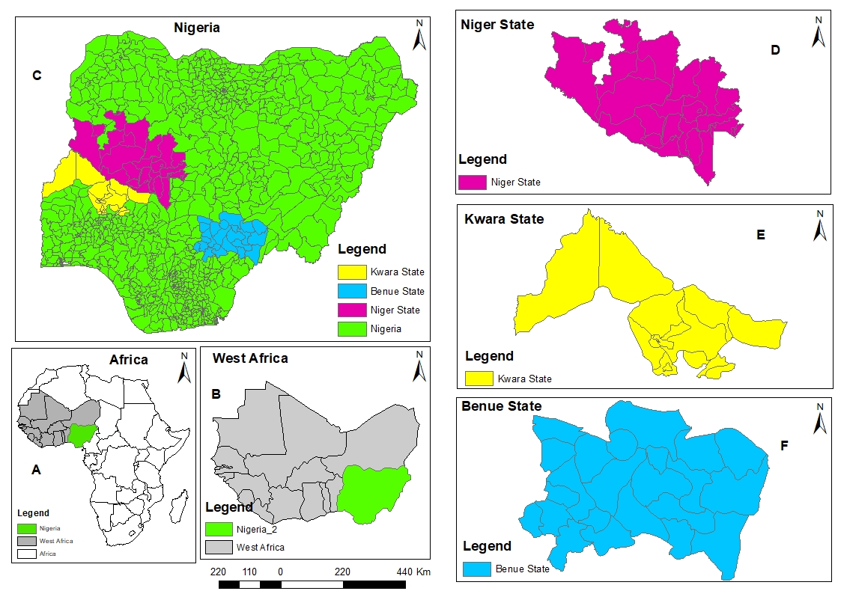
1.5 Description of the Study Area
1.5.1 Location
The study was carried out in the North Central Region of Nigeria with Longitude 4000’-11000’ East of the Greenwich Meridian and Latitude 7000’-11030’ North of the equator.
Figure 1: Map showing study area

Slide 8
3.0 MATERIALS AND METHODS
3.1 Description of Materials
Satellite images, temperature and rainfall data, questionnaires, Geographic Positioning System (GPS) and GIS tools were used
3.1.1 Climate Data:
Air temperature and rainfall data were downloaded from NASA’s website. These data covered 1985-2020.
3.1.2 GIS/Remote Sensing
Portable Global Positioning System (GPS) was used to take all the coordinates needed and Landsat 5 TM, Landsat 7 TM+ and Landsat 8 remote sensing images covering 1990-2020 were employed for the study.
3.1.3 Crops Yields Data
Crops yields data (2005-2020) were extracted from National Agricultural Reports.
3.1.4 Migration Data
Net migration data by United Nations for Nigeria for the period of 2005-2020 were downloaded from the World Bank’s website. These data were accessed on 29th November, 2022.

Slide 9
3.0 MATERIALS AND METHODS [CONTINUATION]
3.1.4 Sample Survey
Primary data were collected using expert interview, focused group discussions and questionnaire.
Multi-stage random sampling technique was used to select a sample size of 600 respondents.
Locations that are mostly affected by land use and land cover change and migration in the three States were selected after due consultations with the experts and stakeholders (village heads, extension officers, ADP staff etc.)

Slide 10
3.0 MATERIALS AND METHODS [CONTINUATION]
3.2 Method of Data Analysis
The processed satellite imageries were analyzed using maximum likelihood classification into five (5) LULC classes: vegetation, water body, agricultural land, barren land and built-up area.
The results were assessed for accuracy using a scale range of -0.1 to 1, any scale above 0.5 to 1 indicated an accurate assessment while scale below 0.5 was considered inaccurate.
Mann-Kendall test was used to determine the trend of temperature and rainfall.
Crops yields were subjected to regression analysis

Slide 11
PRIMARY AND SECONDARY MEANS OF DATA ACQUISITION
Climate Data
Landsat Satellite Data
GPS, Focus Group Discussion and Social Survey
Crop Yields Data
Minimum Temperature
Geo-referencing and Pictures
Crop Yields of Maize, Yam, Cassava, Rice and Groundnut
Classification ROIs Sampling, NDVI
Maximum Temperature
Post-Classification Accuracy assessment, Kapa, LULC Maps for 1990, 2000, 2013 and 2020
Feasibility Study and Transect Walk
Average Temperature
Rainfall
Questionnaire Administration, FGD and Expert Interview
Trend Analysis
Rate of Migration in 1990, 2000, 2013 and 2020
CLIMATE CHANGE AND LAND USE IMPACTS ON MIGRATION AND FOOD SECURITY
Figure 4: Methodology Flowchart

Slide 12
4.0 KEY RESULTS
4.1 Objective 1: Examining the trends in temperature and rainfall patterns in North Central Region of Nigeria (1985-2020)
Figure 5: Trend Analysis of Air Temperature and Rainfall for Niger State
There was an upward and statistically significant increase in the trend at a 5% level of significance in minimum, maximum and average temperatures of Niger State since the computed p-value (<0.0001) is less than the significant level, alpha (0.05)
There was a downward and statistically significant decreasing trend in the annual rainfall of Niger State (p=0.006, α=0.05 and Sen’s slope (Q)= -14.324)

Slide 13
4.0 KEY RESULTS (Cont.)
4.1 Objective 1: Examining the trends in temperature and rainfall patterns in North Central Region of Nigeria (1985-2020)
Figure 6: Trend Analysis of Air Temperature and Rainfall for Kwara State
There was an upward and statistically significant increasing trend in minimum temperature of Kwara State.
There was statistically insignificant trends in maximum temperature, average temperature and annual rainfall of Kwara State because their p-values are greater than alpha.

Slide 14
4.0 KEY RESULTS (Cont.)
4.1 Objective 1: Examining the trends in temperature and rainfall patterns in North Central Region of Nigeria (1985-2020)
Figure 7: Trend Analysis of Air Temperature and Rainfall for Benue State
There was an upward and statistically significant increase in the trends of minimum, maximum and average temperatures of Benue State (p (<0.0001 ) is less than α(=0.05)
There was a downward and statistically significant decreasing trend in the annual rainfall of Benue State [p=0.010, α=0.05 and Sen’s slope (Q)= -11.661]

Slide 15
4.0 KEY RESULTS (Cont.)
4.1 Objective 1: Examining the trends in temperature and rainfall patterns in North Central Region of Nigeria (1985-2020)
Table 1: Trend Analysis of Air Temperature and Rainfall for Niger, Kwara and Benue States
State | Test | Min Temp | Max Temp | Average Temp | Rainfall
Niger | P-value (two-tailed) | <0.0001 | <0.0001 | <0.0001 | 0.006
 | Mann-Kendall stat (S) | 330 | 296 | 324 | -204
 | Kendali’s tau | 0.524 | 0.470 | 0.514 | -0.324
 | Alpha | 0.05 | 0.05 | 0.05 | 0.05
 | Sen’s slope Q | 0.047 | 0.066 | 0.059 | -14.324
 | Var (s) | 5390 | 5390 | 5390 | 5390
 | Trend | Increasing | Increasing | Increasing | Decreasing
Kwara | P-value (two-tailed) | 0.002 | 0.817 | 0.099 | 0.902
 | Mann-Kendall stat (S) | 234 | 18 | 122 | -10
 | Kendali’s tau | 0.371 | 0.029 | 0.194 | -0.016
 | Alpha | 0.05 | 0.05 | 0.05 | 0.05
 | Sen’s slope Q | 0.020 | 0.04 | 0.012 | -0.328
 | Var (s) | 5390 | 5390 | 5390 | 5390
 | Trend | Increasing | Insignificant | Insignificant | Insignificant
Benue | P-value (two-tailed) | <0.0001 | <0.0001 | <0.0001 | 0.010
 | Mann-Kendall stat (S) | 329 | 302 | 340 | -190
 | Kendali’s tau | 0.523 | 0.479 | 0.540 | -0.302
 | Alpha | 0.05 | 0.05 | 0.05 | 0.05
 | Sen’s slope Q | 0.036 | 0.052 | 0.044 | -11.661
 | Var (s) | 5390 | 5390 | 5390 | 5390
 | Trend | Increasing | Increasing | Increasing | Decreasing

Slide 16
4.0 KEY RESULTS (Cont.)
4.1 Objective 1: Examining the trends in temperature and rainfall patterns in North Central Region of Nigeria (1985-2020)
Table 2: Descriptive Statistics of Air Temperature and Rainfall.
States | Parameters | Observations (No of Years) | Minimum | Maximum | Mean | Variance | Standard Variation | Coefficient of Variation (CV) %
Niger | Min Temp. (⁰C) | 36 | 19.979 | 22.999 | 21.260 | 0.525625 | 0.725 | 3.41016
 | Max Temp. (⁰C) | 36 | 30.080 | 33.933 | 31.582 | 1.256641 | 1.121 | 3.54949
 | Average Temp. (⁰C) | 36 | 25.086 | 28.466 | 26.421 | 0.801025 | 0.895 | 3.38746
 | Rainfall (mm) | 36 | 440.480 | 2005.040 | 1317.210 | 115355.3 | 339.640 | 25.7848
Kwara | Min Temp. (⁰C) | 36 | 20.160 | 21.737 | 21.125 | 0.154449 | 0.393 | 1.86036
 | Max Temp. (⁰C) | 36 | 29.903 | 31.995 | 30.818 | 0.346921 | 0.589 | 1.91122
 | Average Temp. (⁰C) | 36 | 25.135 | 26.796 | 25.971 | 0.175561 | 0.419 | 1.61334
 | Rainfall (mm) | 36 | 802.150 | 1646.040 | 1253.692 | 38784.18 | 196.937 | 15.7086
Benue | Min Temp. (⁰C) | 36 | 20.556 | 22.719 | 21.669 | 0.287296 | 0.536 | 2.47358
 | Max Temp. (⁰C) | 36 | 29.233 | 32.078 | 30.348 | 0.597529 | 0.773 | 2.54712
 | Average Temp. (⁰C) | 36 | 25.034 | 27.399 | 26.008 | 0.404496 | 0.636 | 2.4454
 | Rainfall (mm) | 36 | 878.950 | 2280.250 | 1344.667 | 87799.62 | 296.310 | 22.0359
Comparatively, the results show that Niger State seems to be the warmest out of all the three States because it has the highest increase in annual minimum, annual maximum and annual average temperatures and it also has highest decrease in rainfall over the last 36 years.
Benue State follows Niger State in terms of warming.
Kwara State is seen to be the coolest when compared with other two States because of its insignificant change in temperature and rainfall patterns in the last 36 years.

Slide 17
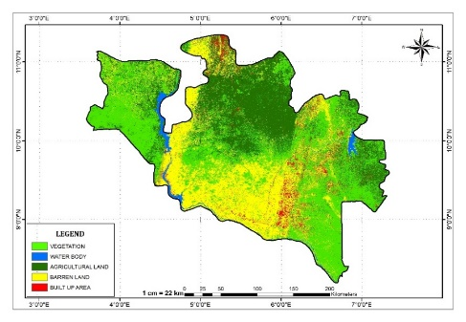
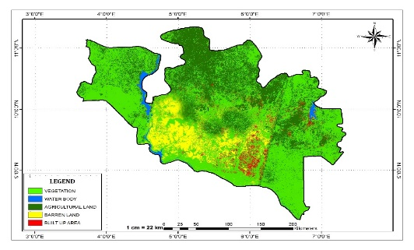
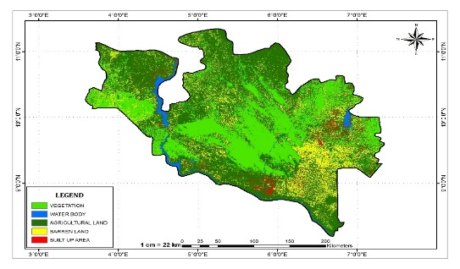
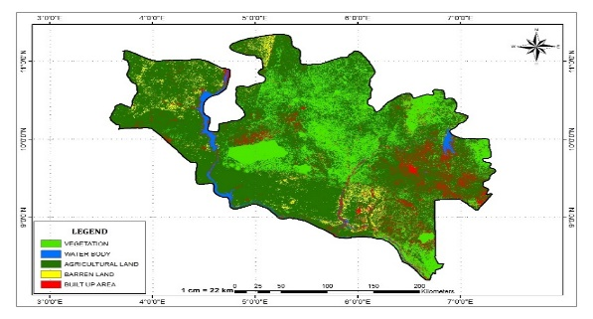
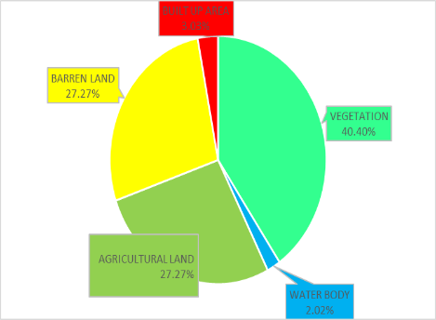
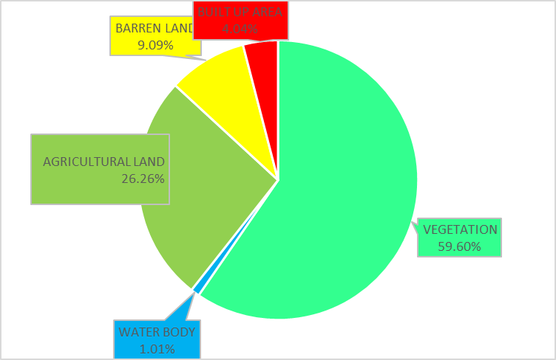
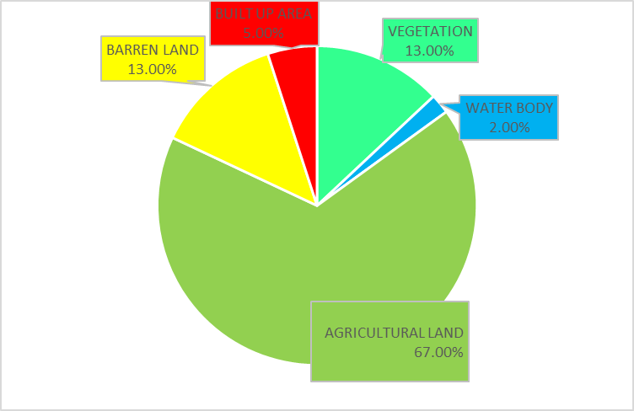
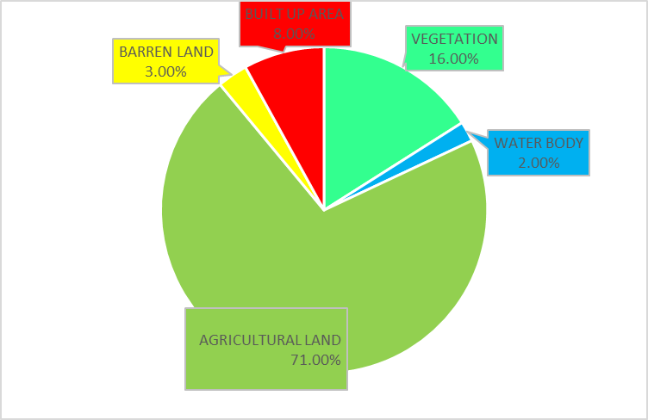
4.0 KEY RESULTS (Cont.)
4.1 Objective 2: Assessment of the spatio-temporal dynamics of land use within the period of 1990-2020
Figure 9: Classified Land Use and Land Cover 1990, 2000, 2013 and 2020 for Niger State
The total land area of Niger State is approximately 71121km².
There was an increase in vegetation between 1990 and 2000 which might be as result of change in weather.
It drastically got converted to agricultural land and built-up areas in 2013 and 2020. This can be attributed to increase in population hence needs for increase in food supply and settlement.

Slide 18
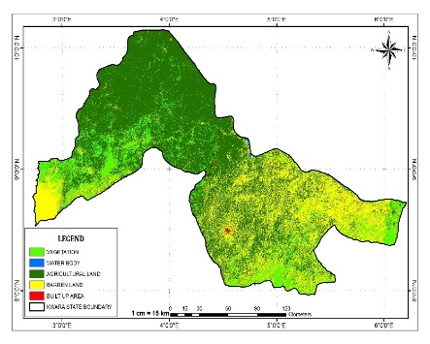
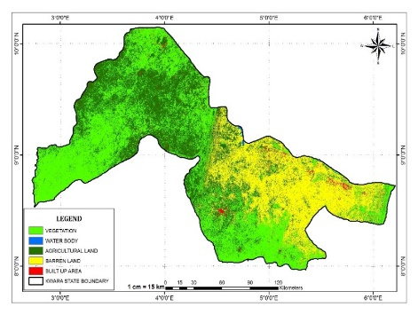
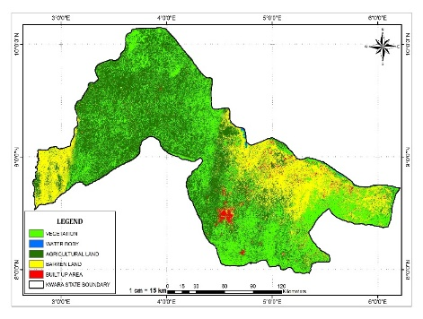
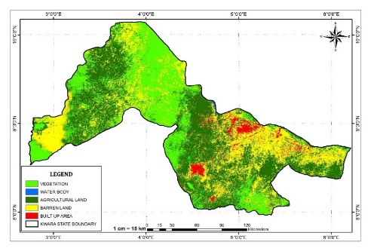
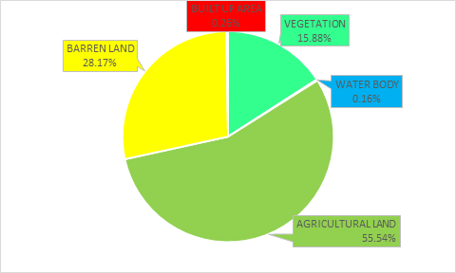
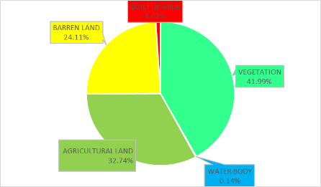
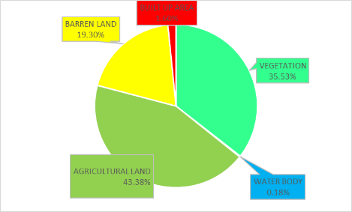
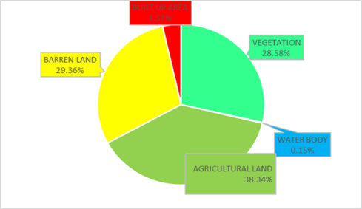
4.0 KEY RESULTS (Cont.)
Objective 2: Assessment of the spatio-temporal dynamics of land use within the period of 1990-2020
Figure 10: Classified Land Use and Land Cover 1990, 2000, 2013 and 2020 for Kwara State
The total land area of Kwara State is approximately 35420km².
Vegetation increased between 1990 and 2020 possibly because of change in weather.
Most of the agricultural and vegetation areas especially in the cities were converted to built-up areas and barren land between 1990 and 2020.
The sudden increase in barren land and decrease in agricultural land in 2020 might be due to the continuous usage of agrochemicals.

Slide 19
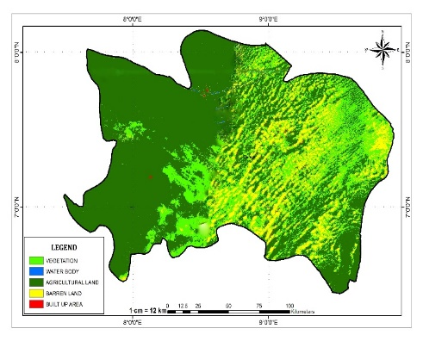
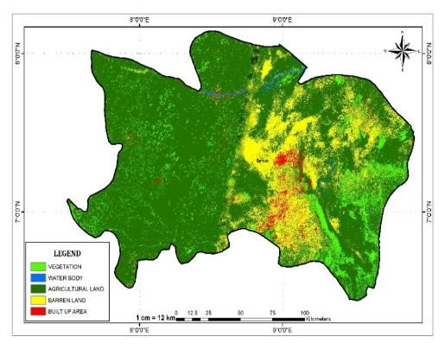
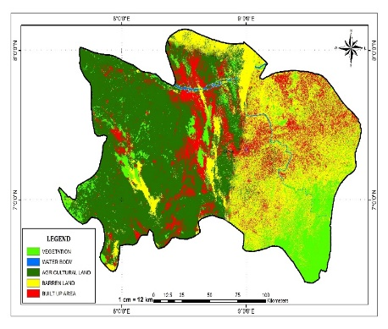
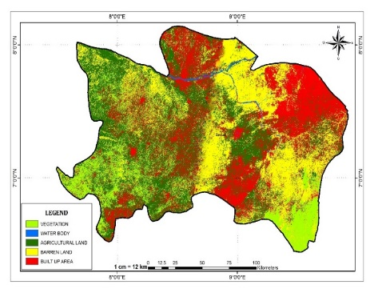
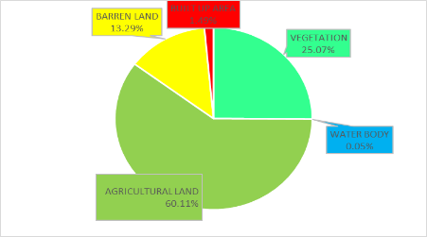
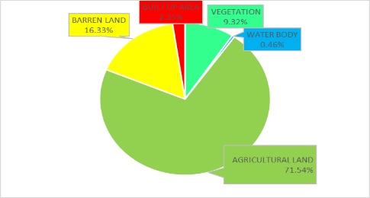
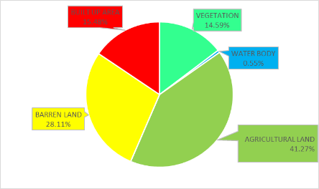
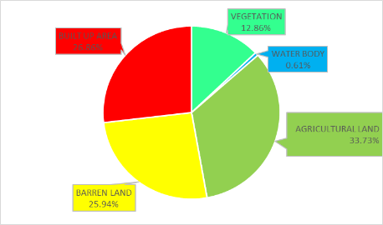
4.0 KEY RESULTS (Cont.)
Objective 2: Assessment of the spatio-temporal dynamics of land use within the period of 1990-2020
Figure 11: Classified Land Use and Land Cover 1990, 2000, 2013 and 2020 for Benue State
The total land area of Benue State is approximately 31308km².
Most of the agricultural and vegetation areas in every part of Benue State were converted to built-up areas and barren land between 1990 and 2020.
The sudden increase in barren land and decrease in agricultural land in 2020 might be due to the continuous usage of agrochemicals.

Slide 20
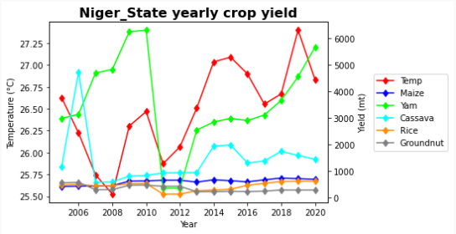
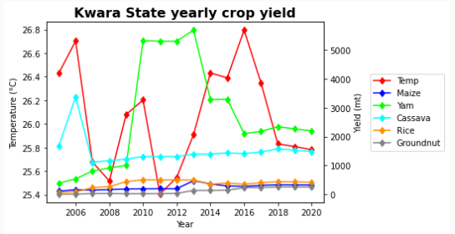
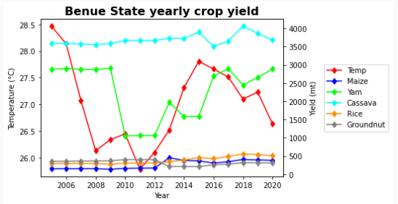
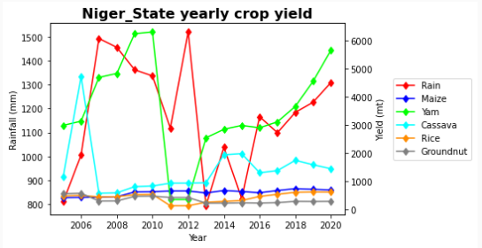
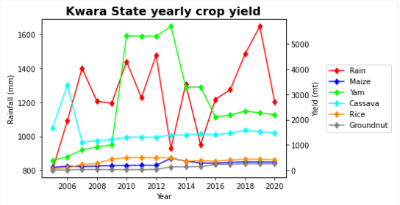
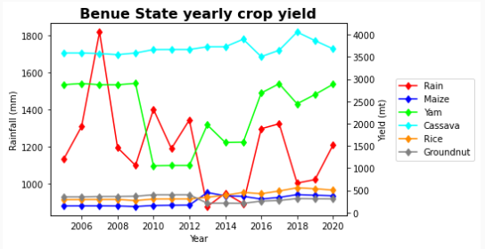
4.0 KEY RESULTS (Cont.)
Objective 3: Evaluation of the resultant impacts climate change and land use on migration as it affects food production
Figure 15: Relationship Between Climate Parameters (Air Temperature and Rainfall) and Crop Yields in Niger, Kwara and Benue State
Temperature and rainfall had different impacts on different food crops

Slide 21
Univariate Regression Analyses Showing the Influence of Changes in LULC on Migration in Niger, Kwara and Benue States
State |  |  | VG | WB | AL | BL | BA | R²
Niger | NetMig | p-value | 0.117 | 0.108 | 0.110 | 0.004 | 0.002 | 0.637
 |  | Coeff. | -150.622 | 9425.086 | -247.240 | -24.570 | -76.485
Kwara | NetMig | p-value | 0.289 | 0.764 | 0.371 | 0.005 | 0.002 | 0.547
 |  | Coeff. | 6.107 | 2249.173 | -27.764 | 33.074 | -146.095
Benue | NetMig | p-value | 0.119 | 0.112 | 0.111 | 0.014 | 0.953 | 0.632
 |  | Coeff. | 2012.620 | 133980.975 | 728.388 | -23.600 | -0.178
Coeff.=Coefficient, NetMig=Net Migration, VG=Vegetation, WB=Waterbody, AL=Agricultural Land, BL=Barren Land, BA=Built-up Area.
Sources: NAERLS, Zaria-Nigeria and United Nations
Changes in LULC classes had impacts on migration

Slide 22
4.0 KEY RESULTS (Cont.)
Objective 3: Evaluation of the resultant impacts climate change and land use on migration as it affects food production
Table 3: Regression Analysis of Crop Yields and Average Annual Temperature for Niger, Kwara and Benue States
State | Test |  | Maize | Yam | Cassava | Rice | Groundnut
Niger | R-square |  | 0.416699 | 0.105757 | 0.067583 | 0.307474 | 0.198948
 | Significance F |  | 0.009346 | 0.707548 | 0.349414 | 0.264931 | 0.09562
 | Regression coefficient |  | -2525.45028 | -5937.33 | -11684.5 | -2080.68 | 2810.735496
 | t-statistic |  | -2.4469 | -0.23843 | -0.8631 | -0.96292 | 2.043816
 | P-value |  | 0.029383 | 0.815263 | 0.403728 | 0.353157 | 0.061782
 | Alpha |  | 0.05 | 0.05 | 0.05 | 0.05 | 0.05
 | Remarks |  | Significant | Insignificant | Insignificant | Insignificant | Insignificant
Kwara | R-square |  | 0.022778 | 0.057822 | 0.237259 | 0.138538 | 0.157064
 | Significance F |  | 0.591334 | 0.387983 | 0.065545 | 0.17188 | 0.16066
 | Regression coefficient |  | -585.505 | 28701.48 | -14043.4 | 2989.456 | -2404.14
 | t-statistic |  | -0.37946 | 0.990963 | -1.8167 | 1.662088 | -1.41838
 | P-value |  | 0.710473 | 0.339791 | 0.092382 | 0.120405 | 0.181523
 | Alpha |  | 0.05 | 0.05 | 0.05 | 0.05 | 0.05
 | Remarks |  | Insignificant | Insignificant | Insignificant | Insignificant | Insignificant
Benue | R-square |  | 0.127419 | 0.14698 | 0.025484 | 0.176928 | 0.309846
 | Significance F |  | 0.191521 | 0.158363 | 0.569828 | 0.118472 | 0.031146
 | Regression coefficient |  | -1361.42 | -8956.69 | 2786.693 | -1241.38 | 1822.225
 | t-statistic |  | -1.14684 | -1.19823 | 1.795888 | -1.27489 | 2.923898
 | P-value |  | 0.272117 | 0.252218 | 0.095779 | 0.224663 | 0.011851
 | Alpha |  | 0.05 | 0.05 | 0.05 | 0.05 | 0.05
 | Remarks |  | Insignificant | Insignificant | Insignificant | Insignificant | Significant
There was a moderate statistically significant negative relationship between maize yields and temperature in Niger State i.e., increase in temperature will lead to decrease in maize yields while there was statistically insignificant relationship between temperature and other crops in Niger State.
There was statistically insignificant relationship between average annual temperature and all the five food crops in Kwara State.
There was a weak statistically significant positive relationship between temperature and groundnut in Benue. Increase in temperature will lead to increase in groundnut yield while there was statistically insignificant relationship between temperature and other crops in Benue State.
Seemingly low R-square values in all the States indicate that the crop yields in three States were majorly influenced by other factors like the case of Niger State the use of fertilizers, good crop seeds, the use of agro-technological equipment, effective crop management among others

Slide 23
4.0 KEY RESULTS (Cont.)
Objective 3: Evaluation of the resultant impacts climate change and land use on migration as it affects food production
Table 4: Regression Analysis of Food Crops and Annual Rainfall for Niger, Kwara and Benue States.
State | Test |  | Maize | Yam | Cassava | Rice | Groundnut
Niger | R-square |  | 0.021701 | 0.105896 | 0.218328 | 0.039461 | 0.198948
 | Significance F |  | 0.600341 | 0.236589 | 0.079067 | 0.477866 | 0.09562
 | Regression coefficient |  | 696.2194998 | 458.9965 | 3987.723 | 261.8344 | 2810.735496
 | t-statistic |  | 4.778645 | 0.177835 | 2.951467 | 1.079341 | 1.035275
 | P-value |  | 0.00036039 | 0.861594 | 0.01124 | 0.300055 | 0.061782
 | Alpha |  | 0.05 | 0.05 | 0.05 | 0.05 | 0.05
 | Remarks |  | Significant | Insignificant | Significant | Insignificant | Insignificant
Kwara | R-square |  | 0.036034 | 0.000483 | 0.047218 | 0.03784 | 0.00736
 | Significance F |  | 0.498013 | 0.938002 | 0.436602 | 0.487235 | 0.77058
 | Regression coefficient |  | 378.471 | 3088.718 | 2244.071 | 243.2187 | 74.47113
 | t-statistic |  | 2.274284 | 0.953476 | 2.391908 | 1.178311 | 0.394968
 | P-value |  | 0.040546 | 0.357742 | 0.032575 | 0.259792 | 0.699797
 | Alpha |  | 0.05 | 0.05 | 0.05 | 0.05 | 0.05
 | Remarks |  | Significant | Insignificant | Significant | Insignificant | Insignificant
Benue | R-square |  | 0.407281 | 0.03284 | 0.340163 | 0.153158 | 0.339094
 | Significance F |  | 0.010462 | 0.518052 | 0.022479 | 0.14916 | 0.022743
 | Regression coefficient |  | 649.8109 | 1546.965 | 4116.353 | 580.6521 | 114.483
 | t-statistic |  | 5.067436 | 1.482908 | 24.59748 | 4.48553 | 1.432242
 | P-value |  | 0.000216 | 0.161932 | <0.000001 | 0.000613 | 0.175679
 | Alpha |  | 0.05 | 0.05 | 0.05 | 0.05 | 0.05
 | Remarks |  | Significant | Insignificant | Significant | Significant | Insignificant
There was a positive relationship between rainfall and all the crops in all the three States (some were significant and some were insignificant)
There was a weak statistically significant positive relationship between maize and cassava yields and rainfall in Niger and Kwara States i.e., increase in rainfall will lead to increase in their yields while there was statistically insignificant relationship between rainfall and other crops in these two States.
There was a weak statistically significant positive relationship between maize, cassava and groundnut yields and rainfall in Benue State i.e., increase in temperature will lead to increase in their yields while there was statistically insignificant relationship between rainfall and yam and groundnut.
Seemingly low R-square values in all the States indicate that the crop yields in the three States were majorly influenced by other factors like the case of Niger State the use of fertilizers, good crop seeds, the use of agro-technological equipment, effective crop management among others

Slide 24
Multivariate Regression Analyses Showing the Influence of Net Migration and LULC on Crop Yields of Niger, Kwara and Benue States
State | Crop |  | NetMig | VG | WB | AL | BL | BA | R²
Niger | Maize | p-value | 0.402 | 0.017 | 0.018 | 0.017 | 0.013 | 0.004 | 0.871
 |  | Coeff. | 0.001 | 0.791 | -48.123 | 1.286 | 0.094 | 0.344
 | Rice | p-value | 0.166 | 0.314 | 0.245 | 0.281 | 0.004 | 0.020 | 0.741
 |  | Coeff. | -0.003 | -0.648 | 46.104 | -1.122 | -0.202 | -0.454
 | Groundnut | p-value | 0.000 | 0.001 | 0.000 | 0.000 | 0.052 | 0.022 | 0.942
 |  | Coeff. | 0.003 | 1.446 | -88.427 | 2.322 | -0.91 | -0.332
 | Cassava | p-value | 0.192 | 0.628 | 0.623 | 0.629 | 0.575 | 0.461 | 0.297
 |  | Coeff. | 0.025 | -3.114 | 192.911 | -5.003 | 0.317 | 1.248
 | Yam | p-value | 0.024 | 0.322 | 0.283 | 0.301 | 0.010 | 0.015 | 0.522
 |  | Coeff. | -0.070 | -9.544 | 635.345 | -16.140 | -2.607 | -7.175
Kwara | Maize | p-value | 0.341 | 0.026 | 0.826 | 0.350 | 0.004 | 0.001 | 0.707
 |  | Coeff. | 0.001 | -0.054 | -6.045 | 0.110 | -0.166 | 0.826
 | Rice | p-value | 0.069 | 0.614 | 0.624 | 0.308 | 0.049 | 0.048 | 0.762
 |  | Coeff. | -0.003 | -0.014 | -17.084 | 0.152 | -0.137 | 0.566
 | Groundnut | p-value | 0.328 | 0.000 | 0.121 | 0.161 | 0.045 | 0.000 | 0.936
 |  | Coeff. | 0.001 | -0.093 | 21.167 | -0.079 | -0.055 | 0.549
 | Cassava | p-value | 0.065 | 0.563 | 0.873 | 0.885 | 0.883 | 0.732 | 0.409
 |  | Coeff. | 0.016 | -0.094 | 32.706 | -0.124 | -0054 | 0.520
 | Yam | p-value | 0.615 | 0.622 | 0.314 | 0.058 | 0.003 | 0.008 | 0.698
 |  | Coeff. | 0.010 | 0.203 | -536.889 | 4.521 | -3.625 | 12.779
Benue | Maize | p-value | 0.651 | 0.001 | 0.001 | 0.001 | 0.044 | 0.007 | 0.920
 |  | Coeff. | 0.000 | 15.664 | 1023.150 | 5.504 | 0.093 | 0.038
 | Rice | p-value | 0.969 | 0.018 | 0.015 | 0.017 | 0.399 | 0.000 | 0.955
 |  | Coeff. | <0.0001 | 5.983 | 403.900 | 2.141 | -0.17 | 0.057
 | Groundnut | p-value | 0.971 | 0.000 | 0.000 | 0.000 | 0.058 | 0.521 | 0.898
 |  | Coeff. | <0.0001 | -15.567 | -1013.039 | -5.479 | -0.077 | -0.007
 | Cassava | p-value | 0.774 | 0.686 | 0.686 | 0.692 | 0.503 | 0.153 | 0.368
 |  | Coeff. | 0.001 | 4.825 | 316.186 | 1.676 | 0.058 | 0.036
 | Yam | p-value | 0.105 | 0.018 | 0.016 | 0.016 | 0.005 | 0.013 | 0.752
 |  | Coeff. | -0.014 | 104.799 | 7051.711 | 38.088 | -1.202 | 0.290
Coeff.=Coefficient, NetMig=Net Migration, VG=Vegetation, WB=Waterbody, AL=Agricultural Land, BL=Barren Land, BA=Built-up Area
Sources: NAERLS, Zaria-Nigeria and United Nations

Slide 25
4.0 KEY RESULTS (Cont.)
4.3 Objective 4: Identification of sustainable adaptation strategies to minimize the impacts of climate change and land use changes and migration monitoring at different levels.
Table 5: List of the Selected Communities in The Study Area
NIGER STATE
NIGER ADP ZONE 1 |  |  |  | NIGER ADP ZONE 2
Katcha LGA |  | Bida LGA |  | Bosso LGA |  | Suleja LGA
Badeggi Community | Shaba-Woshi Community | Batavovogi Community | Debarako Community | Shata Shiqmar Community | Lokoto Community | Chaza Community | Rafinseyi Community
KWARA STATE
KWARA ADP ZONE C |  |  |  | KWARA ADP ZONE D
Asa LGA |  | Moro LGA |  | Oke-Ero LGA |  | Irepodun LGA
Alapa Community | Ballah Community | Olooru Community | Shao Community | Imode Community | Ayedun Community | Araromi-Ipo Community | Okeya-Ipo Community
BENUE STATE
BENUE ADP ZONE B OR NORTHERN ZONE |  |  |  | BENUE ADP ZONE C OR CENTRAL ZONE
Makurdi LGA |  | Gwer East LGA |  | Obi LGA |  | Otukpo LGA
Tse-Ayihe Community | Agan Communities | Ikapayongo Community | Taraku Community | Ijegwu Community | Okpokwu-Ito Community | Otobi Community | Asa-Otukpo Community
ADP: Agricultural Development Project
LGA: Local Government Area

Slide 26
4.3.2 Socioeconomic Characteristics of the Respondents
Figure 16: Socio-Economic Characteristics
Mostly male and married with household size of above 5.
Moderate level of education.
Hailed from divers ethnic groups like Yoruba, Nupe, Tiv, Idoma, Igede, Gbagyi, Hausa, Gwagi, Fulani, Igbo, Igala, Gwari, and Bassa.

Slide 27
4.3.3 Respondents’ Climate Change awareness
Most of the respondents indicated that they have heard about climate change from radio and television.
Figure 17: Climate Change Awareness
Majority of the respondents were of the opinion that rainfall pattern has been decreasing while air temperature has been fluctuating in the last 20 years.

Slide 28
4.3.4 Impacts of Migration
Figure 18: Impacts of Migration
No fewer than 3 family members on the average migrate to neighbouring states in the last 5 years.
This is due to unstable weather condition, land degradation, land use change, hunger, schooling, natural disaster, insecurity among others.
They believed that negative impacts of climate and land use change on migration have led to decrease in food production of the region.

Slide 29
4.3.5 Adaptation to Impacts of Climate and Land Use Changes on Food Security
Figure 19: Adaptation to Impacts of Climate Change and Land Use on Food Security
Majority of the respondents adapt to negative impacts of climate and land use change on food security by changing their farming methods, diversifying their incomes, getting supports from external bodies.
Others saw change of profession, migration to another place either temporarily or permanently as means of adapting to these impacts.

Slide 30
4.4 Implications of Results
Climate change and frequent land use changes are having huge impacts on migration leading to decrease in food availability, accessibility, affordability and utilization in the region.

Slide 31
5.0 CONCLUSION AND RECOMMENDATIONS
Food security is adversely affected by climate change exacerbated by LULC change in diverse pathways.
LULC change has effect on ecosystem goods and services leading to migration of people especially rural dwellers.
There was a statistically significant increase in temperature and decrease in rainfall in Niger and Benue and States while there was statistically insignificant increase in temperature and rainfall in Kwara State from 1985-2020.
There was a statistically significant negative relationship between temperature and maize yields in Niger State and statistically significant negative relationship between temperature and groundnut in Benue State while statistically insignificant relationship existed between temperature and all the five crops in Kwara State between 2005-2020.
There was a statistically significant relationship between maize and cassava, and rainfall in all the three States while there was statistically insignificant relationship between rice, yam and groundnut, and rainfall in all the three States.
LULC of Niger State between 1990-2020 show that most of the vegetation, barren land and water areas in the state have been converted to agricultural land and built-up areas possibly because of increase in population which necessitates increase in food supply and settlement
LULC of Kwara and Benue States between 1990-2020 show that most of the vegetation, agricultural land and water bodies in the two states have been converted to built-up areas and Barren land.

Slide 32
5.0 CONCLUSION AND RECOMMENDATIONS (Cont.)
This might due to the continuous usage of pesticides, insecticides, herbicides and pesticides by the farmers in most parts of the state and this makes the farmers to migrate from these areas while leaving most of the land portions barren
There is continuous decrease in NDVI values especially in the rural areas of the three states between 1990-2020. This indicates incessant migration of people from rural areas to cities.
It is recommended that government and the relevant stakeholders should provide enabling environment and infrastructure for the rural dwellers to reduce the rate of rural-urban migration in the study areas.
Also, improved technology and seeds (drought resistant, flood resistant etc.) should be provided for the farmers.
Government and relevant agencies should convert the vast barren lands in the study area to profitable agricultural and housing use so as to boost food security and reduce housing deficit in the study area.

Slide 33
6.0 REFERENCES
Dahiru, T. M., & Tanko, H. (2018). The effects of climate change on food crop production in northern nigeria. International Journal of Research-GRANTHAALAYAH, 6(9), 458-469.
Ideki, O., & Weli, V. E. 2019. Analysis of Rainfall Variability Using Remote Sensing and GIS in North Central Nigeria. Atmospheric and Climate Sciences, 9(2), 191-201.
Ngutsav, A. S., Adzande, P., Iorliam, S., Ogwuche, J., Gyuse, T. T., & Ujoh, F. (2021). The Impact of Migration on Household’s Livelihoods in River Benue Basin. Politics.
Ugbem, C. E. (2019). Climate Change and Insecurity in Northern Nigeria.

Slide 34
I THANK YOU ALL FOR YOUR RAPT ATTENTION

