Slide 1



PhD Defence
Urban Landscape Structure Dynamics and Ecosystem Regulating Services in the Changing Climate of the Rainforest and Guinea Savanna Ecoregions of Nigeria
Rotimi O. Obateru
B.Sc. Geography (Ibadan); M.Sc. Geography (Ibadan); M.Sc. Environmental Mgt. (PAU)
Major Supervisor: Professor A. A. Okhimamhe
Co-supervisor: Professor Olutoyin A. Fashae
Co-supervisor: Professor Dr. Christopher Conrad
20th January 2025

Slide 2
Content Outline
Introduction
Statement of the Research Problem
Aim and Objectives of the Study
Study Locations
Justification of the Study
Conceptual Framework, Theoretical Framework & Literature Review
Research Methodology
Results and Discussion
Conclusion
Recommendations
Contribution to Scientific Knowledge
Acknowledgment

Slide 3
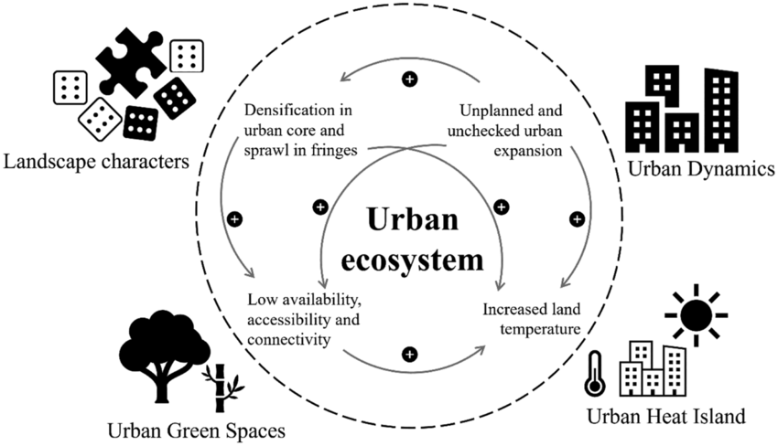
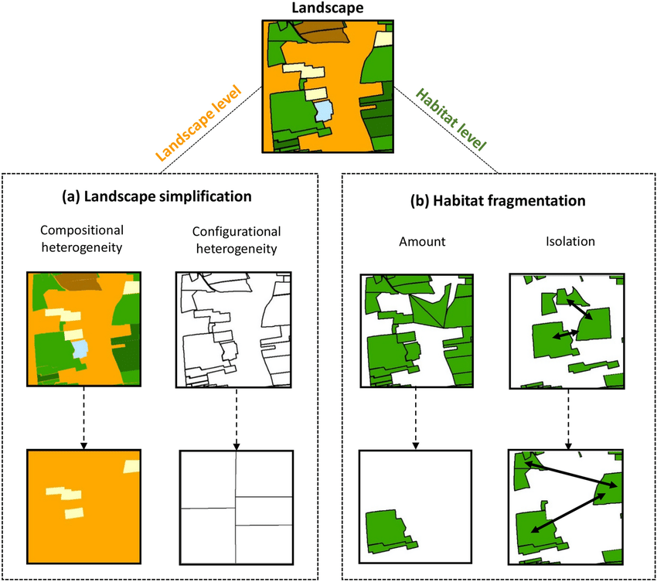
Introduction
Ecosystem services provide annual benefits valued at $125–140 trillion (OECD, 2019).
EU Biodiversity Strategy 2030 emphasises reversing ecosystem degradation to bolster urban resilience.

Slide 4
Statement of the Research Problem
Limited studies on spatiotemporal changes in landscape structure and regulating services in sub-Saharan Africa.
Previous research focused on land use and land cover (LULC) impacts, carbon stock in protected areas, or coarse spatial resolutions.
Research gap & why it matters
Urban regulating services are crucial for addressing climate extremes, carbon balance, and water systems (MA, 2005).
Insufficient attention to landscape diversity’s role in ecosystem resilience (Inkoom et al., 2018).

Slide 5
Aim and Objectives of the Study
To assess the changes in urban landscape structure and their impacts on ecosystem regulating services in the light of the changing climate in the Rainforest and Guinea savanna ecological regions of Nigeria.
assess the spatial and temporal changes in landscape structure (landscape composition, configuration and connectivity) in cities of the Rainforest and Guinea savanna ecoregions between 1986 and 2022;
model the spatiotemporal distribution of ecosystem regulating services in relation to landscape changes in cities of the ecoregions between 2002 and 2022;
investigate the characteristics and drivers of the changes in landscape and ecosystem regulating services in cities of the ecoregions;
assess the trend and pattern of climatic (precipitation and temperature) changes in cities of the ecoregions between 1981 and 2022; and
analyse the impact of future changes in landscape structure on the resilience and sustainability of ecosystem regulation services within and between the cities of the two ecoregions under specific climatic scenarios.

Slide 6
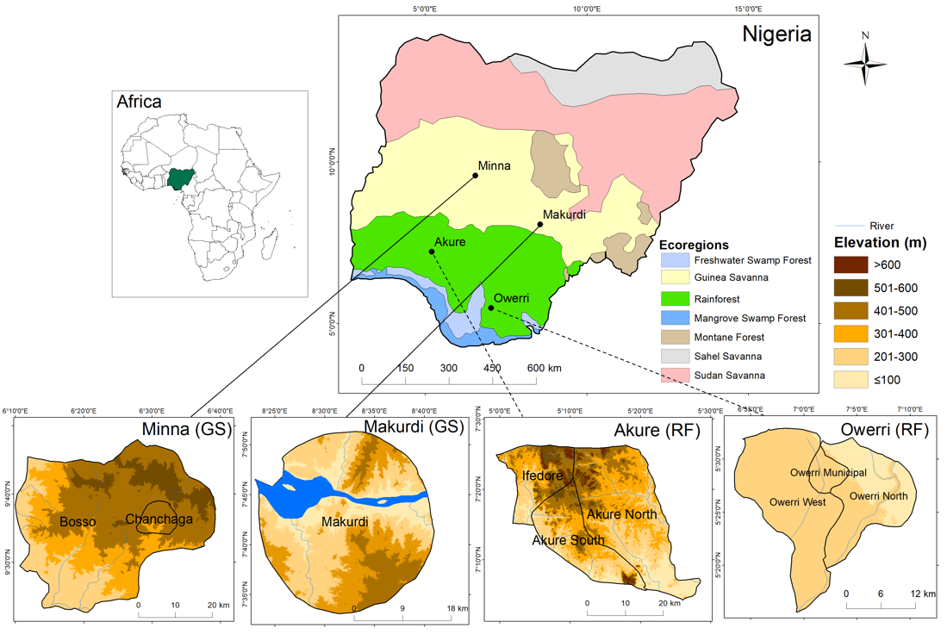
Study Locations
Increased land degradation in Nigeria, with over 55% primary forest loss (FAO, 2010).
Tropical rainforest and guinea savanna are among the most threatened zones (CILSS, 2016).
Ethnobotanical diversity representative of West Africa rainforest ecosystem (RF)
Notable agricultural production and collection areas (GS)
Figure 1: The Study Locations; RF = Rainforest; GS = Guinea savanna

Slide 7
Justification of the Study
Practical and Policy Applications
Baseline resource for Nigeria’s Federal Ministry of Lands, Housing, and Urban Development.
Anticipates future land use patterns and ecosystem management pathways.
Innovative Methodology
Introduces machine learning and geospatial techniques for urban ecosystem monitoring.
Strengthens the link between landscape ecology and climate change science.
Advances knowledge on urban ecosystem dynamics across ecological regions.
Alignment with SDGs
Goal 11: Reduce cities' per capita environmental impact.
Goal 13: Integrate climate change measures into urban planning.
Goal 15: Conserve and restore terrestrial ecosystems while mitigating urban expansion

Slide 8
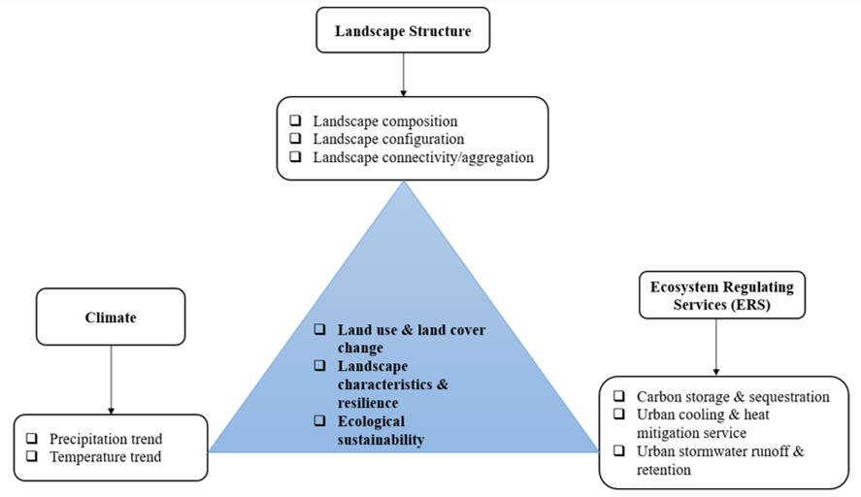
Conceptual Framework
Figure 2: Conceptual framework depicting the link between landscape structure, ecosystem regulating services and climate and their influence on landscape resilience and ecological sustainability.

Slide 9
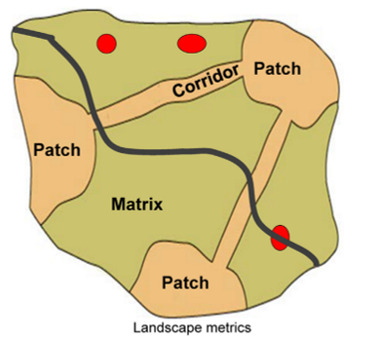
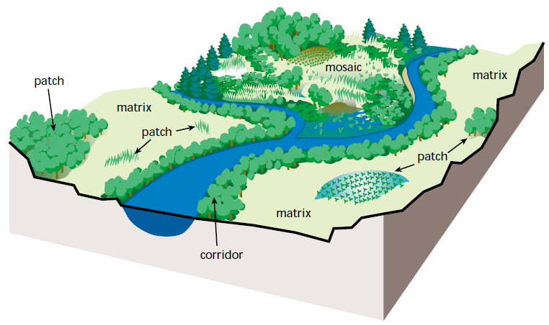
Theoretical Framework
Figure 3a: Representation of landscape structure based on the Patch Matrix Model
Figure 3b Representation of landscape structure based on the Patch Matrix Model (Source: adapted from Lausch et al., 2015)

Slide 10
Literature Review
The reviewed studies on landscape structure and ecosystem services can be grouped into four categories:
landscape composition and patterns (e.g., Lamy et al., 2016; Liu et al., 2020; Chen et al., 2021), focusing on the effects of spatial configurations on ES but lacking temporal depth;
specific landscape features (e.g., Badora & Wróbel, 2020), emphasizing biodiversity-related ES in protected forests;
landscape change and ecosystem trends (e.g., Biratu et al., 2022; Arowolo et al., 2018), highlighting habitat loss and LULC impacts on ES; and
methodological innovations (e.g., Inkoom et al., 2017), addressing data scarcity but limited in scope. These studies reveal gaps in fine-scale, integrative analysis.

Slide 11
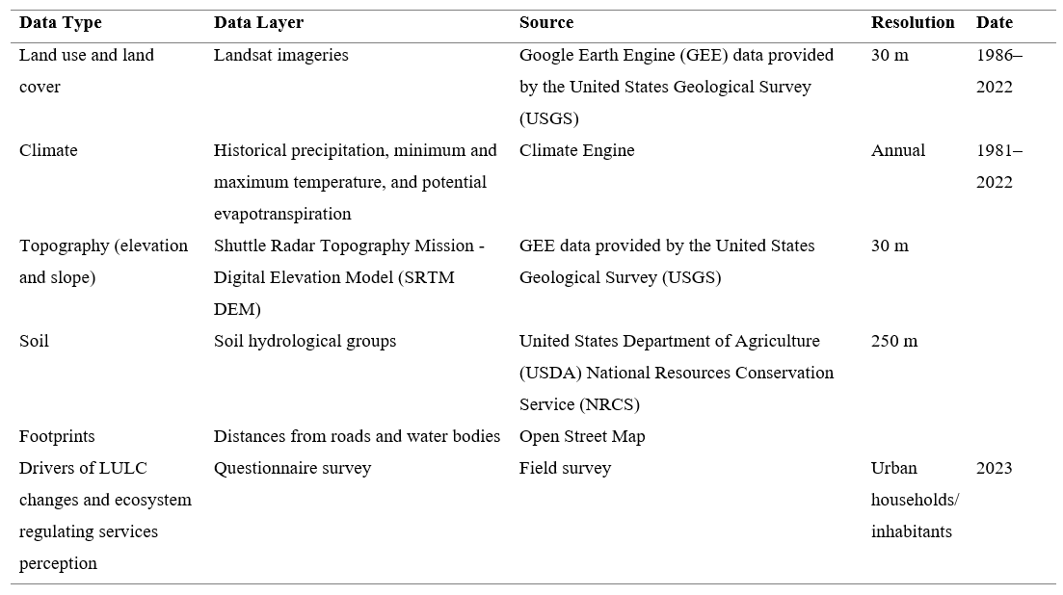
Research Methodology
Figure 1: Data types and sources

Slide 12
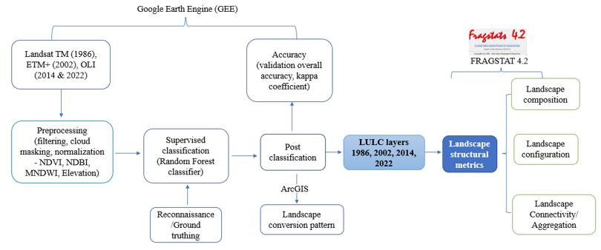
Objective 1: Spatial and temporal changes in landscape composition, configuration and connectivity
Figure 4: Flow chart of landscape structure

Slide 13
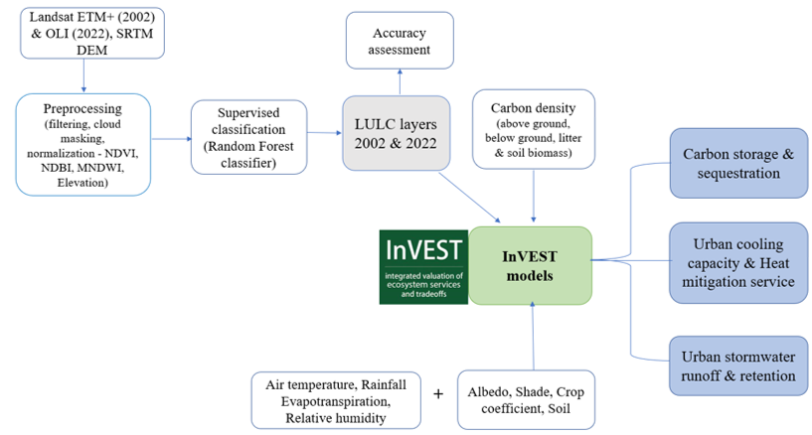
Objective 2: Modelling the spatial and temporal variability of ecosystem regulating services
Geostatistics
Spatial units & = Direction-distance gradient using a 12-compass rose system & a 5 km multiple ring buffer.
Geographically Weighted Regression = Effect of landscape changes (NDVI) on ERS
Figure 5: Schematic illustration of the methodology workflow for ecosystem regulating services

Slide 14
Objective 3: Characteristics and drivers of the changes in landscape and ecosystem services
Data Sampling
Population data sourced from CityPopulation (2022) website.
Sample size: 1,552 respondents across LGAs (Akure, Owerri, Makurdi, Minna).
Sampling: Cochran’s formula at a 5% error margin, 95% confidence.
Questionnaire administered to households using systematic and convenient sampling.
Statistical Analysis
Weighted Rank Index for ranking drivers of landscape changes.
Tests:
  Kruskal-Wallis: Variation in land use types and ecosystem services.
  Dunn’s Test: Pairwise comparisons with Bonferroni correction.
Regression Models:
  Multinomial logistic regression for relationships between socioeconomic factors and landscape concerns.
  Model selection via AIC, BIC; strength evaluated with Nagelkerke R².
Visuals:
  Word clouds, Sankey diagrams (R programming).
Data Collection
Digital surveys via Kobo Toolbox.
Sections:
  Socioeconomic status.
  Landscape change drivers and characteristics.
  Ecosystem service status and performance.

Slide 15
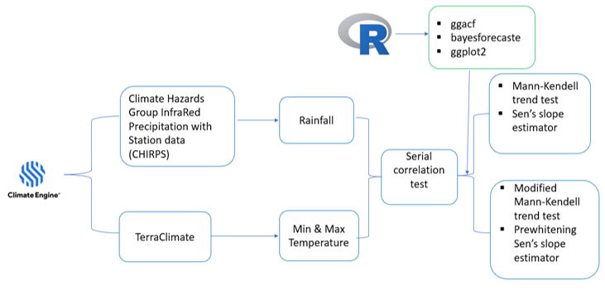
Objective 4: Trend and pattern of climatic (precipitation and temperature) changes
Figure 5: Workflow of the data processing operations for climate analysis

Slide 16

Objective 5: Future dynamics of landscape structure and ecosystem regulating services
Future LULC Simulation
Cellular Automata–Artificial Neural Network (CA-ANN) model
Process:
  Predicts 2042 LULC changes using MOLUSCE in QGIS.
  Inputs: Historical LULC (1986, 2002, 2022), slope, elevation, and road proximity maps.
  Validation: Kappa verification method (>70% accuracy).
  Metrics: 5000 iterations, 10 hidden layers, learning rate (0.205), momentum (0.1).
Landscape Structure Prediction
Metrics computed using FRAGSTAT:
  Patch Density (PD), Largest Shape Index (LSI), Contagion Index (CONTAG), and Shannon’s Diversity Index (SHDI).
Ecosystem Service Modelling
Integrated LULC simulation into InVEST for:
  Carbon storage/sequestration.
  Heat mitigation.
  Stormwater retention.
Analysis:
Historical climate data for future trend assessment.
Spearman rank correlation to evaluate landscape structure and ecosystem services association.

Slide 17
Results and Discussion

Slide 18
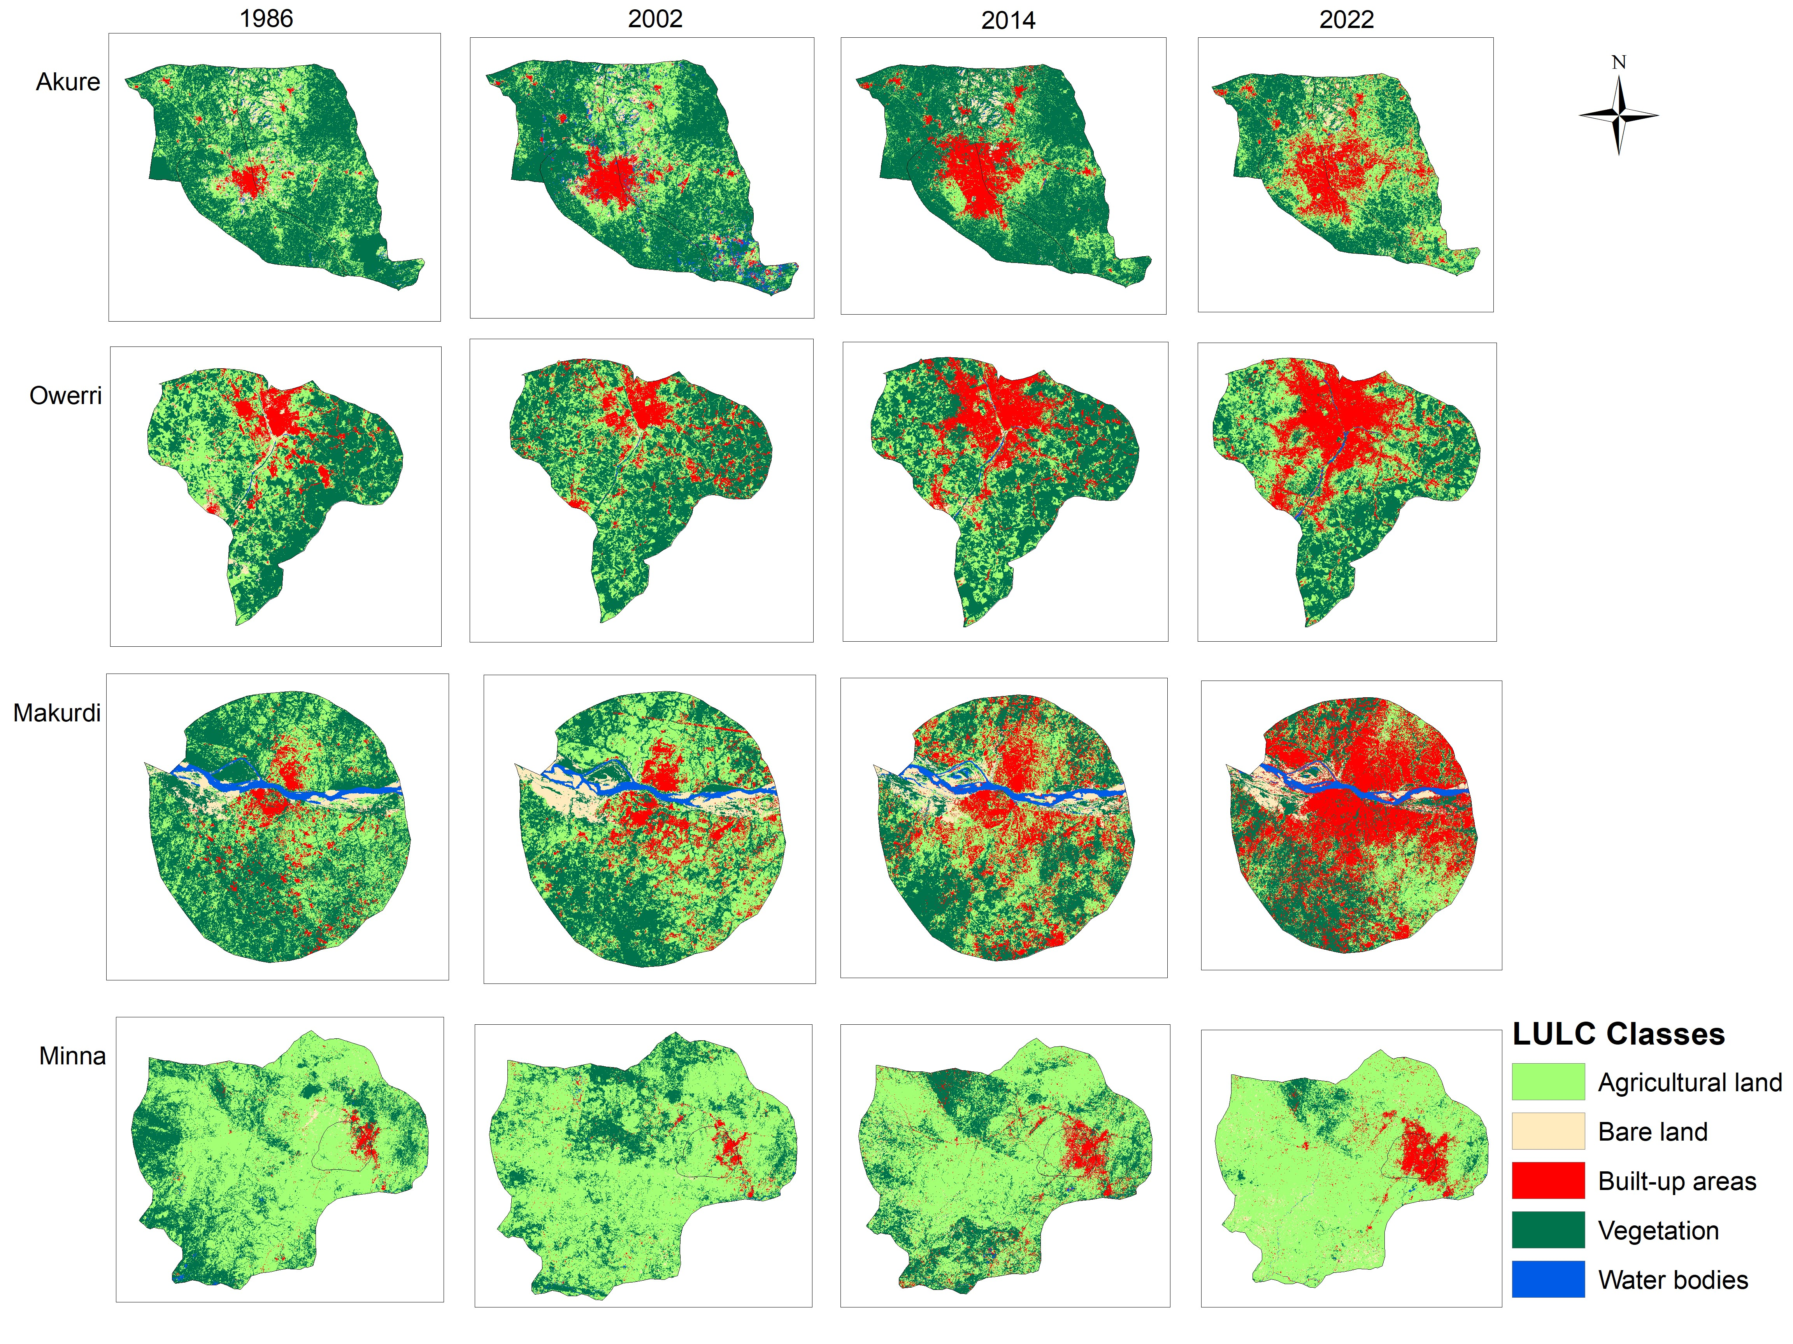
Objective 1a: Dynamics of landscape structure
Accuracy Assessment
The overall accuracy for supervised classification ranged from 86.67% to 97.30%.
Kappa coefficients ranged between 82.70% and 96.38%.
Urban Expansion:
Observed in all cities; highest in Makurdi (Guinea savanna) and Akure (rainforest).
Supports findings of Bakoji et al. (2020) on urban growth at the expense of agricultural land and natural vegetation.
Figure 6: Land use and land cover pattern from 1986 to 2022

Slide 19
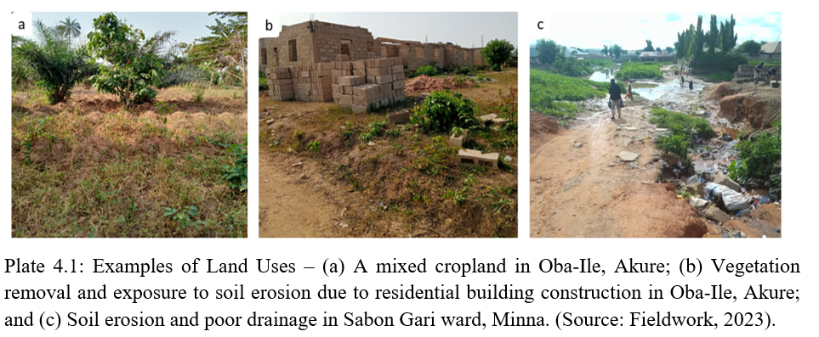
Objective 1b: Dynamics of landscape structure
Agricultural Land Expansion
Example: Minna saw an increase from 40.37% to 47.69% (2002–2014).
Conforms with Arowolo & Deng (2018) and Zubairu et al. (2019) on increased demand for farming due to urban growth.
Positive correlation with LPI (r = 0.86) and AI (r = 0.39); suggests densification and compaction with urban expansion.
Landscape Restoration: Decrease in PD and ED in some cities suggests potential for landscape restoration (e.g., Akure, Makurdi).

Slide 20
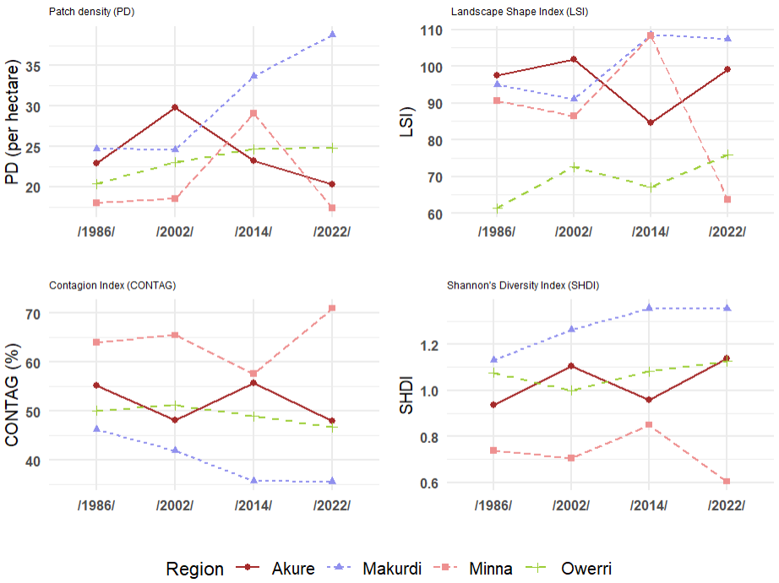
Objective 1c: Dynamics of landscape structure
PD: Increased across cities; highest fragmentation in Makurdi and Minna (savanna ecoregion).
Positive correlation with LPI (r = 0.86) and AI (r = 0.39); suggests densification and compaction with urban expansion.
Landscape Restoration: A decrease in PD and ED in some cities suggests potential for landscape restoration (e.g., Akure, Makurdi).
Figure 7: Landscape structural pattern from 1986 to 2022

Slide 21
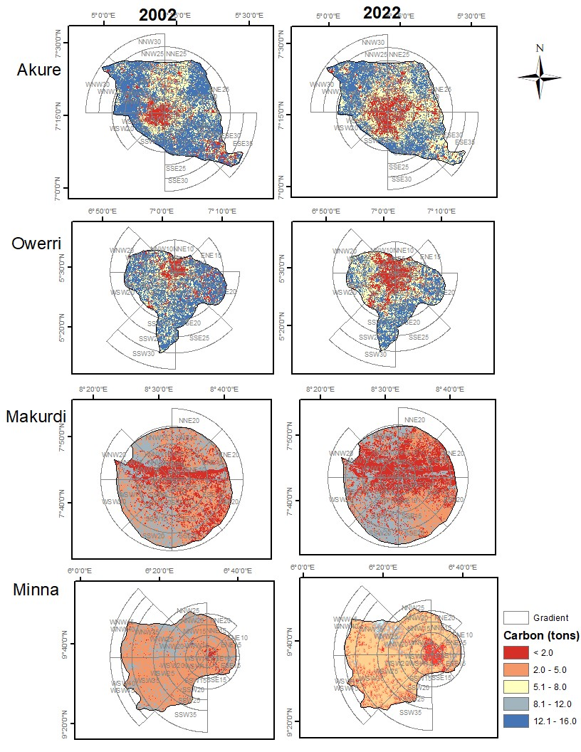
Objective 2a: Modelling ecosystem regulating services (carbon storage & sequestration)
Deforestation: Agricultural expansion and human settlements lead to a decline in carbon storage.
Cities observed a carbon loss of ~0.92%–1.69% annually between 2002-2022.
Improvement in Rainforest Cities
Vegetation health improved between 20-30 km buffer (NDVI increase in Akure and Owerri).
Agriculture practices like rotational bush fallowing contributed to this (Aweto, 2021).
Spatial Variation in Carbon Sequestration & NDVI
Guinea savanna cities showed higher spatial variation (adjusted R²: 43.93%–65.06%) compared to rainforest cities (adjusted R²: 25.93%–34.19%).
Figure 8: Spatial Distribution of Carbon Storage in 2002 and 2022

Slide 22
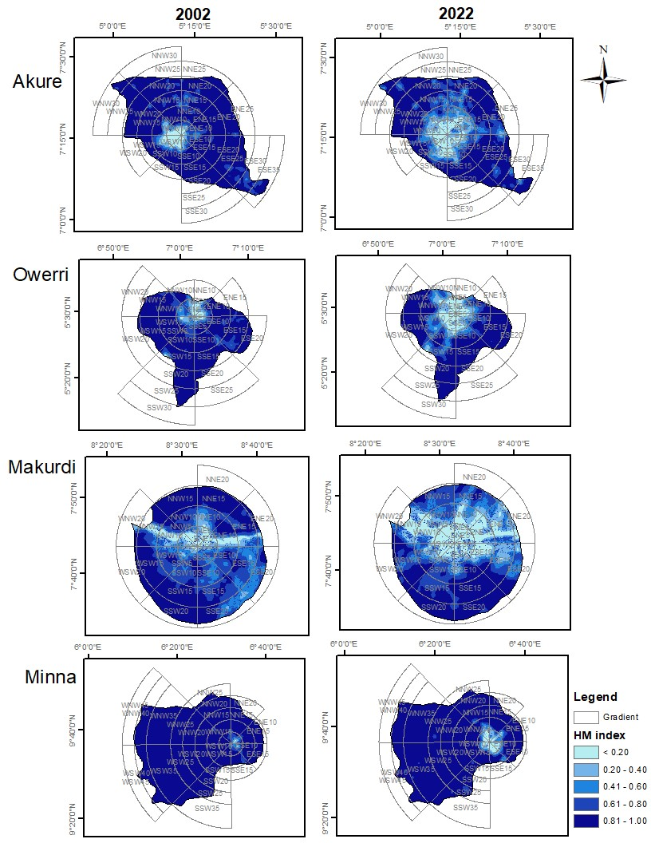
Results 2b: Modelling ecosystem regulating services (urban cooling and heat mitigation services)
Urban Warming
Low cooling capacity and heat mitigation at the core of cities (< 0.20 HMI).
Urban expansion increases average temperature to >24°C, suggesting urban warming effect (Ronch et al., 2020).
Vegetation's Role:
Rainforest cities had stronger contributions of NDVI to HMI (adjusted R²: 67.99%–91.80% vs. 35.60%–50.50% in Guinea savanna cities).
Areas with higher vegetation cover showed stronger cooling effects (Zawadzka et al., 2021; Makinde & Agbor, 2019).
Figure 9: Heat Mitigation Index (HMI) for 2002 and 2022

Slide 23
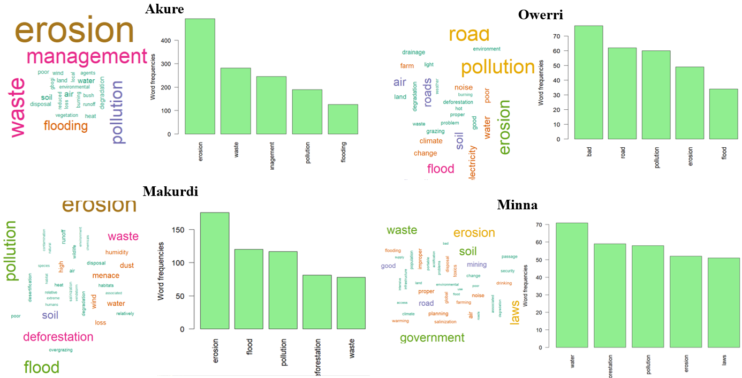
Objective 3: Perceived characteristics of landscape and ES changes
Bush Burning: Prevalent in Owerri & Minna, exacerbating land degradation (Arowolo & Deng, 2018; Martínez et al., 2011).
Logging & Charcoal Production: Significant in Minna & Owerri, driven by poverty & inadequate energy access (Munthali et al., 2019).
Climate Variability: Least impact in Akure (29%), greater in other cities (42%)—28.5% (Akure), 34.4% (Makurdi) variance in landscape change (Msofe et al., 2019).
Urban Planning Issues: Poor enforcement in Akure & Minna; sand mining impacts Minna & Owerri.
Public Perception:
Akure & Makurdi recognize negative impacts of population increase and economic activities on landscapes.
Figure 10: Textural and Word Cloud Analysis of Socioenvironmental Challenges Confronting the Cities

Slide 24
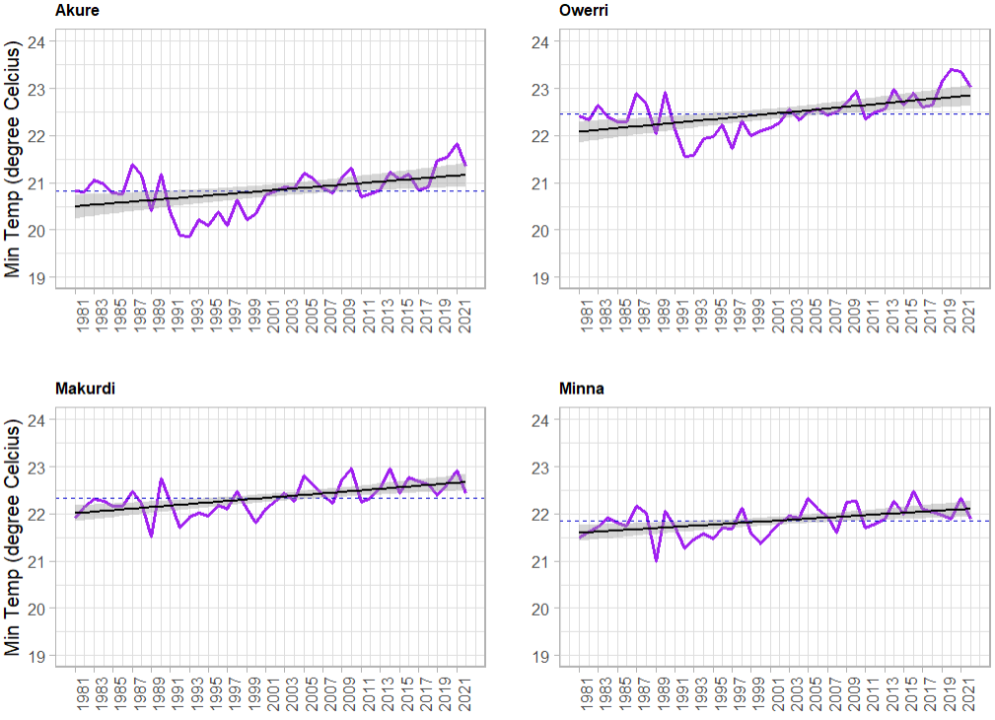
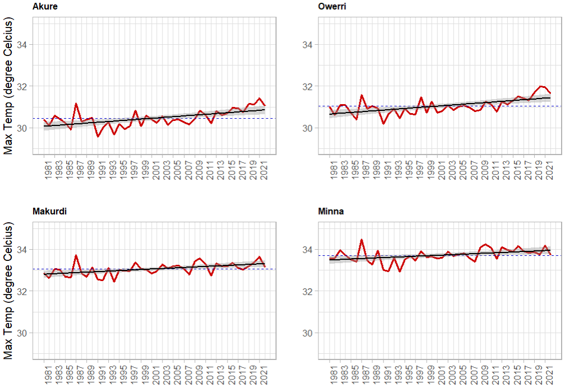
Objective 4: Trend and pattern of climatic variation
Figure 12: Maximum Temperature Pattern
Figure 11: Minimum Temperature Pattern

Slide 25
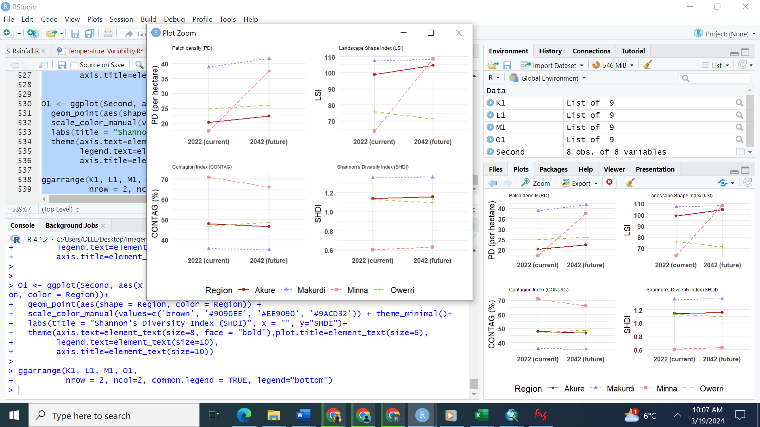
Objective 5: Future changes in landscape patterns on the landscape resilience of the sustainability of ecosystem regulating services
Future land use prediction between 2022 and 2042 suggested that built-up areas might expand by 6.63% (Akure), 5.99% (Owerri), 1.01% (Makurdi), and 1.20% (Minna) with the rainforest cities showing a higher tendency for more rapid urban growth.
Patch Density (PD): Rising trend in landscape fragmentation (1986–2014, 2022–2042) across all cities.
Fragmentation: Reduces the effectiveness of urban green spaces in carbon sequestration and climate regulation.
Landscape Diversity: Greater diversity may improve some ecosystem services but could reduce others (Liu et al., 2020; Chen et al., 2021).
Figure 13: Current and Future Landscape Structural Characteristics at the Landscape Level

Slide 26
Conclusion
The dwindling capacity of ecosystem regulating services is a result of landscape changes across all cities, regardless of ecological setting.
Developmental processes and activities have a greater influence on landscape characteristics and ecosystem services than ecological differences.
Demographic factors influence urban residents’ ecological concerns, especially in cities such as Akure, Owerri, and Minna.

Slide 27
Recommendation
Policy Recommendations
City-Specific Ecological Management: Prioritize sustainable land use, urban planning, and environmental awareness.
Agricultural Practices: Promote sustainable farming and agroforestry.
Performance Improvement
Community Involvement: Engage residents in landscape management through education and sustainable practices.
Urban Afforestation: Expand green infrastructure and carbon sequestration efforts (e.g., REDD+).
Future Research Directions
Investigate spatial patterns of urban ecosystem services across other ecoregions.
Use high-resolution imagery and field data for improved biophysical models.
Focus on socio-environmental drivers such as population, migration, and land ownership systems.

Slide 28
Contribution to Scientific Knowledge
Environmental Monitoring: Quantification and prediction of landscape changes and ecosystem regulating services.
Methodological Contribution: Applied the Patch-Corridor-Matrix Model and ecosystem services framework, integrating machine learning, geospatial methods, ecological metrics, and socioeconomic techniques.
Impact of Development Processes: Found that developmental processes have a greater influence on altering landscape characteristics and ecosystem services than ecological variation.
Expanding Knowledge Frontiers: Contributed to landscape ecology and environmental management by improving understanding of landscape changes and their impact on ecosystem services across varied urban and ecological settings.

Slide 29







Acknowledgement
Supervisors:
Professor Appollonia Okhimamhe
WASCAL CC & HH, Federal University of Technology, Minna
Professor Olutoyin A. Fashae
Department of Geography, University of Ibadan, Nigeria
Professor Dr. Christopher Conrad
Department of Geoecology, Martin Luther University, Halle, Germany
Sponsor: West African Science Service Centre on Climate Change and Adapted Land Use & German Federal Ministry of Education and Research

Slide 30


