Slide 1
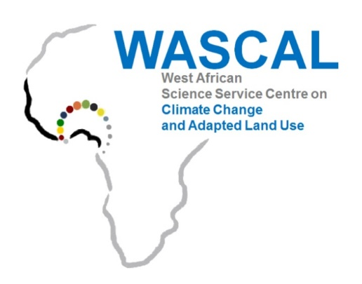


WEST AFRICAN SCIENCE SERVICE CENTRE ON CLIMATE CHANGE AND ADAPTED LAND USE
Doctoral Research Programme on Climate Change and Human Habitat
FEDERAL UNIVERSITY OF TECHNOLOGY, MINNA, NIGERIA
PhD ORAL EXAMINATION
A SPATIO-TEMPORAL ANALYSIS OF CLIMATE CHANGE AND SETTLEMENT DYNAMICS IN ABUJA AND OUAGADOUGOU IN WEST AFRICAN SAVANNAH REGION
SUPERVISORS:
Prof. Appollonia A. OKHIMAMHE
Federal University of Technology, Minna, Nigeria
Dr. Oble NEYA
National Centre for Scientific and Technological Research, Burkina Faso
Dr. Michael THIEL
Julius-Maximilians-University of Würzburg, GERMANY
PhD Candidate
GADIAGA Aliou
Ph.D/SPS/FT/2021/13001
28/08/2025

Slide 2
PLAN OF PRESENTATION
Introduction
Problem Statement
Study Area
Justification
Conceptual Framework
Type of Data
Methodology
Results
Conclusion
Introduction
Problem Statement
Study Area
Justification
Conceptual Framework
Type of Data
Methodology
Results
Conclusion
Recommendation

Slide 3
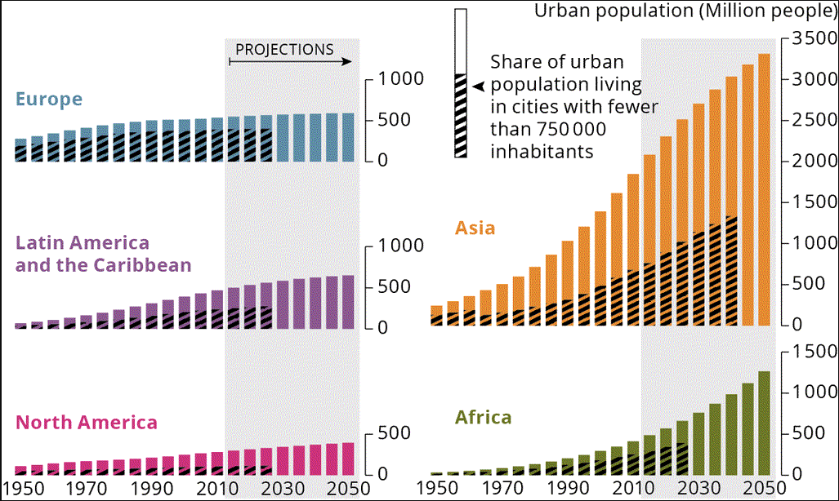
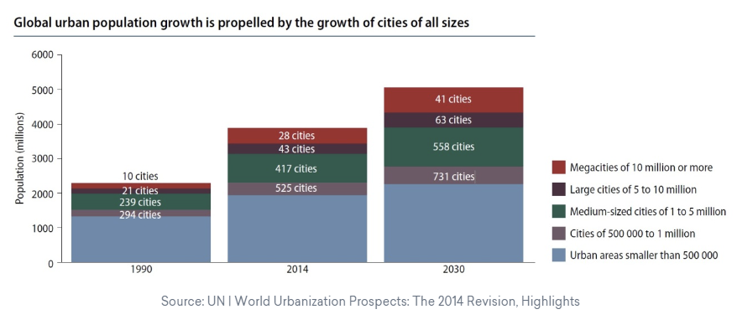
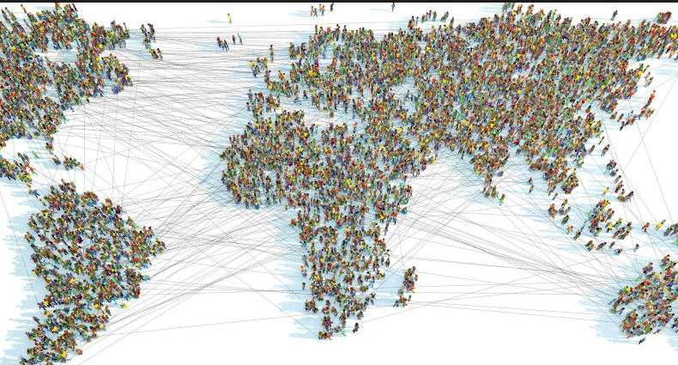

INTRODUCTION
Introduction
Problem Statement
Study Area
Justification
Conceptual Framework
Type of Data
Methodology
Results
Conclusion
It is estimated that urban areas are expanding at twice the rate of the urban population
(IPCC, 2022)
Between now and 2050, 90% of the expected increase in the world’s urban population will take place in the urban areas of Africa and Asia.
(Prospects World Urbanization, 2014)
Source : European Environment Agency: Urban trends by world regions
https://www.eea.europa.eu/data-and-maps/figures/urban-trends-by-world-regions

Slide 4
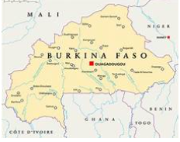
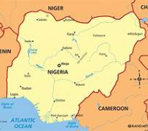
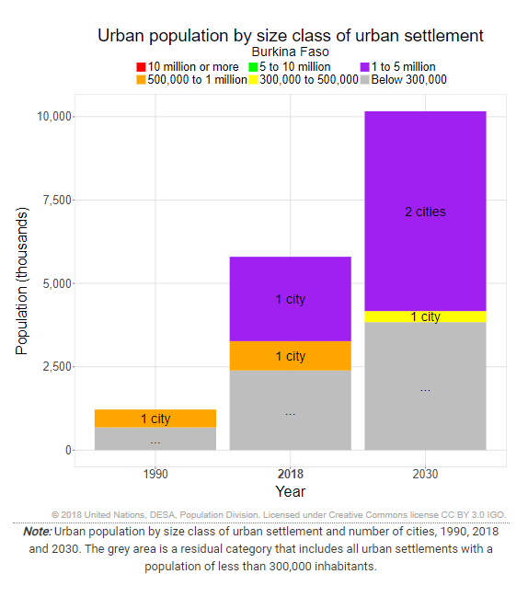
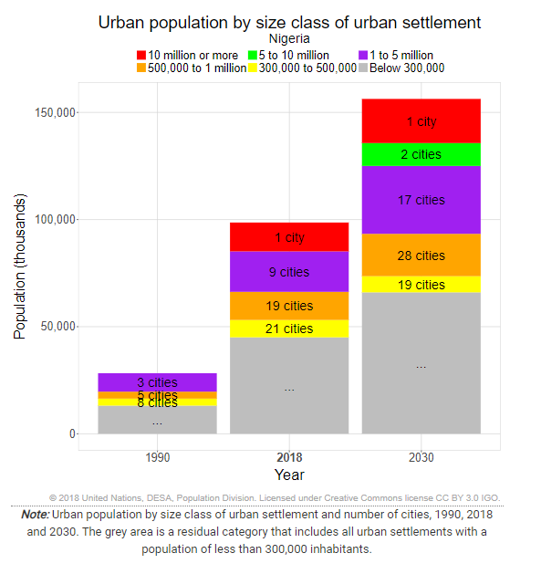
INTRODUCTION
Introduction
Problem Statement
Study Area
Justification
Conceptual Framework
Type of Data
Methodology
Results
Conclusion
BURKINA FASO
NIGERIA

Slide 5
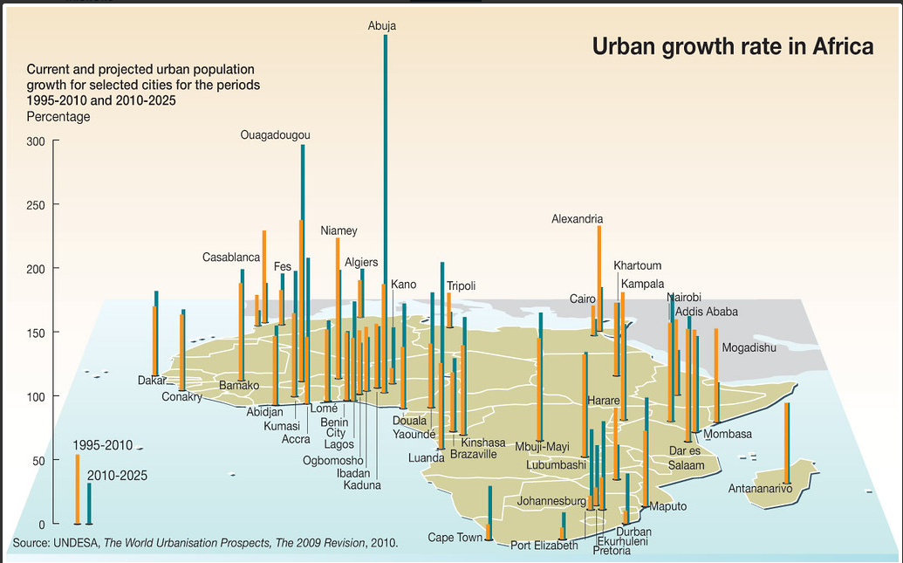
INTRODUCTION
Introduction
Problem Statement
Study Area
Justification
Conceptual Framework
Type of Data
Methodology
Results
Conclusion
Africa’s urban centres are currently growing at an annual rate that is the fastest compared to other regions. The urban expansion is expected to continue, with cities like Abuja and Ouagadougou expecting very high growth in the next decade (UNDESA, 2010)
Notes:
https://www.grida.no/resources/8196
Year: 2011
From collection: Green Hills, Blue Cities - an Ecosystems Approach to Water Resources Management for African Cities
Cartographer: Riccardo Pravettoni

Slide 6

PROBLEM STATEMENT
Introduction
Problem Statement
Study Area
Justification
Conceptual Framework
Type of Data
Methodology
Results
Conclusion
Urbanisation has disadvantages because of its influence on the climate and the extreme weather events that are observed.
Climate change, through its direct and indirect effects, is already threatening hundreds of millions of urban dwellers in low and middle-income countries (http://pubs.iied.org/pubs/pdfs/10549IIED.pdf

Slide 7
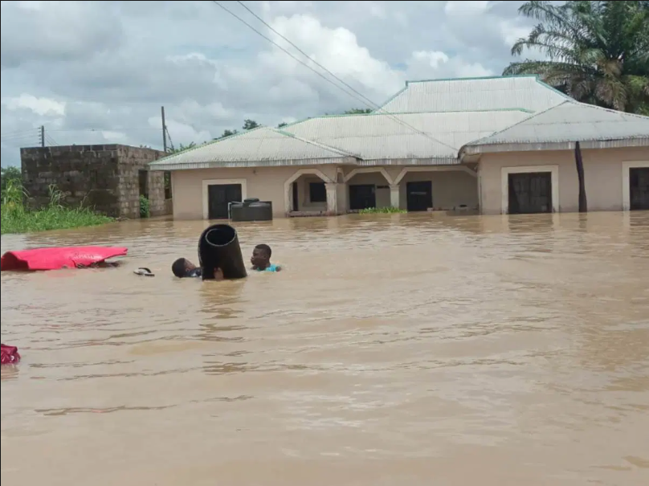
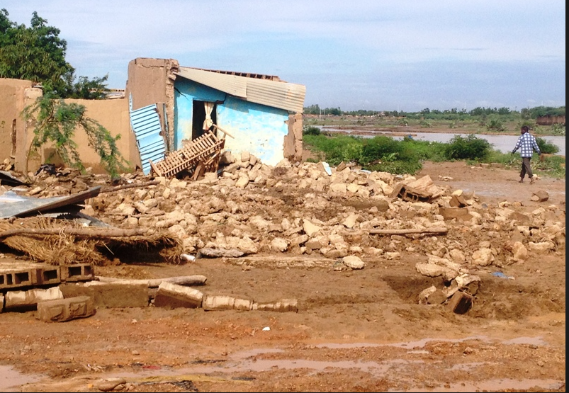
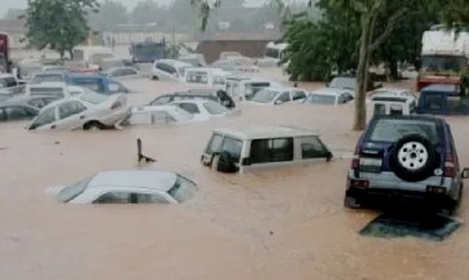
PROBLEM STATEMENT
Introduction
Problem Statement
Study Area
Justification
Conceptual Framework
Type of Data
Methodology
Results
Conclusion
Especially in fast-growing cities like Abuja, the main causes of flooding are attributable to the increase in human population, clogging of rivers and canals due to poor waste disposal habits and increase in paved areas (Balogun et al., 2020).
From 1992 to 2018 the city of Ouagadougou has experienced more than 50 occurrences of flooding (Francis, 2019).

Slide 8
Introduction
Problem Statement
Study Area
Justification
Conceptual Framework
Type of Data
Methodology
Results
Conclusion
PROBLEM STATEMENT
Urban areas in both developed and developing countries will increasingly feel the effects of climate change phenomena, resource depletion, food insecurity and economic instability, which is why they need to be addressed effectively if cities are to be sustainable (United Nations, 2011).
Through better urban practices, the impact of cities on climate change can be mitigated and, conversely, cities can reduce the impact of climate change on themselves (Quenault et al., 2011)
Notes:
https://www.afrik.com/burkina-faso-les-inondations-font-un-mort-a-ouagadougou

Slide 9

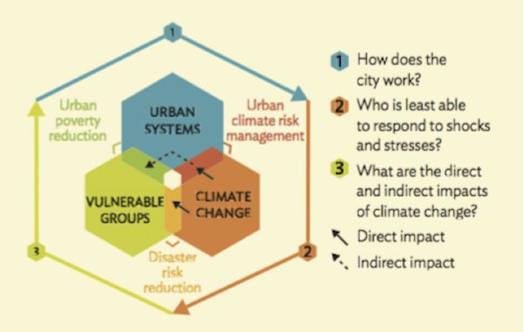
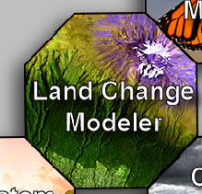
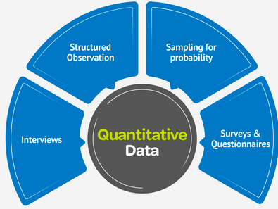
AIM AND OBJECTIVES OF THE STUDY
Introduction
Problem Statement
Study Area
Justification
Conceptual Framework
Type of Data
Methodology
Results
Conclusion
AIM
Assess the impact of climate change in relation to the spatiotemporal dynamics of Ouagadougou and Abuja within the last three decades.
Evaluate, comparatively, the functional and structural long term temporal growth of two cities in the Savanna region of West Africa, namely Abuja and Ouagadougou.
Objective
01
Assessing the impacts of climate change on the growth of these two cities, with the view of establishing a link between them.
Objective
02
Model the future urban growth in these two cities by 2052.
Objective
03
Identify and compare the adaptation and mitigation strategies employed by the two cities towards climate resilience.
Objective
04

Slide 10
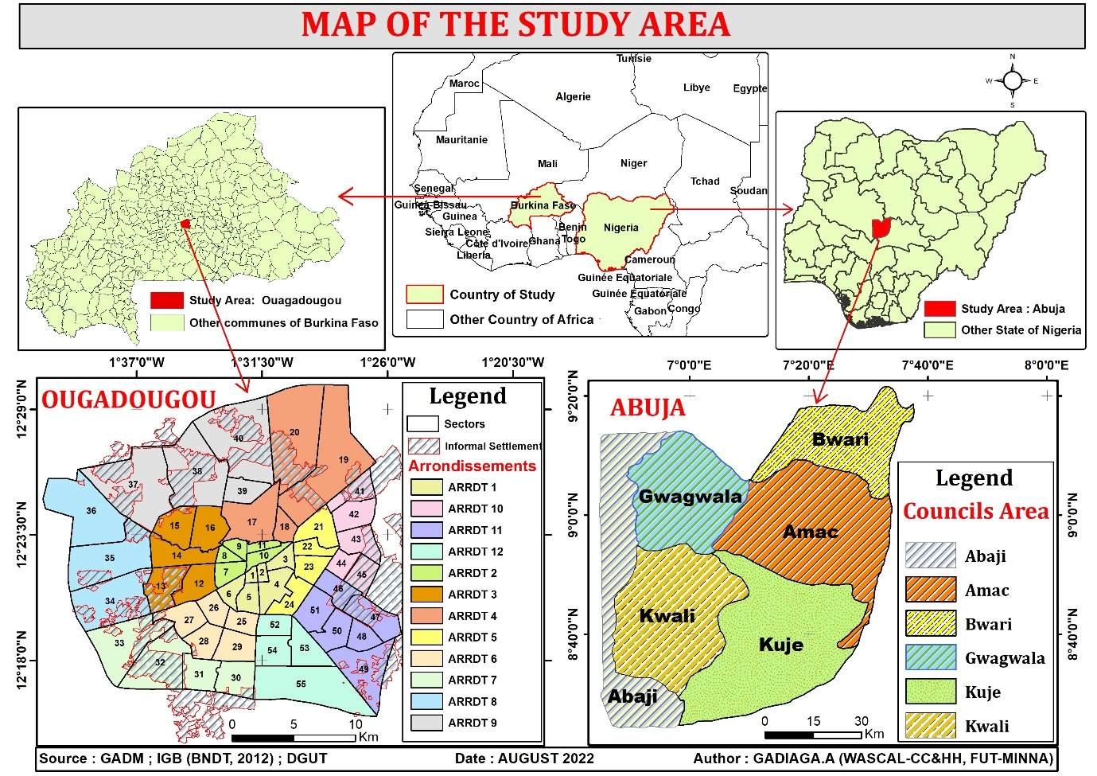
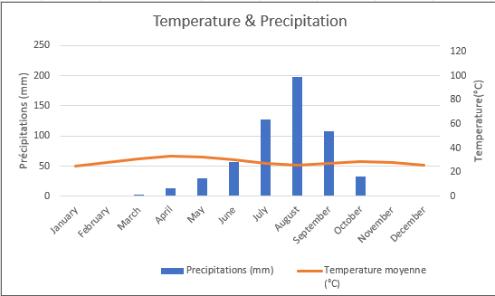
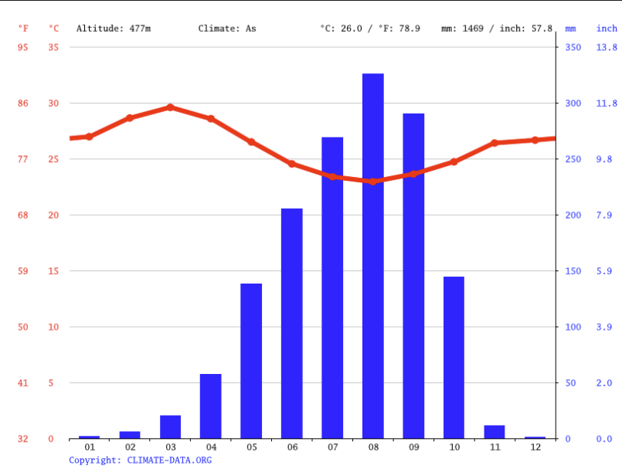
DESCRIPTION OF STUDY AREA
Introduction
Problem Statement
Study Area
Justification
Conceptual Framework
Type of Data
Methodology
Results
Conclusion
Location, Climate, Population, Area and Division
STUDY AREA | OUAGADOUGOU | ABUJA
Country | Burkina Faso | Nigeria
Location | Middle of Burkina Faso | Middle of Nigeria
Climate
Planning | Natural dynamics (since the colonisation) | Everything is planned in Advance (Created recently )
Population | 585,920 in 1992 and 3,055,788 in 2022 | 399,927 in 1992 and 3,652,029 in 2022.
Function | Capital | Capital
Area | 520 km² | 7654 km²
Division | 12 Arrondissements and 55 Sectors | 6 Local Government Area and 62 Wards
OUAGADOUGOU

Slide 11




JUSTIFICATION OF THE STUDY
Introduction
Problem Statement
Study Area
Justification
Conceptual Framework
Type of Data
Methodology
Results
Conclusion
Contribution to the body of knowledge:
Bring knowledge on the effects of urbanisation and its influence on the urban climate.
Serve as a tool for the development, planning and dissemination of climate change mitigation and adaptation strategies.
Performance improvement:
Enable national institutions, NGOs, programmes and departments working on urbanisation and climate change to operationalise their intervention.
Policy improvement
Improve urbanisation policies in Burkina Faso and Nigeria.
Improve climate change mitigation and adaptation policies in urban areas.
Further research
This study aims to fill the gaps in the research already carried out on the subject.

Slide 12
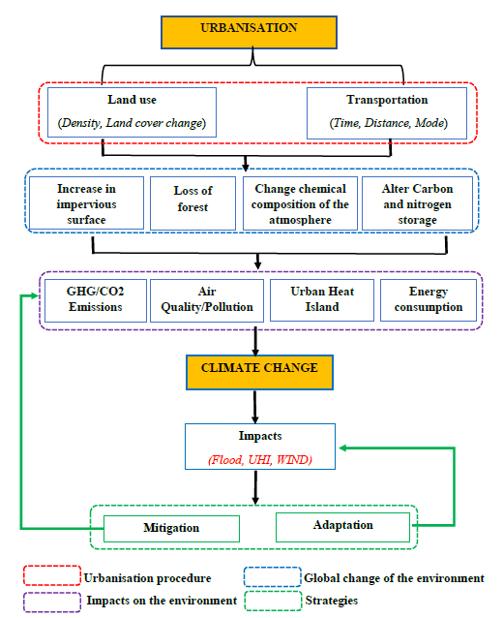
Introduction
Problem Statement
Study Area
Justification
Conceptual Framework
Type of Data
Methodology
Results
Conclusion
CONCEPTUAL FRAMEWORK
Notes:
https://www.afrik.com/burkina-faso-les-inondations-font-un-mort-a-ouagadougou

Slide 13
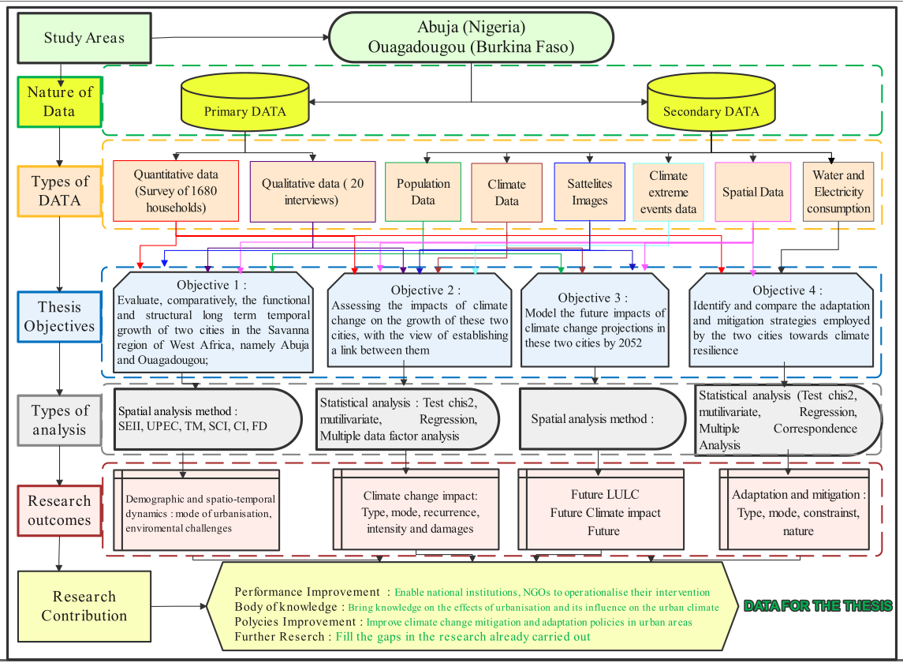
METHODOLOGY
Introduction
Problem Statement
Study Area
Justification
Conceptual Framework
Type of Data
Methodology
Results
Conclusion
CARACTERISTICS/TYPE OF DATA FOR THE RESEARCH

Slide 14
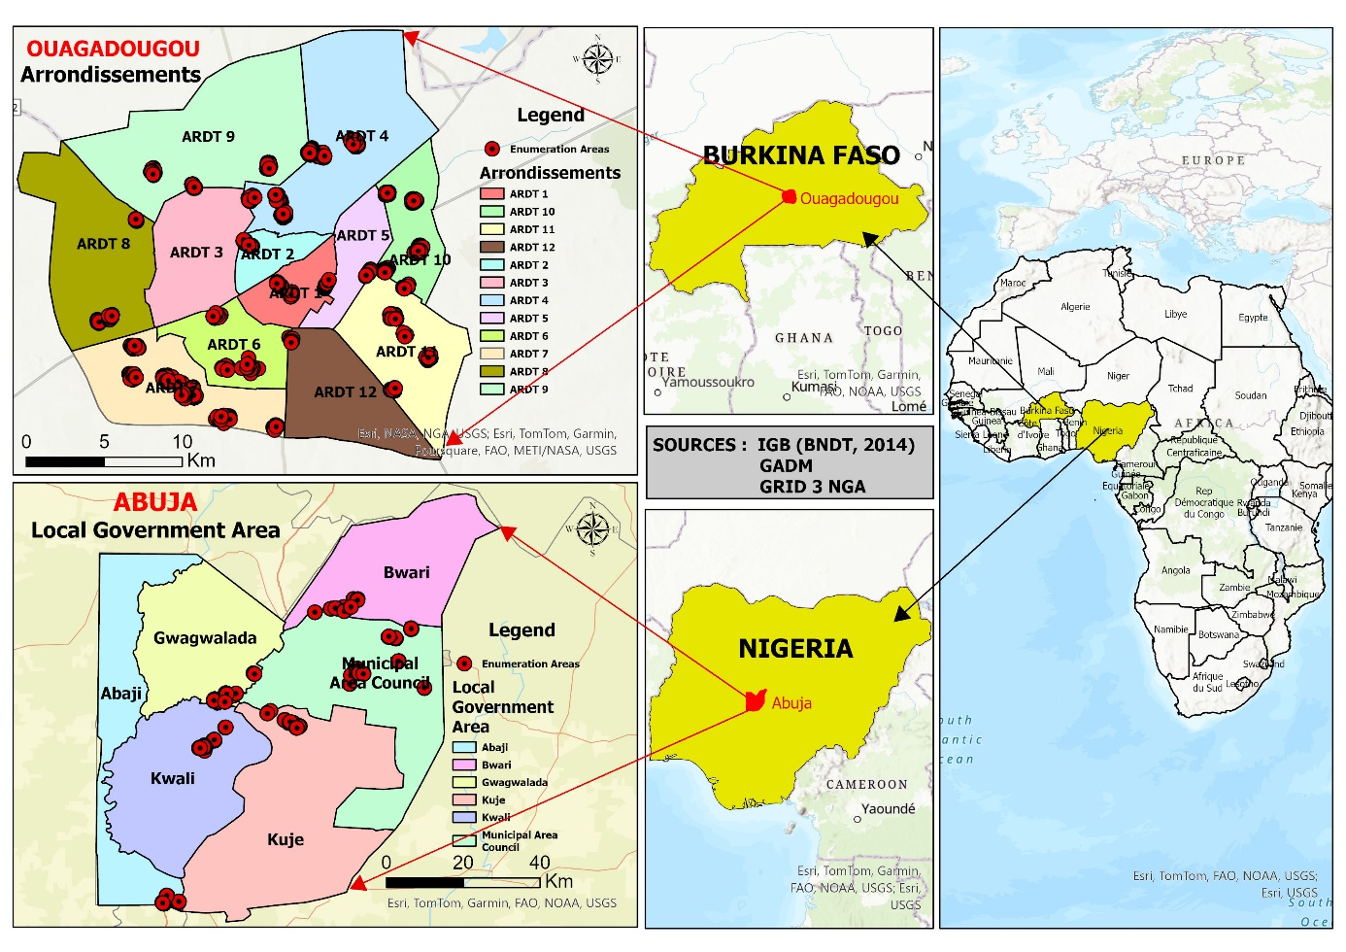
METHODOLOGY
Introduction
Problem Statement
Study Area
Justification
Conceptual Framework
Type of Data
Methodology
Results
Conclusion
Spatial and demographic sample
ABUJA
OUAGADOUGOU
Local Government Area | Enumeration Area | Household | Population size in 2022
Abuja municipal Area Council | 12 | 240 | 1 693 400
Abaji | 6 | 120 | 127 900
Bwari | 6 | 120 | 500 100
Gwagwalada | 6 | 120 | 346 000
Kuje | 6 | 120 | 212 100
Kwali | 6 | 120 | 188 000
TOTAL | 42 | 840 | 3 067 500
Arrondissements | Enumeration Area | Household | Population size in 2019
Arrondissement 01 | 2 | 40 | 102 528
Arrondissement 02 | 2 | 40 | 83 436
Arrondissement 04 | 5 | 100 | 207 647
Arrondissement 05 | 2 | 40 | 129 984
Arrondissement 06 | 4 | 80 | 222 854
Arrondissement 07 | 8 | 160 | 282 837
Arrondissement 08 | 3 | 60 | 152 880
Arrondissement 09 | 4 | 80 | 336 483
Arrondissement 10 | 6 | 120 | 263 969
Arrondissement 11 | 4 | 80 | 254 928
Arrondissement 12 | 2 | 40 | 66 314
TOTAL | 42 | 840 | 2 103 860

Slide 15
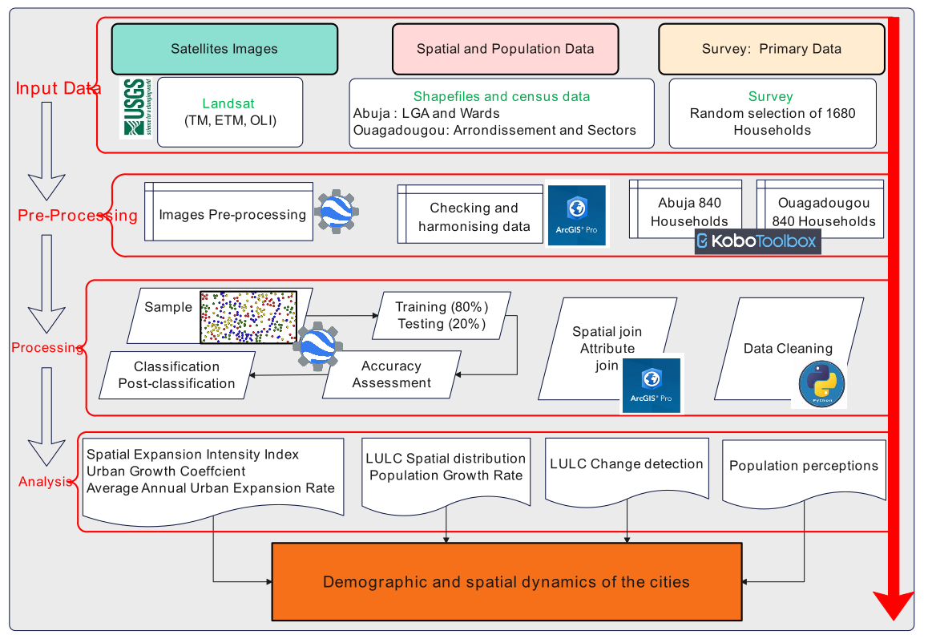
METHODOLOGY
Introduction
Problem Statement
Study Area
Justification
Conceptual Framework
Type of Data
Methodology
Results
Conclusion
Methodology of objective 1 : Settlement dynamics

Slide 16
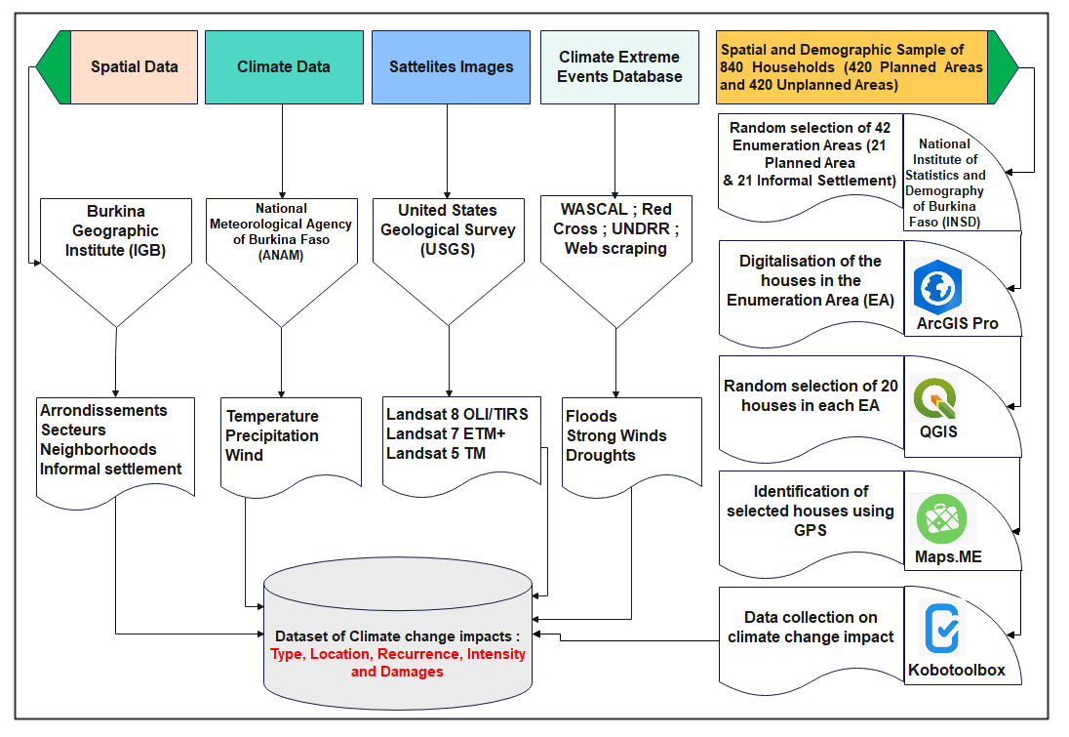
METHODOLOGY
Introduction
Problem Statement
Study Area
Justification
Conceptual Framework
Type of Data
Methodology
Results
Conclusion
Methodology of objective 2 : Climate change extreme event in Urban Area

Slide 17
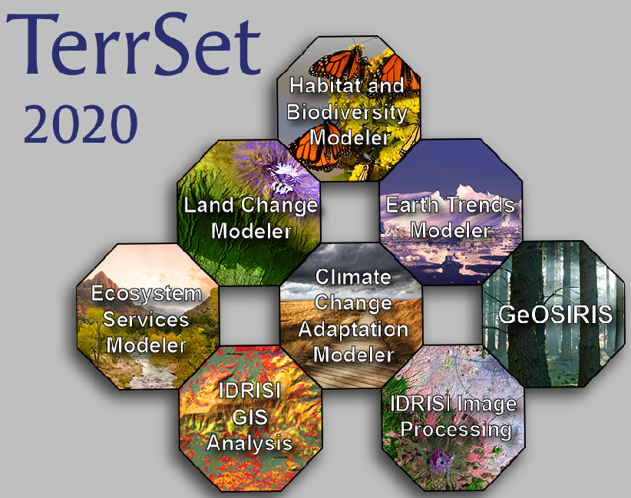
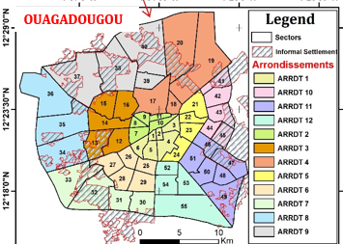
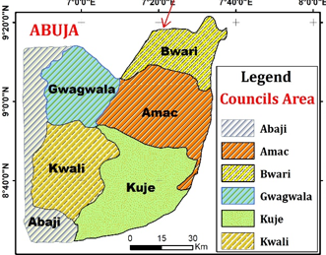
METHODOLOGY
Introduction
Problem Statement
Study Area
Justification
Conceptual Framework
Type of Data
Methodology
Results
Conclusion
Methodology of objective 3 : Future land Use land cover Prediction
Dependents Variables :
Ouaga
Abuja
Land Change Modeler
LULC 2012
LULC 2022
LULC 2013
LULC 2022
Independents Variables :
Distance to Roads
Population density
Localities/villages
Slope
Prediction of LULC in 2052

Slide 18
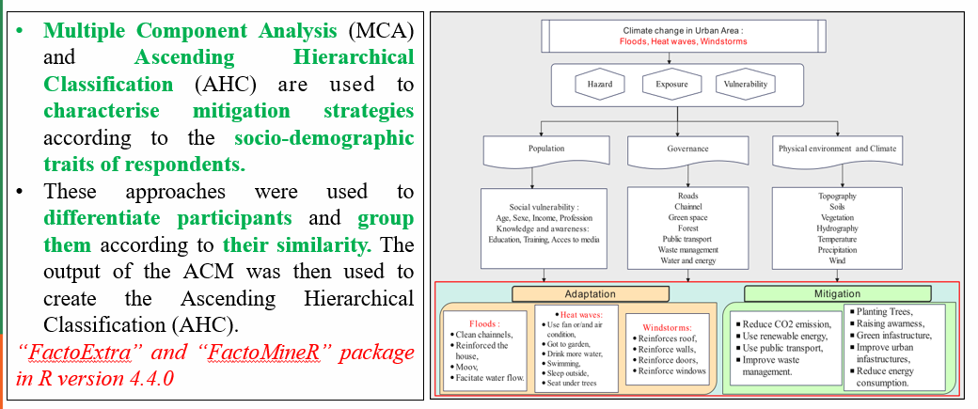
METHODOLOGY
Introduction
Problem Statement
Study Area
Justification
Conceptual Framework
Type of Data
Methodology
Results
Conclusion
Methodology of objective 4 : Climate change adaptation and mitigation

Slide 19
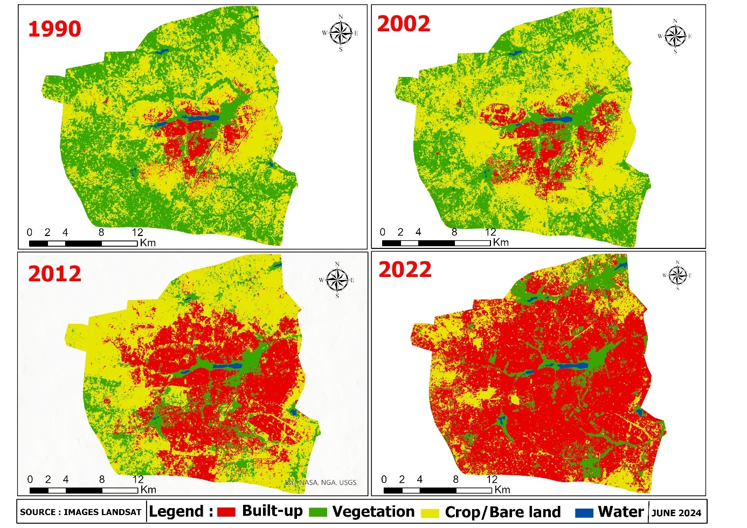
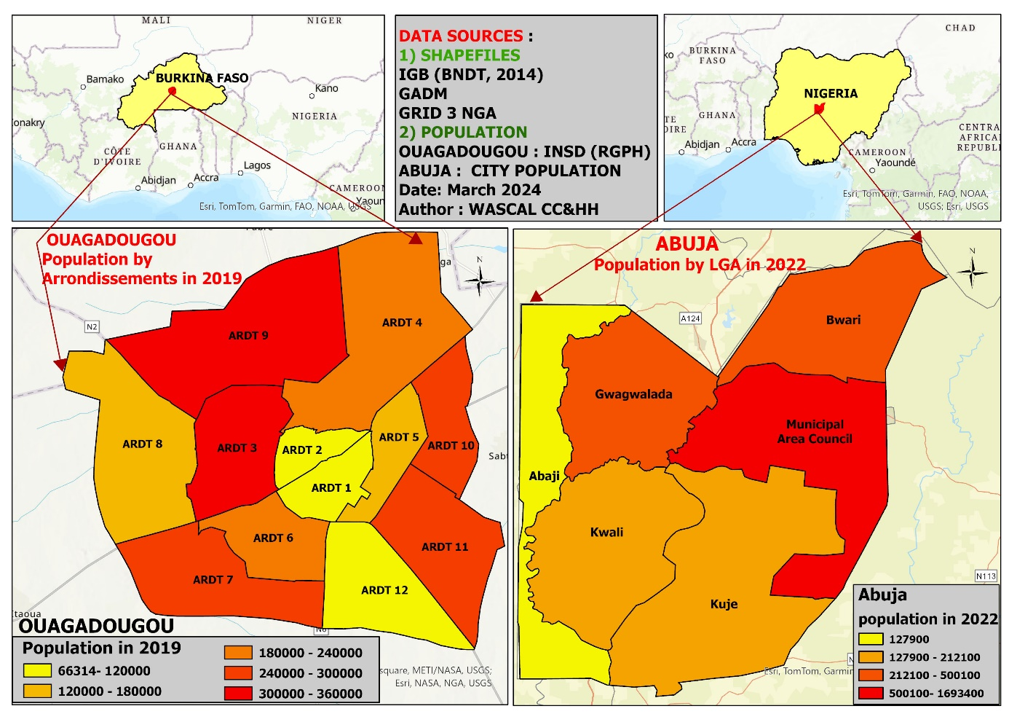
RESULTS OBJECTIVE 1
Introduction
Problem Statement
Study Area
Justification
Conceptual Framework
Type of Data
Methodology
Results
Conclusion
Demographic and spatial dynamics in Ouagadougou and Abuja
LULC in Ouagadougou

Slide 20
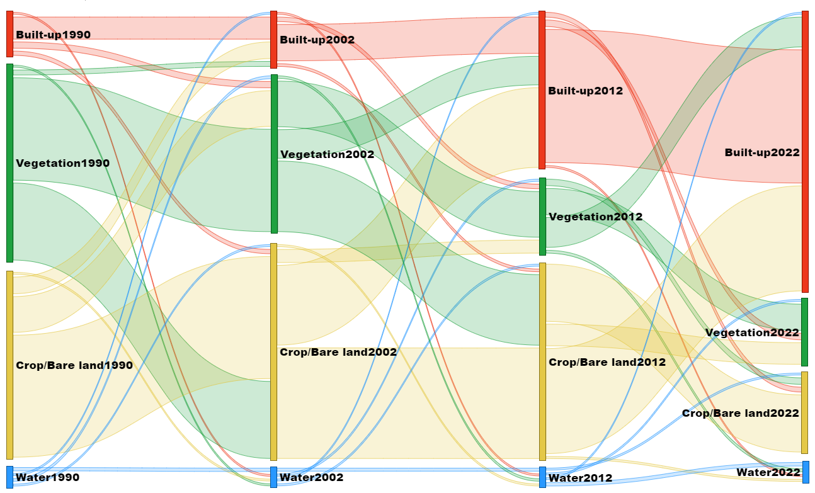
RESULTS OBJECTIVE 1
Introduction
Problem Statement
Study Area
Justification
Conceptual Framework
Type of Data
Methodology
Results
Conclusion
Demographic and spatial dynamics in Ouagadougou and Abuja
Land use land cover change in Ouagadougou

Slide 21
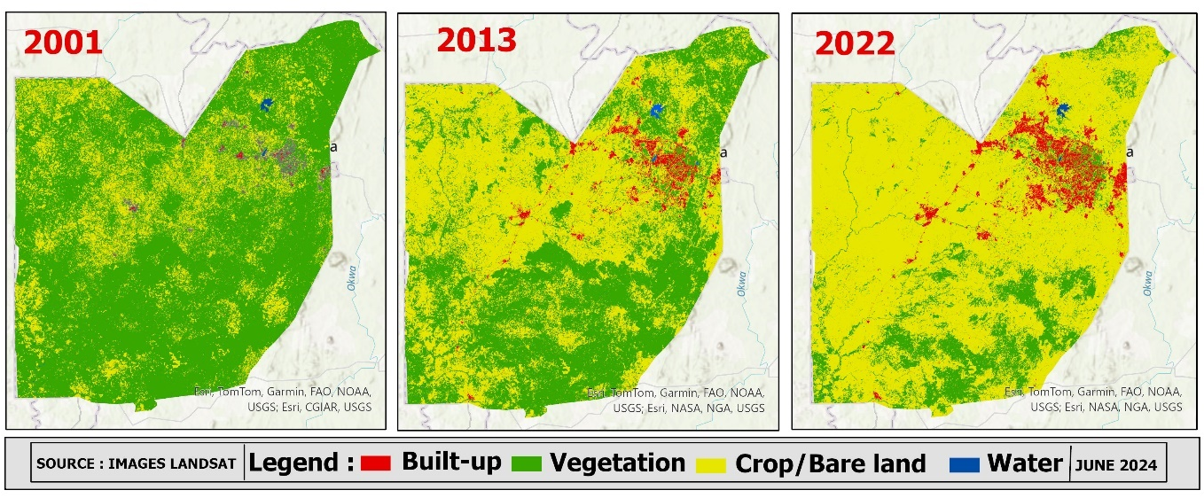
RESULTS OBJECTIVE 1
Introduction
Problem Statement
Study Area
Justification
Conceptual Framework
Type of Data
Methodology
Results
Conclusion
Demographic and spatial dynamics in Ouagadougou and Abuja
LULC in Abuja

Slide 22
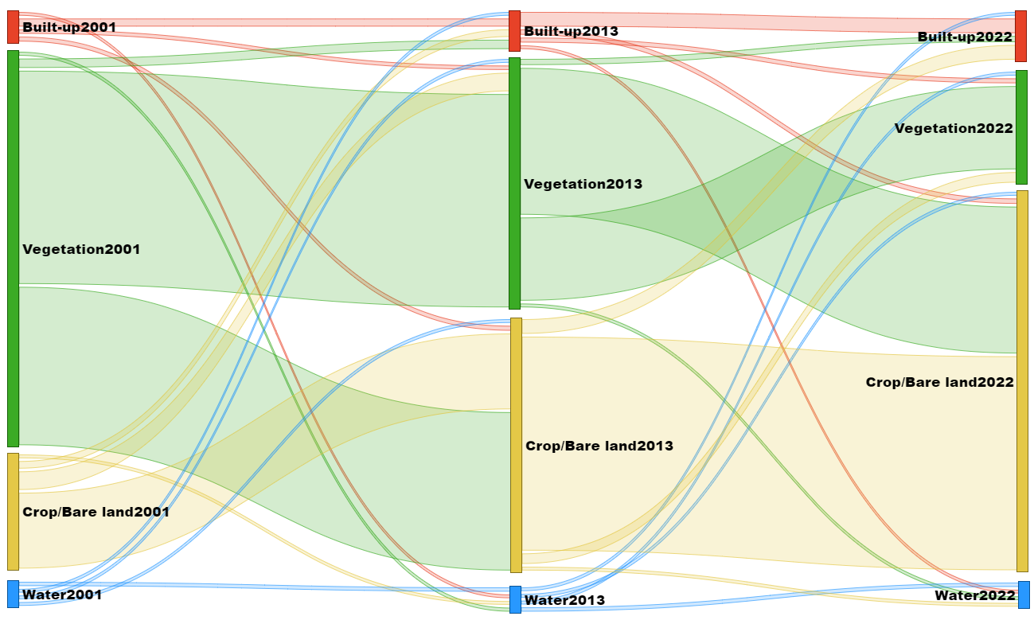
RESULTS OBJECTIVE 1
Introduction
Problem Statement
Study Area
Justification
Conceptual Framework
Type of Data
Methodology
Results
Conclusion
Demographic and spatial dynamics in Ouagadougou and Abuja
Land use land cover change in Abuja

Slide 23

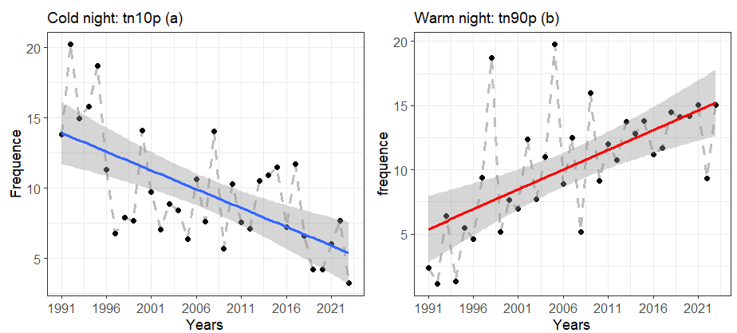
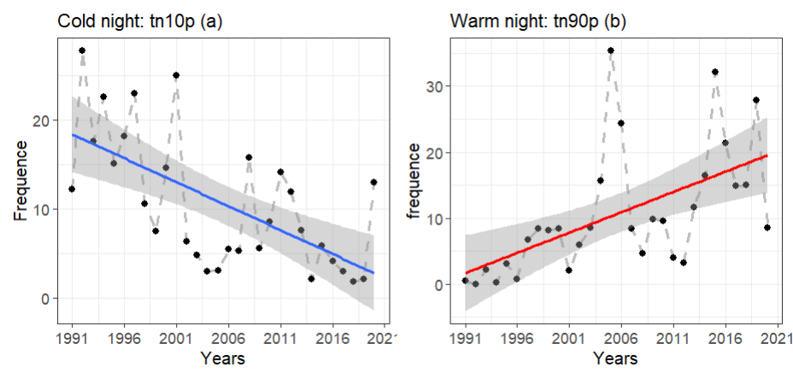
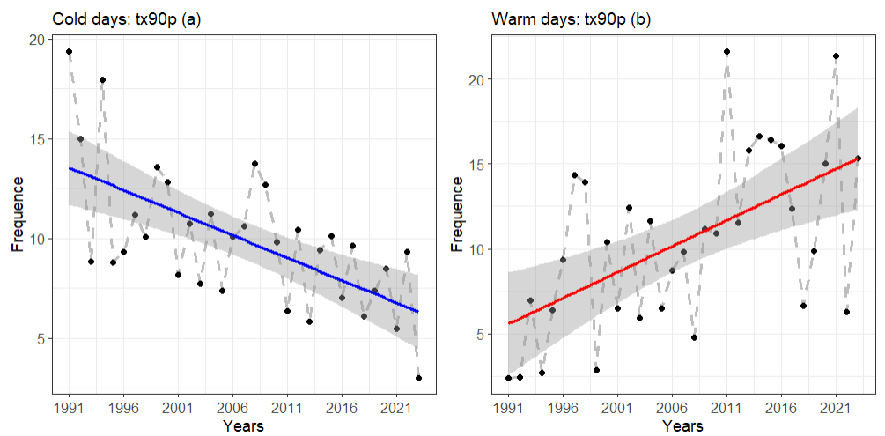
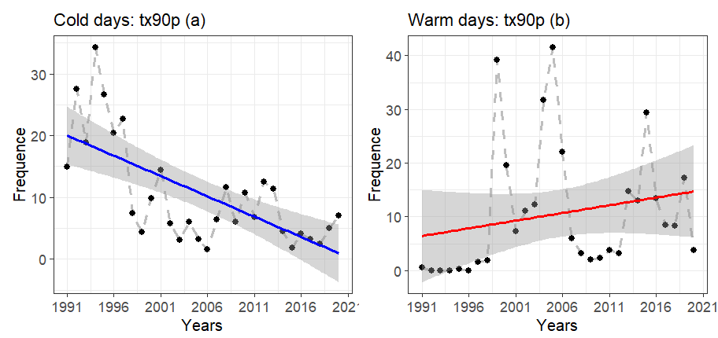
Introduction
Problem Statement
Study Area
Justification
Conceptual Framework
Type of Data
Methodology
Results
Conclusion
RESULTS OBJECTIVE 2
Climate change impacts in urban areas
Ouagadougou
Temperatures Trends in Abuja and Ouagadougou
Abuja
Notes:
https://www.afrik.com/burkina-faso-les-inondations-font-un-mort-a-ouagadougou

Slide 24
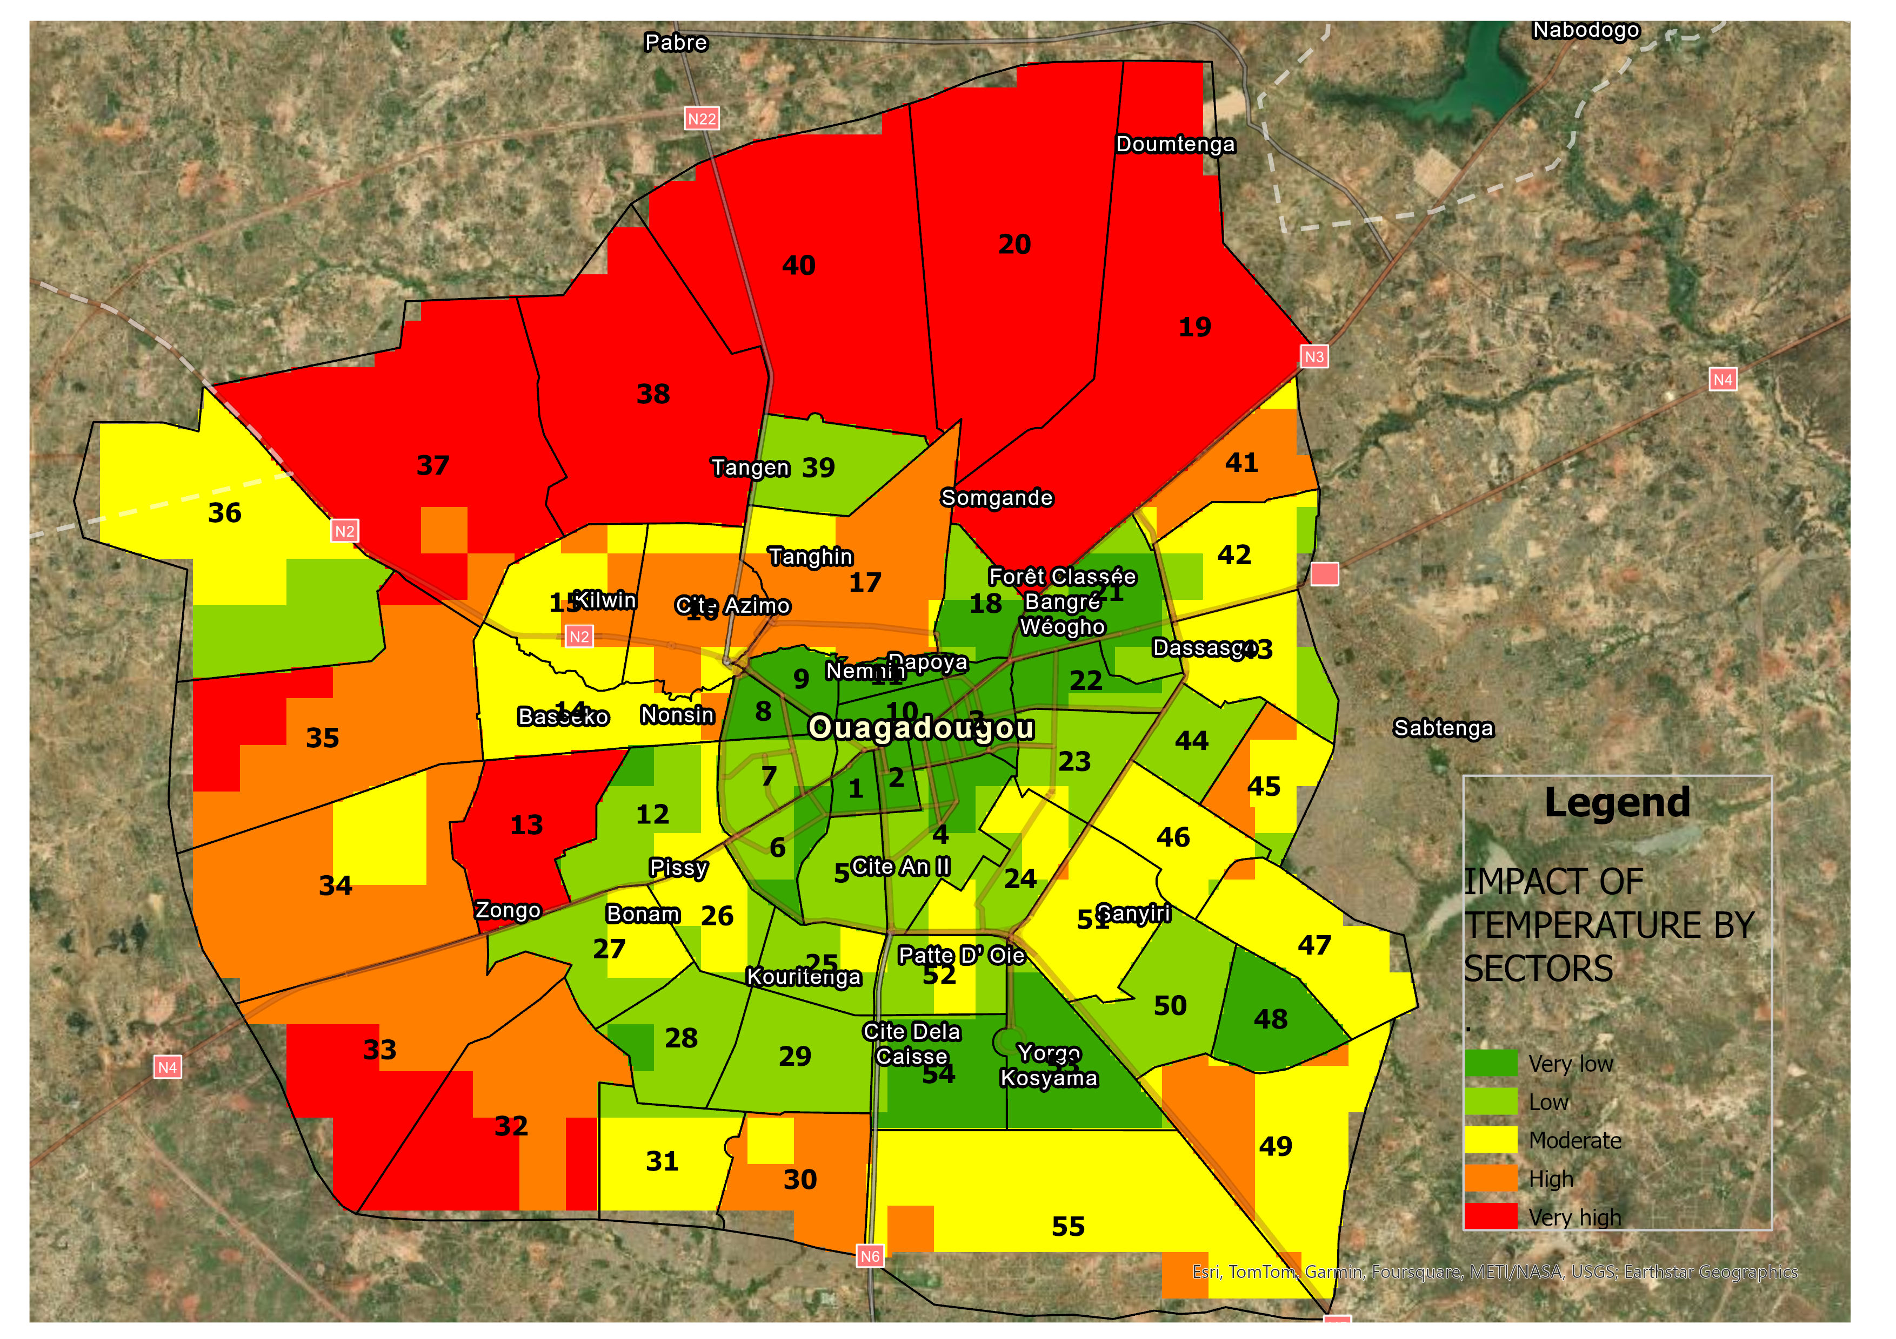
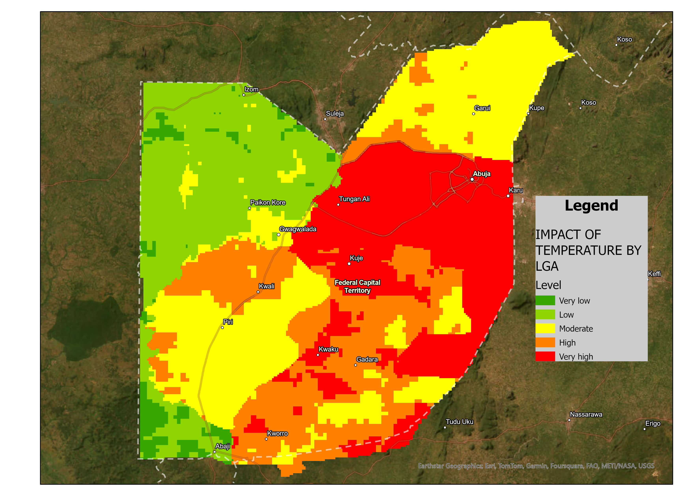
Introduction
Problem Statement
Study Area
Justification
Conceptual Framework
Type of Data
Methodology
Results
Conclusion
RESULTS OBJECTIVE 2
Climate change impacts in urban areas
Distribution of impact of high Temperatures
OUAGADOUGOU
ABUJA
Increase in water consumption (79.71%),
Insomnia (69.62%), General fatigue (55.29%) and Headaches (50.79%)
Increase in water consumption (64.18%), General fatigue (52.08%), Headaches (49.14%) and Insomnia (28.85%).
Notes:
https://www.afrik.com/burkina-faso-les-inondations-font-un-mort-a-ouagadougou

Slide 25
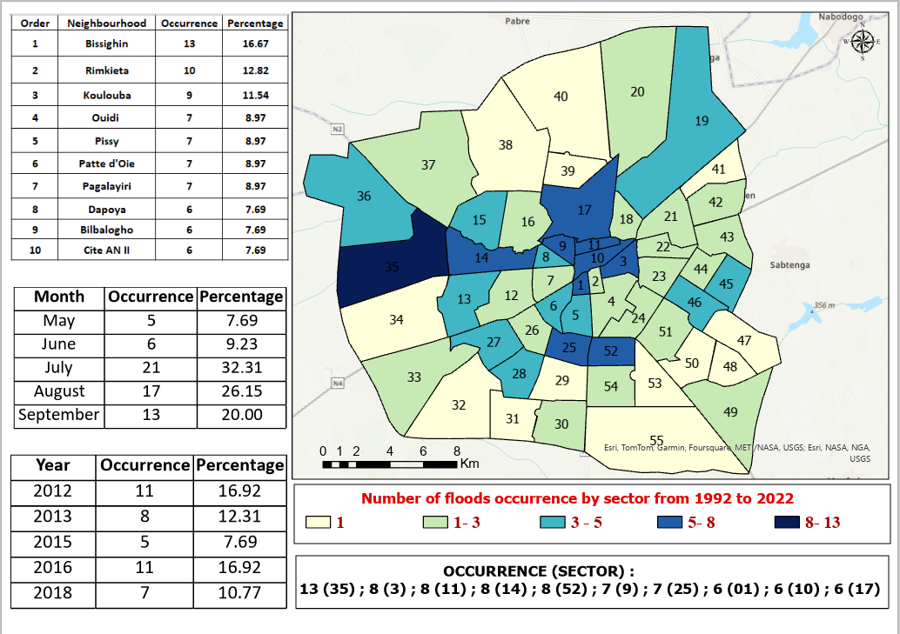
Introduction
Problem Statement
Study Area
Justification
Conceptual Framework
Type of Data
Methodology
Results
Conclusion
RESULTS OBJECTIVE 2
Climate change impacts in urban areas
Floods recurrence in Ouagadougou
40.7% had been affected by flooding at least once in their current residence in the last 30 years.
74.85% knew people who had also been affected by the floods

Slide 26
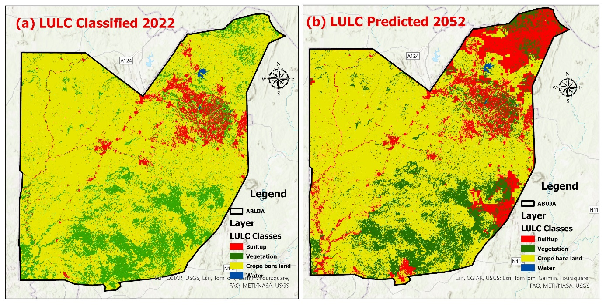
Introduction
Problem Statement
Study Area
Justification
Conceptual Framework
Type of Data
Methodology
Results
Conclusion
RESULTS OBJECTIVE 3
Future urban expansion in 2052
Prediction of future LULC in Abuja
Three main factors influence most built-up expansion:
1.Settlements / localities
2.Roads Development
3. Altitude

Slide 27
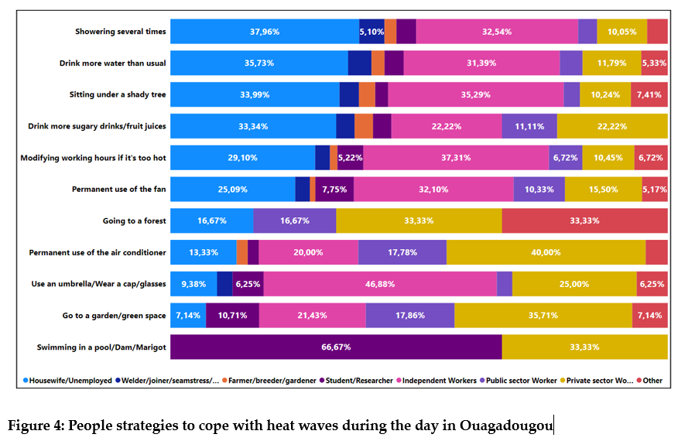
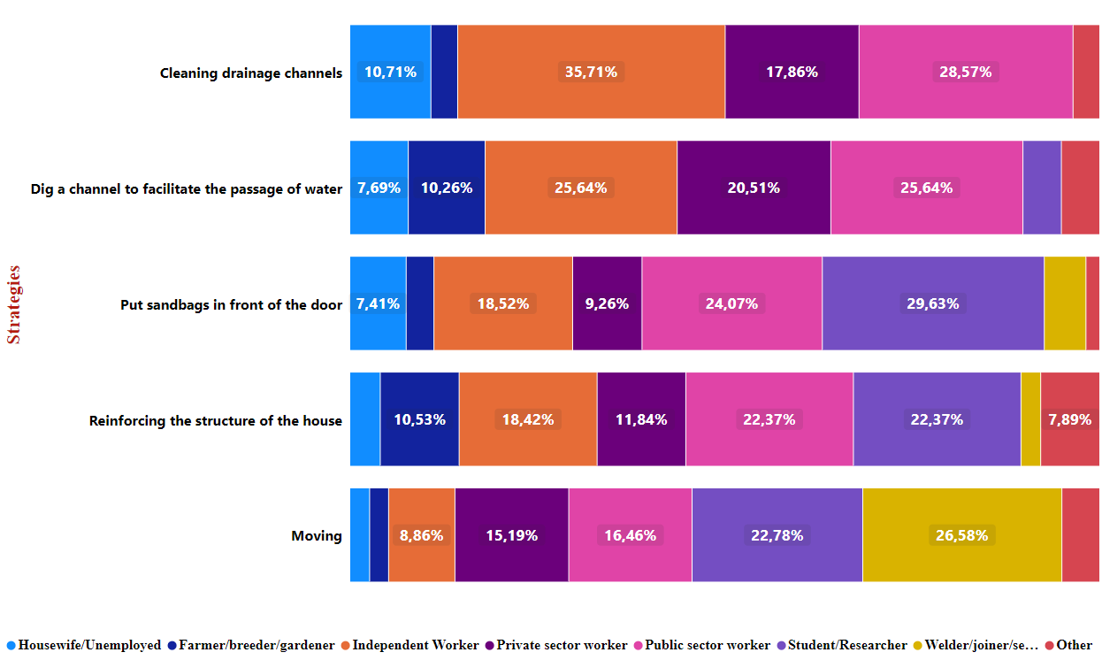
Introduction
Problem Statement
Study Area
Justification
Conceptual Framework
Type of Data
Methodology
Results
Conclusion
RESULTS OBJECTIVE 4
Climate Change adaptation and mitigation strategies
Adaptation strategies
Heat waves adaptation strategies Ouagadougou
Flood adaptation strategies Abuja

Slide 28
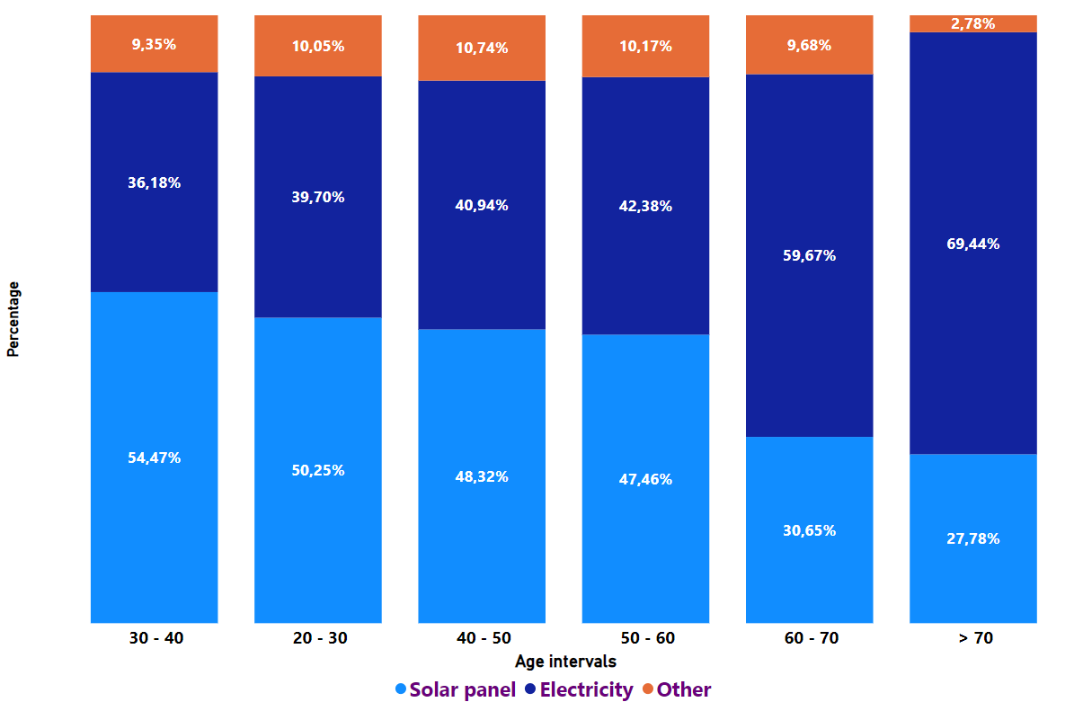
Introduction
Problem Statement
Study Area
Justification
Conceptual Framework
Type of Data
Methodology
Results
Conclusion
RESULTS OBJECTIVE 4
Climate Change adaptation and mitigation strategies
Mitigation strategies
Ouagadougou
Abuja

Slide 29
CONCLUSION
Introduction
Problem Statement
Study Area
Justification
Conceptual Framework
Type of Data
Methodology
Results
Conclusion
In terms of spatial dynamics, the results of this study reveal growing urbanisation, characterised by an exponential increase in the surface area occupied by built-up.
The area occupied by built-up increased four time (Abuja) between 2001 and 2022, and almost ten time (Ouagadougou) between 1990 and 2022.
The results showed that respondents in both cities adopt various measures to adapt to each climate phenomenon, but the level of adoption of these measures differs from one city to another.
The spatial distribution of the phenomena by sector in the city of Ouagadougou and by LGA in the city of Abuja shows disparities between the different urban areas.

Slide 30
CONCLUSION
Introduction
Problem Statement
Study Area
Justification
Conceptual Framework
Type of Data
Methodology
Results
Conclusion
In addition, the same populations are sometimes affected simultaneously by several climatic hazards.
The study reveals that population density, degradation of vegetation, poor planning and lack of public awareness are factors that contribute to the recurrence of extreme weather events.
The findings revealed a low level of adoption of climate change mitigation measures. Households make little use of renewable energy. In particular, in Ouagadougou, there is a total lack of use of public transport by the population
The results also showed that the authorities reacted poorly to extreme climate events in these two cities.

Slide 31
RECOMMENDATIONS
Introduction
Problem Statement
Study Area
Justification
Conceptual Framework
Type of Data
Methodology
Results
Conclusion
Policy Improvement
Improve urban planning
Improve urban infrastructure
Promote the use of public transport
Promote environmental protection
and conservation
Promote the development of green spaces
Encourage protection of vegetation
Encourage tree planting
Encourage participation in reforestation campaigns

Slide 32
RECOMMENDATIONS
Introduction
Problem Statement
Study Area
Justification
Conceptual Framework
Type of Data
Methodology
Results
Conclusion
Promote the use of materials that are suitable and affordable for the population
Develop and diversify public transport and encourage people
to use it.
Performance Improvement
Ensure that people already living in flood-prone areas are relocated to non-risk areas.
Promote the use of renewable energies such as solar panels, wind power, and biogas.

Slide 33

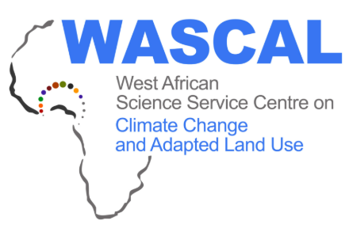





ACKNOWLEDGEMENTS
Introduction
Problem Statement
Study Area
Justification
Conceptual Framework
Type of Data
Methodology
Results
Conclusion
TEAM OF SUPERVISORS
Prof. Appollonia A. Okhimamhe
Federal University of Technology, Minna, Niger State, NIGERIA
2. Dr Oble Neya
National Centre for Scientific and Technological Research, Ouagadougou, BURKINA FASO
3. Dr Michael Thiel
Julius-Maximilians-University of Würzburg, GERMANY

