Slide 1
Impacts of urban land use and topography on surface temperature in Ouagadougou and Bobo-Dioulasso, Burkina Faso
By
OUEDRAOGO, Valentin
PhD/SPS/FT/2019/11123
PhD external defense
Main Supervisor: Co-Supervisors:
Prof. Jaiye J. DUKIYA Dr. Kwame Oppong HACKMAN
Dr. Michael THIEL
14 December 2023

Slide 2
Presentation outline
Background of the study
Problem statement
Research questions
Aim and objectives
Justification
Description of the study area
Scope of the study
Results
Implications of results
Conclusion and recommendations
References
Methodology
Key literature

Slide 3
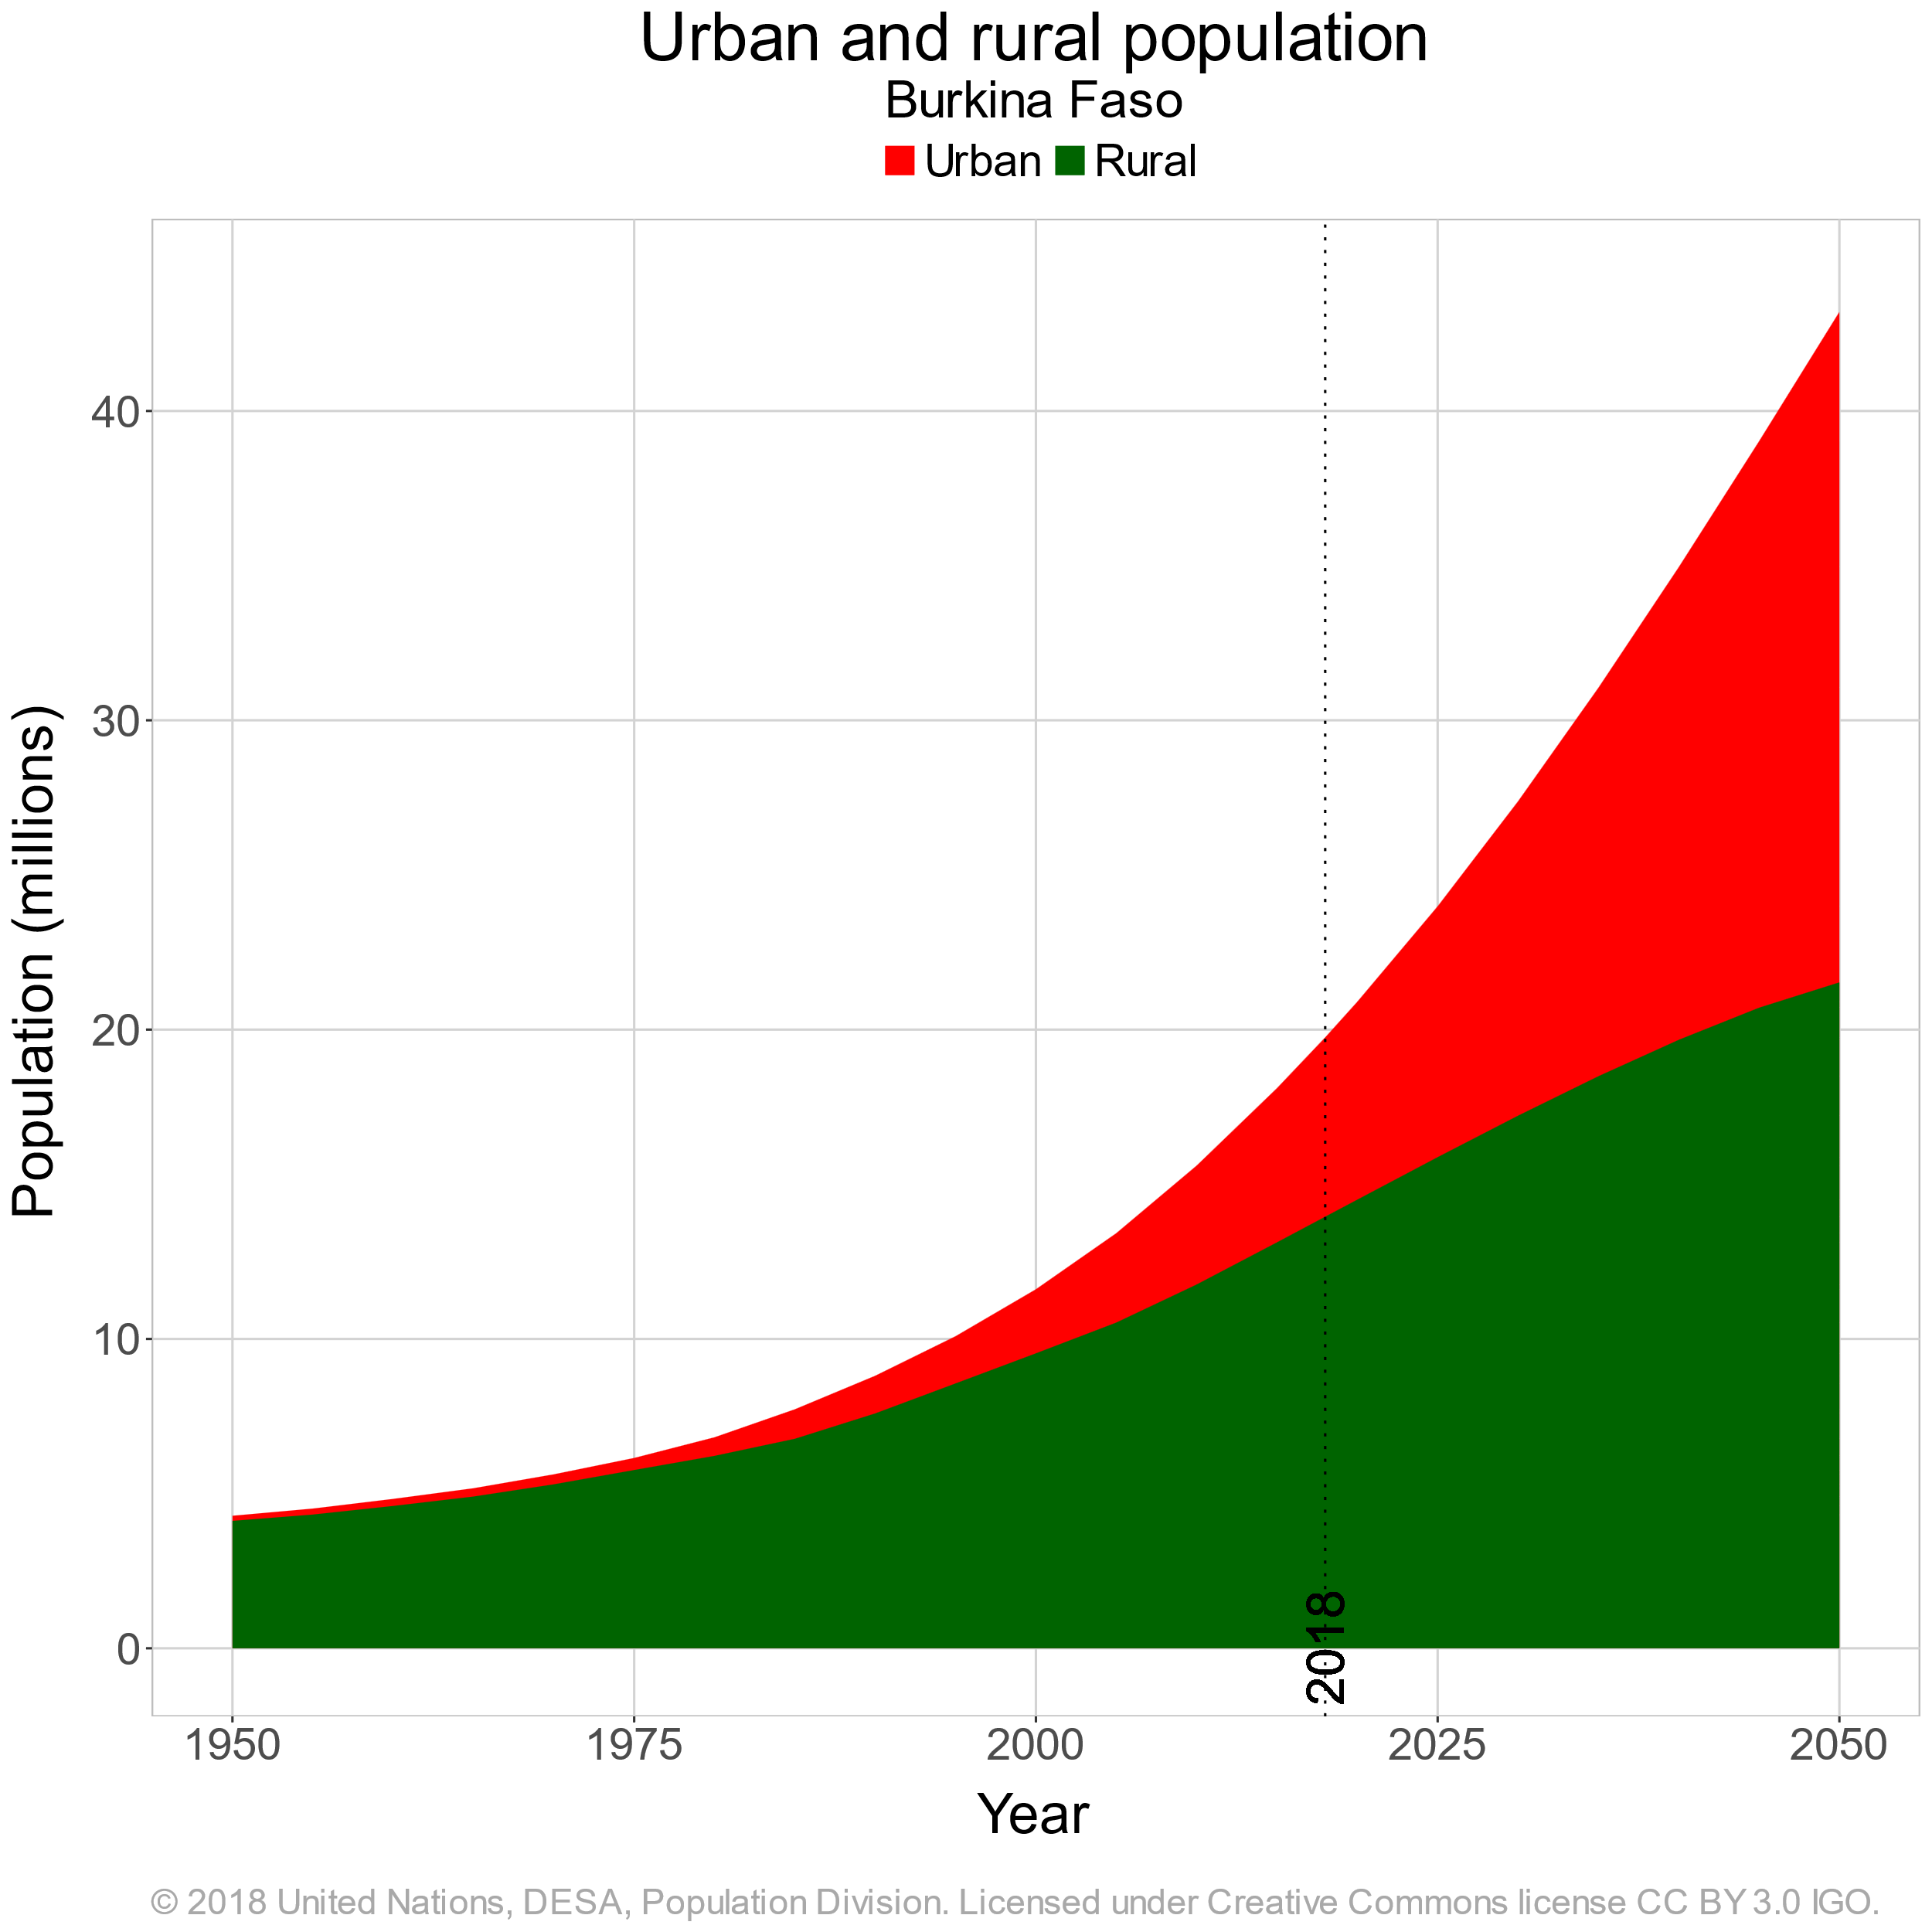

Background of the study (1/2)
Rapid urban population growth worldwide
6.68 billion by 2050 (UN, 2018)
50%
Notes:
Urbanization is a source of increased consumption, and fossil fuel usage, increase global warming, and cause climate change (Sannigrahi et al., 2017).
6.68 billion urban dwellers by 2050 (UN, 2018).
The urban population’s exposure to the risk of temperature-related diseases is intensified by the SUHI phenomenon and climate change (Zhang et al., 2020, Estoque et al., 2020).

Slide 4
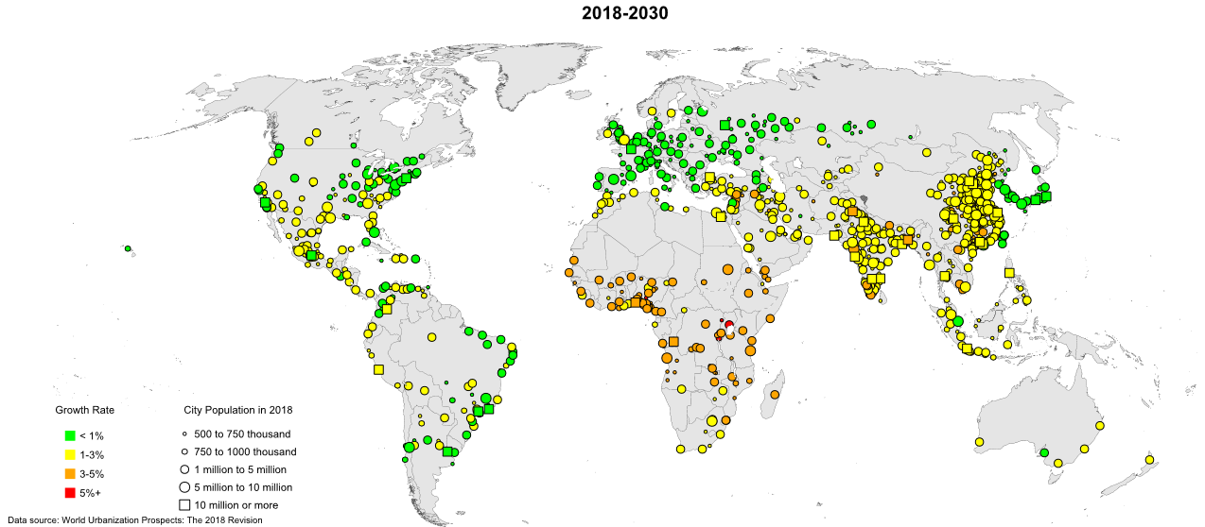
Background of the study (2/2)
Rapid urban population growth in Sub-Saharan Africa
Figure 1: Urban growth rate in 2018 (Source: World Urbanisation Prospect)
Increasing urbanization trend all over the world, with a peak in Africa (Stemn & Kumi-Boateng, 2020)
Notes:
Most of the rapid growing cities are encountered in Sub-Saharan Africa.
As a result, cities will be exposed to climate change from greenhouse gas-induced radiative forcing and Urban Heat Island.

Slide 5
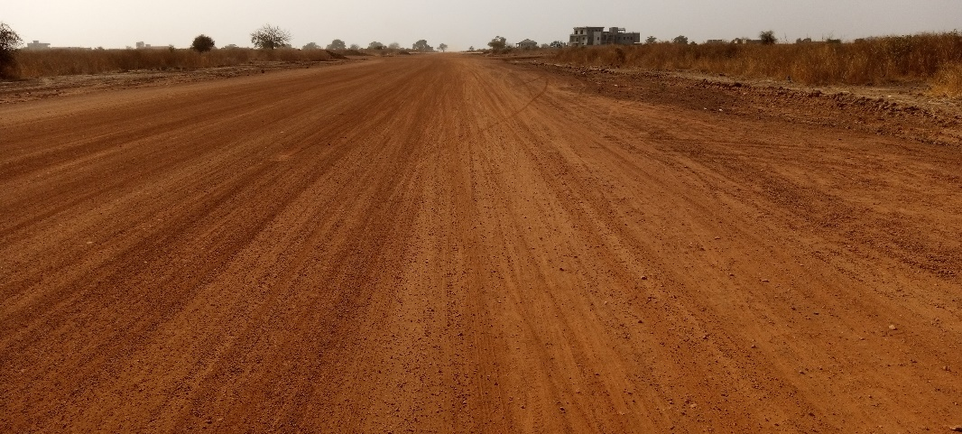
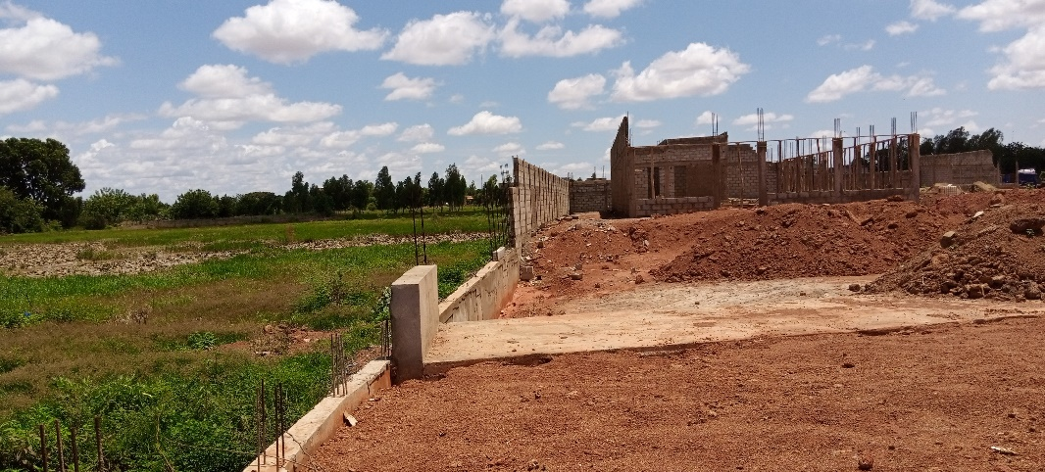
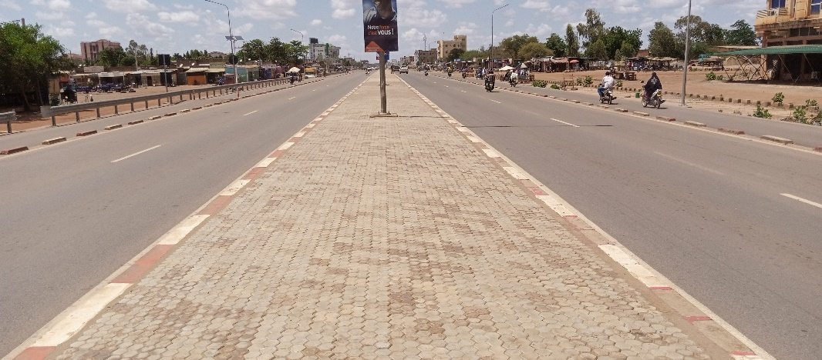
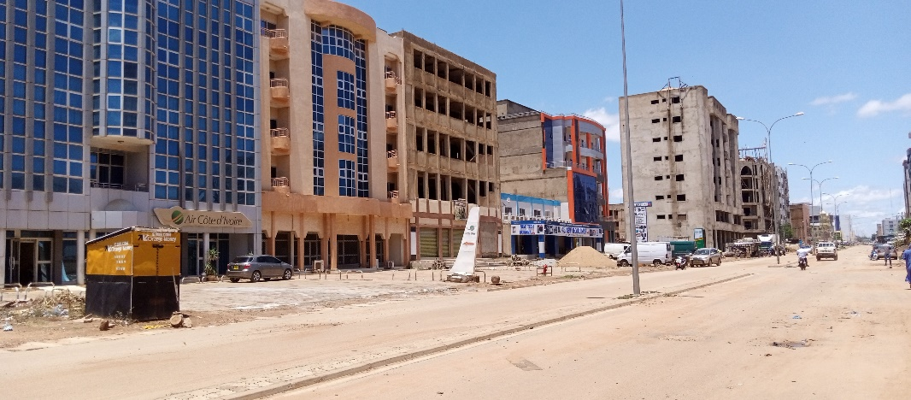
Problem statement (1/2)
Urban growth causes LULC changes in Burkina Faso
Land clearing for built-up
Concrete surfaces expansion
Notes:
Consequently the urban land use/cover change affects the thermal characteristics of the surface and then, the urban heat island intensity (Sannigrahi et al., 2017)

Slide 6
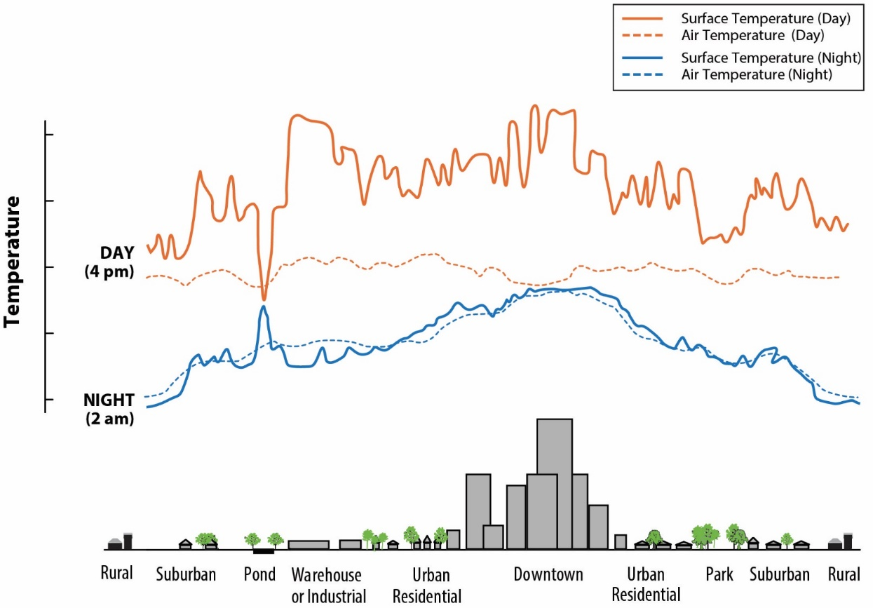
Problem statement (2/2)
Urban surface thermal properties modification and LST increase;
Cities are 10-15°C hotter than rural surroundings (European Commission)
Intensification of urban population’s exposure to the risk of temperature-related diseases (Estoque et al., 2020).
LST is the radiative skin temperature of the land surface.
Its depends on solar radiation, surface albedo, vegetation cover and soil moisture.
Figure 2: LST and air temperature pattern over different LULC types
Notes:
The Surface Urban Heat Island (SUHI) from LST depends on the biophysical characteristics of the land (Fonseka et al., 2019), and topography (Peng et al., 2020).
The challenge is to understand how urban LULC change affects surface temperature and changes the geographic distribution of temperature-related diseases.

Slide 7
Research questions (1/1)
What are the major Land Use/Land Cover changes in Ouagadougou and Bobo-Dioulasso from 2003 to 2021?
what is the trend of the meteorological and satellite-based thermal emission data between 2003 and 2021 in the two cities?
what is the correlation between the surface temperature and the urban Land Use/Land Cover changes in the two cities?
to what extent is the surface temperature related to the spatial distribution of temperature-related diseases in the two cities?
what will be the future trend of Land Use/Land Cover changes and surface temperature in the two cities?

Slide 8
Aim and objectives (1/1)
Aim: Analyse the influence of urban land use and topography on surface temperature in Ouagadougou and Bobo-Dioulasso. This in line with SDG 11 “Sustainable cities and communities”
Objectives
Assess the degree of Land Use/Land Cover changes in Ouagadougou and Bobo-Dioulasso between 2003 and 2021;
Carry out comparative trend analysis of the meteorological and satellite-based thermal emission data from 2003 to 2021 between the two cities;
Determine the correlation between surface temperature and urban Land Use/Land Cover changes in the two cities;
Assess the level of relationship between the spatial distribution of temperature-related diseases and surface temperature in the two cities;
Carry out future projection of Land Use/Land Cover and surface temperature

Slide 9



Justification (1/1)
Benefits for municipal authorities, urban planners and decision-makers;
Contribute to the achievement of UN SDG
Use of cloud computing,… addition to literature;
Further research on urban growth modelling, climate change mitigation/adaptation
Notes:
…by providing information on the types of land uses that increase the heat capacity of the urban surface, for a better sustainable land use policy development.
SDG11 on “Sustainable cities and communities”, SDG13 on “Climate action”; and SDG15 on “Life on land”. Indeed, the implementation of sustainable land use policy including building codes policy, green spaces development, open spaces development, blue infrastructures development can play a key role in improving the thermal comfort for a better urban liveability;
GEE to perform a time series analysis of the surface temperature and land use/cover. The findings are a valuable addition to the literature on applied climatology in the African region.
Clear understanding of the spatio-temporal pattern of the two variables for further research on urban growth modelling and climate change mitigation/adaptation in urban areas.

Slide 10
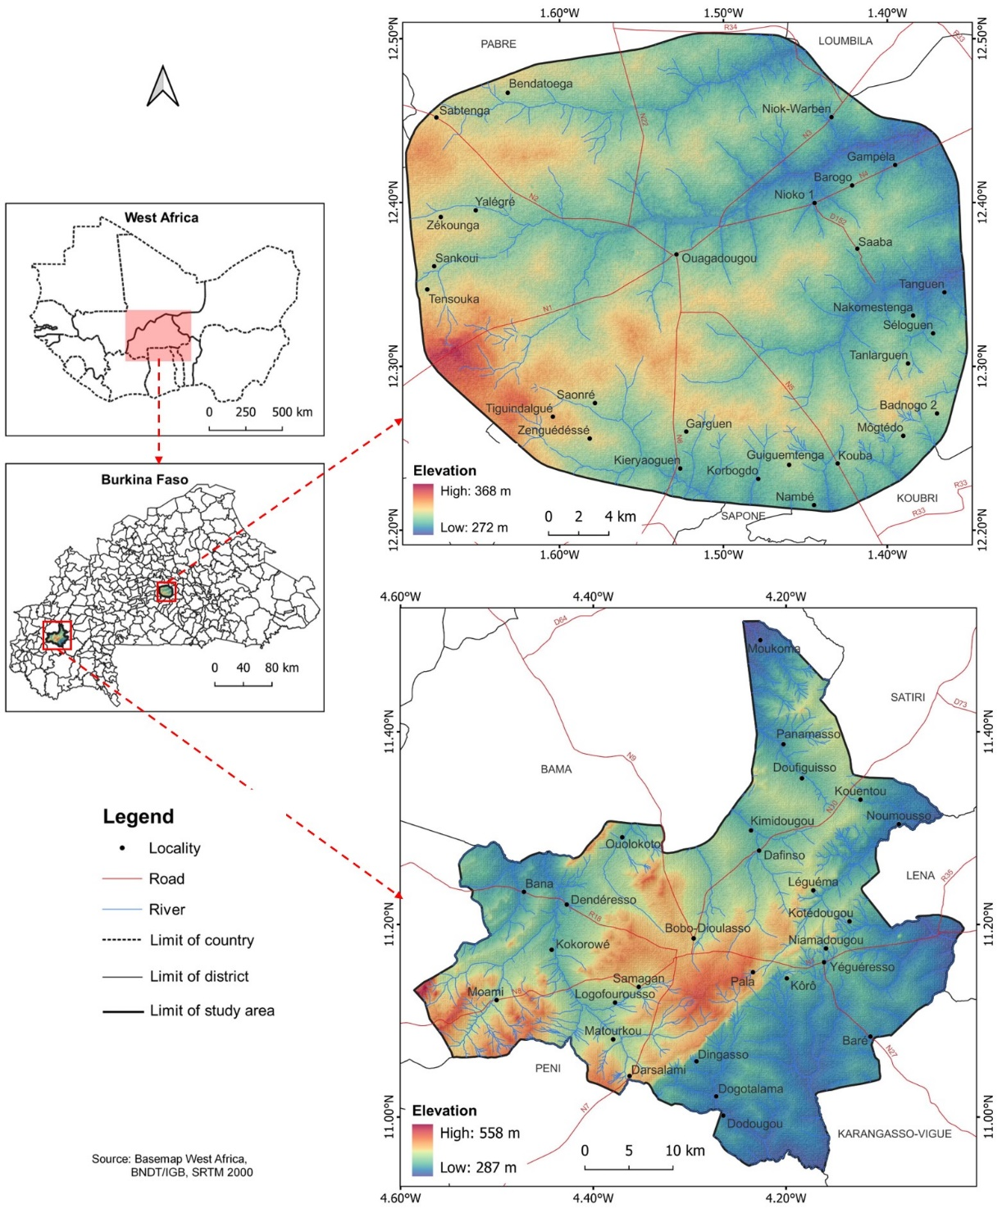
Description of the study area (1/2)
Ouagadougou; Centre, country capital, first city; administrative and political centre
Bobo: Western, second city of the country, economic capital
Figure 3: Study area location

Slide 11
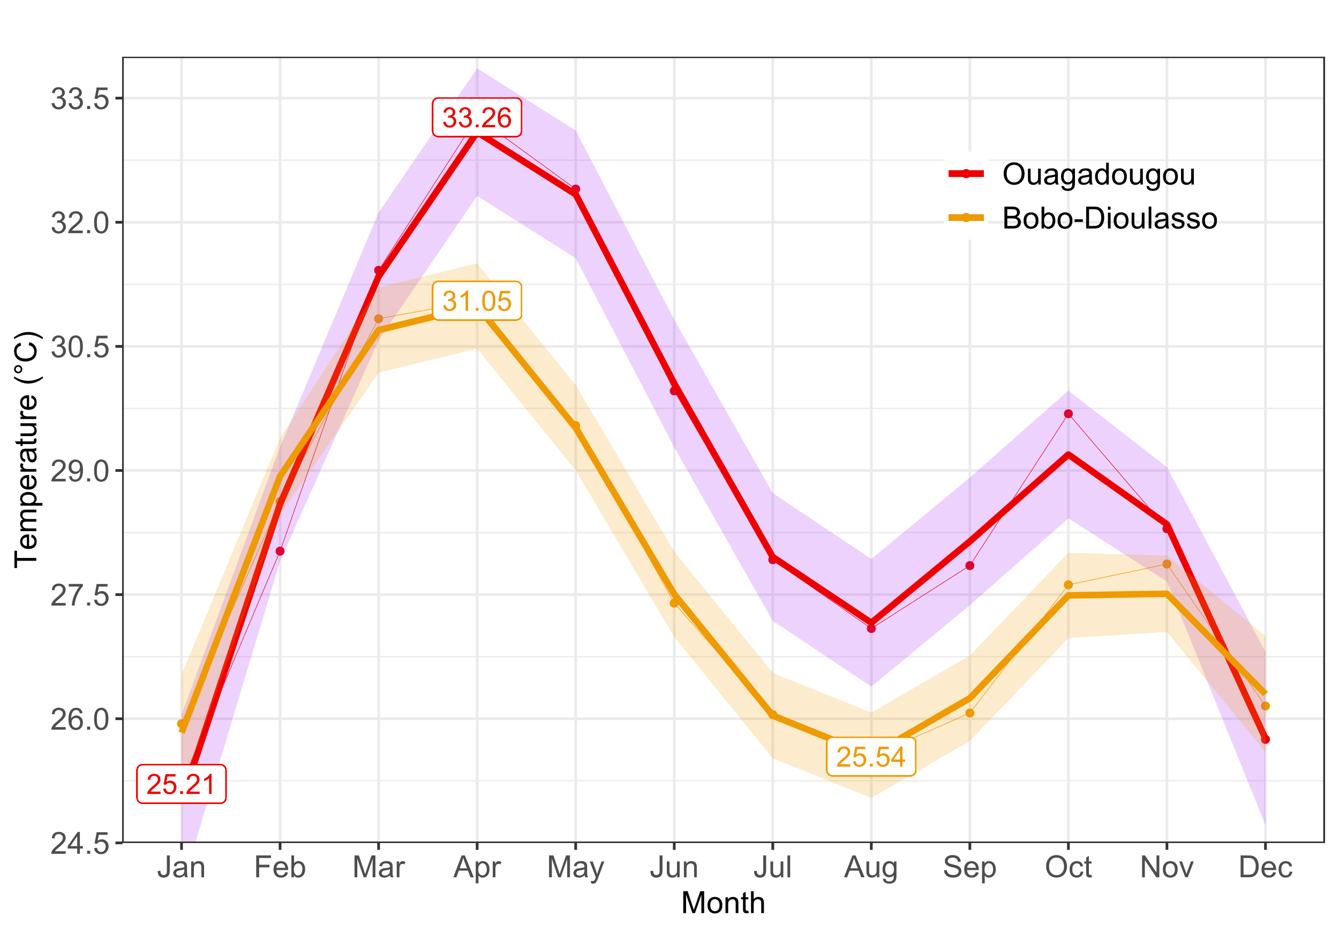
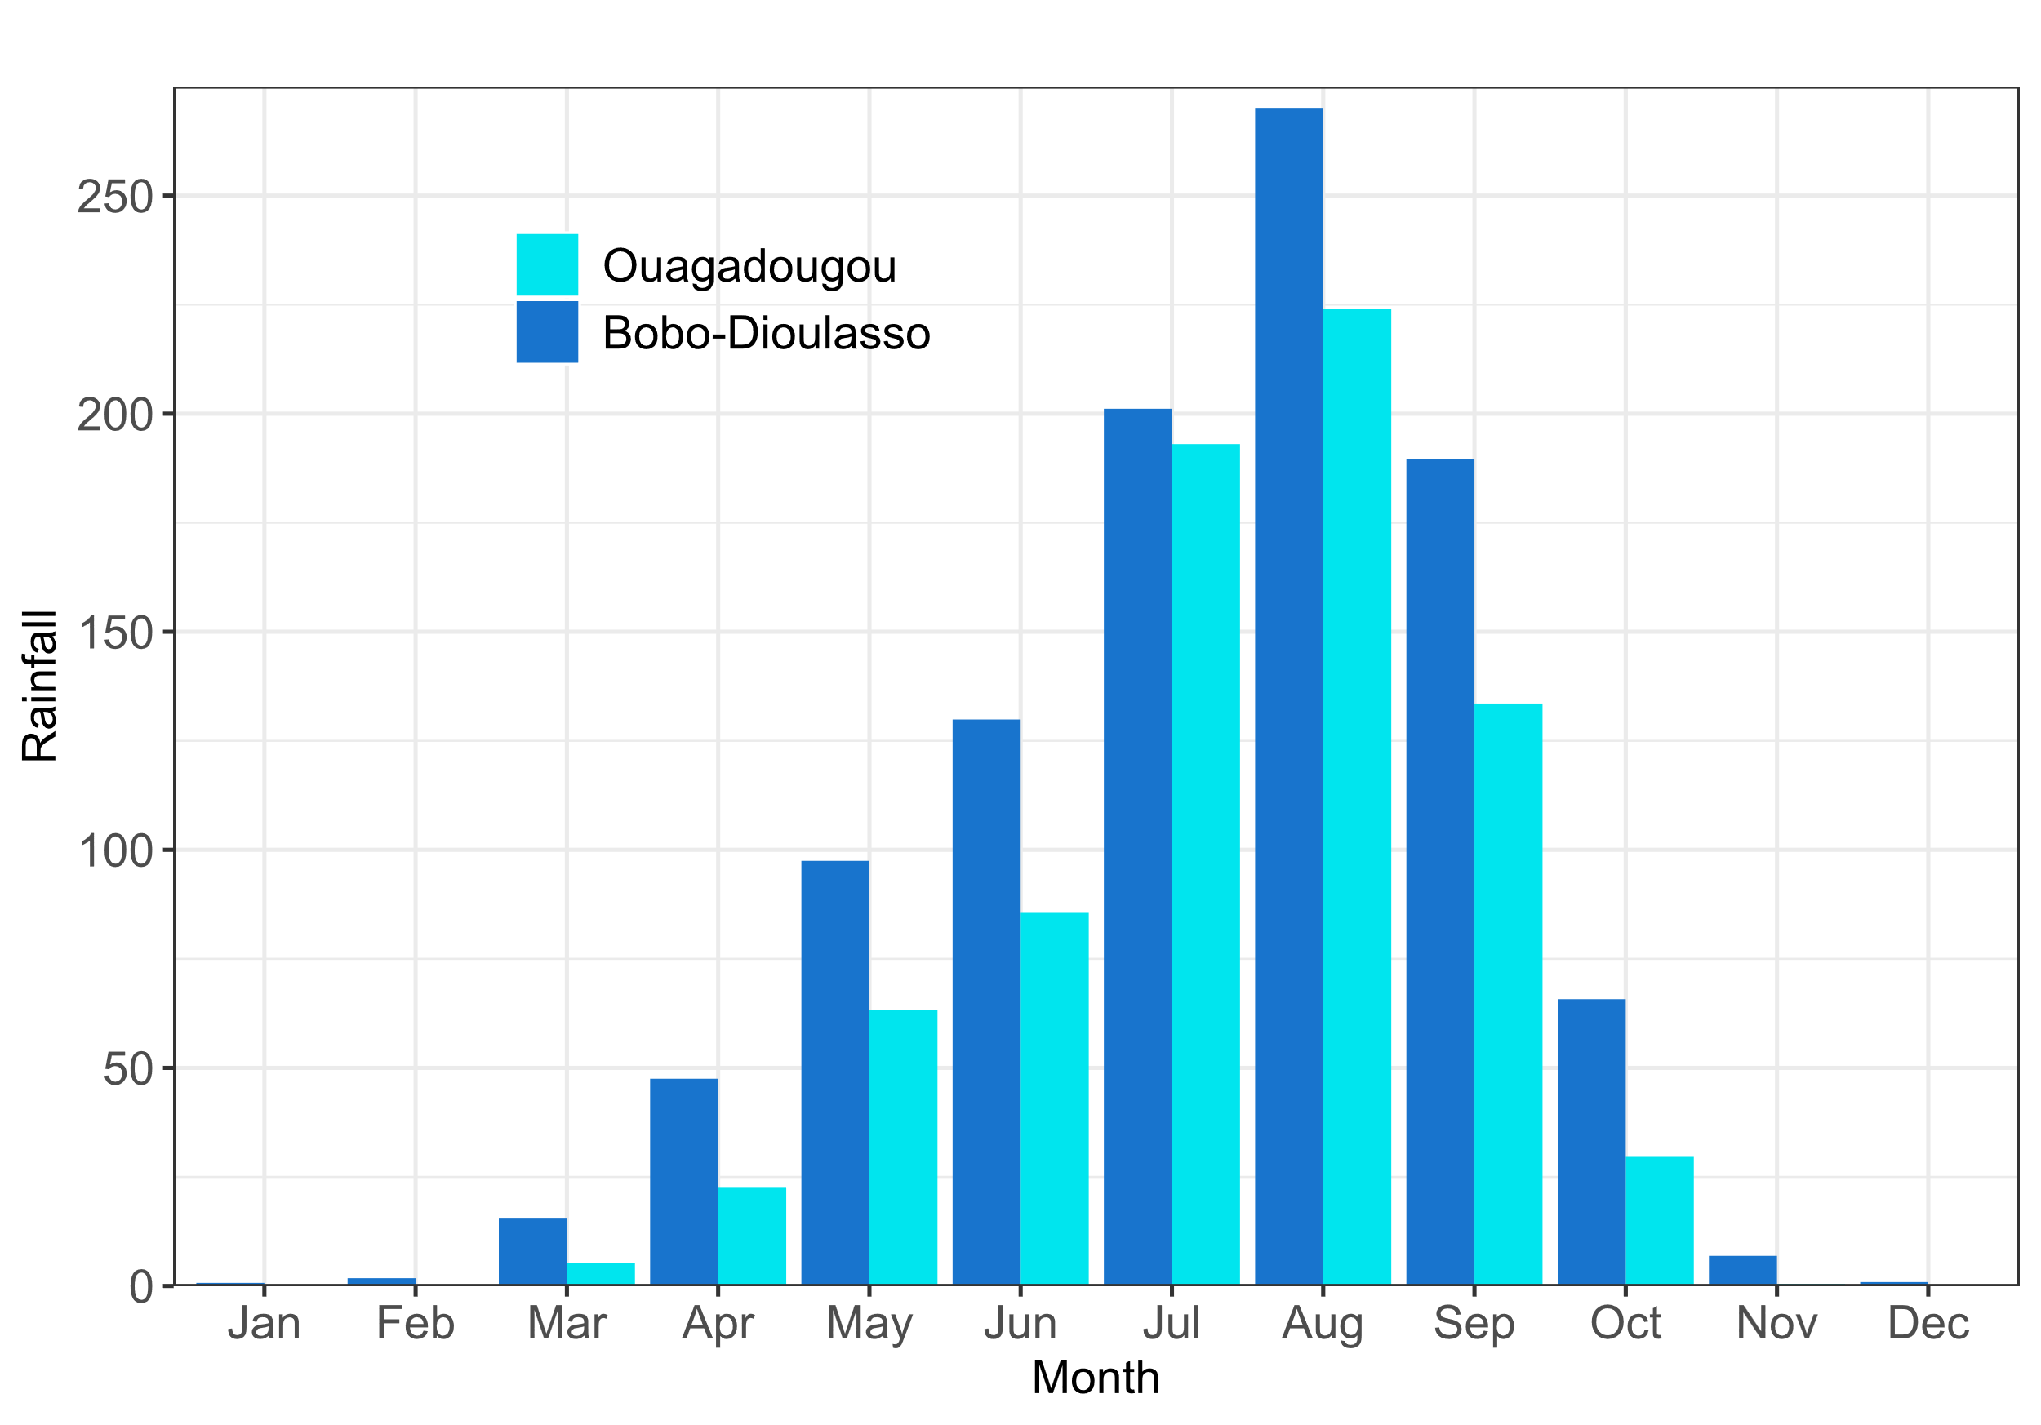
Description of the study area (2/2)
Soudanian ITCZ regulated climate, high temperature, unimodal rainfall pattern with maximum in August
Figure 4: Average monthly temperature from 1980 to 2020
Figure 5: Average monthly rainfall from 1980 to 2020
Average altitude: 300 m (Ouaga) and 400 m (Bobo) above sea level;
Increasing human footprint (built-up, farmlands);
Rapid population growth and urban expansion in the 2 cities

Slide 12
Scope of the study (1/1)
The present research has a temporal scope of 19 years (2003 - 2021);
The study covers the metropolises of Ouagadougou and Bobo-Dioulasso;
The research focuses on Land Use/Land Cover assessment, air temperature analysis, land surface temperature assessment and the health implications of temperature;
This research uses the existing meteorological data captured by ground stations and satellites platforms such as Landsat and MODIS Aqua.

Slide 13
Key literature (1/1)
Alavipanah et al. (2015) demonstrated the role of vegetation in mitigating urban LST, using factional method.
Hackman et al., (2020) investigated the temporal dynamics of the growth of Kumasi, using 20-years Landsat time series and Machine learning algorithms in Google Earth Engine;
Lindén (2011) used ground observations data to characterize the nocturnal cool island in Ouagadougou. It was demonstrated that vegetation was the key factor in urban cooling while the built areas were limiting the effects.
Shiff et al. (2021). Used temporal Fourier technics to fill MODIS LST gap and create a continuous daily LST data

Slide 14
Methodology (1/2)
Data used
Table 1: Description of data used
Data type | Period | Resolution | Usage | Source
Image Landsat TM | 2003-2012 | 30 m | LULC assessment | Google Earth Engine Data Catalogue
Image Landsat ETM+ | 2003-2013 | 30 m | LULC assessment
Image Landsat-8 OLI | 2014-2021 | 30 m | LULC assessment
Image SRTM V3 | 2000 | 30 m | Topography factors generation
Ground truth samples |  |  | LULC accuracy assessment | Field work, Google Earth HR images
MODIS Aqua LST | 2003-2021 | daily | LST assessment | Google Earth Engine Data Catalogue
ERA5 Air temperature | 2003-2021 | daily | LST gap filling
Surface latente heat flux | 2003-2021 | hourly | Surface energy budget description | Google Earth Engine Data Catalogue
Surface sensible heat flux | 2003-2021 | hourly
Air temperature data | 1980- 2020 | monthly | Study area description | National Agency of Meteorology
Rainfall data |  | monthly |  | National Agency of Meteorology
Diseases data | 2017-2021 | monthly | Temperature related diseases analysis | Ministry of Health
LULC mapping
LST and Air
temperature analysis
Surface energy budget trend
Study area description
Diseases analysis

Slide 15







Methodology (2/2)
Methods employed
MODIS Aqua LST (2003-2021)
ERA 5 Land air temperature (2003-2021)
Landsat Images
(TM, ETM+, OLI)
Google Earth HR Images
Actual LULC
2021
LULC 2009
(T1)
LULC 2015
(T2)
Driver
Variables
Objective 1
Missing data
assessment
Temporal Fourier Analysis
Images
Pre-processing
Reference samples extraction
Change Analysis
MODIS LST
climatology
Air temperature
climatology and anomaly
Training (80%) and
testing (20%)samples
Objective 2
Change Map
(T2-T1)
images
MLP-NN
Model
October-December median images
Air temperature anomaly +
LST climatology
(Shiff et al., 2021)
Gap filling (blending)
Transition Potential images
Predictors composite
Classification
(RF, SVM, GTB)
MODIS LST continuous
Markov Chain Modelling
LULC
images
Gap-filled LST
T-test, Pearson
correlation
Validation
Projected LULC 2021
Objective 3
Reclassification
Resampling
Zonal statistics
District layer
LULC Simulation for 2027 and 2050
LULC reclassified in built and non-built
LST at 900*900 grid
Mean LST per district
MLR LST model
Aggregate
(fact=30)
Spearman correlation
Diseases (malaria, dengue, meningitis)
Objective 5
Average LST in 2027 and 2050
Correlation, median analyses
Built and non-built cover per pixel
Figure 6: Methodological flowchart
Correlation LST and disease
Built and non-built ratio, and equivalent LST per pixel
Zonal
statistics
Objective 4

Slide 16
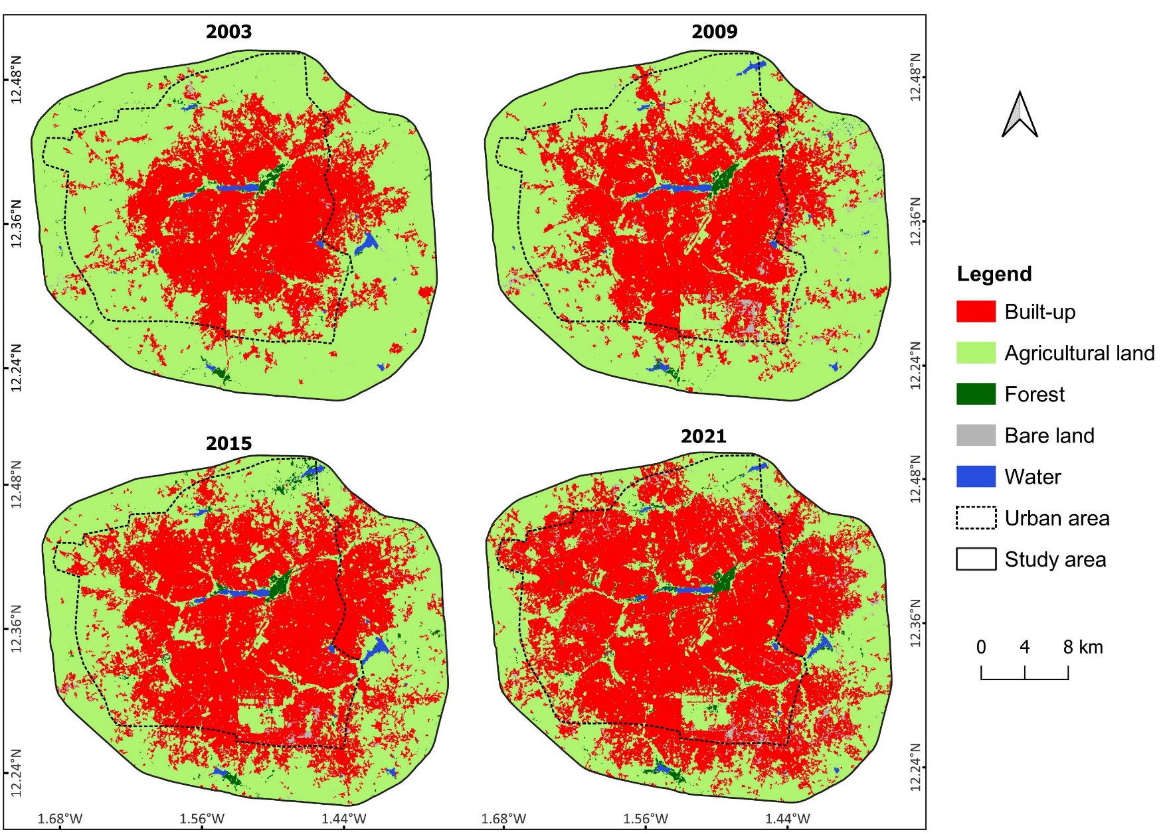
Results and Discussion/Objective 1 (1/5)
Land Use/Land Cover (LULC) mapping
Expansion of built-up class;
Decreasing of agricultural class,
Forest and bare land increased (land cleaning for building)
Figure 7: LULC distribution in Ouagadougou

Slide 17
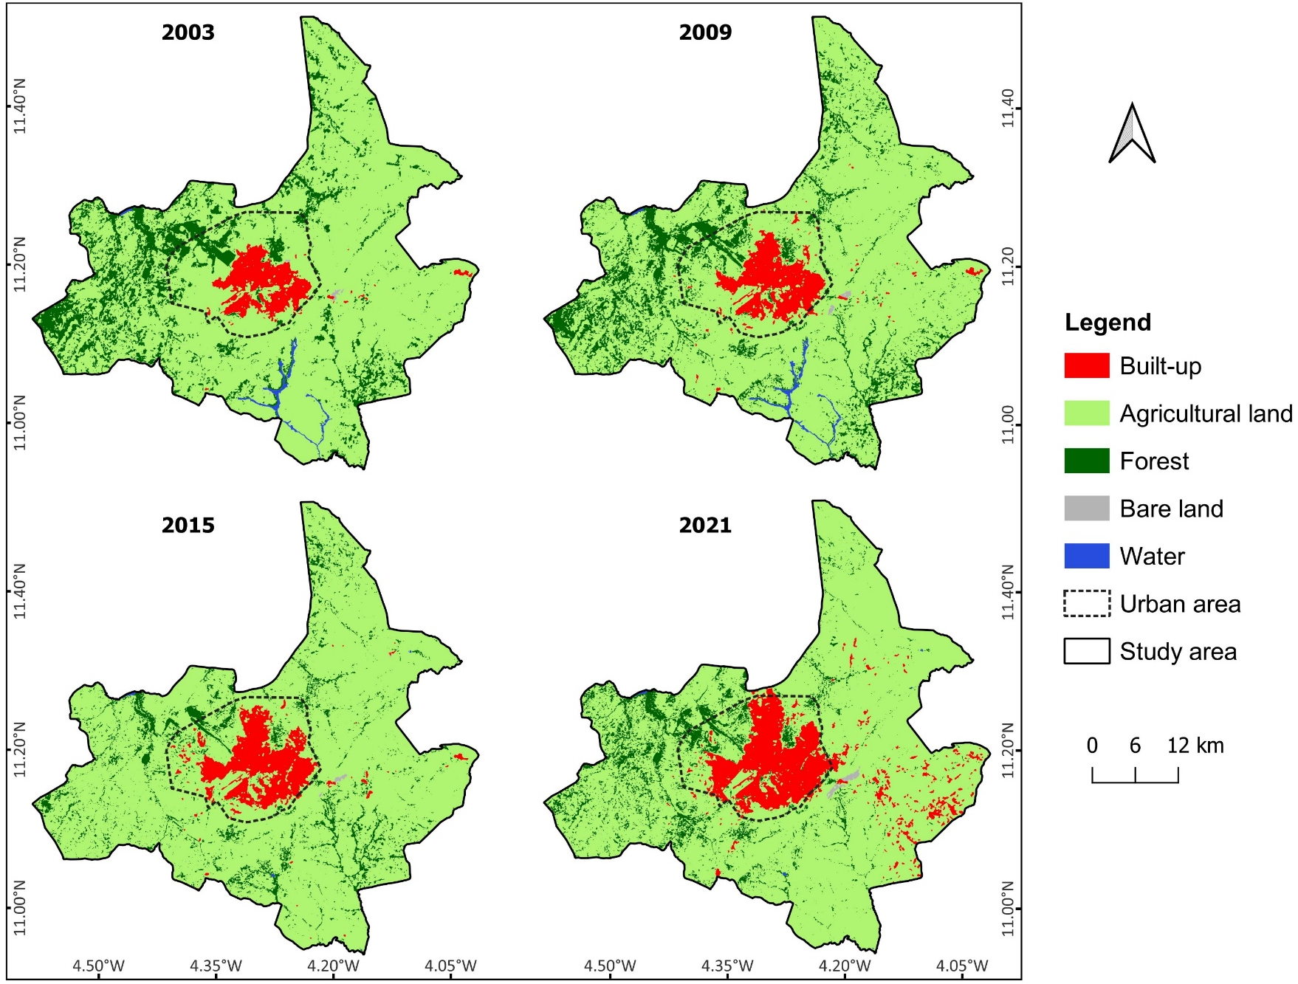
Results and Discussion/Objective 1 (2/5)
Land Use/Land Cover (LULC) mapping
Dominant class is agricultural;
Increase of built-up class;
Bare land increased (land cleaning for building)
Figure 8: LULC distribution in Bobo-Dioulasso

Slide 18
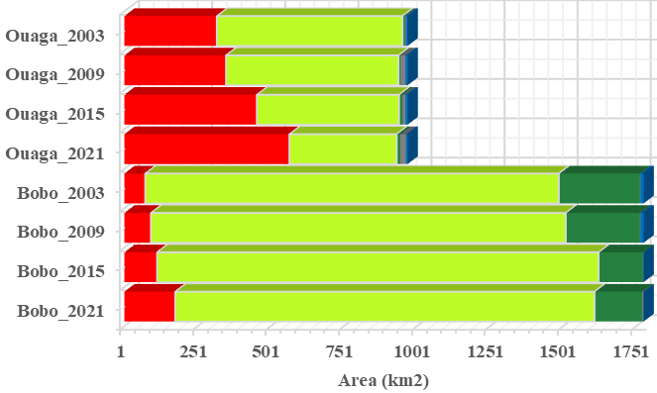
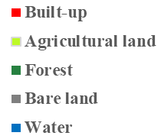
Results and Discussion/Objective 1 (3/5)
LULC trend
Increasing of built-up area in both cities (+78.13% in Ouaga and +140.7% in Bobo);
Decreasing of agricultural area in Ouaga (-42.25%)and increasing in Bobo (+1.38%)
Figure 9: LULC evolution between 2003 and 2021
Similar results were found by Mahmoud et al., 2016 in Nigeria and Rimal et al., 2018 in Nepal
Explanation: Rapid urban population growth (45.1% in Ouaga and 16.9% in Bobo, in 2019) causes LULC changes, as shown by Al Kafy et al., 2019 in Bengladesh

Slide 19
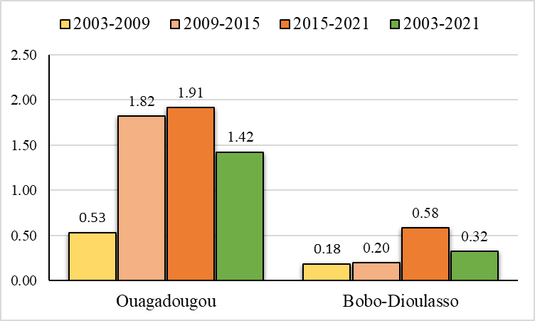
Results and Discussion/Objective 1 (4/5)
Urban Area Expansion
Ouaga expands rapidly than Bobo, with high intensity in 2015-2021 and 2009-2015
Bobo recorded large expansion 2015-2021
Figure 10: UAEII in Ouagadougou and Bobo-Dioulasso

Slide 20
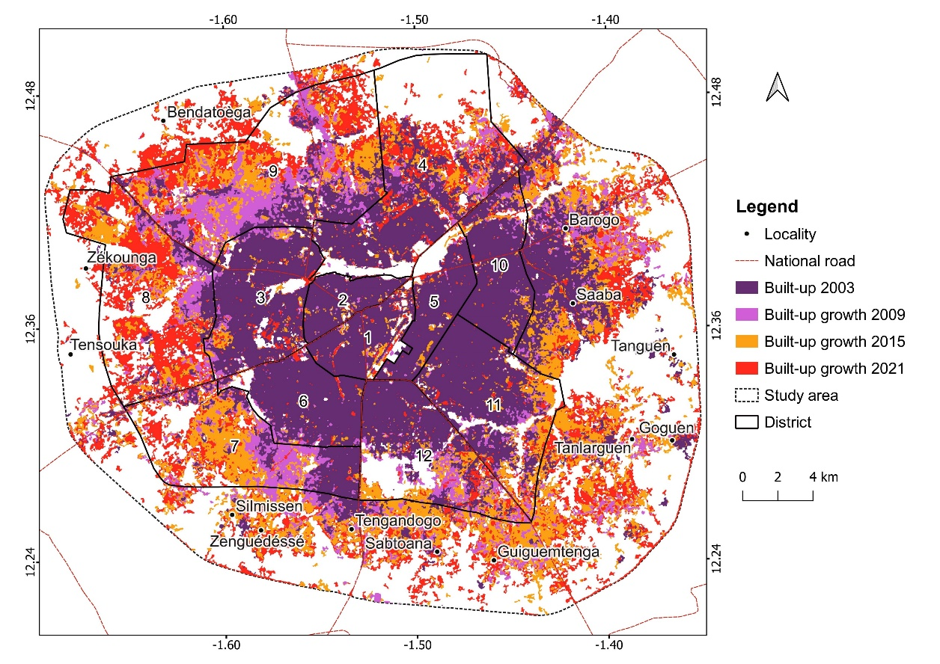
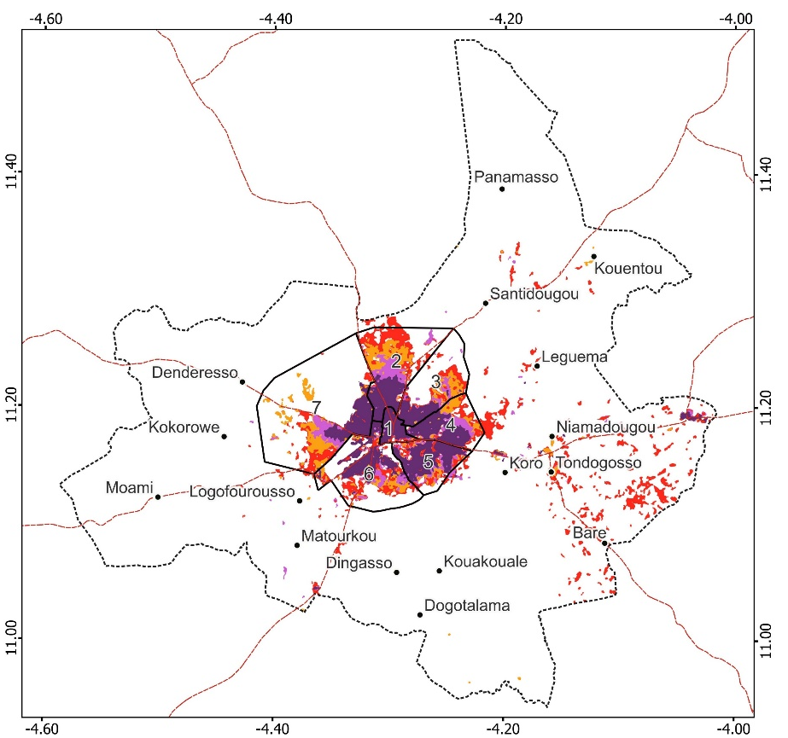
Results and Discussion/Objective 1 (5/5)
Urban Area Expansion
Figure 11: Built-up expansion in Ouagadougou and Bobo-Dioulasso
Built-up expansion has exceeded the city boundaries; particularly in Ouaga;
Due to informal settlements and development of public and private estates around the cities.
Similar situation was found by Hackman et al., 2020 in Kumasi, Ghana

Slide 21
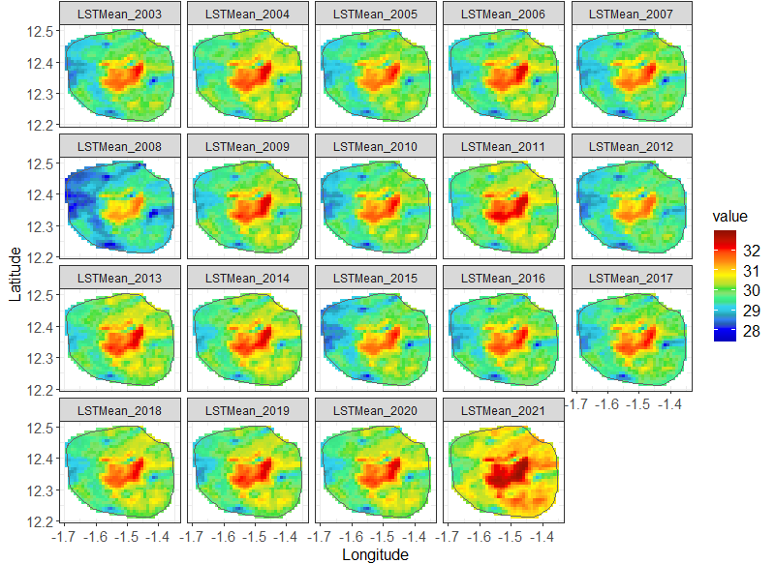


Results and Discussion/Objective 2 (1/9)
LST spatial distribution
LST island in the inner city, compared to the surroundings
2021: 7th warmest year (2015-2021) globally (WMO,2022)
Figure 12: Yearly mean LST distribution in Ouagadougou

Slide 22
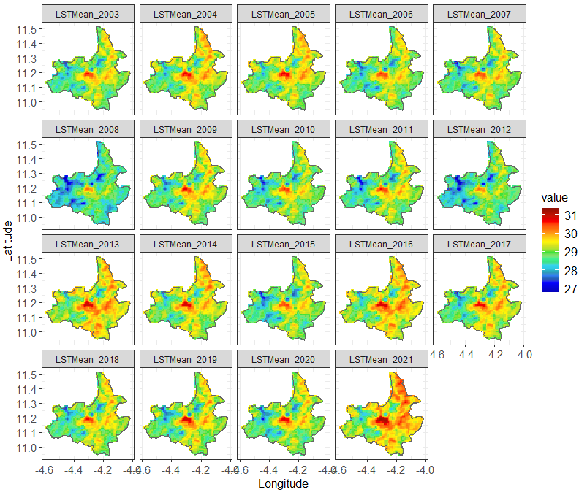


Results and Discussion/Objective 2 (2/9)
LST spatial distribution
LST island in the inner city compared to the surroundings
Similar to studies on urban LST patterns in Nigeria (Adeola Fashae et al., 2020), in Ethiopia (Tafesse and Suryabhagavan, 2019)
Figure 13: Yearly mean LST distribution in Bobo-Dioulasso

Slide 23
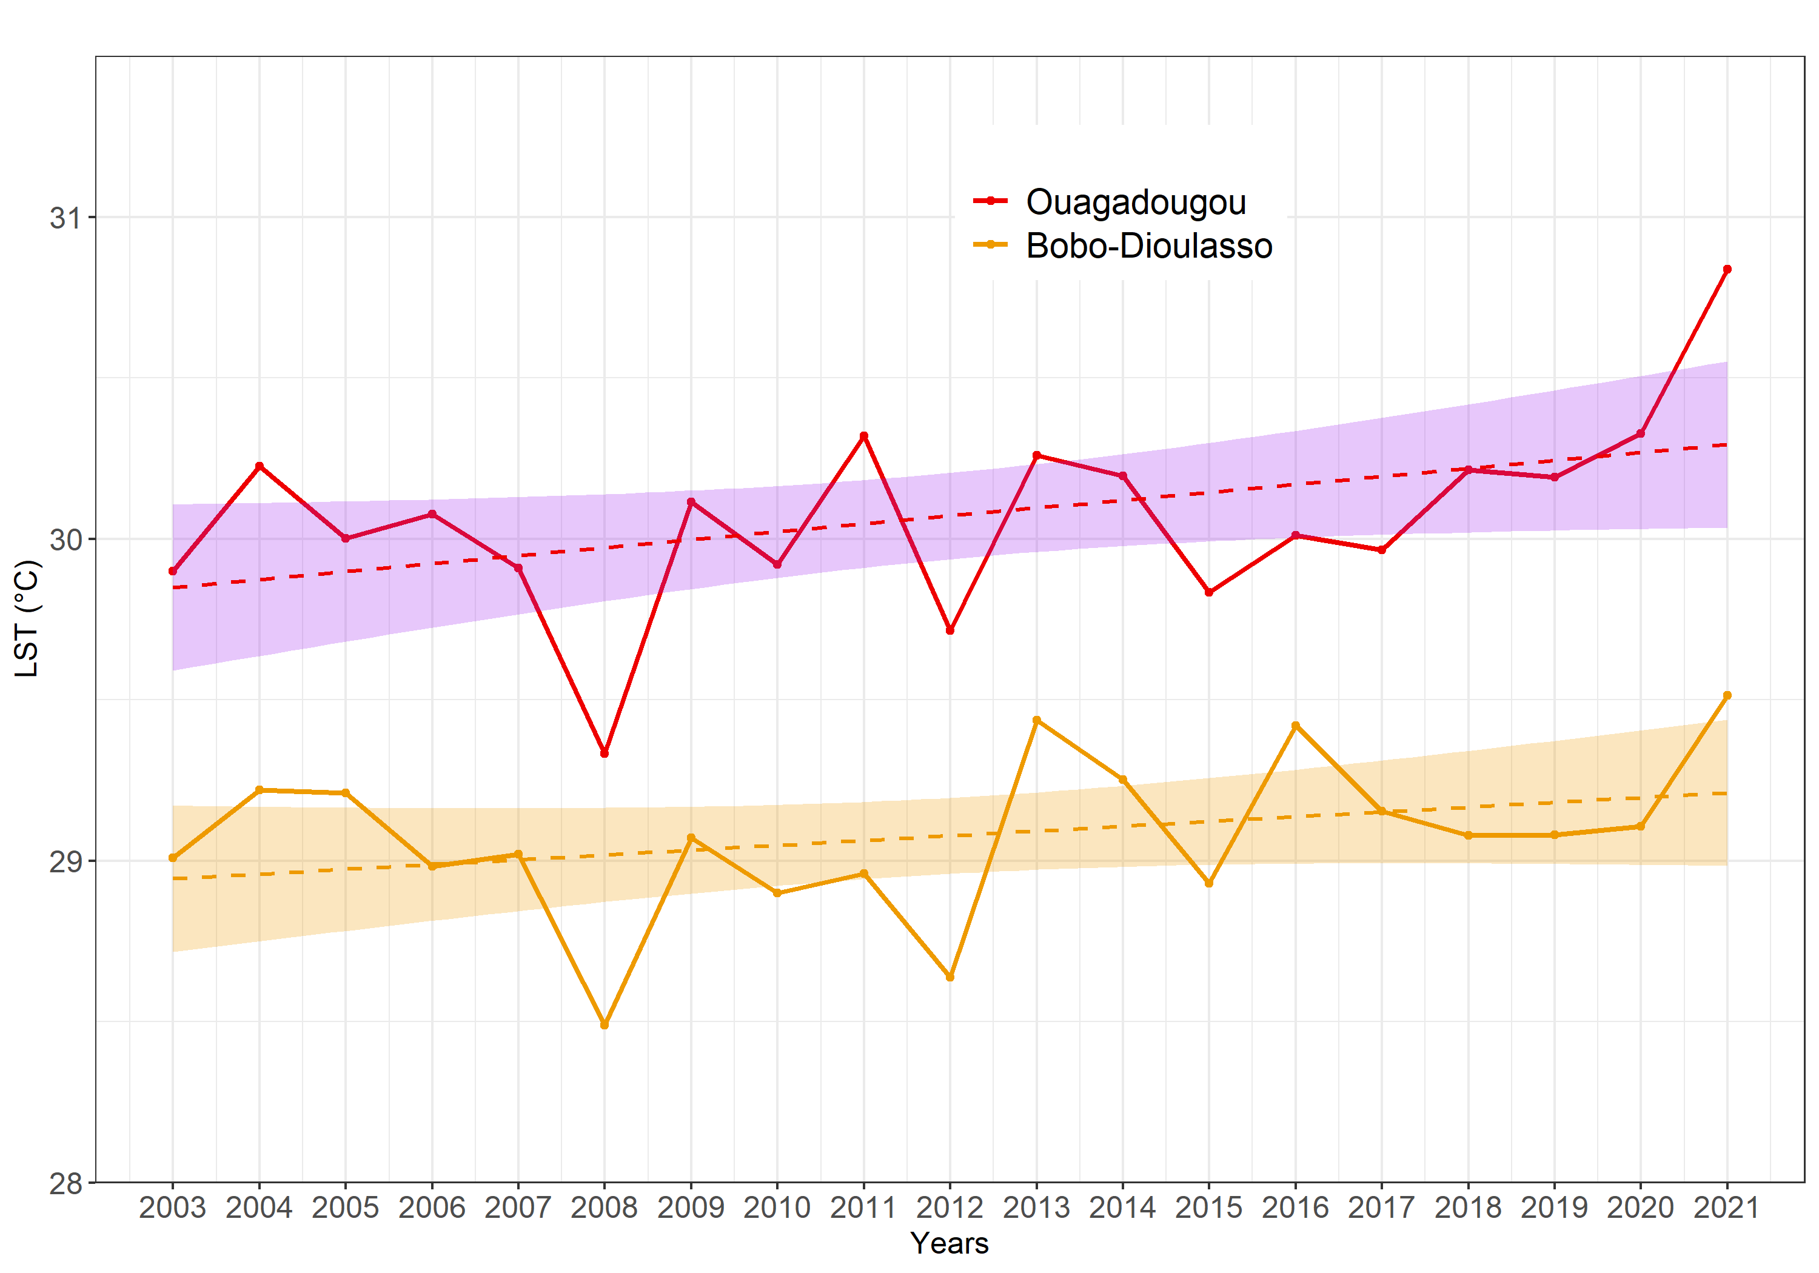
Results and Discussion/Objective 2 (3/9)
LST yearly trend
More increasing trend in Ouaga than Bobo;
Man Kendall trend test showed a Non-significant trend (P>0.05).
Trend in line with the global LST trend, which continually increases years (ESA, 2022)
Figure 14: Yearly mean LST trend
Notes:
Increasing trend for yearly mean;

Slide 24
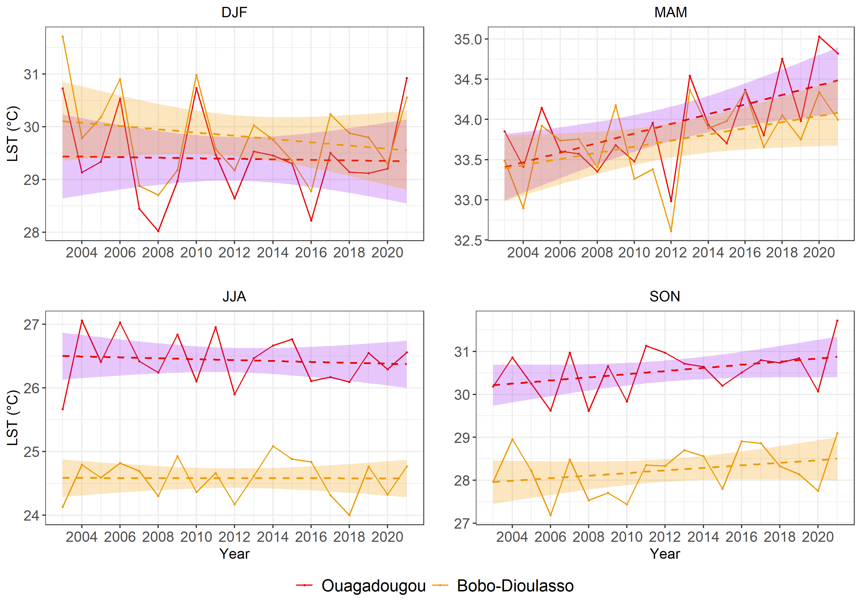
Results and Discussion/Objective 2 (4/9)
LST seasonal trend
MAM and SON showed increasing trend in both sites;
Man Kendall trend test showed a significant trend for MAM in Ouaga;
Global yearly trend is driven by MAM season
Dry and hot period with high net radiation in the inner city, due to clear sky conditions and high heat storage materials (Offerle et al., 2005).
Figure 15: Seasonal mean LST trend
Notes:
Increasing trend for MAM, SON values;

Slide 25
Results and Discussion/Objective 2 (5/9)
Comparison LST and air temperature
Table 2: T-test metrics
Confidence interval exclude null value;
LST and air temperature are different, in terms of mean value;
LST is higher than the ambient air temperature (Heat and Protocol, 2015)
 | Ouagadougou | Bobo-Dioulasso
Confidence interval | -1.54 to -1.31 | -1.49 to -1.26
Mean LST | 30.07 | 29.08
Mean airT | 28.65 | 27.70
p-value | P<0.05 | P<0.05

Slide 26
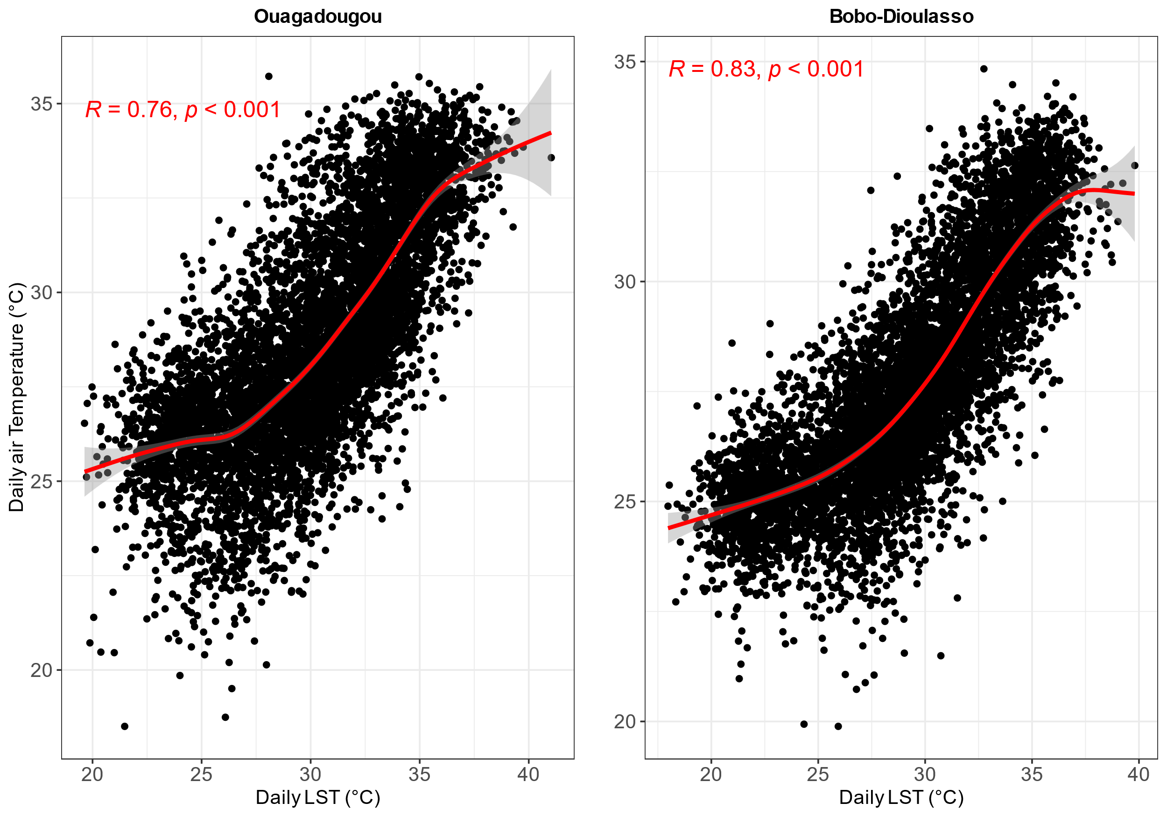
Results and Discussion/Objective 2 (6/9)
Correlation LST and air temperature
Strong positive correlation between LST and air temperature.
R²= 58% for Ouaga and 69% for Bobo;
Similar results were found by Guha et al. (2020) in India.
Figure 16: LST and air temperature correlation

Slide 27
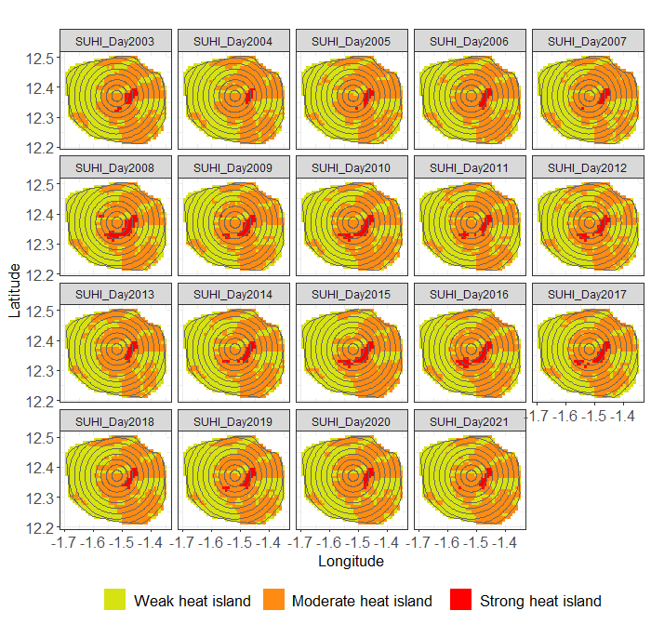

Results and Discussion/Objective 2 (7/9)
SUHI spatial distribution in Ouagadougou
Figure 17: Yearly SUHI distribution in Ouagadougou
Strong heat island in the inner city
Large coverage in night-time

Slide 28
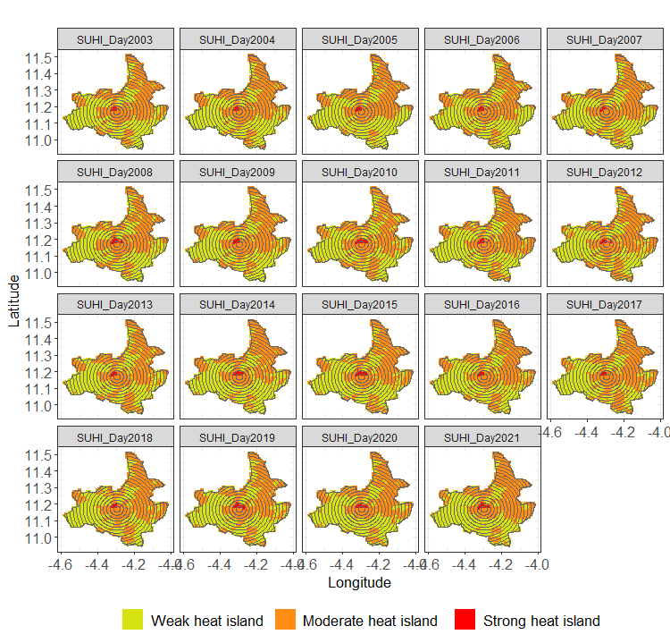
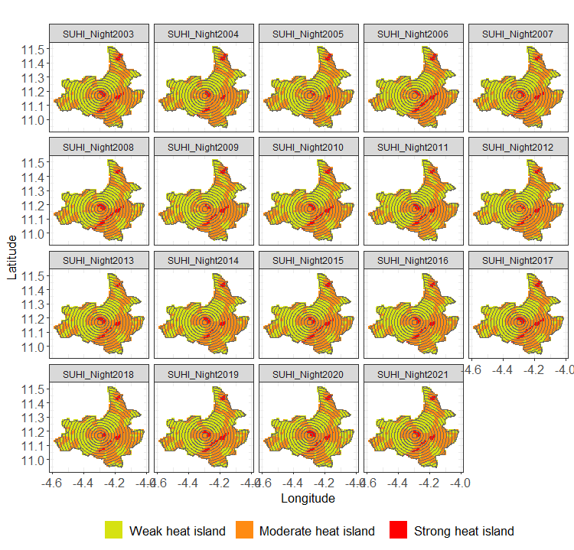
Results and Discussion/Objective 2 (8/9)
SUHI spatial distribution in Bobo-Dioulasso
Figure 18: Yearly SUHI distribution in Bob-Dioulasso
Strong heat island in the inner city
Large coverage in night-time

Slide 29
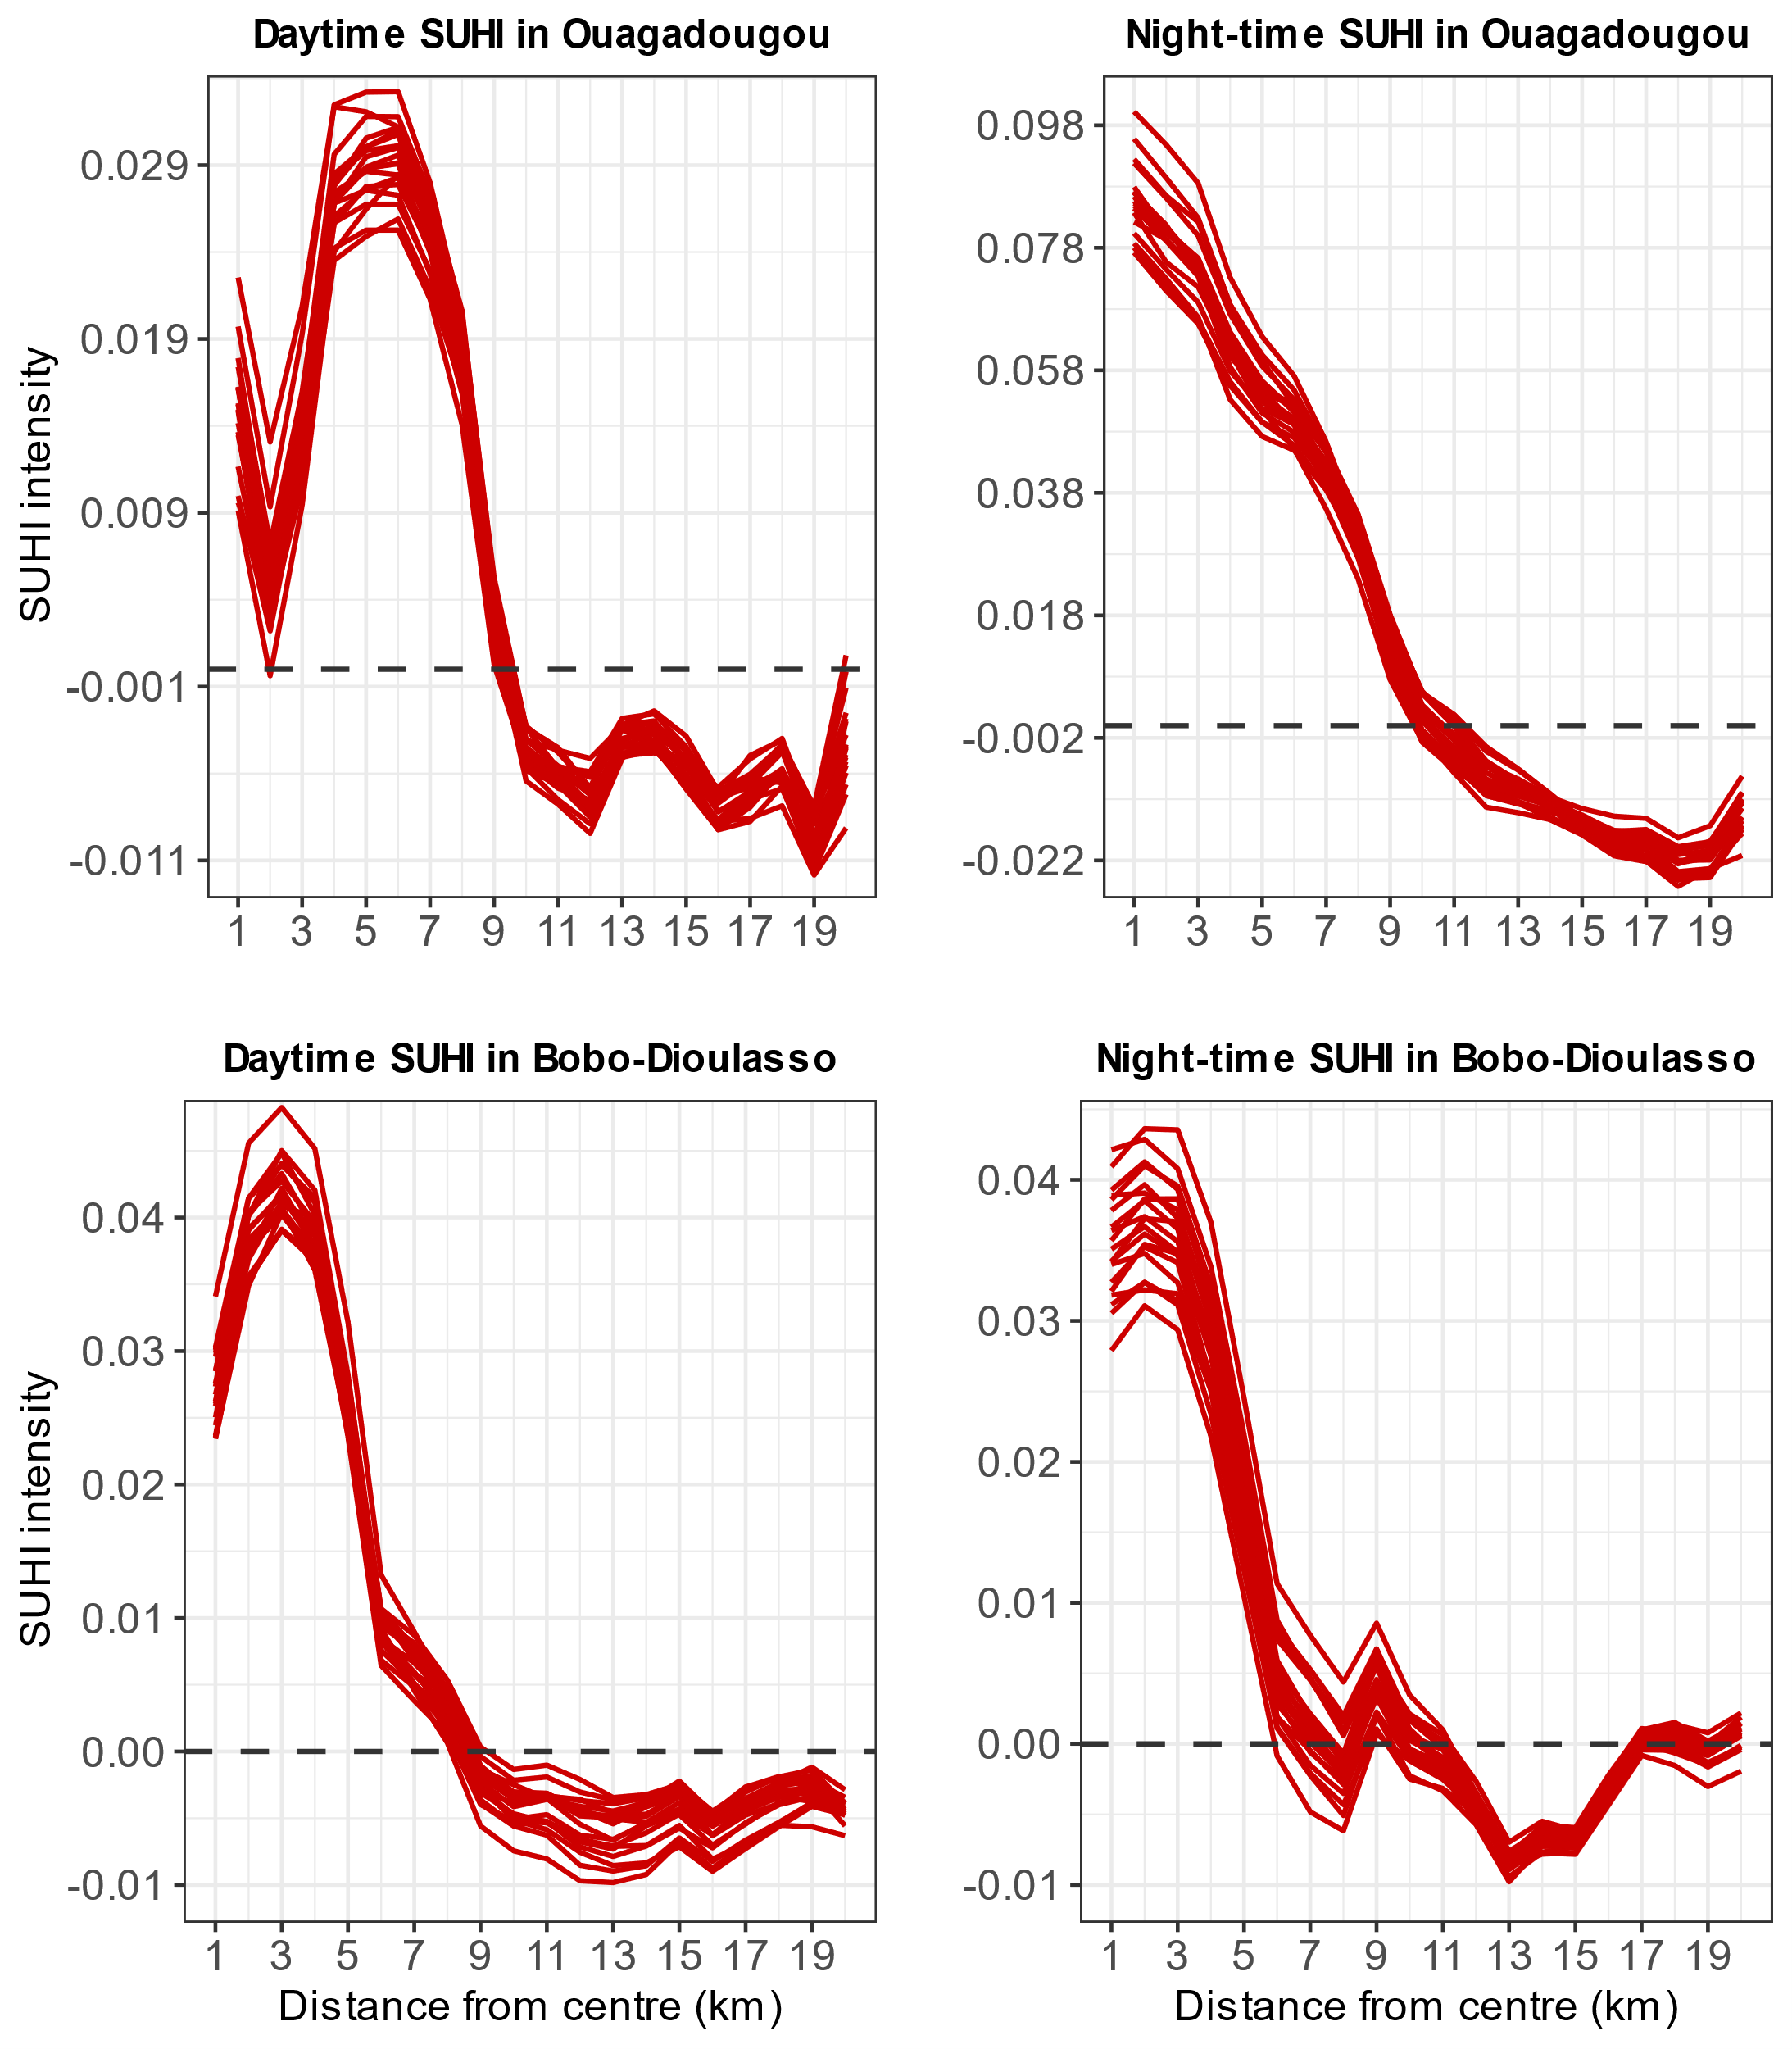
Results and Discussion/Objective 2 (9/9)
SUHI trend
Positive SHUI towards the core city, negative values in the surroundings;
Finding agrees with that of Simwanda et al. (2019): in growing cities in Africa, the CBDs exhibit high SUHI
Figure 19: SUHI intensity patterns according to the distance from the city centre

Slide 30
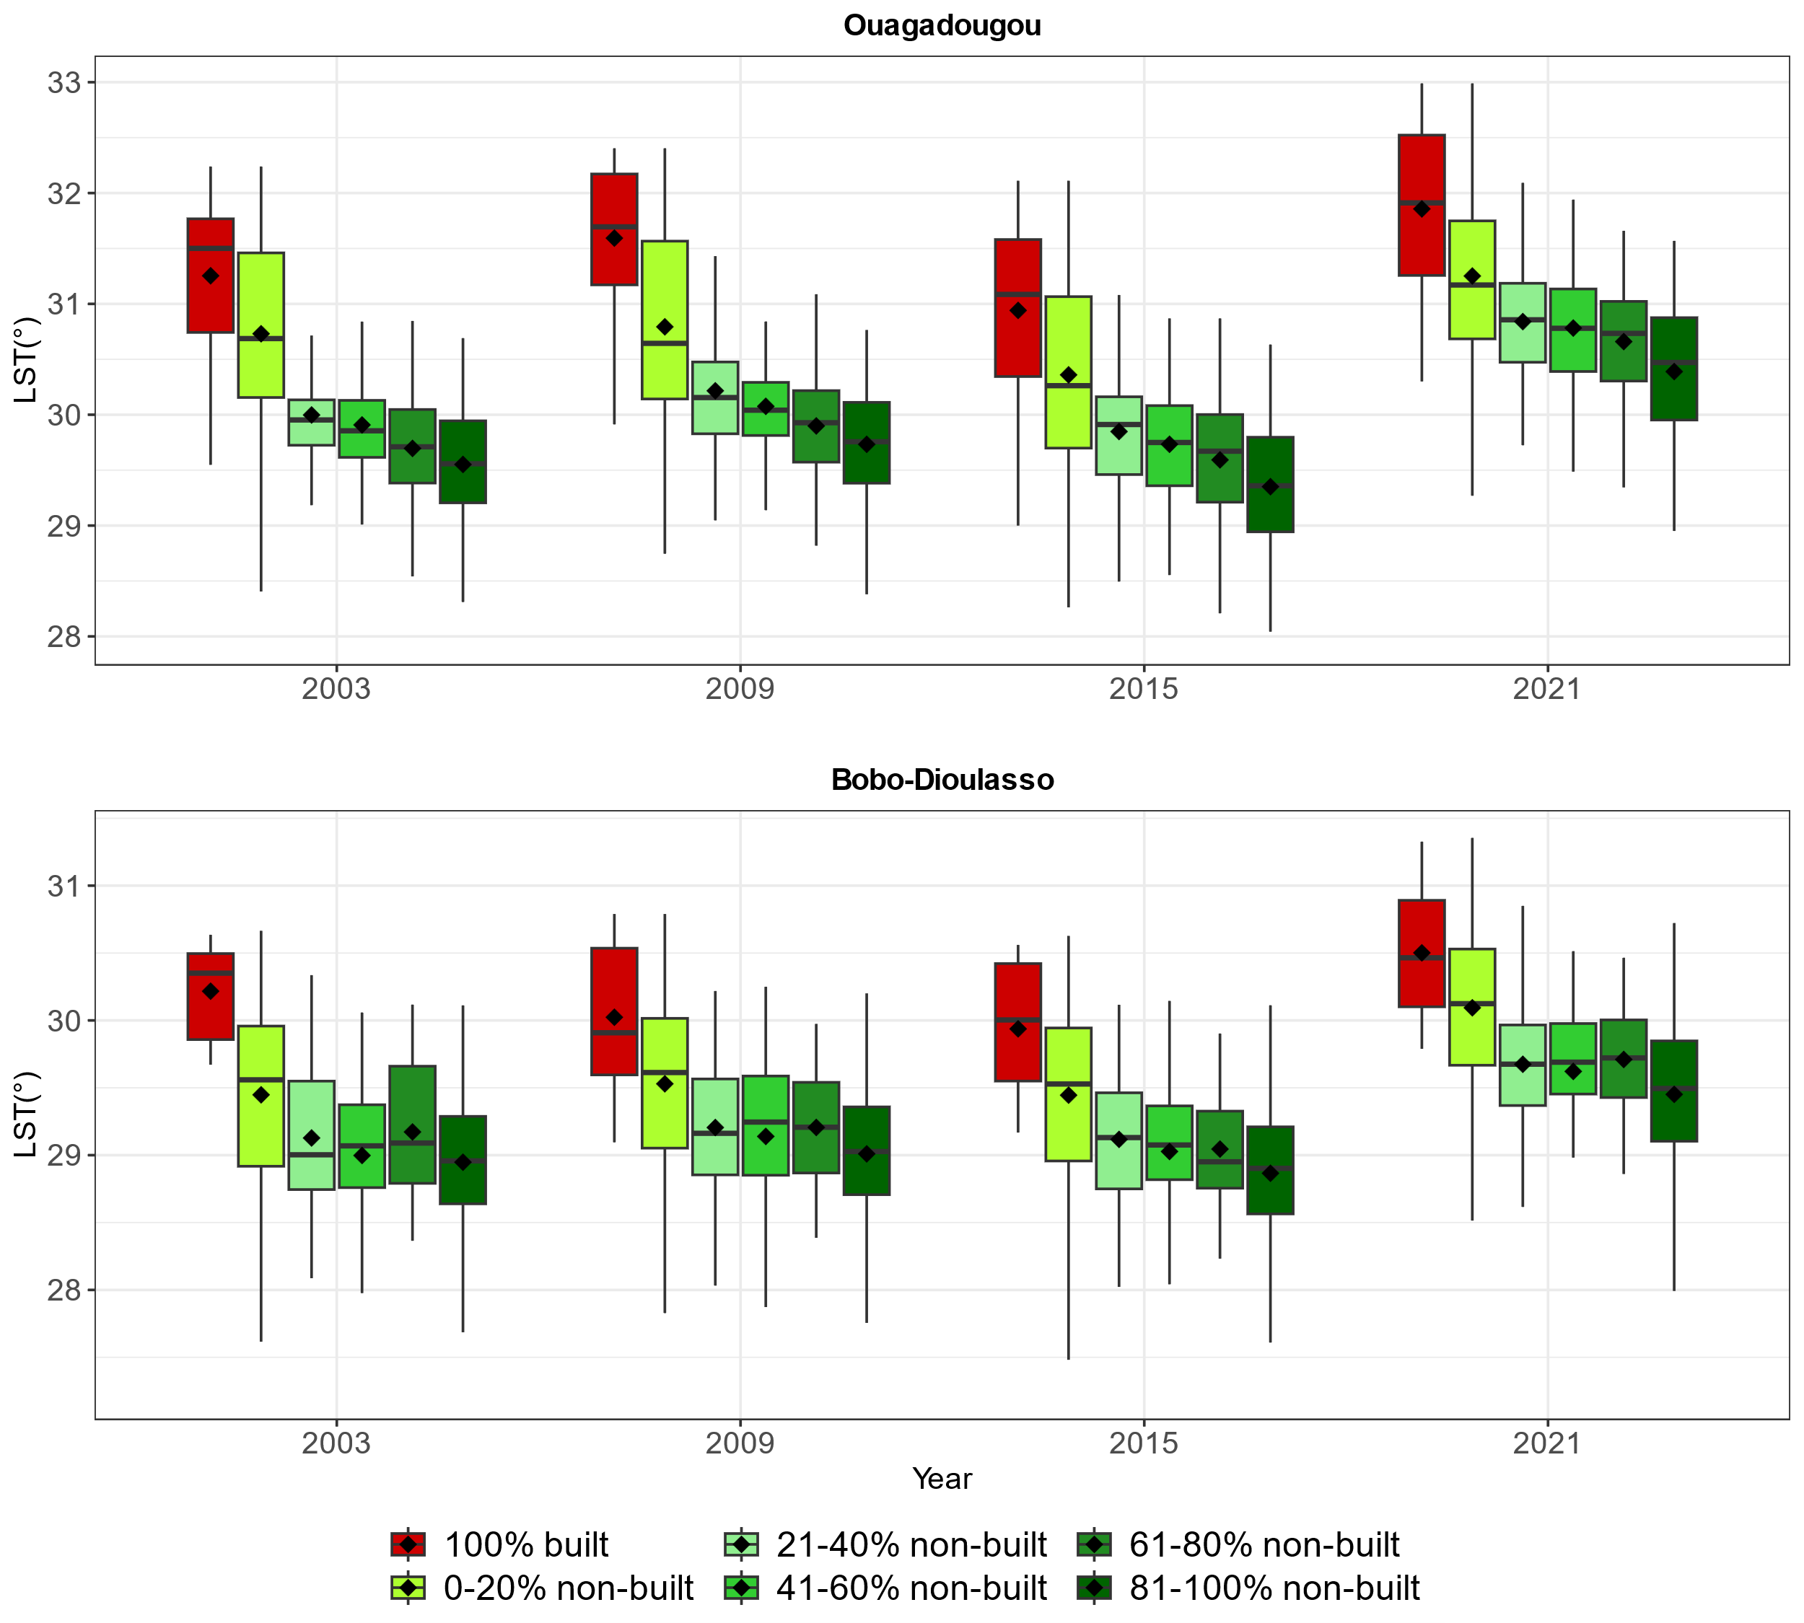
Results and Discussion/Objective 3 (1/3)
LULC and LST patterns
Linear pattern in Ouaga than Bobo;
The higher the non-built rate, the lower the LST
Results corroborate that of Simwanda et al. (2019) in Lagos, Lusaka, Nairobi and Addis Ababa: cities with high proportion of impervious surfaces are the warmest
Figure 20: Built-up and non-built-up LST pattern

Slide 31
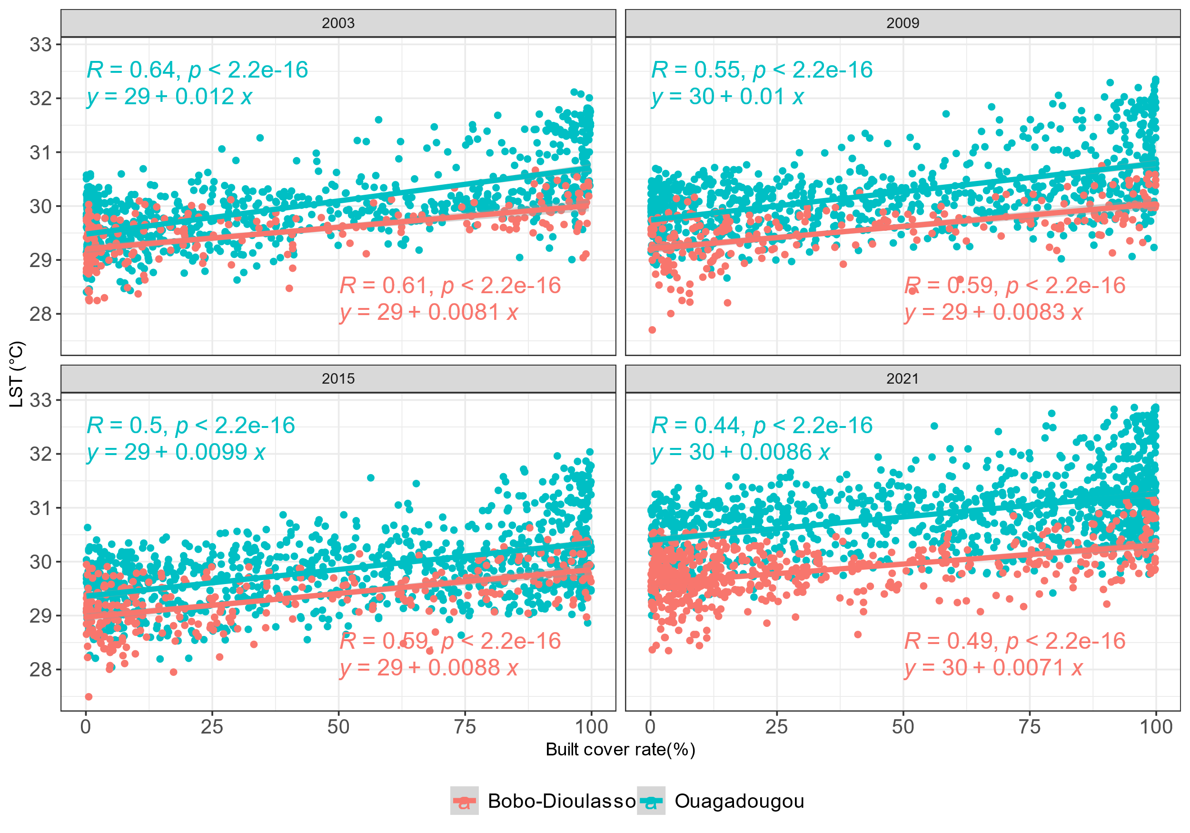
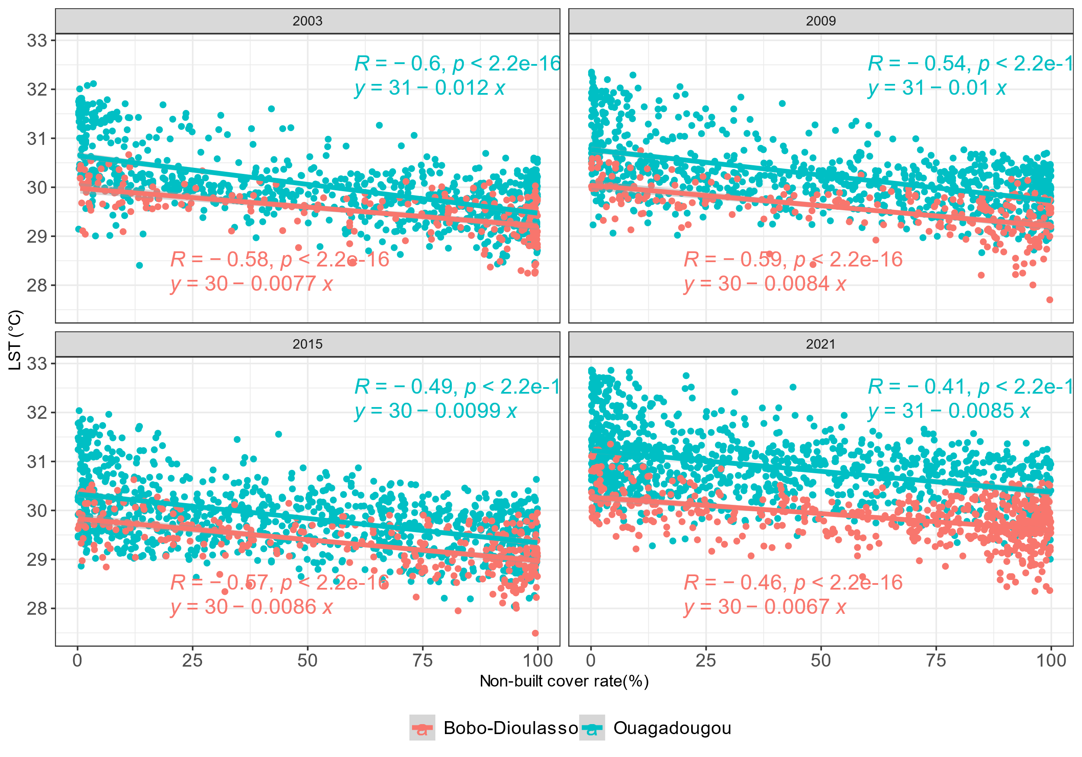
Results and Discussion/Objective 3 (2/3)
LULC and LST correlation
(a)
(b)
Figure 21: Correlation between Built cover (a), non built-cover (b) and LST
Between 19 and 41% of LST increase is due to built-up coverage increase
Between 17 and 36% of LST decrease is linked to non-built-up coverage increase
Similar with the findings of Imran et al. (2021) using spectral indices

Slide 32
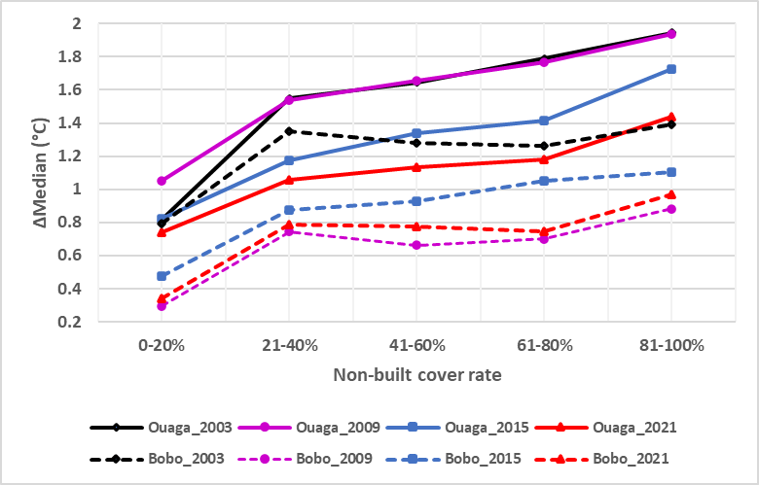
Results and Discussion/Objective 3 (3/3)
Non-built cover cooling effect
Lower cooling in Bobo-Dioulasso (0.29 - 1.39°C) than in Ouagadougou (0.74 - 1.94°C);
Median difference got smaller towards 2021: all types of LULC LST increased
Result in line with that of Di Leo et al. (2016) and Shi et al. (2021): non-built-up classes can attenuate the warming effects of built-up
Figure 22: Contribution of non-built cover to urban cooling

Slide 33
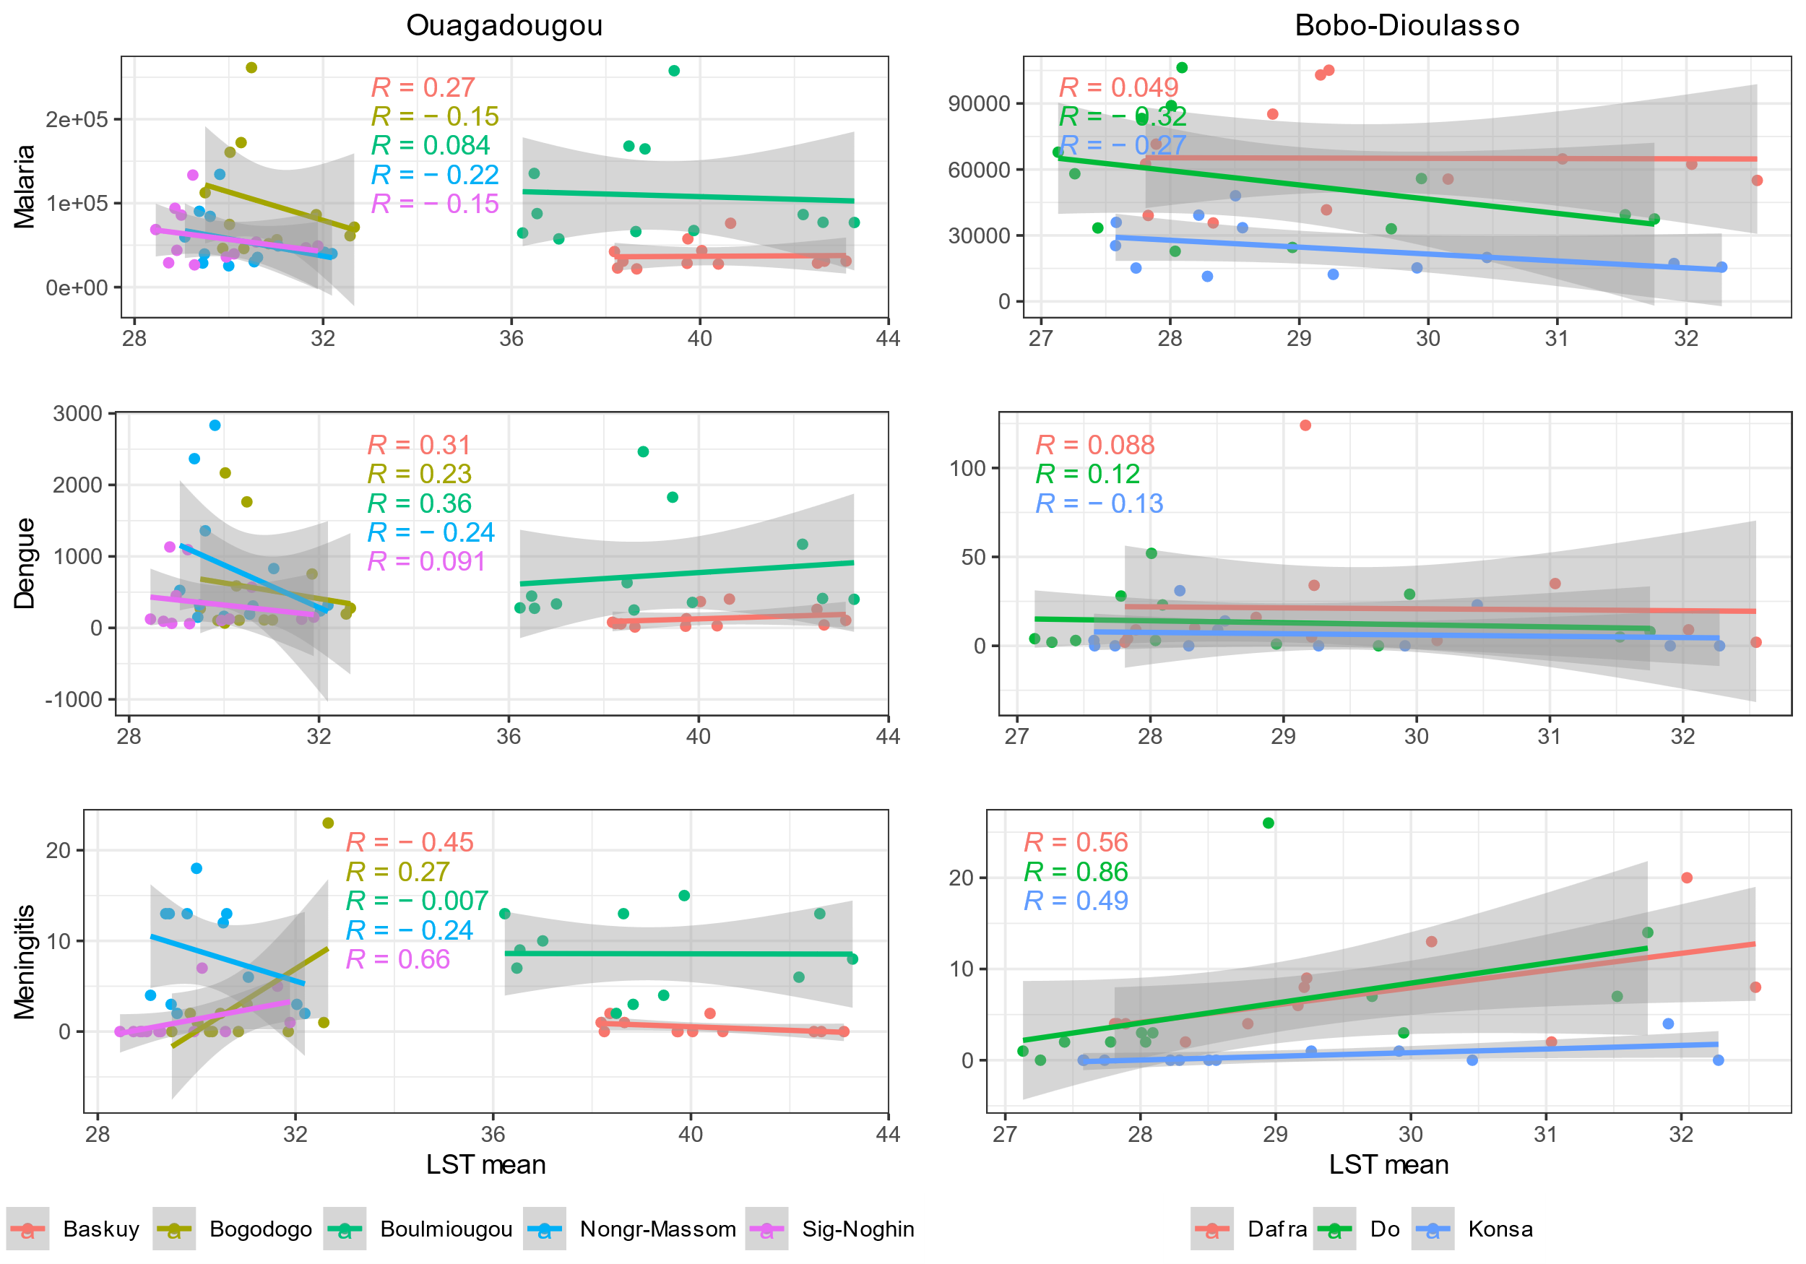
Results and Discussion/Objective 4 (1/1)
LST and diseases correlation
Weak to negligible correlation for malaria and dengue;
Moderate (R= 0.46 – 0.66) to strong (R=0.86) for meningitis, especially in Bobo
In line with the pattern of meningitis regarding air temperature, as shown by Chen et al. (2022).
Figure 23: Correlation between LST and diseases

Slide 34
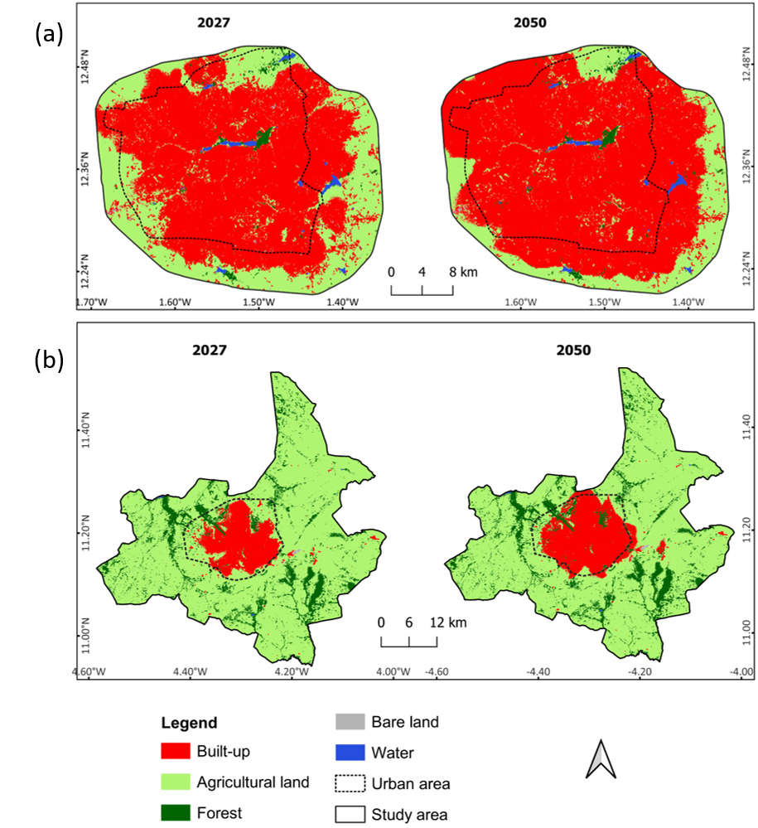
Results and Discussion/Objective 5 (1/2)
Future projection of LULC
In Ouaga, built-up dominated with 65.27% in 2027 and 78.65% in 2050;
In Bobo, agricultural remains the major LULC class with 73.74% in 2050.
Result in line with Yangouliba et al. (2022)
Figure 24: Predicted LULC for 2027 and 2050 under BAU scenario in Ouagadougou (a) and Bobo-Dioulasso (b)

Slide 35
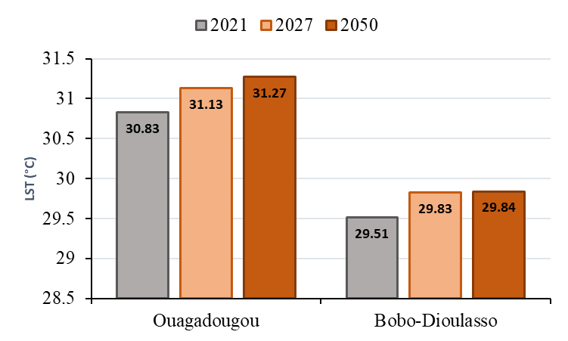
Results and Discussion/Objective 5 (2/2)
Future projection of LST
Increase in mean LST in both cities;
Rapid increase of 0.3°C during 2021-2027 in Ouaga and Bobo
Figure 25: Trend in mean LST for 2021, 2027 and 2050 under the BAU scenario in Ouagadougou and Bobo-Dioulasso

Slide 36
Implications of results (1/1)
The present results showed an increasing trend of built-up area, LST and has a strong relationship with the 2 m air temperature.
Increasing LST implies increasing air temperature, then atmospheric warming;
Continuous increase of air temperature in the next years;
Intensification of climate change effects on the population (diseases)

Slide 37
Conclusion and recommendation (1/5)
Conclusion
The research revealed a continuous increase of human foot print, causing an increase LST in Ouagadougou and Bobo-Dioulasso.
The LST increasing trend is affecting the atmosphere which warms accordingly.
The LST drives the outbreak of diseases such as meningitis.

Slide 38
Conclusion and recommendation (2/5)
Recommendation
For performance improvement
The Ministry of Urban Planning should integrate non-urban landscape development into real estate project implementations to mitigate LST;
The Ministry of Environment should ensure that real estate development agencies incorporate green areas to increase non-built-up surfaces in urban setting;
Afforestation and green building programmes should be made priority activities in all the urban areas, with the hope of reducing the current and future LST in the two cities;

Slide 39
Conclusion and recommendation (3/5)
Recommendation
For policy
The Ministry of Urban Planning should re-visit the zoning ordinance in favour of green building and high-rise building in residential estate development as a policy in Burkina Faso.
This policy will increase more house ownership and mitigate urban sprawl and LST.

Slide 40
Conclusion and recommendation (4/5)
Recommendation
For further research
Assess the long-term correlation between LST and air temperature for LST-air temperature complementation modelling;
The Ministry of Health should embrace total automation of hospital detail records especially that of epidemiology that can be used in conjunction with LST data for health related disaster vulnerability modelling and forecast.

Slide 41
Conclusion and recommendation (5/5)
Recommendation
Contribution to the body of knowledge
The development of built-up surfaces is a push factor in LST increasing while non-built-up surfaces contribute to environmental cooling in both cities;
The findings shed light on the limitation of the current urbanisation system that contributes to the deterioration of urban climatic conditions;
There is a need to reconsider urban planning to avoid “the all grey” city, and promote and implement more vegetated and water percolation-enabled surfaces.

Slide 42
References
Chen, J., Jiao, Z., Liang, Z., Ma, J., Xu, M., Biswal, S., Ramanathan, M., Sun, S., & Zhang, Z. (2022). Association between temperature variability and global meningitis incidence. Environment International, 171(August 2022), 107649. https://doi.org/10.1016/j.envint.2022.107649
Stemn, E., & Kumi-Boateng, B. (2020). Modelling of land surface temperature changes as determinant of urban heat island and risk of heat-related conditions in the Wassa West Mining Area of Ghana. Modeling Earth Systems and Environment, 6(3), 1727–1740. https://doi.org/10.1007/s40808-020-00786-x
United Nations. (2018). World Urbanization Prospects. In Demographic Research (Vol. 12). https://population.un.org/wup/Publications/Files/WUP2018-Report.pdf
Alavipanah, S., Wegmann, M., Qureshi, S., Weng, Q., & Koellner, T. (2015). The role of vegetation in mitigating urban land surface temperatures: A case study of Munich, Germany during the warm season. Sustainability (Switzerland), 7(4), 4689–4706. https://doi.org/10.3390/su7044689
Hackman, K. O., Li, X., Asenso-Gyambibi, D., Asamoah, E. A., & Nelson, I. D. (2020). Analysis of geo-spatiotemporal data using machine learning algorithms and reliability enhancement for urbanization decision support. International Journal of Digital Earth, 13(12), 1717–1732. https://doi.org/10.1080/17538947.2020.1805036
Shiff, S., Helman, D., & Lensky, I. M. (2021). Worldwide continuous gap-filled MODIS land surface temperature dataset. Scientific Data, 8(1), 1–10. https://doi.org/10.1038/s41597-021-00861-7
Lindén, J. (2011). Nocturnal Cool Island in the Sahelian city of Ouagadougou, Burkina Faso. International Journal of Climatology, 31(4), 605–620. https://doi.org/10.1002/joc.2069
Mahmoud, M. I., Duker, A., Conrad, C., Thiel, M., & Ahmad, H. S. (2016). Analysis of settlement expansion and urban growth modelling using geoinformation for assessing potential impacts of urbanization on climate in Abuja City, Nigeria. Remote Sensing, 8(3). https://doi.org/10.3390/rs8030220
Rimal, B., Zhang, L., Keshtkar, H., Haack, B. N., Rijal, S., & Zhang, P. (2018). Land use/land cover dynamics and modeling of urban land expansion by the integration of cellular automata and markov chain. ISPRS International Journal of Geo-Information, 7(4). https://doi.org/10.3390/ijgi7040154
Al Kafy, A., Al-Faisal, A., Mahmudul Hasan, M., Sikdar, M. S., Hasan Khan, M. H., Rahman, M., & Islam, R. (2019). Impact of LULC Changes on LST in Rajshahi District of Bangladesh: A Remote Sensing Approach. Journal of Geographical Studies, 3(1), 11–23. https://doi.org/10.21523/gcj5.19030102
Adeola Fashae, O., Gbenga Adagbasa, E., Oludapo Olusola, A., & Oluseyi Obateru, R. (2020). Land use/land cover change and land surface temperature of Ibadan and environs, Nigeria. Environmental Monitoring and Assessment, 192(2). https://doi.org/10.1007/s10661-019-8054-3
Tafesse, B., & Suryabhagavan, K. V. (2019). Systematic modeling of impacts of land-use and land-cover changes on land surface temperature in Adama Zuria District, Ethiopia. Modeling Earth Systems and Environment, 5(3), 805–817. https://doi.org/10.1007/s40808-018-0567-1
Offerle, B., Jonsson, P., Eliasson, I., & Grimmond, C. S. B. (2005). Urban modification of the surface energy balance in the West African Sahel: Ouagadougou, Burkina Faso. Journal of Climate, 18(19), 3983–3995. https://doi.org/10.1175/JCLI3520.1
Heat, U., & Protocol, I. (2015). Appendix D Urban Heat Island Protocol for Mapping Temperature Projections. November.
Guha, S., Govil, H., Gill, N., & Dey, A. (2020). Analytical study on the relationship between land surface temperature and land use/land cover indices. Annals of GIS, 26(2), 201–216. https://doi.org/10.1080/19475683.2020.1754291
Simwanda, M., Ranagalage, M., Estoque, R. C., & Murayama, Y. (2019). Spatial analysis of surface urban heat Islands in four rapidly growing african cities. Remote Sensing, 11(14), 1–20. https://doi.org/10.3390/rs11141645
Imran, H. M., Hossain, A., Islam, A. K. M. S., Rahman, A., Bhuiyan, M. A. E., Paul, S., & Alam, A. (2021). Impact of Land Cover Changes on Land Surface Temperature and Human Thermal Comfort in Dhaka City of Bangladesh. Earth Systems and Environment, 5(3), 667–693. https://doi.org/10.1007/s41748-021-00243-4
Shi, Y., Liu, S., Yan, W., Zhao, S., Ning, Y., Peng, X., Chen, W., Chen, L., Hu, X., Fu, B., Kennedy, R., Lv, Y., Liao, J., Peng, C., Rosa, I. M. D., Roy, D., Shen, S., Smith, A., Wang, C., … Zhu, Y. (2021). Influence of landscape features on urban land surface temperature: Scale and neighborhood effects. Science of the Total Environment, 771, 145381. https://doi.org/10.1016/j.scitotenv.2021.145381
Di Leo, N., Escobedo, F. J., & Dubbeling, M. (2016). The role of urban green infrastructure in mitigating land surface temperature in Bobo-Dioulasso, Burkina Faso. Environment, Development and Sustainability, 18(2), 373–392. https://doi.org/10.1007/s10668-015-9653-y

Slide 43
THANK YOU FOR
YOUR ATTENTION

Slide 44
WASCAL A DECADE
Lets celebrate together

