Slide 1


PhD External defense
Federal University of Technology, Minna, Nigeria, WASCAL CC&HH
EVALUATION OF THE IMPACT OF URBAN SPRAWL DYNAMICS ON ECOSYSTEM SERVICES IN SELECTED METROPOLITAN AREAS IN TOGO AND GHANA
By
Adjowa Yéwa TOSSOUKPE
PhD/SPS/FT/2021/13010
Major supervisor: Prof Jiaye DUKIYA
Co-supervisor: Dr. Fousseni FOLEGA
Co-supervisor: Dr. Michael THIEL
July, 2025

Slide 2
Outline
Background and problem statement
Aim and objectives
Justification to the study
Study area
Data and Methods
Results and discussion
Conclusion and recommendations
Contribution to knowledge

Slide 3
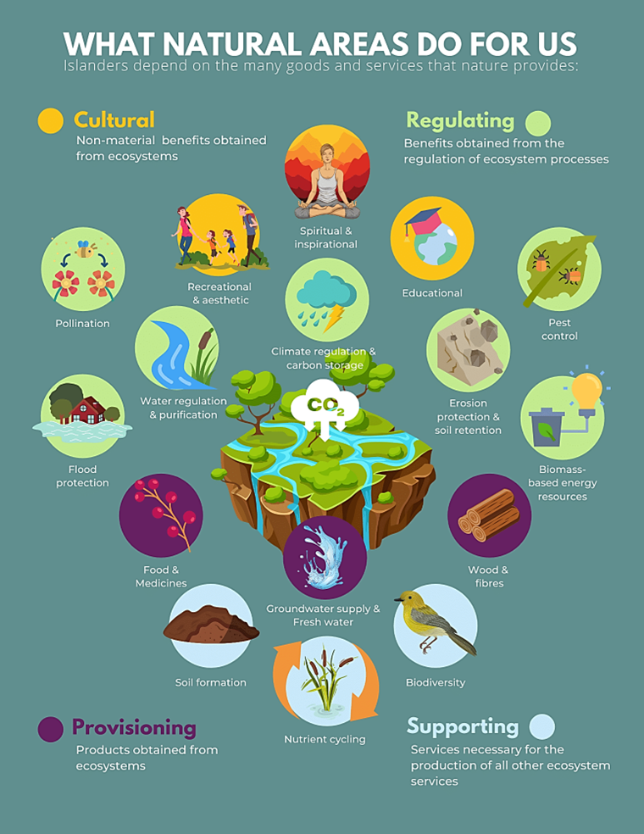
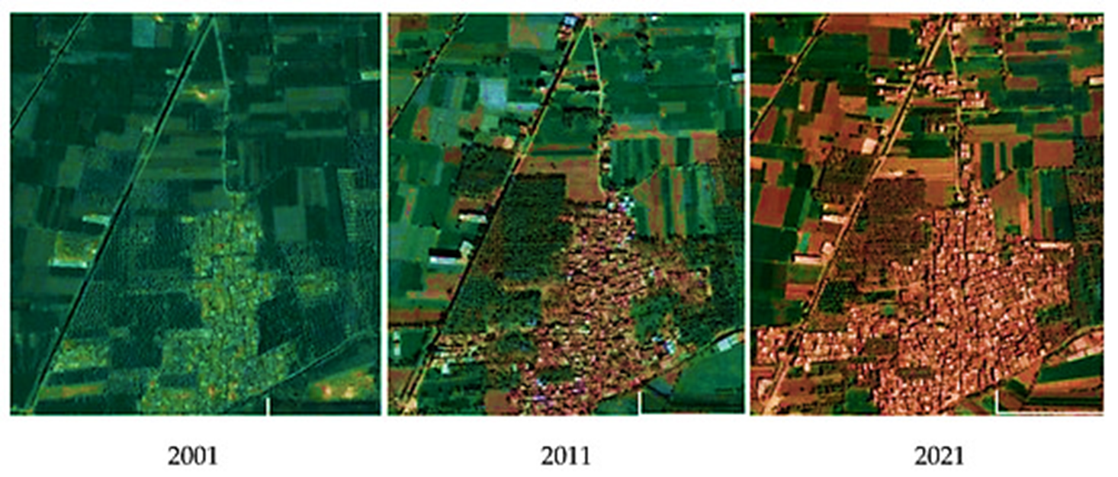
Background and problem statement (1/3)
By 2050, 68 % of the world’s population will live in cities
5 billion people may be at risk from diminishing ecosystem services, particularly in Africa (Chaplin-Kramer et al., 2019)

Slide 4
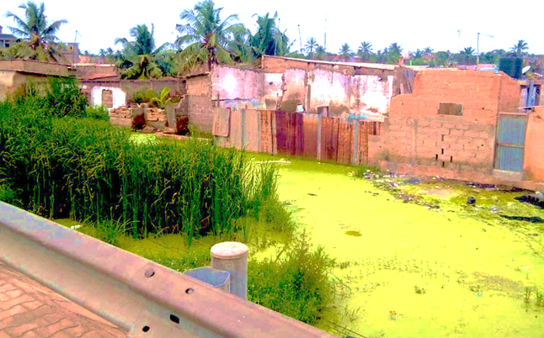
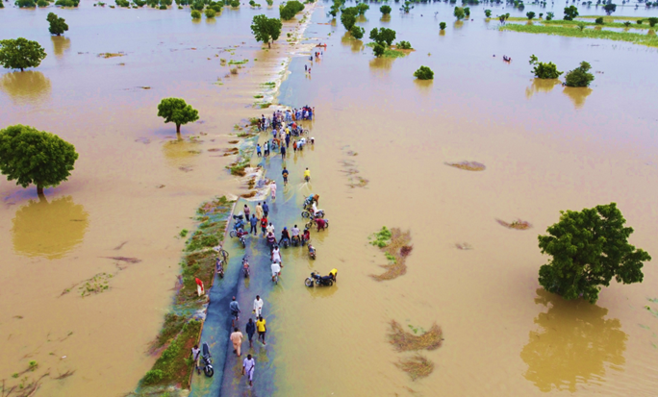
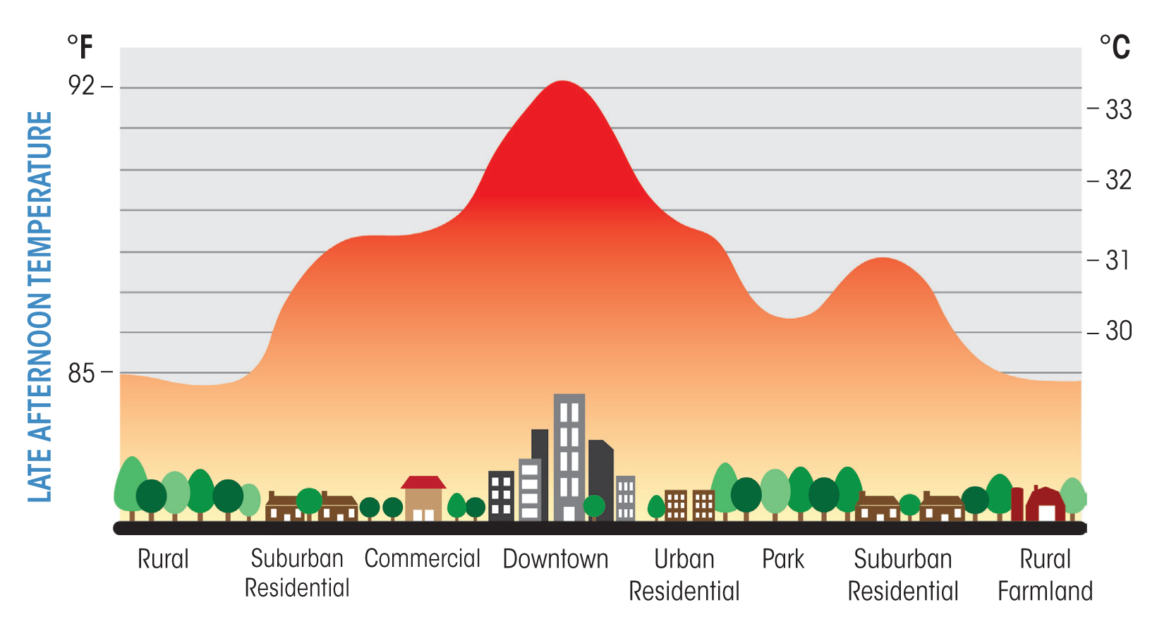
Background and problem statement (2/3)
Both cities face significant challenges
Insecure tenure systems,
unregulated land markets,
Uncontrolled expansion, without considering the nature of the soil
inadequate housing
In DAGL and GAMA, expansion has mainly been at the expense of their vegetation cover
Rise in temperature
Reduction of infiltration capacity

Slide 5
Background and problem statement (3/3)
LULC changes and urban expansion in DAGL (Somadjago et al., 2020; Amouzoukpo, 2021)
LULC changes and urban expansion in GAMA (Asabere et al., 2020; Addae and Oppelt, 2019; Akubia and Bruns, 2019)
How do these changes affect ecosystem services?
Flood risk control, Urban cooling, and
Carbon storage services have not been thoroughly evaluated in prior studies.
The decline of these services can exacerbate vulnerabilities to climate-related hazards, making it imperative to assess their status within the context of ongoing urban development in DAGL and GAMA.

Slide 6

Aim and objectives (1/1)
This study aims at assessing and comparing the impact of urban sprawl development on ecosystem services in Togo and Ghana towards the achievement of sustainable urban development in both countries
1 Assess the spatial and temporal changes in the expansion of urban areas and the change in land use and land cover in DAGL and GAMA
2 Analyze the distribution and variation in the provision of the selected ecosystem
services from 1986 to 2023 in DAGL and GAMA
3 Evaluate the relationship between urban sprawl and ecosystem service provision in the selected metropolitan areas DAGL and GAMA

Slide 7
Justification to the study (1/1)
POLICIES
??
Empower planners and decision makers to make informed choices regarding land use, infrastructure development, and environmental protection.
Disconnect between urban policies and land used by the population
Provide insights for urban planners and environmental managers working towards the achievement of SDG, Goal 11, Goal 13, Goal 15
Uncontrolled development, driven by customary landowners
Provide a pathway for further research on urban sustainability, resilience and ecosystem protection,
Enhance scientific knowledge on the relationship between urbanisation, land use change, and ecosystem services.
housing shortages, structural imbalances exacerbated

Slide 8
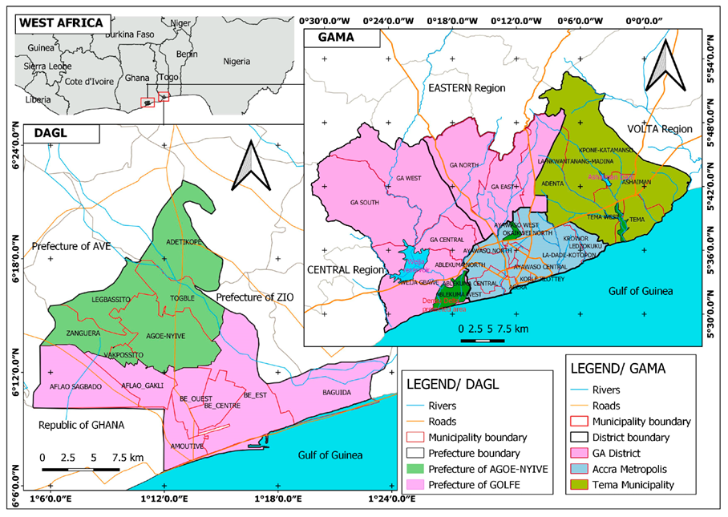
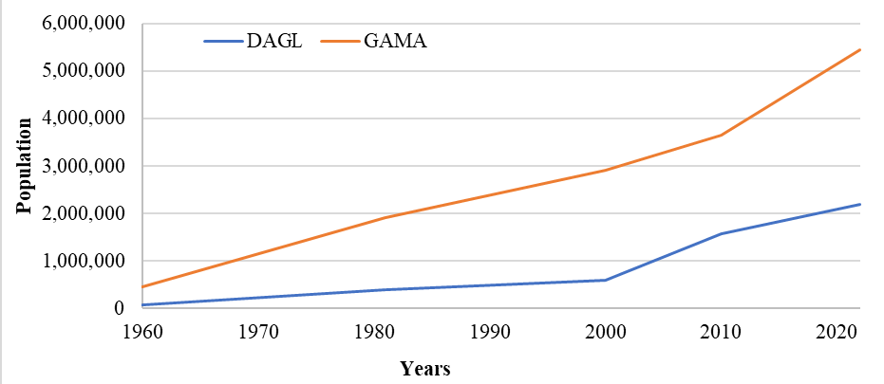
Study area (1/1)
District Autonome du Grand Lomé (DAGL) in Togo
Greater Accra Metropolitan Area (GAMA) in Ghana
Tropical savannah climate
Natural vegetation

Slide 9
Data and Method (1/5)
Data type | Sources | Date
Landsat data | Google Earth Engine (GEE) | 1986-2023 (DAGL) 1991-2023 (GAMA)
Climate data | Togolese meteorological office (DGMN) Ghana Meteorological Agency (GMet) | 1992-2022
Global settlement/World settlement Footprint Google Earth images | Google Earth Engine (GEE) Google Earth Pro | 2018/ 2015 2002/2015/2017/2023
Ground truth data | Field | 2023
aboveground biomass, belowground biomass, soil and dead organic matter | (IPCC) 2006 ESA CCI Global Forest Above Ground Biomass on Earth Map Owoade et al. (2020)
Evapotranspiration data | GEE | 2001-2023
Hydrologic Group Data | United States Department of Agriculture

Slide 10
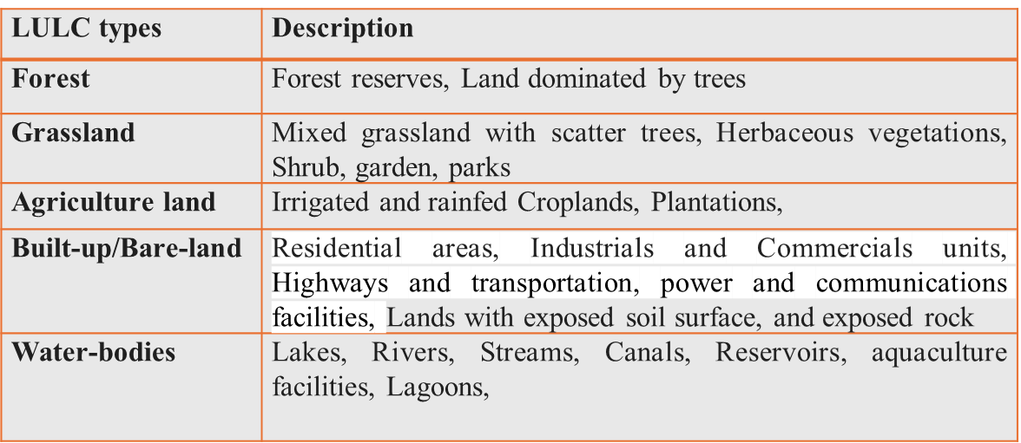
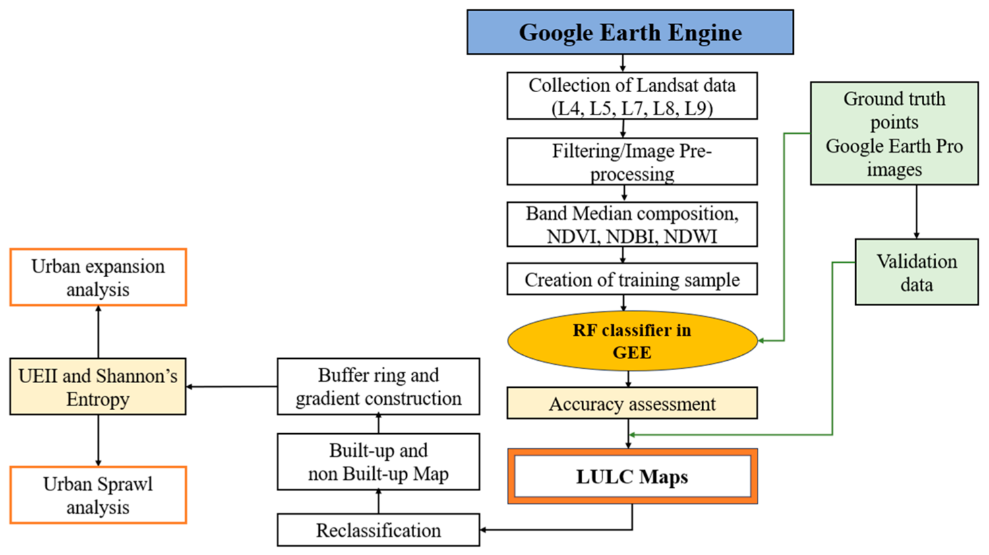
Data and Method (2/5)
Flow chart 1: LULC /Urban expansion analysis/Urban sprawl quantification

Slide 11
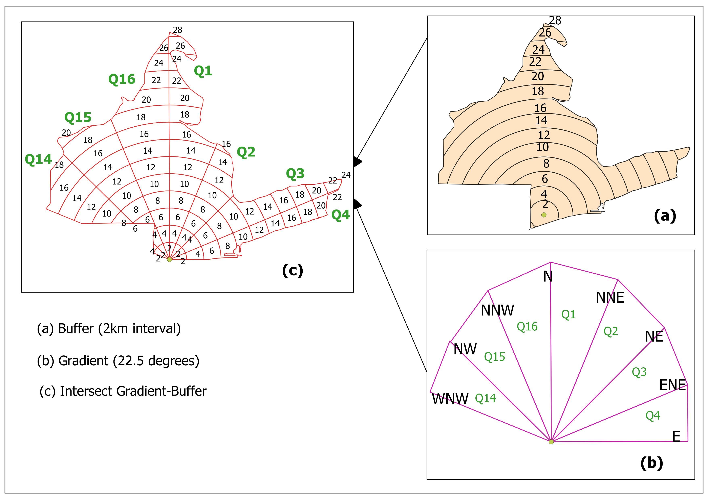
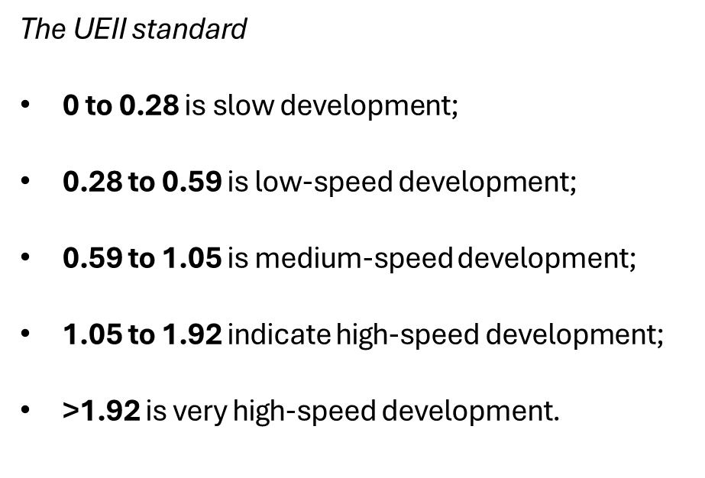
Data and Method (3/5)
Urban expansion analysis/ Directional analysis
Urban expansion intensity (UEII)
  Urban sprawl/ Relative Shannon Entropy
Value closer to 0 means compact urban growth,
Values closer to 1 indicate dispersed distribution

Slide 12
Data and Method (4/5)
Ecosystem services assessment
Carbon storage and sequestration
Urban cooling
InVEST
(Integrated Valuation of Ecosystem Services and Trade-offs)
Flood risk
mitigation

Slide 13
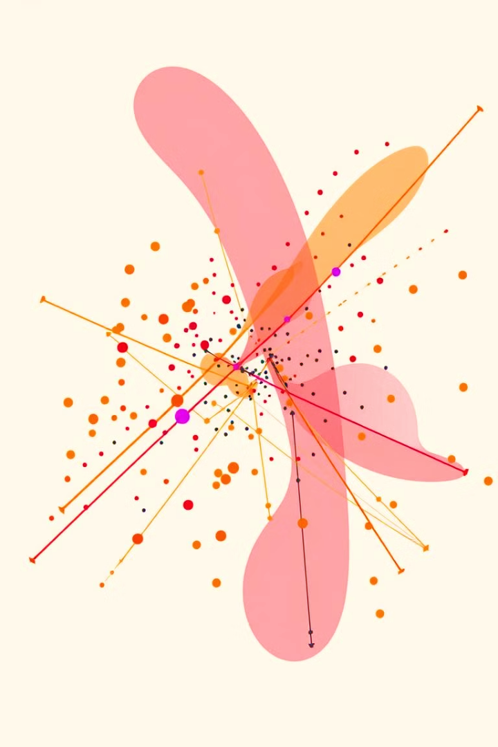


Data and Method (5/5)
Relationship between Urban Expansion and ESs
Independent variables
Urban/built-up area
Population density
NDVI (Normalized Difference Vegetation Index
NDBI (Normalized difference built-up index)
Correlation Analysis
Pearson’s
correlation
Spatial Regression Analysis
Geographically Weighted Regression (GWR)
Dependent variables (ESs)
Carbon storage
Urban cooling
Flood risk control

Slide 14
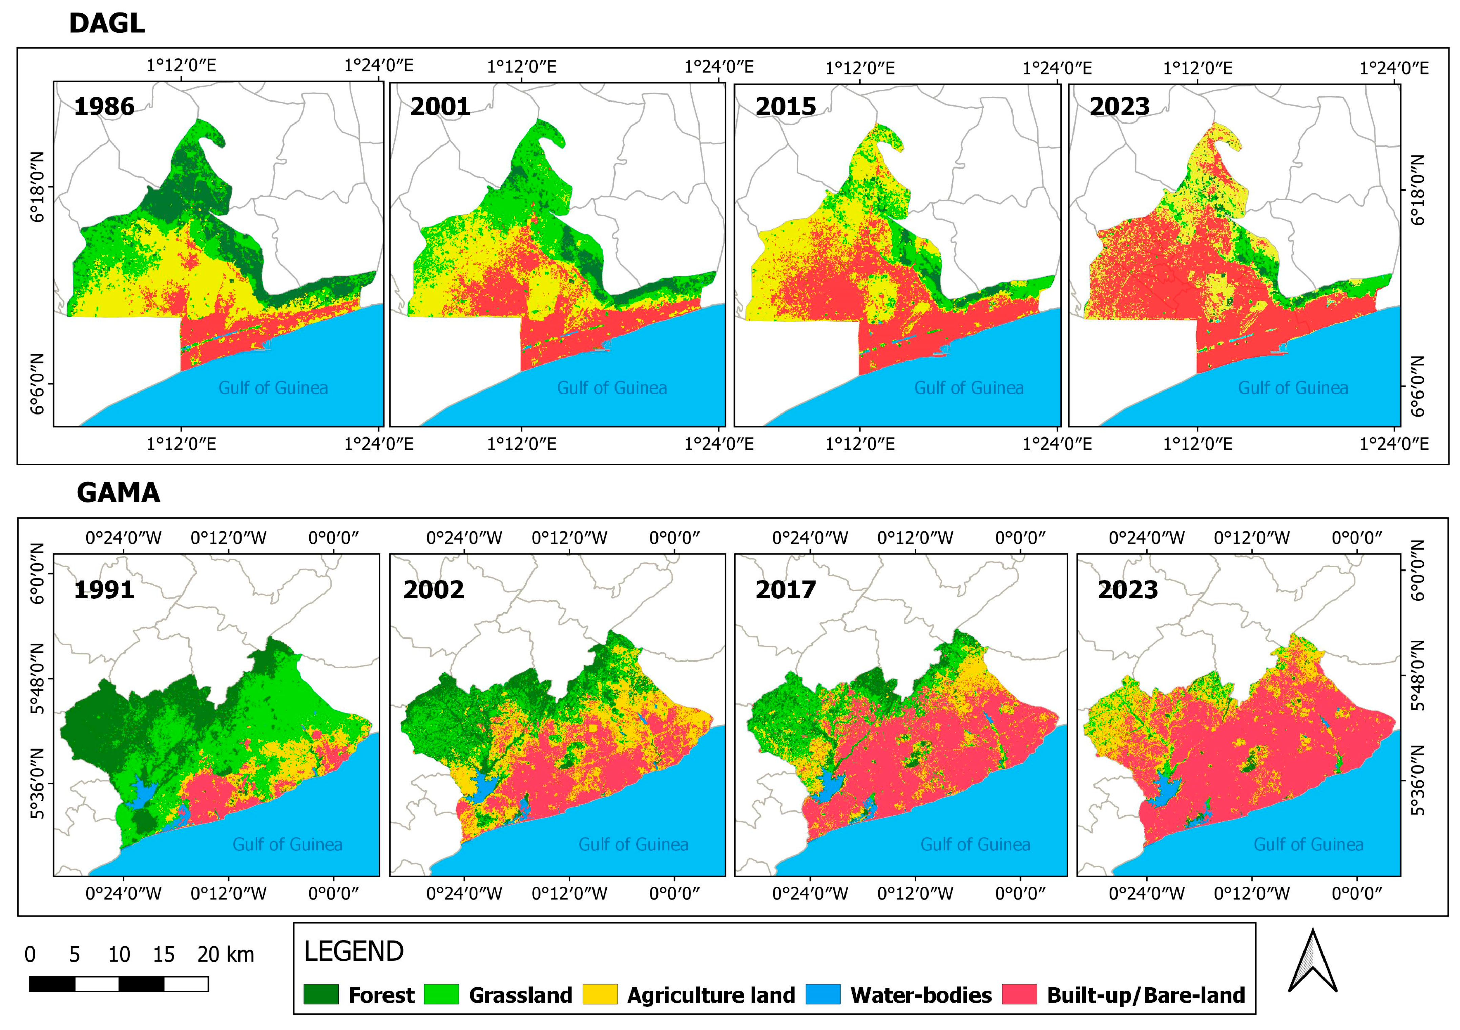
Results and discussion (1/10)
Trend in land use and land cover (LULC)
LULC Map for DAGL and GAMA

Slide 15
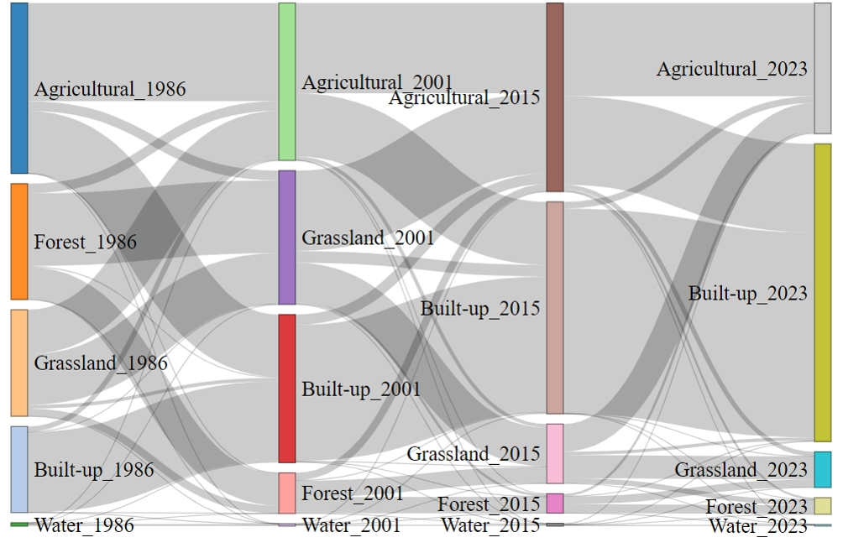
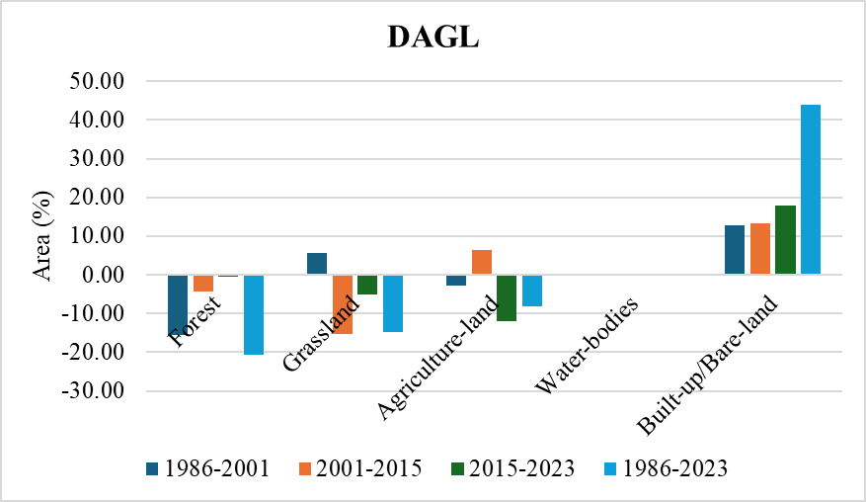

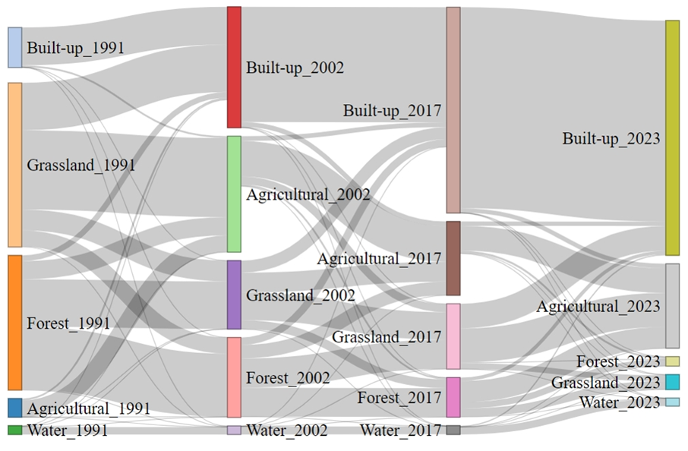
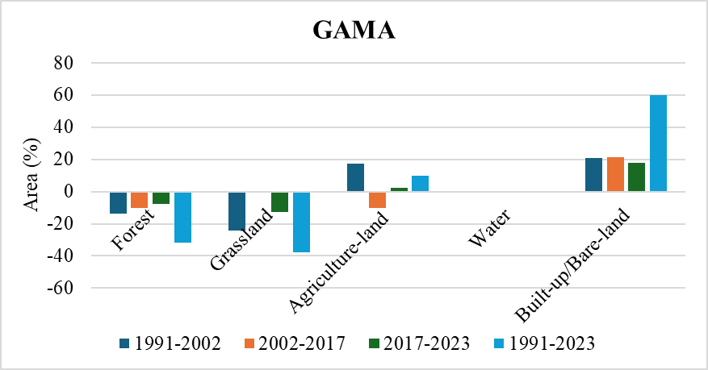

Results and discussion (2/10)
Trend in LULC
Amouzoukpo et al.2021
Ghana MFA, 2018

Slide 16
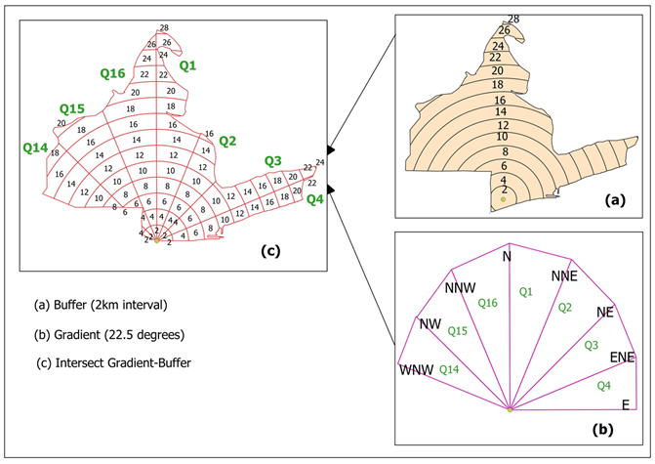
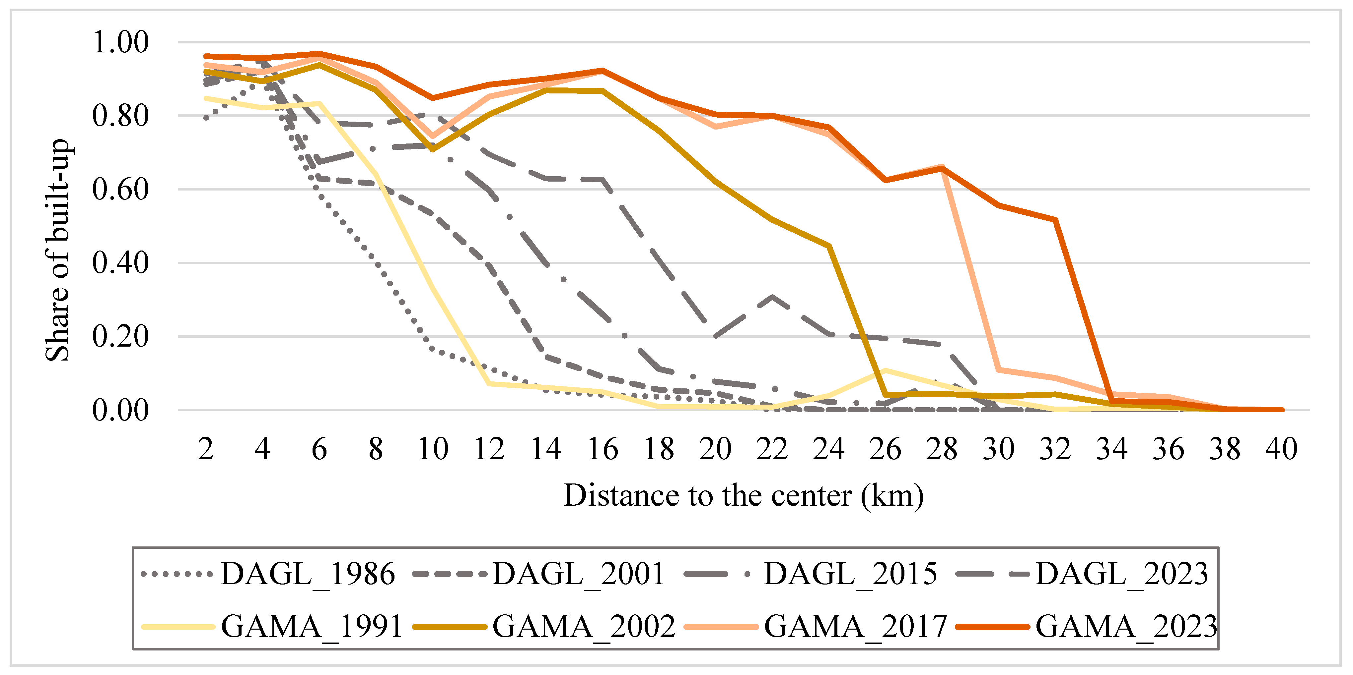
Results and discussion (3/10)
Spatial patterns of urban
expansion
The development in GAMA is as fast as in DAGL; however, the urban density over distance is much higher in GAMA compared to DAGL

Slide 17
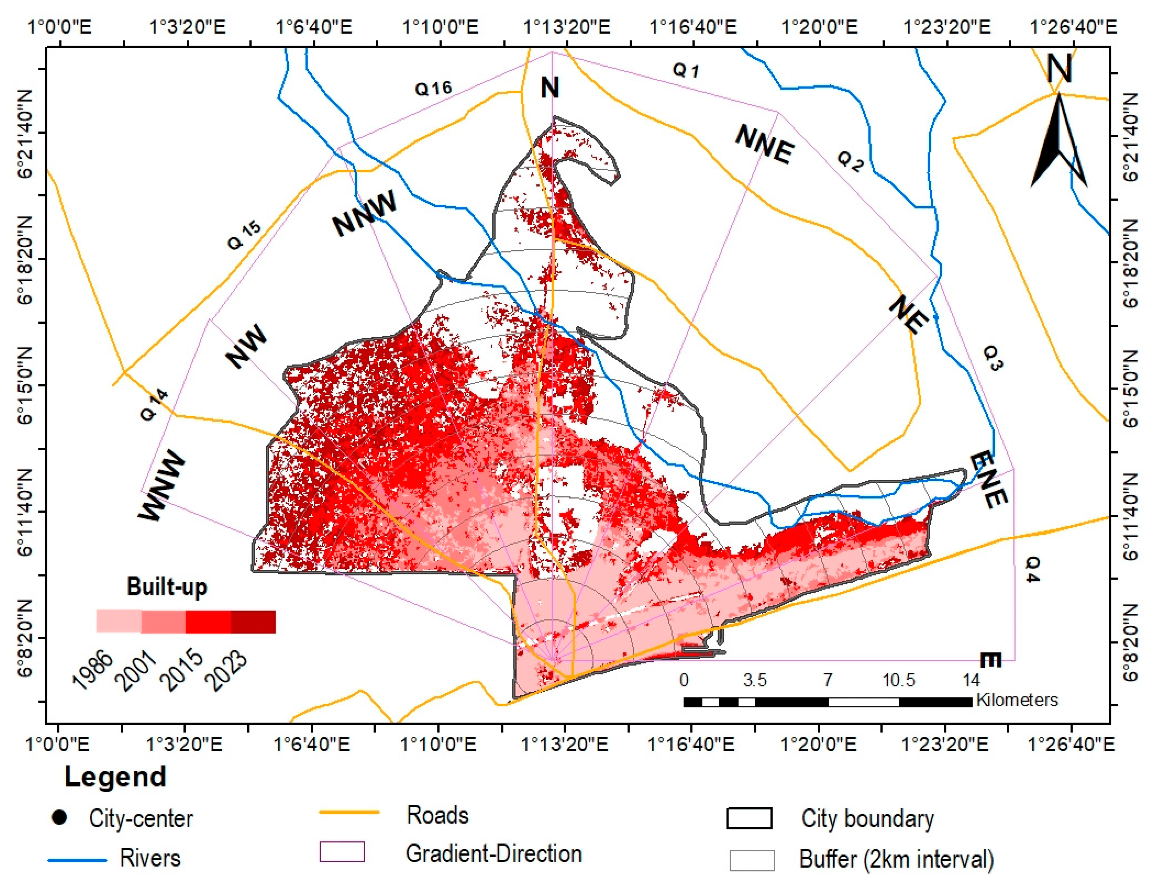
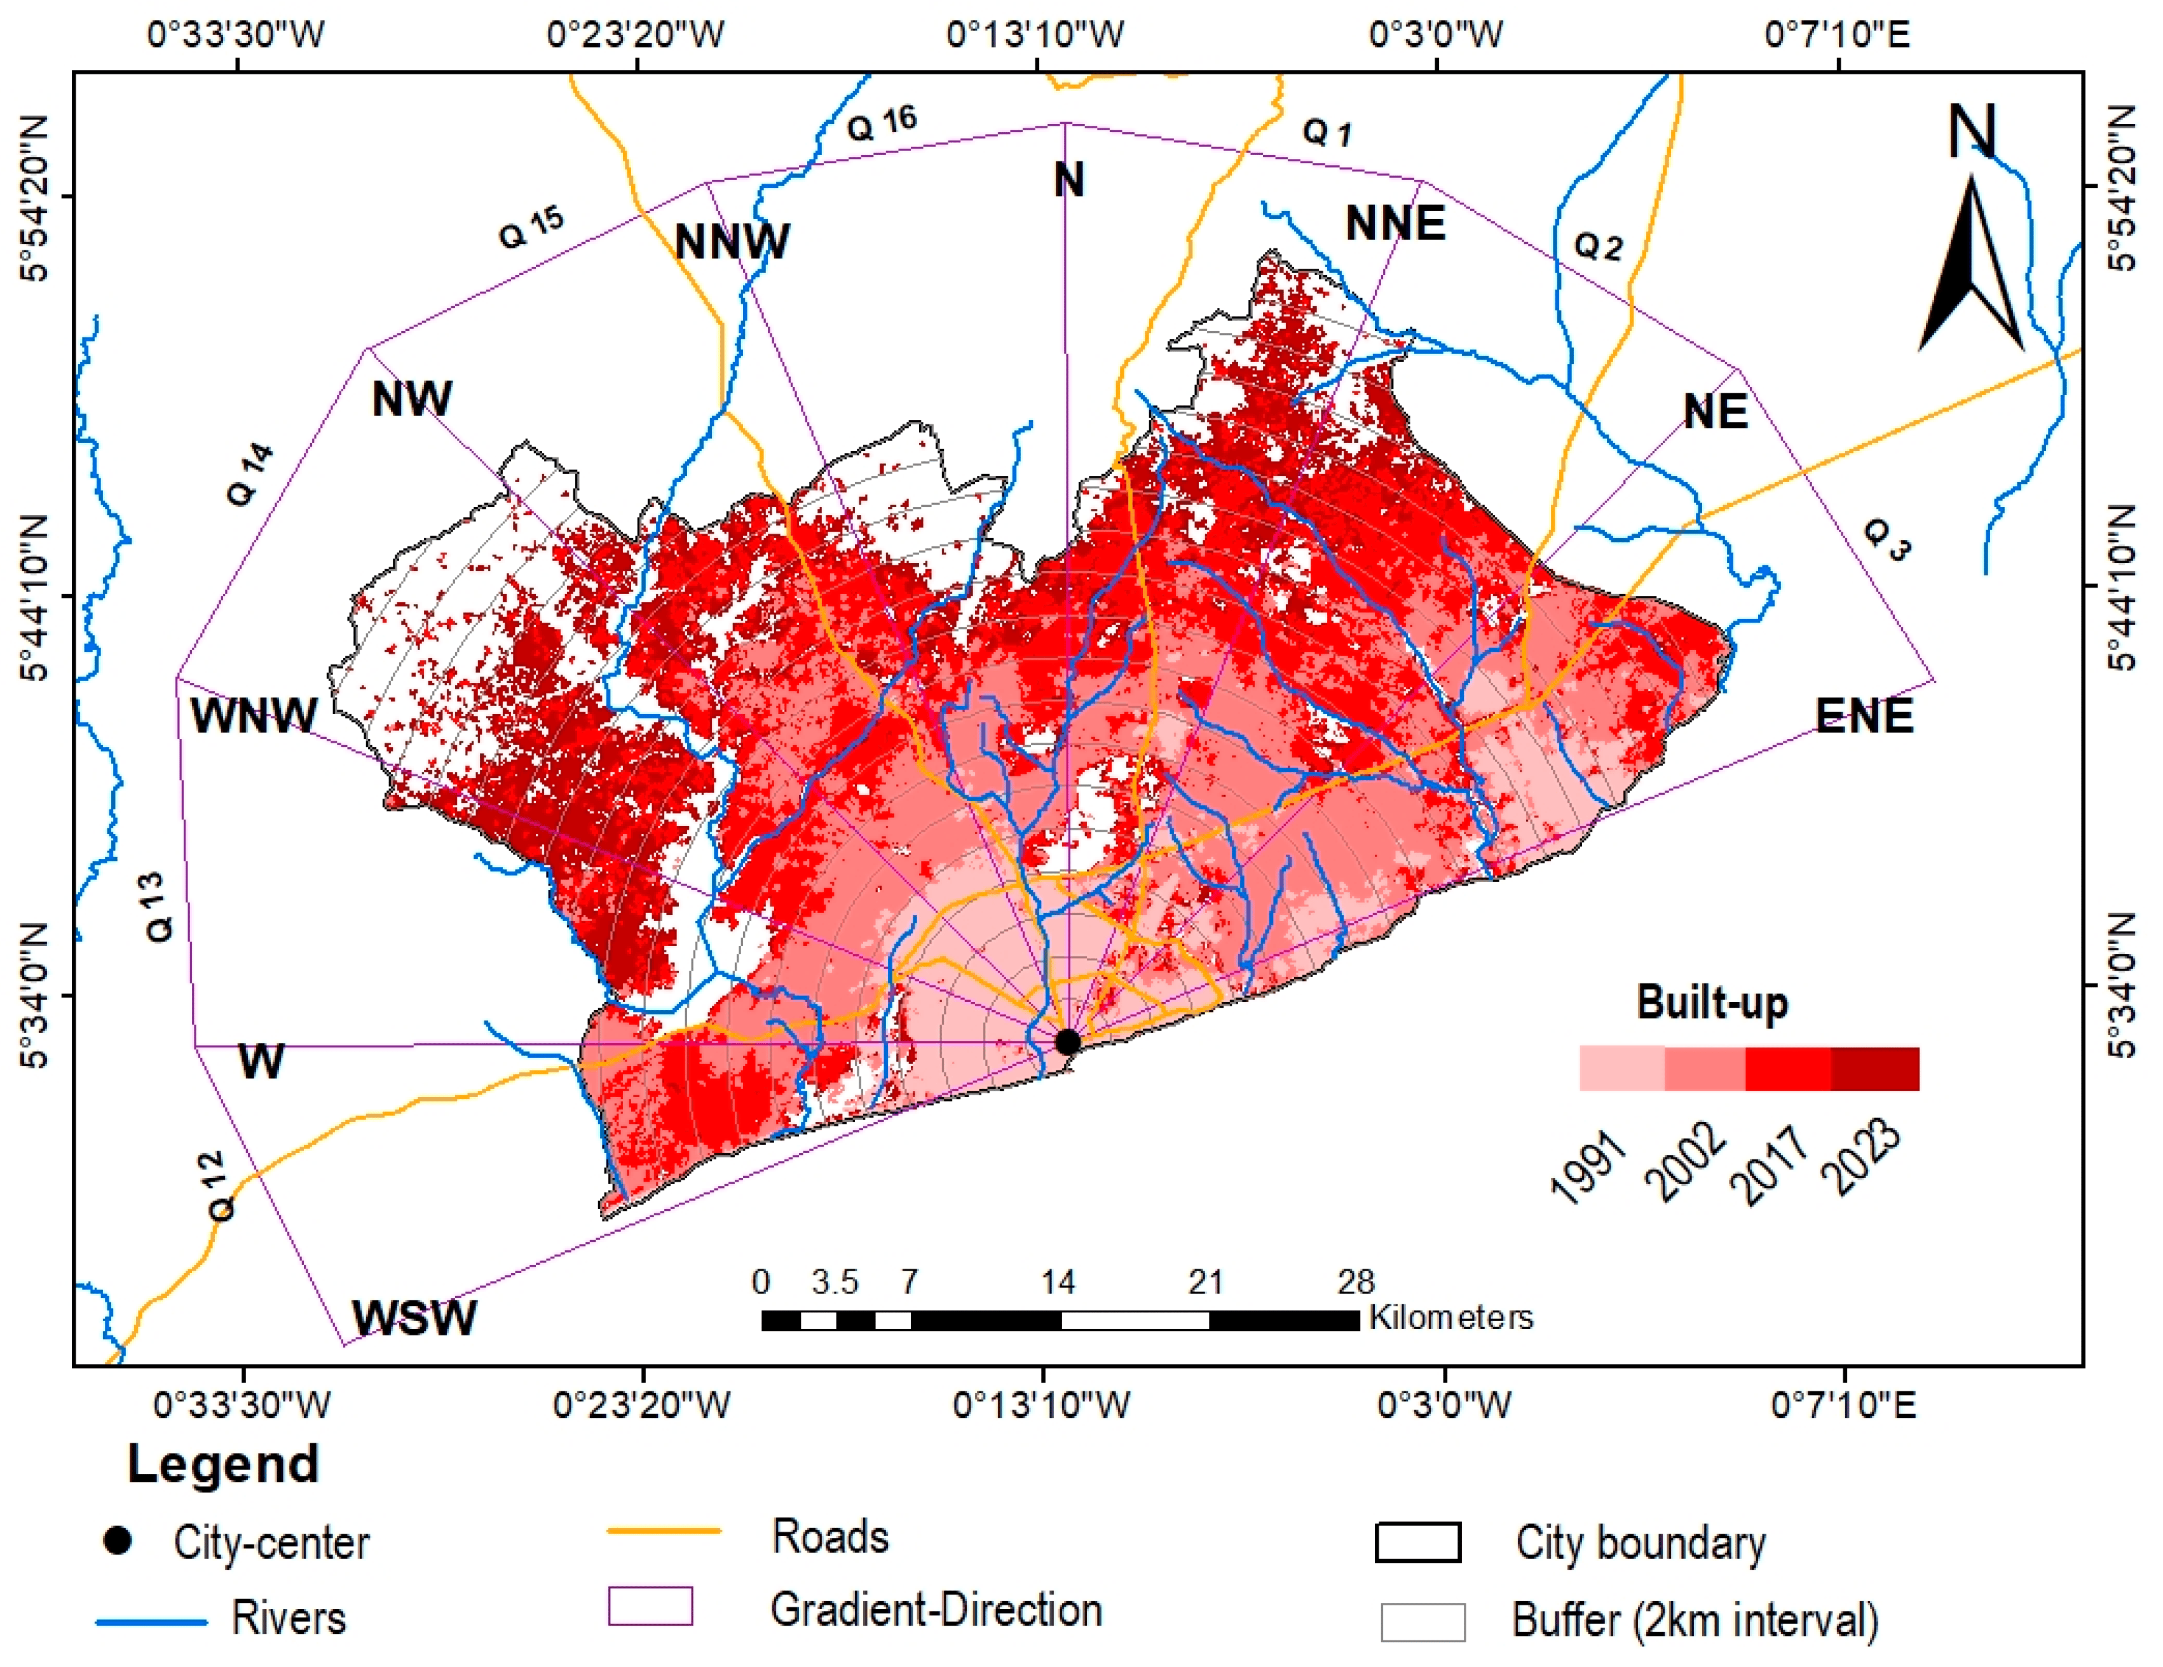
Results and discussion (4/10)
Spatial patterns of urban expansion
DAGL
GAMA

Slide 18
Results and discussion (5/10)
Urban sprawl
Major contributory factors are the improved transportation networks in the two cities that link them to other regions
Relative Shannon’s entropy for DAGL and GAMA
Area | Period | Entropy | Relative Entropy
DAGL | 1986 | 2.01 | 0.76
 | 2001 | 2.33 | 0.88
 | 2015 | 2.43 | 0.92
 | 2023 | 2.51 | 0.95
GAMA | 1991 | 2.46 | 0.82
 | 2002 | 2.72 | 0.91
 | 2017 | 2.87 | 0.96
 | 2023 | 2.85 | 0.95
Value closer to 0, compact urban growth (higher density),
Value closer to 1, dispersed distribution (low-density urban development)

Slide 19
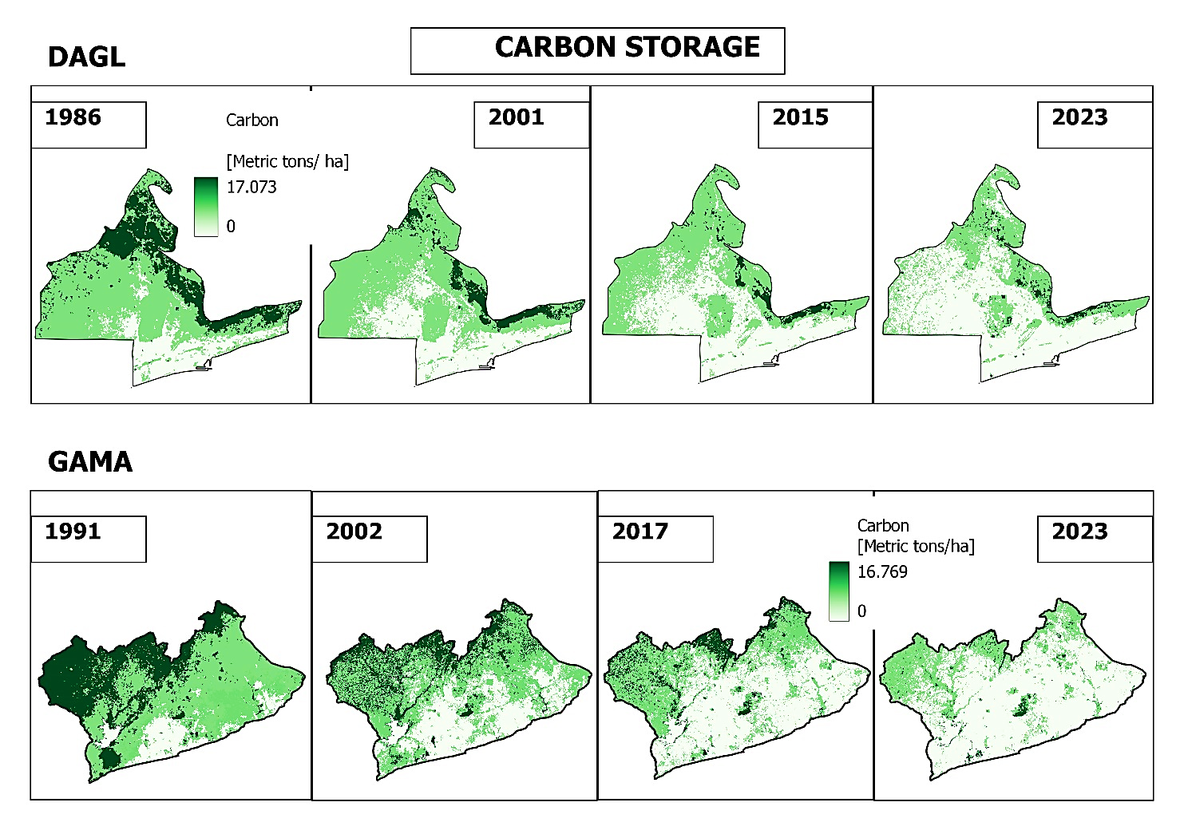
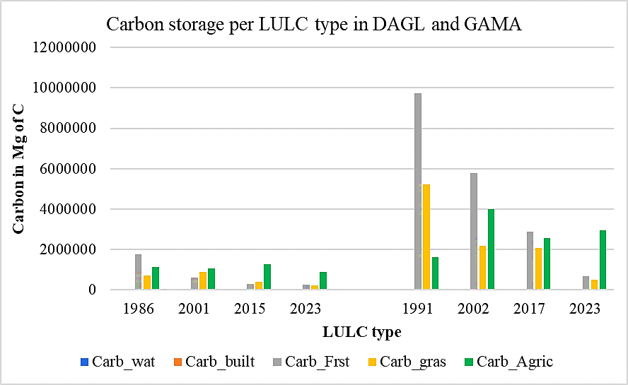
Results and discussion (6/10)
Carbon storage and sequestration: Greenery’s Powerhouse
Confirmed by Sun et al. (2018), in the Atlanta Metropolitan area, USA
Carbon storage map in DAGL and GAMA
Hailu et al. (2024) in Addis Ababa, Ethiopia

Slide 20
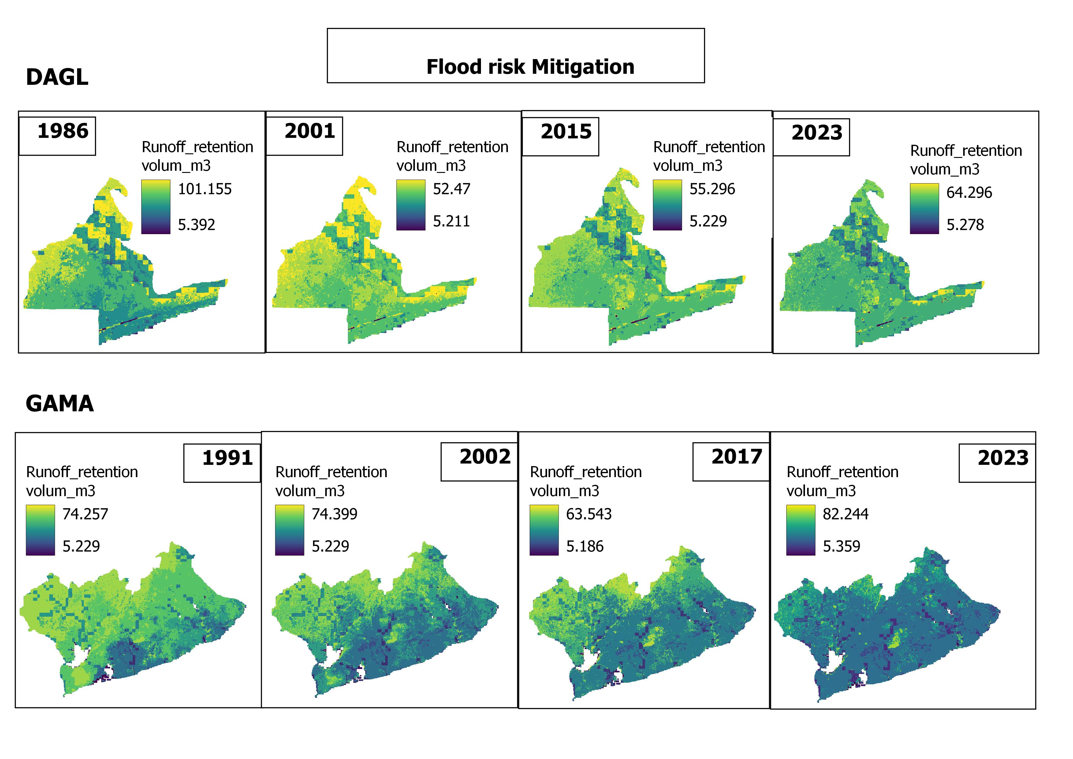
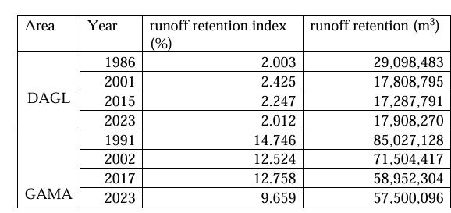
Results and discussion (7/10)
Flood risk mitigation: Greenery’s Resilience
Confirmed by Li et al. (2018) in Shenyang, China
Bose and Mazumdar (2023) in Kolkata City, India

Slide 21
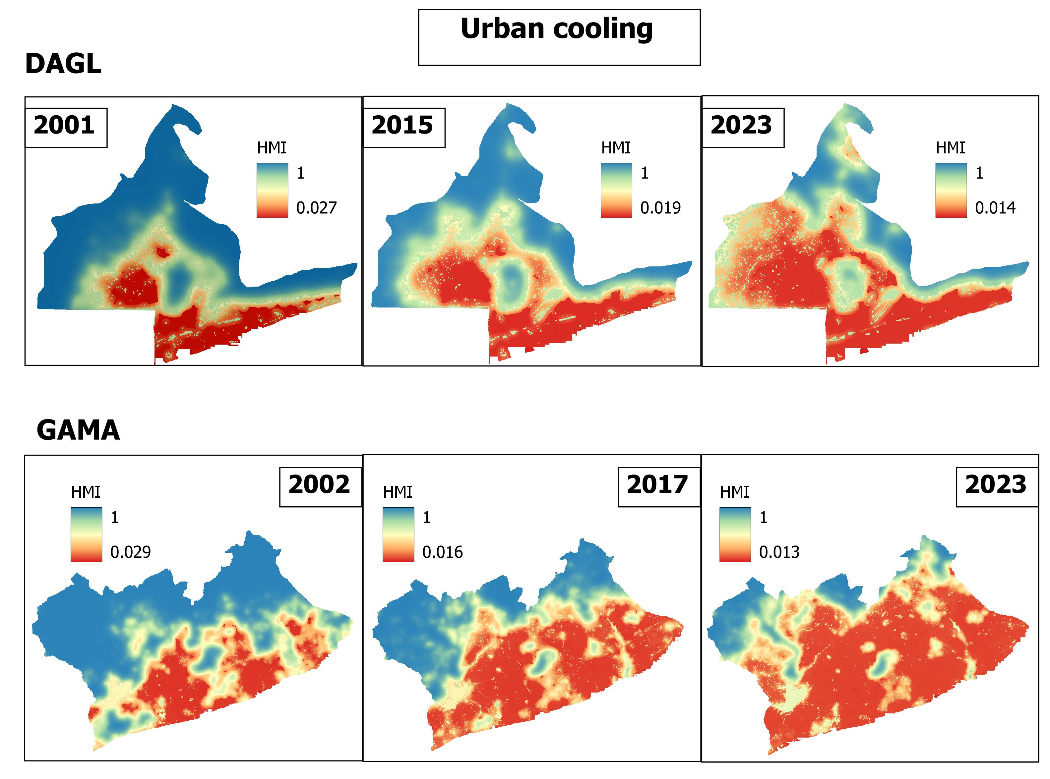
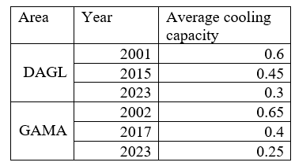
Results and discussion (8/10)
Urban cooling: Beat the heat
Confirmed by Wu et al. (2024) in Yangzhou City, China
HMI: Heat Mitigation Index

Slide 22
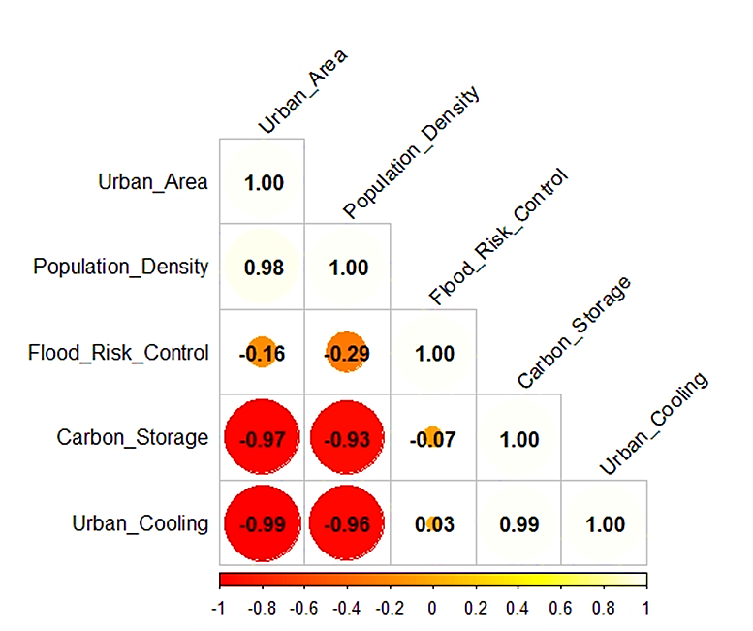
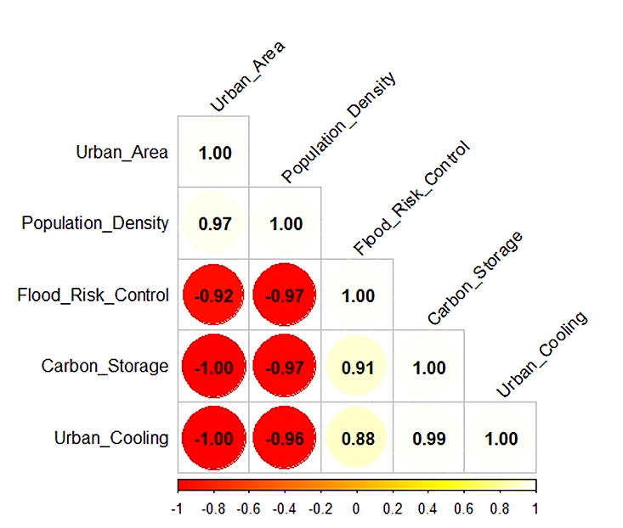

Results and discussion (9/10)
Relationship between Urban Expansion and ESs
Pearson’s correlation analysis
DAGL
GAMA's geographic location makes it particularly vulnerable to flooding due to its coastal position
High population density in informal settlements in GAMA located in flood-prone zones

Slide 23
Results and discussion (10/10)
Relationship between Urban Expansion and ESs
Urban expansion’s ecological impact is service-specific
while vegetation loss and built-up growth jointly explain carbon storage and urban cooling patterns,
Geographic Weighted Regression (GWR)
Runoff retention appears less directly linked to these factors
NDVI is a strong predictor, highlighting the critical role of vegetation in these services.

Slide 24
Conclusion and recommendations (1/2)
Policy improvement
The Ministry of Urban Planning in Togo and Ghana should adopt mixed land use and vertical development
Governmental agencies should promote urban agriculture, green corridors, and integrate green infrastructure into building design
Performance improvement
Encouraging community participation in urban planning processes
Communities should also be encouraged to adopt nature-based solutions
Further research
This research provides a pathway for further investigation into urban sustainability and ecosystem protection
Further research should expand the comparative analysis to include additional cities in West Africa.

Slide 25
Contributions to the Body of Knowledge
i. Provides valuable insights into the interplay between urbanisation, land use change, and ecosystem services.
iii. By assessing a suite of ecosystem services, including carbon storage, heat mitigation, cooling capacity, and runoff retention, this study offers a more holistic perspective.
ii. The study's methodological approach, incorporating machine learning, geospatial techniques, and directional analysis, provides insights into the spatial patterns of urban expansion in each city.
iv. It serves as a model for similar studies in other regions, facilitating comparative analyses and the development of broader theories.

Slide 26



Thanks for your attention

