Slide 1
External Defense
EVALUATION AND MODELLING OF CLIMATE CHANGE EFFECT ON RIVER NIGER FLOOD DYNAMICS AND ADAPTATION STRATEGIES IN LOKOJA AND NIAMEY, WEST AFRICA
Presented by :
DOULLA NOUHOU Youssoufa
PhD/SPS/FT/2021/13006
Major Supervisor:
Engr.Prof. Martins Yusuf Otache,
Dr. Abdourahamane Illiasou Salamatou,
Dr. Olasunkanmi Habeeb Okunola

Slide 2
Outline Of The Presentation
Background
Statement of problem
Aim and Objectives
Materials and Methods
Findings
Conclusions

Slide 3
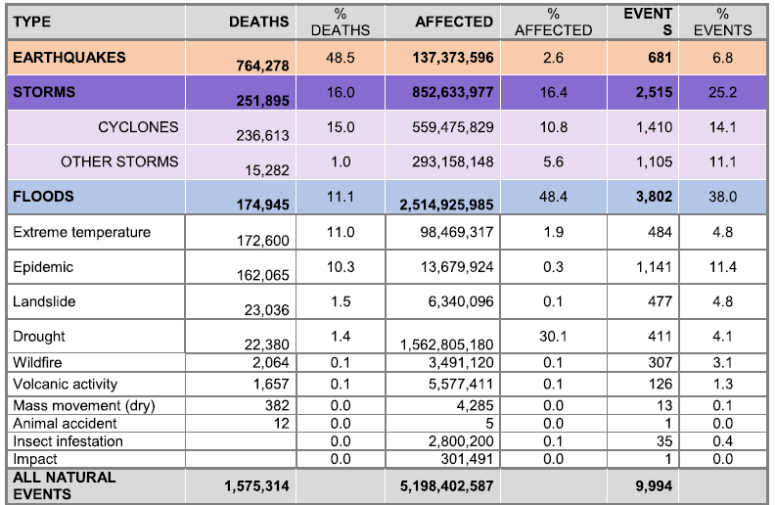
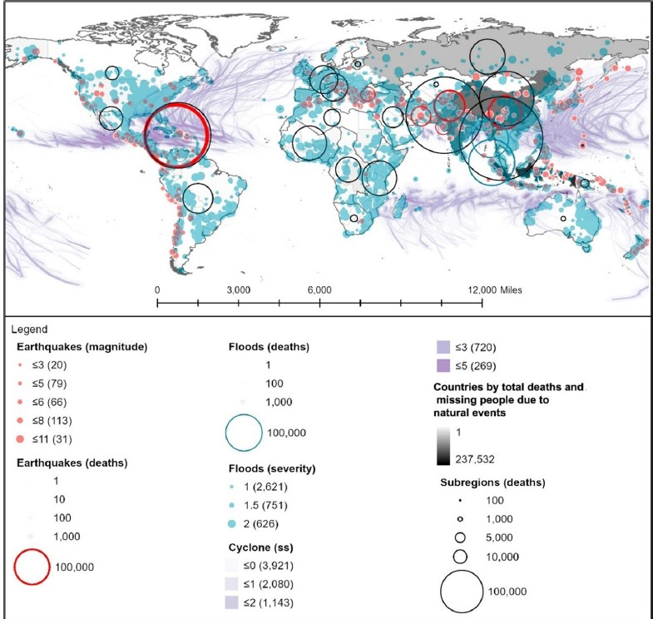
BACKGROUND TO THE STUDY
Flood is a natural event or occurrence where a piece of land (or area) that is usually dry suddenly gets submerged under water. Floods occur when there is excessive rainfall, river overflow, dam breakage, or any other situation where the land cannot absorb or channel the water efficiently (NOAA), 2020.
It is the most devastating natural disaster,
There is an exponential increase in the incidence (WMO)
Between 1995 and 2020, it affected 2.5 billion people (CRED & USAID, 2020; Guha-Sapir et al., 2015).
resulted in the deaths of more than 170,000 people, accounting for 11% of total deaths
Notes:
Therefore, quantitative and qualitative assessments of changes in flood characteristics under climate change in river basins are critically important and are strongly requested by policy-makers, river engineers, and flood fighters for practical river basin management against increasing flood risk

Slide 4
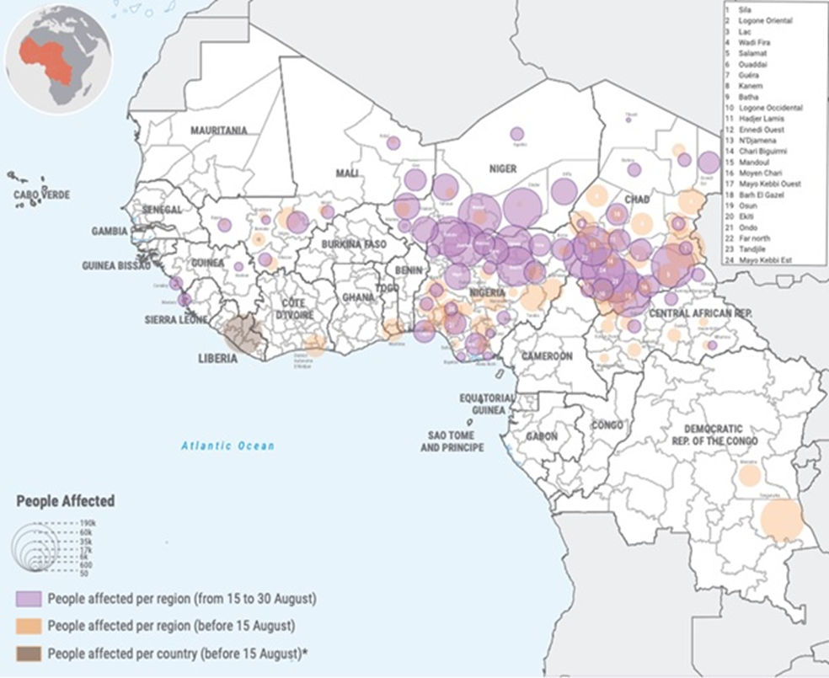
Trend:
Since the beginning of the 21st century, extreme events such as floods have occurred in several parts of the region (Di Baldassarre et al., 2010, Bologo et al 2019)
There is a seeming an increase in flooding in the Sahelian Region:
increase in extreme rainfall events in sub-Saharan Africa 1970 Valentin and Koné (2016), Amogu et al.,(2010), Oguntunde et al., (2017), Massazza et al., (2021)
On September 2024, the whole region was hit by heavy rains that were considered responsible for violent floods from the coast of Dakar to the port of Congo
Implications : Causes severe flooding leading to land and vegetation degradation
West and Central Africa: Flooding Situation Overview - as of 6 September 2024 | OCHA (unocha.org))
Therefore:
Understanding of future rainfall and river discharge trends are essential
especially, the impacts on river basins from extreme floods, water storage, and other events due to climate change.

Slide 5
Research Gap
They often neglect spatial analyses integrating climate, demography and infrastructure, underestimate transboundary challenges and socio-urban vulnerabilities, and
do not sufficiently explore future scenarios combining climatic and human pressures.
Current research focuses mainly drought analyses,
hydrological and rainfall trends
Existing remedial actions:
Disaster management mainly focuses on post-disaster assistance, disaster response and efforts to rehouse victims.
Problem
Inadequate planning for risk makes it one of the main reasons for the vulnerability of the population (Tarchiani et al., 2021).
This absence remains a handicap for the authorities' ability to anticipate and react effectively
compromises the resilience of exposed populations,
Implication: increasing the social, economic and environmental impacts of extreme events

Slide 6
Aim and Objectives
1. Analysis of land use and land cover patterns and the associated implications
The aim of the study is to evaluate and model the climate change effect on River Niger Flood dynamics and adaptation strategies in lokoja and Niamey, West Africa focusing on flood risk analysis and mitigation
2. Determination of flood susceptibility, vulnerability and risk distribution
3. Development of flood scenarios under varying climate change projections
4. Development of flood risk profiles and adaptation strategies

Slide 7
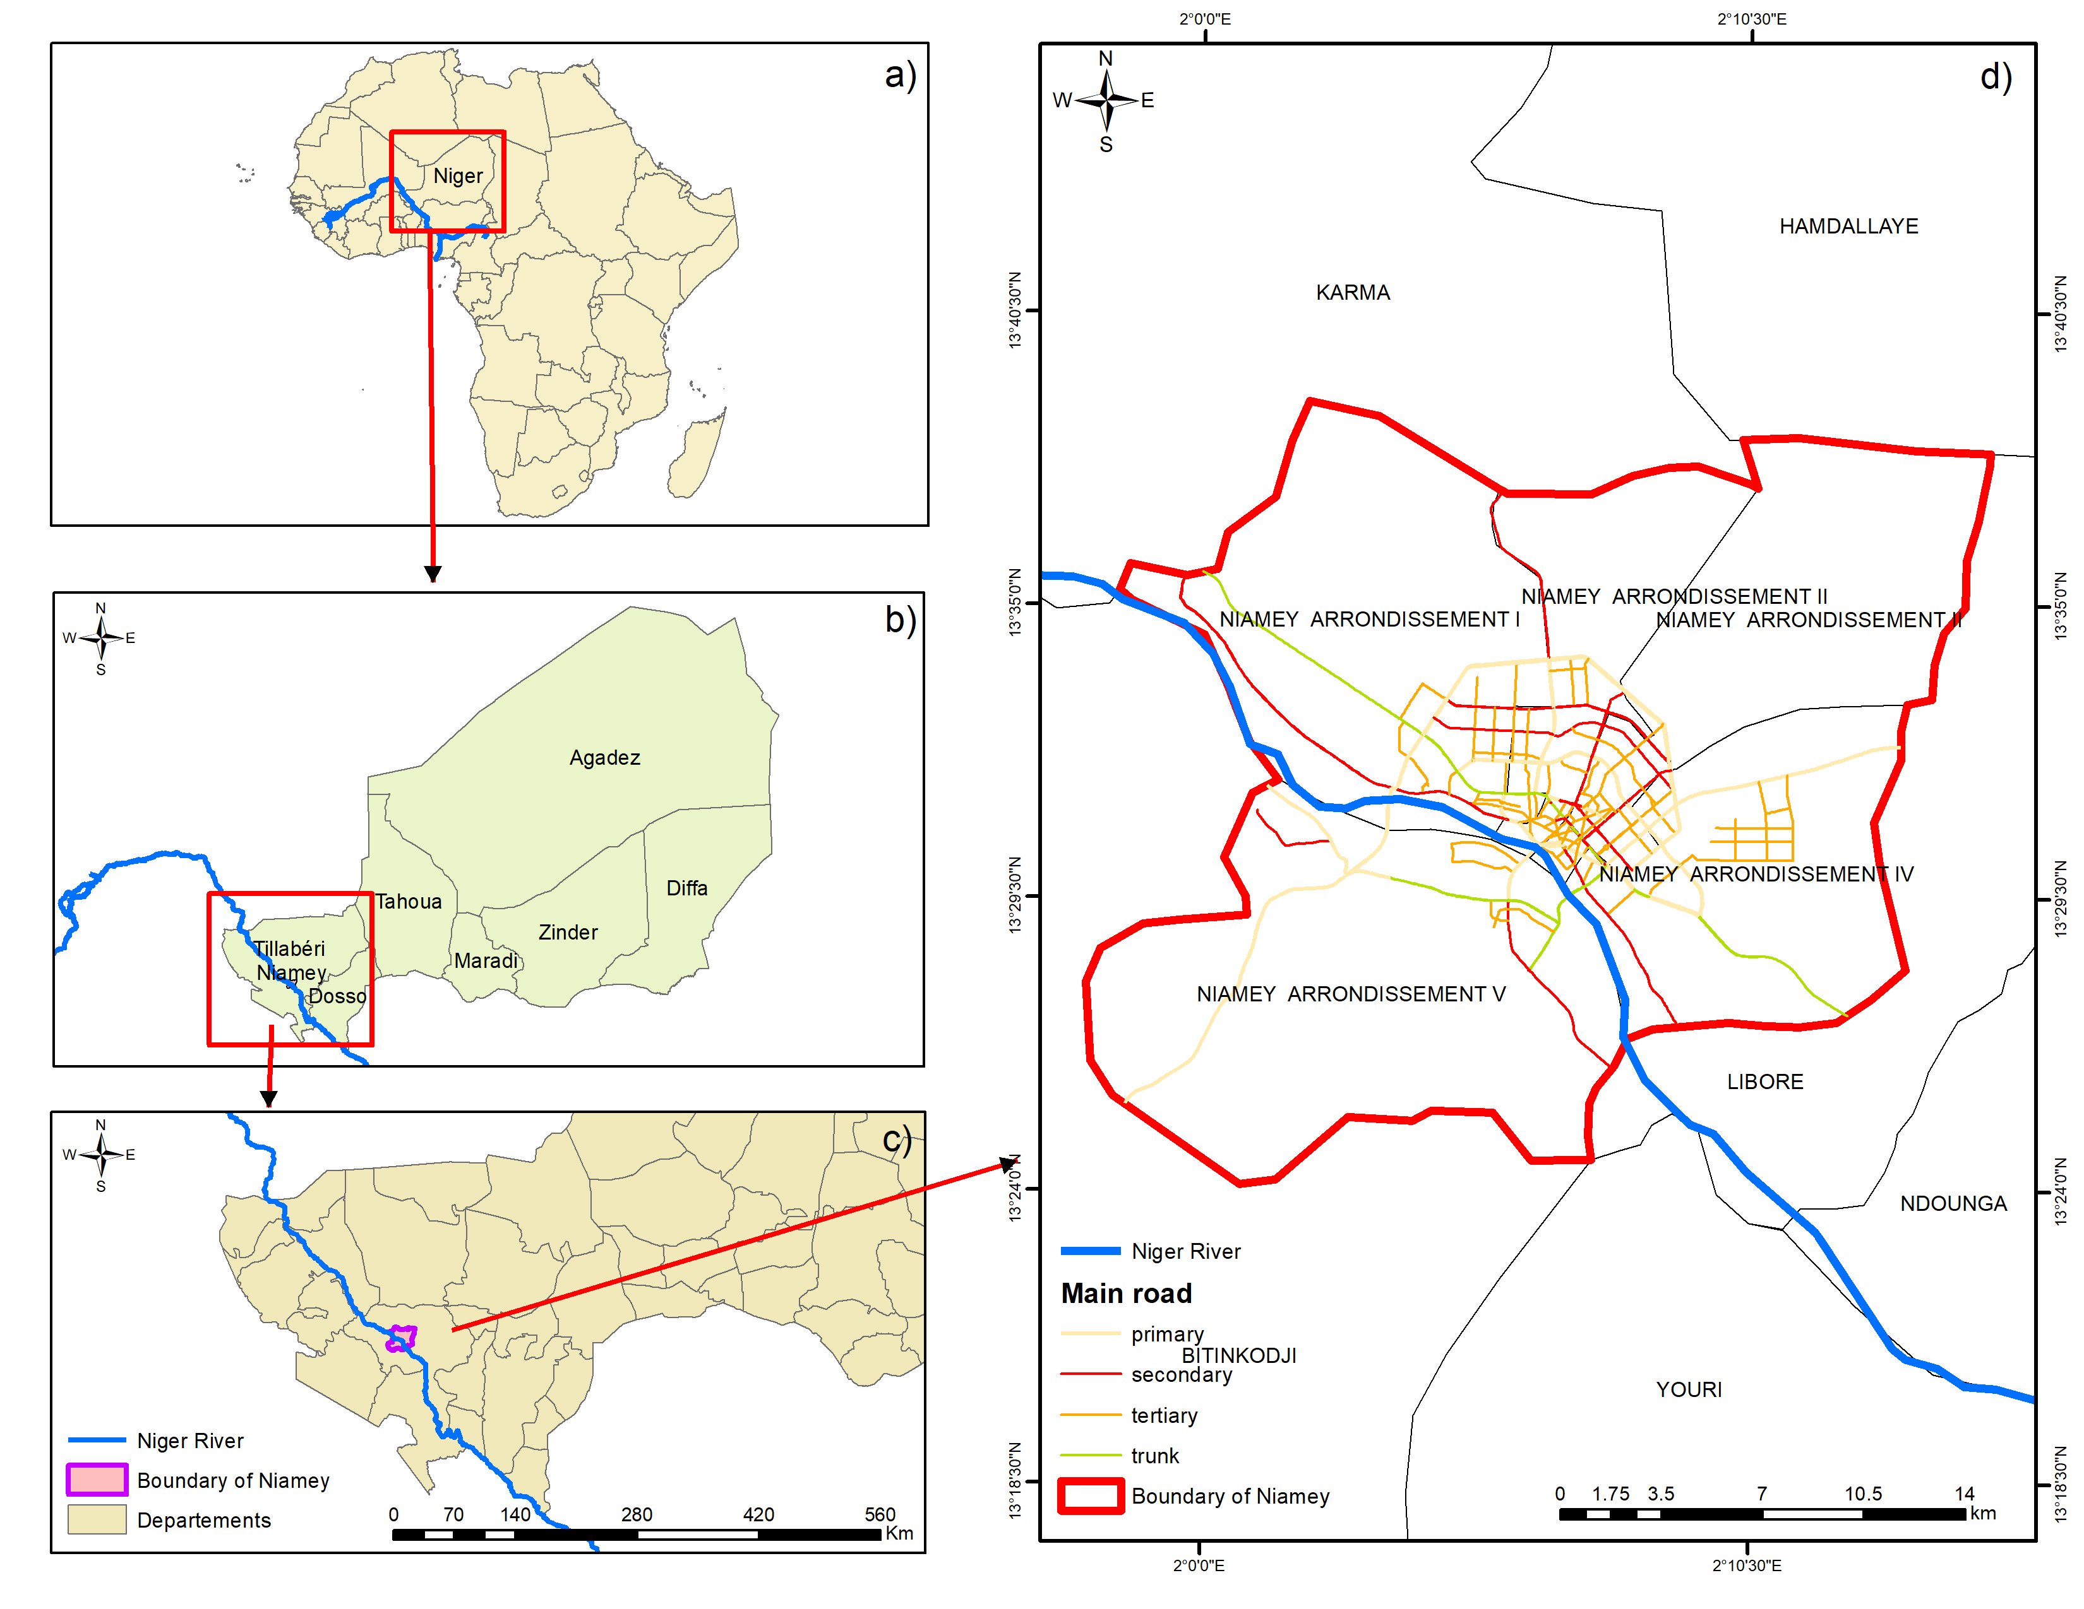
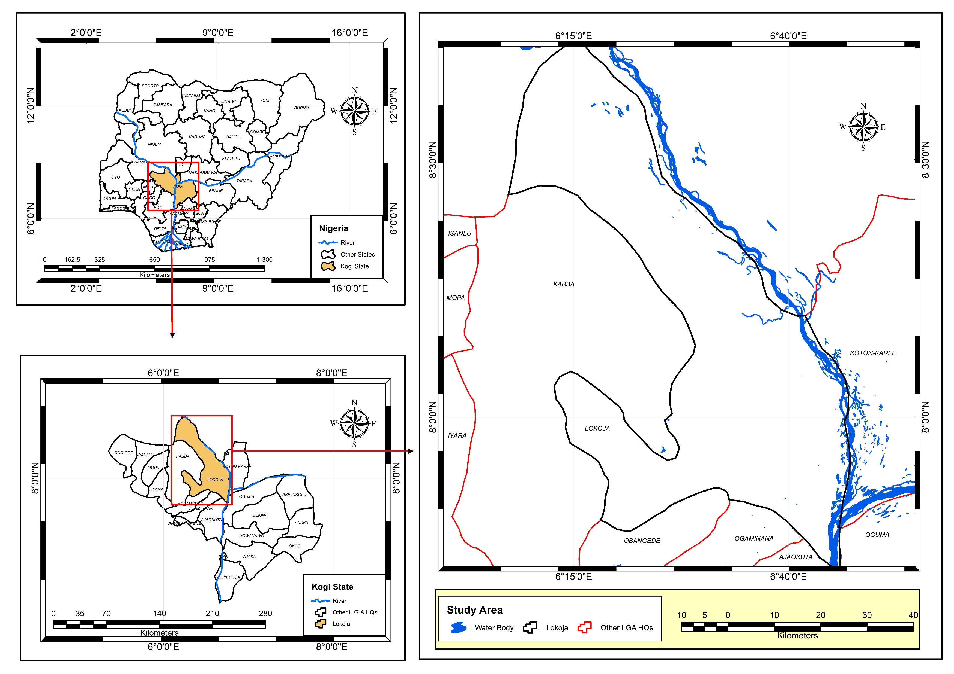
(i) Study Area and Data
The study area covers Niamey (Niger) and Lokoja (Nigeria) located on the Niger River. Lokoja covers an area of 3180 km²; it is known as the confluence city of the Niger and Benue rivers and is the capital of the Kogi State. Niamey represents the political and administrative capital of Niger with a total area of 240 km²
Materials and Methods
Lokoja (Nigeria)
Niamey (Niger)

Slide 8
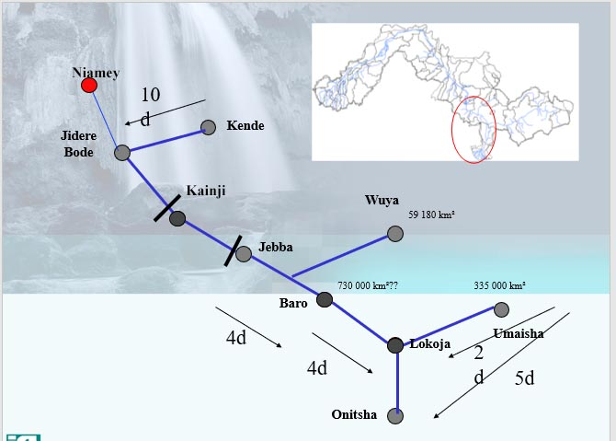
Schematics of Flood dynamics
Niamey (Upstream Zone)
Flood Drivers:
  Local Rainfall: Extreme precipitation → Rapid urban runoff.
  Seasonal Inflows: Contributions from right-bank tributaries and Guinean floods (upper basin).
  Lokoja (Confluence Zone)
  Flood Drivers:
  Confluence Effect: Niger + Bénoué rivers → High flow concentration.
  Upstream Extremes: Heavy rainfall in upper basins amplifies downstream risks.
  Steep Slopes: Accelerates runoff → Flash floods.
  Topographical Traps: River convergence + compacted soils → Prolonged inundation.
a)
(a) deleterious spatial inundation, (b) Flow build-up and propagation, and ( c ) enhanced residence time
b)
Both these cities are representative of the challenges faced by communities along the Niger: hydrological variability, climatic impacts and human pressures.

Slide 9
DATA TYPE AND SOURCE
The data collected in the Niamey and lokoja study area includes meteorological data, as well as hydrological and population data, as shown in the table below
The data collected:
Primary data
Secondary data
Other secondary data have been downloaded online as the work has progressed, These include Landsat satellite images and the digital elevation model (DEM), which is currently available on the EARTH EXPLORER website as an open access file.
Type of data | Extend | Source
Rainfall data | Daily data 30 years data for the period 1991 to 2021 | Direction National de la Meteorologie du Niger (DMN) and Nigerian Meteorological Agency (Nimet)
Temperature | Daily data 30 years data for the period 1991 to 2022 | Direction National de la Meteorologie du Niger
Streamflow | Daily data for 30 years for the period of 1990 to 2022 | Autorite du Bassin du fluve Niger(ABN) or Niger River Basin Authority (NBA), National Inland Waterways Authority (NIWA,) and Nigeria Hydrological Services Agency (NIHSA)
River stage or level | Daily data for 30 years for the period of 1990 to 2023 | Autorité du Bassin du fleuve Niger(ABN) or Niger River Basin Authority (NBA) National Inland Waterways Authority (NIWA,) and Nigeria Hydrological Services Agency (NIHSA)
Administration of structured questionnaire | 400 households | communities likely to be affected by flooding

Slide 10
Methods of Data Analysis
Obj 1: Assessment of Land Use and Land cover patterns
Methodology: Remote sensing and GIS techniques were used to assess Land Use and Land Cover (LULC) changes over 30 years (1991–2021) at 15-year intervals in two study areas, enabling detailed spatial and temporal analysis of land use patterns.
Data Sources: Satellite images from the USGS, specifically Landsat, were obtained for 1991, 2006, and 2021, chosen for their high-quality data suitable for LULC studies.
Data Processing: ArcGIS software was utilised to create composite images by combining spectral bands, improving the detection and classification of features like water bodies, vegetation, and urban areas.
Accuracy Assessment: The reliability of the classifications was evaluated using precision tests, including the Kappa index and overall accuracy metrics, to ensure the results accurately reflected actual land cover conditions.
Methods

Slide 11
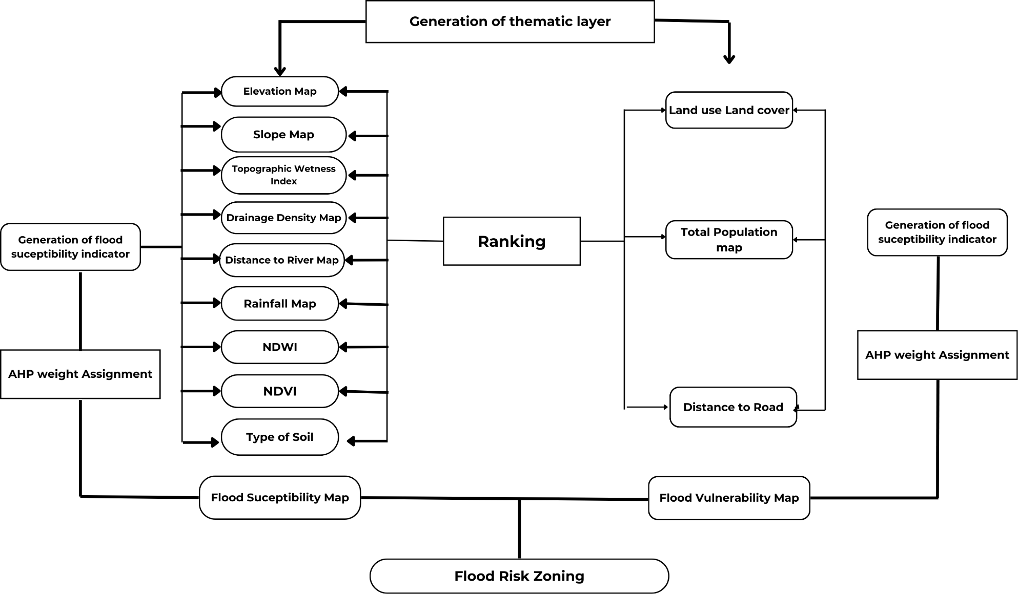
Obj 2 : Determination of flood vulnerability and risk distribution
In this objective, the multi-criteria analysis technique AHP combined with the GIS environment was used to produce the flood susceptibility, vulnerability and risk map. This technique provides a systematic approach to evaluated and integrating the impacts of various factors that involve different degrees of information

Slide 12
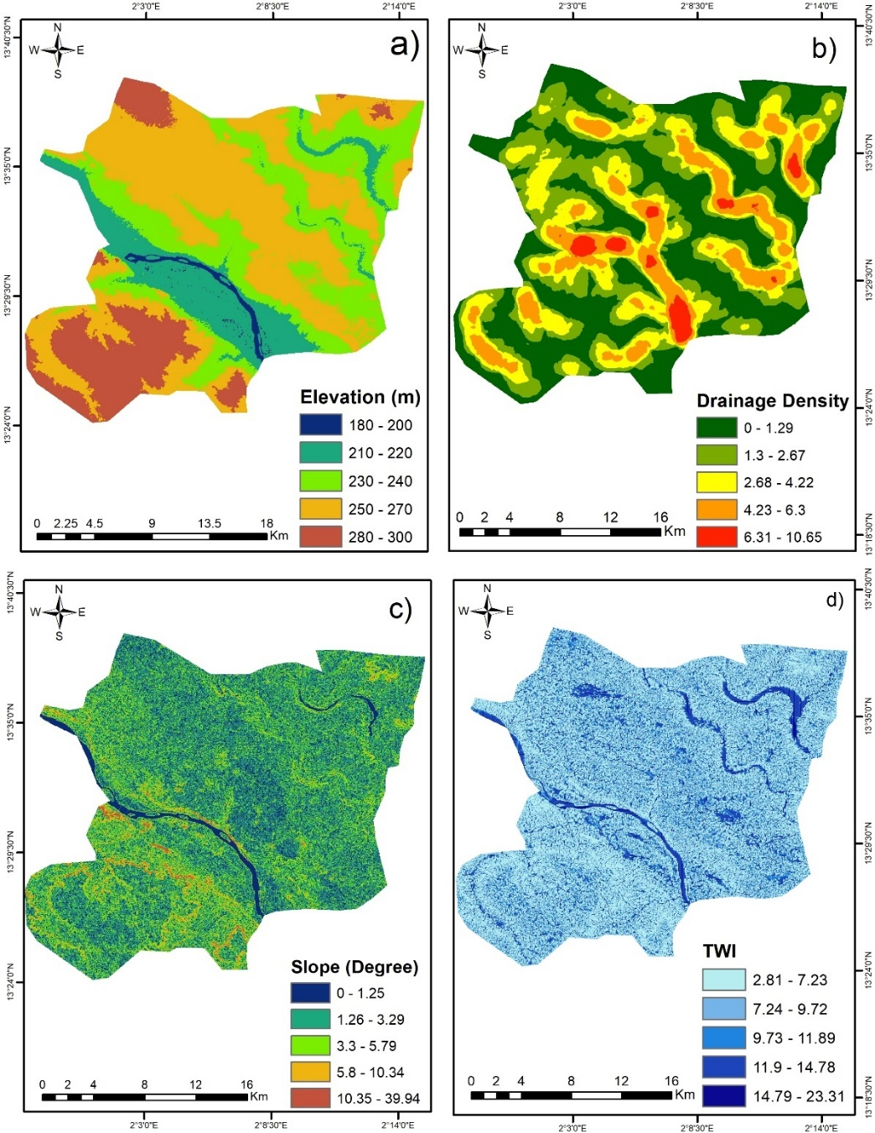
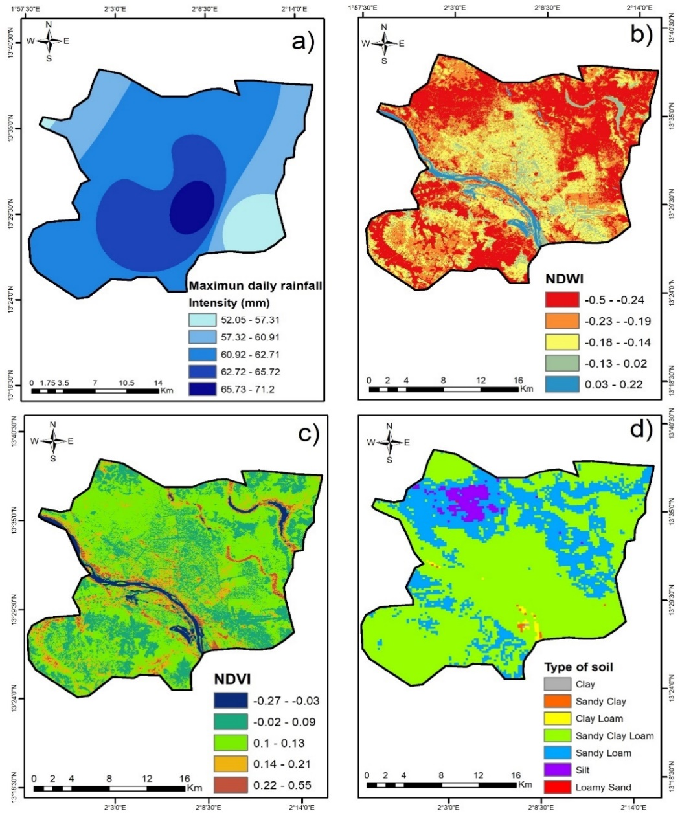
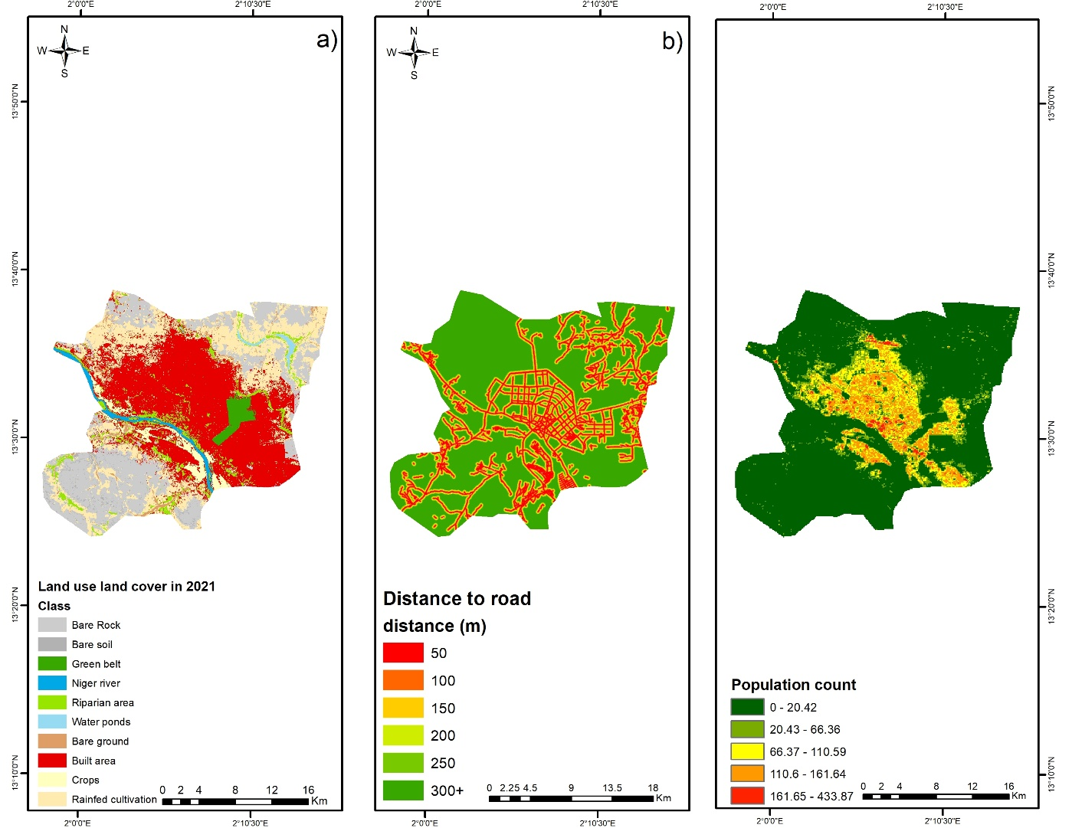
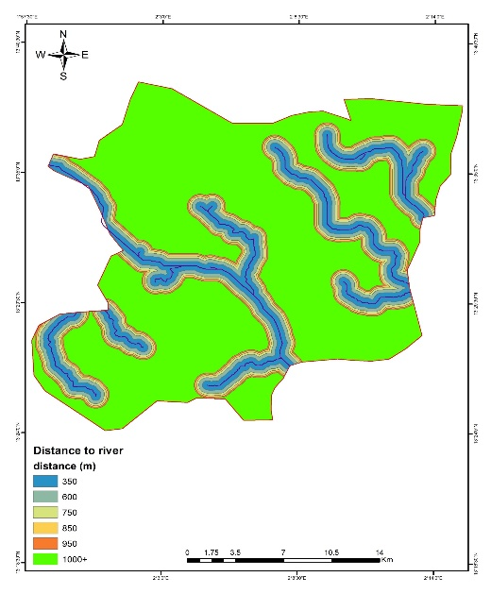
Thematic layer for flood susceptibility and vulnerability for Niamey
e)
Thematic layer for flood susceptibility
Thematic layer for flood Vulnerability

Slide 13
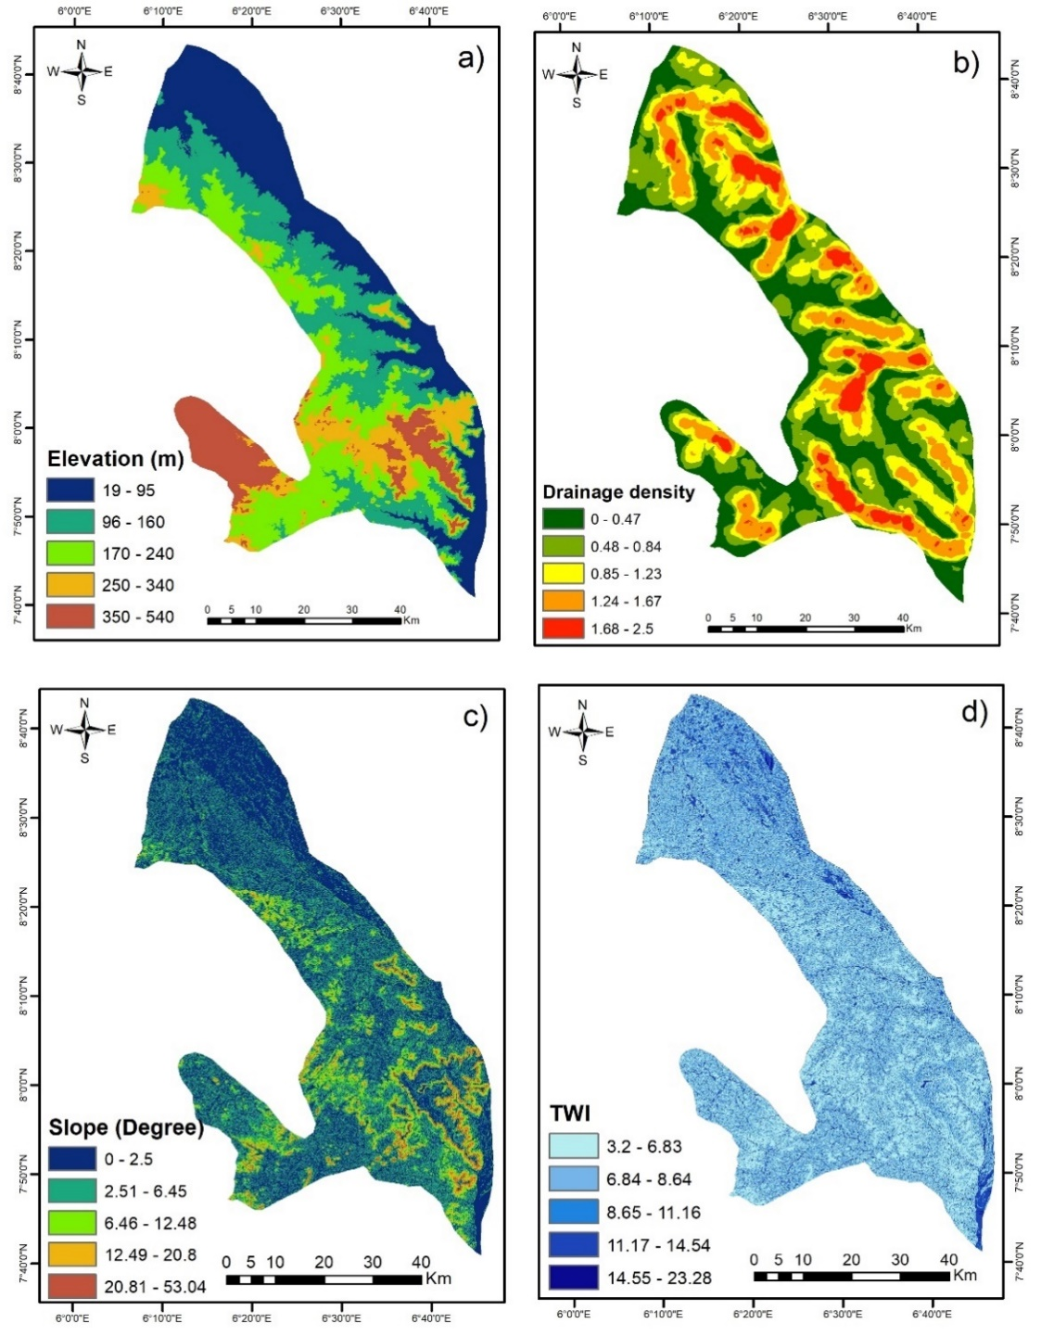
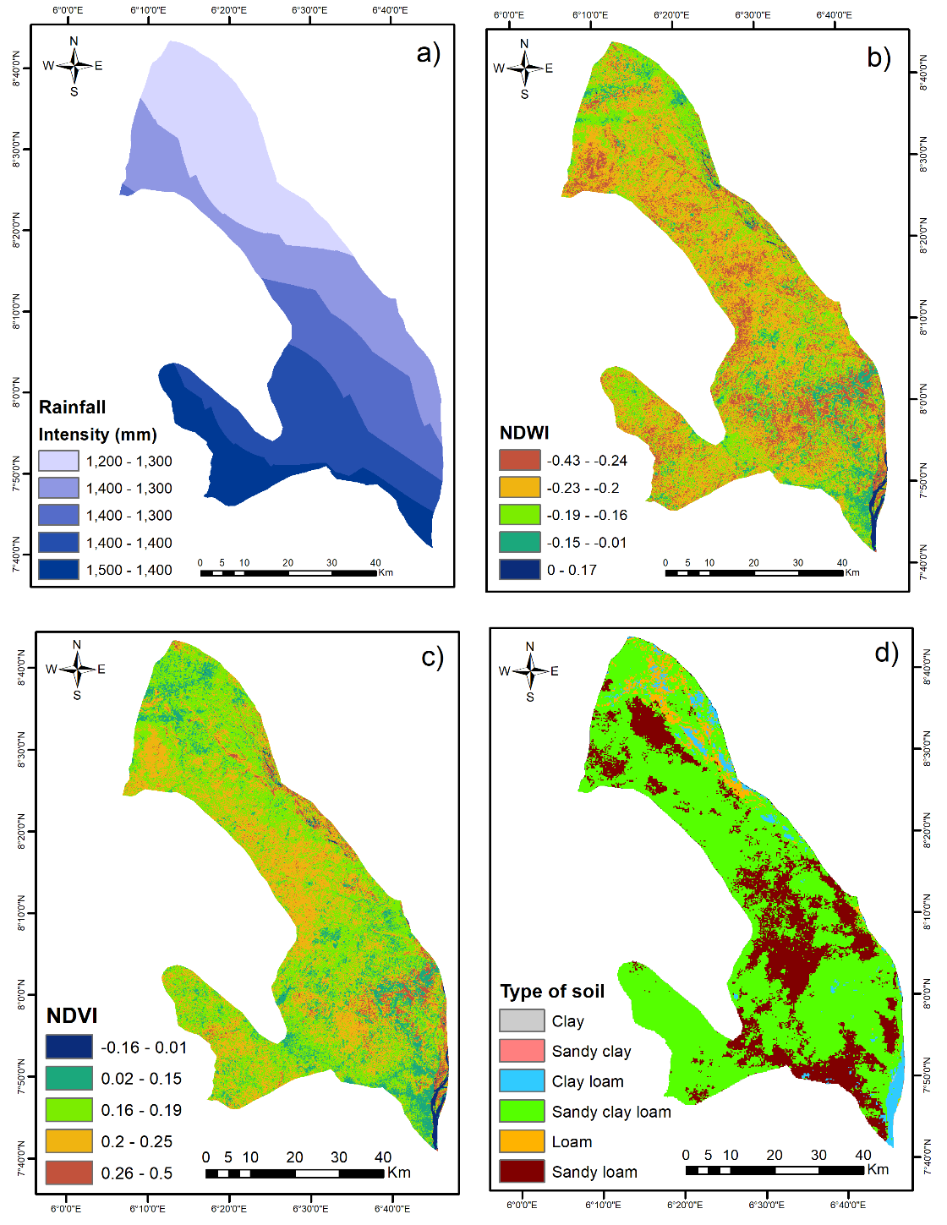
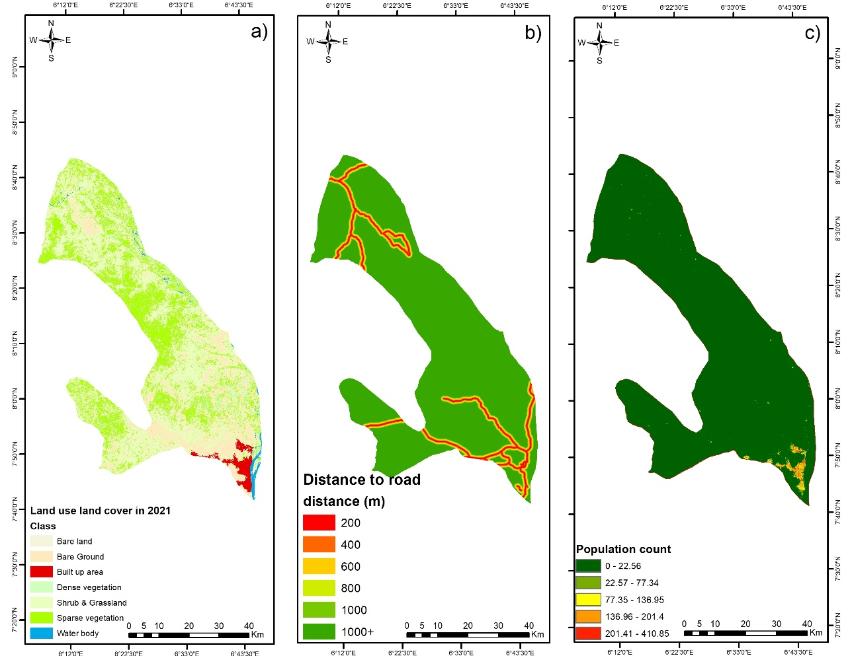
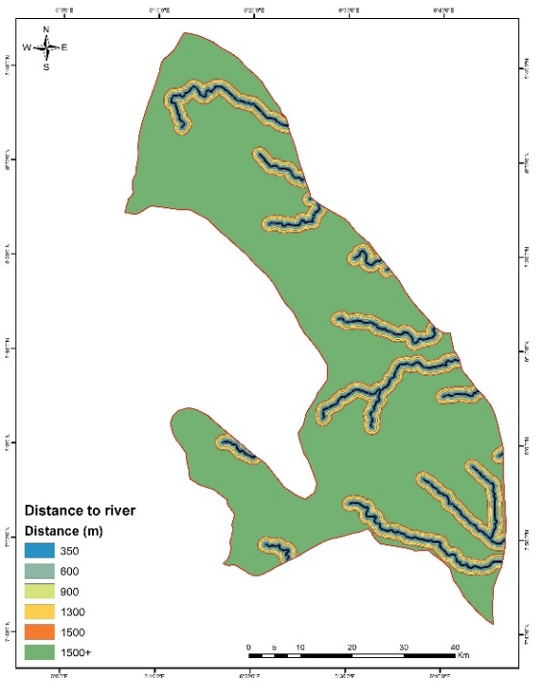
Thematic layer for flood susceptibility and vulnerability for Lokoja
e)
Thematic layer for flood Vulnerability
Thematic layer for flood susceptibility

Slide 14
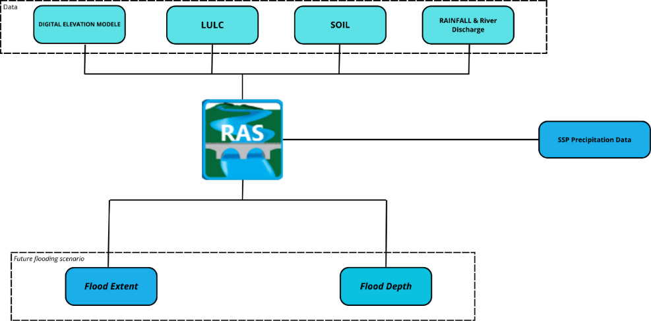
Obj 3: Development of flood scenarios under varying climate change projections
Based on future data, we have classified the quantity of flooding into 4 intensities:
less than 50 mm,
moderate 50 - 99 mm
strong 100-149 mm and
very strong > 150mm.
This has enabled us to identify the different areas likely to be flooded by different precipitation amounts.
Software Use
R studio to extract and validate the SSP data
HEC-RAS: to simulate flood
Arc GIS: To validate model and mapping of result

Slide 15
Obj 4: Development of flood risk profiles and adaptation strategies
1. The Study Focus:
  Targets households near rivers in Niamey and Lokoja.
  Surveys 384 heads of households per city (total 768).
  Selection criteria: directly affected by flooding, exclude area outside the floodplain
2. The analysis relied on surveys using a 4-point Likert scale. Responses were categorised as: strongly disagree,
disagree,
agree,
strongly agree,
with a mean score of ≥ 2.5, indicating agreement on effective flood risk management practices.
3. SWOT Matrix:
Analyses strengths, weaknesses, opportunities, and threats.
Identifies and prioritises strategies.
Results in four actionable approaches
This methodology provides a structured way to evaluate perceptions, prioritize interventions, and develop sustainable flood management strategies

Slide 16
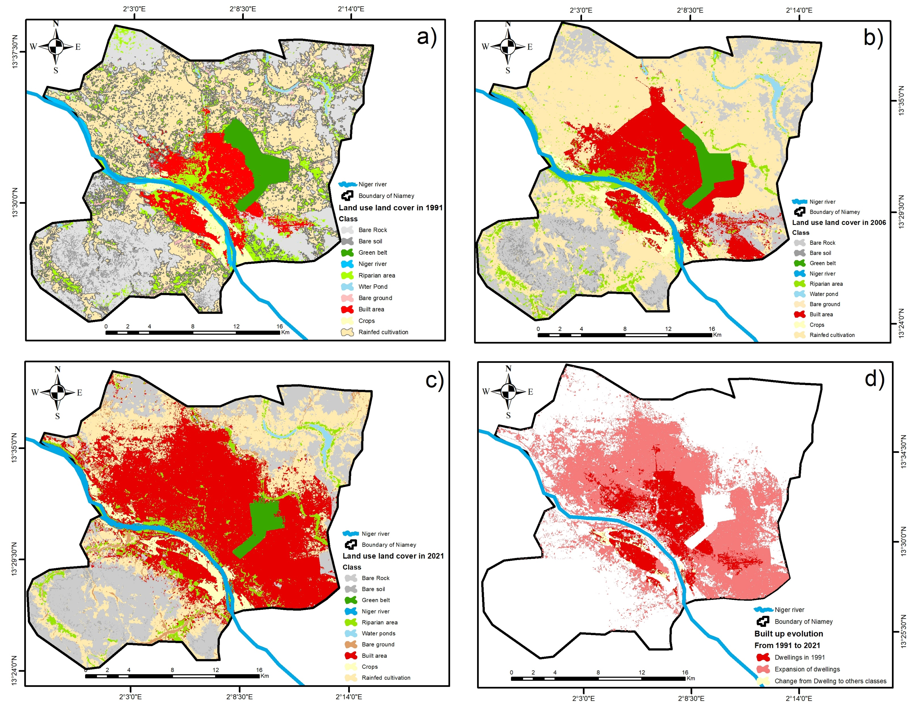
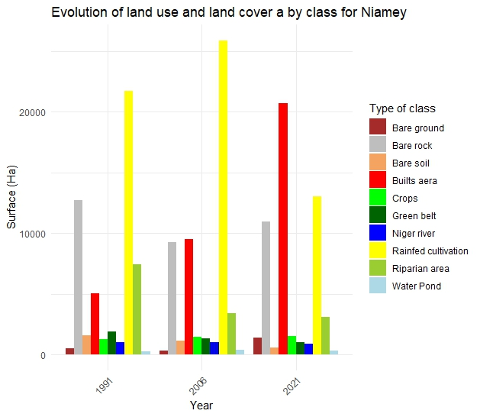
Objective 1:
Analysis of land use and land cover patterns and the associated implications
Niamey city between 1991 and 2021 revealed that the areas of water bodies, agricultural lands, human settlements, and bare lands increased by 14.66%, 18%, 312.88%, and 175.29%, respectively
Key findings

Slide 17
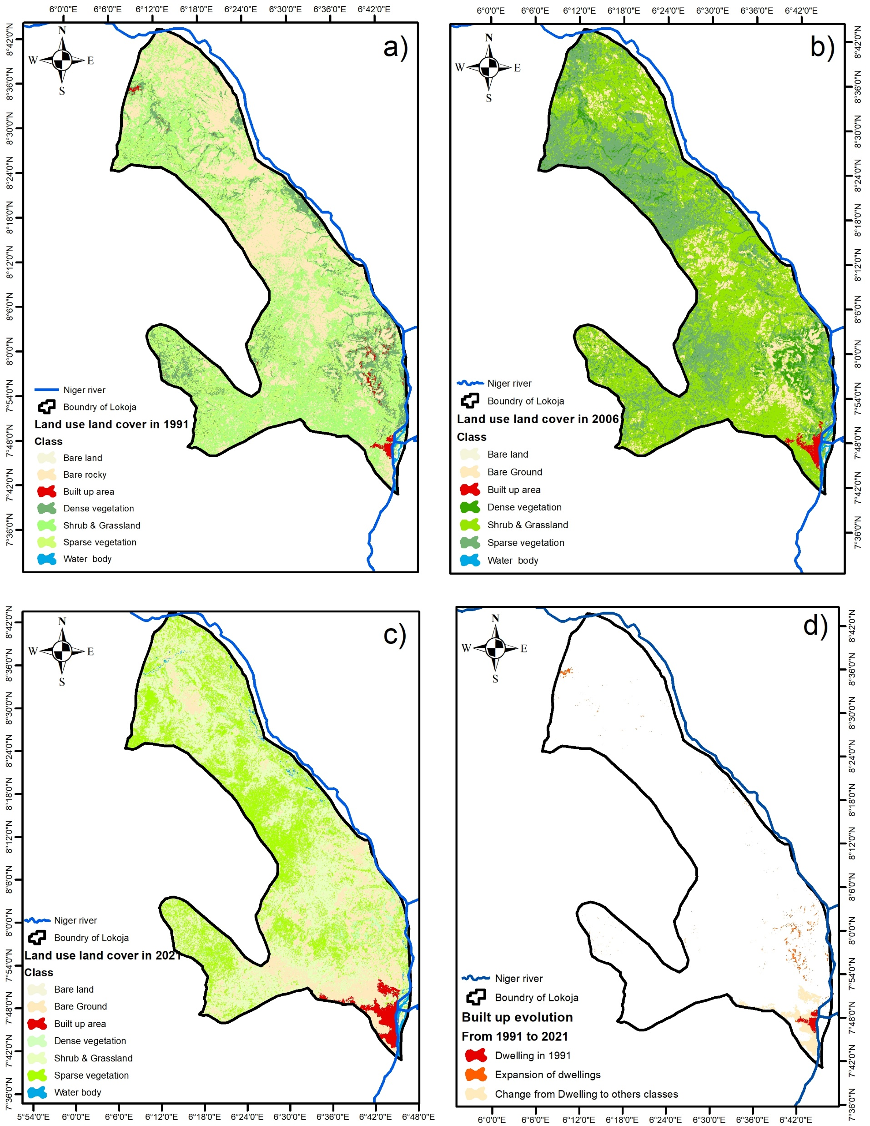
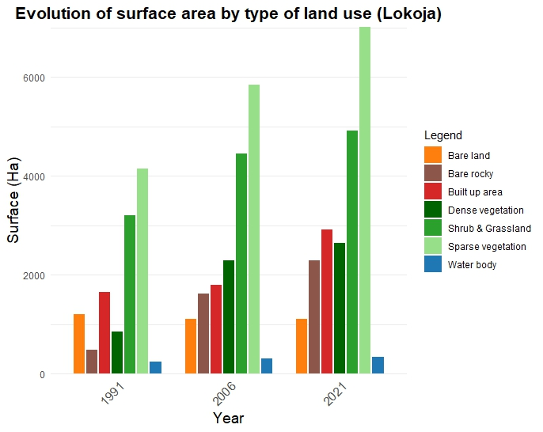
Lokoja area, the area of water bodies, human settlements, shrubs and grasslands, and sparse vegetation increased by 106.62%, 143.51%, 48.95%, and 40.25%,

Slide 18
Key Findings on Urbanisation and Flooding
Urban Expansion Impact:
  Built-up areas increased: +143.5% in Lokoja, +312.88% in Niamey.
  Impermeable surfaces increase runoff, reducing soil absorption and worsening flood vulnerability.
Vegetation Loss:
  Vegetation loss reduces soil infiltration, increasing runoff.
  Loss of riparian zones removes natural flood buffers.
Flooding Influence:
  Niamey: Urban expansion and land degradation intensify seasonal and Guinean input-related flooding.
  Lokoja: Reduced vegetation increases Niger and Bénoué river flow accumulation, worsening floods.

Slide 19
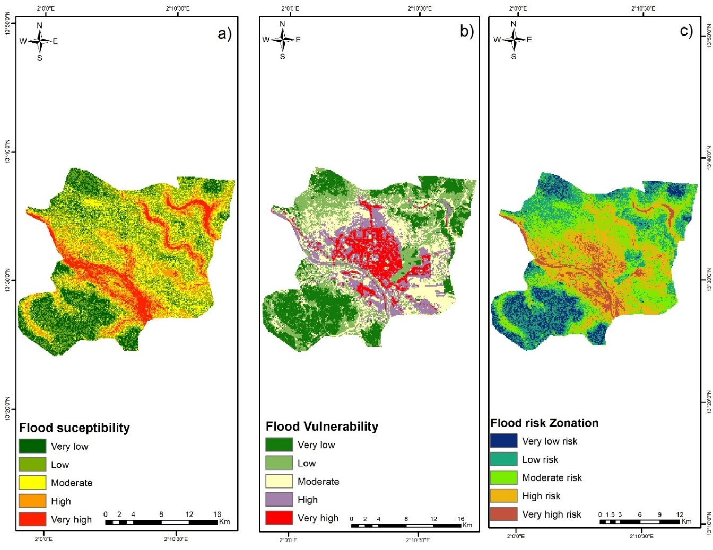
Obj 2 : Determination of flood vulnerability and risk distribution
(a) Niamey:
  32% of the region is at risk, with a high concentration in low-lying areas.
  26% are exposed to very high and high risks.
  Moderately vulnerable areas dominate (31%), particularly in the city center.
.

Slide 20
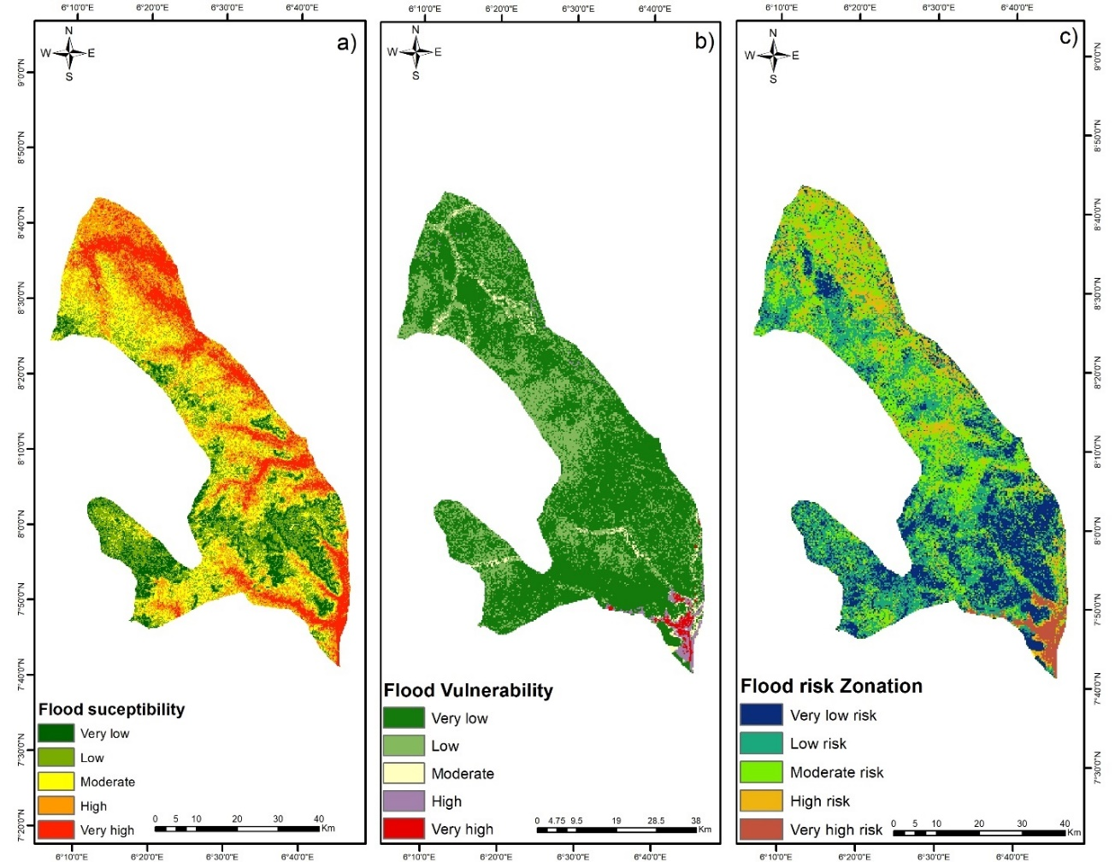
Obj 2 : Determination of flood vulnerability and risk distribution
b) Lokoja:
  15% of the region is at risk, with a high concentration near rivers.
  Very high and high-risk areas account for 41%.
  Risk is moderate throughout, with low-risk areas in the north and very high-risk pockets in the south.
(Flooding Factors:
  Caused by topography, intense rainfall, inadequate drainage infrastructure, and changes in land use (urbanization, deforestation).
  Climate change amplifies these risks, making floods more frequent and unpredictable

Slide 21
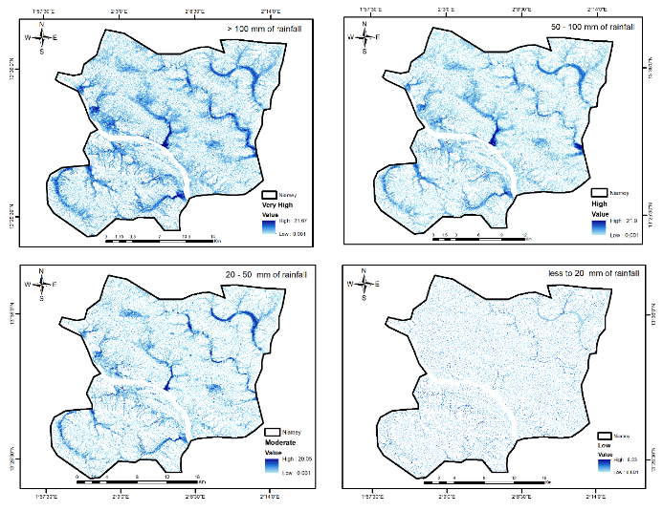
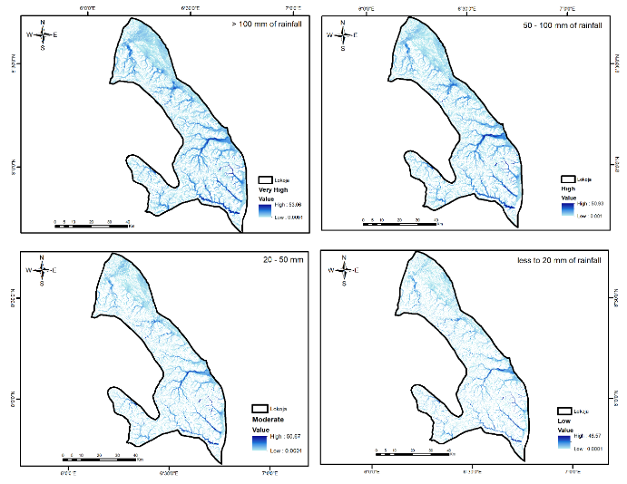
Obj 3: Development of flood scenarios under varying climate change projections
Both cities share vulnerabilities linked to their proximity to rivers and their rugged topography.
However, Niamey, with its flat landscape and dense urbanisation, sees its risks concentrated in a small area, whereas. covering 51.11% of the city's surface area (284.68 km²), classified as ‘very high’ vulnerability.
Lokoja, which is larger, combines steeply sloping areas with vast flood plains.
In both cases, impermeable surfaces (roads, buildings) reduce water infiltration, turning moderate rainfall into a significant risk.
This distribution highlights the existence of a marked rainfall gradient influenced by topography and the hydrographic network

Slide 22
0bj4 : Development of flood risk profiles and adaptation strategies
Flood risk management based on respondes
Lokoja:
1 Need to prioritise :
Prioritise preventive measures (mean = 3.32),
financial aid for renovations (mean = 3.30),
Build to healths center and improuvent education policies (mean = 3.32).
SWOT analysis emphasizes need for:
community-owned plans, green infrastructure, and financial resources to strengthen preparedness and resilience.
(B) Niamey:
Key strategies
Adapting infrastructure to withstand flooding (mean = 2.03), using dikes (mean = 2.02), and leveraging natural landscapes like wetlands (mean = 2.01).
2. Swot Analysis suggested
improvement to flood warnings and limited government action necessitate
investments in disaster education,
early warning systems, and flood-resistant materials.

Slide 23
Summary and Recommendations
Flood Risk Factors:
  Climate change increases flood frequency and severity.
  Rapid urbanization and land use changes in Lokoja and Niamey heighten flood risk.
  Settlement expansion, altered hydrological balance, and poor flood control infrastructure increase vulnerability in riparian areas.
  Current flood management lacks integrated structural and non-structural measures.
Policy Recommendations:
  Prioritize integrated flood risk management via the Niger Basin Authority and national agencies.
  Enhance cross-border collaboration, data sharing, and joint decision-making for better early warning and preparedness.
  Enforce urban planning reforms with strict zoning, green infrastructure, permeable surfaces, and ecological drainage.
Infrastructure and Mitigation Improvements:
  Invest in flood-resistant designs: modular walls, buildings on stilts, and vegetated trenches.
  Use socio-ecological risk indices to target interventions and optimize resources.
  Improve dam operations with maintenance, real-time monitoring, and emergency protocols.
  Promote sustainable urban planning, resilient roads, strict land-use policies, awareness campaigns, and relocation incentives for vulnerable communities.

Slide 24
Thank you For your Attention

